Slide 1
Update on the winding study
Results of the pre-torsion and HT campaigns
Dariusz Pulikowski^{1,2}, Friedrich Lackner¹
¹CERN, TE - MSC - Large Magnet Facility, Geneva
²West Pomeranian University of Technology, Szczecin
03.11.2017

Slide 2
Outline
Quick recap of winding indicators;
Pre-torsion influence on bare and insulated cable;
Deformation of the specimen after heat treatment.

Slide 3
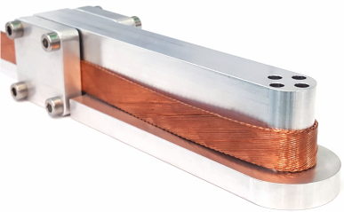
Winding deformation indicators
That's it.
Path
Envelope
Pop-out
Protrusion

Slide 4
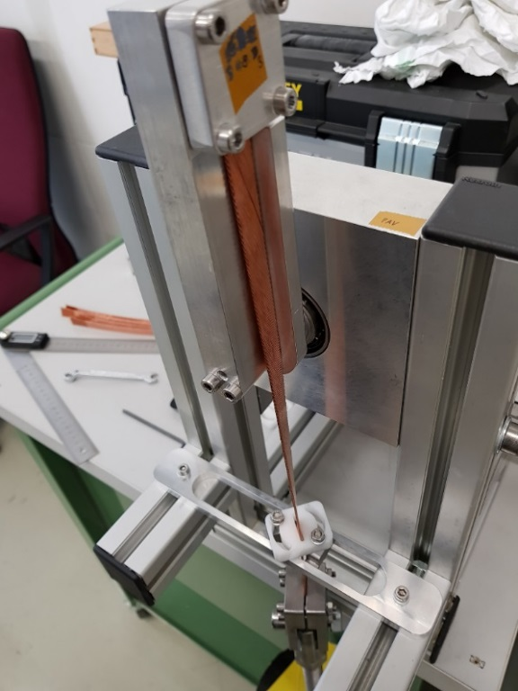
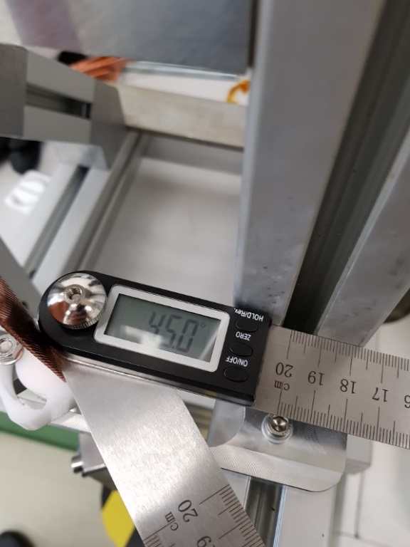
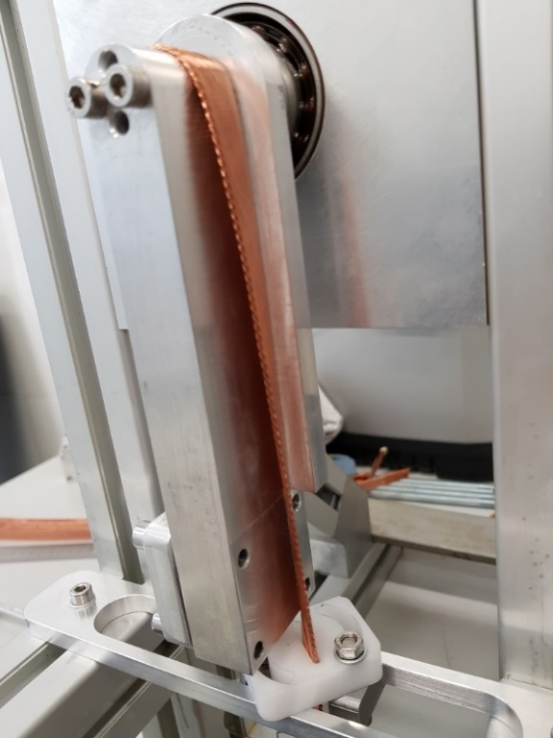
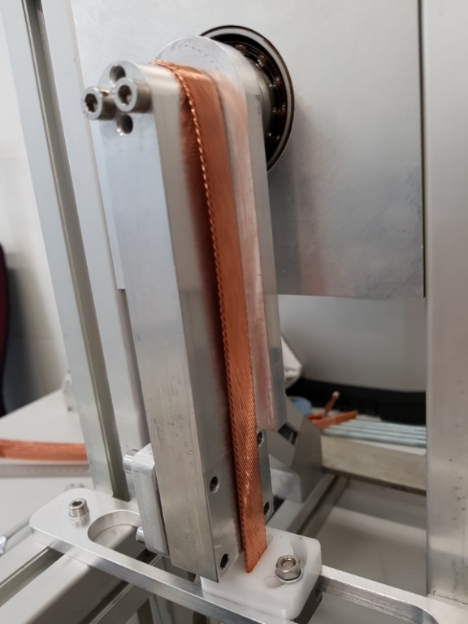
How to apply pre-torsion
Pre-torsion – maintaining the cable twist throughout the winding with use of the angular guide. Investigating the clockwise twist, i.e. tightening of the cable.
11 T RRP Nb₃Sn cable;
Cable ID: H15OC0194A (CR4 coil)
20 kg of winding mass;
Standard 20 mm diameter sample holder;
Favourable winding direction;
Adjusting the cable torsion with the angular guide: 0°, 22.5°, 45°.
1. clamp
2. mesure
3. wind
4. adjust to clamp

Slide 5
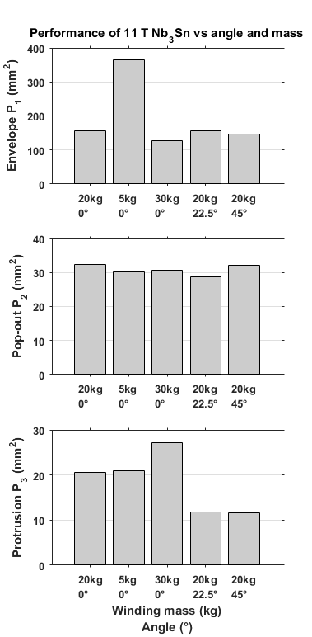
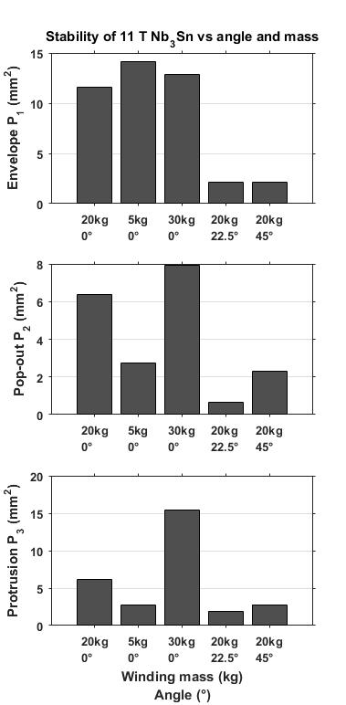
Pre-torsion of bare cable
Performance and stability of specimens wound with different mass and angle indicated on the horizontal axis;
The results of the winding with 5 kg and 30 kg winding mass 0° pre-torsion, added for reference.
Winding mass
Torsion angle

Slide 6
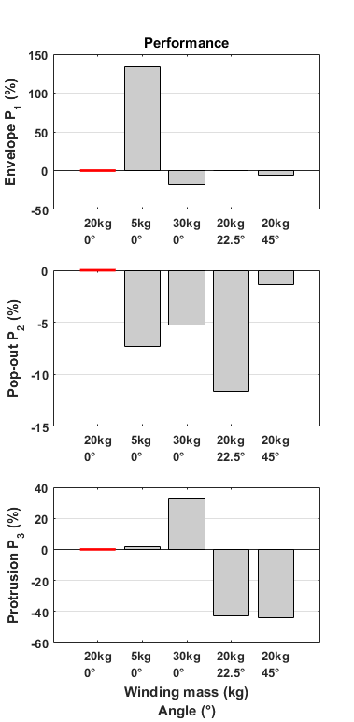
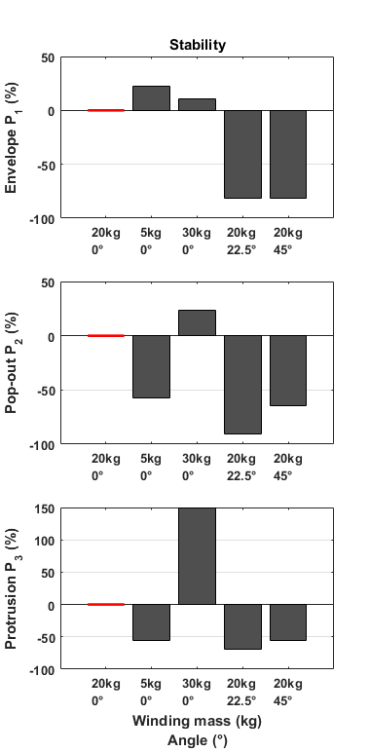
Pre-torsion of bare cable in %
Percentage change in performance and stability versus specimen wound with 20 kg and 0°;
One can see an improvement in all cases with applied twist angle;
The adjustment of the torsion angle is equally important as the winding mass.

Slide 7
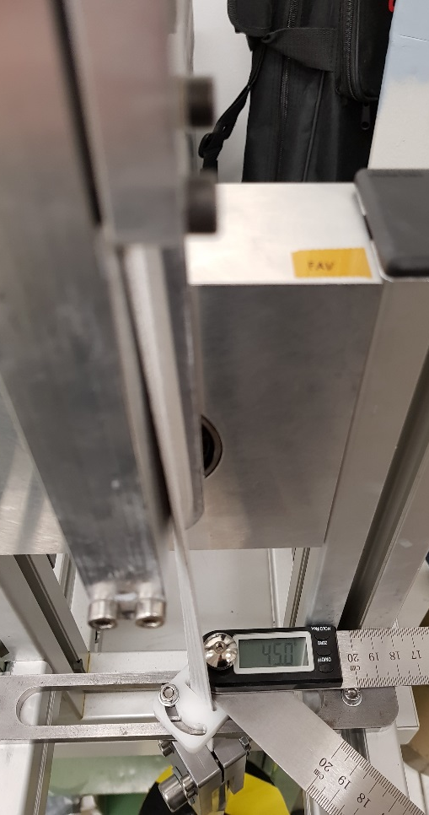
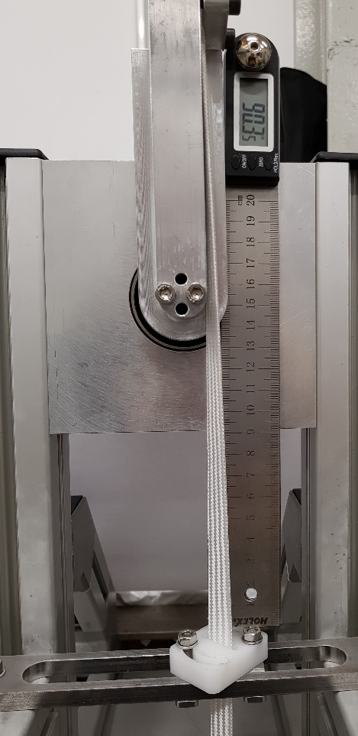
Pre-torsion of insulated cable
11 T RRP Nb₃Sn cable;
Cable ID: H15OC0209A (CR6 coil)
20 kg of winding mass;
Standard 20 mm diameter sample holder;
Favourable winding direction;
Adjusting the cable torsion with the angular guide: 0°, 22.5°, 45°.

Slide 8
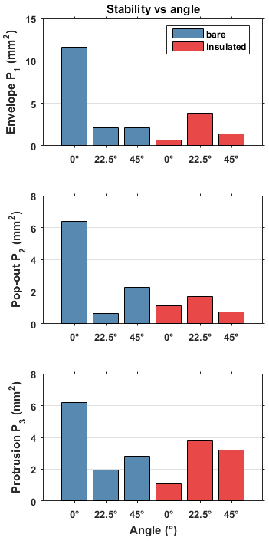
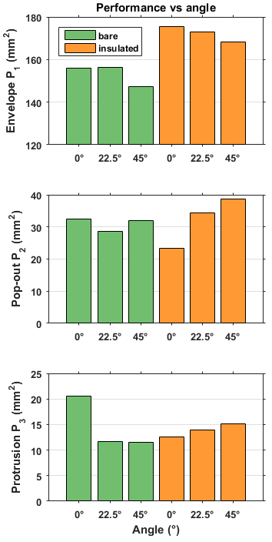
Pre-torsion of bare and insulated cable
Comparison of the pre-torsion influence on the stability and performance of the winding with bare and insulated cable.
11 T RRP Nb₃Sn cable;
Bare from CR4 coil;
Insulated from CR6 coil;
20 kg of winding mas;
Scanning method valid for insulated cable (no coating);
Visible improvement due to insulation layers.

Slide 9
Pre-torsion – summary
The adjustment of the torsion angle of the uninsulated cable is equally important as the winding mass;
The insulation layers improve measured stability and performance of the winding;
The laser scanning method is valid for insulated cable (no coating required);
Presumably, the smaller pre-torsion angle can decrease the deformation of the insulated cable.
Next step:
Conducting tests with smaller pre-torsion angle and unfavourable direction.

Slide 10
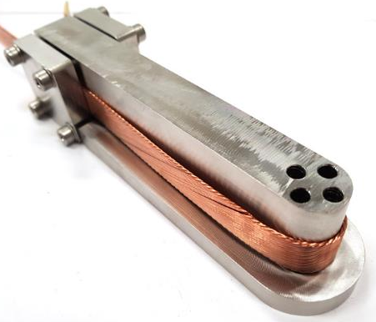
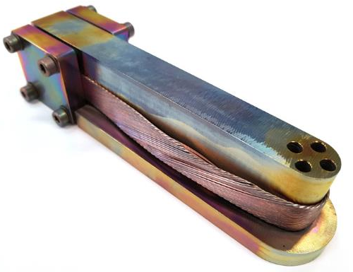
Investigating the reaction process
Specimen wound with Nb₃Sn 11 T CR4 cable and 20kg tension, sample holder made of 316LN;
Analysis based on a fine-scan of a specimen geometry before and after the reaction.
Heat treatment

Slide 11
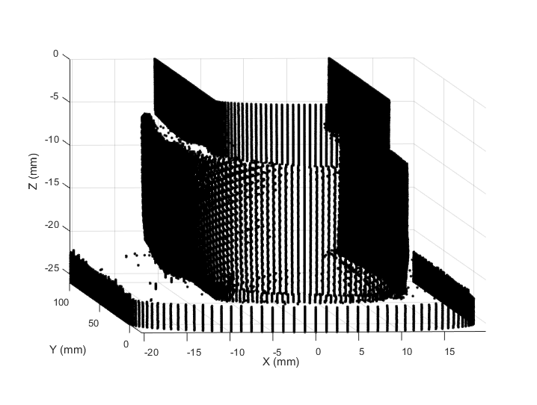
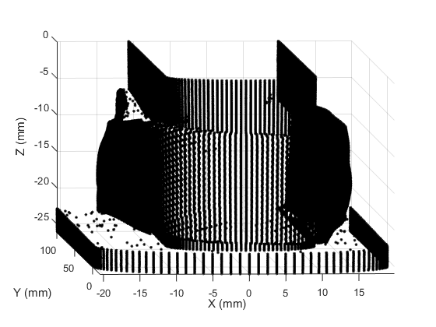
Before & after reaction
Noticeable cable deformation;
Dense measurement 586,751 points/scan.

Slide 12
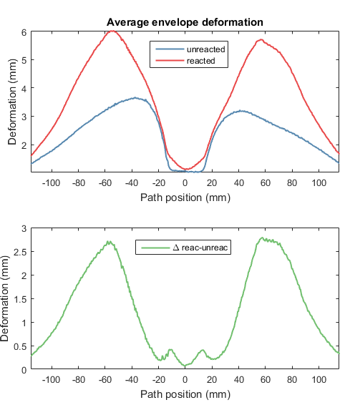
Deformation of the reacted specimen
The average envelope of the specimen before reaction (in blue) and after reaction heat treatment (in red).
The larger deformation of the reacted specimen may indicate the relaxation of the winding tension during reaction.
MQXF reaction cycle;
11 T RRP Nb₃Sn bare cable;
Unreacted length is: 231.45 mm;
Reacted length is: 231.93 mm;
The difference in length is: 0.48mm;
The cable elongation is: 0.2078%.

Slide 13
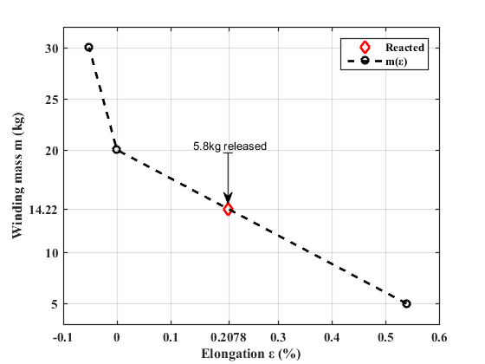
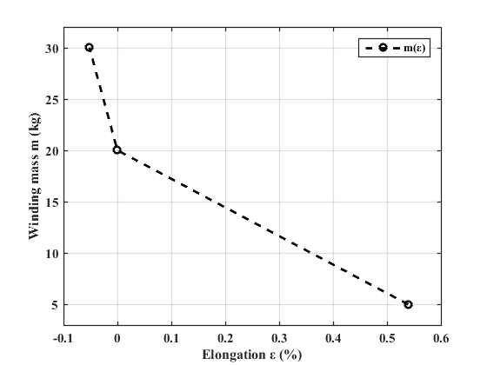
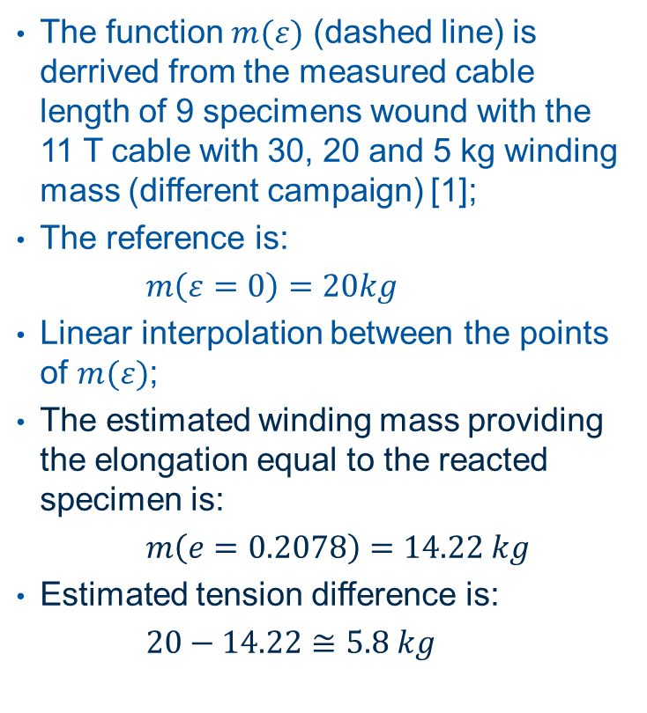
Estimation of the cable tension after the heat treatment
The function $m(ε)$ (dashed line) is derrived from the measured cable length of 9 specimens wound with the 11 T cable with 30, 20 and 5 kg winding mass (different campaign) [1];
The reference is:
$m\left(ε=0\right)=20kg$
Linear interpolation between the points of $m(ε)$;
The estimated winding mass providing the elongation equal to the reacted specimen is:
$m\left(e=0.2078\right)=14.22 kg$
Estimated tension difference is:
$20−14.22≅5.8 kg$
[1] https://indico.cern.ch/event/628937/

Slide 14
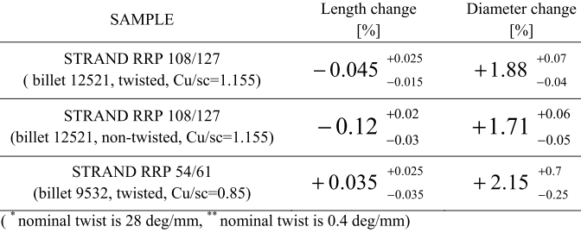
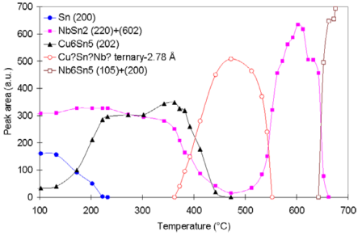
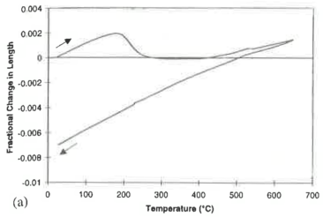
Deformation during HT
[1] D. Bocian, G. Ambrosio, and G. M. Whitson, “Measurements of Nb₃Sn conductor dimension changes during heat treatment,” Adv. Cryog. Eng., vol. 193, pp. 193–200, 2012.
[2] M. Di Michiel and C. Scheuerlein, “Phase transformations during the reaction heat treatment of powder-in-tube Nb₃Sn superconductors,” Supercond. Sci. Technol., vol. 20, no. 10, pp. 55–58, 2007.
[3] D. R. Dietderich, J. R. Litty, and R. M. Scanlan, “Dimensional changes of Nb₃Sn, Nb₃Al and Bi₂Sr₂CaCu₂O₈ conductors during heat treatment and their implication for coil design,” Adv. Cryog. Eng., vol. 44, pp. 1–8, 1998.

Slide 15
Reacted specimen – summary
Obtained results allow investigating the wound cable deformation after the HT. Presumably, it is possible to estimate the released winding tension.
The presented results are preliminary:
One specimen was reacted;
The function m(𝜀) is linearly interpolated and consists of low amount of data points;
The correlation of the deformation and the winding mass needs to be confirmed, e.g. the friction during relaxation is not present in m(𝜀) function.
Next steps:
Performing HT of the Nb₃Sn strand wound with the presented setup, for reference deformation measurement;
Perform HT of the additional specimen wound with bare and insulated cable;
Conducting reference winding tests in order to include the friction in the m(𝜀) function, e.g. releasing the tension of the specimen wound with initial 20 kg;
CT of winding specimen before and after HT?

Slide 16
Thank you for your attention

