Slide 1

How do Large Collaborations Work? Why?
LHC-ATLAS As An Example
ESADE Executive Management
November 14, 2017
Markus Nordberg, Head of Resources Development
Development and Innovation Unit (IPT-DI)

Slide 2


Slide 3


Slide 4
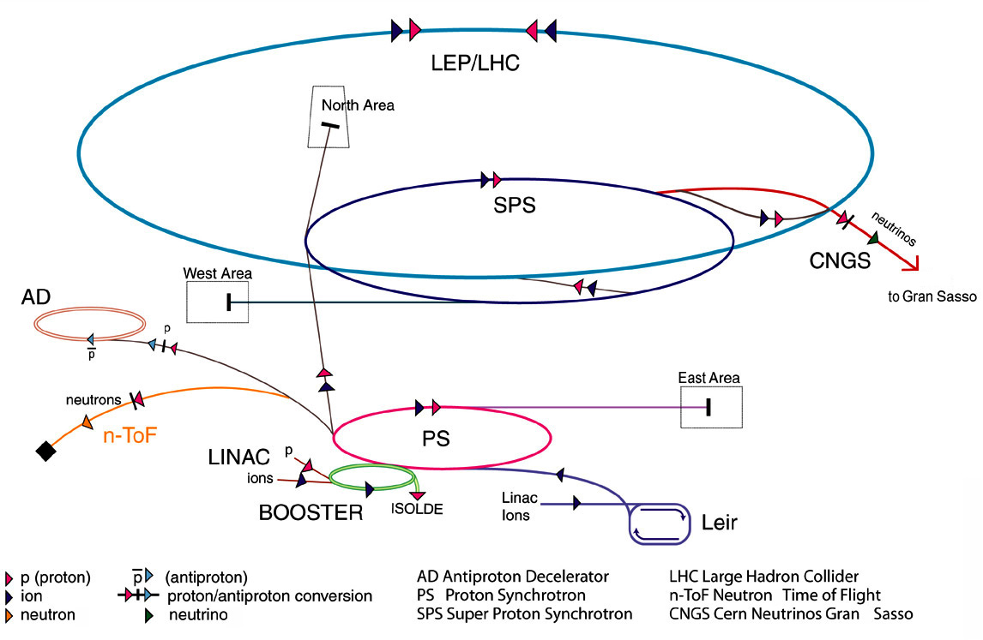
CERN's mission: to build particle accelerators
Accelerator chain at CERN, a complex business

Slide 5
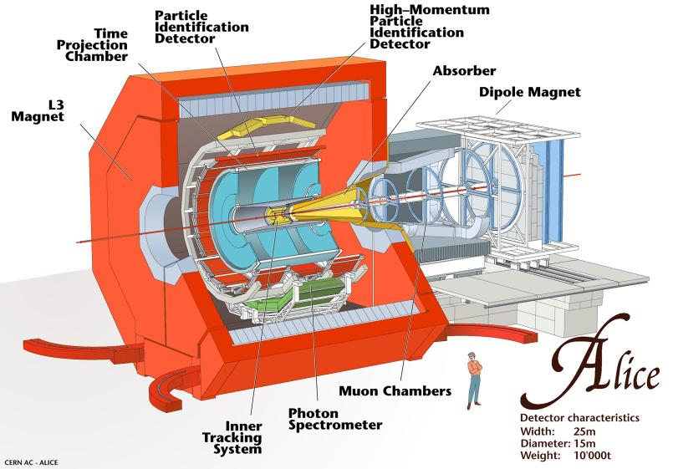
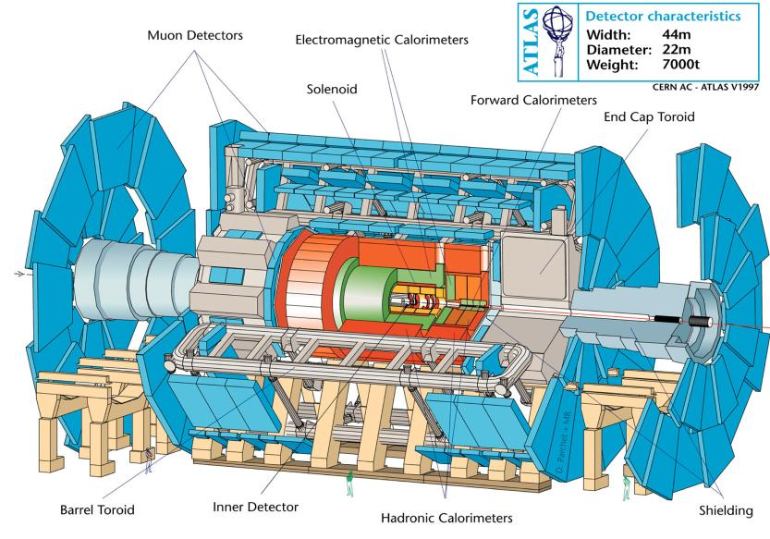
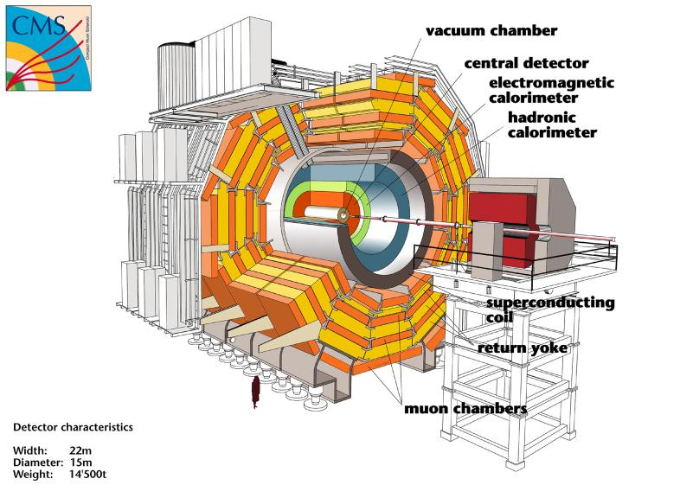
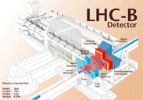
LHC Experiments

Slide 6


Slide 7
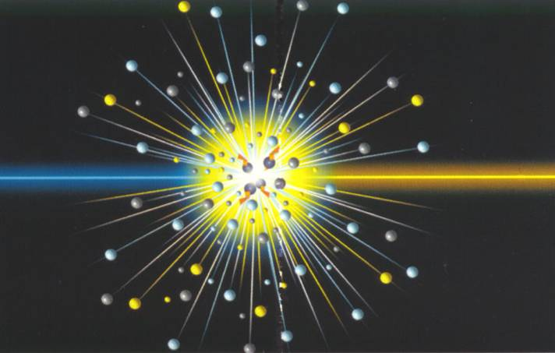

Slide 8
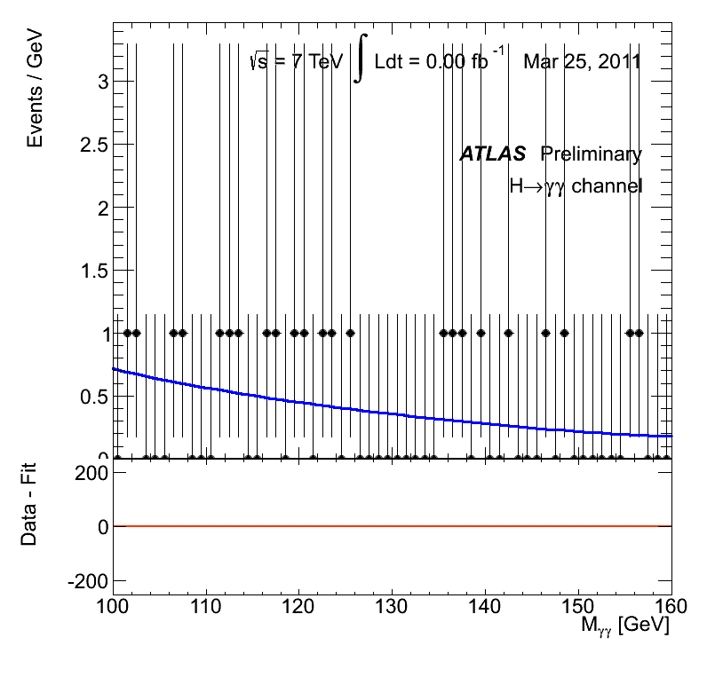

Slide 9
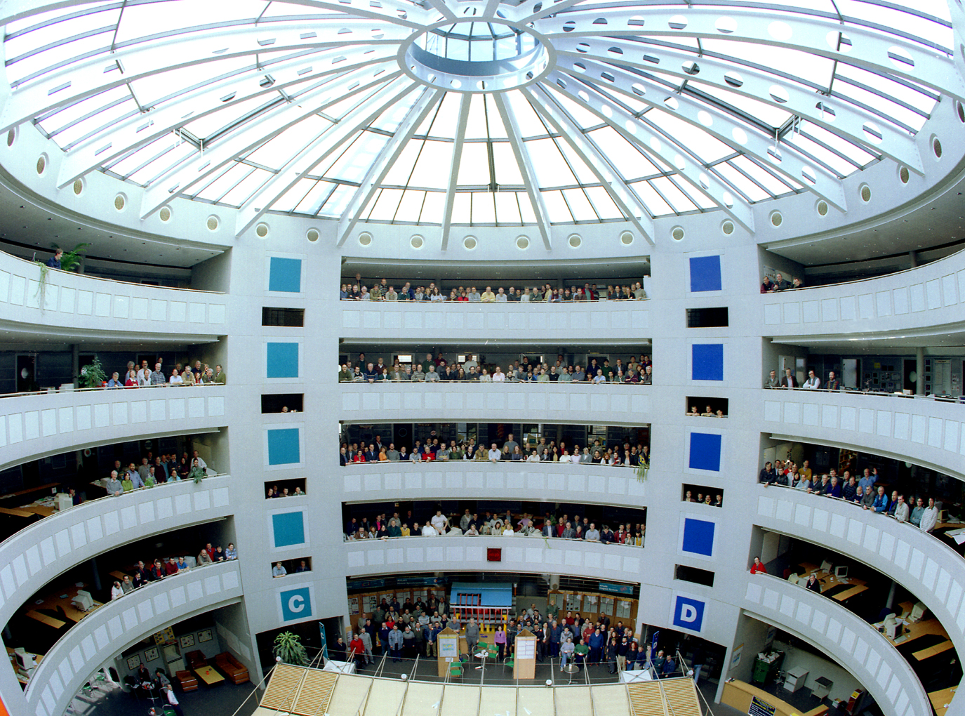

Slide 10
Albany, Alberta, NIKHEF Amsterdam, Ankara, LAPP Annecy, Argonne NL, Arizona, UT Arlington, Athens, NTU Athens, Baku, IFAE Barcelona, Belgrade, Bergen, Berkeley LBL and UC, HU Berlin, Bern, Birmingham, UAN Bogota, Bologna, Bonn, Boston, Brandeis, Bratislava/SAS Kosice, Brookhaven NL, Buenos Aires, Bucharest, Cambridge, Carleton, CERN, Chinese Cluster, Chicago, Chile, Clermont-Ferrand, Columbia, NBI Copenhagen, Cosenza, AGH UST Cracow, IFJ PAN Cracow, UT Dallas, DESY, Dortmund, TU Dresden, JINR Dubna, Duke, Frascati, Freiburg, Geneva, Genoa, Giessen, Glasgow, Göttingen, LPSC Grenoble, Technion Haifa, Hampton, Harvard, Heidelberg, Hiroshima, Hiroshima IT, Indiana, Innsbruck, Iowa SU, Irvine UC, Istanbul Bogazici, KEK, Kobe, Kyoto, Kyoto UE, Lancaster, UN La Plata, Lecce, Lisbon LIP, Liverpool, Ljubljana, QMW London, RHBNC London, UC London, Lund, UA Madrid, Mainz, Manchester, CPPM Marseille, Massachusetts, MIT, Melbourne, Michigan, Michigan SU, Milano, Minsk NAS, Minsk NCPHEP, Montreal, McGill Montreal, RUPHE Morocco, FIAN Moscow, ITEP Moscow, MEPhI Moscow, MSU Moscow, Munich LMU, MPI Munich, Nagasaki IAS, Nagoya, Naples, New Mexico, New York, Nijmegen, BINP Novosibirsk, Ohio SU, Okayama, Oklahoma, Oklahoma SU, Olomouc, Oregon, LAL Orsay, Osaka, Oslo, Oxford, Paris VI and VII, Pavia, Pennsylvania, Pisa, Pittsburgh, CAS Prague, CU Prague, TU Prague, IHEP Protvino, Regina, Ritsumeikan, UFRJ Rio de Janeiro, Rome I, Rome II, Rome III, Rutherford Appleton Laboratory, DAPNIA Saclay, Santa Cruz UC, Sheffield, Shinshu, Siegen, Simon Fraser Burnaby, SLAC, Southern Methodist Dallas, NPI Petersburg, Stockholm, KTH Stockholm, Stony Brook, Sydney, AS Taipei, Tbilisi, Tel Aviv, Thessaloniki, Tokyo ICEPP, Tokyo MU, Toronto, TRIUMF, Tsukuba, Tufts, Udine/ICTP, Uppsala, Urbana UI, Valencia,
UBC Vancouver, Victoria, Washington, Weizmann Rehovot, FH Wiener Neustadt, Wisconsin, Wuppertal, Würzburg, Yale, Yerevan
A GLOBAL PROJECT
The project comprises ~4000 people in the collaboration + thousand of industrial relations

Slide 11
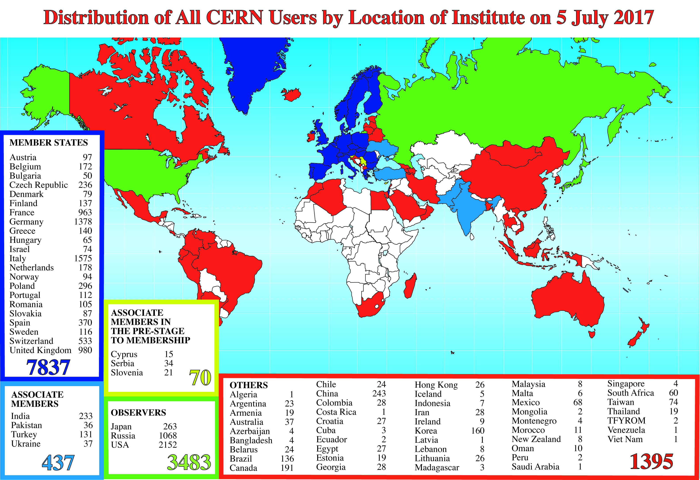

Slide 12
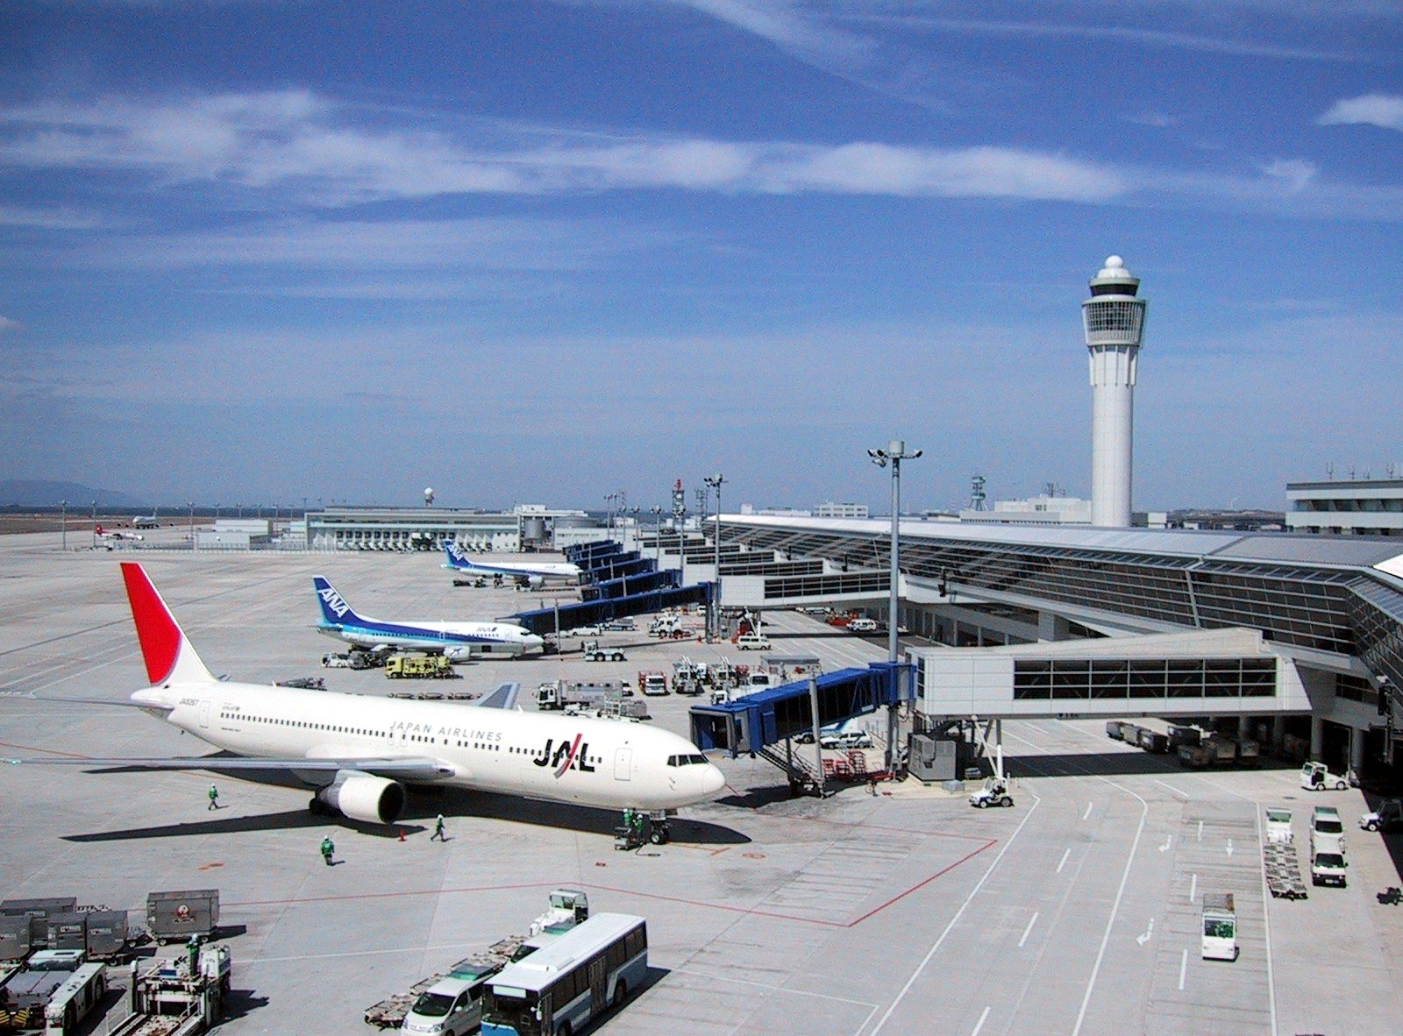

Slide 13


Slide 14


Slide 15


Slide 16


Slide 17


Slide 18

Notes:
18

Slide 19
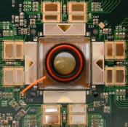
Evolution of Experiments
  Initial (conceptual) project planning started by informal, ad-hoc group(s) of interested scientists in mid 1980’s
  Timeline
    Late 1980’s: Further R&D was needed to prove feasibility of proposed technical concepts. CERN initiated formal, generic detector R&D projects
    Early 1990’s: Bottom-up detector proposals; merging into Letters of Intent (LoI, 1992)
    Mid 1990’s: Technical Proposals (TP,1995); sub-detector prototyping; sub-system Technical Design Reviews (TDRs)
    Late 1990/Early 2000’s: Approval of Cost Book; signing of MoU; start of detector modules manufacturing (always following a Production Readiness Review PRR and respective TDRs); start of installation at CERN (cavern handed over in 2003)
    Mid 2000’s: Installation, commissioning of Detectors in the cavern; completed in 2008 for initial runs
  Initial project coordination was implicit and handled by the contact persons for the early proposals. After LoI in 1992, the project coordination was carried out by elected mgmt teams
    Later on, reporting interactions got defined and set up in the MoU (signed in 1998)

Slide 20
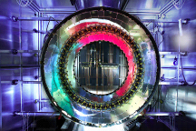
Memorandum of Understanding (MoU)
  The Project Charter is the Memorandum of Understanding (MoU)
  Legally non-binding agreement based on best effort
  Drafted between CERN (Host Lab) and Funding Agencies, the MoU describes the sharing of detector hardware construction responsibilities and costs
  Relationship between the Host Lab and ATLAS broadly defined
  Fundamental principle of deliverables (in-kind contributions)
    Potluck party
    Deliverables grouped around sub-projects
    Items not pledged for are pooled centrally, funds collected as “tax”
  The construction cost envelope in 1995 Swiss Francs was 475 MCHF
      Direct costs, excluding manpower, R&D, institute infrastructure, prototyping, VAT
      Major exchange rates fixed (e.g. $/CHF=1.1; GBP/CHF =1.8)
      No centralized budget contingency
      CERN provides technical infrastructure support, but is also a participating scientific institute
  Project personnel (management, project leaders, coordinators) are elected by the community
  Participating institutes have equal voting rights

Slide 21
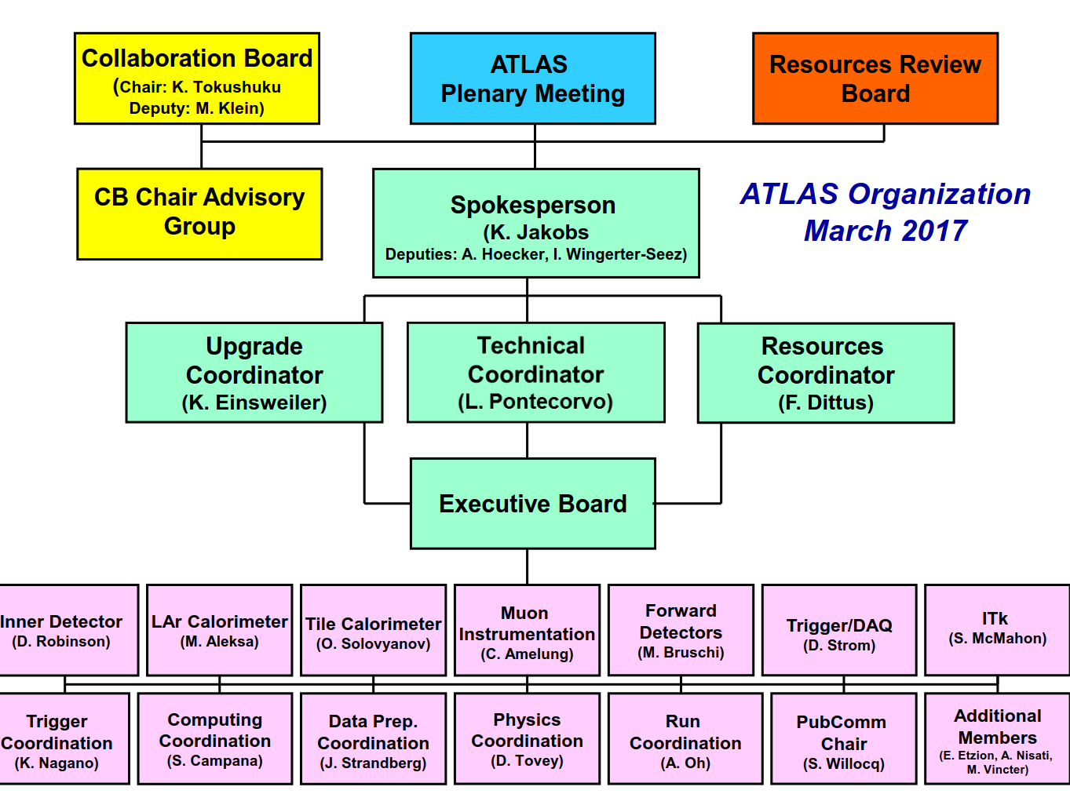

Slide 22
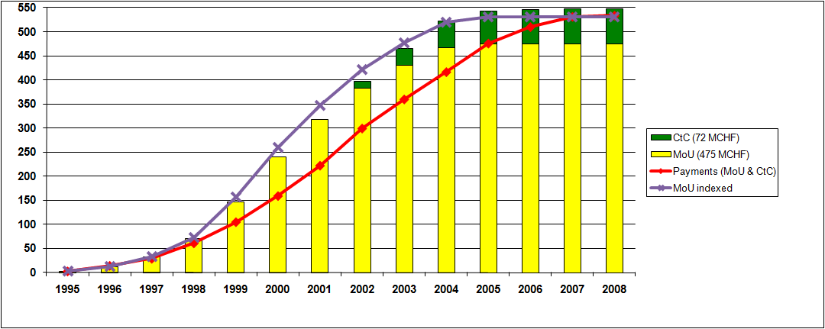
Project Funding at Completion EoY 2008 (ATLAS)

Slide 23
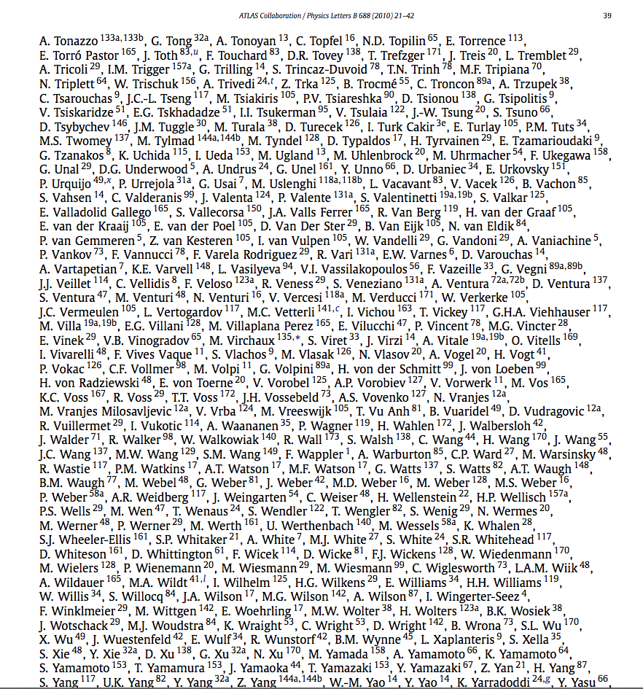
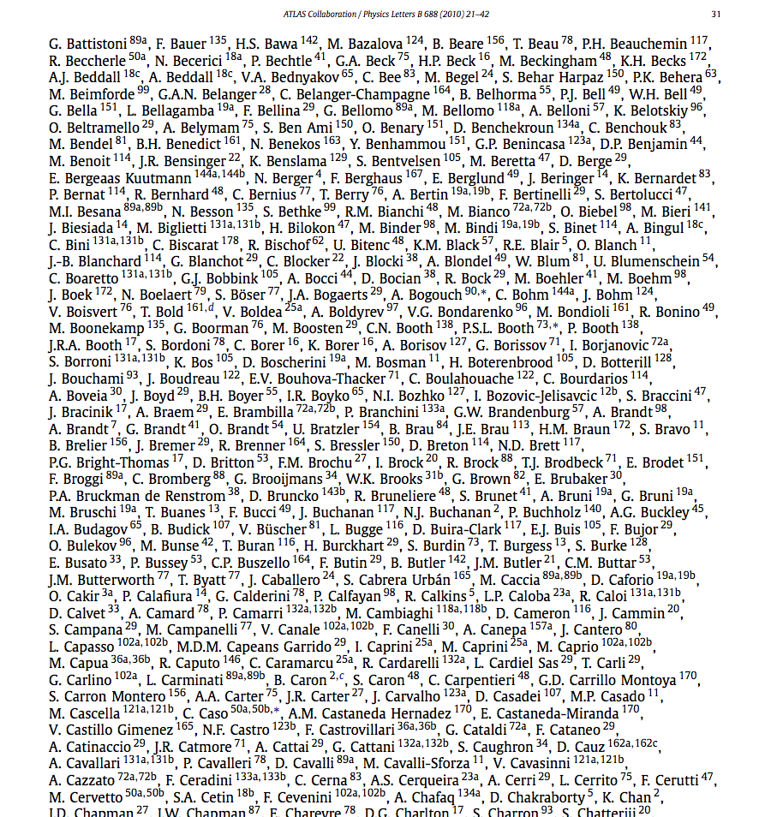
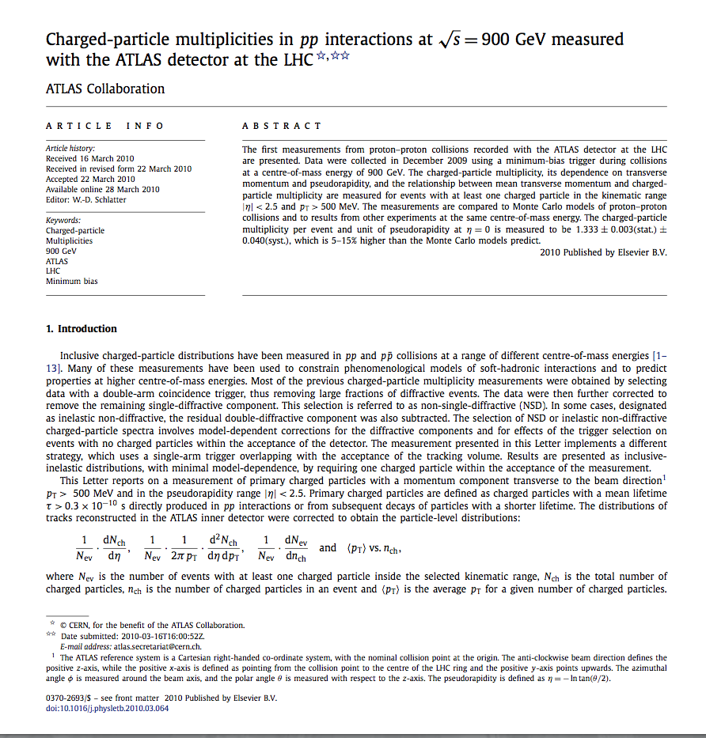
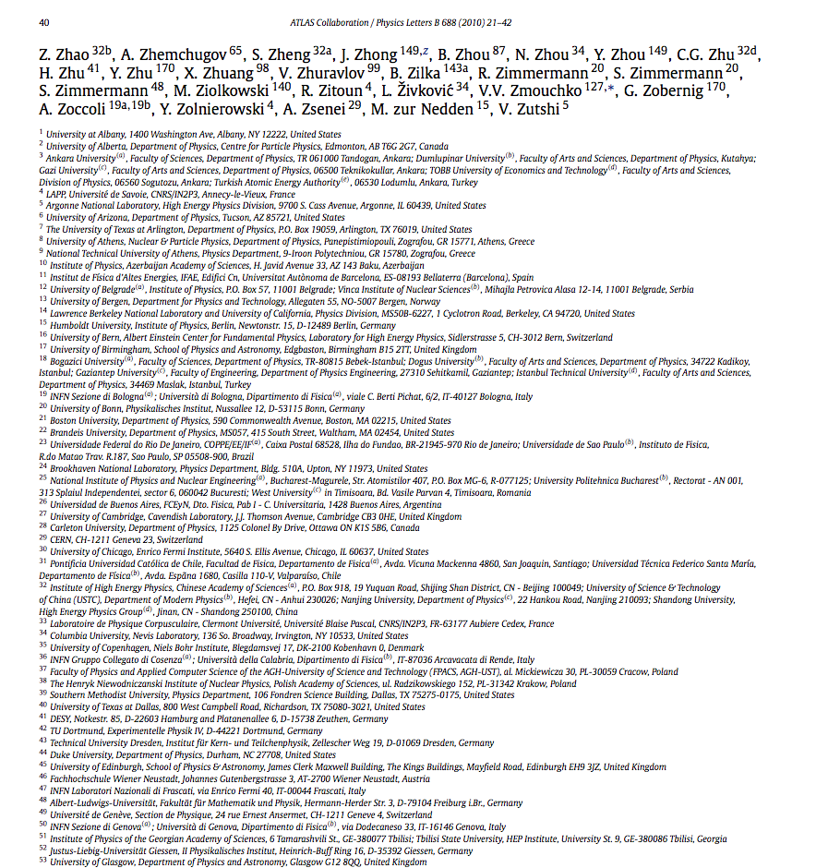
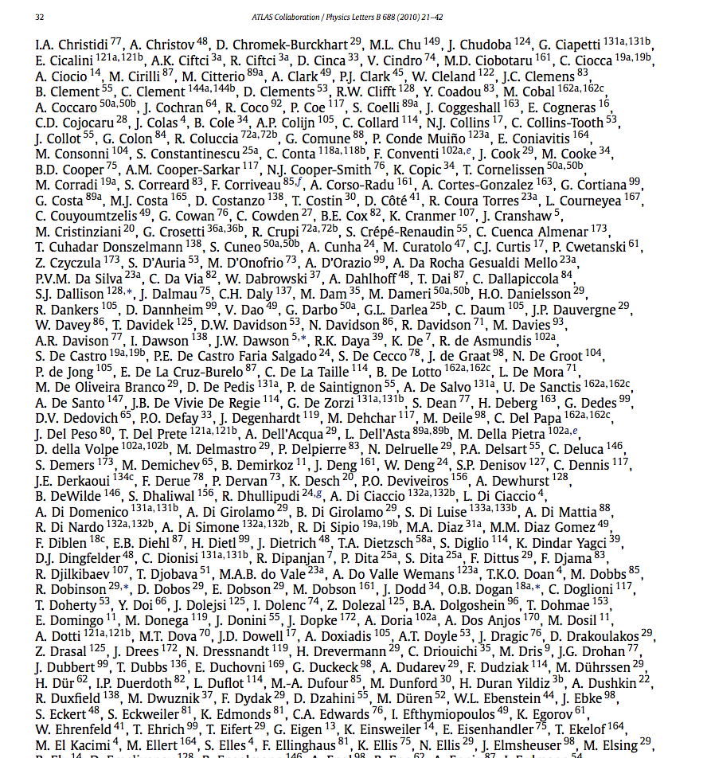
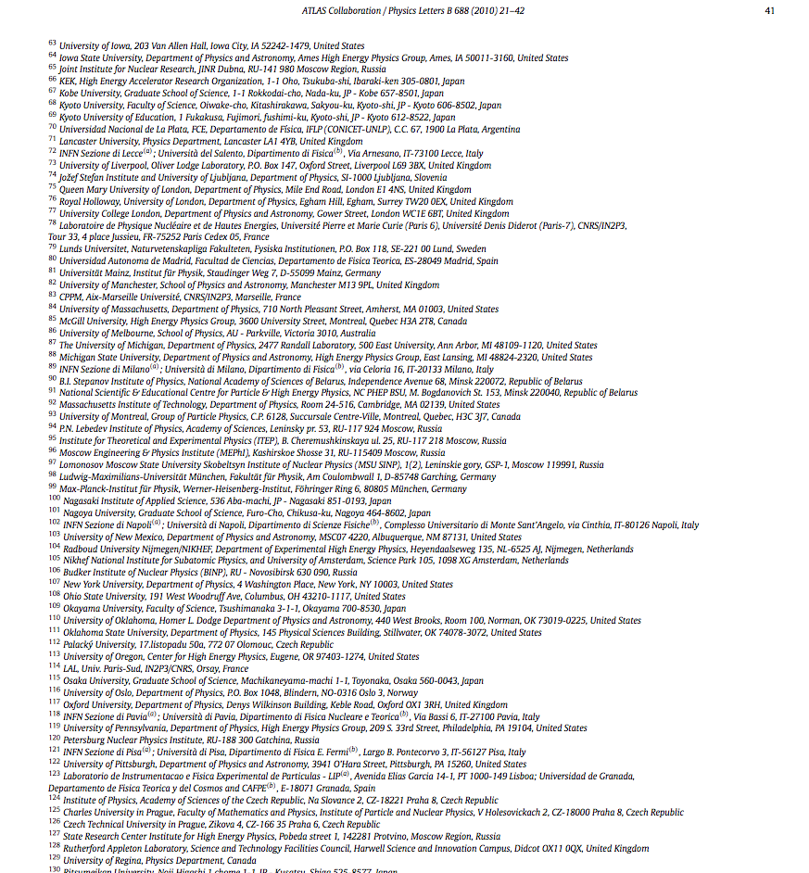
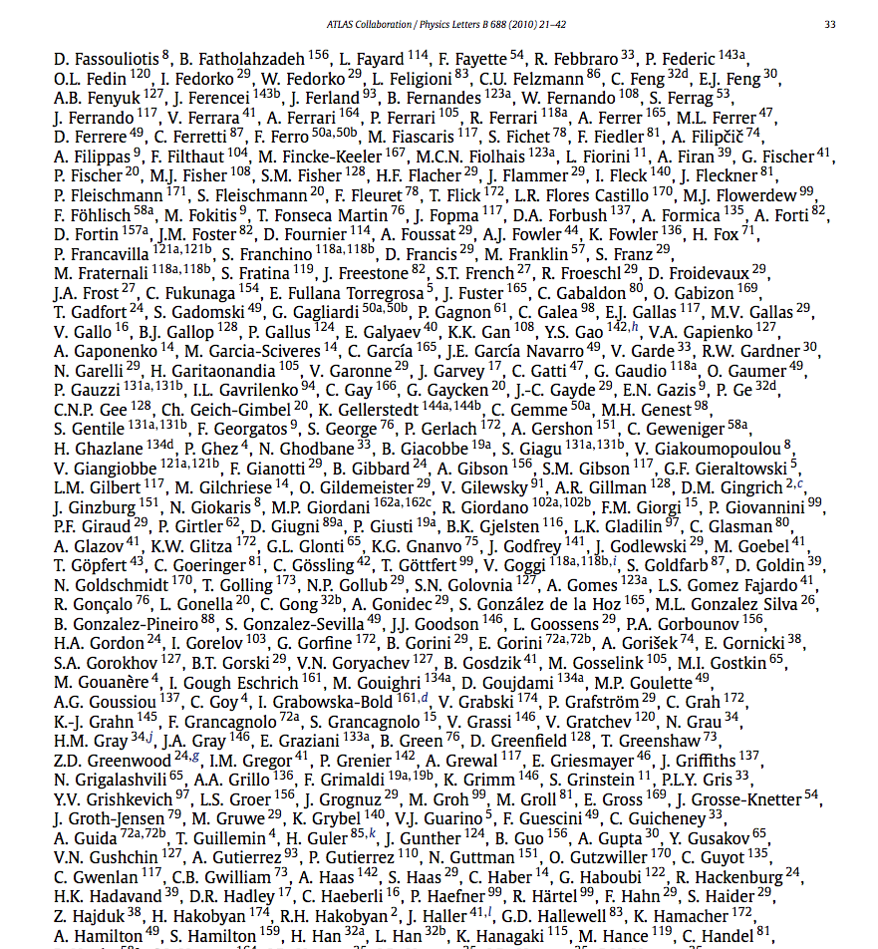
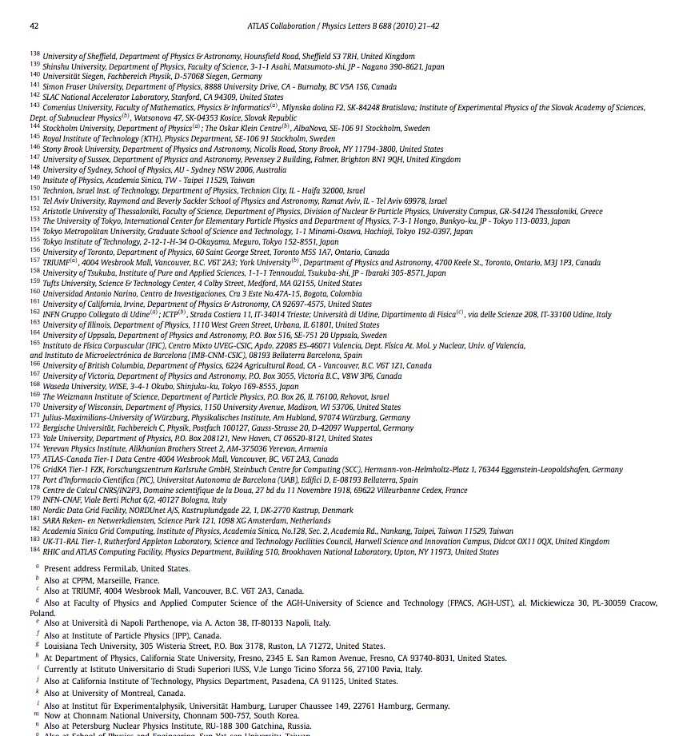
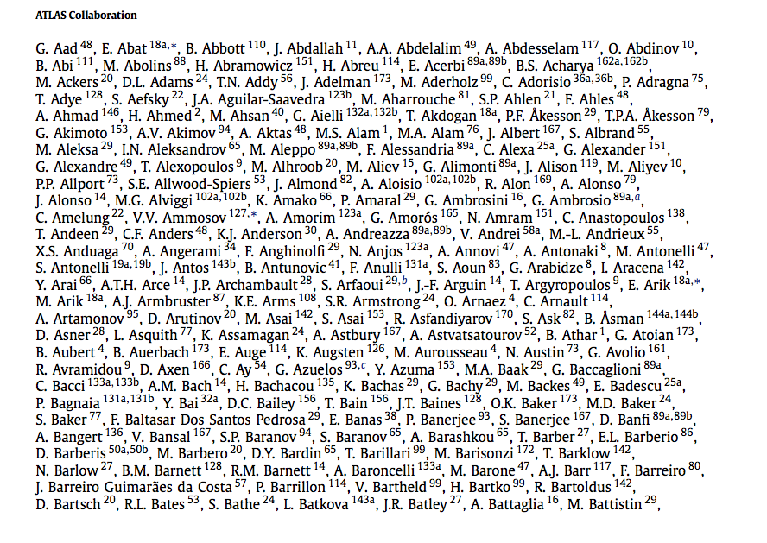
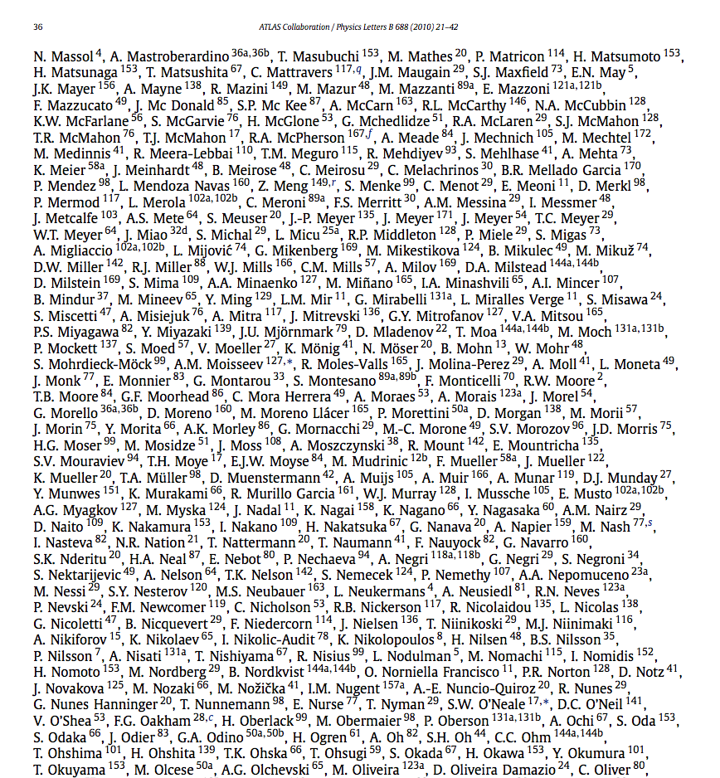

Slide 24


Slide 25
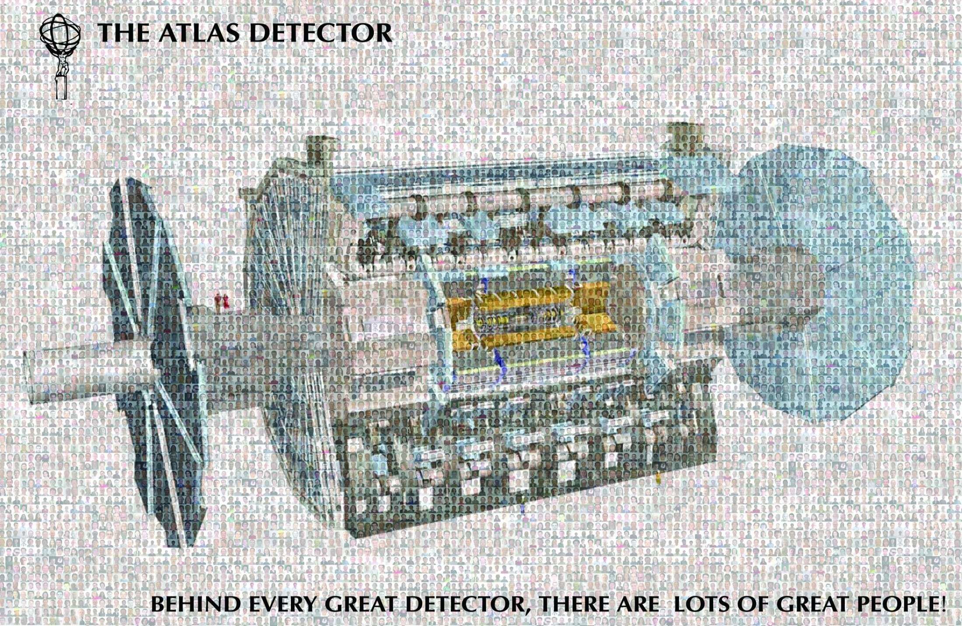

Slide 26
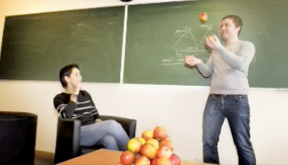
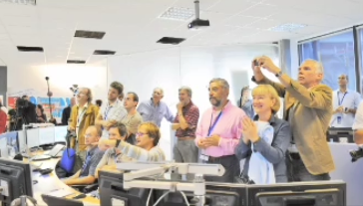
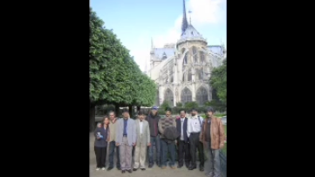
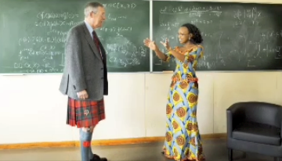
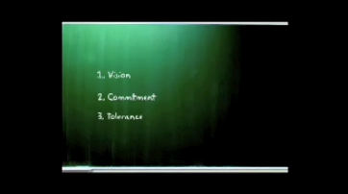
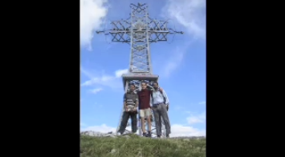
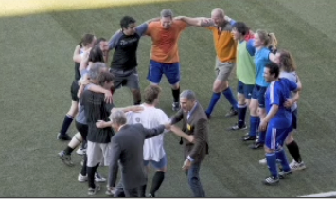
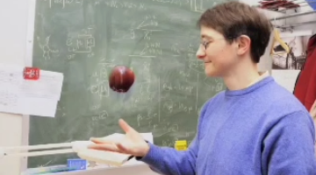
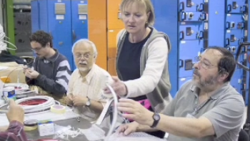
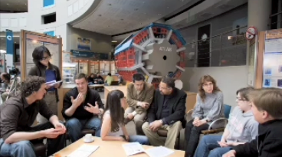
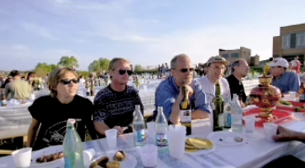
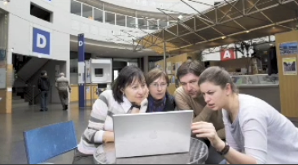
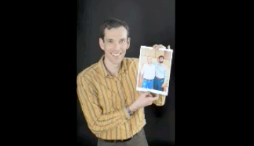

Slide 27

Conclusions

Slide 28
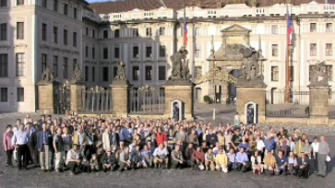
Communitarian Bonds
  Shared Vision
    One common aim of “Out of this world” discoveries; such as the Higgs
    Better understanding of the fundamental forces and particle (Big Bang)
  Shared Commitment
    Passion to “Can-do”
    Members of Collaborations prepared to solve the encountered technological (and human) challenges
    Willingness to accept also less glorious tasks for the common good
    Some have been working for LHC Experiments since mid 1980s…
    Trust in colleagues fulfilling their commitments (MoU)
  Shared Tolerance
    Willingness to work together, irrespective of geographical location or language barriers
    Willingness to share information
    Principle of “Raw Diamond”

Slide 29


Slide 30
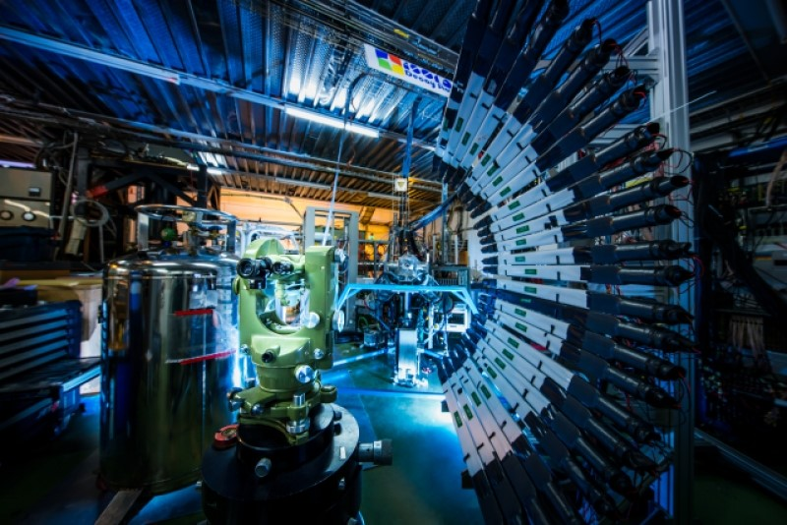
Simple Micro Rules
Allow people to dream (5% makes already a difference)
Tolerate diversity
Let the physics decide, not the hierarchy
Collaborate and compete
Question and justify – Respect the Dukes of Doubt rather than Kings of Truth

Slide 31
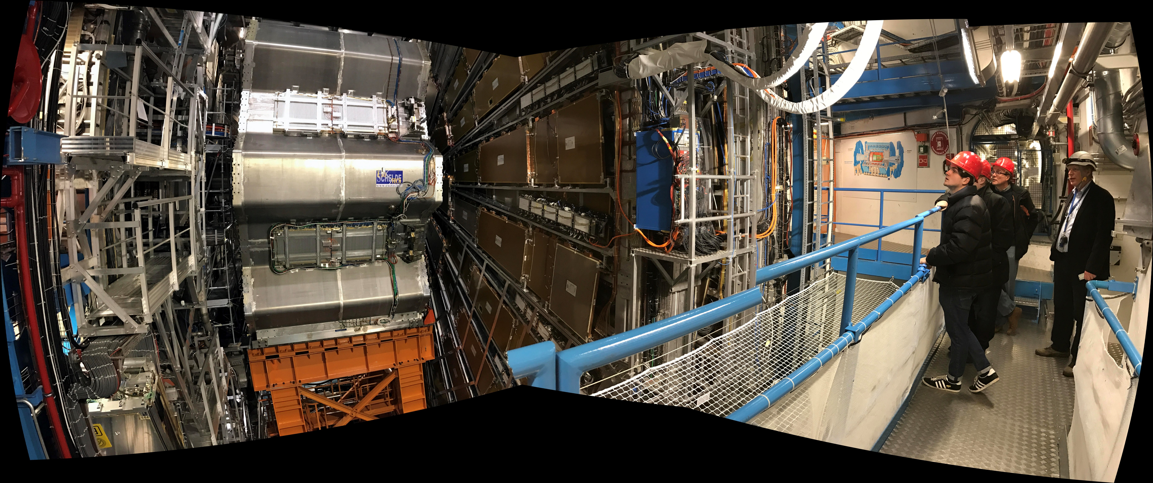
Simple Macro Rules (2)
Set up Collaboration structures that respect individual freedom and which do not impose formal authority
Elect leaders based on technical competence, credibility and trust rather than ego and authority
Allow ad-hoc expert teams to emerge and quickly respond to encountered scientific and technical hurdles
Keep everyone on board, give everyone a voice
Set up peer review processes and arbitration mechanisms

Slide 32
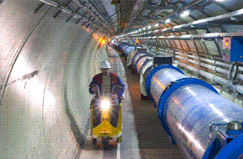
Cultures of Experiments
  There are several underlying sub-cultures in LHC Experiments
    Physics culture versus Engineering culture
    Hardware oriented culture versus software/computing etc.
    Sub-system cultures (e.g in ATLAS,. ”LAr culture versus Muons culture”)
    Geographical cultures (“North versus South; West versus East”; languages)
  Such cultural diversity originates itself from
    Global nature of modern high energy physics (ca 40 countries, 70 nationalities)
    Decentralized nature of resources, diverse funding sources
    Different ways to account and organize resources
  Project cycles and dominating cultures
    Sub-system/engineering culture more dominant during construction
    Physics culture very strong during project definition (design); then resurfaces when physics analysis starts

Slide 33
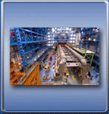
How are (tough) decisions made?
  Consensus-driven approach
  Bottom-up approach, in consultation with Experiment management
    Management can’t dictate, instead coordinates and steers the process
  Keep everyone on board!
  “Factorize” the encountered problems as much as possible
  Working groups come up with alternative solutions, they select and propose the most suitable one
  Leave tough decisions to the last possible moment (without compromising the schedule)
  Collaboration Board approves collaboration actions (one institute, one vote)
  Financial matters approved in the Resources Review Board
    But I do not recall in ATLAS over 12 years no voting

Slide 34
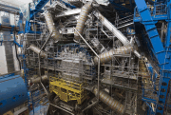
Monitoring and Information Systems
  Collection, recording and reporting of Project performance and progress information
    Information is regularly collected from the sub-system project leaders for Project stakeholders: Collaboration Board, Executive Board, CERN Mgmt, Research Review Board
  Collected information is submitted to different informatics tools (e.g. EDMS, PPT, CDS, EUCLID/CATIA, OTP, other web-based reporting tools)
  Experiment Mgmt reviews the collected data and summarizes it for reporting
      Schedule issues, technical performance issues,
      Organization issues, financial issues
      Science policies, Project personnel nominations, budgets
      Project progress, milestones met, encountered technical issues (excluding resources)
      All resources related matters; project status reports

Slide 35
How to keep members informed and involved?
  Roughly 1 000 members of e.g. ATLAS Collaboration are physically at CERN at any given moment
  How then do we keep the other 2000 – 3000 members informed and involved?
    Broadcasting of regular weekly common meetings
    Working groups use Collaborative tools (videoconferencing)
    Collaboration Weeks ~ 4 times a year
    Collaboration Board meetings ~ 4 times a year
    Many email-groups

Slide 36
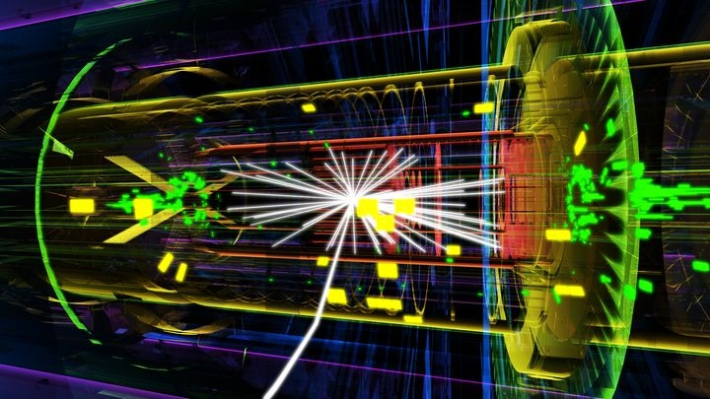
Anything to Learn From?
  Lessons learned?
    It can be done ☺
    But not necessarily best solution for more conventional projects
  What should be changed or improved (for the future)?
    Handling of contingency
    Sharing of responsibilities (better mechanisms to ensure deliverables)
  Can it be replicated?
    Sure; for next generation physics experiments (and not only HEP)…
    Projects around eScience have similar characteristics (see next slide)
    Open science/innovation models
    Industrial R&D management models (laissez-faire)?

Slide 37
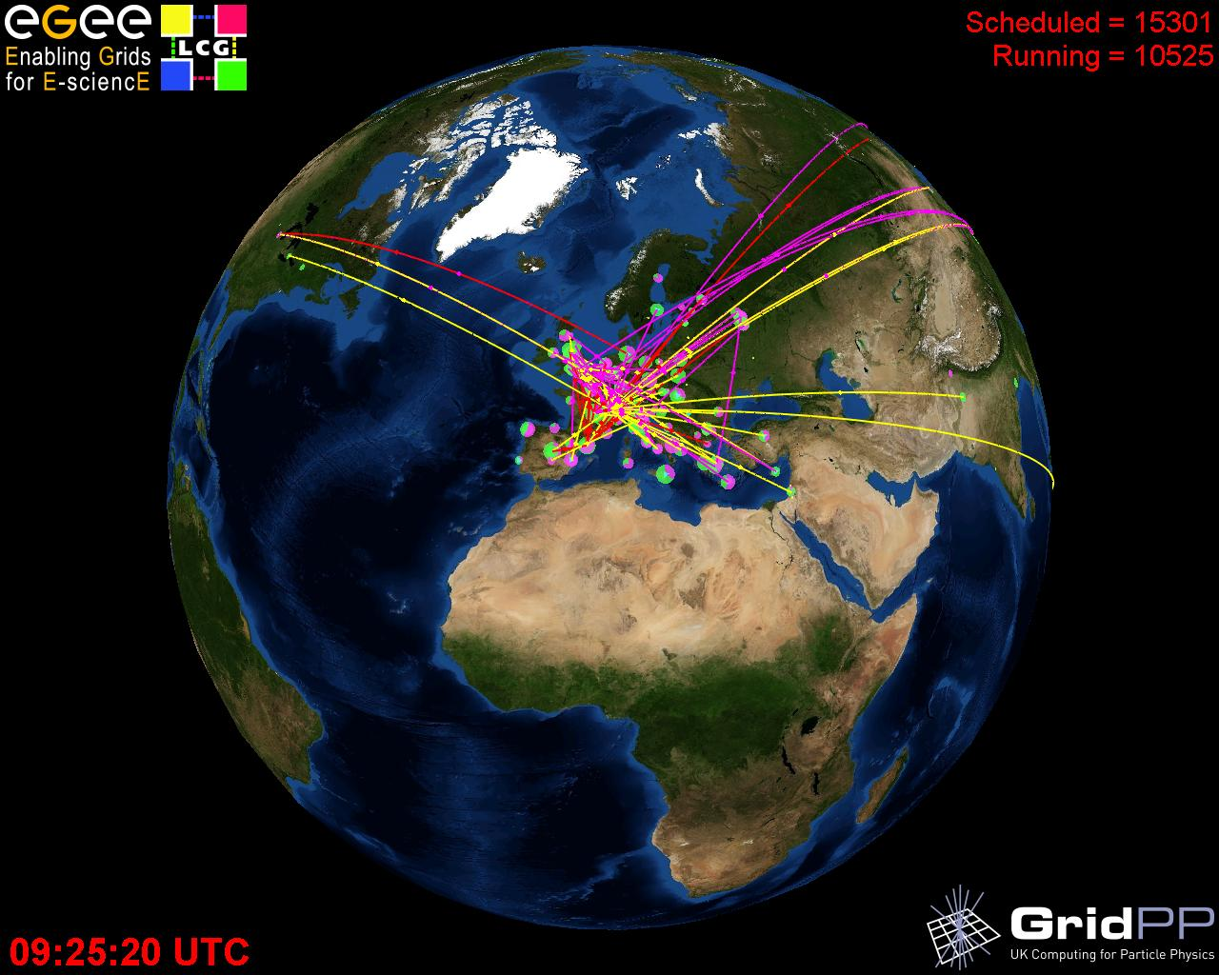

eScience Infrastructure ingredients
People & Training & skills
Computers, Comp. aided services
e-Libraries
Archives/Curation centres
Multidisciplinary Collaborations:
Common objectives
Open sharing
Critical mass
Trust and respect
Declaration of best efforts
Quality Assurance Service-oriented
interoperable open Software
Large Data
Repositories
Communication means
Facilities, Instruments & services
Networks

Slide 38
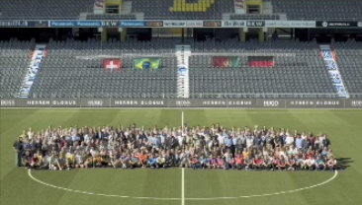
Conclusions
  LHC Experiments are large scientific projects that can be described as
    Complex
    Global
    Culturally diverse
    Shared vision, commitment and tolerance
    Efforts made to hear the individual
  They are not managed like a corporation
  Instead,
    Run by self-managed individuals and teams
    Have a Spokesperson, not a CEO
    Guided by engagement, discussions, trial & trust, and justification rather than hierarchical powers or ex-ante directives
    A challenge for coordination …
  So what is it?
    Your comments and views would be much appreciated!

