Slide 1
LIU-PSB EVM Status
Data extraction: 15 November 2017

Slide 2
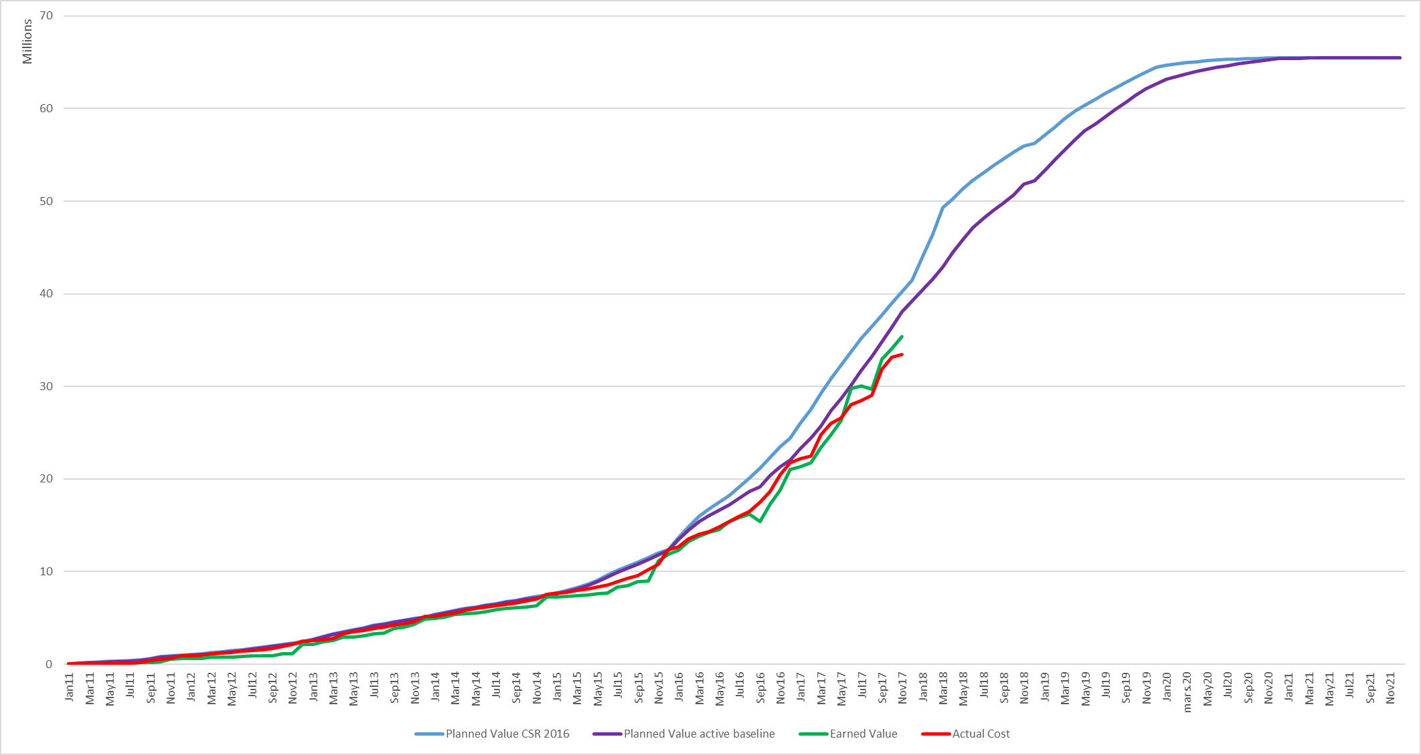
LIU-PSB Dashboard

Slide 3
Variances by Workpackage

Slide 4
LIU-PSB Crosstab by Group
CET objective 1st December | Charges | 74%
 | Commitments | 96%

Slide 5
Spare Slides

Slide 6
LIU-PSB Crosstab – BE Department

Slide 7
LIU-PSB Crosstab – EN Department

Slide 8
LIU-PSB Crosstab – SMB Department

Slide 9
LIU-PSB Crosstab – TE Department

Slide 10
LIU-PSB Crosstab – TE Department

