Slide 1
ELENA electron cooler progress
Lars V. Jørgensen, BE-BI-EA

Slide 2
Progress on preparing the electron cooler for insertion in ELENA
Most vacuum components and magnetic system arrived at the AD about 3-4 weeks ago.
Assembly progressing pretty steady with one component of magnetic and associated vacuum chamber installed at a time followed by leak testing before the next component installed.
First main drift magnet with vacuum chamber and BPMs.
Then first toroid section with the elaborate 3D gymnastics of the individual coils to get the toroid chamber in.

Slide 3
Progress on preparing the electron cooler for insertion in ELENA - II
Second toroid section installed
Vertical solenoids with the vertical vacuum chambers installed
Squeeze coil installed
Gun vacuum chamber installed.
On schedule for insertion in ELENA in early December.
Expansion coil will only be installed after bake-out.
Collector will be installed when the system is in its final position in the ELENA ring because the ceramic breaks in collector are very sensitive to schocks.
Electrical connections and cooling connections to be made (as far as possible) before insertion.
Magnets will all be tested with a 1 A current before insertion (no cooling available at that position)

Slide 4
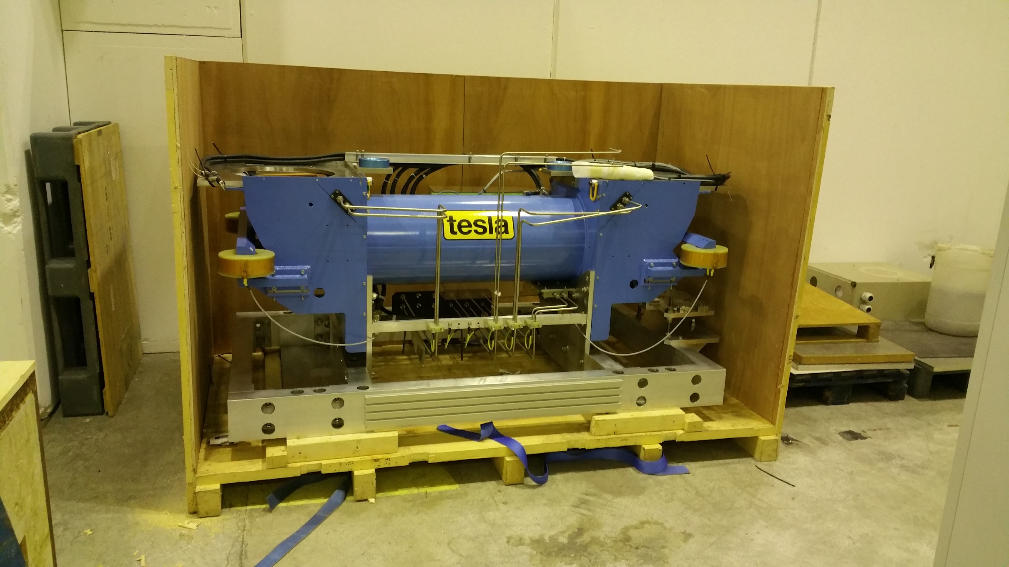
Photos of installation of ELENA ecooler

Slide 5
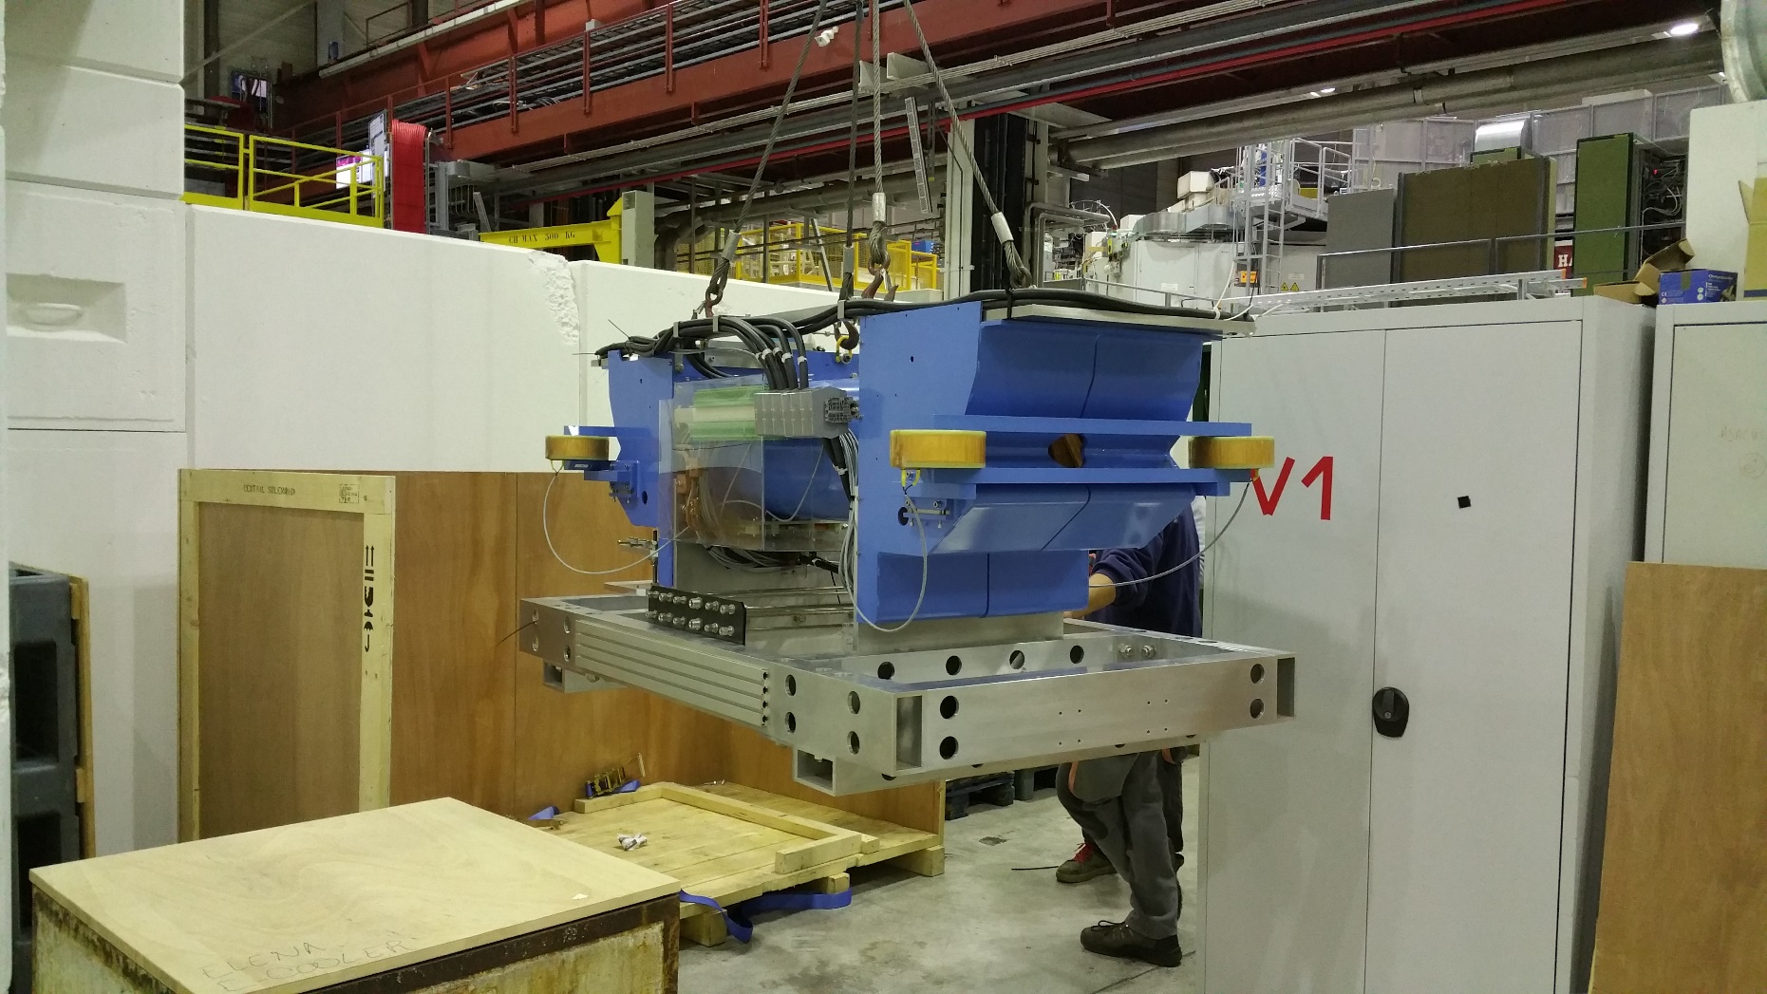
Ecooler assembly

Slide 6
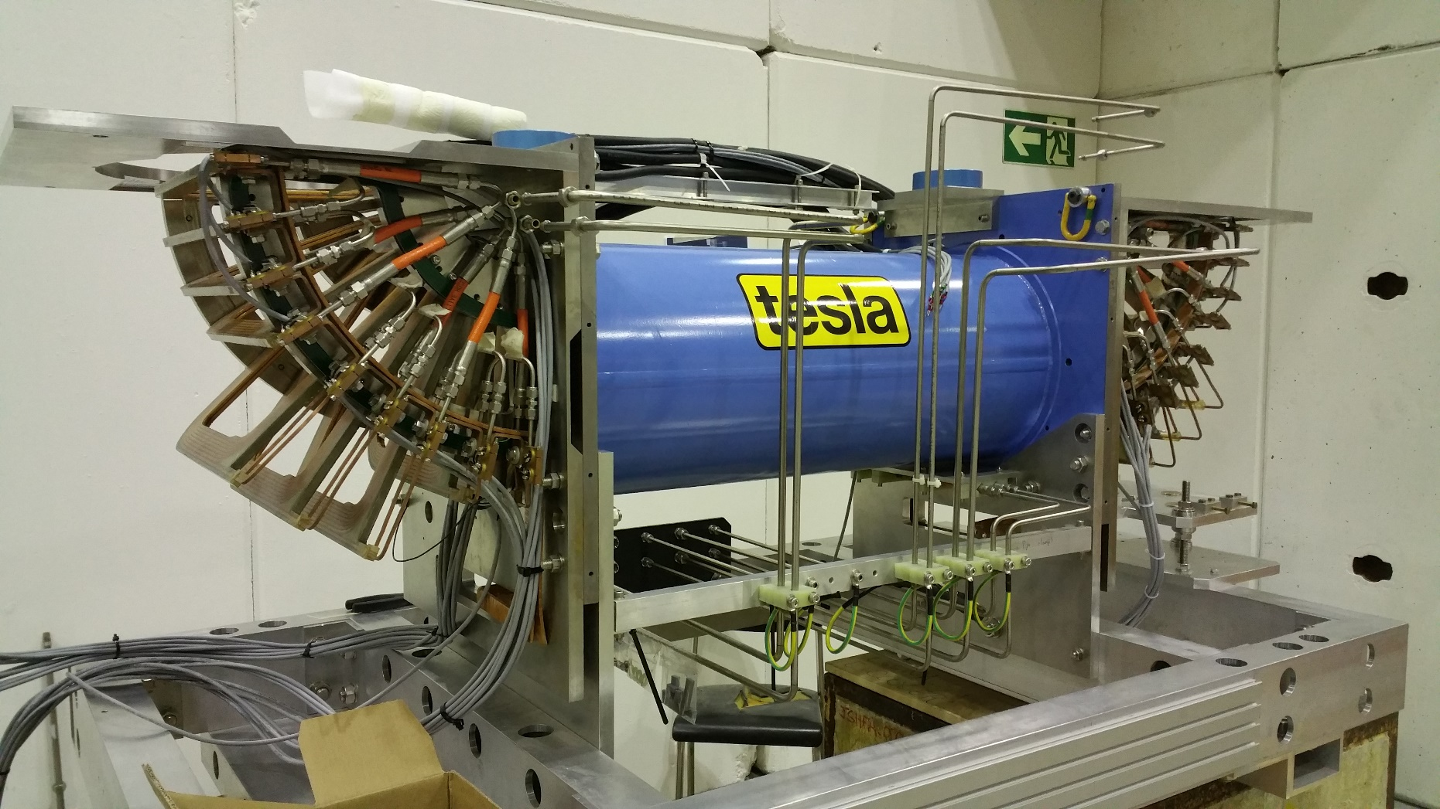
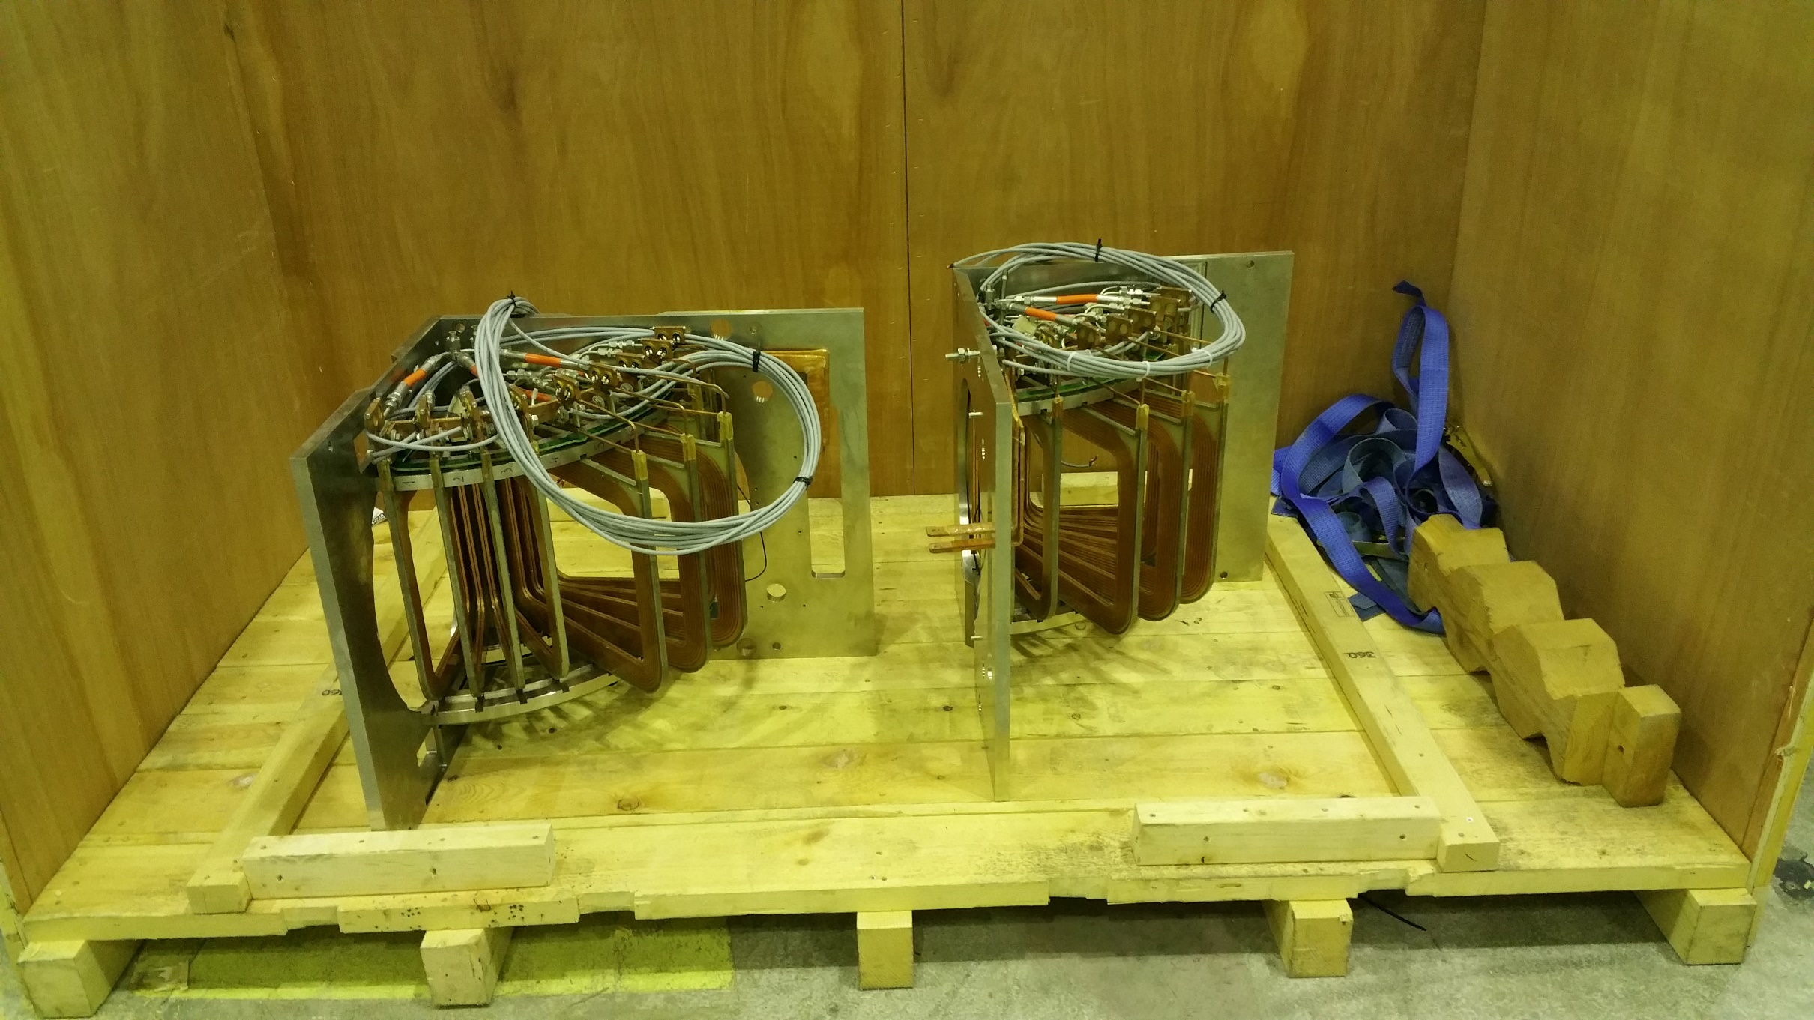
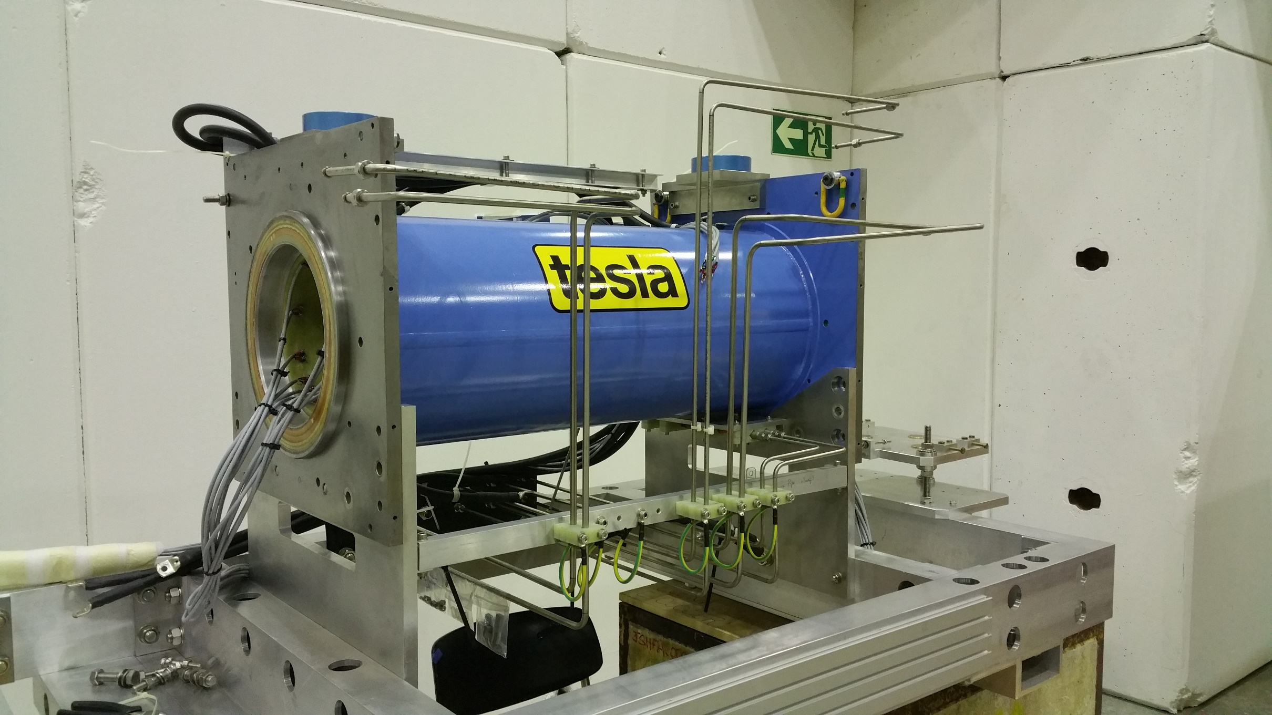

Slide 7
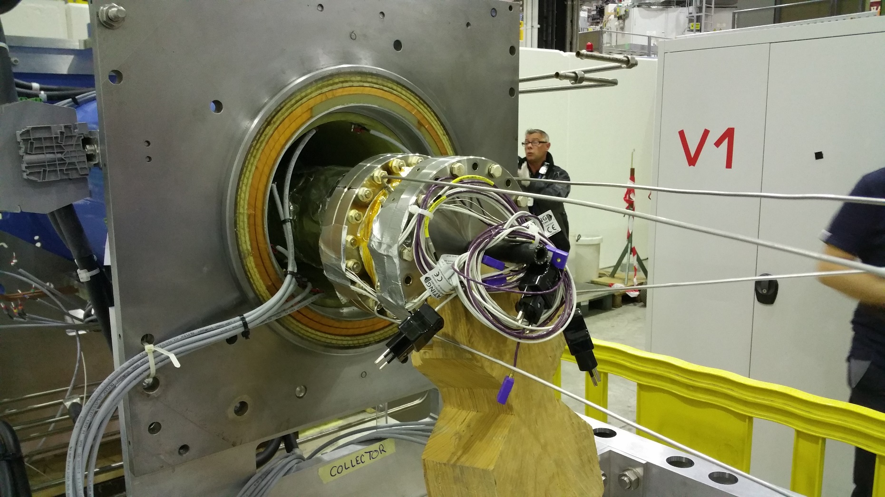
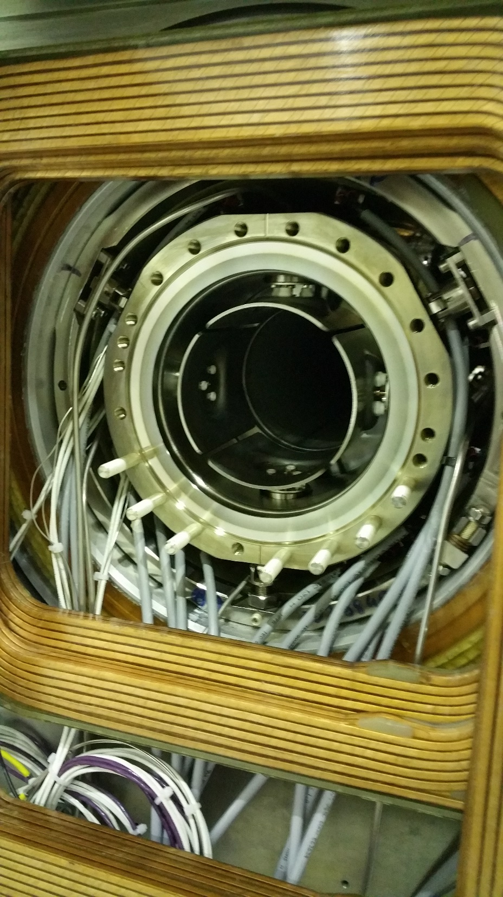

Slide 8
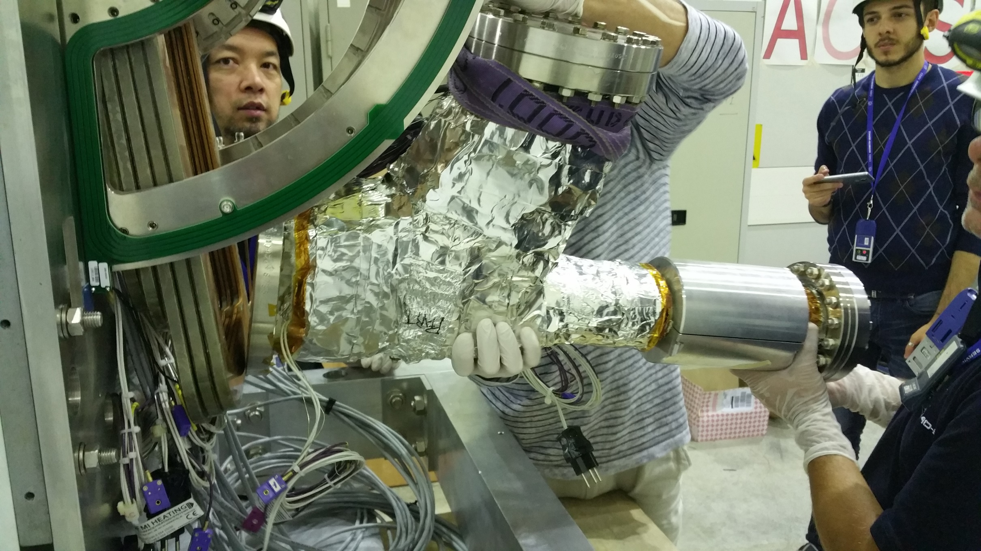
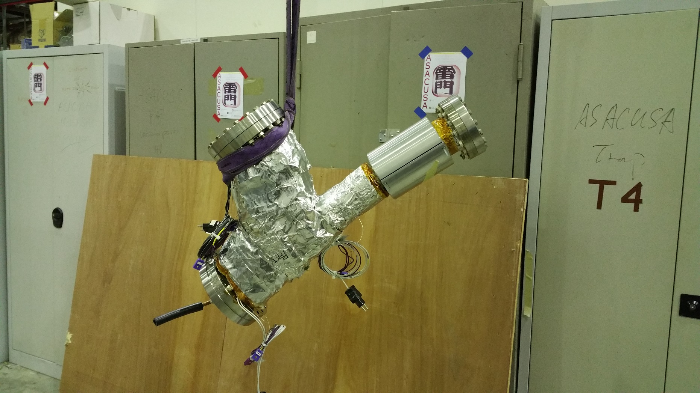
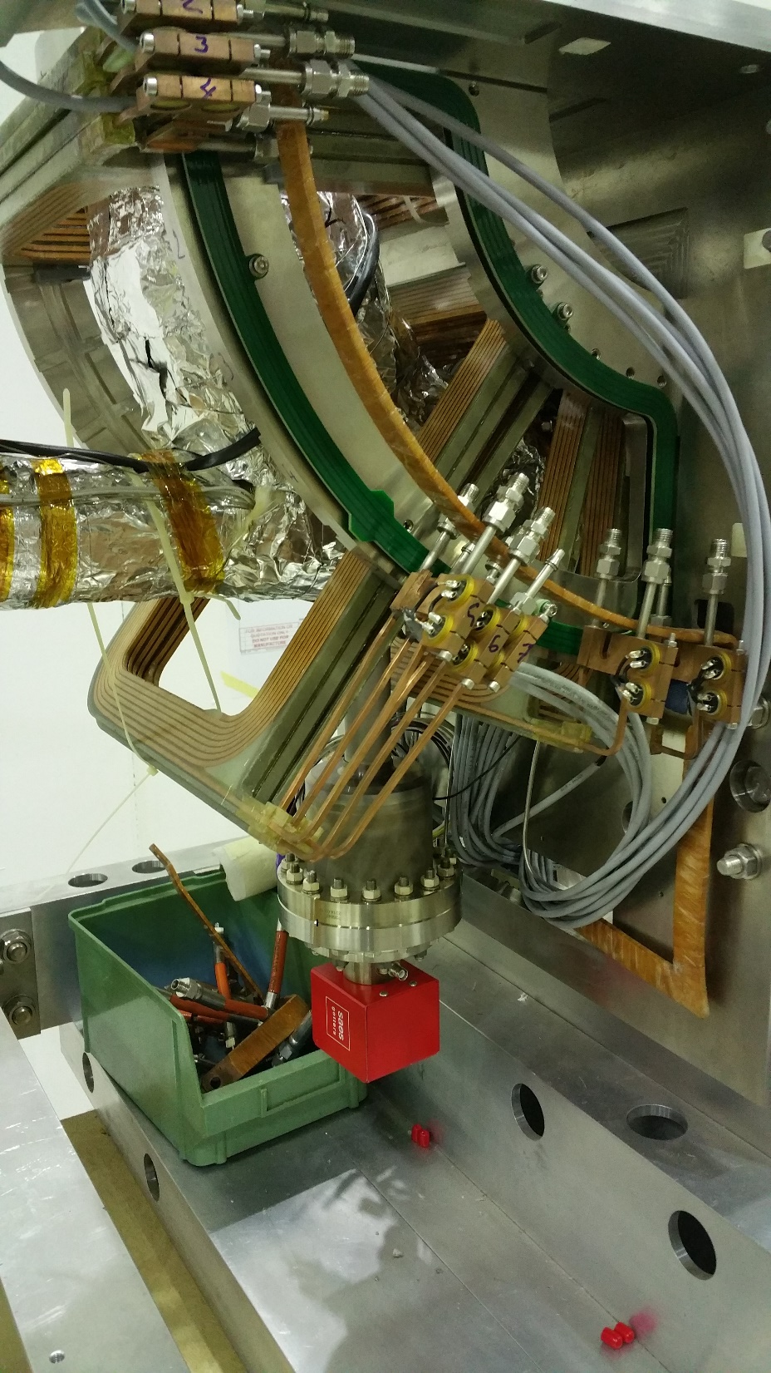

Slide 9
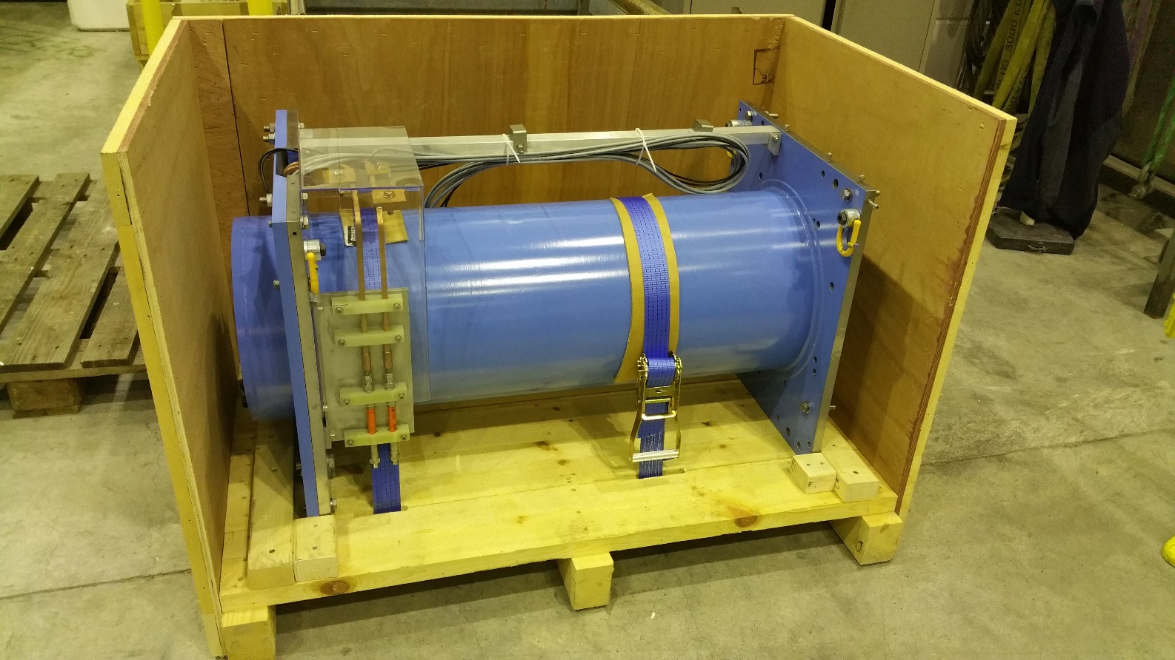
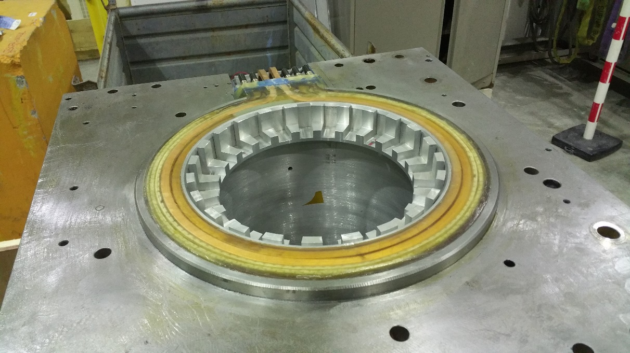
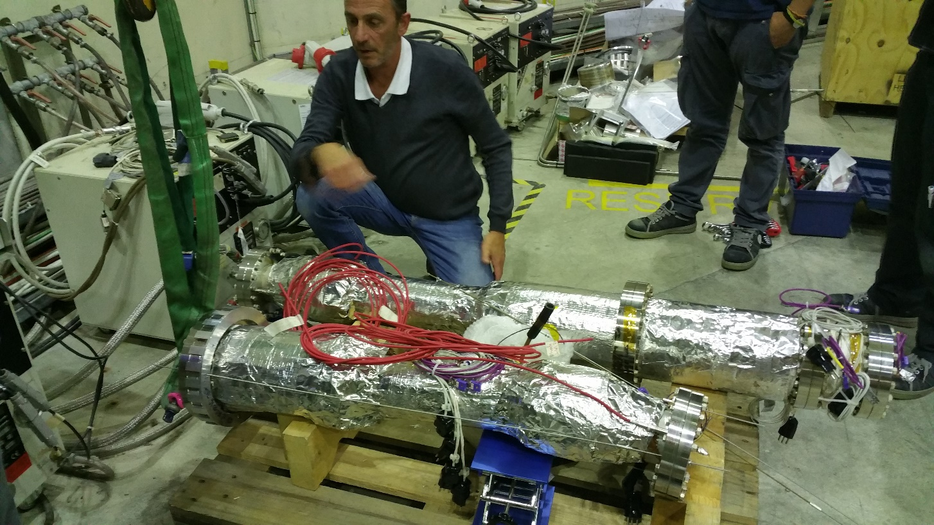
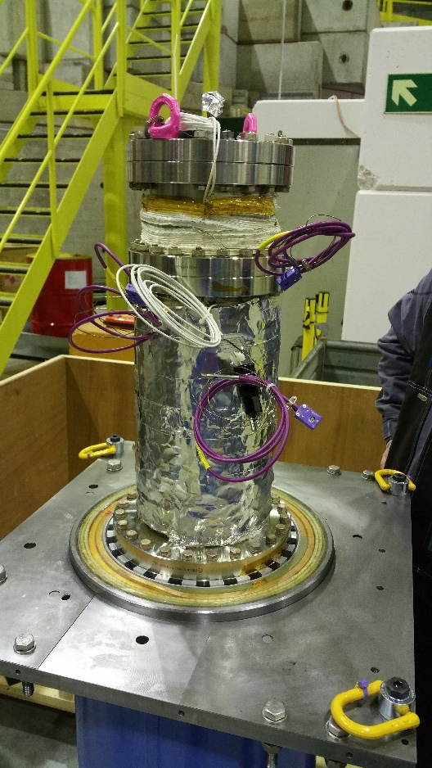

Slide 10
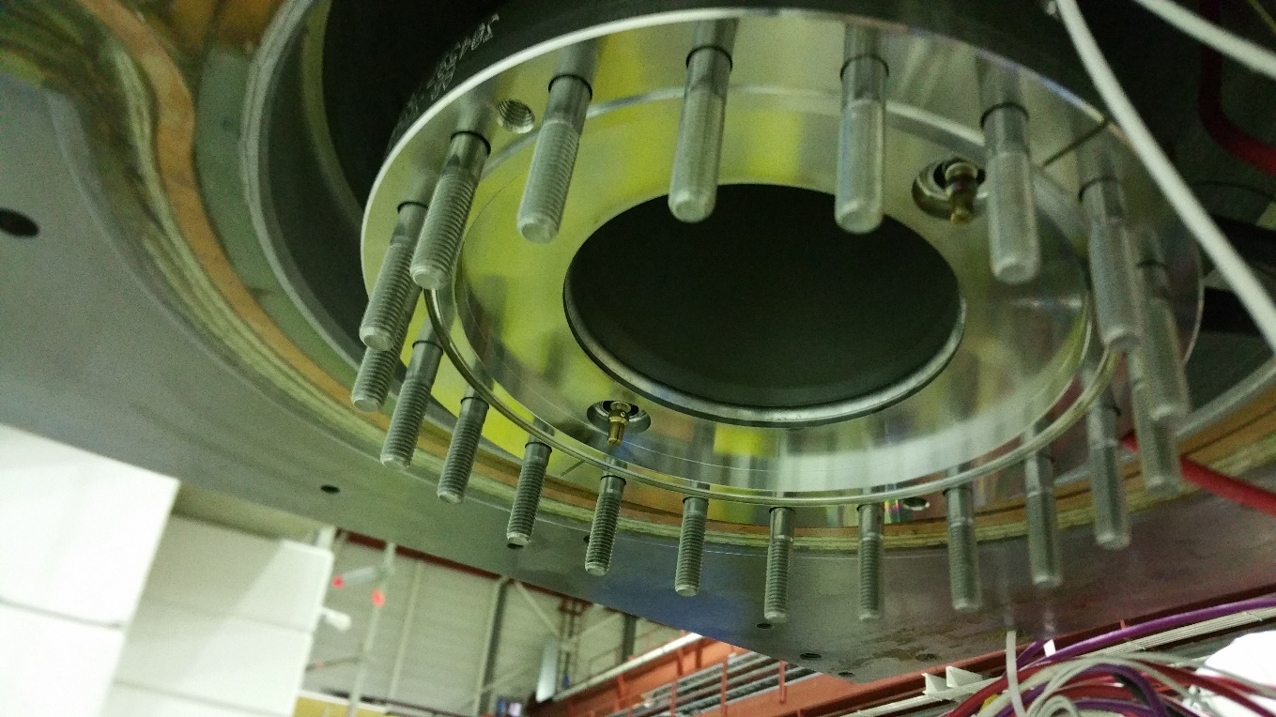
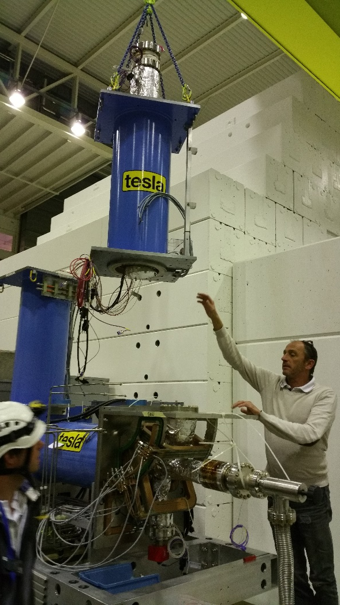
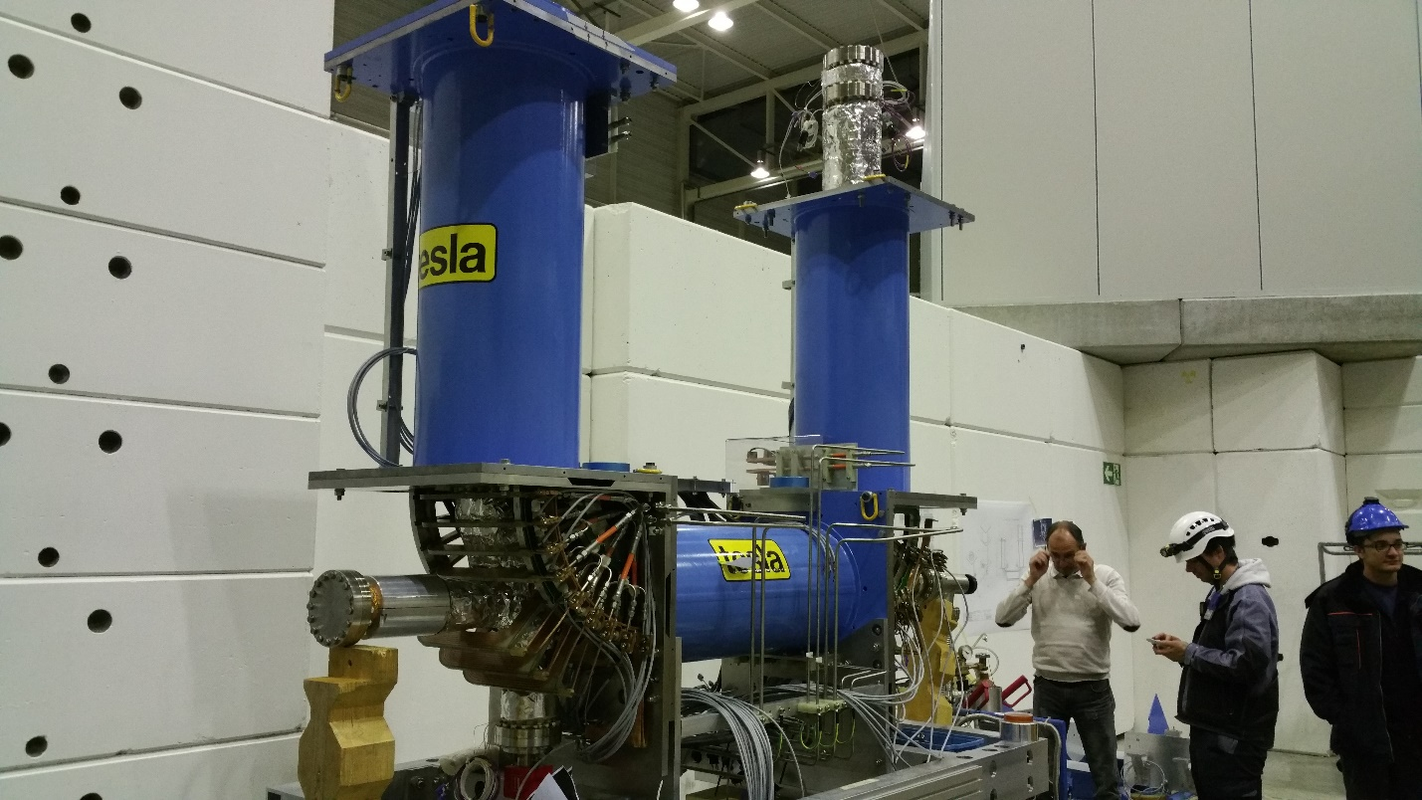

Slide 11
