Slide 1
Copper Measurements with High Frequency Ultrasound Microscope
Antti Meriläinen^{1,2}, Ivan Kassamakov^{1,2}, Markus Aicheler², Kenneth Österberg^{1,2} and Edward Hæggström¹
1) Department of Physics, University of Helsinki
2) Helsinki Institute of Physics

Slide 2
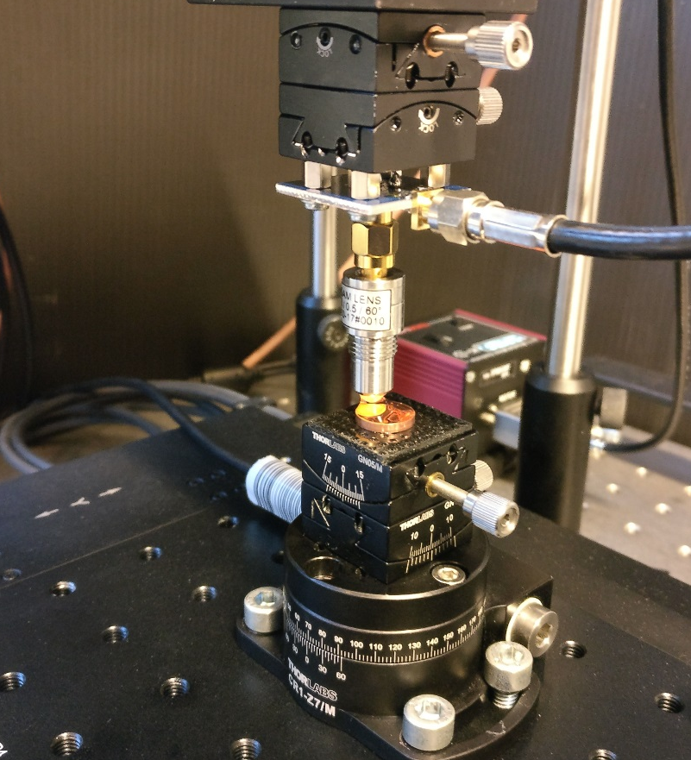
Why Acoustic Microscope
Optical methods do not measure elasticity
Tapping mode AFM is not easy to calibrate for elasticity
µCT Does not see elasticity close to the surface
Goniometer tilt stage
Ultrasound transducer
Sample
Goniometer tilt stage
XY Stage
1 cm

Slide 3
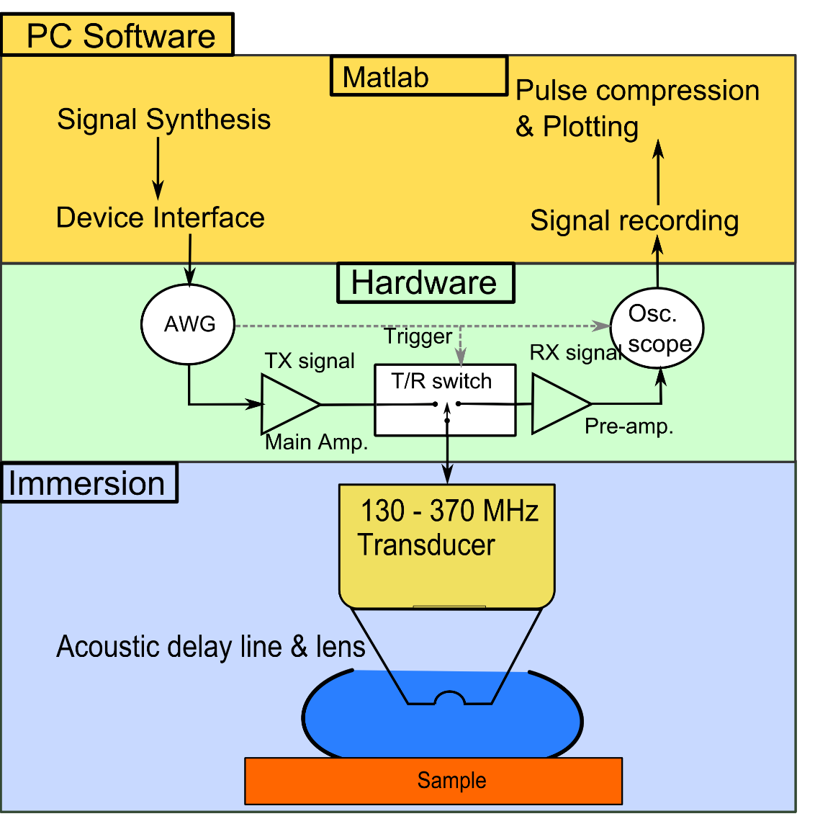
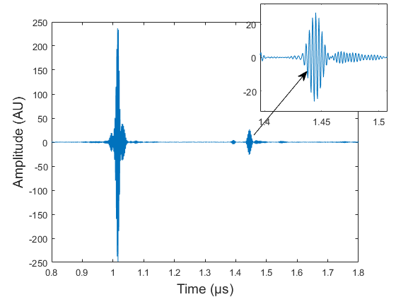
Pulse Echo Measurements
Single Pixel
Time-of-Flight
Echo Amplitude
Time-of-Flight: Surface Topography
Amplitude: Mechanics

Slide 4
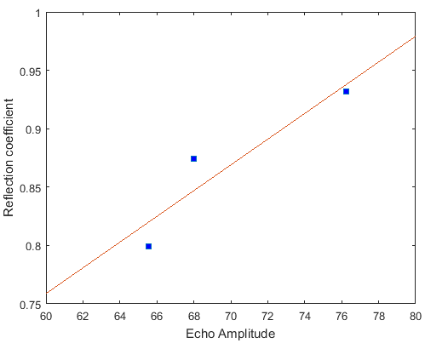

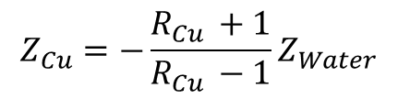
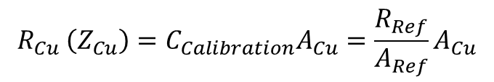
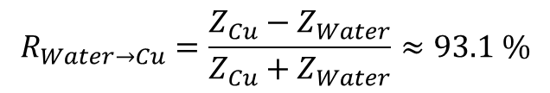
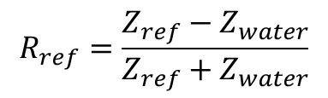



Math of Acoustic Reflection
Time-of-Flight
$$C is Speed of Sound$$
$$s=\frac{c_{Water}}{t}$$
$$t is Time of Flight$$
Echo Amplitude Calibration
$$R_{Water→Cu}=\frac{Z_{Cu}−Z_{Water}}{Z_{Cu}+Z_{Water}}≈93.1 \%$$
$$R_{ref}=\frac{Z_{ref}−Z_{water}}{Z_{ref}+Z_{water}}$$
$$R_{Cu }\left(Z_{Cu}\right)={C_{Calibration}A}_{Cu}=\frac{R_{Ref}}{A_{Ref}}A_{Cu}$$
Sapphire
$$Z_{Cu}=−\frac{R_{Cu }+1}{R_{Cu }−1}Z_{Water}$$
Silicon
Copper
UV Fused
Silica
$$A=Ech{oes}^{′} Amplitude$$

Slide 5


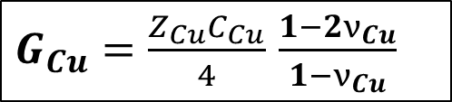




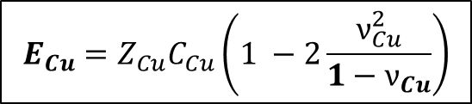

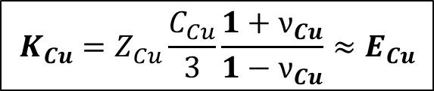

Math of Acoustic Reflection
Echo Amplitude: Mechanics from acoustic impedance
$$Bulk Modulus K$$
$$K_{Cu}=Z_{Cu}\frac{C_{Cu}}{3}\frac{1+ν_{Cu}}{1−ν_{Cu}}≈E_{Cu}$$
$$Z_{Cu}\left(A_{Cu }\right) Is Calculated$$
$$Z_{Cu}=\frac{K_{Cu}+ \frac{4}{3}G_{Cu}}{C_{Cu}}$$
$$Young^{′}s Modulus E$$
$$E_{Cu}=Z_{Cu}C_{Cu}\left(1 −2\frac{ν_{Cu}^{2}}{1−ν_{Cu}}\right)$$
$$Z_{Cu}=C_{Cu}{\text{ρ}}_{Cu}$$
$$Shear Modulus G$$
$G_{Cu}=\frac{Z_{Cu}C_{Cu}}{4}$ $\frac{1−2ν_{Cu}}{1−ν_{Cu}}$
${\text{ρ}}_{Cu}$ is the density of copper
$ν_{Cu}$ is Poisson's ratio of copper

Slide 6
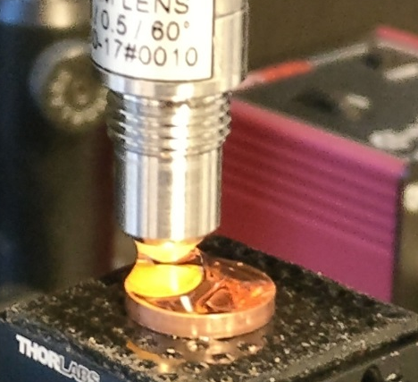
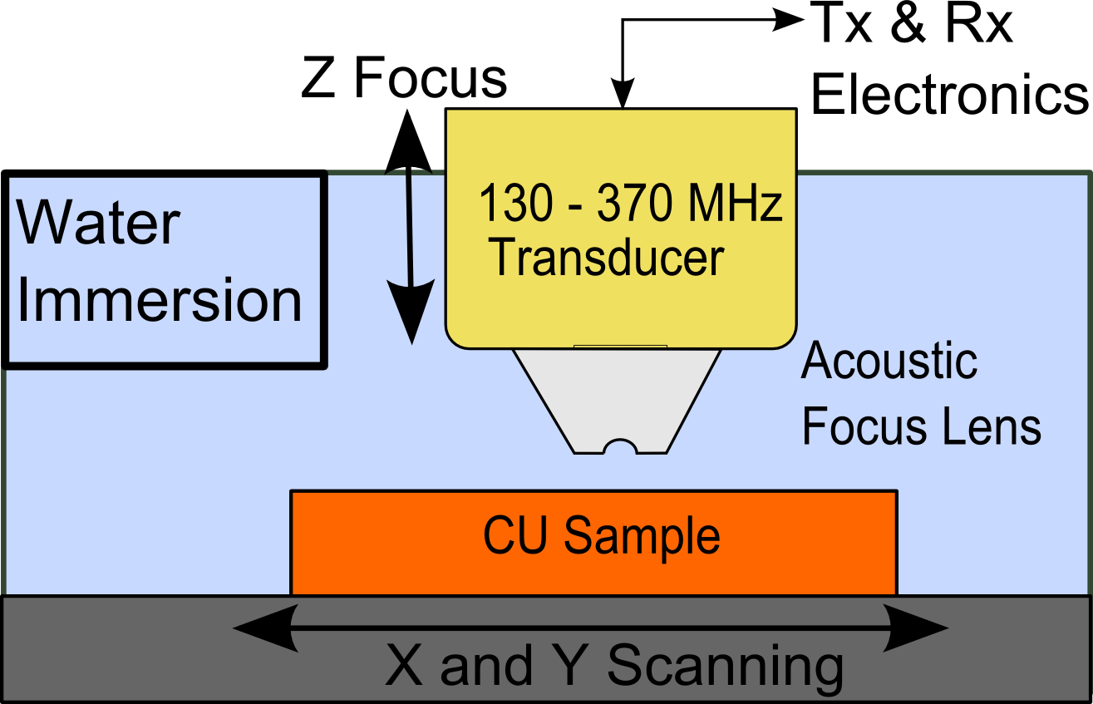
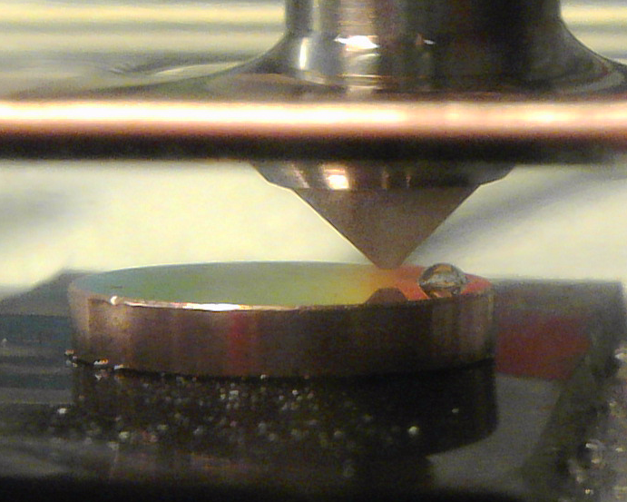
Scanning Acoustic Microcopy
10 mm
Frequency range: 130 – 370 MHz
Pixel-by-Pixel Imaging
Areas 1 mm * 1 mm
  Stepping 1-3 µm
Focus size: less than 3.5 µm
Imaging time: ~1-5 min/mm²
10 mm

Slide 7
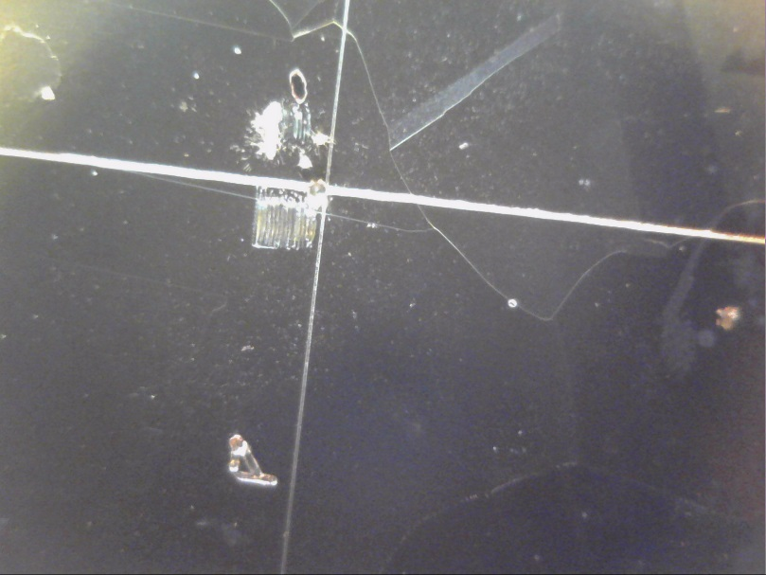
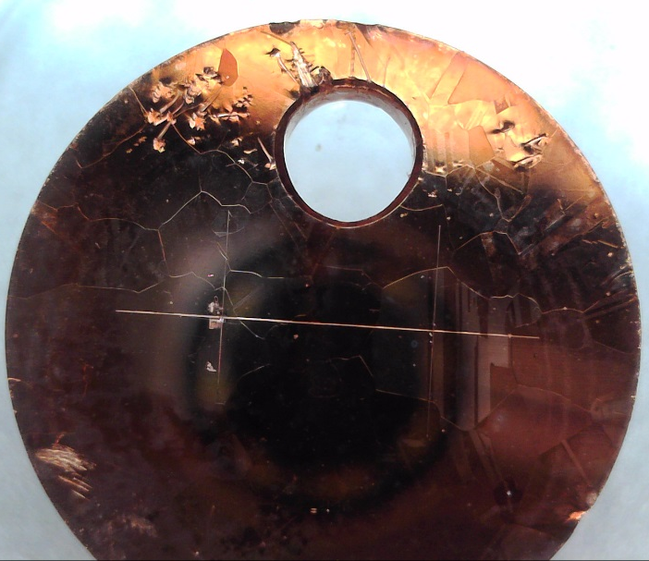
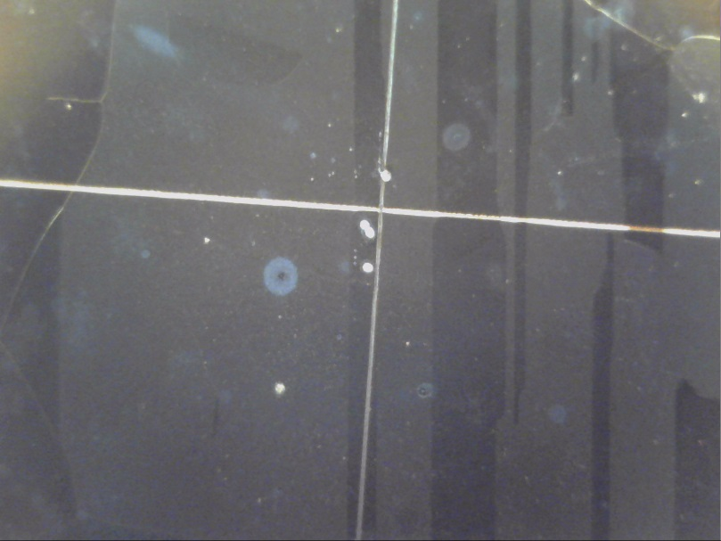
Copper Sample #1
Field Emission Sample

Slide 8
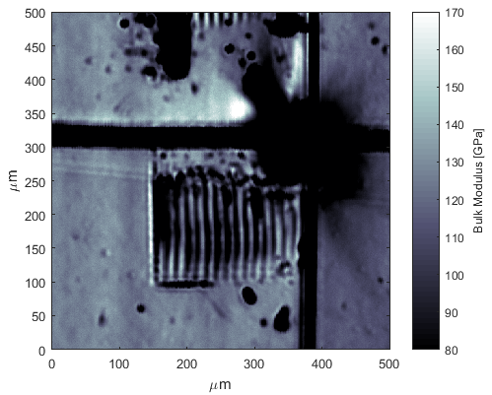
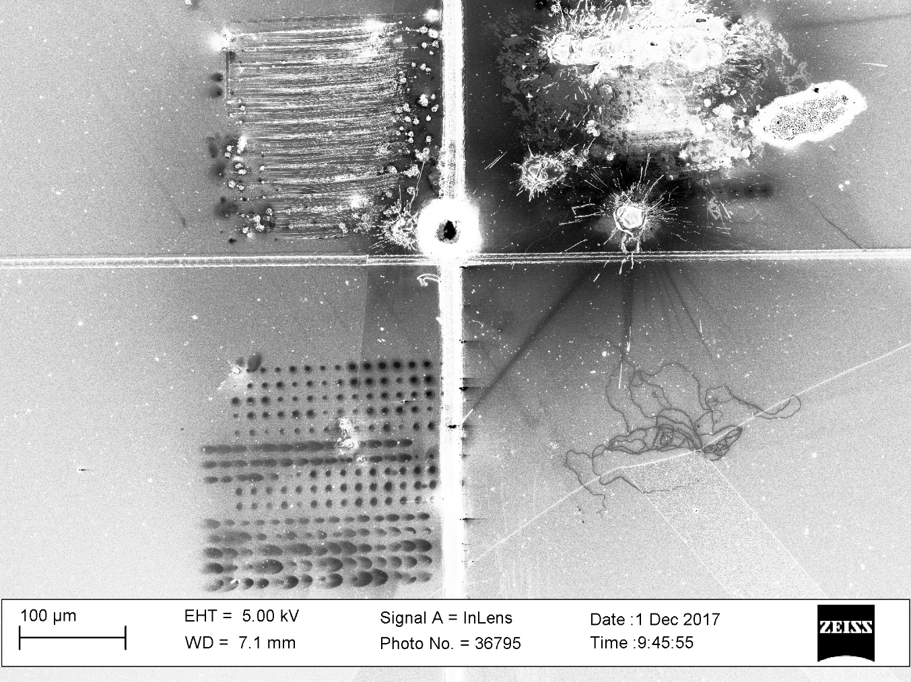
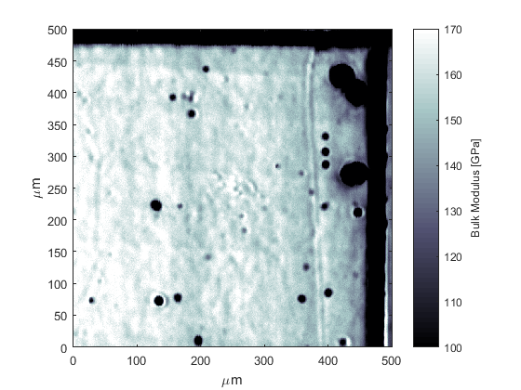
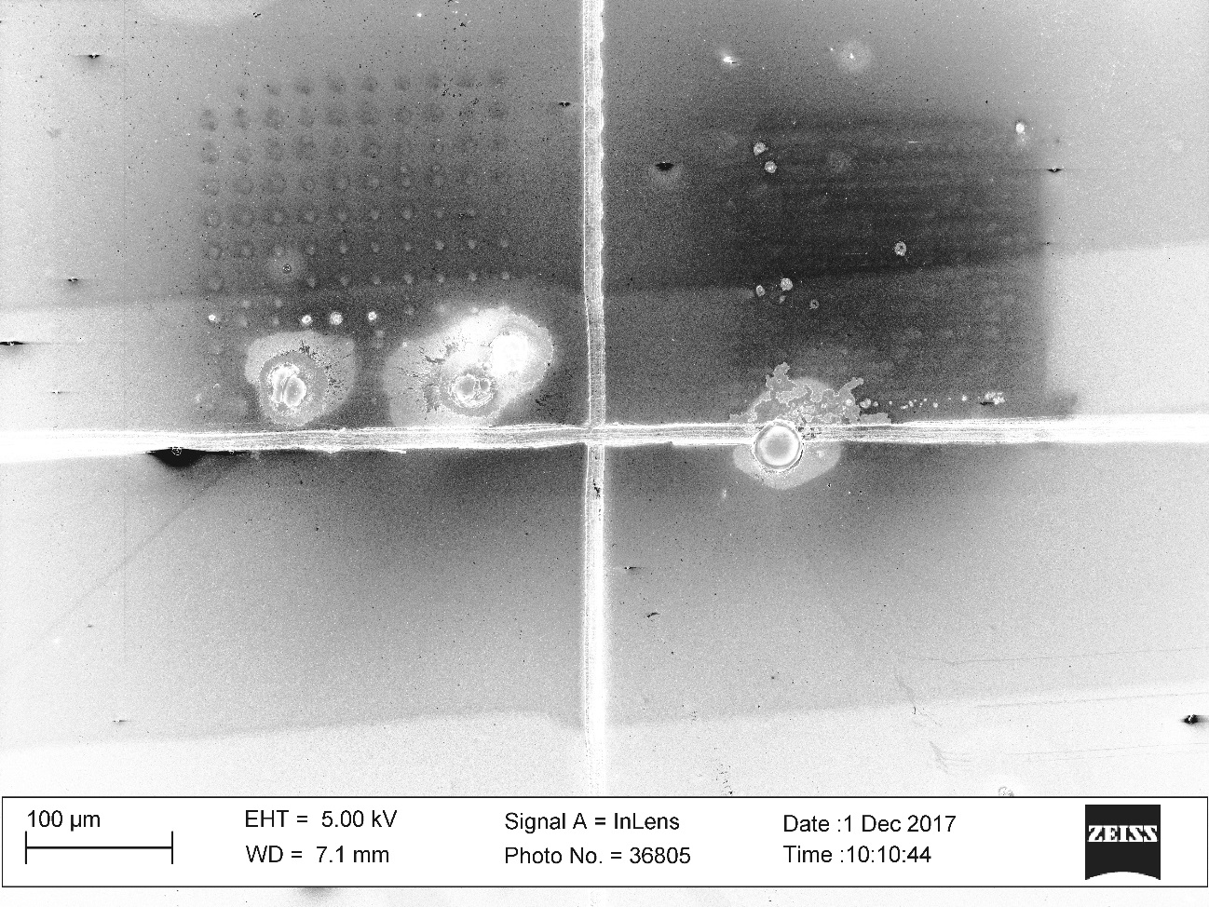
Field Emission Areas
250 MHz Transducer
Optical
Ultrasound
HR-SEM

Slide 9
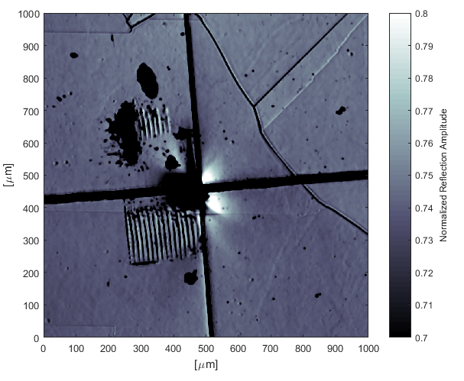

Large Area US Images
400MHz Transducer
Resolution 2.5 μm
Transducer is uncalibrated
  Normalized color scale

Slide 10
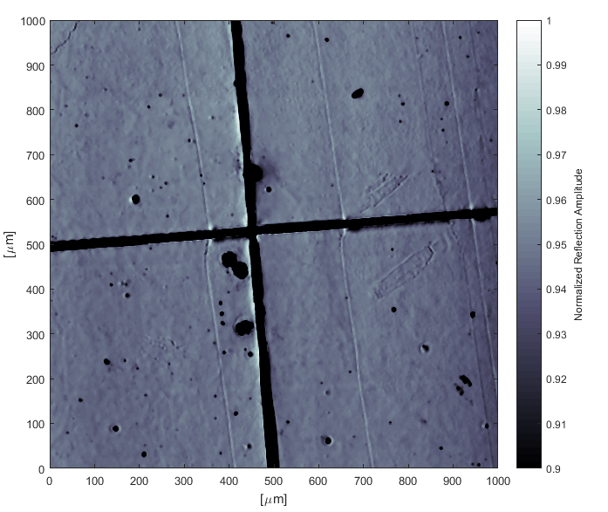

Large Area US Images
400MHz Transducer
Resolution 2.5 μm
Transducer is uncalibrated
  Normalized color scale

Slide 11
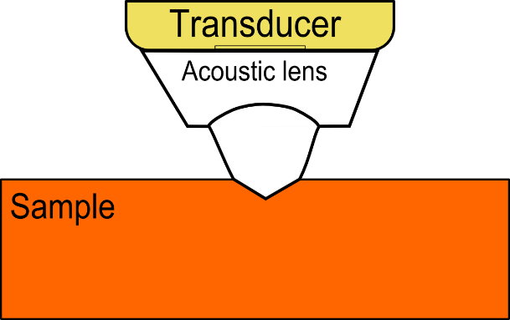
Beneath the surface
Challenges:
Over 90% of sound reflects from Cu surface
Focused transducer are designed for water
  Limited working distance
  Total reflection
  Wave bend in water-copper interface
Echoes are weak
  Low noise system needed
  Background rejection
Synthetic Aperture Focusing Technique (SAFT)
  Good phase control
  CPU, GPU and memory needed
  Only qualitative contrast

Slide 12
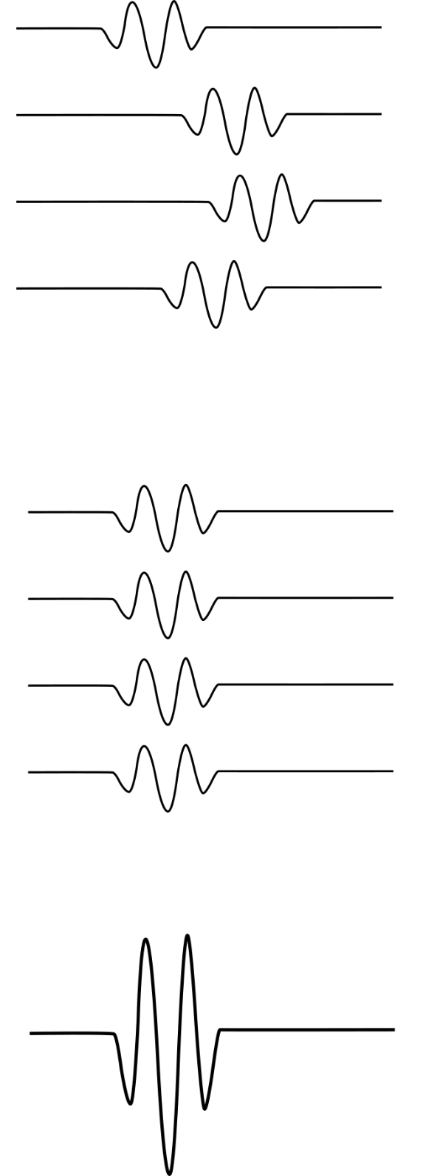
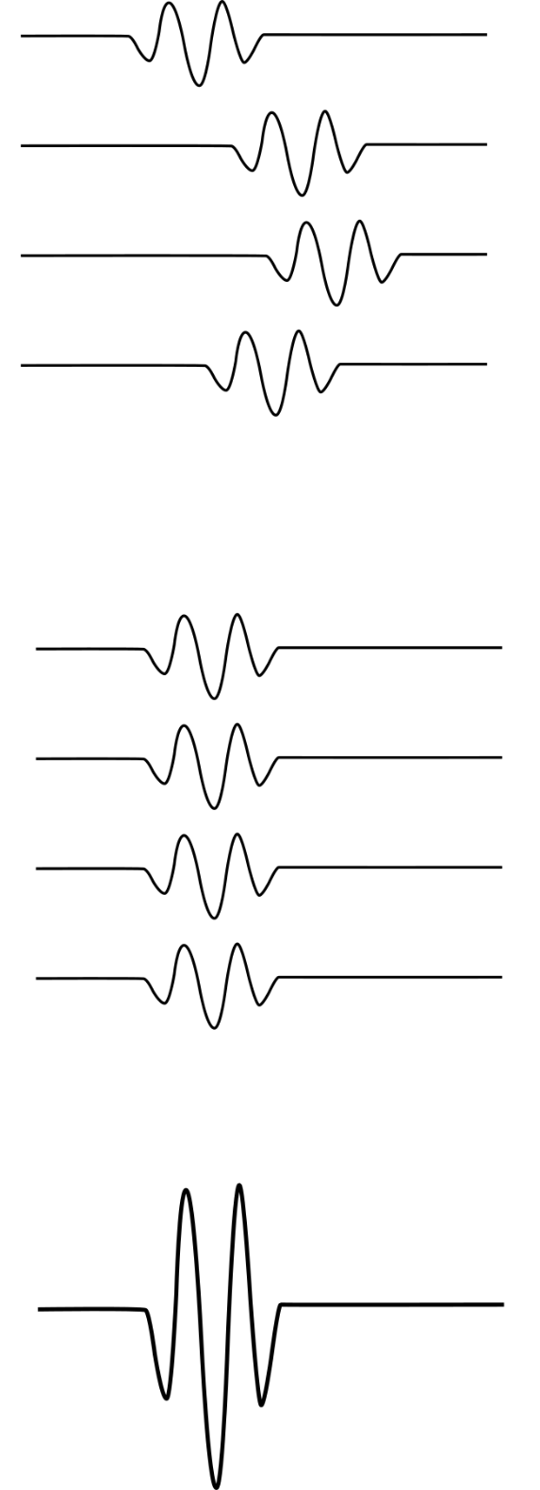
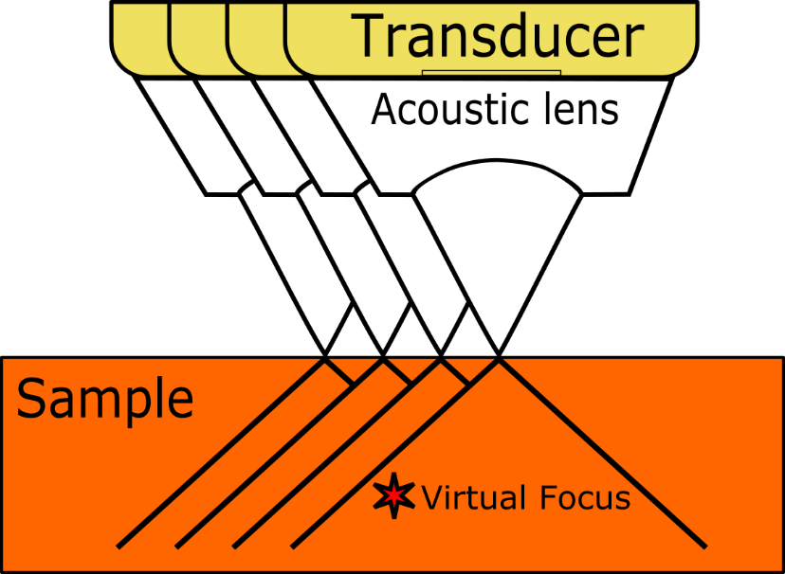
Synthetic Aperture
Focusing Technique (SAFT)
Rx Signals
Delay Filter
∑(…) =

Slide 13
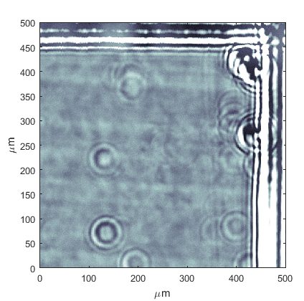
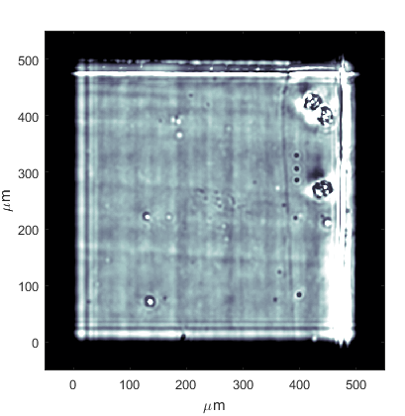
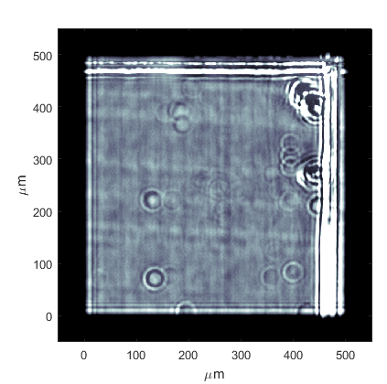
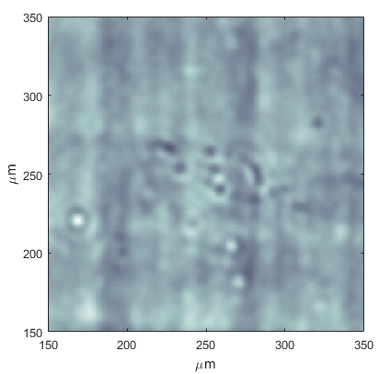
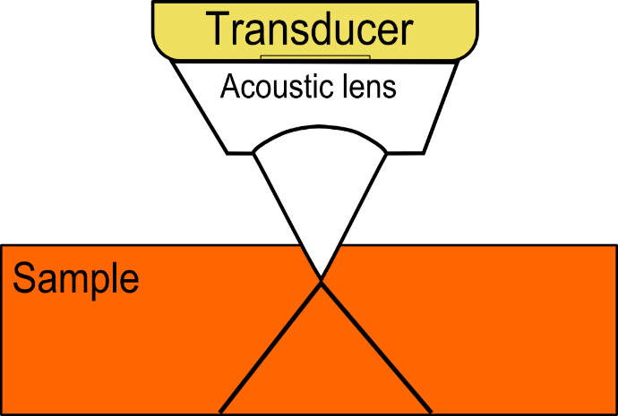
SAFT Results
250 MHz Transducer
Original
-70 μm Focus
-30 μm Focus
-70 μm Focus
-30 μm Focus
Original Focus

Slide 14
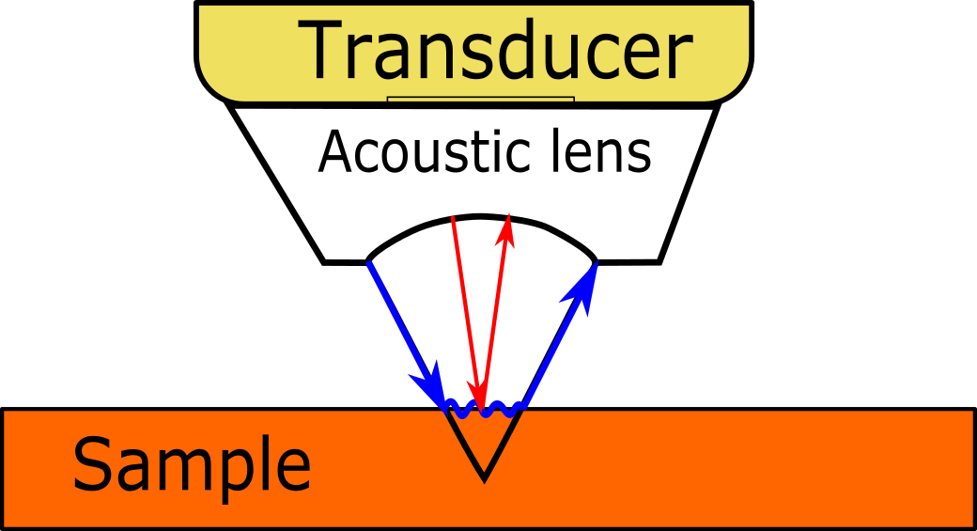
Future Work
Surface elasticity (GPa)
  Scattering from non-flat surface
Surface wave-velocity
  Another acoustic parameter
  V(z) -technique
  More accurate stiffness
Look under the surface / SAFT
  Need more research

Slide 15
Questions and Comments
Thank you for your attention!
Acknowledgements to:
Dr. Marek Jacewicz
Mr. Jere Hyvönen

Slide 16
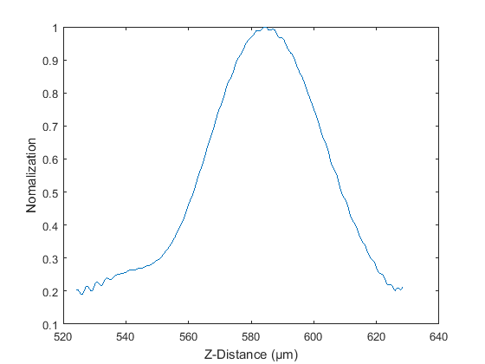
Z-Focus vs Amplitude

Slide 17

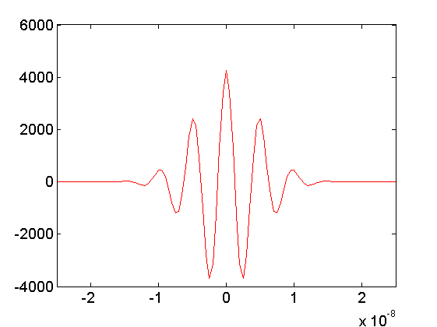
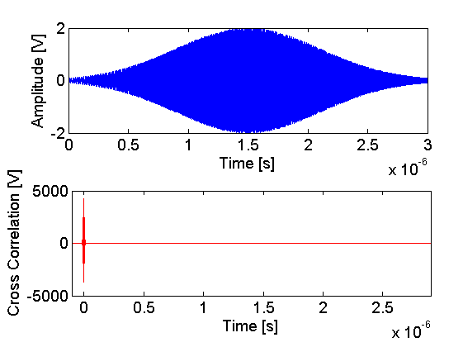


Pulse Compression
Cross Correlation
dt descript depth resolution
dt depends on bandwidth
dt

Slide 18
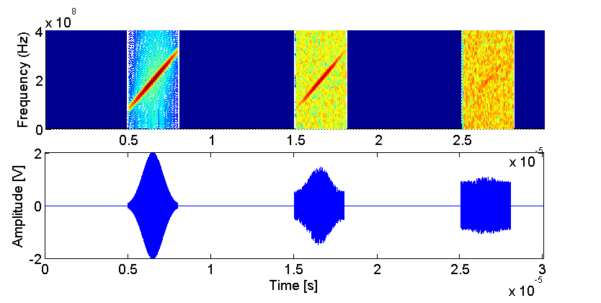
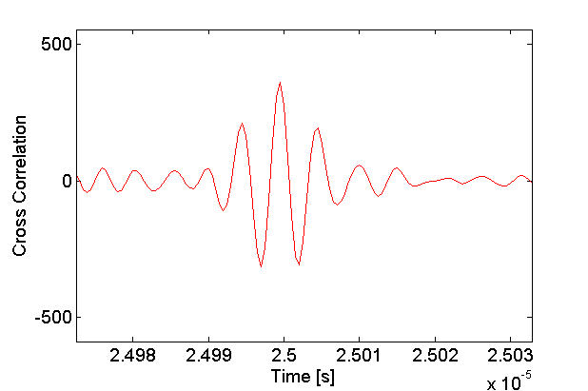
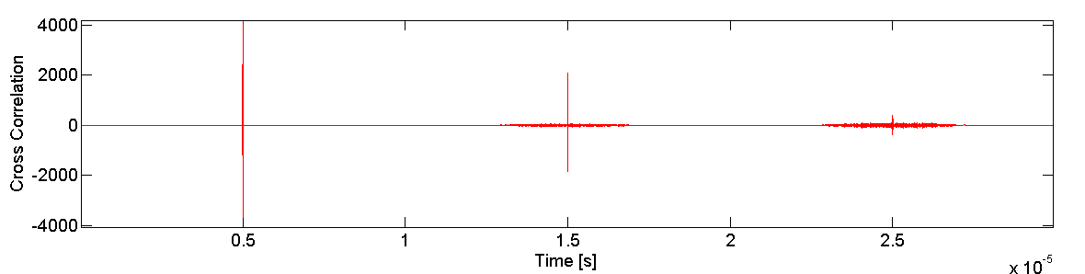
Coded Signal and SNR
SNR =1
SNR =0.1

