Slide 1
Compression test on annealed copper samples – HT Nb₃Sn
EDMS 1871901
Christian Löffler – CERN
Dr.-Ing. David von Mirbach – MPA Stuttgart
Dr.rer.nat. Joachim Kinder – MPA Stuttgart
CA6931507
LMF_FEA-meeting 24-11-17

Slide 2
scope
Three batches of copper samples, heat treated at three different temperature for 48 h.
  210 °C, 400 °C and 640 °C
  CU-OFE-ASTM C10100 D 12,7 mm
  One batch = four samples
  50 K/h
WHY?
  No material data available for fully annealed copper in compression

Slide 3
experiment
Compression test at room temperature after the heat treatment
  DIN 50106:2016-11
  1 mm/min
  Contact sample to die was lubricated
  One extensometer on the die and one on the sample
  R_{dp0.2} after DIN 50106
  Per batch:
    2 samples were cycled to 50, 100, 150 MPa
    2 samples directly to 30 % compression

Slide 4
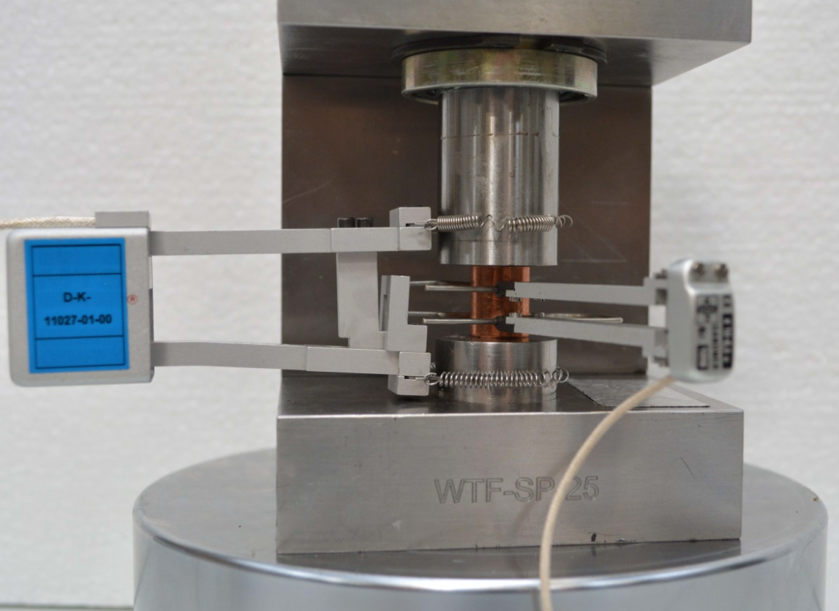
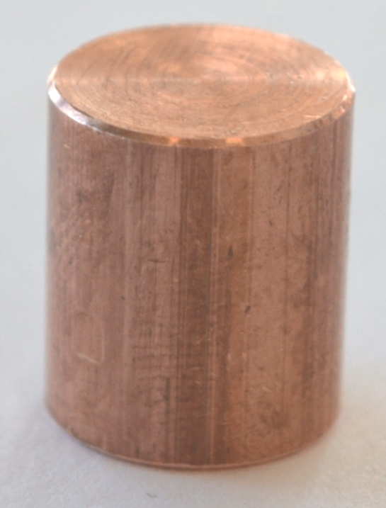
experiment
sample – 12.6 x 15 mm
setup

Slide 5
Results
HT to 210 °C reduces the RP_{dp0.2} from 309 to 248 MPa
HT to 400 and 640 °C changes the material to show basically no elastic behavior
  400 °C - RP_{dp0.2} 35 MPa
  640 °C - RP_{dp0.2} 19 MPa

Slide 6
Results – no HT
No heat treatment
No plastification at 100 MPa
First irreversible deformation at 120 MPa

Slide 7
Results – HT 210 °C
Heat treatment to
210 °C
Elastic behavior until 50 MPa
First plasticity occurs at 65 MPa
Elliptic stress-strain curve

Slide 8
Results – HT 400 °C
Heat treatment to
400 °C
Elastic behavior until 8 MPa
No elepticity

Slide 9
Results – HT 400 °C
Plot zoomed in
Heat treatment to
400 °C
Elastic behavior until 8 MPa

Slide 10
Results – HT 640 °C
Heat treatment to
640 °C
Elastic behavior until 5 MPa

Slide 11
Results – HT 640 °C
Plot zoomed in
Heat treatment to
640 °C
Elastic behavior until 5 MPa

Slide 12
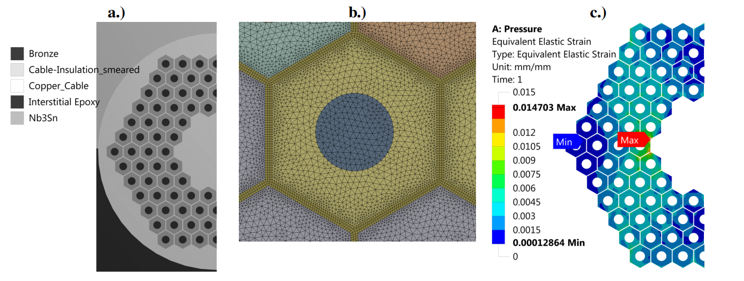
conclusion
After a heat treatment to 640 °C the copper is fully annealed with a yielding point of 5 MPa
  The behavior is nearly perfectly bi-linear
  Tangent modulus 1.5 – 2.5 GPa
  Modulus after plastification 85 – 95 GPa
Very similar values were used in the past for the strain dependency analysis Nb3Sn by:
  G. Vallone, C. Löffler,
  N. Mitchell etc.

