Slide 1
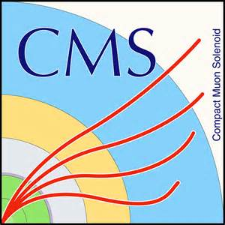

An attempt to prove the Higgs mechanism through experimentation at CMS
By The ESADE crazy particles team

Slide 2
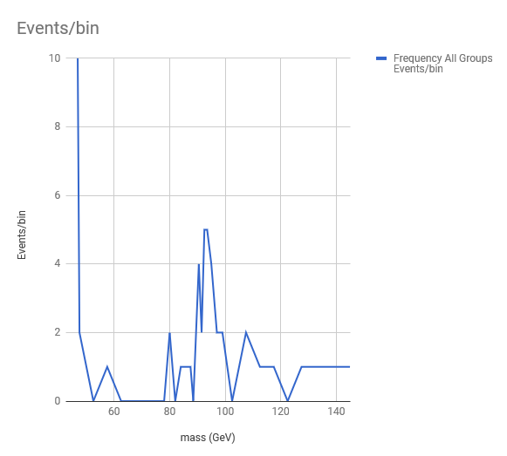
There is evidence that there is a Z Boson, with the mass we expected to find (91 GeV)

Slide 3
There is also a small evidence for W boson around 80 GeV
This is an experiential confirmation of the standard model theory

Slide 4
We have also observed 7 Higgs-like events:
4 two photons
1 two electrons and two muons
2 four muons
Average mass 112 +/- 15 GeV compatible within one sigma with the true Higgs mass value (125 GeV)

Slide 5
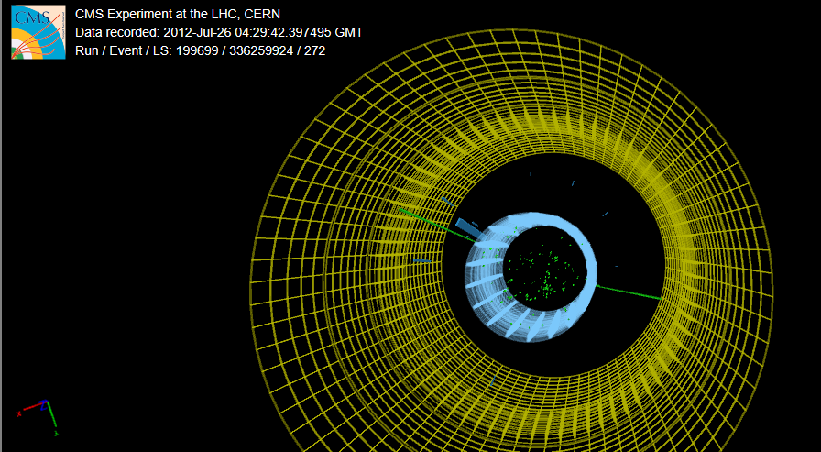
Example of a Higgs-like event with 2 photons and 123.7 GeV

Slide 6
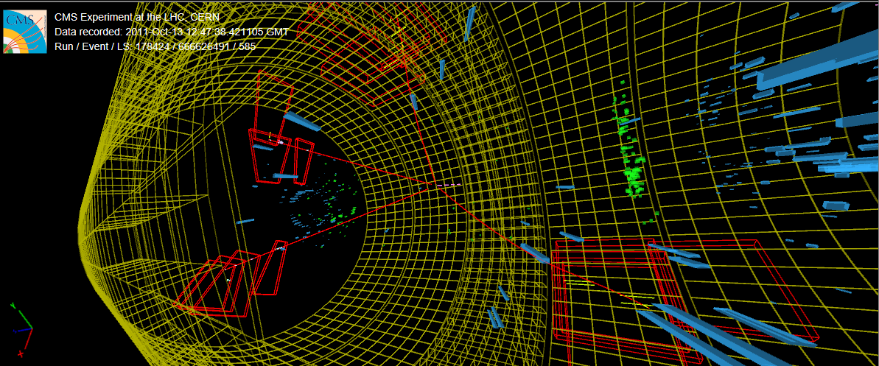
Example of a Higgs-like event with 4 muons and 91.12 GeV

Slide 7
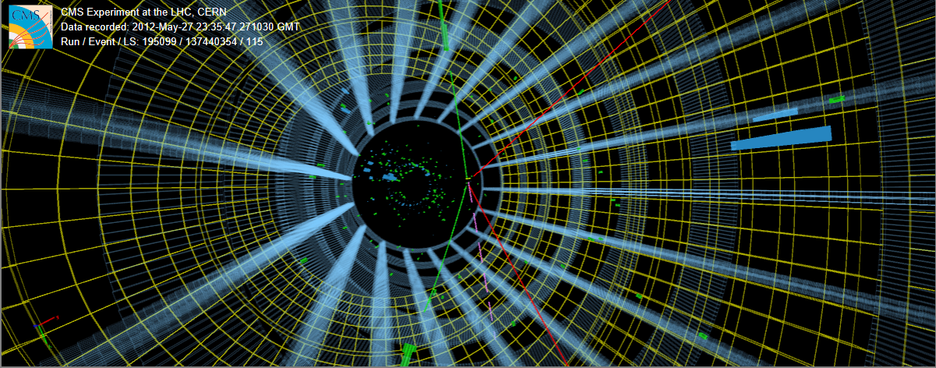
Example of a Higgs-like event with 2 electrons and 2 muons and mis-reconstructed energy with 131.4 GeV

Slide 8
And we also found a bunch of weird things…

Slide 9
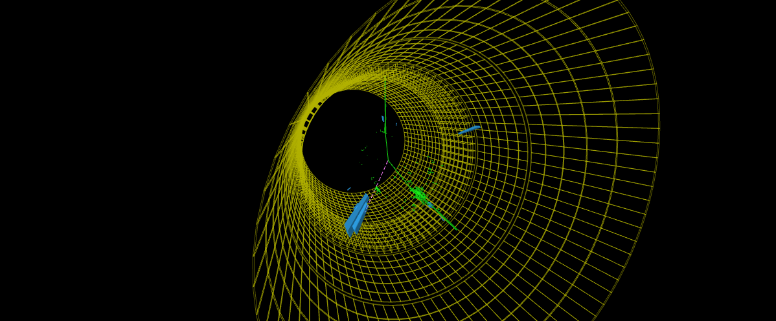
ONE Z WITH MASS 330.04 GeV

Slide 10
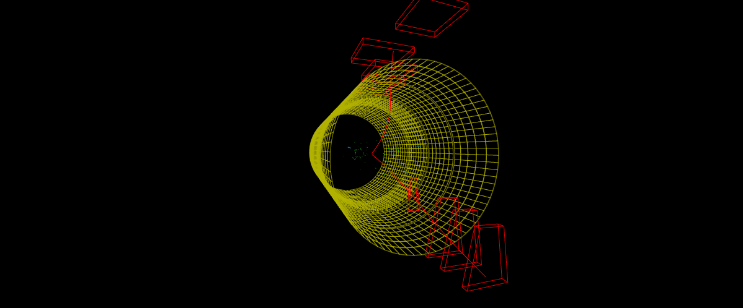
ONE EVENT OF 2 MUONS VERY LOW MASS

Slide 11
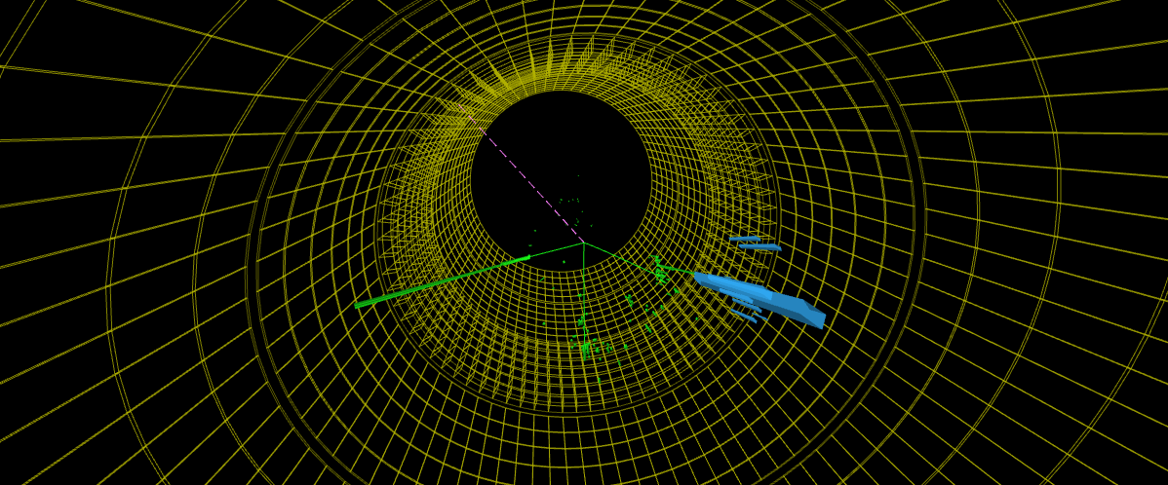
ONE Z OF 2 ELECTRONS AND 1 W OF ELECTRON AND NEUTRINO (choosing the closest to 91GeV)

Slide 12


