Slide 1
Dispersion and CM energy shifts
J. Wenninger

Slide 2
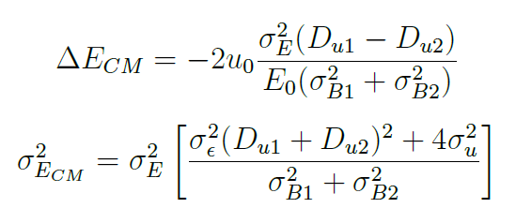

Dispersion and energy
The change of CM energy and energy spread at the IP are affected by the local dispersion:
The energy spread depends on the dispersion sum, the energy shift on the difference.
For a detailed derivation:

Slide 3
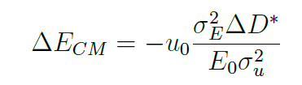

Dispersion and energy
The equation for the change of CM energy can be simplified to
Some numerical values (with strong BS) for the vertical plane:
To achieve ΔE_{CM} ~ 10 keV →
The beam must be optimized to better than 1% of the beam size !

Slide 4
Dispersion and energy
For a rms dispersion in the ring of ~ 1 mm, scaling to the IP using the betatron function ratio of 1 mm versus 50 m (scaling with √) one obtains a typical dispersion:
The assumption of 1 μm difference dispersion is therefore not unrealistic at this stage, it could be worse depending of the actual correction and errors.
To control the beam offset to such an accuracy probably means frequent scanning of the beams one against each other with sufficient amplitude to obtain a good fit → at least 0.5-1σ !
To evaluate ΔD* one can repeat the exercise of optimization at different RF frequencies (energy offsets). For ΔD* =1 μm the shift in separation of the beams is 2u₀ = 1 nm for dp/p of 0.1%.

