Slide 1
FCC-ee beam polarization and
Energy Calibration
Workshop
https://indico.cern.ch/event/669194/
EPOL group:
K Oide CERN/KEK,
S. Aumon, P. Janot , D. El Kechen, T. Lafevre, A. Milanese, T. Tydecks, J. Wenninger, F. Zimmermann, CERN
W. Hillert, D Barber DESY,
D. Sagan, Cornell
G. Wilkinson, Oxford
E Gianfelice-Wendt, FERMILAB
A Blondel , M Koratzinos, GENEVA
P. Azzurri (Pisa)
M Hildreth, Notre-Dame USA
I Koop , N Muchnoi, A Bogomyagkov, S. Nikitin, D. Shatilov BINP; NOVOSIBIRSK

Slide 2
Some references (not a complete set!):
B. Montague, Phys.Rept. 113 (1984) 1-96;
Polarization at LEP, CERN Yellow Report 88-02;
Beam Polarization in e+e- CERN-PPE-93-125 Adv.Ser.Direct.High Energy Phys. 14 (1995) 277-324;
L. Arnaudon et al., Accurate Determination of the LEP Beam Energy by resonant depolarization,
Z. Phys. C 66, 45-62 (1995).
Spin Dynamics in LEP http://dx.doi.org/10.1063/1.1384062
Precision EW Measts on the Z Phys.Rept.427:257-454,2006 arXiv:0509008v3
D.P. Barber and G. Ripken ``Handbook of Accelerator Physics and Engineering” World Scientific (2006), (2013)
D.P. Barber and G. Ripken, Radiative Polarization, Computer Algorithms and Spin Matching in Electron Storage Rings arXiv:physics/9907034
for FCC-ee:
First look at the physics case of TLEP arXiv:1308.6176, JHEP 1401 (2014) 164
DOI: 10.1007/JHEP01(2014)164
M. Koratzinos FCC-ee: Energy calibration IPAC'15 arXiv:1506.00933
E. Gianfelice-Wendt: Investigation of beam self-polarization in the FCC-ee arXiv:1705.03003

Slide 3
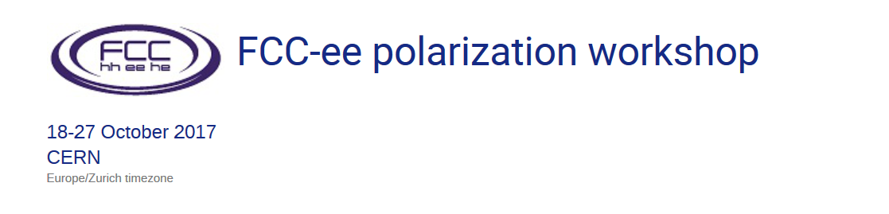
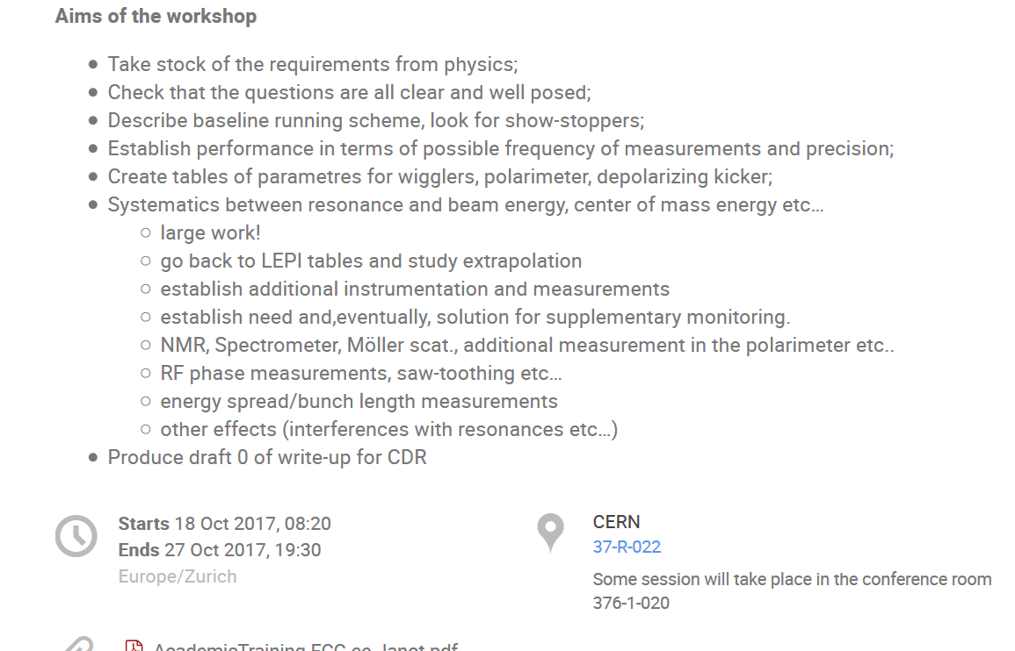

Slide 4
Requirements from physics
Z peak study very precisely as function of E_{CM} in the region of the Z peak
-- cross-section e+e- → Z→ X
-- muon forward-backward asymmetry
Physics output:
-- Z mass and width, ➔ from cross-sections
-- electroweak mixing angle sin²θ_{W}^{eff} (m_{Z}), QED coupling α_{QED} (m_{Z}) ➔ from A_{FB}(μμ)
Combine high statistics (510¹² Z) with high precision knowledge on E_{CM} -- aim at ΔE_{CM}=100 keV
For the Z peak cross-section and width, require energy spread uncertainty Δσ_{E}/σ_{E} =0.2%
NB: at 2.10³⁶/cm²/s , the full LEP statistics of 10⁶ muon pairs or 2.10⁷ Hadronic decays
is repeated every 6 minutes in each experiment
(2.10³⁶/cm²/s = 2/pb/s)
A fantastic machine!

Slide 5
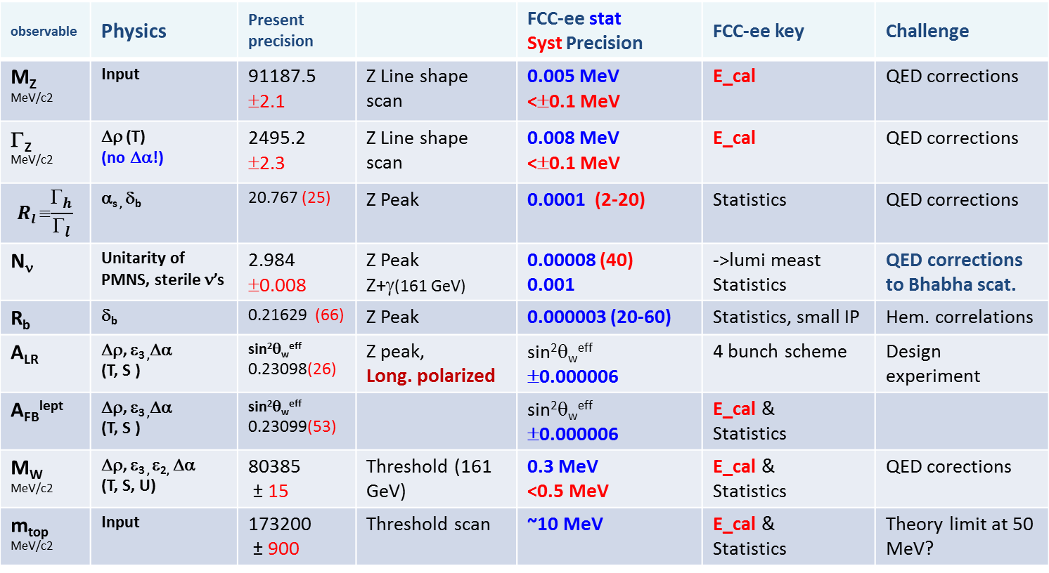
observable | Physics | Present precision |  | FCC-ee stat Syst Precision | FCC-ee key | Challenge
M_{Z} MeV/c2 | Input | 91187.5 ±2.1 | Z Line shape scan | 0.005 MeV <±0.1 MeV | E_cal | QED corrections
Γ_{Z} MeV/c2 | Δρ (T) (no Δα!) | 2495.2 ±2.3 | Z Line shape scan | 0.008 MeV <±0.1 MeV | E_cal | QED corrections
$$Rl ≡\frac{Γ_{h}}{Γ_{l}}$$ | α_{s ,} δ_{b} | 20.767 (25) | Z Peak | 0.0001 (2-20) | Statistics | QED corrections
N_{ν} | Unitarity of PMNS, sterile ν’s | 2.984 ±0.008 | Z Peak Z+γ(161 GeV) | 0.00008 (40) 0.001 | ->lumi meast Statistics | QED corrections to Bhabha scat.
R_{b} | δ_{b} | 0.21629 (66) | Z Peak | 0.000003 (20-60) | Statistics, small IP | Hem. correlations
A_{LR} | Δρ, ε_{3 ,}Δα (T, S ) | sin²θ_{w}^{eff} 0.23098(26) | Z peak, Long. polarized | sin²θ_{w}^{eff} ±0.000006 | 4 bunch scheme | Design experiment
A_{FB}^{lept} | Δρ, ε_{3 ,}Δα (T, S ) | sin²θ_{w}^{eff} 0.23099(53) |  | sin²θ_{w}^{eff} ±0.000006 | E_cal & Statistics
M_{W} MeV/c2 | Δρ, ε_{3 ,} ε_{2,} Δα (T, S, U) | 80385 ± 15 | Threshold (161 GeV) | 0.3 MeV <0.5 MeV | E_cal & Statistics | QED corections
m_{top} MeV/c2 | Input | 173200 ± 900 | Threshold scan | ~10 MeV | E_cal & Statistics | Theory limit at 50 MeV?

Slide 6
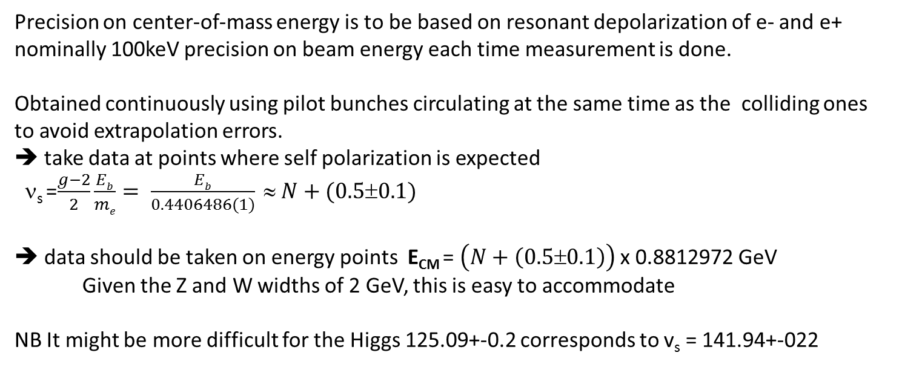
Precision on center-of-mass energy is to be based on resonant depolarization of e- and e+
nominally 100keV precision on beam energy each time measurement is done.
Obtained continuously using pilot bunches circulating at the same time as the colliding ones
to avoid extrapolation errors.
➔ take data at points where self polarization is expected
ν_{s} =$\frac{g−2}{2}\frac{Eb}{me}= \frac{Eb}{0.4406486(1)} ≈ N+(0.5±0.1)$
➔ data should be taken on energy points E_{CM} = $\left(N+\left(0.5±0.1\right)\right)$ x 0.8812972 GeV
Given the Z and W widths of 2 GeV, this is easy to accommodate
NB It might be more difficult for the Higgs 125.09+-0.2 corresponds to v_{s} = 141.94+-022

Slide 7
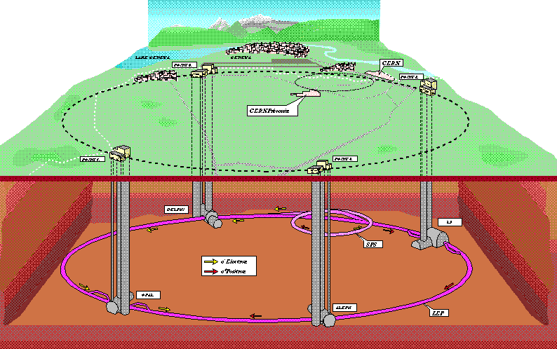
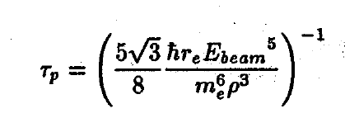
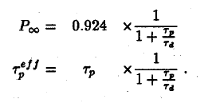
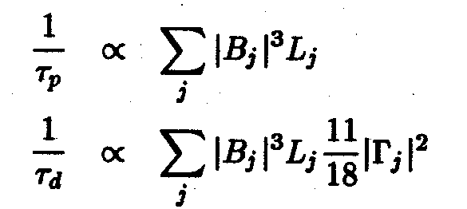

LEP (1989-2000) first observation of P⊥ in 1990
first resonant depolarization in 1991
Systematic campaigns for Z scan in 1993, 1995
=310 minutes
at 45.6 GeV in LEP
250 hours in FCC-eeZ!
14 hours at WW
orbit
imperfections
Spin tune at the Z peak : 103.5
The scan points 101.5 / 103.5 / 105.5 are perfect optimum for Z width meast
scan points at 100.5 and 106.5 and 107.5 are good for Δα_{QED} measurement
Spin tune for W threshold 179.5 -- 183.5

Slide 8
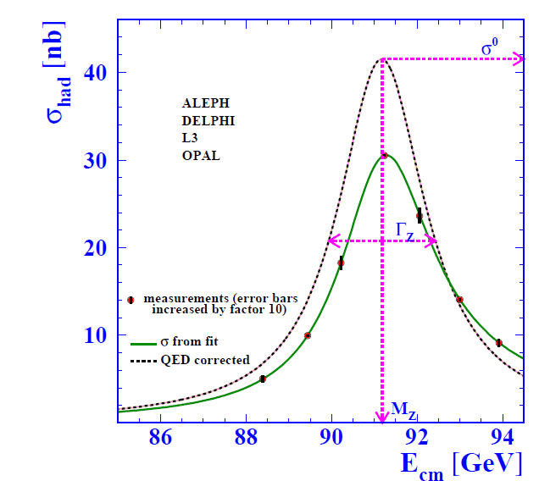

Slide 9
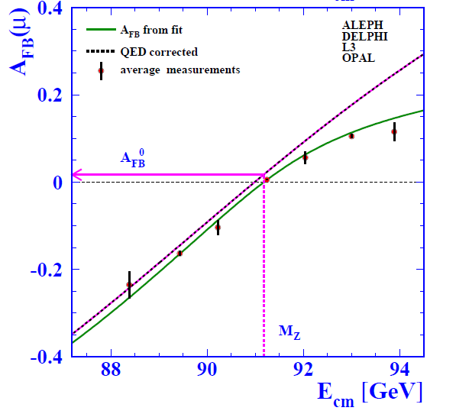

Slide 10
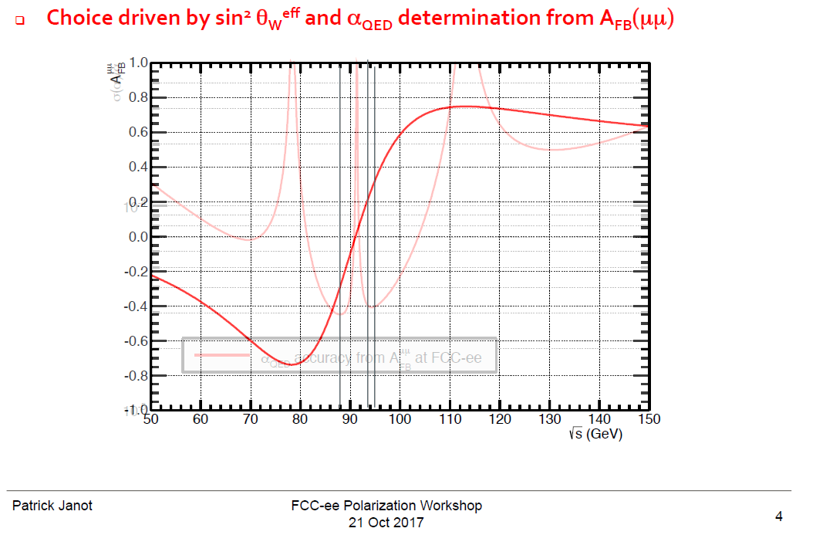

Slide 11
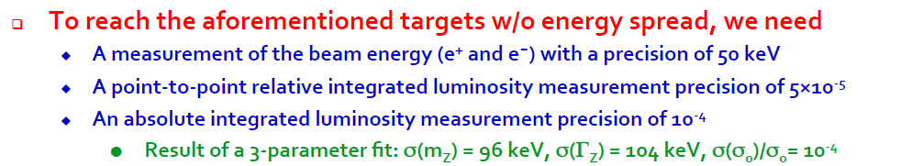
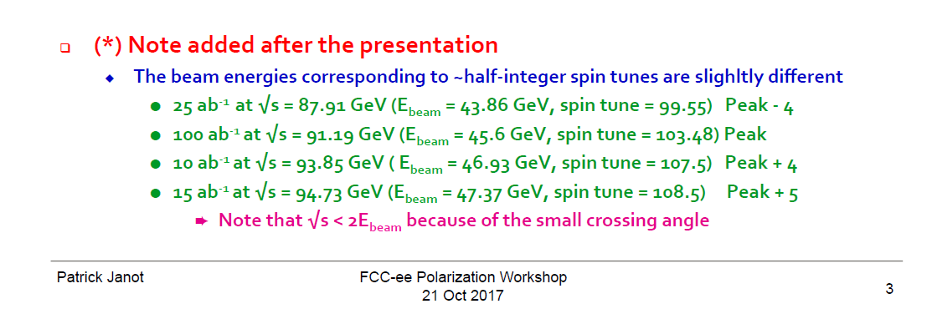
Towards a run plan

Slide 12
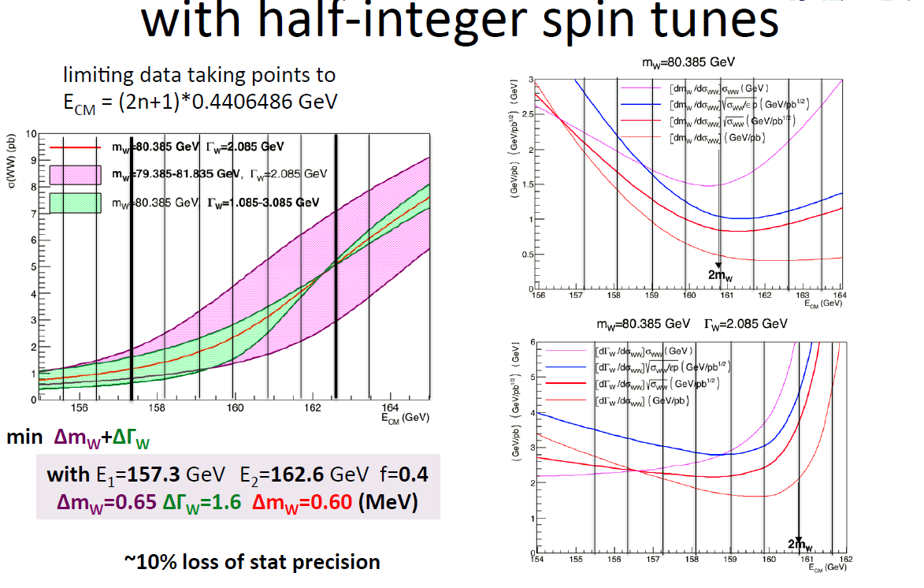
These are the beam energies for the W threshold measurement
P. Azzurri

Slide 13
LEP (1989-2000) first observation of P⊥ in 1990
first resonant depolarization in 1991
Systematic campaigns for Z scan in 1993, 1995
=310 minutes
at 45.6 GeV in LEP
250 hours in FCC-eeZ!
14 hours at FCC-eeW
orbit
imperfections
Spin tune at the Z peak : 103.5
The scan points 101.5 / 103.5 / 105.5 are perfect optimum for Z width meast
scan points at 100.5 and 106.5 and 107.5 are good for Δα_{QED} measurement
Spin tune for W threshold 179.5 -- 183.5

Slide 14
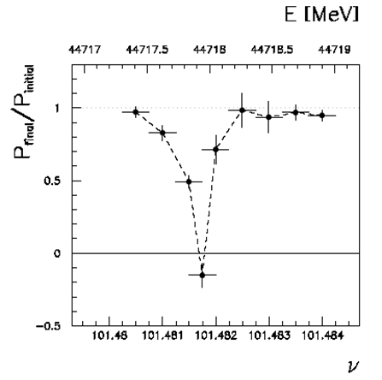
Beam Polarization can provide t main ingredient to Physics Measurements
Transverse beam polarization provides beam energy calibration
by resonant depolarization
→ low level of polarization is required (~10% is sufficient)
→ at Z & W pair threshold polarization comes naturally
→ at Z use of asymmetric wigglers at beginning of fills
since polarization time is otherwise very long.
→ use ‘single’ non-colliding bunches and calibrate continuously
during physics fills to avoid issues encountered at LEP
→ this is possible with e+ and e- Compton polarimeter (commercial laser)
→ should operate and calibrate at energies corresponding to half-integer spin tune
→ must be complemented by analysis of «spin tune» to E_CM relationship
For beam energies higher than ~90 GeV can use ee → Z γ or ee → WW events
to calibrate E_{CM} at ±5-10 MeV level: matches requirements for m_{H} and m_{top} measts
Aim: Z mass & width to ~100 keV (stat: 10 keV) W mass & width to ~500 keV (stat : 300 keV)

Slide 15
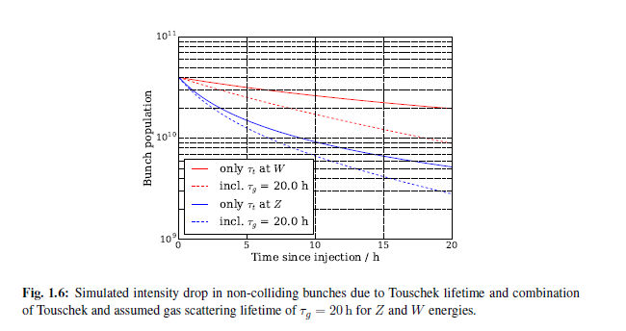
A limitation: Touschek effect
Oide-san pointed out that the ‘pilot bunches’ would lose particles due to Touschek effct
Indeed they have such small emittance
that the bunch populations reduces
fast if it is larger that 4 10¹⁰ at the Z
this is less of an issue at the W
and higher
Tobias has calculated the effect
(and written it up in the CDR!)

Slide 16
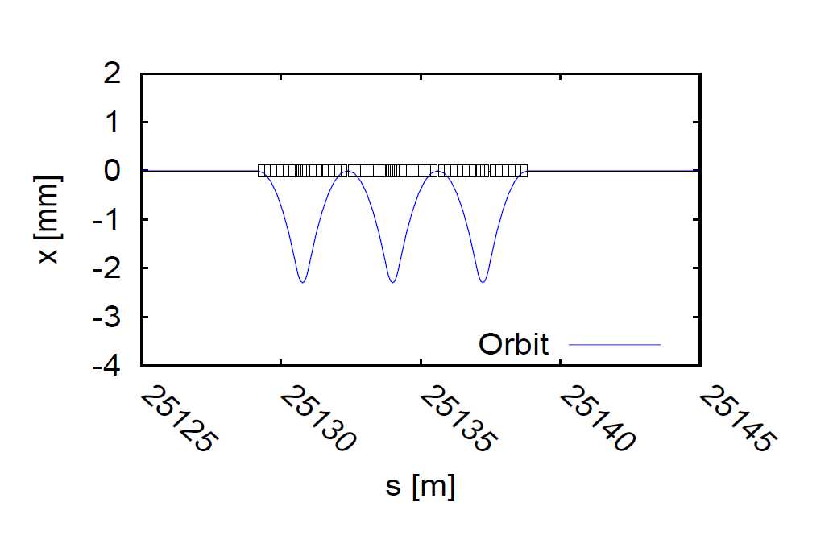
Hardware requirements: wigglers
Given the long polarization time at Z, wigglers will be necessary.
An agreement was reached on a set of 8 wiggler units per beam
Polarization wigglers
8 units per beam, as specified by Eliana Gianfelice
B+=0.7 T L+ = 43cm L-/L+ = B+/B- = 6
at Eb= 45.6 GeV and B+= 0.67 T
=> P=10% in 1.8H σ_{Eb} = 60 MeV E_{crit}=902 keV
placed e.g. in dispersion-free straight section H and/or F

Slide 17
Obtaining transverse polarization
Given the long polarization time at Z, wigglers will be necessary.
An agreement was reached on a set of 8 wiggler units per beam *->
Depolarization is driven by resonances whose driving terms are vertical orbit distortions
created by imperfections, compound with the energy spread and vertical dispersion.
Sandra Aumon (CERN), presented the simulation work on orbit corrections.
David Sagan (Cornell) described fast and efficient correction algorithms
Eliana presented results of spin simulations showing very good prospects at the Z
after adequate vertical orbit and vertical dispersion corrections.
Detector solenoids have no effect because they are compensated in situ.
Further spin matching is not necessary at the Z. Wigglers can be used to shorten the
time it takes to get 10%(5%) polarization to 1.8(0.9)hrs.

Slide 18
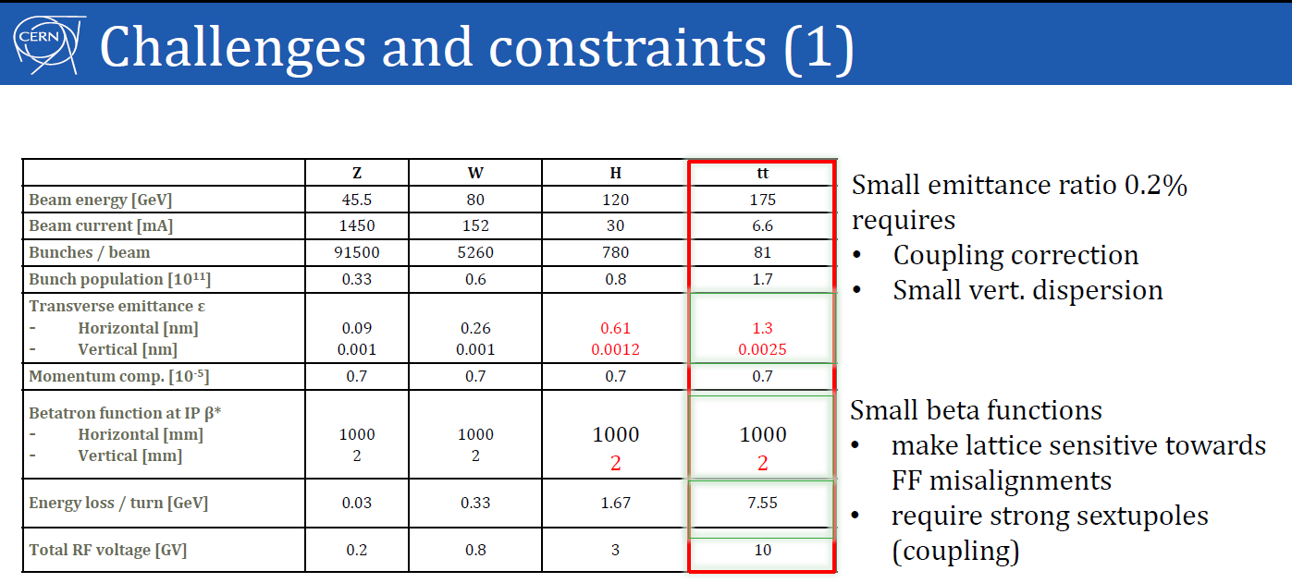
Constraints for transverse polarization are similar as for high luminosity.

Slide 19
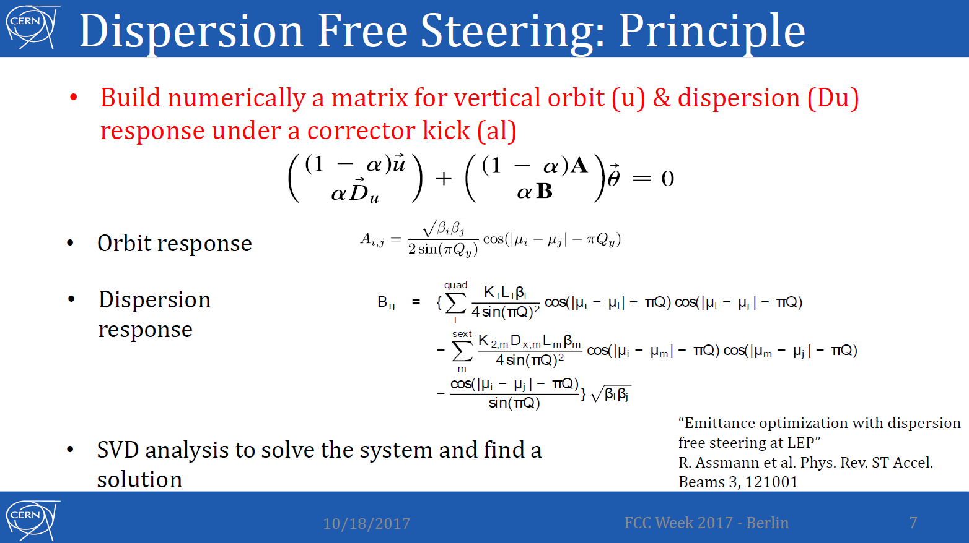

Slide 20
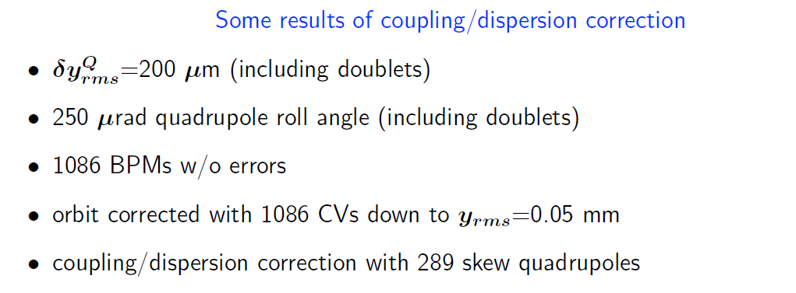
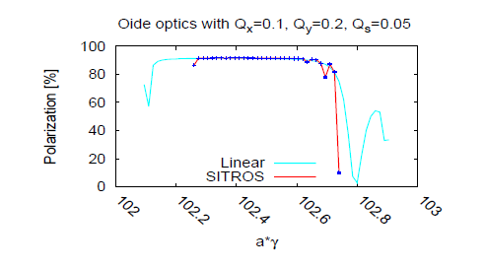
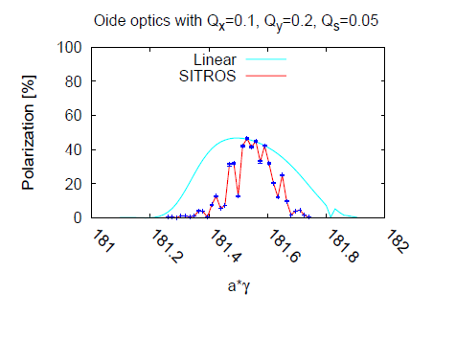
Simulations of polarization level with SITROS
at the W
at the Z
Excellent level of polarization at the Z (even with wigglers) and sufficient at the W.

Slide 21
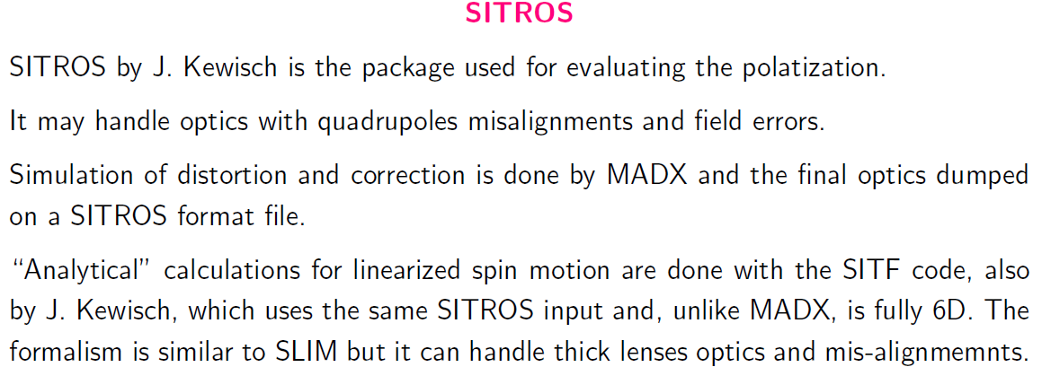
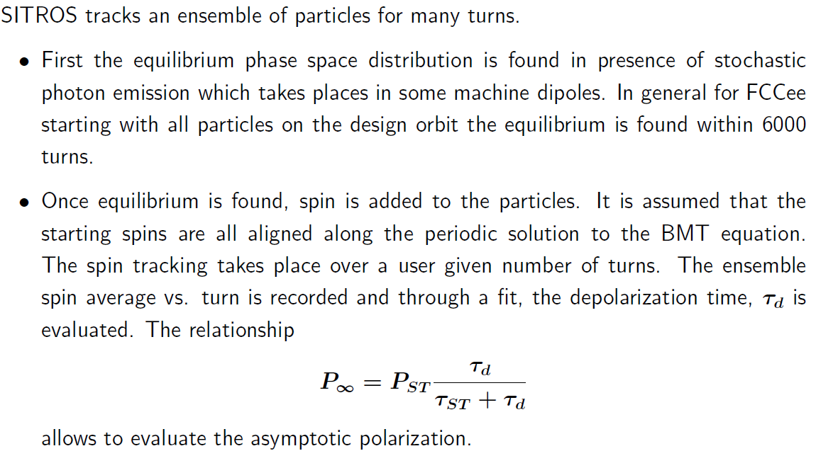
Spin calculation starts with
closed orbit
spin periodic solution of
BMT equation
3. multiturn tracking using photon
emission is some dipoles
Approximate but best there is.

Slide 22
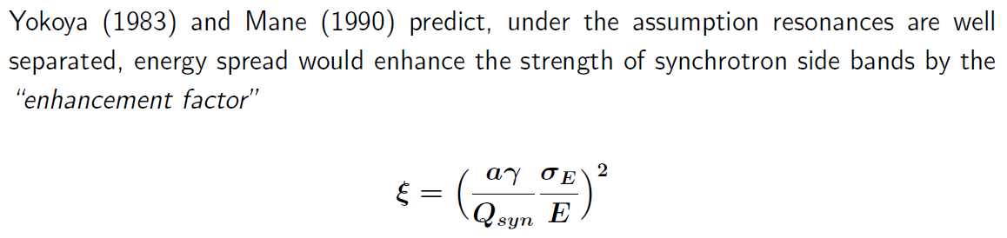
The Qs issue
The parameter list of FCC-ee gives the following values for the tunes
fractional part of Qx/2= 0.569 ➔ fractional part of Qx = 0.138
fractional part of Qy/2= 0.61 ➔ fractional part of Qy = 0.22
Qs/2 = 0.0125 ➔ Qs = 0.025
he synchrotron oscillation frequency Qs is small compared to LEP (Qs=0.083)
number of turns to complete an energy oscillation is 1/Qs =40
As a result the Qs resonances are close to eachother and perhaps enhanced. (I. Koop)

Slide 23
FCC-ee baseline parameters
“reduced luminosity target (~-10%)”
D. Shatilov, K. Oide,
NEW, October 2017
parameter | Z | W | H (ZH) | ttbar
beam energy [GeV] | 45.6 | 80 | 120 | 182.5
arc cell optics | 60/60 | 90/90 | 90/90 | 90/90
momentum compaction [10⁻⁵] | 1.48 | 0.73 | 0.73 | 0.73
horizontal emittance [nm] | 0.27 | 0.28 | 0.63 | 1.45
vertical emittance [pm] | 1.0 | 1.0 | 1.3 | 2.7
horizontal beta* [m] | 0.15 | 0.2 | 0.3 | 1
vertical beta* [mm] | 0.8 | 1 | 1 | 2
length of interaction area [mm] | 0.42 | 0.5 | 0.9 | 1.99
tunes, half-ring (x, y, s) | (0.569, 0.61, 0.0125) | (0.577, 0.61, 0.0115) | (0.565, 0.60, 0.0180) | (0.553, 0.59, 0.0350)
longitudinal damping time [ms] | 414 | 77 | 23 | 6.6
SR energy loss / turn [GeV] | 0.036 | 0.34 | 1.72 | 9.21
total RF voltage [GV] | 0.10 | 0.44 | 2.0 | 10.93
RF acceptance [%] | 1.9 | 1.9 | 2.3 | 4.9
energy acceptance [%] | 1.3 | 1.3 | 1.5 | 2.5
energy spread (SR / BS) [%] | 0.038 / 0.132 | 0.066 / 0.153 | 0.099 / 0.151 | 0.15 / 0.20
bunch length (SR / BS) [mm] | 3.5 / 12.1 | 3.3 / 7.65 | 3.15 / 4.9 | 2.5 / 3.3
Piwinski angle (SR / BS) | 8.2 / 28.5 | 6.6 / 15.3 | 3.4 / 5.3 | 1.39 / 1.60
bunch intensity [10¹¹] | 1.7 | 1.5 | 1.5 | 2.8
no. of bunches / beam | 16640 | 2000 | 393 | 39
beam current [mA] | 1390 | 147 | 29 | 5.4
luminosity [10³⁴ cm⁻²s⁻¹] | >200 | >30 | >7 | >1.3
beam-beam parameter (x / y) | 0.004 / 0.133 | 0.0065 / 0.118 | 0.016 / 0.108 | 0.094 / 0.150
luminosity lifetime [min] | 70 | 50 | 42 | 44
time between injections [sec] | 122 | 44 | 31 | 32
allowable asymmetry [%] | ±5 | ±3 | ±3 | ±3
required lifetime by BS [min] | 29 | 16 | 11 | 10
actual lifetime by BS (“weak”) [min] | > 200 | 20 | 20 | 25

Slide 24
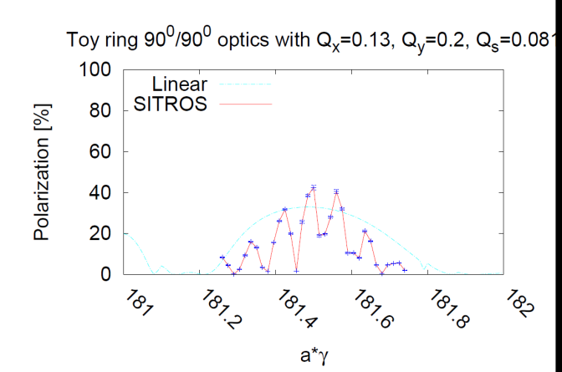
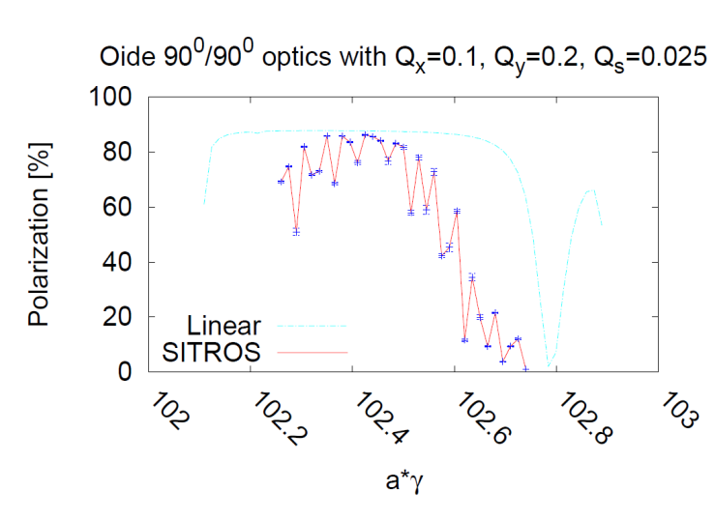
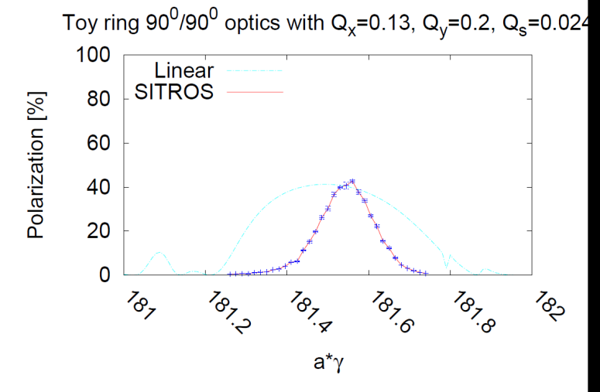
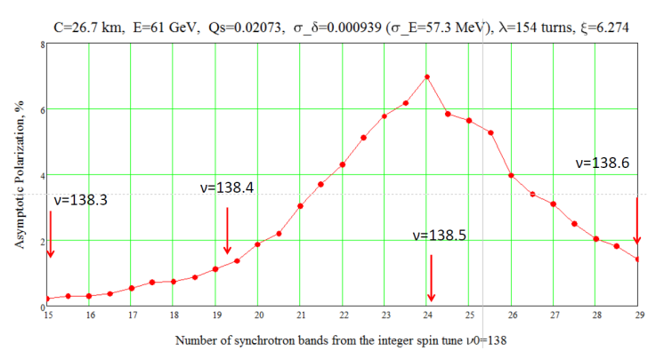
The Qs issue
Eliana and Ivan independently checked the possible effect
at the W with Qs = 0.08 ➔
Eliana, at the Z Qs=0.025
Ivan K, at 61GeV Qs=0.02
W, Qs = 0.024
➔ Similar polarization level, smoother curves.

Slide 25
Hardware requirements: polarimeters
Efficient polarimeter is necessary.
Polarimeters, one for each beam
Backscattered Compton γ +e → γ + e γ from 532 nm (2.33 eV) laser
Nickolai Muchnoi pointed out that scattered electron contains anti-correlated information
on e-beam polarization and gives information on beam energy
Practical arrangement similar to LEP for the detection of the photon,
but complemeted with an electron spectrometer

Slide 26
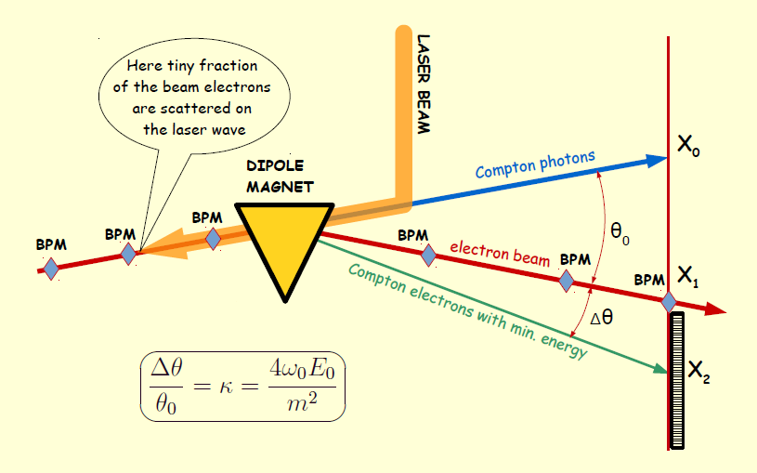

Slide 27
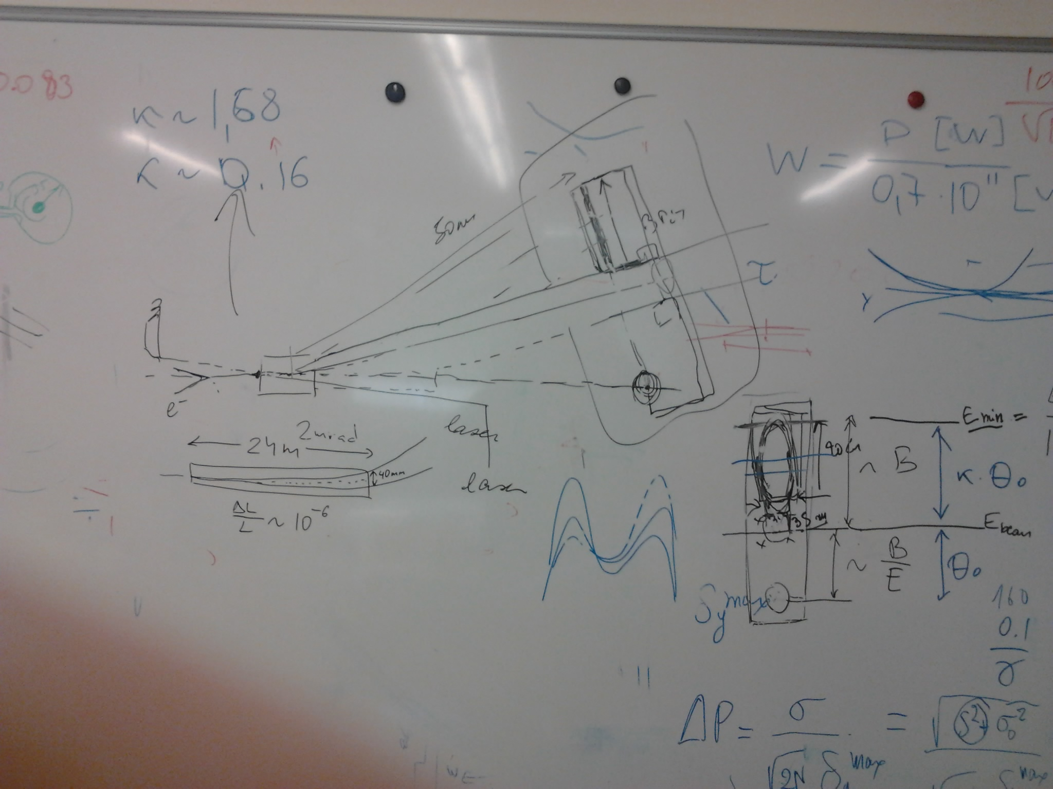

Slide 28
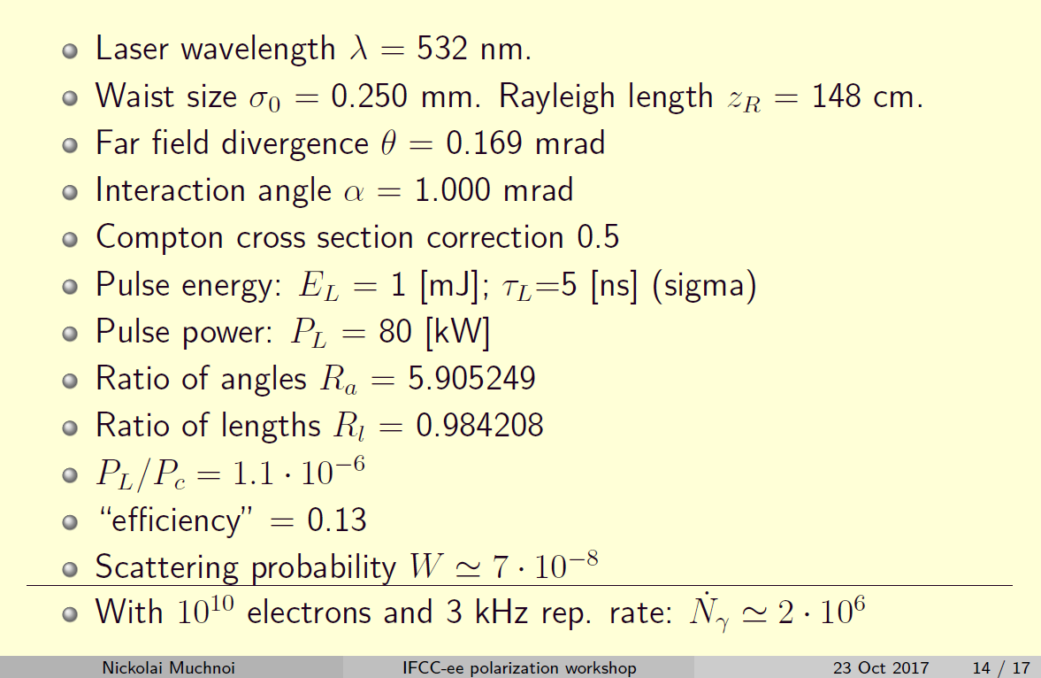
Compton Polarimeter: Rates

Slide 29
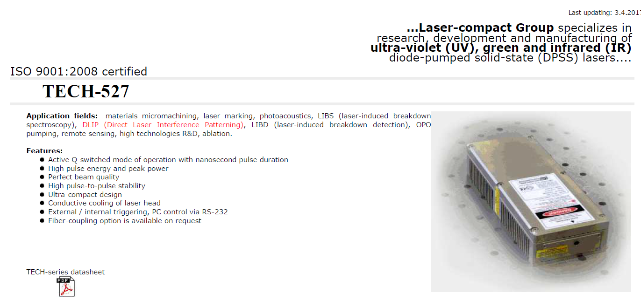
Compton Polarimeter: Laser
http://laser-export.com/prod/527.html

Slide 30
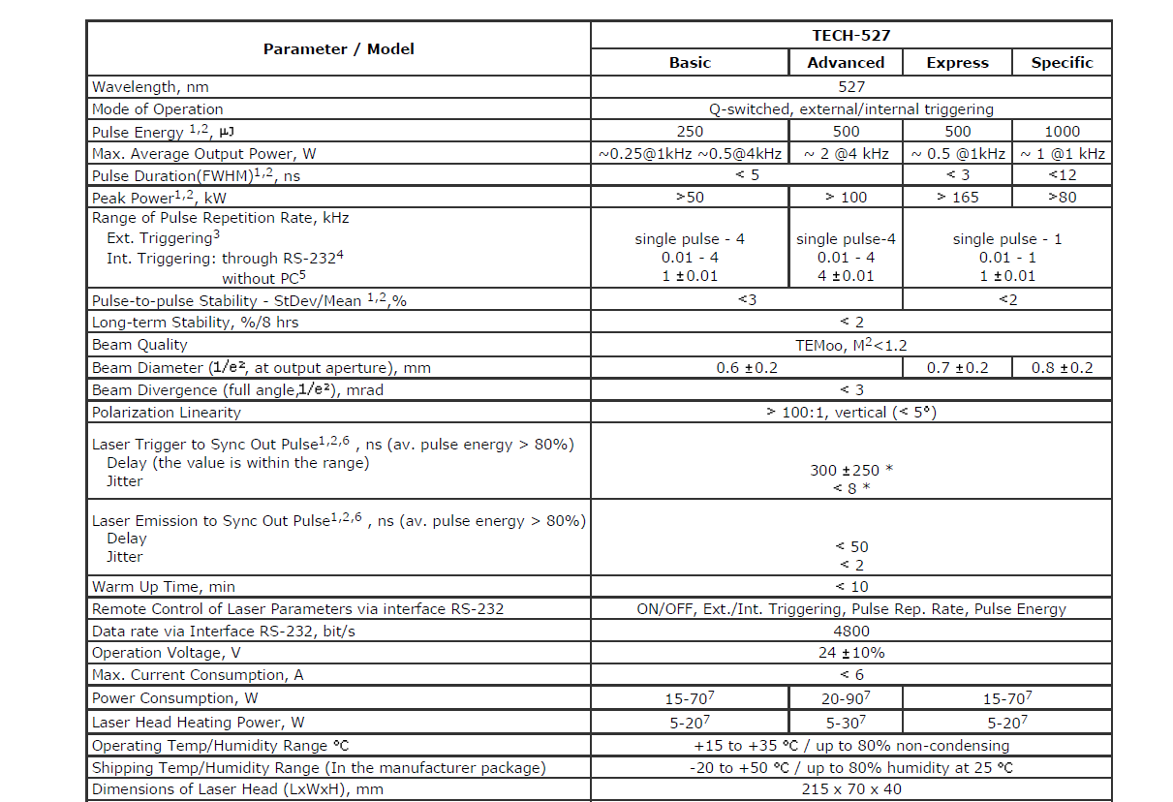

Slide 31
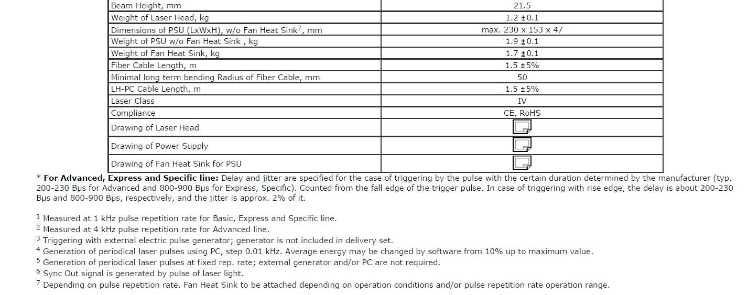

Slide 32
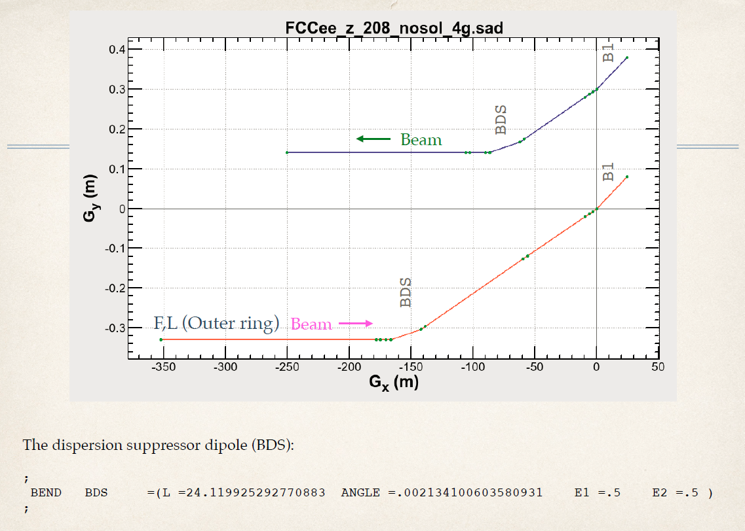
e’
e
laser
γ

Slide 33
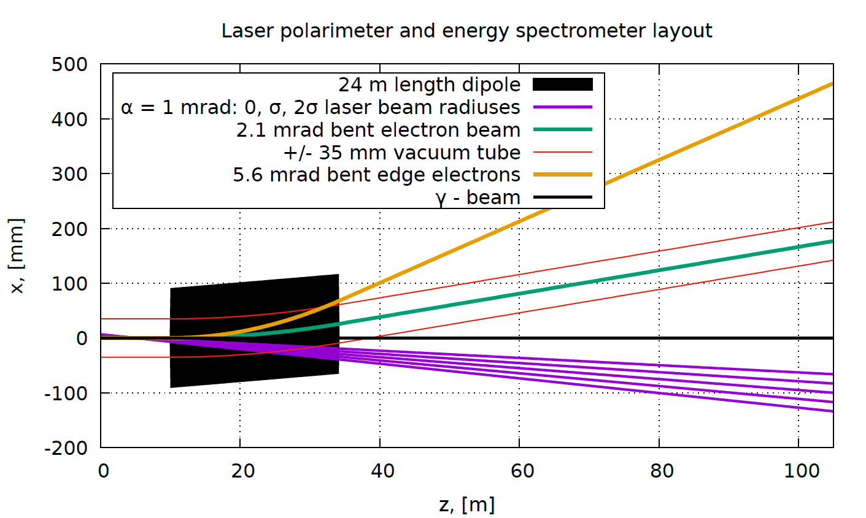

Slide 34
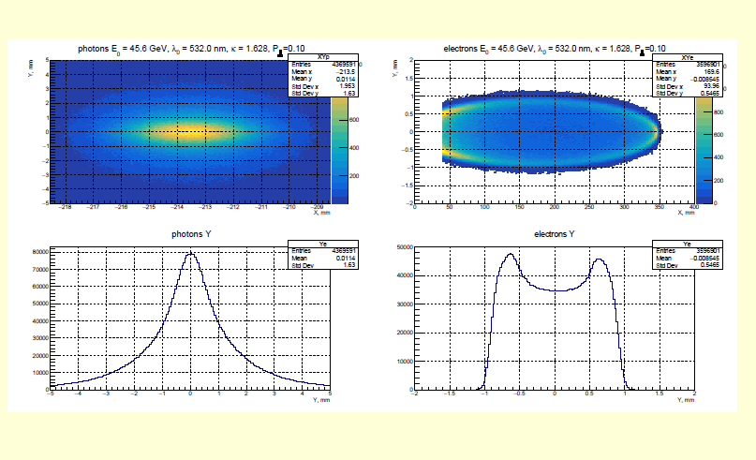
±1mm
350mm

Slide 35
it is expected that beam polarization can be measured to P ± 1% (absolute)
in a few seconds. (if the level is 5%, this is 5σ). To be verified with improved fitter (Nickolai)

Slide 36
polarimeter-spectrometer situated 100m from end of dipole.
Using the dispersion suppressor dipole with a lever-arm of 100m from the end of the dipole, one finds
-- minimum compton scattering energy at 45.6 GeV is 17.354 GeV
-- distance from photon recoil to Emin electron is 0.628m
 | laser (eV) | beam (GeV) | mc2(MeV) | B field | R | LM | theta | L | true beam
 | 2.33 | 45.6 | 0.511 | 0.013451 | 11300 | 24.119 | 0.002134 | 100 | 45.60005
nominal kappa = 4. E_laser.Ebeam_nom/mc2 | 1.627567296
true kappa = 4. E_laser.Ebeam_true/mc2 | 1.627568924
nominal Emin | 17.35445561
true Emin | 17.35446221
position of photons | 0
nominal position of beam (m) | 0.239182573
true position of beam (m) | 0.239182334 | 2.39182E-07
nominal position of min (m) | 0.628468308
true position of min (m) | 0.628468069 | 2.39182E-07
mouvement of beam and end point
are the same:
0.24microns for δEb/Eb=10⁻⁶ (δEb=45keV)
628mm
239mm
0
± 1mm
70mm
FCC-ee plane
end point
elliptic distribution
of scattered electrons
beam spot
and BPM
recoil photon
spot

Slide 37
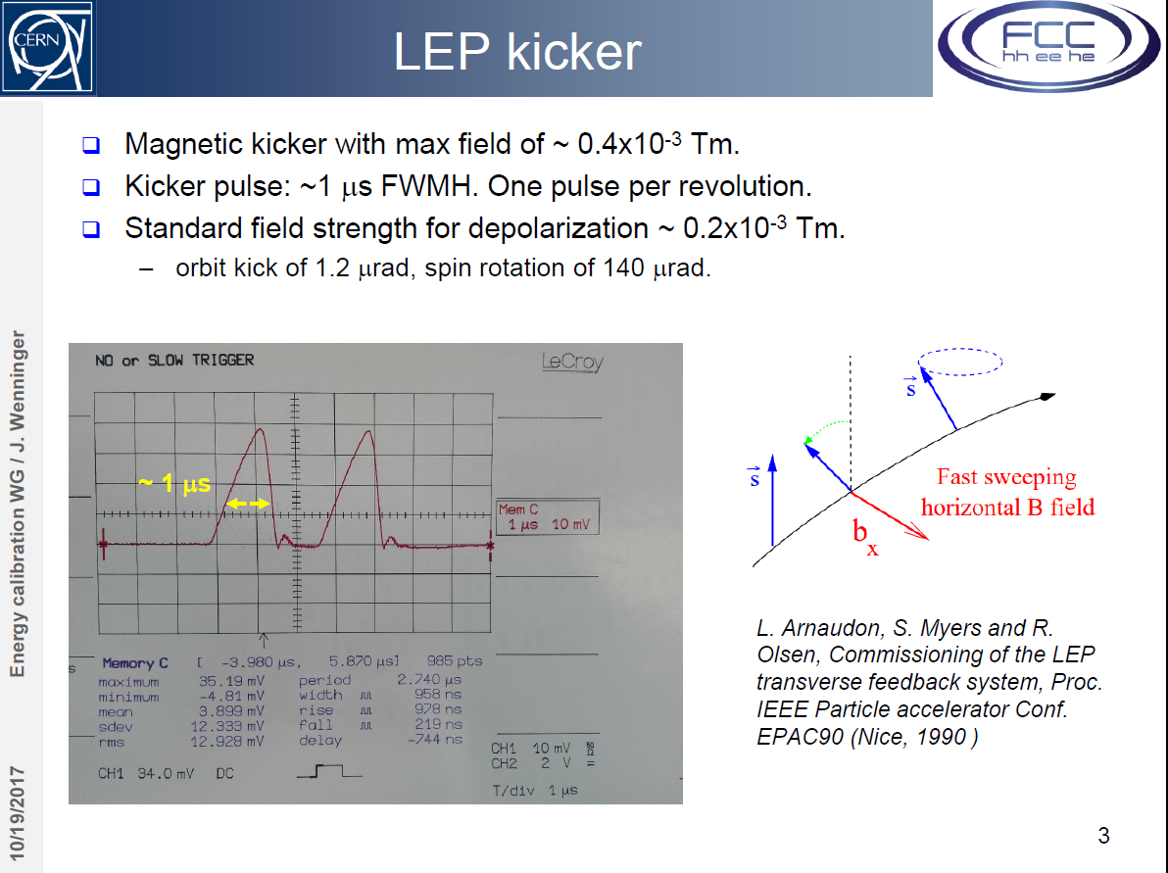
Depolarization
This is not-so trivial in FCC-ee!
16700 bunches circulate
time-between-bunches = 19ns,
depolarize one-and-only-one
of them.
Kicker must have fast (<9ns) rise.

Slide 38
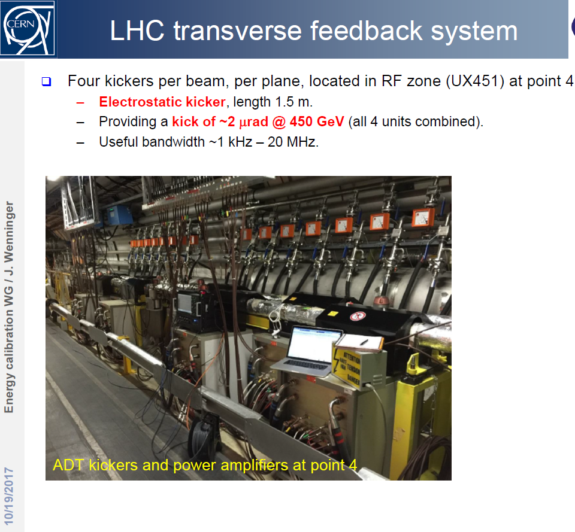
The LHC TF system works essentially on a bunch by bunch basis for 25ns.
They would provide a transverse kick of up to ~20 mrad at the Z peak with ~10 MHz bandwidth. This is 10x more than what we may need-
a priori OK !

Slide 39
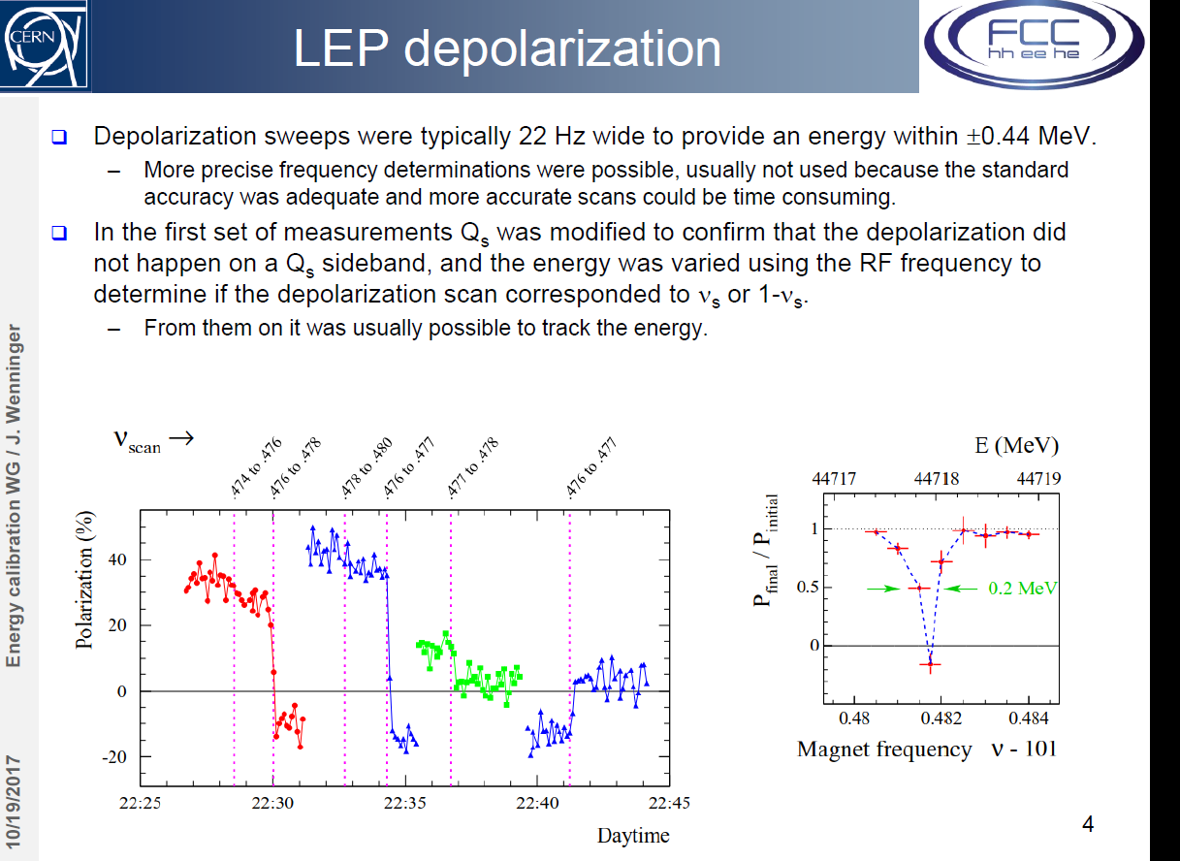
However… I.Kopp has reproduced by
simulation the depolarization for LEP,
but with the very low Qs value at FCC-ee
(and maybe other reasons?) could not
simulate a depolarization for FCC-ee.
need to investigate energy sweep
parameters further

Slide 40
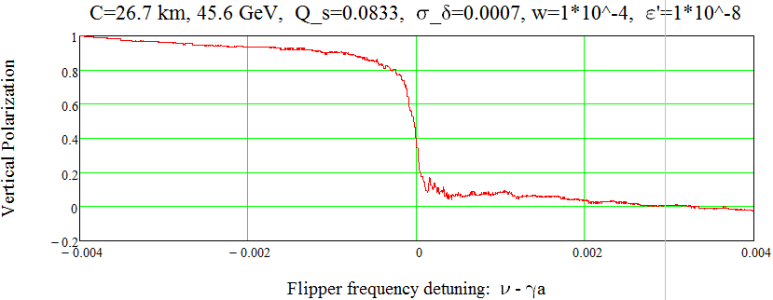
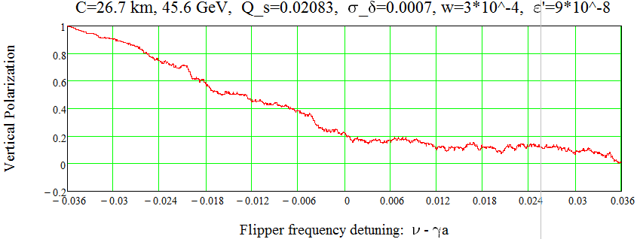
searching for the right kicker parameters
Ivan Koop
Bench marking the code by LEP simulation
at E=45.59 GeV
LEP at E=45.59 GeV:
normal depolarizer and low Q_s.

Slide 41
From resonant depolarization to Center-of-mass energy
-- 1. from spin tune to beam energy--
The spin tune may not be en exact measurement of the average of the beam energy
along the magnetic trajectory of particles. Additional spin rotations may bias the issue.
Anton Bogomyagkov and Eliana made some estimates.
synchrotron oscillations ΔE/E -2 10⁻¹⁴
Energy dependent momentum compaction ΔE/E 10⁻⁷
Solenoid compensation 2 10⁻¹¹
Horizontal betatron oscillations ΔE/E 2.5 10⁻⁷
Horizontal correctors ΔE/E 2.5 10⁻⁶
if horizontal orbit change by >0.8mm between calibration is unnoticed
or if quadrupole stability worse than 5 microns over that time.
Uncertainty in chromaticity correction O(10⁻⁶ ± 510⁻⁸
invariant mass shift due to beam potential 4 10⁻¹⁰

Slide 42
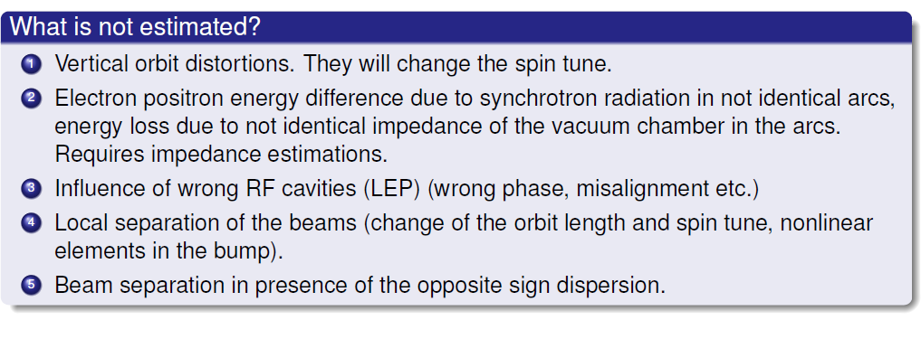
Anton’s conclusions

Slide 43
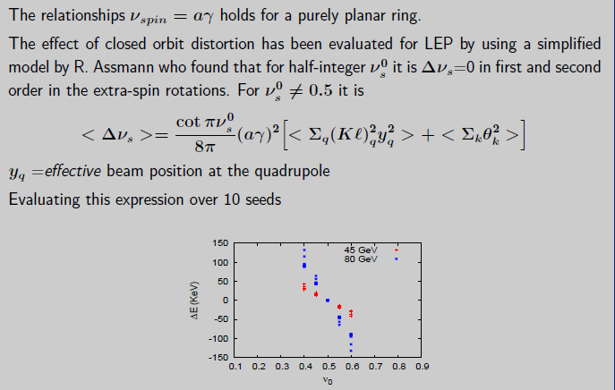
Vertical orbit distortions
Eliana
10⁻⁶ at the Z
and 210⁻⁶ at the W

Slide 44
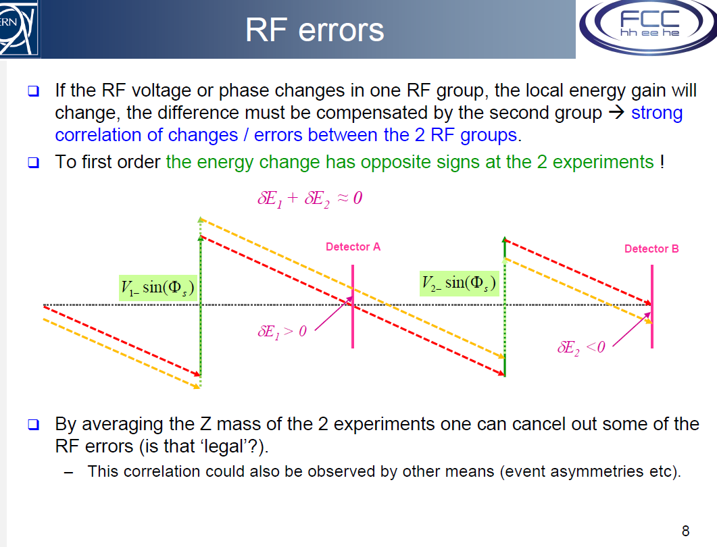
Energy gains (RF)
and energy losses (Arcs and Beamsstrahlung)
At LEP the disposition of the RF units
on each side of the experiments
had the effect that any asymmetry
in the RF would change the energy
of the beams at the IP, but not
the average energy in the arcs.
At FCC-ee, because the sequence is
RF – energy loss – IP – energy loss- RF
such errors have little effect on the
relationship between average energy
in the arcs and that at the IP.
They can induce a difference between
e+and e- (can be measured in expt!)
Jorg Wenninger.

Slide 45

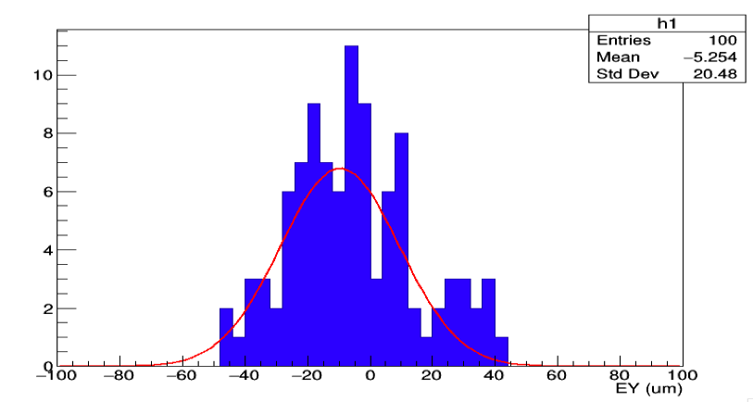
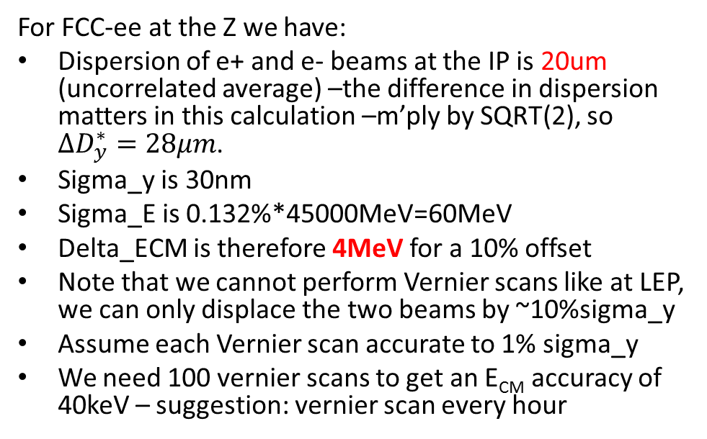
Opposite sign dispersion at IP
For FCC-ee at the Z we have:
Dispersion of e+ and e- beams at the IP is 20um (uncorrelated average) –the difference in dispersion matters in this calculation –m’ply by SQRT(2), so $∆D_{y}^{∗}=28μm$.
Sigma_y is 30nm
Sigma_E is 0.132%*45000MeV=60MeV
Delta_ECM is therefore 4MeV for a 10% offset
Note that we cannot perform Vernier scans like at LEP, we can only displace the two beams by ~10%sigma_y
Assume each Vernier scan accurate to 1% sigma_y
We need 100 vernier scans to get an E_{CM} accuracy of 40keV – suggestion: vernier scan every hour
FCC-ee 45GeV
Dima El Khechen

Slide 46
Measure vertical dispersion at the IP
According to Katsunobu Oide:
Use BPMs at the high beta points on both sides of the IP
If relative BPM resolution is 1 um, then resolution on dispersion is 1um/(dp/p)
(dp/p) (achieved through change of RF frequency) cannot be more than 1% to avoid non-linearities
➔ leading to a resolution on D_{y} of 100um on both sides of the IP
The dispersion at the IP is the sum of the dispersions on both sides of the IP, which have opposite signs as they are about 180 degrees apart.
Thus the dispersion at the IP is the subtraction of two big numbers, so relative cross calibration of the two BPMs is also important
knowing the optics it may be possible to perform a fit to the dispersion function…
More work is needed here. The required resolution (around 5um) is not yet there.

Slide 47
Beamstrahlung
Beamstrahlung is the emission of photons by particles of one beam (e⁺⁻)
in the field of the other (e⁻⁺)
In a linear collider it leads to a low energy tail of the collision energy distribution
and a systematic bias.
One would think it results in a similar effect in a circular machine.
BUTIn a circular collider it initiates a synchrotron oscillation! The particle energy distribution
remains symmetric, but the energy spread is very much enlarged.
Quantitatively the energy loss at the the IP in presence of beamstrahlung is 0.7 MeV
As Dmitry Shatilov points out this energy loss is compensated by the RF and
the difference between colliding bunches and non-colliding bunches will remain small
(I have verified: this is the case at least if the beamstrahlung is symmetric between the beams)

Slide 48
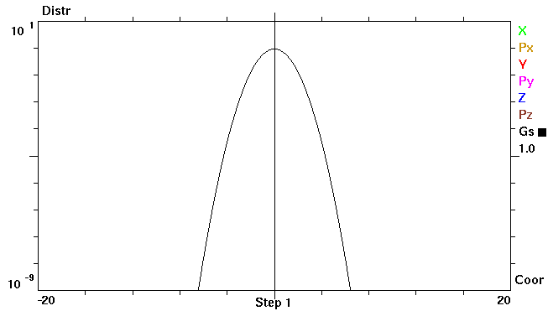
Without Beamstrahlung
Gauss with σ_{E} = σ_{E0}
Lg₁₀ (ρ /ρ₀)
δE/σ_{E0}

Slide 49
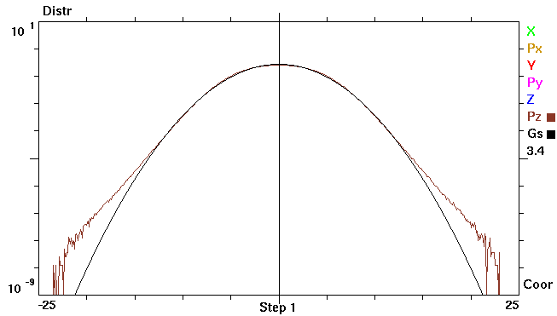
with Beamstrahlung E = 45.6 GeV
σ_{E0}/E = 0.00038, σ_{E}/E = 0.00132, Black line: Gauss with σ_{E} = 3.4 σ_{E0}
Lg₁₀ (ρ /ρ₀)
δE/σ_{E0}
Energy acceptance: 1.3% = 34.2 σ_{E0}

Slide 50

E = 80 GeV
σ_{E0} = 0.00066, σ_{E} = 0.00153, Black line: Gauss with σ_{E} = 2.3 σ_{E0}
Lg₁₀ (ρ /ρ₀)
δE/σ_{E0}
Energy acceptance: 1.3% = 19.7 σ_{E0}

Slide 51

Determination of Energy spread
At the Z peak we collect 10⁶ μμ events
every 5 minutes
their kinematics is affected by
-- energy spread
-- e+ vs e- energy difference.
Patrick has shown that indeed both
can be determined with extremely
good precision with these events.

Slide 52


Slide 53


Slide 54


Slide 55
Investigation of possibilities of Beam Instrumentation at FCC-ee
towards the precision determination of center-of-mass energies
The table of parameters indicates that
-- we have 16640 bunches/beam in the 97.5 km machine. Bunch spacing is <19.5ns)
-- we plan to have 250 non-interacting pilot bunches
-- to measure the beam polarization and depolarization frequency,
thus infer the beam energy.
-- but other parameters must be checked as well
-- one issue is that pilot bunch populations might be 10 times smaller < colliding ones
-- the properties of the pilot bunches should be compared to those of the interacting bunches
to guarantee the identity of pilot bunches wrt colliding bunches
-- position (follow up of position to keep energy constant against tides etc..)
-- energy (for instance beam position in dispersive sections)
-- energy spread as it is strongly affected by beamstrahlung
(examples bunch length in straight section)
beam size in dispersive section wrt bunch size in non-dispersive sections
ibid for angular beam size

Slide 56


Streak Camera
‘Streak cameras uses a time dependent deflecting electric field to convert time information in spatial information on a CCD’
Mitsuru Uesaka et al, NIMA 406 (1998) 371
200fs time resolution obtained using reflective optics and 12.5nm bandwidth optical filter (800nm) and the Hamamatsu FESCA 200
  Limitations : Time resolution of the streak camera :
  (i) Initial velocity distribution of photoelectrons : narrow bandwidth optical filter
  (ii) Spatial spread of the slit image: small slit width
  (iii) Dispersion in the optics

Slide 57
Conclusions
We have had a very sucessful workshop and unveiled and number of aspects of
the question of energy calibration that are of great interest.
Several good news
-- running scenario
-- polarimeter-spectrometer set-up
-- polarization levels at Z and W
-- direct measurements of energy spread and energy asymmetries
-- smallness of effect of beamstrahlung and RF
-- etc. etc.
-- started writing the CDR! 25 pages and typing!
some difficulties
-- opposite sign vertical dispersion
-- possible difficulty with depolarizer.
THANK YOU!

Slide 58
Beam Polarization can provide main ingredient to Physics Measurements
Transverse beam polarization provides beam energy calibration
by resonant depolarization
→ low level of polarization is required (~10% is sufficient)
→ at Z & W pair threshold comes naturally
→ at Z use of asymmetric wigglers at beginning of fills
since polarization time is otherwise very long.
→ could be used also at ee → H(126) (depending on exact m_{H} !)
→ use ‘single’ non-colliding bunches and calibrate continuously
during physics fills to avoid issues encountered at LEP
→ this is possible with e+ and e- Compton polarimeter (commercial laser)
→ should calibrate at energies corresponding to half-integer spin tune
→ must be complemented by analysis of «average E_beam» to E_CM relationship
For beam energies higher than ~90 GeV can use ee → Z γ or ee → WW events
to calibrate E_{CM} at ±5-10 MeV level: matches requirements for m_{H} and m_{top} measts
Aim: Z mass & width to ~100 keV (stat: 10 keV) W mass & width to ~500 keV (stat : 300 keV)

Slide 59
Beam Polarization can provide two main ingredients to Physics Measurements
2. Longitudinal beam polarization provides chiral e+e- system
-- High level of polarization is required (>40% )
-- Must compare with natural e+e- polarization due to chiral couplings of electrons (15%)
or with final state polarization analysis for CC weak decays (100% polarized) (tau and top)
-- Physics case for Z peak is very well studied and motivated:
A_{LR} , A_{FB}^{Pol}(f) etc… (CERN Y.R. 88-06)
figure of merit is L.P² --> must not lose more than a factor ~10 in lumi.
self calibrating polarization measurement *→ spares
-- uses : enhance Higgs cross section (by 30%)
top quark couplings? final state analysis does as well (Janot arXiv:1503.01325)
enhance signal, subtract/monitor backgrounds, for ee→WW , ee →H
-- requires High polarization level and often both e- and e+ polarization
➔ not interesting If loss of luminosity is too high
-- Obtaining high level of polarization in high luminosity collisions is delicate in top-up mode

Slide 60


45 GeV
80 GeV
At the Z obtain excellent polarization level
but too slow for polarization in physics
need wigglers for Energy calibration
At the W expectation similar to LEP at Z
→ enough for energy calibration
Simulations by Eliana Gianfelice

Slide 61


Slide 62


LEP Resonant depolarization, 1991
variation of RF frequency
to eliminate half integer
ambiguity

Slide 63


Many effects spoil the calibration if it is performed
outside physics time
-- tides and other ground motion
-- RF cavity phases
-- histeresis effects and environmental effects (trains…etc)

Slide 64

by 1999 we had an excellent model of the energy variations…
but we were not measuring the Z mass and width anymore
– we were hunting for the Higgs boson!

Slide 65
We have concluded that first priority is to achieve transverse polarization
in a way that allows continuous beam calibration by resonant depolarization
(energy measurement every ~10 minutes on ‘monitoring’ single bunches)
- This is a unique feature of circular e+e- storage ring colliders
- baseline runnig scheme defined with monitoring bunches
- the question of the residual systematic error requires further studies of the
relationship between spin tune, beam energy at IRs, and center-of-mass energy
➔ target is 100keV at Z and W pair threshold energies
‘Do we want longitudinal polarization’?
we will discuss this in the following.

Slide 66




PAC 1995
LEP:
This was only tried 3 times!
Best result: P = 40% , ξ*_{y}= 0.04 , one IP
FCC-ee
Assuming 2 IP and ξ*_{y}= 0.01 ➔
reduce luminosity, 10¹⁰ Z @ P~30%

Slide 67

Reduction of polarization due to continuous injection
The colliding bunches will lose intensity continuously due to collisions.
In FCC-ee with 4 IPs, L= 28 10³⁴/cm2/s beam lifetime is 213 minutes
In FCC-ee with 2 IPs, L= 1.4 10³⁶/cm2/s beam life time is 55minutes
Luminosity scales inversely to beam life time.
The injected e+ and e- are not polarized → asymptotic polarization is reduced.
Assume here that machine has been well corrected and beams
(no collisions, no injection) can be polarized to nearly maximum.
(Eliana Gianfelice in Rome talk)
(polarization time is 26h)

Slide 68



We have simulated the simultaneous effect of
-- natural polarization
-- beam consumption by e+e- interactions
-- replenishment with unpolarized beams
assuming optimistically a maximal 90% asymptotic polarization
Running at full luminosity
P_max=0.03! P_eff=0.03
Running at 10% Lumi
P_max=0.24, P_eff=0.21
Running at 1% Lumi
P_max=0.66, P_eff=0.5

Slide 69
Lumi loss factor | L.10^34 | Figure of merit: sum(P²L) | Peff | Pmax
1 | 220 | 0.195 | 0.03 | 0.03
2 | 110 | 0.367 | 0.059 | 0.06
4 | 55 | 0.627 | 0.1078 | 0.11
6 | 37 | 0.805 | 0.149 | 0.16
8 | 27 | 0.924 | 0.184 | 0.2
10 | 22 | 1.003 | 0.214 | 0.24
12 | 18 | 1.053 | 0.24 | 0.27
15 | 15 | 1.09 | 0.27 | 0.32
18 | 12 | 1.101 | 0.3 | 0.35
22 | 10 | 1.088 | 0.33 | 0.4
26 | 8 | 1.059 | 0.354 | 0.43
30 | 7 | 1.023 | 0.37 | 0.46
40 | 5 | 0.92 | 0.41 | 0.52
Δ A_{LR} scales as 1/√(P²L)
Optimum around a reduction of luminosity by a factor 18.
This is still a luminosity of ~10³⁵ per IP… and the effective polarization is 30%.
This is equivalent to a 100% polarization expt with luminosity reduced by 180.

Slide 70
observable | Physics | Present precision |  | FCC-ee stat Syst Precision | FCC-ee key | Challenge
M_{Z} MeV/c2 | Input | 91187.5 ±2.1 | Z Line shape scan | 0.005 MeV <±0.1 MeV | E_cal | QED corrections
Γ_{Z} MeV/c2 | Δρ (T) (no Δα!) | 2495.2 ±2.3 | Z Line shape scan | 0.008 MeV <±0.1 MeV | E_cal | QED corrections
$$Rl ≡\frac{Γ_{h}}{Γ_{l}}$$ | α_{s ,} δ_{b} | 20.767 (25) | Z Peak | 0.0001 (2-20) | Statistics | QED corrections
N_{ν} | Unitarity of PMNS, sterile ν’s | 2.984 ±0.008 | Z Peak Z+γ(161 GeV) | 0.00008 (40) 0.001 | ->lumi meast Statistics | QED corrections to Bhabha scat.
R_{b} | δ_{b} | 0.21629 (66) | Z Peak | 0.000003 (20-60) | Statistics, small IP | Hem. correlations
A_{LR} | Δρ, ε_{3 ,}Δα (T, S ) | sin²θ_{w}^{eff} 0.23098(26) | Z peak, Long. polarized | sin²θ_{w}^{eff} ±0.000006 | 4 bunch scheme | Design experiment
A_{FB}^{lept} | Δρ, ε_{3 ,}Δα (T, S ) | sin²θ_{w}^{eff} 0.23099(53) |  | sin²θ_{w}^{eff} ±0.000006 | E_cal & Statistics
M_{W} MeV/c2 | Δρ, ε_{3 ,} ε_{2,} Δα (T, S, U) | 80385 ± 15 | Threshold (161 GeV) | 0.3 MeV <0.5 MeV | E_cal & Statistics | QED corections
m_{top} MeV/c2 | Input | 173200 ± 900 | Threshold scan | ~10 MeV | E_cal & Statistics | Theory limit at 50 MeV?

Slide 71



Measuring sin²θ_{W}^{eff} (m_{Z})
sin²θ_{W}^{eff} ≡ ¼ (1- g_{V}/g_{A})
g_{V} = g_{L} + g_{R}
g_{A} = g_{L} - g_{R}
arXiv:0509008
$$\left({ge}_{V}^{}\right)$$

Slide 73

 | A_{FB}^{μμ} @ FCC-ee |  | A_{LR} @ ILC | A_{LR} @ FCC-ee
visible Z decays | 10¹² | visible Z decays | 10⁹ | 5.10¹⁰
muon pairs | 10¹¹ | beam polarization | 90% | 30%
ΔA_{FB}^{μμ} (stat) | 3 10⁻⁶ | ΔA_{LR} (stat) | 4.2 10⁻⁵ | 4.5 10⁻⁵
Δ E_{cm} (MeV) | 0.1 |  | 2.2 | ?
ΔA_{FB}^{μμ} (E_{CM} ) | 9.2 10⁻⁶ | ΔA_{LR} (E_{CM} ) | 4.1 10⁻⁵
ΔA_{FB}^{μμ} | 1.0 10⁻⁵ | ΔA_{LR} | 5.9 10⁻⁵
Δ$\text{sin}\text{2}\text{θ}\text{lept}\text{W}$ | 5.9 10⁻⁶ |  | 7.5 10⁻⁶ | 6 10⁻⁶ +?
All exceeds the theoretical precision from Δα(m_{Z}) (310⁻⁵) or the comparison with m_{W} (500keV)
But this precision on Δsin²θ^{lept}_{W} can only be exploited at FCC-ee!

Slide 74


The forward backward tau polarization
asymmetry is very clean.
Dependence on E_{CM} same as A_{LR} negl.
At FCC-ee
ALEPH data 160 pb⁻¹ (80 s @ FCC-ee !)
Already syst. level of 6 10⁻⁵on sin²θ^{eff}_{W}
much improvement possible
by using dedicated selection
e.g. tau→ π v to avoid had. model

Slide 75
Concluding remarks
There are very strong arguments for precision energy calibration with transverse
polarization at the Z peak and W threshold.
2. Given the likely loss in luminosity, and the intrinsic uncertainties in the extraction of
the weak couplings, the case for longitudinal polarization is limited
➔ We have concluded that first priority is to achieve transverse polarization
in a way that allows continuous beam calibration by resoenant depolarization
- this is all possible with a very high precision, both at the Z and the W.
calibration at higher energies can be made from the data themselves at sufficient level.
- the question of the residual systematic error requires further studies of the
relationship between beam energy and center-of-mass energy
with the aim of achieving a precision of O(100 keV) on E_CM

Slide 76
spares

Slide 77
Longitudinal polarization at FCC-Z?
Main interest: measure EW couplings at the Z peak most of which provide measurements
of sin²θ^{lept}_{W} = e²/g² (m_{z})
(-- not to be confused with -- sin²θ_{W} = 1- m_{w}²/m_{z}²
Useful references from the past:
«polarization at LEP» CERN Yellow Report 88-02
Precision Electroweak Measurements on the Z Resonance
Phys.Rept.427:257-454,2006 http://arxiv.org/abs/hep-ex/0509008v3
GigaZ @ ILC by K. Moenig

Slide 78

EWRCs
relations to the well measured
G_{F} m_{Z} α_{QED}
at first order:
Δρ = α /π (m_{top}/m_{Z})²
- α /4π log (m_{h}/m_{Z})²
ε₃ = cos²θ_{w} α /9π log (m_{h}/m_{Z})²
δ_{νb} =20/13 α /π (m_{top}/m_{Z})²
complete formulae at 2d order
including strong corrections
are available in fitting codes
e.g. ZFITTER , GFITTER

Slide 79

Extracting physics from sin²θ^{lept}_{W}
1. Direct comparison with m_{Z}
Uncertainties in m_{top} , Δα(m_{z}) , m_{H} , etc….
Δsin²θ^{lept}_{W} ~ Δα(m_{z}) /3 = 10⁻⁵ if we can reduce Δα(m_{z}) (see P. Janot)
2. Comparison with m_{w}/m_{Z}
Compare above formula with similar one:
sin²θ_{W} cos²θ_{W} = $\frac{1}{1−( ) }$
Where it can be seen that Δα(m_{z}) cancels in the relation.
The limiting error is the error on m_{W}.
For Δm_{W}= 0.5 MeV this corresponds to Δsin²θ^{lept}_{W} = 10⁻⁵

Slide 80

Assume for now ONE experiment at ECM=91.2
Luminosity «baseline» with beta*=1mm : 2.1 10³⁶/cm²/s = 2 pb⁻¹/s,
Sigma_had = 31 10⁻³³cm² ➔ 6.5 10¹¹ qq events/10⁷ year/exp.
Consider 3 years of 10⁷ s
2 10¹² Z→‾qq events (typical exp at LEP was 4.10⁶)
4 10¹¹ Z→‾bb
10¹¹ Z→$$, ττ each

Slide 81

Will consider today the contribution of the Center-of-mass energy systematic errors
Today: step I, compare
ILC measurement of A_{LR} with 10⁹ Z and P_{e-} =80%, P_{e+} =30%
FCC-ee measurement of A_{FB}^{μμ} and A_{FB}^{Pol} ($$) with 2.10¹² Z

Slide 82

Comparing A_{LR} (P) and A_{FB} (μμ)
Both measure the weak mixing angle as defined by the relation A_{l} = $\frac{\left({ge}_{L}^{}\right)2−\left({ge}_{R}^{}\right)2}{\left({ge}_{L}^{}\right)2+\left({ge}_{R}^{}\right)2}$
with $\left({ge}_{L}^{}\right)$ = ½ -sin²θ^{lept}_{W} and $\left({ge}_{R}^{}\right)$ = -sin²θ^{lept}_{W} A_{l} ≈ 8(1/4 -sin²θ^{lept}_{W} )
A_{LR} = A_{e}
A_{FB}^{μμ}= ¾ A_{e} A_{μ} = ¾ A_{l}²
-- A_{FB}^{μμ} is measured using muon pairs (5% of visible Z decays) and unpolarized beams
-- A_{LR} is measured using all statistics of visible Z decays with beams of
alternating longitudinal polarization
both with very small experimental systematics
-- parametric sensitivity $\frac{d\text{A}\text{FB}\text{μμ}}{d\text{sin}\text{2}\text{θ}\text{lept}\text{W}}$ = 1.73 vs $\frac{d\text{A}\text{LR}}{d\text{sin}\text{2}\text{θ}\text{lept}\text{W}}$ = 7.9
-- sensitivity to center-of-mass energy (w.r.t. m_{Z} ) is larger for A_{FB}^{μμ}
$\frac{∂\text{A}\text{FB}\text{μμ}}{∂\sqrt{s}}$ = 0.09/GeV vs $\frac{∂\text{A}\text{LR}}{∂\sqrt{s}}$ = 0.019/GeV
“an 80 MeV uncertainty in Ecm corresponds to a 1% error on A_{LR}’’ (relative error)
But of course A_{FB}^{μμ} benefits from much larger statistics and Ecm precision of circular collider

Slide 83


Measurement of A_{LR}
Verifies polarimeter with experimentally measured cross-section ratios
ΔA_{LR} =
statistics
ΔA_{LR} = 0.000045 with 5.10¹⁰ Z and 30% polarization in collisions.
Δsin²θ_{W}^{eff} (stat) = O(2.10⁻⁶)

Slide 84
Will consider two sources of errors
-- statistics
-- uncertainty on center-of-mass energy (relative to the Z mass)
main inputs taken from
arXiv:hep-ex/0509008v3 precision measurements on the Z resonance
Phys. Rep. 427:257-454,2006
there are other uncertainties but they are very small for A_{FB}
This is a lower limit estimate for A_{LR} ; the systematics related to knowledge of
the beam polarization (80% for e-, 30% for e+) should also be taken into account

Slide 86
 | A_{FB}^{μμ} @ FCC-ee |  | A_{LR} @ ILC | A_{LR} @ FCC-ee
visible Z decays | 10¹² | visible Z decays | 10⁹ | 5.10¹⁰
muon pairs | 10¹¹ | beam polarization | 90% | 30%
ΔA_{FB}^{μμ} (stat) | 3 10⁻⁶ | ΔA_{LR} (stat) | 4.2 10⁻⁵ | 4.5 10⁻⁵
Δ E_{cm} (MeV) | 0.1 |  | 2.2 | ?
ΔA_{FB}^{μμ} (E_{CM} ) | 9.2 10⁻⁶ | ΔA_{LR} (E_{CM} ) | 4.1 10⁻⁵
ΔA_{FB}^{μμ} | 1.0 10⁻⁵ | ΔA_{LR} | 5.9 10⁻⁵
Δ$\text{sin}\text{2}\text{θ}\text{lept}\text{W}$ | 5.9 10⁻⁶ |  | 7.5 10⁻⁶ | 6 10⁻⁶ +?
All exceeds the theoretical precision from Δα(m_{Z}) (310⁻⁵) or the comparison with m_{W} (500keV)
But this precision on Δsin²θ^{lept}_{W} can only be exploited at FCC-ee!

Slide 87
The forward backward tau polarization
asymmetry is very clean.
Dependence on E_{CM} same as A_{LR} negl.
At FCC-ee
ALEPH data 160 pb⁻¹ (80 s @ FCC-ee !)
Already syst. level of 6 10⁻⁵on sin²θ^{eff}_{W}
much improvement possible
by using dedicated selection
e.g. tau→ π v to avoid had. model

Slide 88


Slide 90




Going through the observables
the weak mixing angle as defined by the relation
A_{l} = $\frac{2{ge}_{V}^{}{ge}_{A}^{}}{\left({ge}_{V}^{}\right)2+\left({ge}_{A}^{}\right)2}=$ $\frac{\left({ge}_{L}^{}\right)2−\left({ge}_{R}^{}\right)2}{\left({ge}_{L}^{}\right)2+\left({ge}_{R}^{}\right)2}$
with $\left({ge}_{L}^{}\right)$ = ½ -sin²θ^{lept}_{W} and $\left({ge}_{R}^{}\right)$ = -sin²θ^{lept}_{W}
A_{l} ≈ 8(1/4 -sin²θ^{lept}_{W} ) very sensitive to sin²θ^{lept}_{W} !
A_{LR} = A_{e} measured from (σ_{vis ,L -} σ_{vis ,R} ) / (σ_{vis ,L -} σ_{vis ,R} )
( total visible cross-section had + μμ + ττ (35 nb) for 100% Left Polarization
A_{FB}^{μμ}= ¾ A_{e} A_{μ} = ¾ A_{l}²
Or

