Slide 1
FCC-ee beam polarization and
Energy Calibration
Workshop
https://indico.cern.ch/event/669194/
EPOL group:
K Oide CERN/KEK,
S. Aumon, P. Janot , D. El Kechen, T. Lafevre, A. Milanese, T. Tydecks, J. Wenninger, F. Zimmermann, CERN
W. Hillert, D Barber DESY,
D. Sagan, Cornell
G. Wilkinson, Oxford
E Gianfelice-Wendt, FERMILAB
A Blondel , M Koratzinos, GENEVA
P. Azzurri (Pisa)
M Hildreth, Notre-Dame USA
I Koop , N Muchnoi, A Bogomyagkov, S. Nikitin, D. Shatilov BINP; NOVOSIBIRSK
see my other slides and the workshop site for summary and complete info

Slide 2
Conclusions
We had a very sucessful workshop and unveiled and number of aspects of
the question of energy calibration that are of great interest.
Several good news
-- running scenario, pilot bunches Touschek limited to ~few 10¹⁰ e+- /bunch
-- wigglers (8 3-pole-units per beam)
-- polarimeter/spectrometer set-up (new)
-- polarization levels at Z and W
-- direct measurements of energy spread and energy asymmetries
-- smallness of effect of beamstrahlung and RF
-- etc. etc.
-- started writing the CDR! 25 pages and typing!
some difficulties
-- opposite sign vertical dispersion
-- possible difficulty with depolarizer.
THANK YOU!
see all the slides for more information!

Slide 3
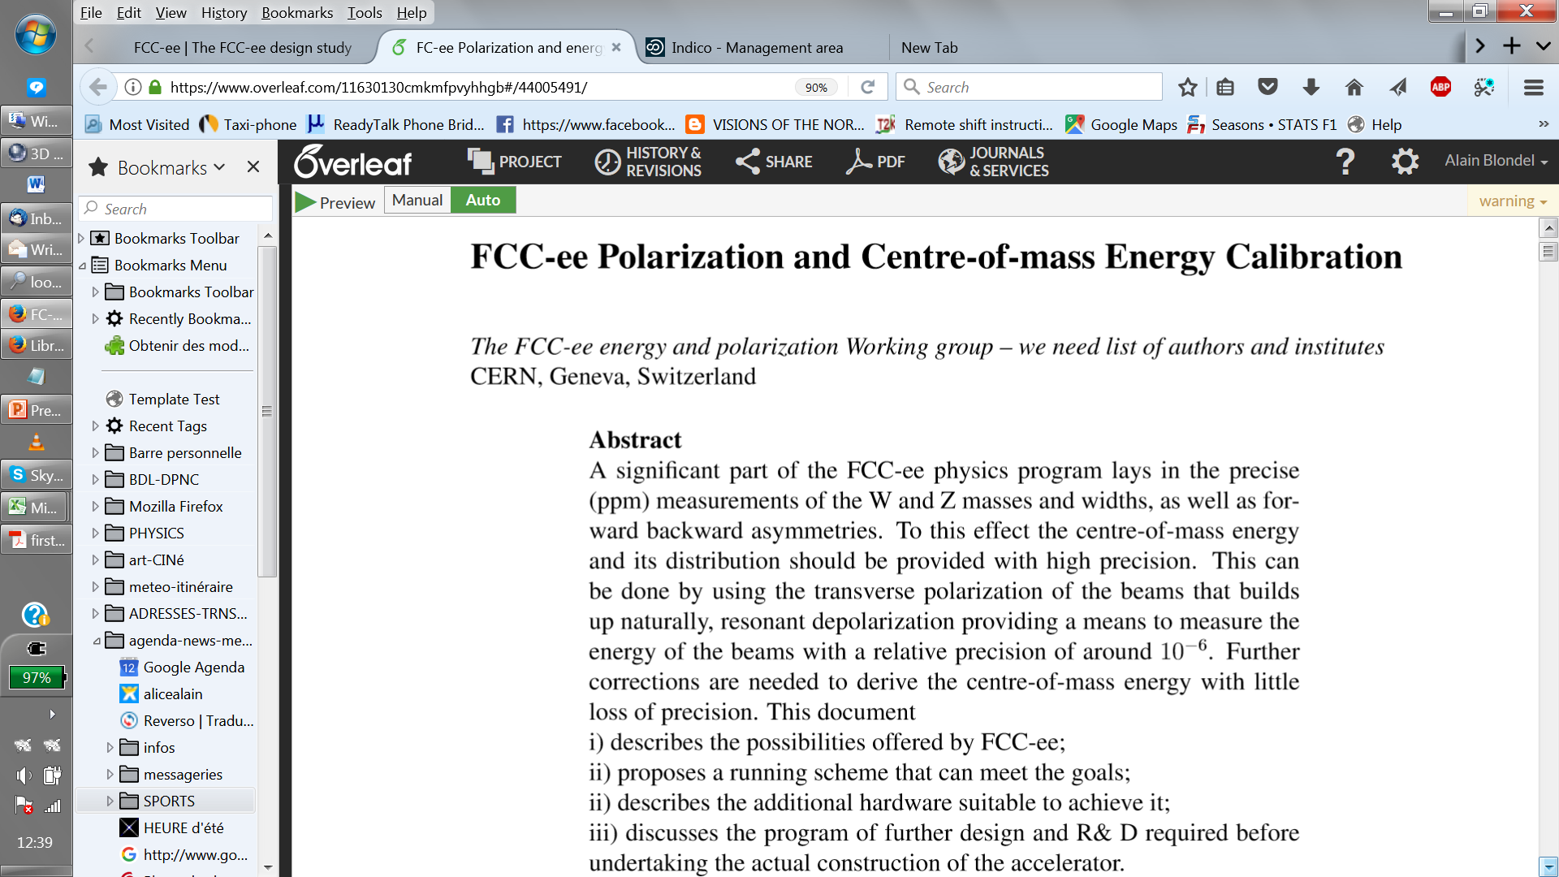

Slide 4
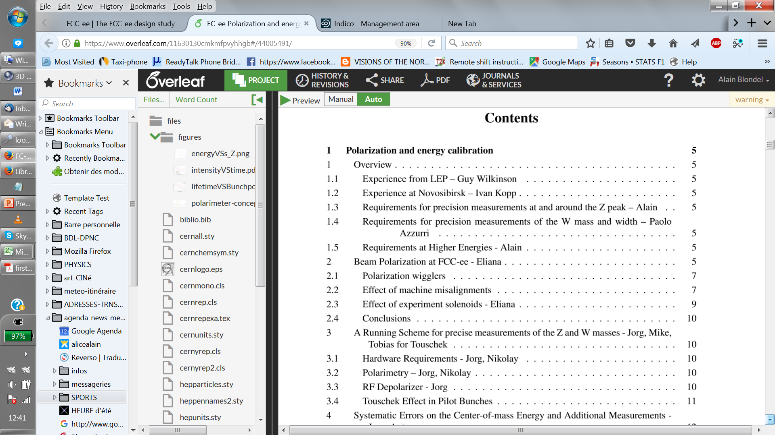
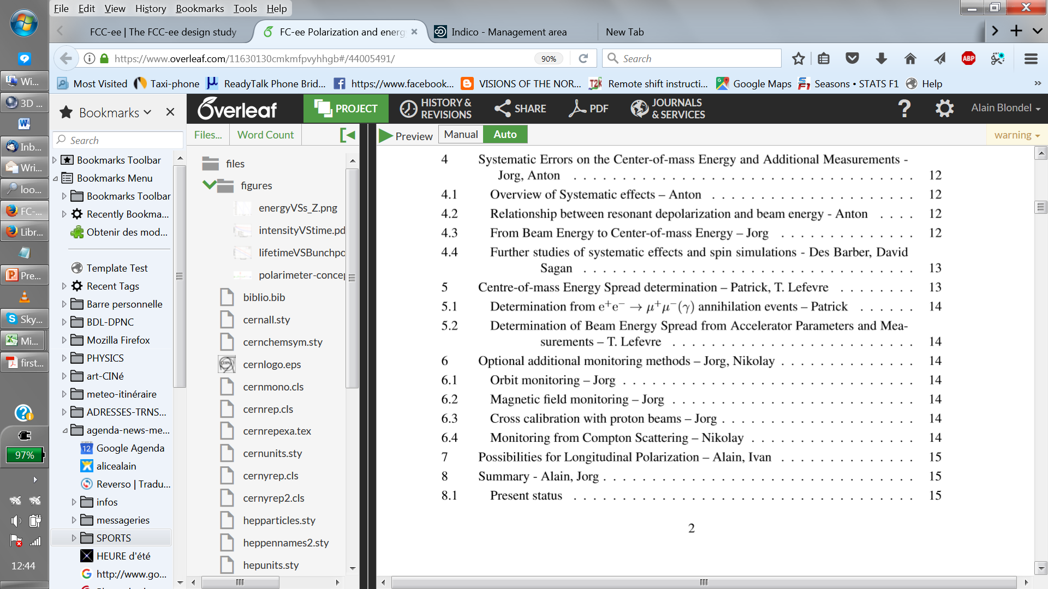
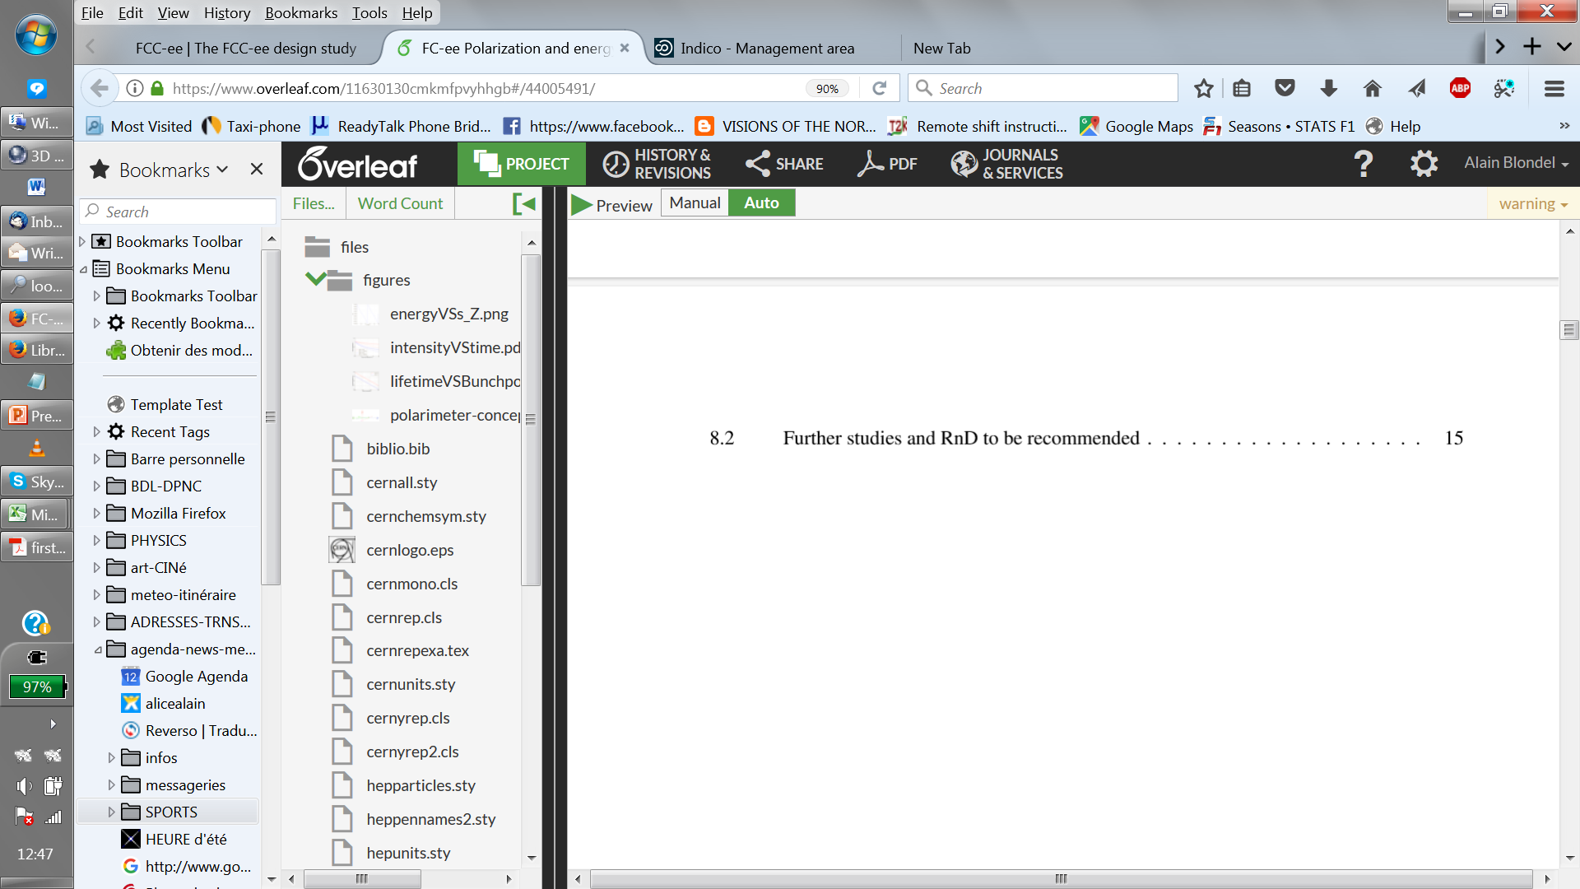

Slide 5
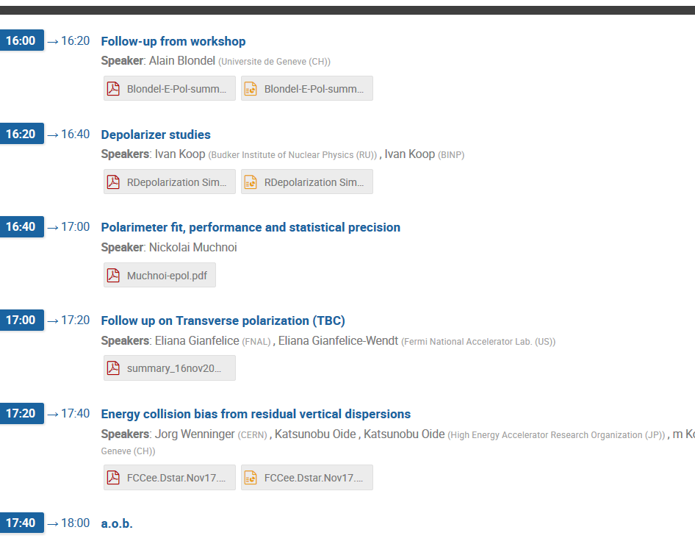
Today:

Slide 6
Following meetings
-- 30 November (at 15:00!)
-- Oide et al Opposite sign dispersion
-- D. Shatilov beamstrahlung effects
--
--
-- 14 December (16:00)
-- 11 January (15:00)
etc…
for the the FCC week in Amsterdam:
Should prepare a session with 4 talks and Posters

Slide 7
Requirements from physics
Z peak study very precisely as function of E_{CM} in the region of the Z peak
-- cross-section e+e- → Z→ X
-- muon forward-backward asymmetry
Physics output:
-- Z mass and width, ➔ from cross-sections
-- electroweak mixing angle sin²θ_{W}^{eff} (m_{Z}), QED coupling α_{QED} (m_{Z}) ➔ from A_{FB}(μμ)
Combine high statistics (510¹² Z) with high precision knowledge on E_{CM} -- aim at ΔE_{CM}=100 keV
For the Z peak cross-section and width, require energy spread uncertainty Δσ_{E}/σ_{E} =0.2%
NB: at 2.10³⁶/cm²/s , the full LEP statistics of 10⁶ muon pairs or 2.10⁷ Hadronic decays
is repeated every 6 minutes in each experiment
(2.10³⁶/cm²/s = 2/pb/s)
A fantastic machine!

Slide 8
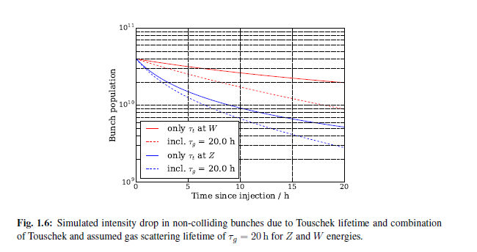
A limitation: Touschek effect
Oide-san pointed out that the ‘pilot bunches’ would lose particles due to Touschek effct
Indeed they have such small emittance
that the bunch populations reduces
fast if it is larger that 4 10¹⁰ at the Z
this is less of an issue at the W
and higher
Tobias has calculated the effect
(and written it up in the CDR!)

Slide 9
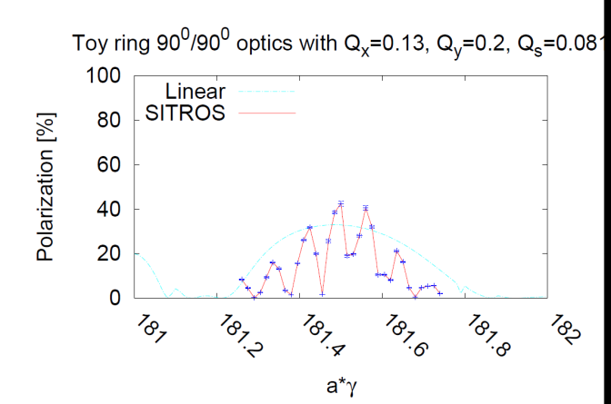
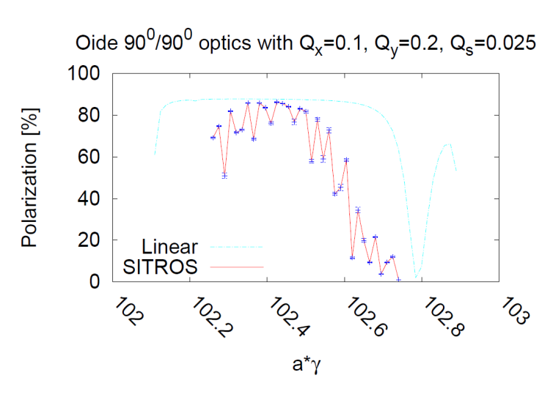
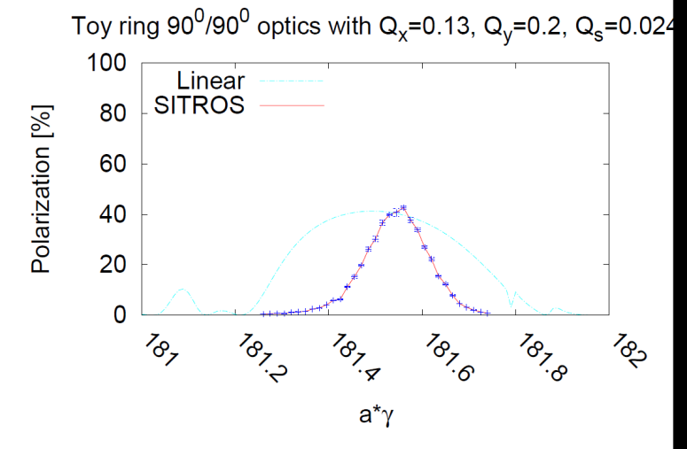
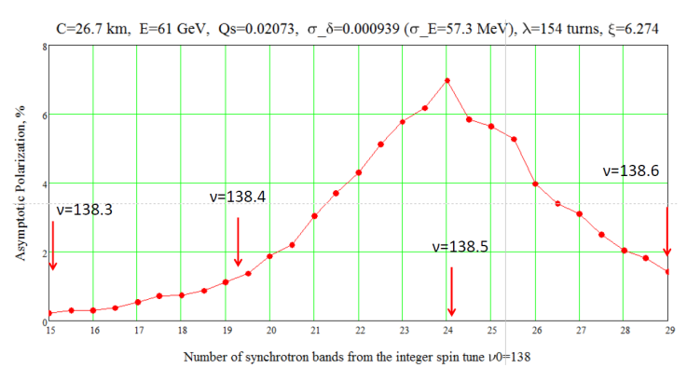
The Qs issue
Eliana and Ivan independently checked the possible effect
at the W with Qs = 0.08 ➔
Eliana, at the Z Qs=0.025
Ivan K, at 61GeV Qs=0.02
W, Qs = 0.024
➔ Similar polarization level, smoother curves.

Slide 10
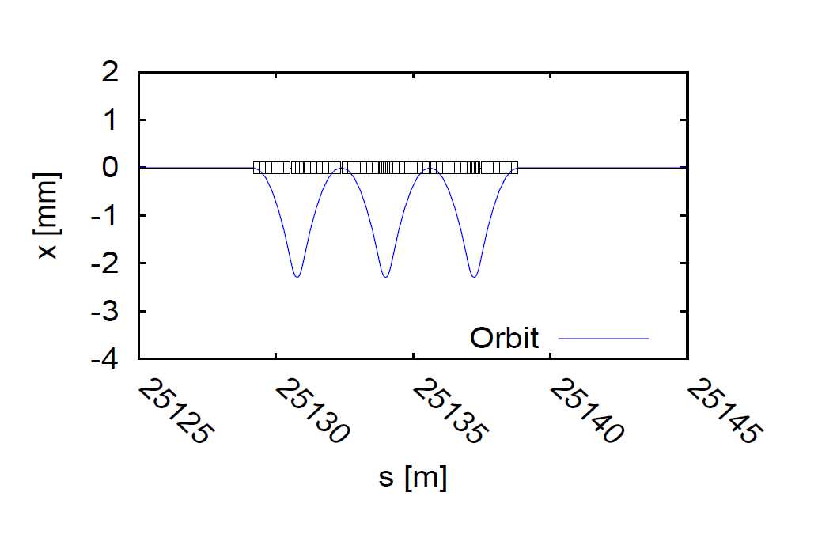
Hardware requirements: wigglers
Given the long polarization time at Z, wigglers will be necessary.
An agreement was reached on a set of 8 wiggler units per beam
Polarization wigglers
8 units per beam, as specified by Eliana Gianfelice
B+=0.7 T L+ = 43cm L-/L+ = B+/B- = 6
at Eb= 45.6 GeV and B+= 0.67 T
=> P=10% in 1.8H σ_{Eb} = 60 MeV E_{crit}=902 keV
placed e.g. in dispersion-free straight section H and/or F

Slide 11
Hardware requirements: polarimeters
Efficient polarimeter is necessary.
2 Polarimeters, one for each beam
Backscattered Compton γ +e → γ + e γ from 532 nm (2.33 eV) laser
Nickolai Muchnoi pointed out that scattered electron contains anti-correlated information
on e-beam polarization and gives information on beam energy
Practical arrangement similar to LEP for the detection of the photon,
but complemeted with an electron spectrometer

Slide 12
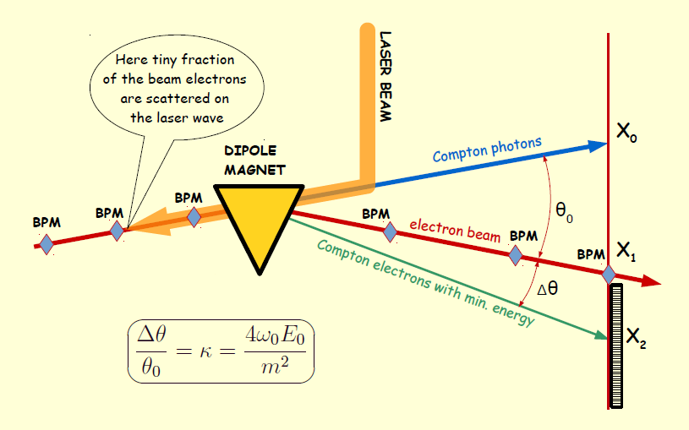

Slide 13
polarimeter-spectrometer situated 100m from end of dipole.
Using the dispersion suppressor dipole with a lever-arm of 100m from the end of the dipole, one finds
-- minimum compton scattering energy at 45.6 GeV is 17.354 GeV
-- distance from photon recoil to Emin electron is 0.628m
 | laser (eV) | beam (GeV) | mc2(MeV) | B field | R | LM | theta | L | true beam
 | 2.33 | 45.6 | 0.511 | 0.013451 | 11300 | 24.119 | 0.002134 | 100 | 45.60005
nominal kappa = 4. E_laser.Ebeam_nom/mc2 | 1.627567296
true kappa = 4. E_laser.Ebeam_true/mc2 | 1.627568924
nominal Emin | 17.35445561
true Emin | 17.35446221
position of photons | 0
nominal position of beam (m) | 0.239182573
true position of beam (m) | 0.239182334 | 2.39182E-07
nominal position of min (m) | 0.628468308
true position of min (m) | 0.628468069 | 2.39182E-07
mouvement of beam and end point
are the same:
0.24microns for δEb/Eb=10⁻⁶ (δEb=45keV)
628mm
239mm
0
± 1mm
70mm
FCC-ee plane
end point
elliptic distribution
of scattered electrons
beam spot
and BPM
recoil photon
spot

Slide 14

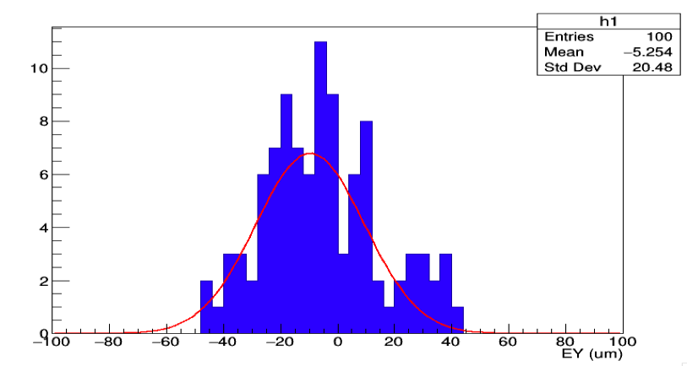
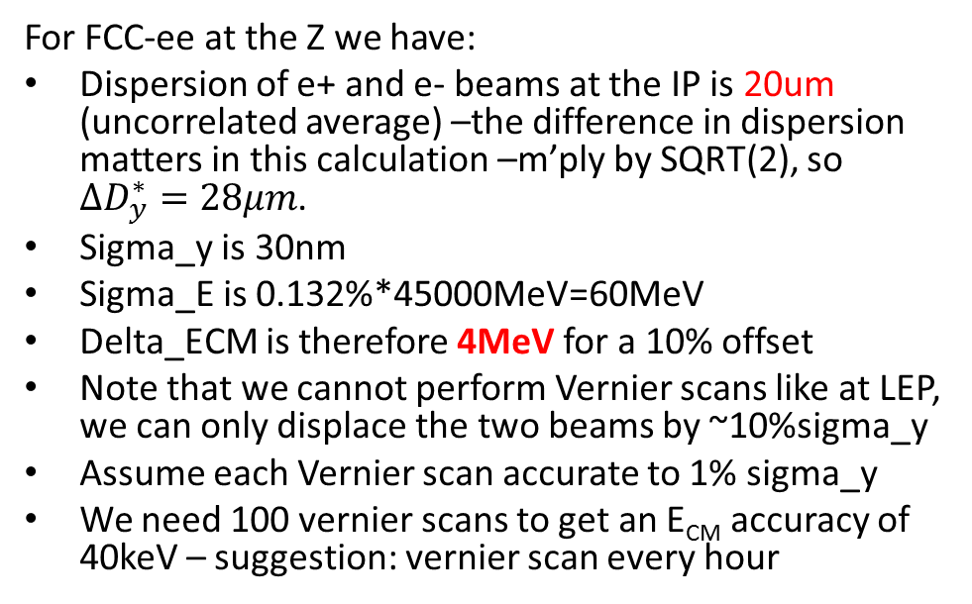
Opposite sign dispersion at IP
For FCC-ee at the Z we have:
Dispersion of e+ and e- beams at the IP is 20um (uncorrelated average) –the difference in dispersion matters in this calculation –m’ply by SQRT(2), so $∆D_{y}^{∗}=28μm$.
Sigma_y is 30nm
Sigma_E is 0.132%*45000MeV=60MeV
Delta_ECM is therefore 4MeV for a 10% offset
Note that we cannot perform Vernier scans like at LEP, we can only displace the two beams by ~10%sigma_y
Assume each Vernier scan accurate to 1% sigma_y
We need 100 vernier scans to get an E_{CM} accuracy of 40keV – suggestion: vernier scan every hour
FCC-ee 45GeV
Dima El Khechen

Slide 15
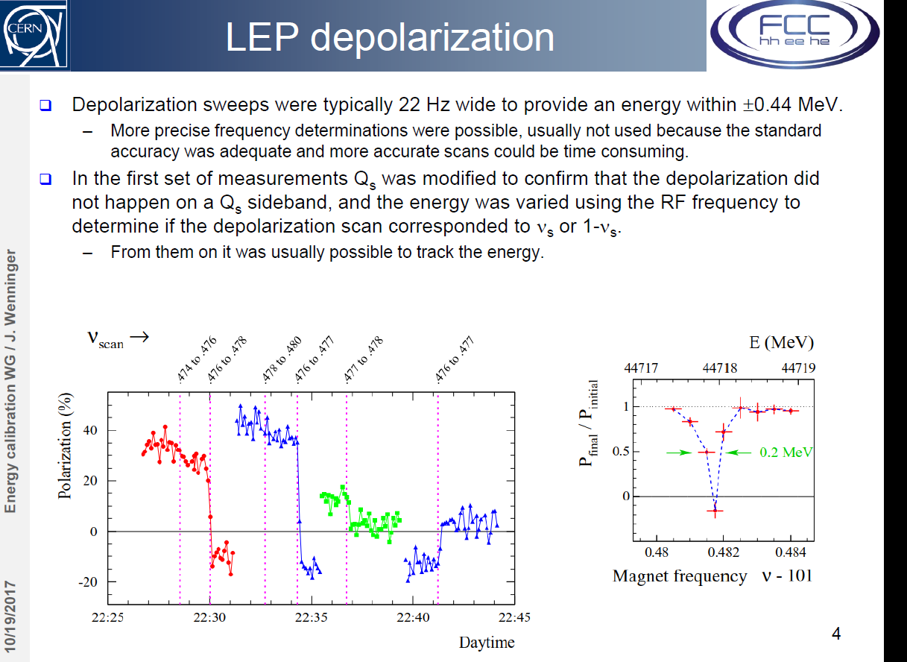
However… I.Kopp has reproduced by
simulation the depolarization for LEP,
but with the very low Qs value at FCC-ee
(and maybe other reasons?) could not
simulate a depolarization for FCC-ee.
need to investigate energy sweep
parameters further

Slide 16
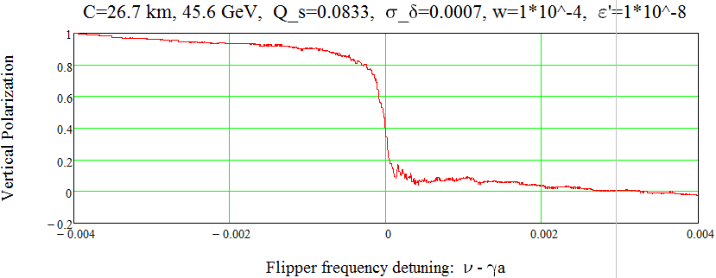
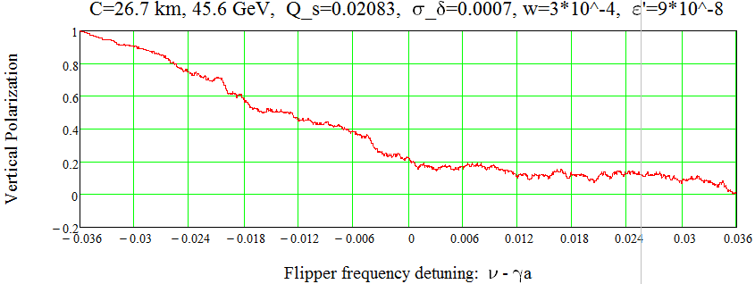
searching for the right kicker parameters
Ivan Koop
Bench marking the code by LEP simulation
at E=45.59 GeV
LEP at E=45.59 GeV:
normal depolarizer and low Q_s.

