Slide 1
Resonant Depolarization Simulations for FCC-ee
Ivan Koop, BINP, 630090 Novosibirsk
FCC-ee beam polarization and energy calibration meeting
16.11.2017, CERN, Geneva

Slide 2
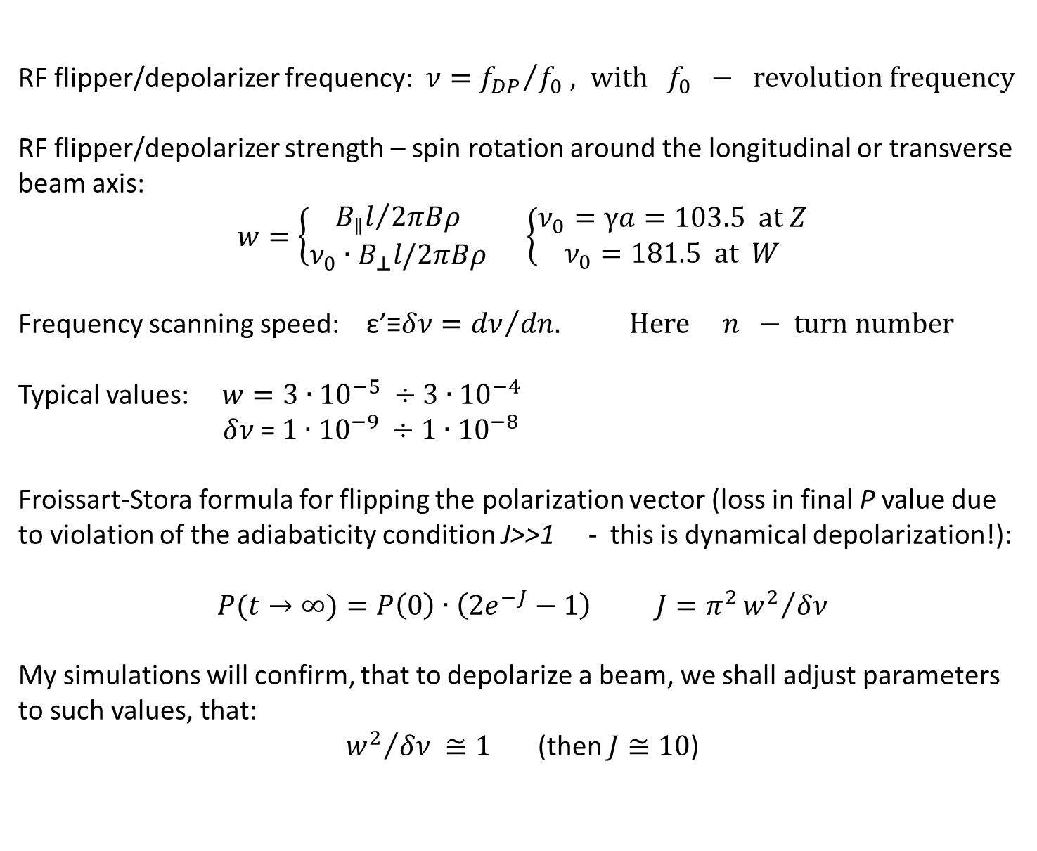
Notations
RF flipper/depolarizer frequency: $ν={f_{DP}}/{f_{0} , with f_{0} − revolution frequency}$
RF flipper/depolarizer strength – spin rotation around the longitudinal or transverse beam axis:
$w=\left\{\begin{matrix}{B_{∥}l}/{2πBρ} \\ {ν_{0}∙B}_{⊥}l/2πBρ\end{matrix}\right.$ $\left\{\begin{aligned}ν_{0}=γa=103.5 at Z \\ ν_{0}=181.5 at W\end{aligned}\right.$
Frequency scanning speed: ε’≡$δν={dν}/{dn. Here n − turn number}$
Typical values: $w=3∙{10}^{−5} ÷3∙{10}^{−4}$
$δν$= $1∙{10}^{−9} ÷1∙{10}^{−8}$
Froissart-Stora formula for flipping the polarization vector (loss in final P value due to violation of the adiabaticity condition J>>1 - this is dynamical depolarization!):
$$P(t→∞)=P\left(0\right)∙\left(2e^{−J}−1\right) J=π^{2}{w^{2}}/{δν}$$
My simulations will confirm, that to depolarize a beam, we shall adjust parameters to such values, that:
${w^{2}}/{δν ≅1}$ (then $J≅10$)

Slide 3
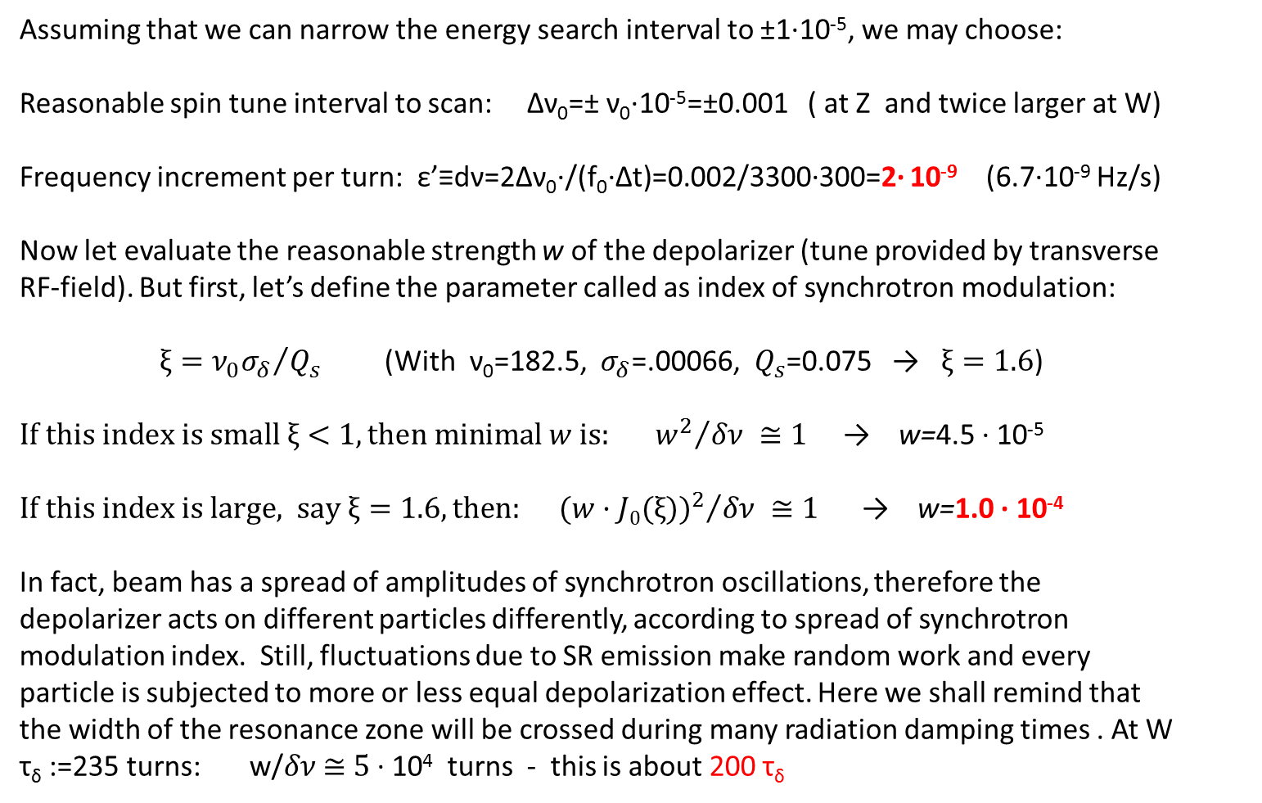
Resonant depolarization parameters and scaling
Assuming that we can narrow the energy search interval to ±1·10⁻⁵, we may choose:
Reasonable spin tune interval to scan: Δν₀=± ν₀·10⁻⁵=±0.001 ( at Z and twice larger at W)
Frequency increment per turn: ε’≡dν=2Δν₀·/(f₀·Δt)=0.002/3300·300=2· 10⁻⁹ (6.7·10⁻⁹ Hz/s)
Now let evaluate the reasonable strength w of the depolarizer (tune provided by transverse RF-field). But first, let’s define the parameter called as index of synchrotron modulation:
${{ξ=ν}_{0}σ_{δ}}/{Q_{s}}$ (With ν₀=182.5, $σ_{δ}$=.00066, $Q_{s}$=0.075 → $ξ=1.6$)
${{If this index is small ξ<1, then minimal w is: w}^{2}}/{δν ≅1}$ → w=4.5 · 10⁻⁵
${{If this index is large, say ξ=1.6, then: (w·J0(ξ))}^{2}}/{δν ≅1}$ → w=1.0 · 10⁻⁴
In fact, beam has a spread of amplitudes of synchrotron oscillations, therefore the depolarizer acts on different particles differently, according to spread of synchrotron modulation index. Still, fluctuations due to SR emission make random work and every particle is subjected to more or less equal depolarization effect. Here we shall remind that the width of the resonance zone will be crossed during many radiation damping times . At W τ_{δ} :=235 turns: w/$δν$ $≅$ $5$ · 10⁴ turns - this is about 200 τ_{δ}

Slide 4
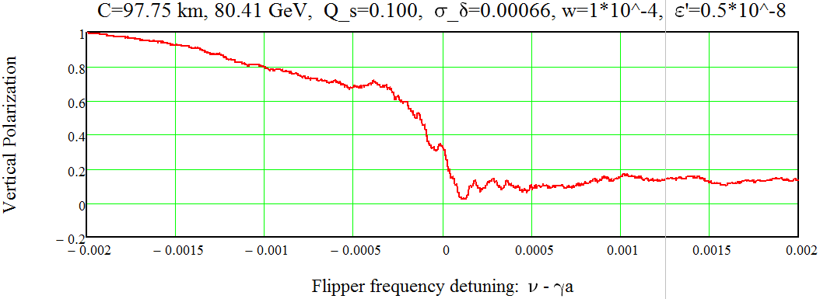
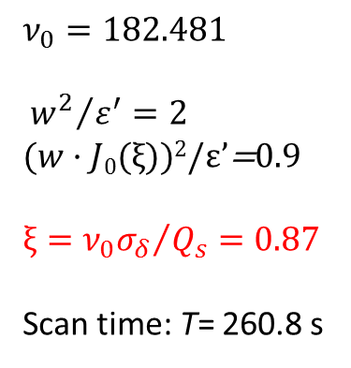
FCC-ee at 80.41 GeV, Qs=0.100, w=10⁻⁴, dν=0.5·10⁻⁸
$$ν_{0}=182.481$$
$${{ w}^{2}}/{ε^{′}=2 }$$
$(w·J0(ξ))$²/ε’=0.9
$${{ξ=ν}_{0}σ_{δ}}/{Q_{s}}=0.87$$
Scan time: T= 260.8 s
With such, relatively high value of the synchrotron tune, the localization of the resonance frequency is quite accurate.
Remind: the wanted accuracy is Δν=0.0001

Slide 5
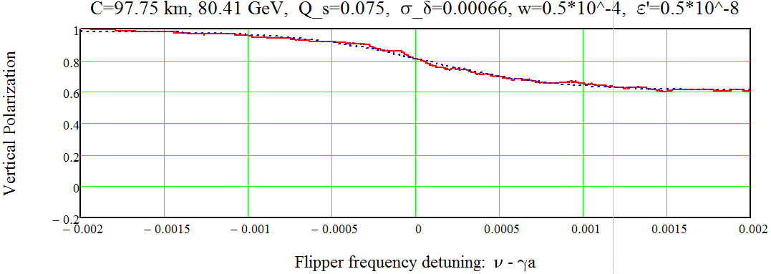
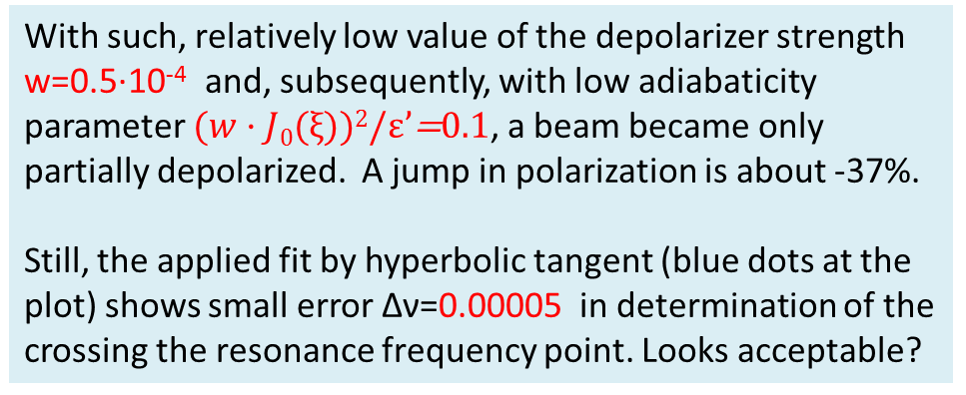
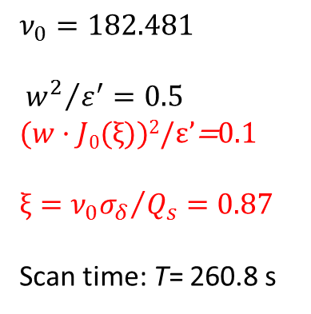
FCC-ee at 80.41 GeV, Qs=0.075, w=.5·10⁻⁴, dν=0.5·10⁻⁸
$$ν_{0}=182.481$$
$${{ w}^{2}}/{ε^{′}=0.5 }$$
$(w·J0(ξ))$²/ε’=0.1
$${{ξ=ν}_{0}σ_{δ}}/{Q_{s}}=0.87$$
Scan time: T= 260.8 s
With such, relatively low value of the depolarizer strength w=0.5·10⁻⁴ and, subsequently, with low adiabaticity parameter $(w·J0(ξ))$²/ε’=0.1, a beam became only partially depolarized. A jump in polarization is about -37%.
Still, the applied fit by hyperbolic tangent (blue dots at the plot) shows small error Δν=0.00005 in determination of the crossing the resonance frequency point. Looks acceptable?

Slide 6
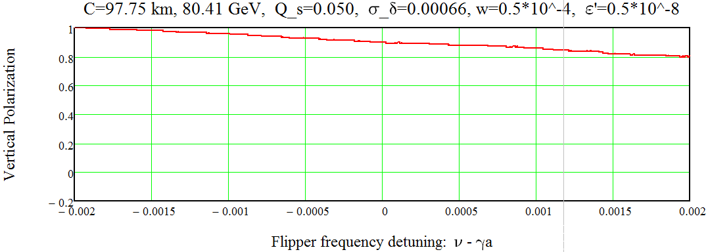
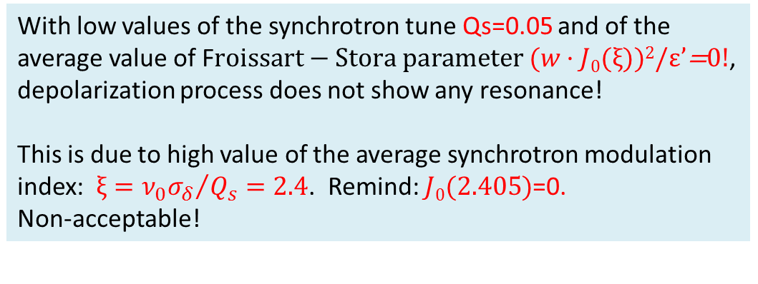
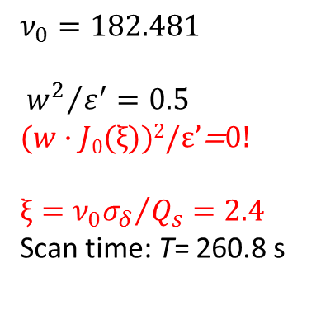
FCC-ee at 80.41 GeV, Qs=0.05, w=.5·10⁻⁴, dν=0.5·10⁻⁸
$$ν_{0}=182.481$$
$${{ w}^{2}}/{ε^{′}=0.5 }$$
$(w·J0(ξ))$²/ε’=0!
$${{ξ=ν}_{0}σ_{δ}}/{Q_{s}}=2.4$$
Scan time: T= 260.8 s
With low values of the synchrotron tune Qs=0.05 and of the average value of F$roissart−Stora parameter (w·J0(ξ))$²/ε’=0!, depolarization process does not show any resonance!
This is due to high value of the average synchrotron modulation index: ${{ξ=ν}_{0}σ_{δ}}/{Q_{s}}=2.4$. Remind: $J0(2.405)$=0.
Non-acceptable!

Slide 7
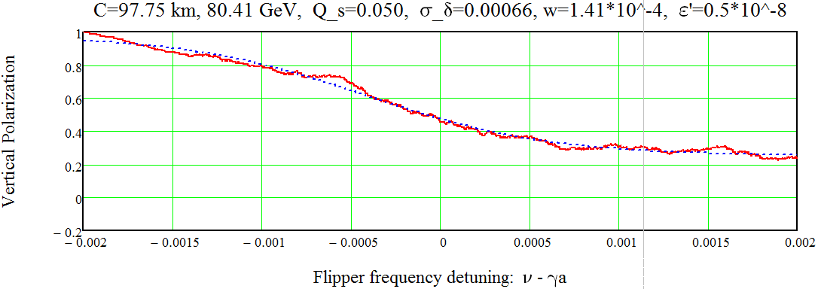
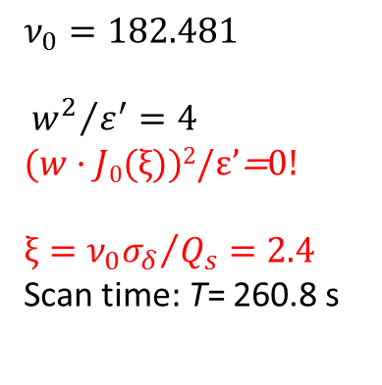
FCC-ee at 80.41 GeV, Qs=.05, w=1.41·10⁻⁴, dν=0.5·10⁻⁸
$$ν_{0}=182.481$$
$${{ w}^{2}}/{ε^{′}=4 }$$
$(w·J0(ξ))$²/ε’=0!
$${{ξ=ν}_{0}σ_{δ}}/{Q_{s}}=2.4$$
Scan time: T= 260.8 s
Try to increase the depolarizer strength up to w=1.41·10⁻⁴.
But not clear, trustable picture we see. Simple fit gives the resonance frequency with an error Δν= - 0.0004.
I think, the last two plots show that the synchrotron tune at W should be made much higher. Its minimal acceptable value is Qs=.075, or even higher!

Slide 8
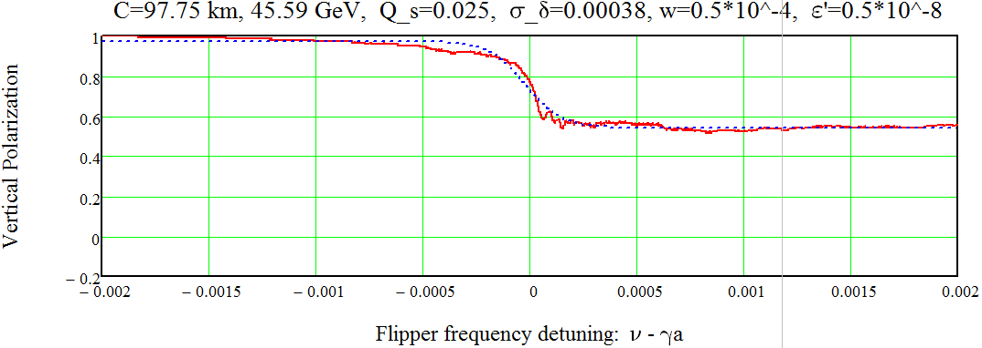
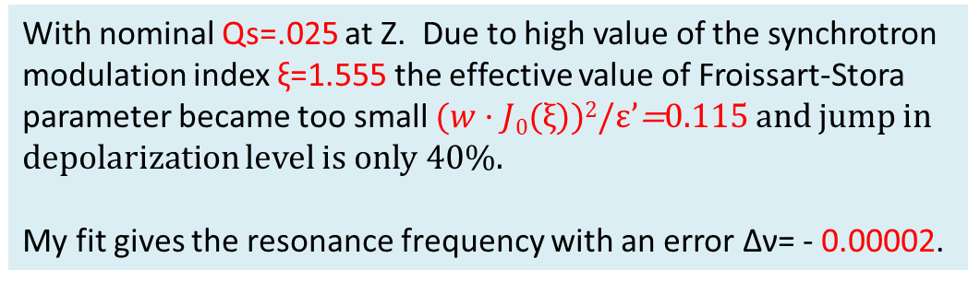
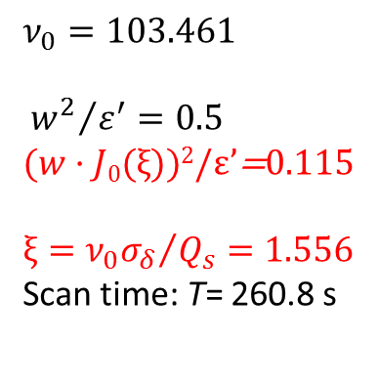
FCC-ee at 45.6 GeV, Qs=.025, w=0.5·10⁻⁴, dν=0.5·10⁻⁸
$$ν_{0}=103.461$$
$${{ w}^{2}}/{ε^{′}=0.5 }$$
$(w·J0(ξ))$²/ε’=0.115
$${{ξ=ν}_{0}σ_{δ}}/{Q_{s}}=1.556$$
Scan time: T= 260.8 s
With nominal Qs=.025 at Z. Due to high value of the synchrotron modulation index ξ=1.555 the effective value of Froissart-Stora parameter became too small $(w·J0(ξ))$²/ε’=0.115 and jump in depolarization level is only 40%.
My fit gives the resonance frequency with an error Δν= - 0.00002.

Slide 9
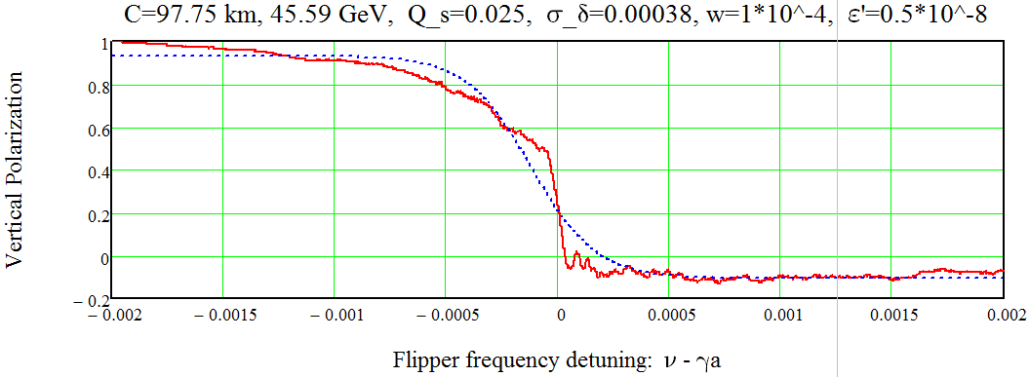
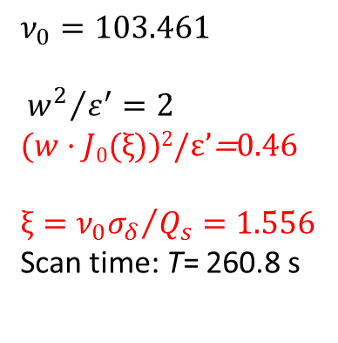
FCC-ee at 45.6 GeV, Qs=.025, w=1·10⁻⁴, dν=0.5·10⁻⁸
$$ν_{0}=103.461$$
$${{ w}^{2}}/{ε^{′}=2 }$$
$(w·J0(ξ))$²/ε’=0.46
$${{ξ=ν}_{0}σ_{δ}}/{Q_{s}}=1.556$$
Scan time: T= 260.8 s
With nominal Qs=.025 at Z. And with strong depolarizer w=1·10⁻⁴.
My simple fit gives the resonance frequency with an error Δν= - 0.00011. But, in fact, the transition zone here is very narrow and is centered to the right spin tune value very well.

Slide 10
Conclusions
At Z peak with the last set of beam and lattice parameters there is no obstacles to perform the Resonant Depolarization, even with such small synchrotron tune as Qs=.025.
At W threshold there is a serious problem with the choice of too low Qs=.023 value. RD works, if Qs will be increased to 0.075, at least.

