Slide 1
GÉANT Network evolution overview
Enzo Capone
Head of Research Engagement and Support
LHCONE-OPN Meeting
RAL (Abingdon), 6 March2018

Slide 2
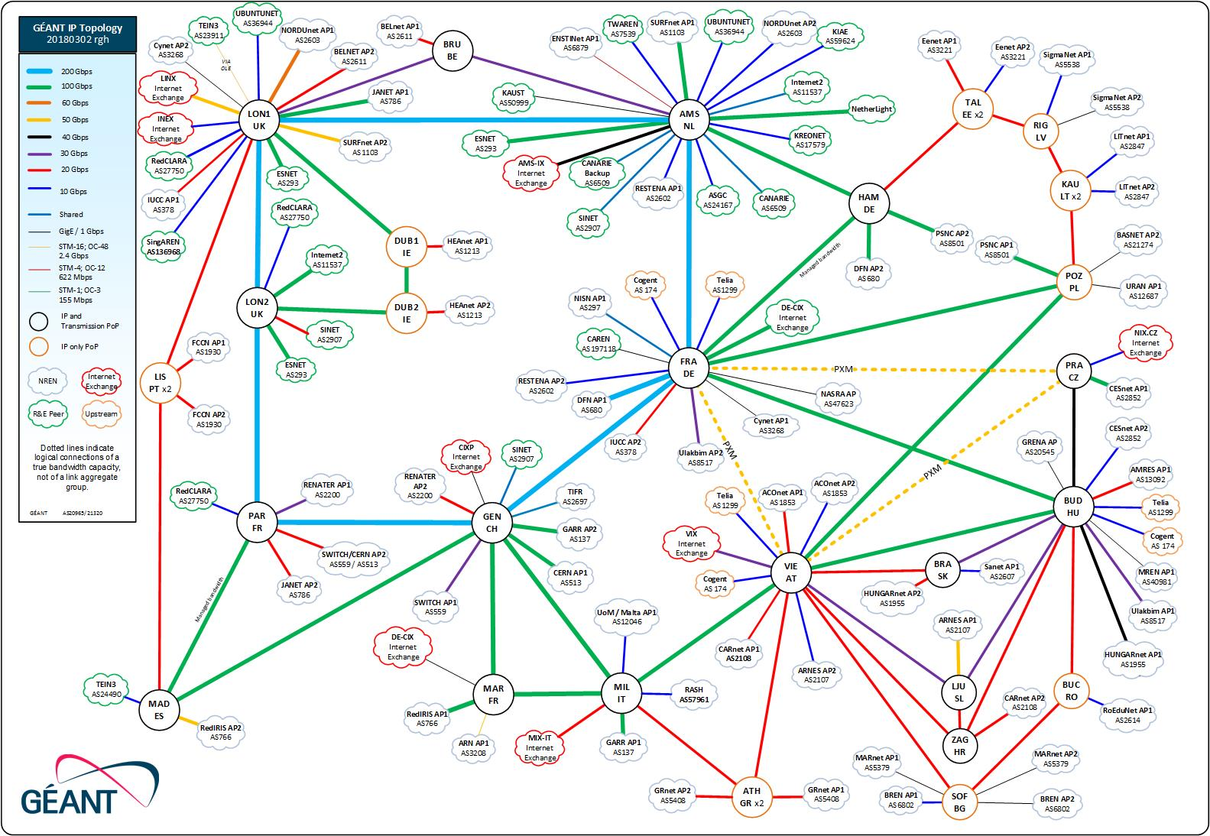
The GÉANT network

Slide 3
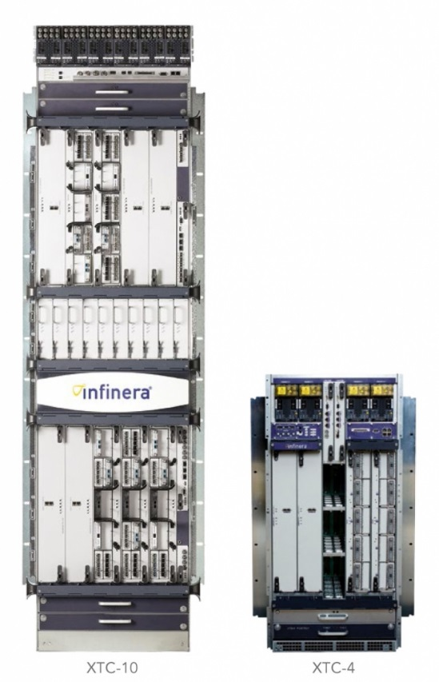
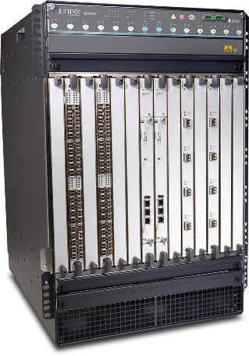
The GÉANT Network now
Made of two main networks
  Infinera-based DWDM
  Juniper-based IP/MPLS
Several overlays on the IP/MPLS network
  Global R&E IP
  LHCONE
  IAS – GÉANT internet service GWS+Peerings
  Cloud VRF
  MDVPN
  P2P VPNs (GN+)
  Project specific L3VPN
MX960

Slide 4
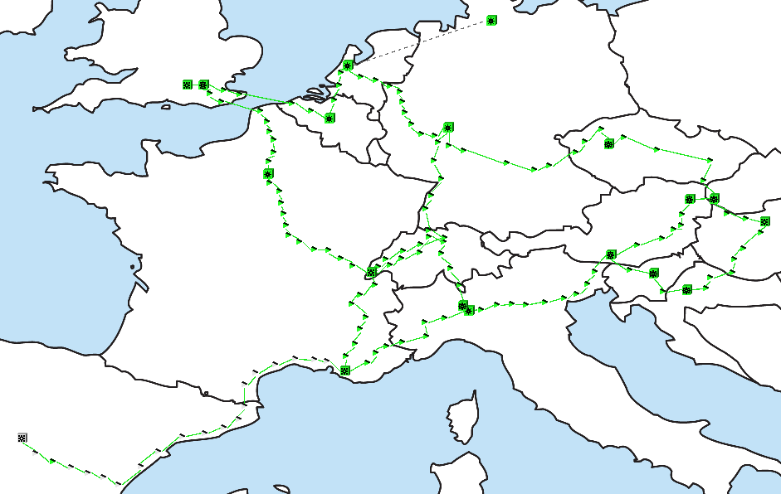
The DWDM network
Based on Infinera DTNx system
Elements providing large capacity Point-to-point across defined fibre routes
10G and 100G Lambda services are provided directly on this infrastructure

Slide 5
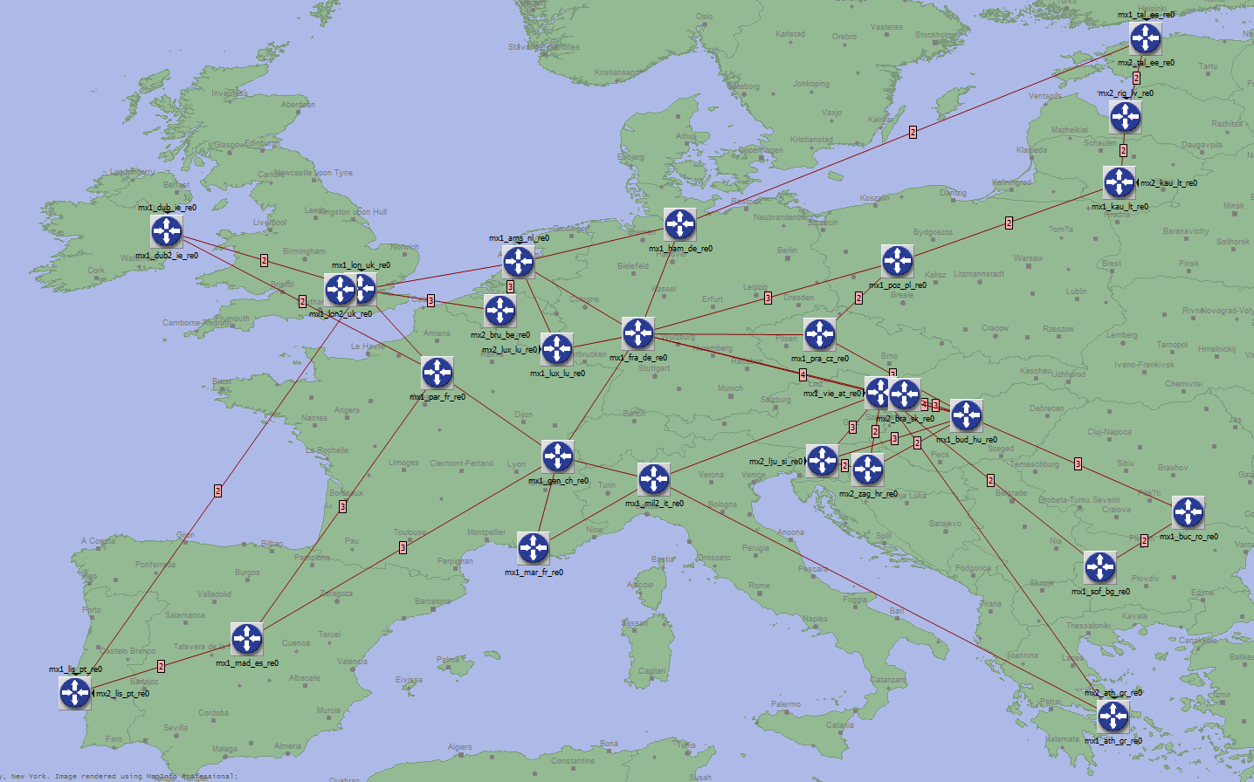
The IP/MPLS network
Juniper MX routers
IP traffic any to any .. with policy
All services except Lambdas are provided here
Use the DWDM network for some of its core links, leased capacity for others
Provides Overlays

Slide 6
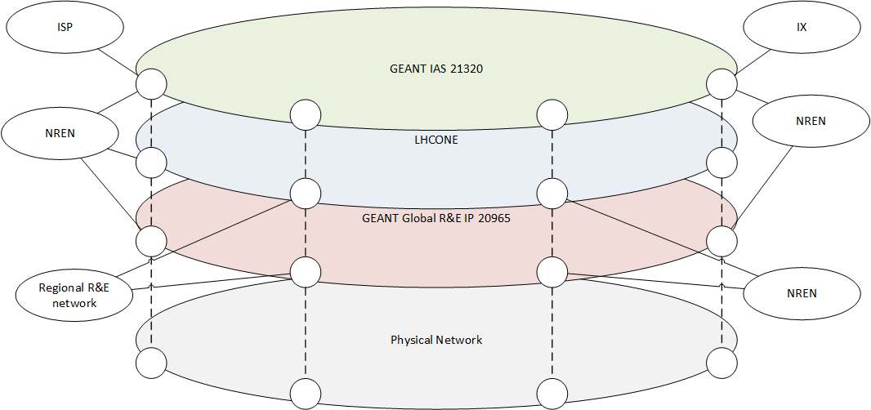
Overlays
Overlays and type of traffic:
Global R&E IP – connects the NRENs and other regional R&E networks
LHCONE – connects NRENs and other regional networks for LHC related data exchange
IAS – connects NREN to ISP and CDN networks
Other important overlays such as MDVPN and Clouds not shown here.

Slide 7
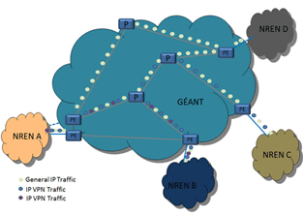
GÉANT network services
GÉANT IP
  Global R&E internet reach
  Commodities internet access
  Cloud connectivity
  LHCONE
GÉANT VPNs
  L3VPNs
  Carrier of Carriers VPN (MD-VPN)
  L2-P2P VPN (GEANT+)
GÉANT Lambdas
  10 or 100G OTN based P2P links
All GÉANT services with the exception of lambdas are accessible through a single interface at any PoP.

Slide 8
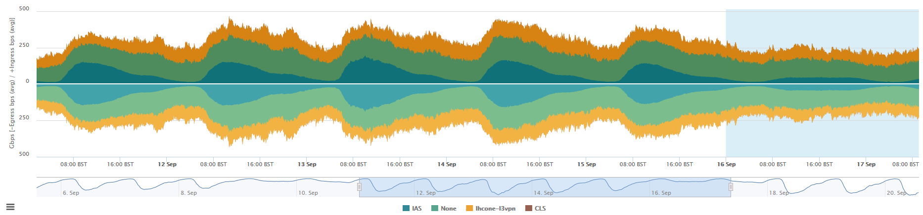
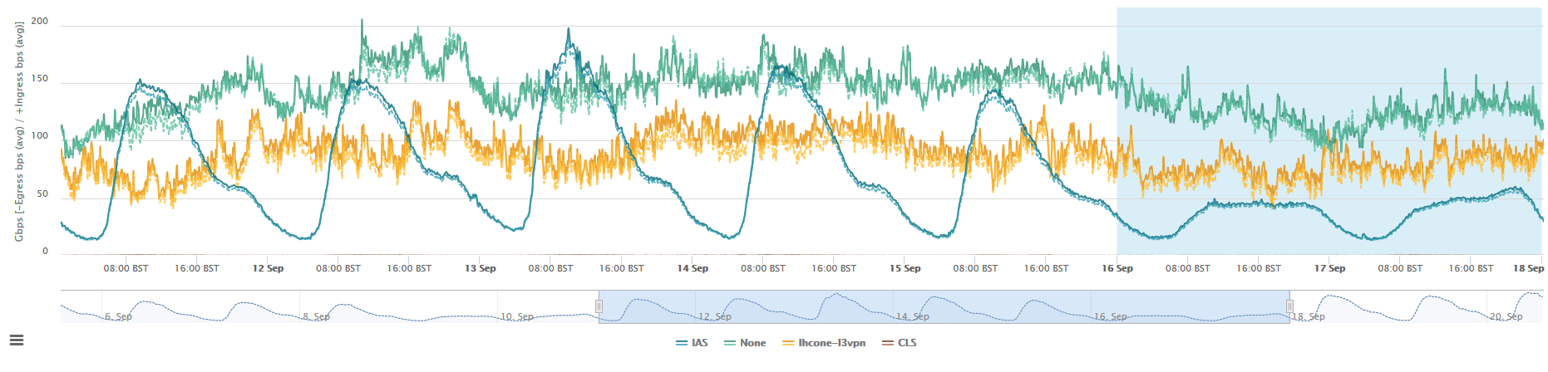
Traffic by Overlay
IAS = Internet service VRF
None = GÉANT Global R&E IP
LHCONE = LHCONE
CLS = Clouds VRF
Less than 10% of traffic falls outside of these 3 largest overlays.

Slide 9
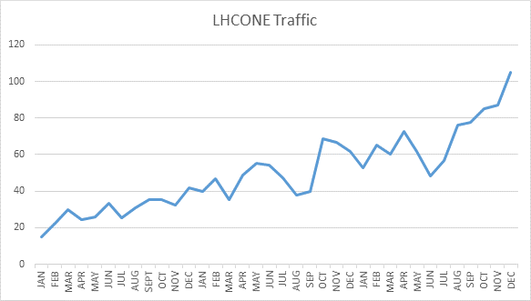
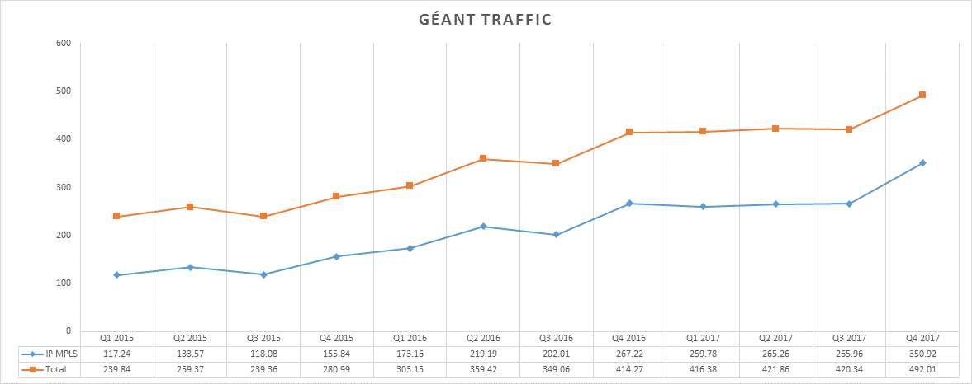
Traffic volumes and growth
Notes:
In Q2 2017 GÉANT received about 4.6 Petabytes of traffic per day, that is 4.6 millions of Gigabytes.
Between 2015 and 2016 the IP/MPLS traffic on the GÉANT network grew by 64%. This has reduced to~50% in the last 4 quarters.
LHC and the high energy physics community has been one of the major drivers for growth.

Slide 10
Challenges and network evolution strategy
Address scalability/cost on transmission layer
Address scalability/cost on IP/MPLS layer
Increase modularity – address vendor locking
Allow for cost per bit optimisation by increasing delivery options
With a growth rate of 64% as seen in 2015 -> 2016 traffic will be 140 times in 10 years
To address these challenges we need to optimise the network architecture and take maximum advantage of the current disruptive trends

Slide 11
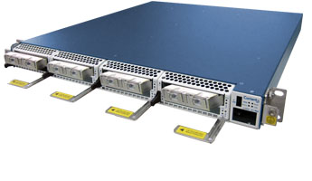
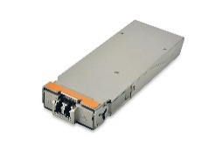
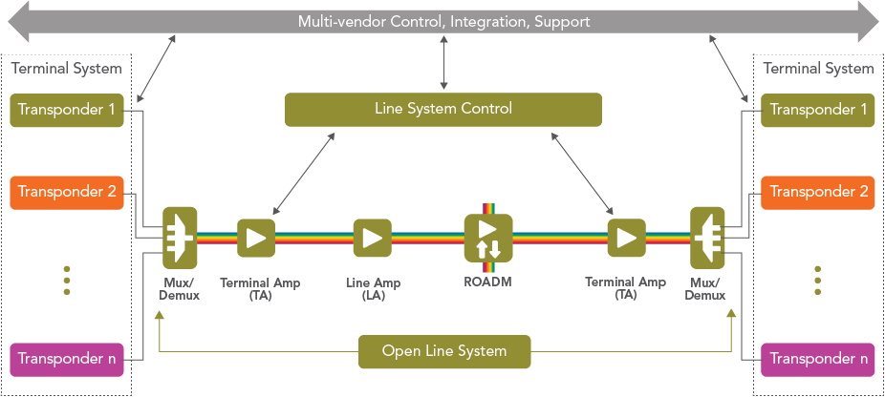
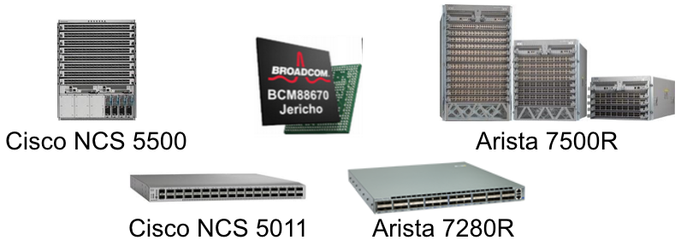
Current trends
DCI boxes with coherent DWDM optics
Open line systems/Alien waves
Merchant silicon for ISPs
Packet optical integration
Low(er)-cost IP/MPLS equipment
Disaggregation (software and hardware)
Notes:
Juniper MX-240

Slide 12
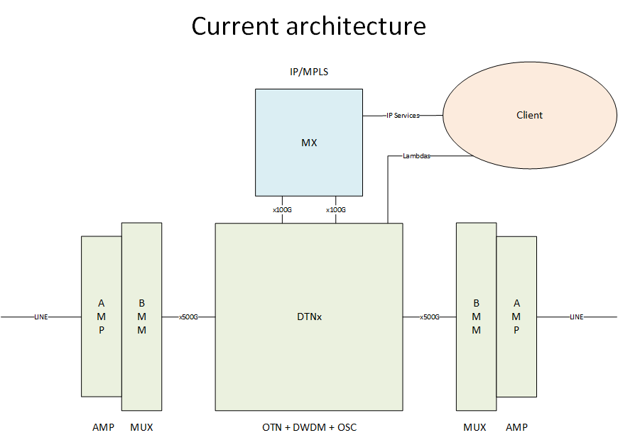
Address scalability cost on transmission layer – current architecture
Problems with current architecture:
DTNx based OTN layer highly expensive
DTNx chassis running out of slots in central PoPs
OTN useful for protection switching and multihop but traffic is 70% unprotected and next hop
OTN chassis are DC powered full rack while DCI are AC powered 1RU
Proliferation of IP/MPLS cross connects to OTN

Slide 13
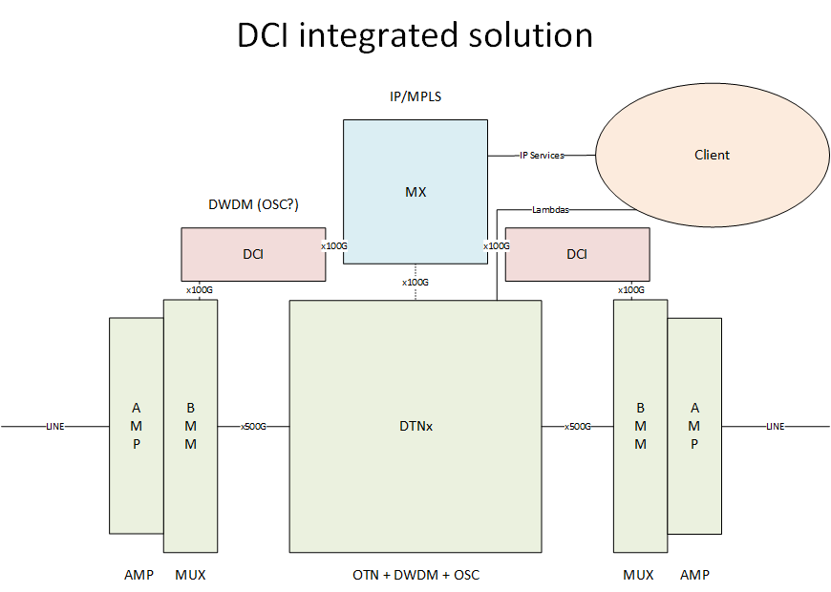
Address scalability cost on transmission layer - future architecture
Solution
Use DCI to provision bandwidth for high capacity IP/MPLS trunks
DCIs are over 6x cheaper than DTNx
Keep DTNx for link management and lambda provisioning greatly simplifying DCI role and minimising risk
Integration of DCI allows for growth offset and generate enough spares to allow to cease spending on DTNx platform
DCI are AC powered 1RU
DCIs can be re-used after line system re-procurement in 2020/2021

Slide 14
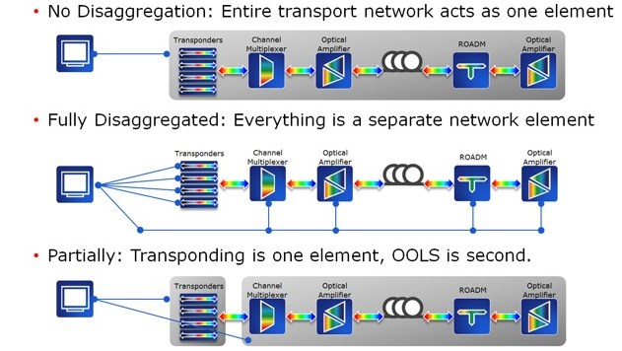
Increase modularity address vendor locking - Open line System
Partly disaggregated line system architecture allows for use of third party transponders on line system by defining a DEMARC at the MUX. This allows for best in breed selection of transponder and avoid vendor locking both financially and in terms of innovation curve.
This also enable better infrastructure sharing by lowering the cost of sharing capacity over fibre.

Slide 15
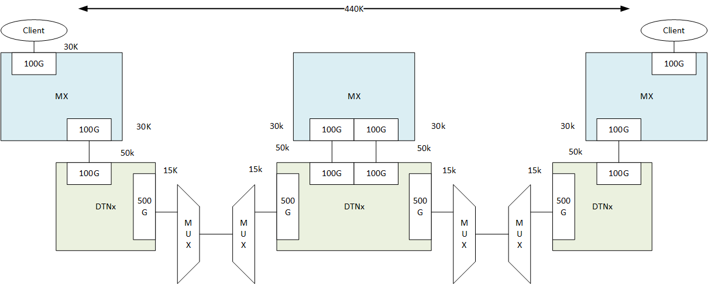
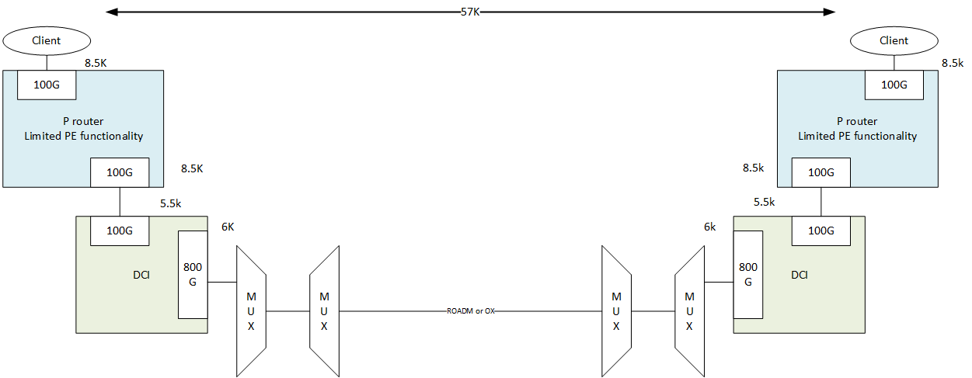
Optimisation of cost per bit by diversifying delivery strategy
Delivering the same bits with different strategies/architectures can lead to a 10x cost reduction for the traffic streams where this can be applied without impact on service levels.
Where services requirements and flow sizes allow lower cost strategy should be used for delivery.
Today GEANT has only 2 costs per bit – Lambdas (DTNx direct) and IP/MPLS ( Juniper MXs) in the future GEANT should have more option to optimise costs.
Notes:
DTN-x vs DCI

Slide 16
Optimisation of cost per bit by diversifying delivery strategy
Notes:
The first column on the left is using MXs and DTNXs and delivering as a pseudo-wire over MPLS.
Second column refers to the delivery over MXs but using OTN to connect the two MXs jumping the middle hop.
Then we have an Optical express through the first hop, this is not regenerating at the DTNx there.
These are the three options available today.
DCI in place of DTNXs, this is DCI/PE, so still through the MX and DCI on the first hop.
You can move then to DCI/P, this is having cheaper P routers switching, non terminating MPLS traffic at intermediate nodes (ARISTA is used for reference).
Then you can move to DCI PE-P, this means that the clients for specific services will be directly connected to the P routers (ie. ARISTA) so the P is now actually a PE (P-PE), but only for access to specific services as it has limited PE functionality
Optical express using DCIs through the first hop and also use P-PE routers

Slide 17
Optimisation of cost per bit – Network access for NRENs at different layers
Allow NREN to access the network at different layers optimising costs and allowing for wider range of services
Sharing of infrastructure will be made easier by allowing access to wavelengths through an open line system
IP services will be split based on sophistication to optimise cost per bit and take advantage of merchant silicon
DCI to offer cost effective access to capacity of dark fibre

Slide 18
Next steps
Deploy DCI equipment
Investigate and deploy cheaper to run MX-240
Understand what the topology we want should look like and who can provide fibre/spectrum
Engage with the DWDM vendors for OLS technology
Prepare the draft of the tender for the next transmission
Explore routing software that runs over white/bright boxes and asses the maturity (for longer term)

Slide 19
Questions?
vincenzo.capone@geant.org

