Slide 1
xRP @ NORDUnet
Lars Fischer
LHCONE meeting
RAL, 7 March 2018

Slide 2
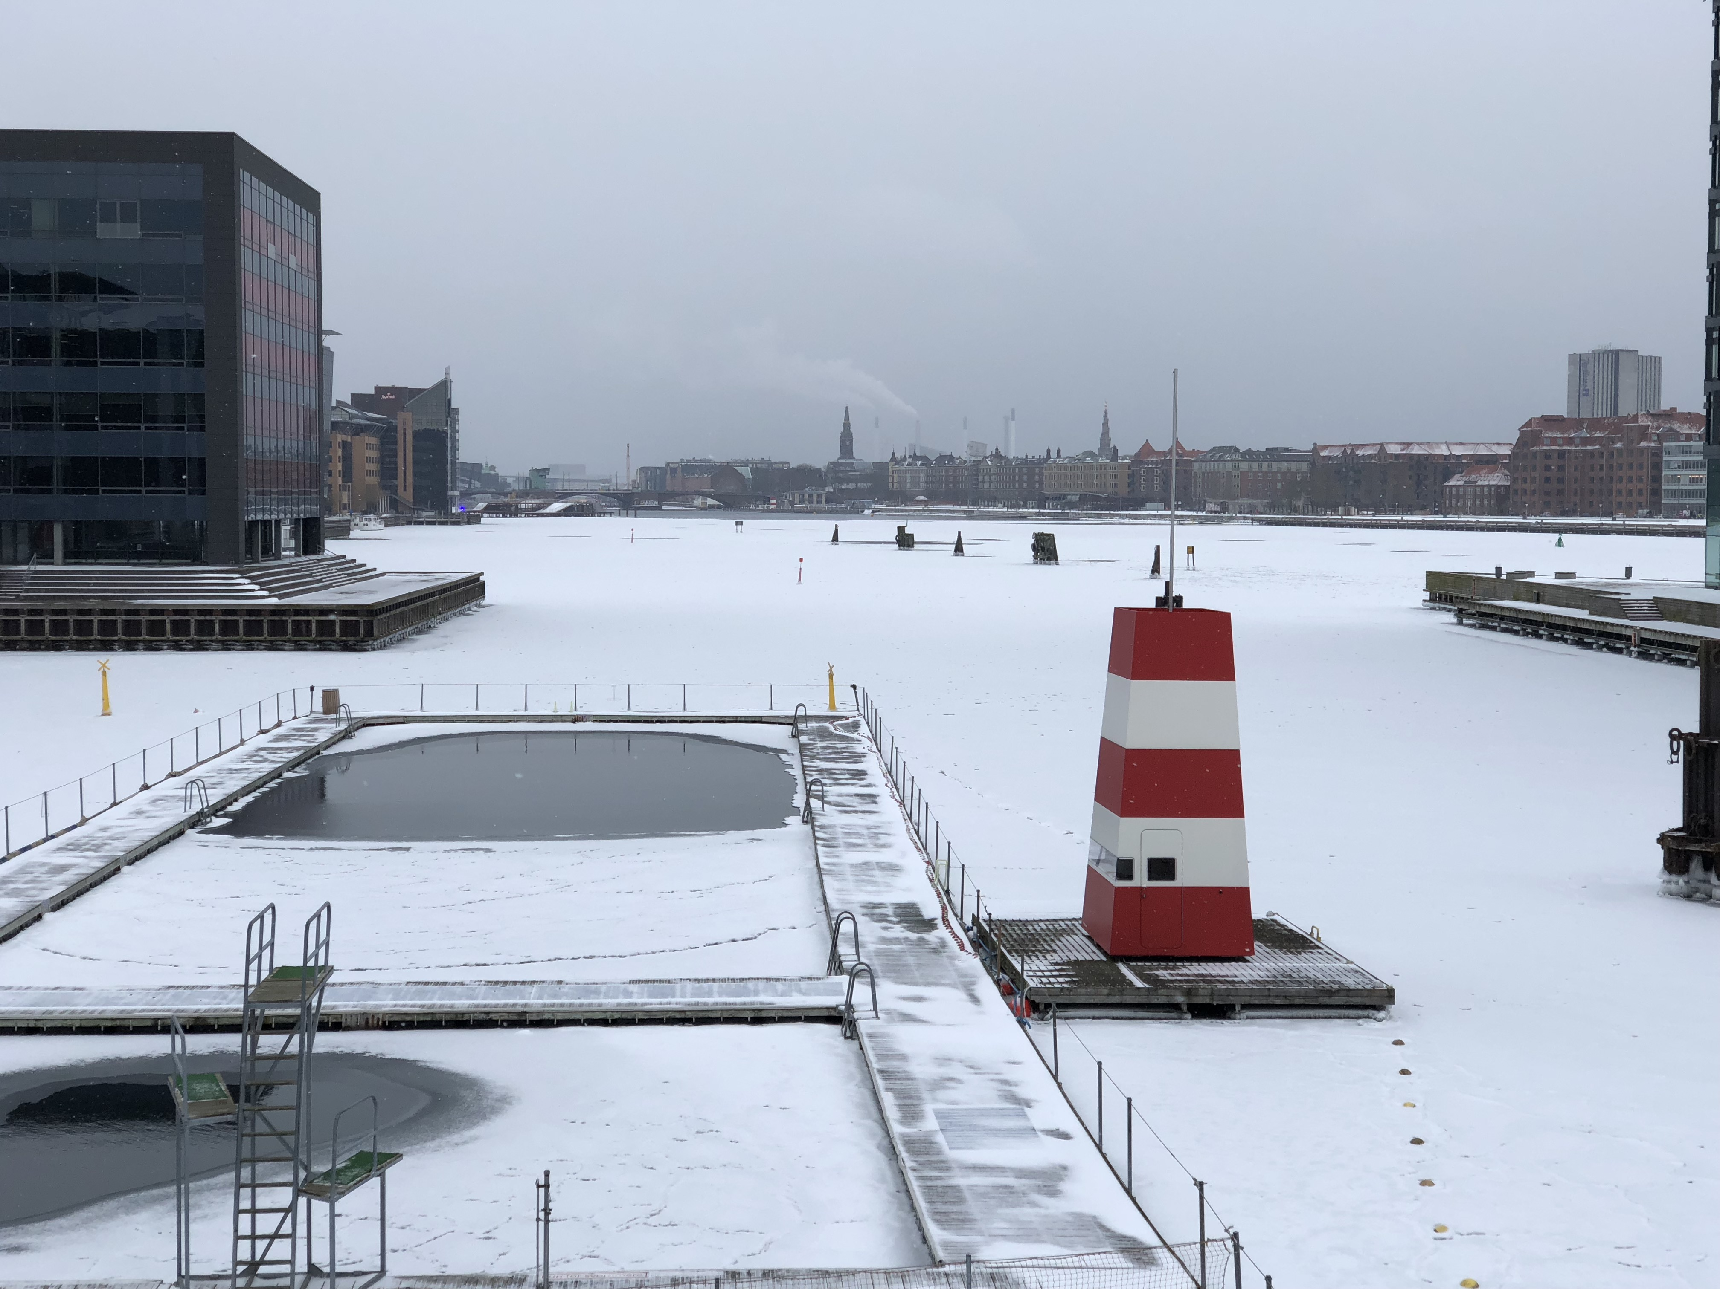
Activities at NORDUnet…

Slide 3
Global Research Platform?
PRP is
  Science Engagement
  Technology
  Communities
Can PRP be replicated?
  Global Reach
  European Communities?
  Global Communities?
  Replication of results in Europe?

Slide 4
Science Engagement
The important part of PRP
  … and also the hard part
NORDUnet + SURFnet
  Promotion of PRP results w/ science engagement teams
  Small-scale experiments
  Candidate science communities?
  Potential projects & funding sources?

Slide 5
Technology
Nordic / European Training Workshops
  Partnership w/ CENIC, NSRC, SURFnet
  2 day Events for Engineers
  First run: 16-17 April, Nordic NRENs + SURFnet
Training setup
  Flightcase w/ private network, private wifi, 2 x 10G FIONA, 24 x 1G FIONETTE
  Built for repeated, local events

Slide 6
Community Building
Informal outreach
  Large science infrastructures – HPC centres, large projects w/ dedicate infrastructure
  Small and medium scale science collaborations - the long tail
  Pilots w/ long tail reseachers
Involving TF-RED
Science engagement session at NORDUnet 2018

Slide 7
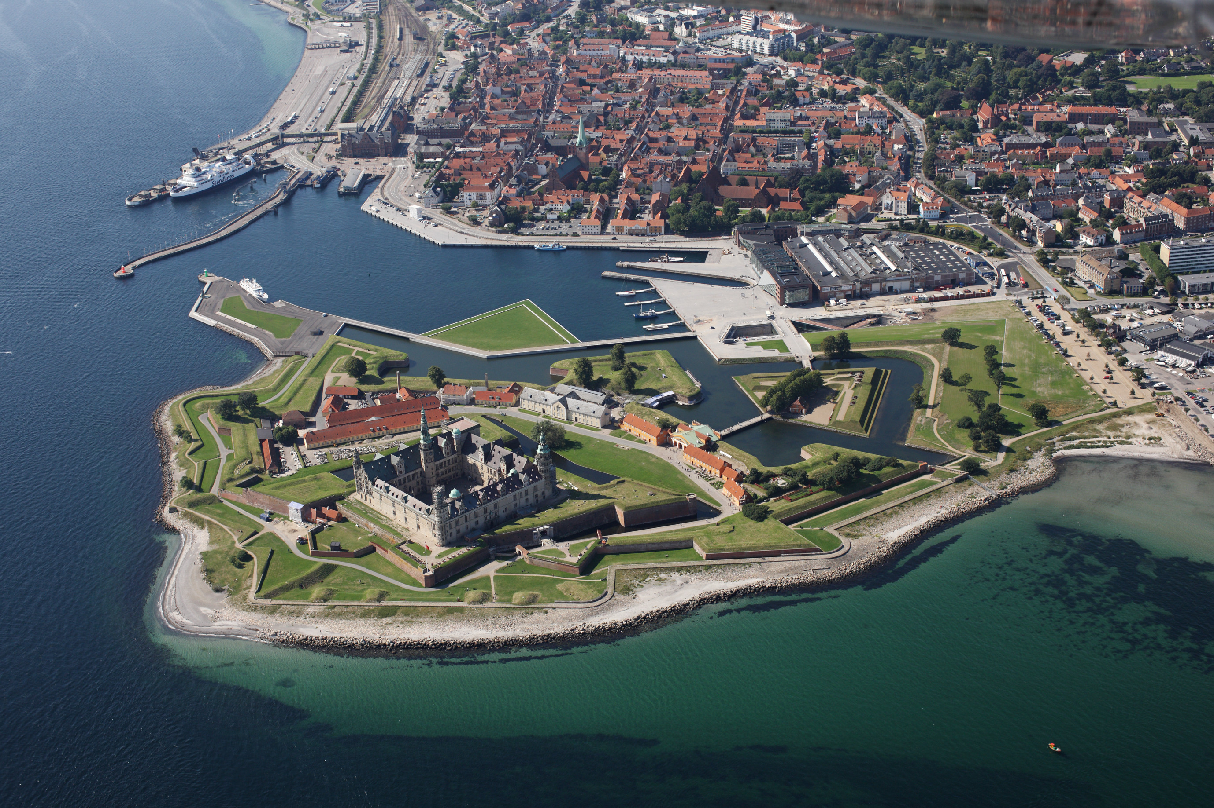
Elsinore, 18-20 Sep 18
To Airport
NORDUnet 2018
Hamlet

Slide 8

Meet the Natives

