Slide 1


High Speed Links on low Mass Cables
Leyre Flores Sanz de Acedo
ACKNOLEDGMENTS: R. Bates, C. Buttar, J.Christiansen, T. Flick, M. Hamer, T. Hemperek S. Kuehn, S. Orfanelly, P. Rymaszewski and S. Vitalte
ACES WORKSHOP AT CERN
24/04/2018

Slide 2
CONTENTS
Introduction
CMS system overview
ATLAS system overview
High Speed Low Mass cable designs and measurements
Summary

Slide 3
INTRODUCTION
  With the current upgrades in the LHC detectors in order to achieve higher luminosity vertex and tracking subdetectors of HEP experiments will deliver data rates in the Gigabit orders
  The commercial solution to deal with such high rates for long distances will be: Data transmitted optically
  However Physics solution: Due to the high radiation environment and low radiation length requirements electrical transmission with custom designs needed
        - In low radiation regions the transmission is done optically (strips)
  This talk will present the different solutions chosen by the two Upgrades programs of ATLAS and CMS pixels to succeed in this issue

Slide 4
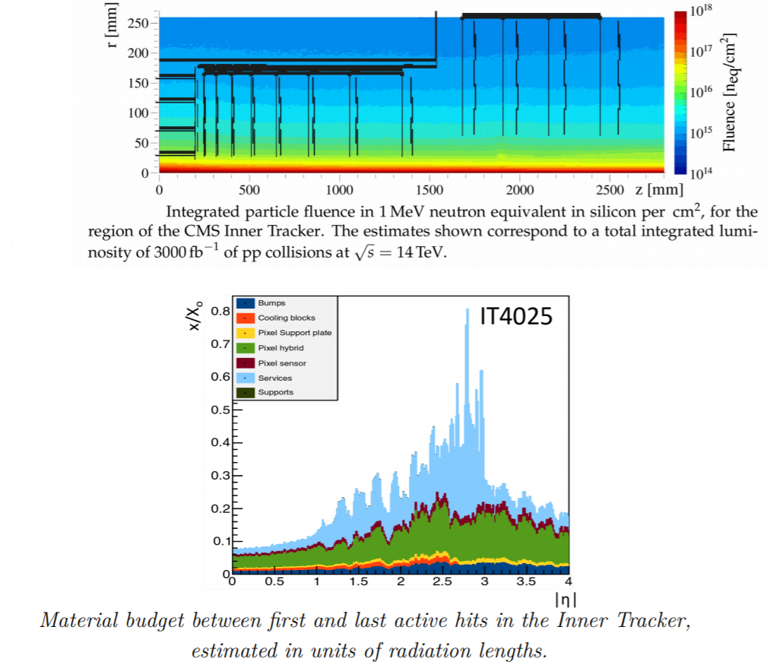
HIGH-SPEED LINKS MAIN CONSTRAINTS
High-data rates
- More current per FE chip so more cooling needed
Very high radiation levels:
- Up to 2.3 x 10¹⁶ n_{eq}/cm²
- Choice of technologies and materials
Material budget considerations:
- Direct impact on tracking performance

Slide 5
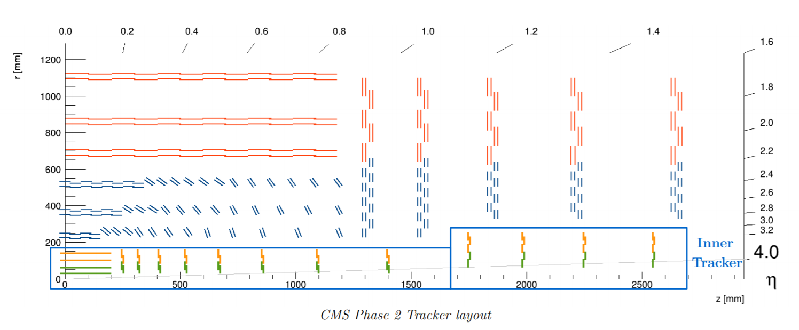
CMS UPGRADE LAYOUT
CMS Phase-II Inner Tracker Upgrade

Slide 6
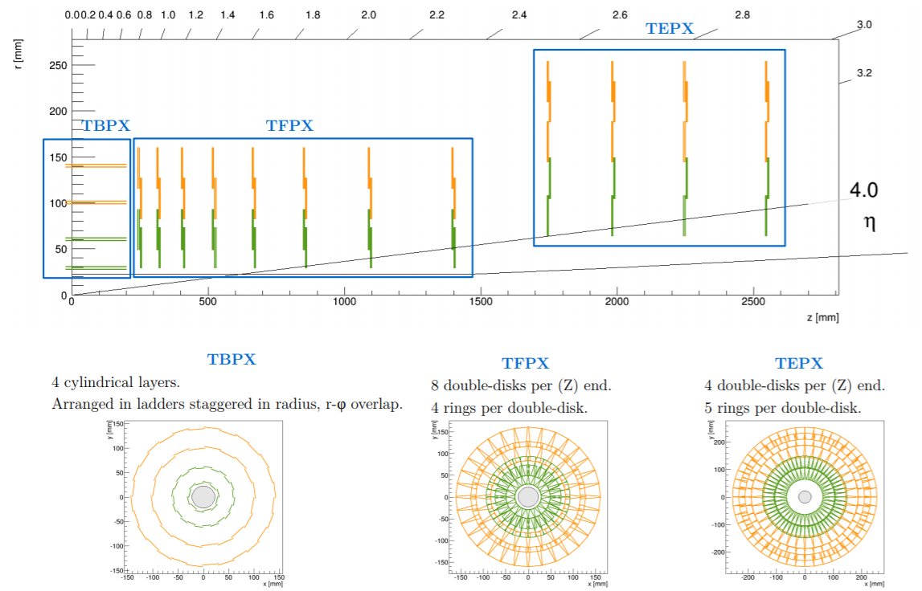
CMS UPGRADE LAYOUT
CMS Phase-II Inner Tracker Upgrade

Slide 7
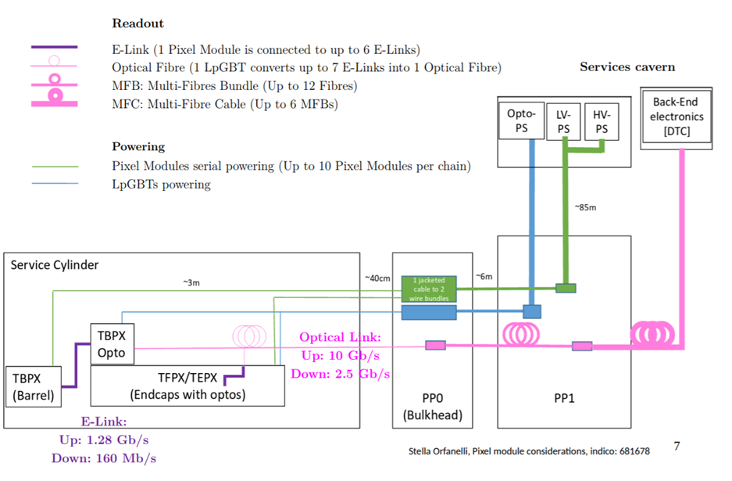
CABLING OVERVIEW
~ 1-1.5m

Slide 8
CMS CABLING OVERVIEW
DATA
DATA (fiber)
  Bi-directional link: uplink at 1.28 Gbps and downlink at 160 Mbps
  The conversion of readout data to optical links at 10.24 Gbps will be done by LpGBT and it is constrained to the fluence stood by this ASIC (approx. 1 x 10¹⁵ n_{eq}/cm² )
  The conversion of the downlink will be done in the LpGBT from 2.56 Gbps to 160 Mbps
  Therefore the LpGBTs will be located in a support at a higher radius around 200 mm
TBX/TPX
OPTOBOX/ LpGBT
CLK/CMD
CLK/CMD (fiber)

Slide 9
CMS CABLING OVERVIEW
  LpGBTs will drive data coming from one module in the inner layers were they are double chips so will have 3 outputs per FE or from two modules in the outer layers as they are single chips, 3 outputs per module
  The E-links will have to take the data for a short distance approx 1.5m at 1.28 Gbps
  - Research on going to decide what type is the e-link going to be: twinax cable, data flex, etc.
  LpGBT output fiber will be grouped in a MFB bundle that will serve 12 modules in PP0 and in PP1 6 of this MFB will be put together in a MFC

Slide 10
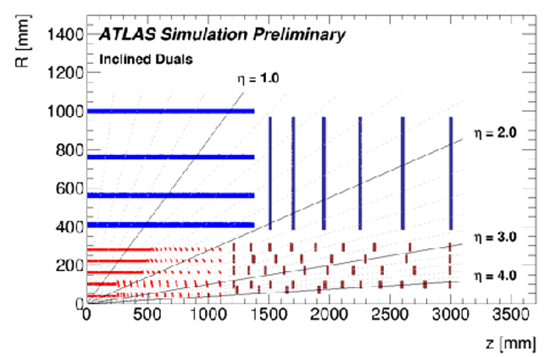
ATLAS UPGRADE LAYOUT
ATLAS Phase-II Tracker Upgrade
Barrel Strips
Forward Strips
Barrel pixel staves
Pixel rings

Slide 11
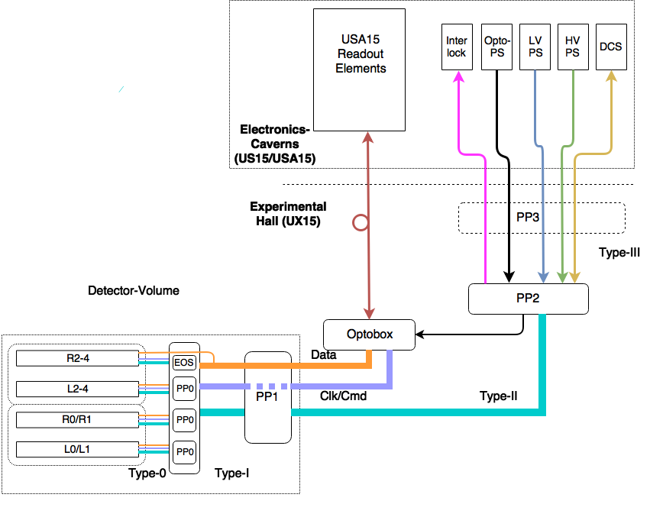
ATLAS CABLING OVERVIEW
ATLAS pixel design requirement was to keep the optobox in a serviceable position, so not inside the inner tracker

Slide 12
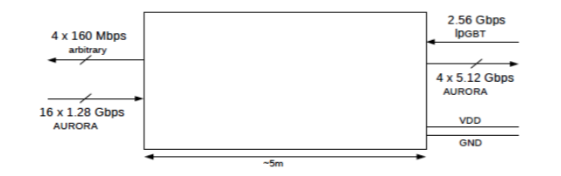
ATLAS DATA TRANSMISSION REQUIREMENTS OVERVIEW
  Connection scheme for the E-Links between PP0 and the Optobox for data transmission
  Bi-directional link: uplink at 5.12 Gbps and downlink at 2.56 Gbps
ACTIVE CABLE
DATA
OPTOBOX
PP0/EoS
Aggregator
Equalizer
CLK/CMD
4 twinaxes at 5.12 Gbps
1 CLK/CMD at 2.56 Gbps

Slide 13
UPLINK ATLAS
  Data/ Uplink cables characteristics (cables can be flexes, twinax , or twisted pair):
  - Low mass, low activation, radiation hard and halogen free
    - Able to transmit differential data at max 5.12 Gbps in Atlas (1.28 Gbps in CMS for approx. 1.5m)
    - Fulfil mechanical constraints to fit in the corresponding envelopes
    - Impedance that matches the rest of the electronics (100 ohms and 70 ohms) investigated so far
    - Should fulfil the 20 dB loss requirement in the full link at 3 GHz (ATLAS)
The optoboxes are at PHI= 0, 90, 180 and 270
Radius spans like this 1500 < R < 2300 mm
Data cable length is 5000mm maximum

Slide 14
DOWNLINK ATLAS
  Several modules will be combined in the optical path and split up in the detector area
  The splitting will happen in the aggregator using LpGBTx chips
  The data input link of the Front-End chip needs to be compatible with the LpGBTx e-link in terms of electrical format and data rate
  • Downlink un-broken, following up-link
  • Low mass, radiation hard and halogen free
  • Should fulfil the 20 dB loss in the whole link
  - Able to transmit differential data at 2.56 Gbps for several meters
  - Single differential pair connection to the module
  - The downlink data is sent to the Front-End chip on the TTC-link
  - The bandwidth for this link will be 160 Mb/s
  - Impedance that matches the rest of the electronics

Slide 15
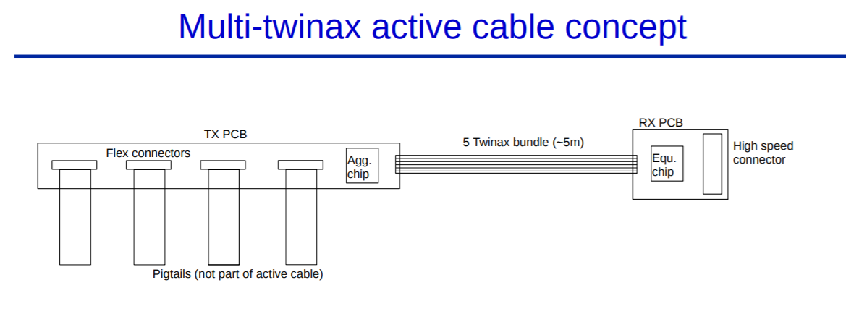
DATA TRANSMISSION REQUIREMENTS OVERVIEW
- 1 Down link at 2.56 Gbps, this downlink is shared over several modules
- 4 Up links at 5.12 Gbps each
- Multiple versions of TX PCB to support different parts of detector
- Power to chip? Probably need an extra small diameter cable. Power will run via the optobox
- The TX and RX PCBs will be custom designs and they might serve as PP0
- The equalizer might be located in the optoboard or the carrier board holding the VTRx modules

Slide 16
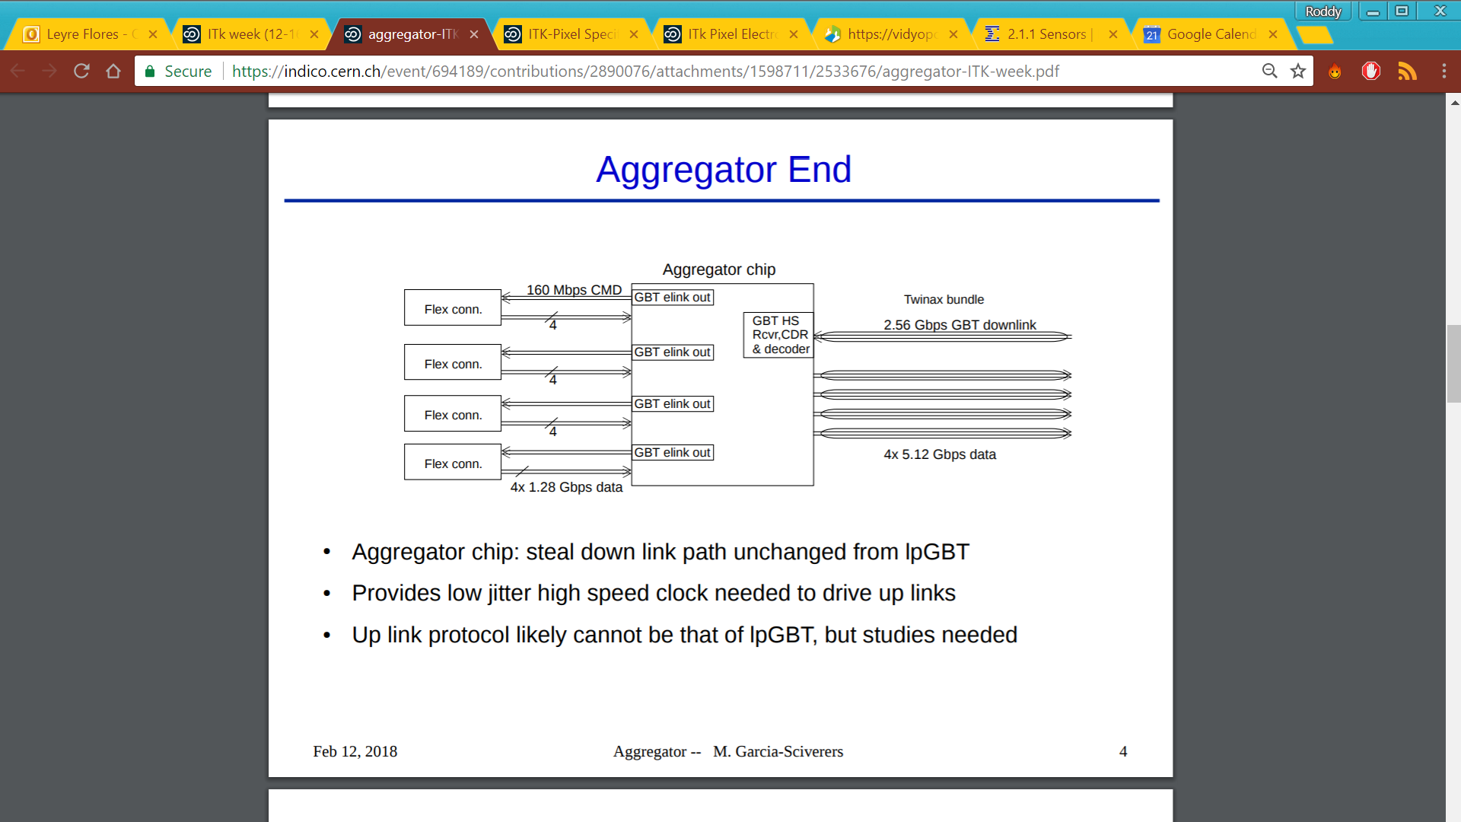
DATA TRANSMISSION REQUIREMENTS OVERVIEW
Aggregator chip: steal down link path unchanged from LpGBT
Provides low jitter high speed clock needed to drive up links
Up link protocol likely cannot be that of LpGBT, but studies needed

Slide 17
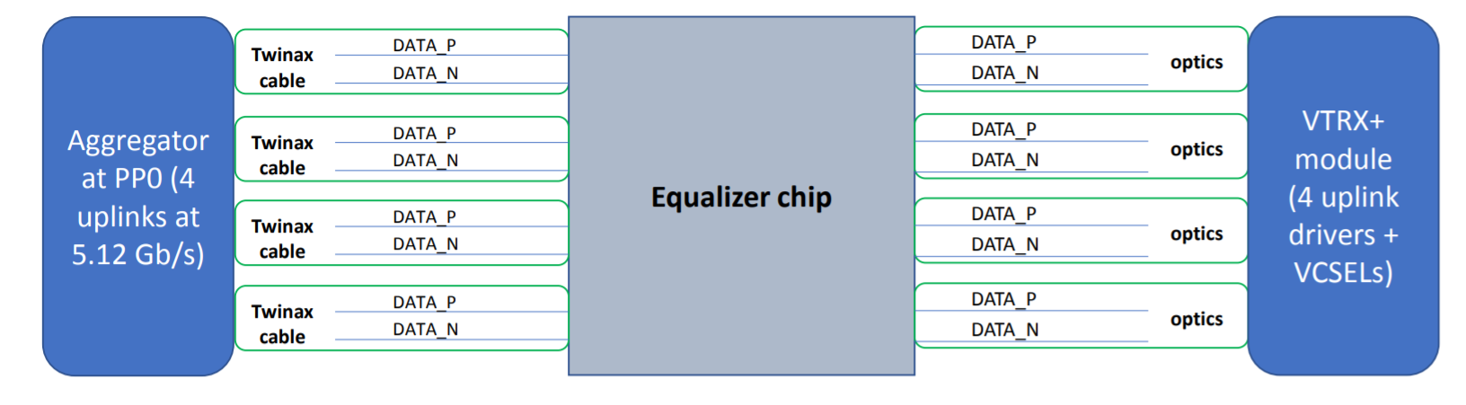
DATA TRANSMISSION REQUIREMENTS OVERVIEW
The equalizer chip will be located at the optobox side
There will be one ASIC per active cable
First prototype end of 2018
Cable recevier ASIC receives 5.12 Gb/s signal
CTLE and CDR (for lower jitter) stages included
Drives signal (at 5.12 Gb/s) to the VTRx+ module inside the optobox.

Slide 18
DATA TRANSMISSION REQUIREMENTS OVERVIEW
  Why are an aggregator ASIC and an equalizer ASIC needed?
  - Due to the high levels of radiation, 500 MRad, designing a serializer and a CDR with very little jitter working at 5.12 Gbps becomes really challenging. Furthermore traces in PCBs at this speed introduce very high losses in the data link and it is proven that cables perform much better
  - Therefore in order to avoid further complications in the pixel chip, this will have a max data output of 1.28 Gbps and several of this lines will be multiplexed in the aggregator chip to achieve the 5.12 Gbps. Besides we will avoid in the modules traces at this speed.
  - As the distance of the data lines to travel is long, 5m, there is a huge degradation of the information and equalization is required in order to achieve a clean eye diagram and low BER.

Slide 19
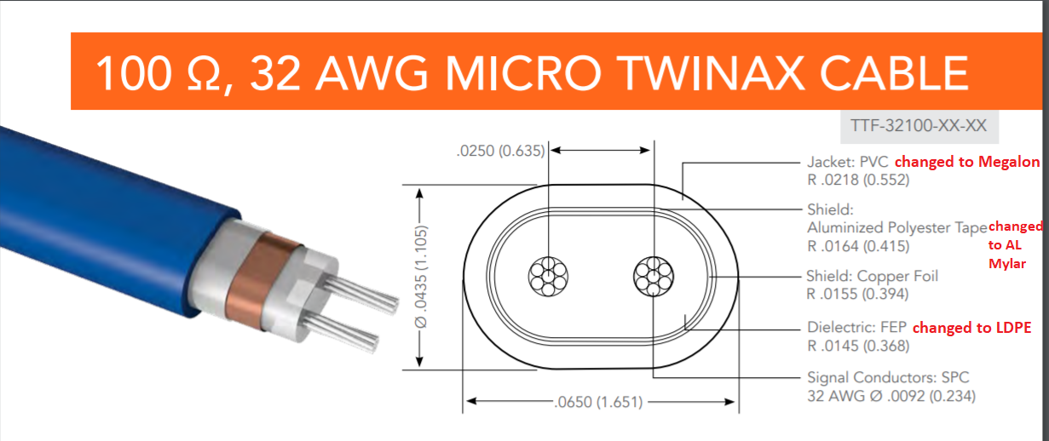
INDUSTRIAL ACTIVE CABLE DESIGN
Ongoing discussions with industry to determine the materials we would like to have (rad length) and if the processes to manufacture it in industry are compatible
Their cable design should perform better than the present Twinax design that has already been tested and was produced by the company Tempflex, now owned by Molex (Thanks to M.Kocian)

Slide 20
FLEX CIRCUIT DESIGN
80µm
100µm
80µm
200µm
500µm
500µm
Solder mask 20µm
Cu 9+25=34µm
NTC1&2 120µm
HV 250µm
K 75µm
Cu 9µm 35% occupancy
DATA FLEX
K+glue 40µm
Cu 9µm 35% occupancy
Reference plane (gnd)
K 75µm
Cu 9+25=34µm
Reference plane (gnd)
Solder mask 20µm
Differential pair element
4 layers stack up: layers 1 and 4 are ground planes that provided reference to layers 2 and 3 that are the signal layers
The lines are differential striplines embedded between the two reference planes (1 and 4). This technique allows to control more efficiently the impedance and adds a shielding for EMI
As a flex (as generally PCBs) is produced with an even number of layers, we took an advantage to embed two layers of signal between the two reference planes

Slide 21
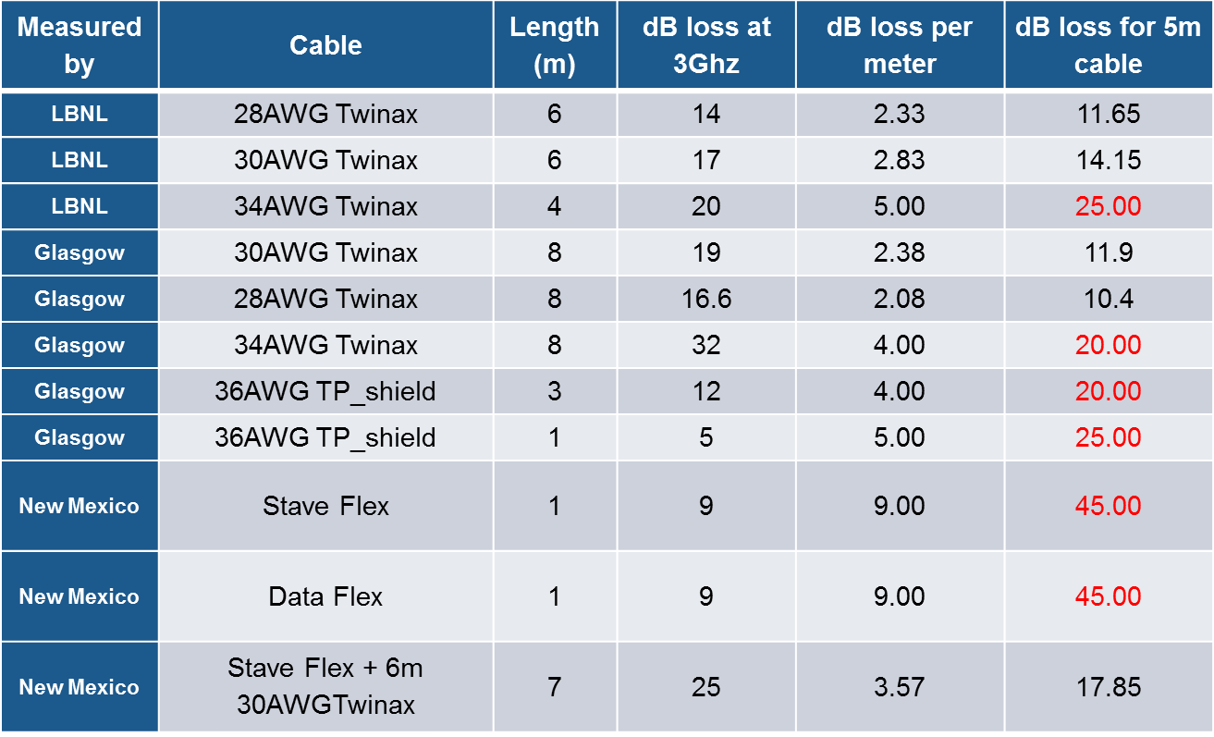
CABLE MEASUREMENTS RESULTS
Recapitulation table of the measurements

Slide 22
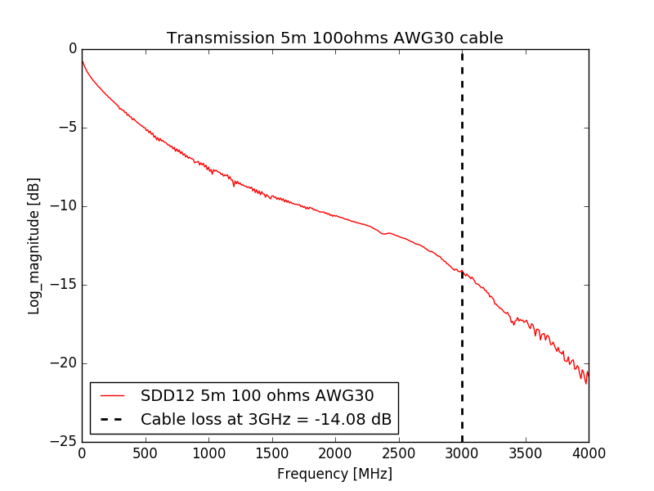
E-LINK TESTING

Slide 23
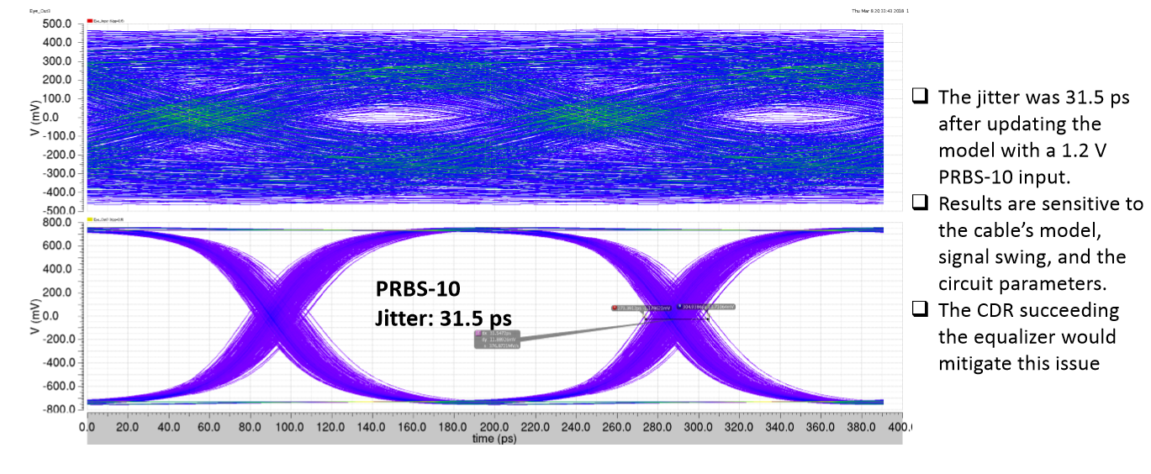
E-LINK TESTING
Equalizer behaviour simulation modelling a cable with the s-parameter of the previous slide
Voltage input 1.2 V and signal type PRBS10
Voltage swing and jitter levels at the output still to be verified with versatile link plus although less than 50 ps is a good sign

Slide 24
E-LINK TESTING
  First results of flex testing with RD53A
DP-SMA adapters are needed to drive RD53A from FPGA (CMD signal) and at the same time send RD53A output via Flex/SMA to oscilloscope
Preliminary Results
RD53A
FPGA
CMD
160Mbps
Signal quality measurement using Tektronix DPOJET package
Used RD53A chip was FIB edited in order to fix a design bug, which degraded jitter performance. Signal quality of RD53B should be similar (or better) than with this correction
DP-SMA
adapter
Flex
or
SMA
DATA
1.28Gbps
Oscilloscope
Tektronix MSO70804

Slide 25
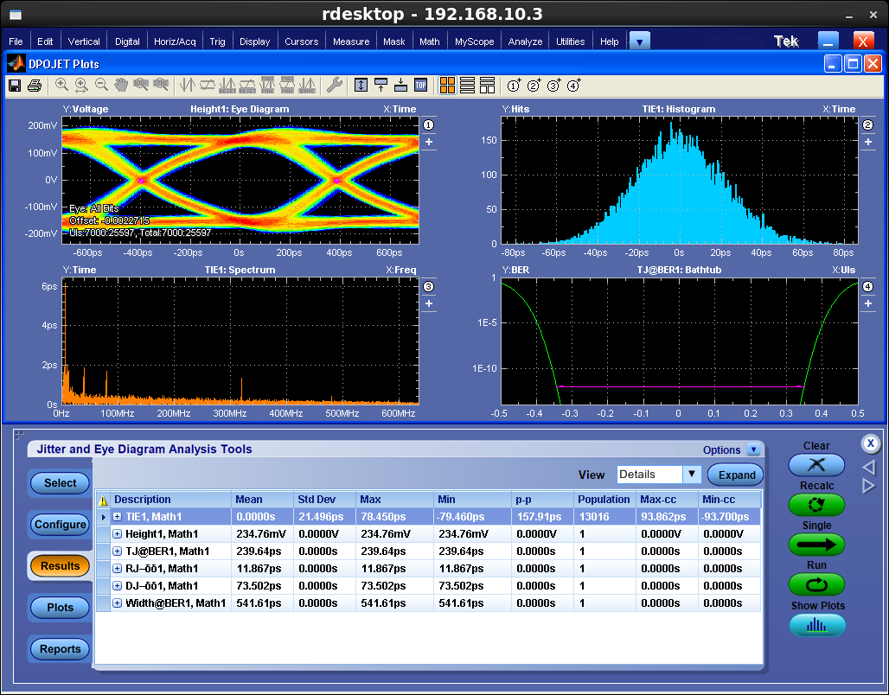
E-LINK TESTING
RD53A running on default settings, except CML output driver and pre-emphasis settings (still not fully optimized)
CMD (160Mbps RD53A input) send through SMA cable
Very preliminary results as this measurement was done a couple of days ago in the lab and more parameters need to be considered, that is why the eye diagram characteristics are not commented
Transmission over a prototype flex with the layout described in slide 20
Further studies completely necessary but promising results
Preliminary Results

Slide 26
SUMMARY
  Data transmission with the Upgrades has become a very challenging task and requires a lot of effort from the community to make it possible
  Data cables have become an important percentage of the total material budget so they need to be designed with care
  Milestones: link designs (flexes and cables), ASIC designs (FE chip, aggregator, equalizer, LpGBT), optobox and careful module layout of the data lines
  Testing should guarantee that the degradation of the data is in within the limits that make it recoverable (jitter tolerance, voltage swing, etc.) and testing equipment will be qualified against industrial reports.
  - ATLAS requirement of 20 dB loss over the full transmission chain must as well be fullfilled

