Slide 1
Common Powering Requirements for CMS and Atlas Tracker Upgrades and First Proposals

Slide 2
Outline
Introduction to the CMS OT requirements
Introduction to the Atlas OT requirements
Preliminary specification and common requirements
First feedback and proposal from the manufacturers
Next steps
Conclusion

Slide 3
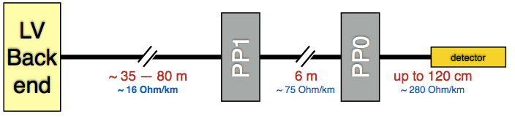
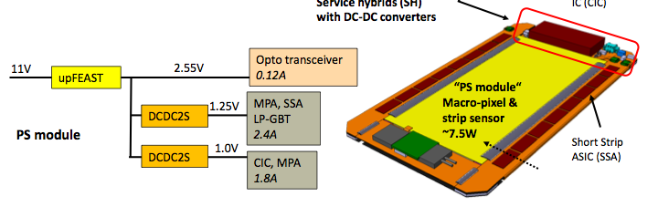
Introduction to the CMS Outer Tracker powering requirements
The CMS OT powering
13296 modules (types: “PS” and “2S”) - individually powered
Common ground on detector side → RTN line floating at PS end
  specific isolation requirements (DC and in frequency) b/w HV, LV RTN lines and local ground/earth
No Vdrop compensation:
  order of 12V at PS connector,
  12-6 V at detector end.
“Wired” safety:
  HV OFF when LV OFF in the
  same module
(no ∆V compensation)
12 - 6 V
HV, LV RTN floating at PS end
~ 7.8 W “PS” modules
~ 5.4 W “2S” modules
HV: 0 ÷ -800 V, 3mA
LV: 5-14 V, 1.5 A,18 W
12 - 6 V
eff ~ 78%
(slide: courtesy of Simone Paoletti, CMS)
eff ~ 85%

Slide 4
Introduction to the CMS Outer Tracker powering requirements
Power grouping
Total of 1224 power cables connecting the OT to power backend
12 HV lines per cable
12 (or 14) LV pairs per cable (serving
detector structures with up to 12
modules)
LV provided by one regulator and
distributed up to 14 LV channels
HV provided by 12 regulators
(slide: courtesy of Simone Paoletti, CMS)

Slide 5
Introduction to the CMS Outer Tracker powering requirements
Implementation options
LV backend system located on balconies in UXC
LV cables length < ~50m
in order to limit Vdrop
B ~ 25 mT and 1-10 Gy
in 10y HL-LHC
LV and HV systems on same racks in UXC:
easier implementation of LV/HV interoperation
sharing interface to interlocks and DCS
48V can be either inside or outside UXC
HV and 48V system in USC
non-hostile area
can look to commonality with other sub-detectors
LV main regulator, LV channels (PSPP), HV channels implemented as separate pieces
(slide: courtesy of Simone Paoletti, CMS)

Slide 6
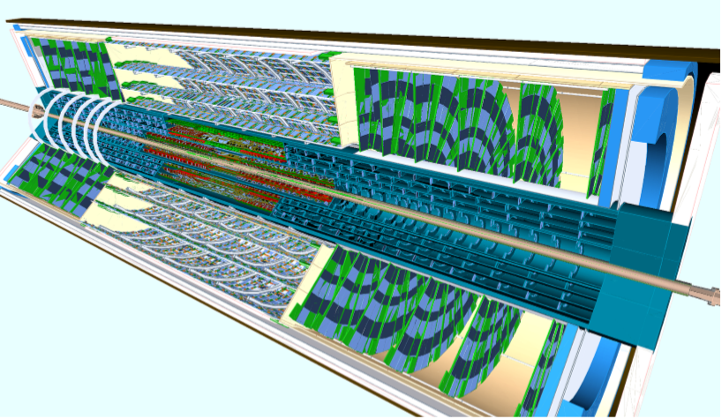
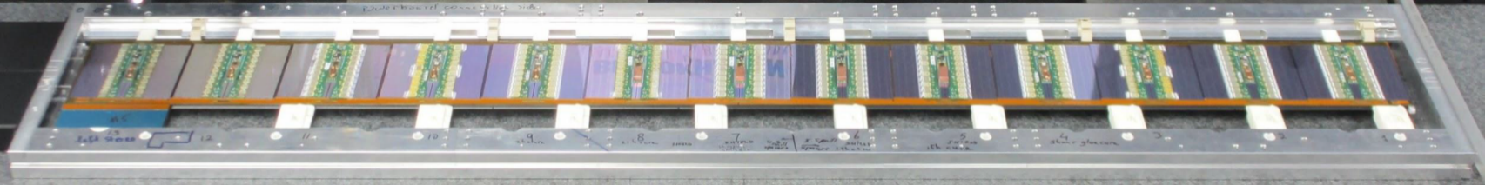
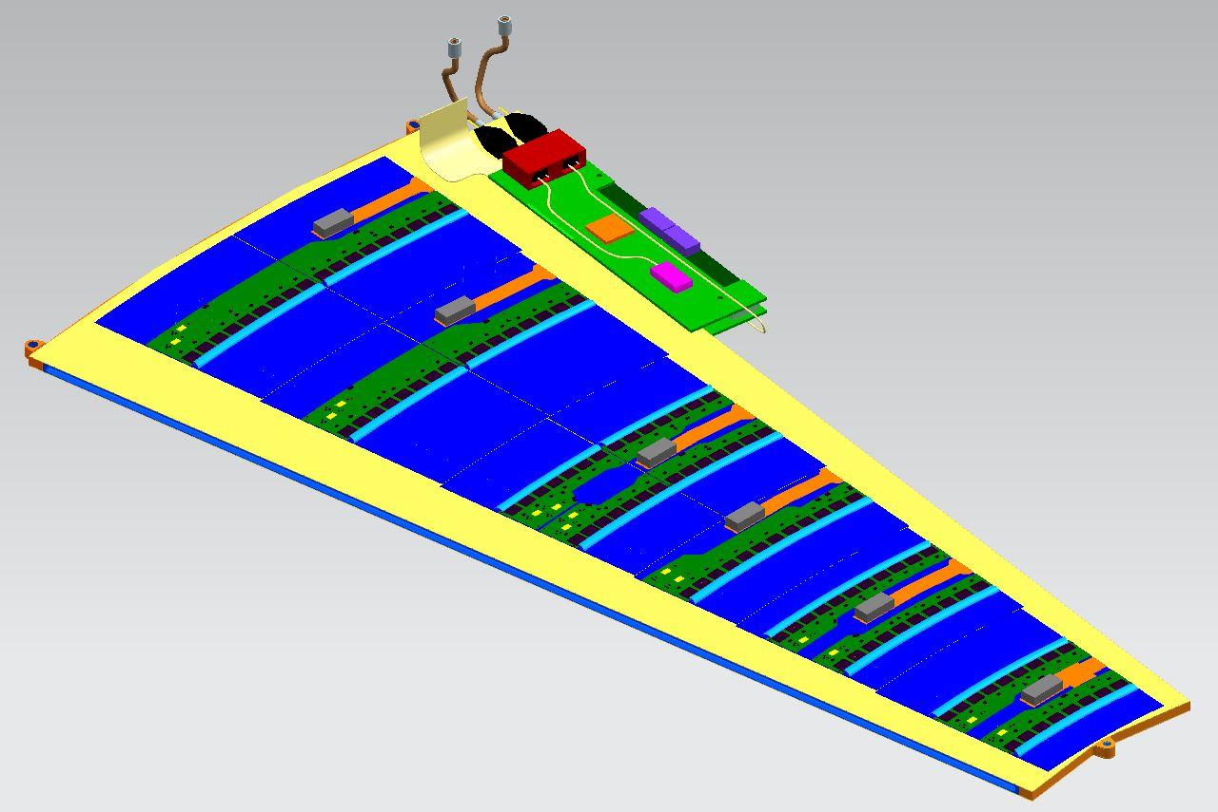
Introduction to the Atlas Outer Tracker powering requirements
Strips Barrel
Strips Endcap
Local on-stave(petal) power distribution
The basic ITk strip detector unit is a module
High number of modules, excludes individual powering
  ITk Strips will have 17888 modules
  Need to group modules
Modules grouped in local structures
  Staves for the barrel. 14 modules per side.
  Petals for the endcap. 9 modules per side.
LV and HV have parallel scheme
  One LV line serves one stave /petal side
  LV DCDC scheme to reduce currents and power losses on cables
  Sensor bias multiplexing : HV parallel power on stave/petal => May lose all sensors if one fails as a short. Investigating rad-hard HV switches to be able to disconnect any failed sensors
  Qualification of HV switches not completed yet => 4 HV lines per side. One HV line for up to 4 modules.
Pixels
ATLAS ITk-Strips Powering System Overview
~60cm
(slide: courtesy of Ewa Stanecka, Atlas)

Slide 7
7
Introduction to the Atlas Outer Tracker powering requirements
Power Requirements
For one stave/petal side:
 | Number of modules | Number of ABC chips | Estimated maximum current
Inner Barrel LV | 14 | 20 | 11A
Inner Barrel HV | 14 |  | 28mA*
Outer Barrel LV | 14 | 10 | 5.5A
Outer Barrel HV | 14 |  | 9.3mA*
Endcap LV | 9 | 8-12 | 5A
Endcap HV | 9 |  | 10mA*
* HV current divided in 4 groups
Maximum current determined for the worst case scenario conditions, namely at the radiation induced current peak of the readout ASICs , and at the end-of-life bias leakage current for the sensors.
Note: These estimates are subject to changes as ASICs and modules will be prototyped and characterized.
(slide: courtesy of Ewa Stanecka, Atlas)

Slide 8
Introduction to the Atlas Outer Tracker powering requirements
ITk Strips powering baseline
In the interests of minimizing the cost, the existing ATLAS Inner Detector (ID) cable plant will be reused as much as possible.
The current baseline for powering ITk-Strips detector employs:
  LV DCDC scheme:
    48V supplies located in the two service caverns, where radiation and magnetic field levels are negligible.
    In PP2 areas custom developed step-down DC/DC converters are foreseen to deliver 11V as measured and monitored at the load.
    The load will be another DC/DC converter at the detector with an operating input voltage of 11V and an absolute maximum of 14 V.
  HV power supplies will be located in the two service caverns.
  The power supplies and the power distribution chain are floating with a fixed reference potential established at the detector.
  The power supplies should be compatible with external detector interlock system
(slide: courtesy of Ewa Stanecka, Atlas)

Slide 9
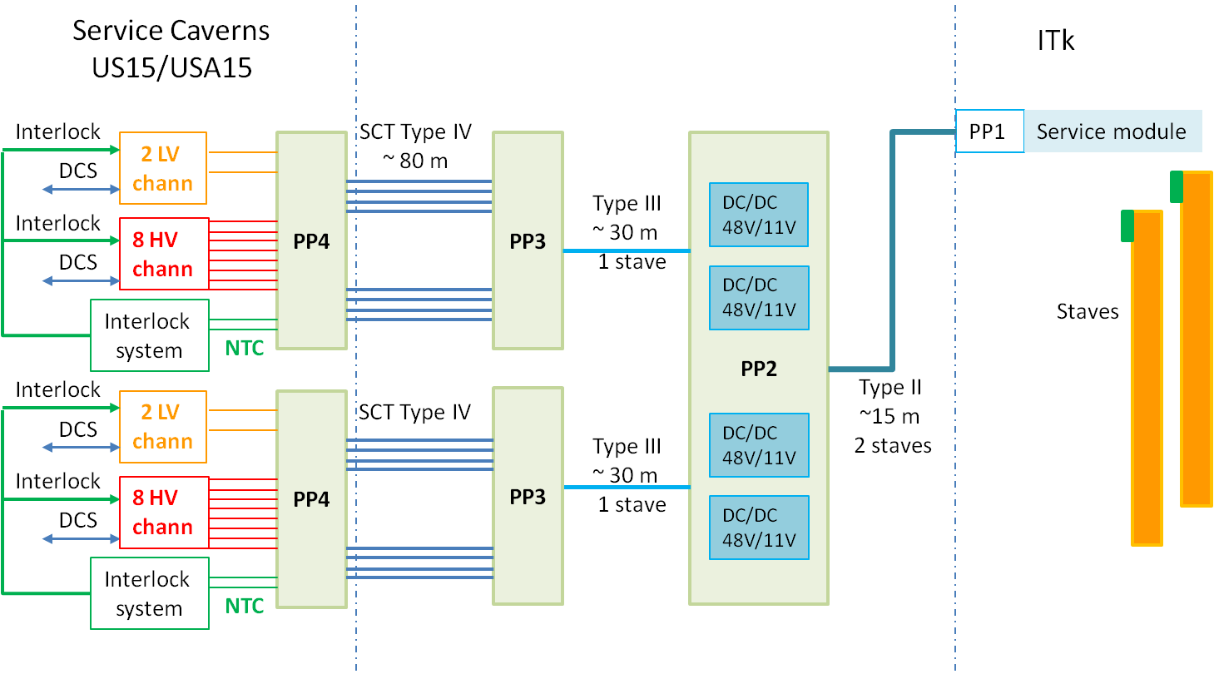
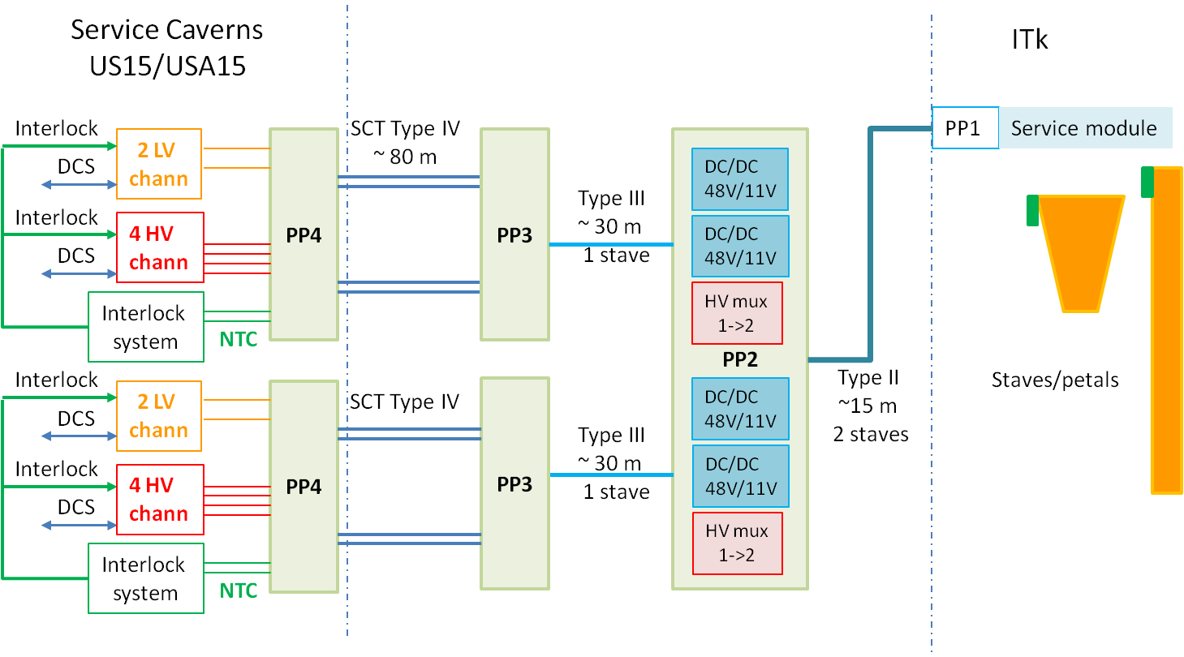
Introduction to the Atlas Outer Tracker powering requirements
Powering scheme
1552 48 V PS channels :
272 chan. for Inner Barrel staves, will require 4A output current of the remaining
1280 chan. serving Outer Barrel staves and petals, require 2A
Inner Barrel staves
3648 HV channels will be required
(max. 750 V, 6 mA).
Assuming HV 1-to-2 multiplexing
at PP2 for outer barrel staves and
petals.
Outer Barrel staves and petals
(slide: courtesy of Ewa Stanecka, Atlas)

Slide 10
Preliminary common specification
Common specification drafted in close collaboration with the CMS and Atlas tk teams
3 power supply manufacturer’s contacted so far
Goals:
  Get power supplies’ experts feedback on the specs
  Asses feasibility, commonalities, challenges
  Quantify required development/customisation efforts
  Improve/mature the tech. specs
  Identify and decide where/what to investigate/develop

Slide 11
Common requirements
Commonalities
AC-DC rectifier systems
  Mains input
  Ouput voltage: 48V (optionally higher)
  Output curr.: 2-6 A (Atlas) and 20-100 A (CMS)
  Max ripple: 500 mVpp
  Efficiency: >90%
  Line and load reg.: 1%
HV PS
  AC or DC input
  Output: 0 to -800 V, 6mA
  Max ripple: 30 mVpp
  VI monit. resolution: 12 bits
Similar monitoring and control features
Similar interlock and inhibit requirements
Slow control (OPC UA based)
All 19’’ rackable solutions
CMS specific constraints
Powering of individual detector modules
Individual wired HV enable according to LV status
Atlas specific constraints
Re-use of existing cabling
DC-DC conversion to < 12V will be Atlas home grown
Individually floating HV channels. Floating range to be defined.

Slide 12
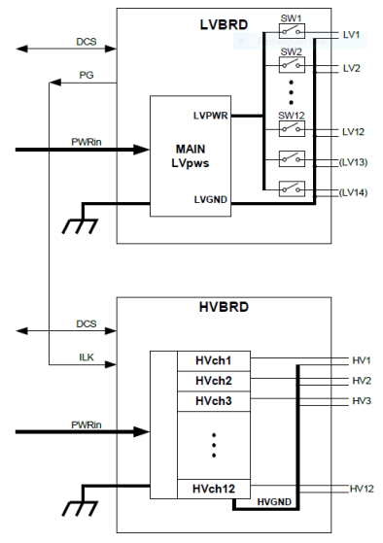
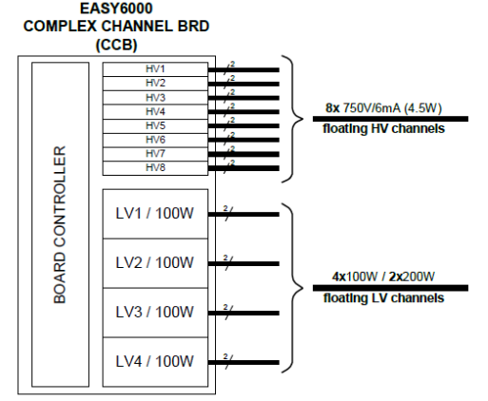
Manufacturer’s proposal (Caen)
10-12 V
COTS equipment
Bulk AC-DC rectifier 48Vdc 4kW
Harsh or std environment possible (COTS)
Note: high voltage (e.g. 380V) could be envisaged
Modular pwr crate (std environment)
Central control unit (std environment)
Potentially HV modules (depending on location and floating range)
Required development efforts
HV modules with higher current
LV modules different between both tk, dev. needed (harsh env. possible)
48 V
CMS simplified scheme
48 V
800V
Atlas simplified scheme
48 V
48 V

Slide 13
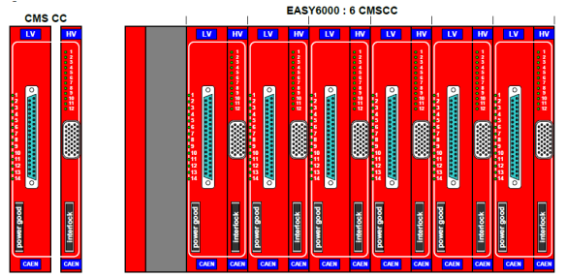
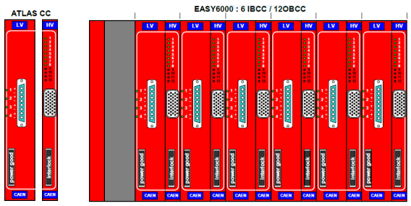
Manufacturer’s proposal (Caen)
Proposal
CMS
1 HV/LV complex board powers 12 det. modules
1224 complex boards
204 crates
34 branch controllers
2 SY4527 (better 4 for redundancy)
204 2.5KW-ACDC-PWS (2U COTS)
34 racks in expt cavern + 10 racks in service cavern (bulk AC-DC)
Atlas
Modular crate case (partly in expt cavern):
456 complex boards
77 crates (assuming 6x6 U like the current EASY3000)
13 branch controllers
77 4KW-ACDC-PWS (2U COTS)
1 SY4527 crate
13 racks in expt cavern + 4 racks in service carvern (bulk AC-DC)
All in service cavern case:
456 LV boards
456 HV boards
77 SY4527(1ctrl+1service+3booster)
16 racks in service cavern
Artistic view of a possible CMS tracker pwr crate
Artistic view of a possible Atlas tracker pwr crate

Slide 14
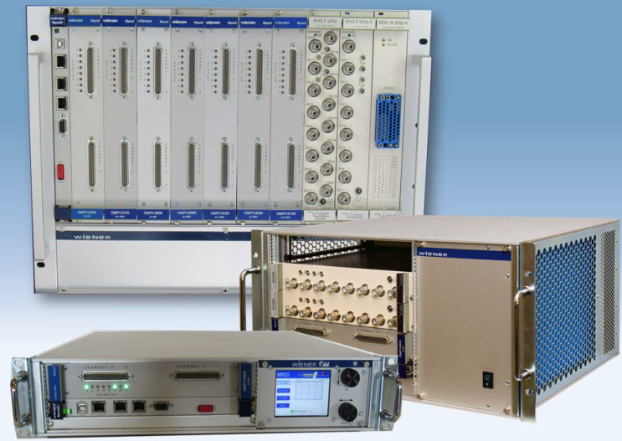
Manufacturer’s proposal (Wiener/Iseg)
COTS equipment
Modular “MPOD” HV+LV powering system (std environment)
LV modules: 2ch 48V 4A or 4ch 48V 2A (std environment)
LV modules: 8, 4 or 2ch 0..16V 5A (std environment)
HV modules:
  16, 24, 48ch 1kV common float gnd
  8 or 16ch 1kV individual float gnd
Central control module (std environment)
Required development efforts
Rad/Mag tolerant DC-DC modules (380V to 4..14V 20A)
LV distributor module with 12 to 16 output channels (for CMS)
Possibly higher power density LV modules (+ higher power chassis)

Slide 15
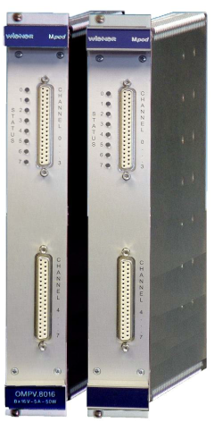
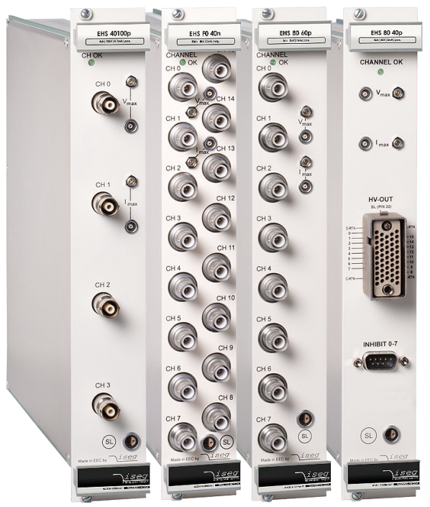
Manufacturer’s proposal (Wiener/Iseg)
Proposal
CMS
(Assuming the use of high pwr density modules)
1 LV distribution module + 1 HV mod. powering 2x12 det. modules
625 HV + 625 LV modules (24 ch. each)
125 MPOD crates
125 control modules
11 racks in experimental cavern (LV) + 11 racks (+ bulk AC-DC needs) in service cavern if LV sits in UXC
(Alternatively 22 racks in service cavern)
(Note: Assuming 24ch. HV module is available)
Atlas
(Assuming the use of high pwr density modules)
Inner barrel (1LV for 4 HV channels)
68 HV (16ch.) + 68 LV (4ch.) modules
14 MPOD crates
14 control modules
Outer barrel (1LV for 2 HV channels)
160 HV (16ch.) + 160 LV (8ch.) modules
32 MPOD crates
32 control modules
3+6 racks respectively in the service cavern

Slide 16

Next steps
Towards commonalities
Upcoming discussions (vendors, team)
Draft specs
Vendor feedback
Next team meeting
Y
<10V
CMS remote HV?
Atlas floating range?
No commonality
X
HV power
LV power
AC-DC rectifier
Infrastructure and SW
N
>10V
No commonality
X
X
Common, mature and detailed technical specification
No commonality
48
48 or 380 Vdc?
3xx
Mainframes, crates, DCS, etc.
Q4-17 Q1-18
Q1-18
Q2-18
Q3-18

Slide 17
Conclusion
Common specification is possible for some of the powering building blocks
  AC-DC bulk rectifier, HV power supplies, Control modules and interfaces, interlocking and inhibit features
Power supply manufacturer’s contacted express interest in participating to the effort
Benefits of common powering solutions:
  Shared development efforts and related NRE costs
  All take advantage of other’s experiences from the specification phase through out the final product qualification
  Higher volumes - Production cost reduced
  Less specific equipment in operation - Easier maintenance, common pool of spares
  Powering becoming a common effort - Less work on a subject which quite often lacks volunteers

Slide 18
Questions / Comments

