Slide 1
Counting rooms constraints and cooling studies
Claudio Bortolin EP-ADO-PO
ACES 2018, April 26, 2018

Slide 2
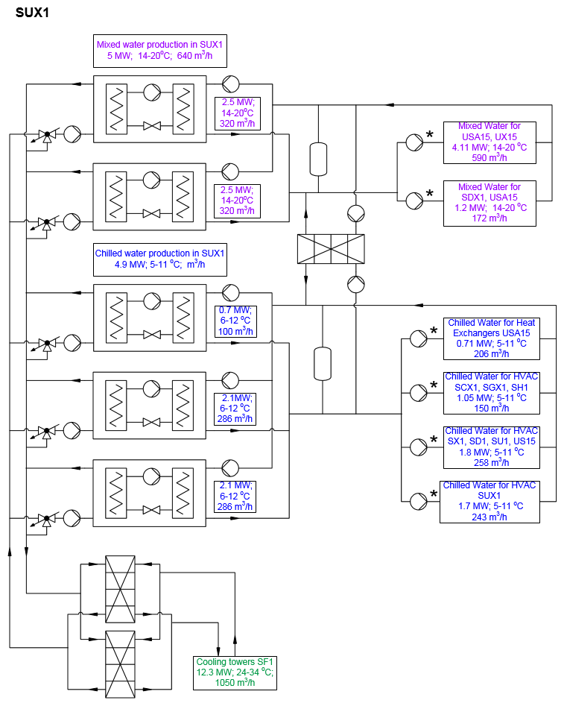
1,46 MW
350 m3/h
12,2 – 15,8 °C
Mixed water flow is at nominal conditions
Redundancy
Detector cooling
Racks USA15
1100 kW
330 m3/h
12,5 – 15,5 °C
1,4 → 2,5 MW
537 m3/h
30 – 34 °C
Racks SDX1
350 kW
100 m3/h
12,5 – 15,5 °C
Detector cooling
HVAC in USA15, SR
673 kW
5 – 11°C
95 m3/h
2,5 MW
386 m3/h
5 – 10,6 °C
100 m3/h
HVAC surface
28 kW
5 – 5,7 °C
35 m3/h
HVAC surface
(ex SU1)
430 kW
4,6 – 6,6 °C
185 m3/h
2,5 MW → 2,7 MW
440 m3/h
26 – 31,3 °C
HVAC for
ATLAS caverns
1,4 MW
5 – 11 °C
200 m3/h
Redundancy
Cooling capacity available… in ΔT only
To be verified what is the contribution of the actual racks heat losses on the HVAC
5,7 MW
24 – 29 °C
980 m3/h
Situation in 2016

Slide 3
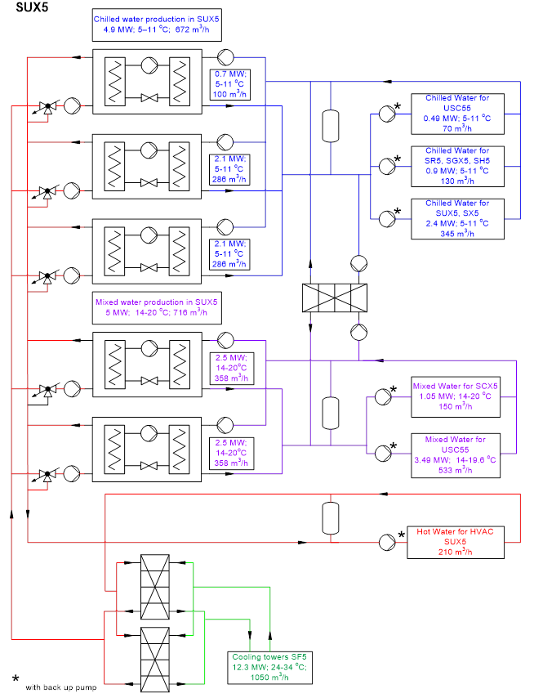

Cooling capacity available… in ΔT
Design values:
Muons 60 kW
ΔT =4K
12.5 m³/h
Yoke 60 kW
ΔT =2K
25 m³/h
BusBar 140kW
ΔT =9.5K
13 m³/h
Mixed water flow is at nominal conditions
Ecal 420kW
ΔT =1.6K
226m³/h
Real value
Racks 2620kW
ΔT =6K
376m³/h
Racks 544kW
ΔT =1.2K
390m³/h
Situation in 2016

Slide 4

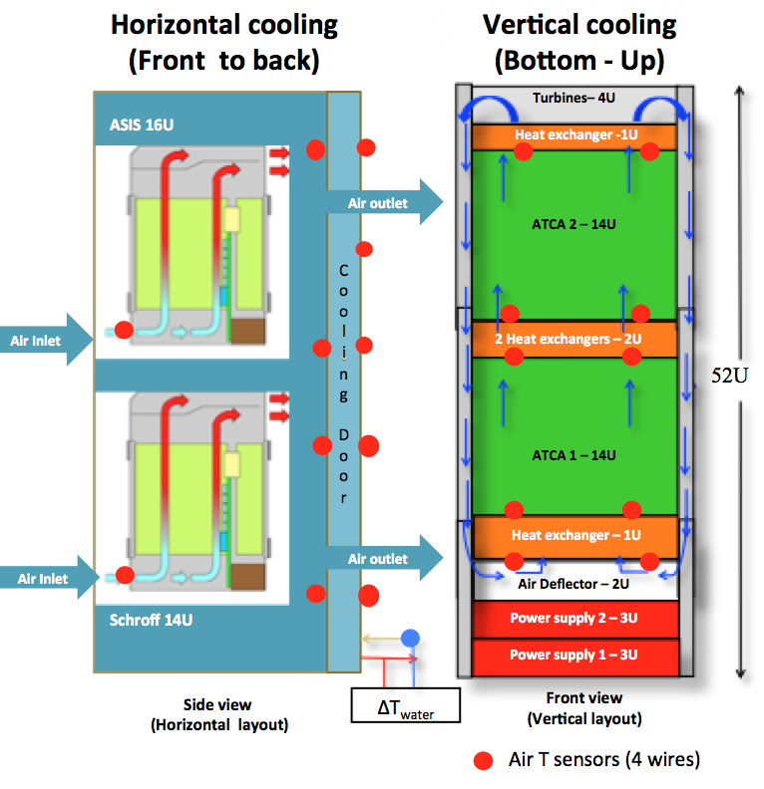
Racks cooling evaluation: Why?
We needed to study the impact of the ATCA integration in the USA15 counting rooms
To assess the efficiency of the existing cooling infrastructures: cooling power available only in ΔT. Impact of the heat losses on the HVAC.
To compare different configurations (horizontal and vertical airflow) identifying any boundary condition
To evaluate the impact on the safety of the environment (i.e.: noise)

Slide 5
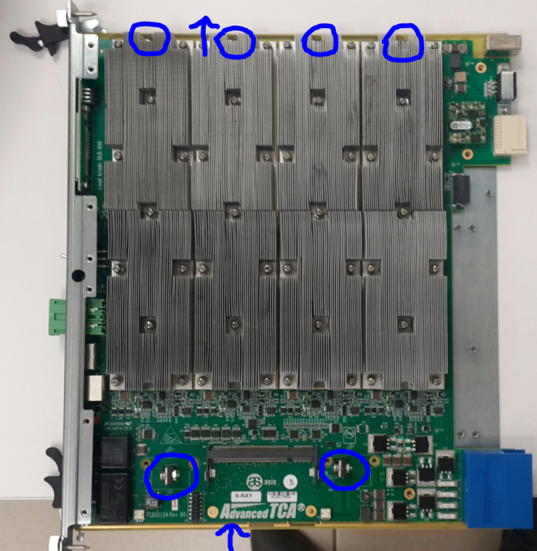
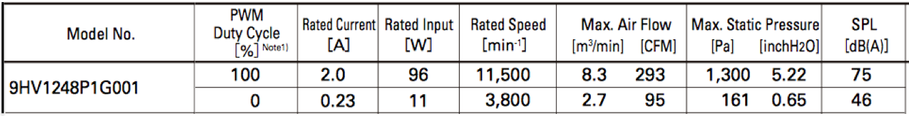
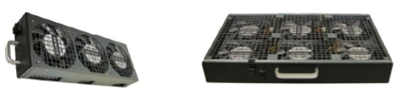
Test campaign 2016/17: Inside the shelves
ASIS load blades: maximum power 600W
Comtel load blades: maximum power 350W
Zone 1
Zone 2
Zone 3
Zone 4
Front
Rear
Rear
Front
Inlet 1
Inlet 2
14 x Comtel blades: 6* Embedded Temperature sensors (green) + 6 air T sensors (blue)
14 x ASIS blades: 6 Temperature sensors (inlet and outlet)
3x
1x
3 x 3 fans on the top, 1 x 6 fans on the bottom. 96 W x fan (nominal). Power measured was 140W/fan.

Slide 6
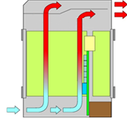
(ATCA2 14x450W, ATCA1 14x350W, water flow 3m³/h)
Horizontal cooling: equipment and sensors layout
ASIS 16U with ASIS LB
C
o
o
l
I
n
g
D
o
o
r
Q= mC_{p} (T_{out}- T_{in}) = 0.83 × 4.18 ×3.1=
= 10.8 kW (78% of the total power)
Total power 13.9kW
23.8°C
34.4°C
23.2°C
Air Outlet
Air Inlet
32.7°C
22.1°C
21.9°C
3 kW released to the environment in forced convection-> HVAC in USA15 already at the maximum.
21.7°C
31.7°C
Air Outlet
Air Inlet
31.7°C
20.8°C
21.5°C
Schroff 14U with Comtel LB
Water inlet temperature 14.6°C ±0.3°C
∆T=3.1°C

Slide 7
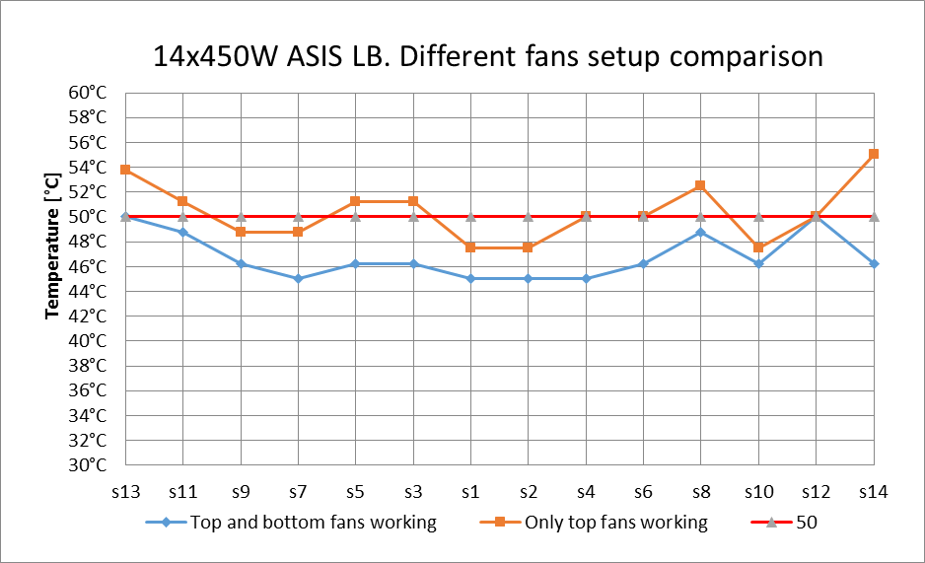
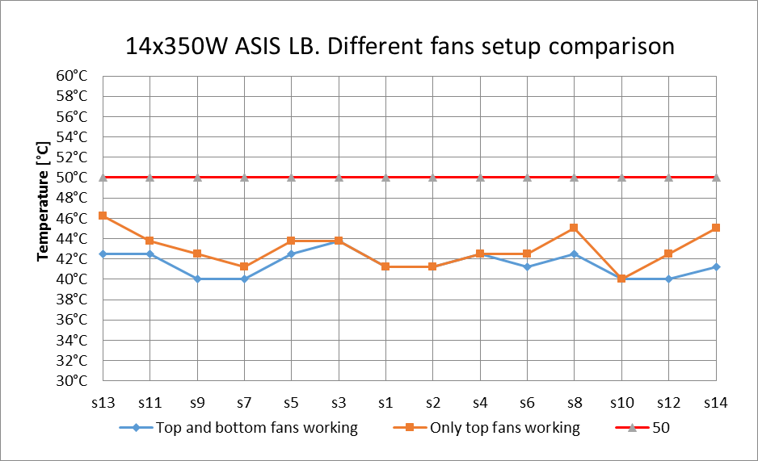
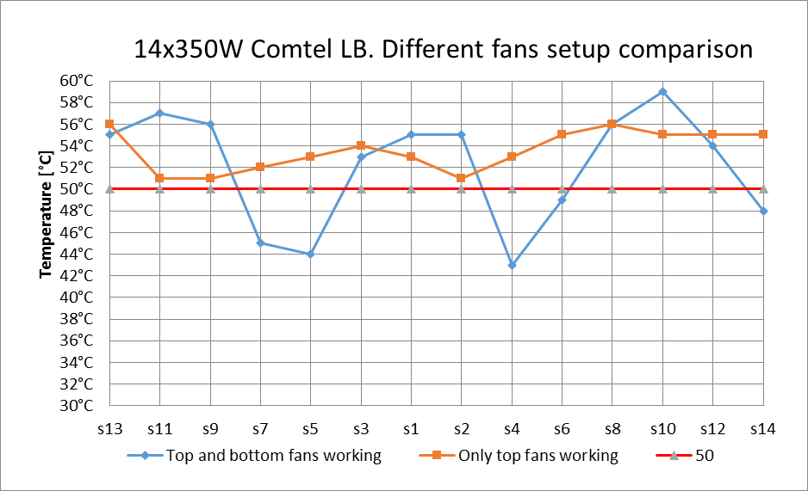
Comparison between tests with and without bottom fans
Water inlet temperature 14.6°C ±0.3°C
WBF – without bottom fans
BF – with bottom fans
Average max T
WBF [°C] | BF[°C]
42.9 | 41.5
Average max T
WBF [°C] | BF [°C]
50.4 | 46.8
Average max T
WBF [°C] | BF [°C]
53.6 | 52.1
ASIS Crate 14x450W
ASIS Crate 14x350W
Schroff Crate 14x350W
Av. ∆T = WBF-BF = 3.6K
Av. ∆T = WBF-BF = 1.4K
Av. ∆T = WBF-BF = 1.5K
ASIS crate performance with bottom fans working is better than with only top fans (the average maximum temperature of the blades is 3.6K lower, while power dissipation is 450W per blade);
Schroff crate performance is poor in both cases although with only top fans working the airflow is much more homogeneous.

Slide 8
Repositioning of the crates (air outlet temperatures)
Water inlet temperature 14.6°C ±0.3°C
Water flow 3m³/h |  | Water flow 2.4m³/h |  | Water flow 1.8m³/h (same as ATLAS CR)
ASIS top | ASIS bot | ASIS top | ASIS bot | ASIS top | ASIS bot
23.8°C | 22.4°C | 24.4°C | 23.4°C | 25.1°C | 24°C
23.2°C | 23.8°C | 23.9°C | 24.8°C | 24.5°C | 25.4°C
21.9°C | 21°C | 22.6°C | 21.9°C | 22.1°C | 22.2°C
21.7°C | 20.6°C | 22.3°C | 21.6°C | 21.8°C | 22°C
21.5°C | 20.7°C | 22.1°C | 21.4°C | 22.6°C | 21.7°C
22.4°C | 21.7°C | 23.1°C | 22.6°C | 23.2°C | 23.1°C
Cooling Door
ASIS crate 14x450W
Schroff crate 14x350W
Av. outlet T
The lower the water flow, the higher temperature of the air released to the environment.
Placing the crate which produce more heat on the bottom of the rack causes more efficient distribution of the heat through the rack and decreases the temperature of the released air to the room.

Slide 9
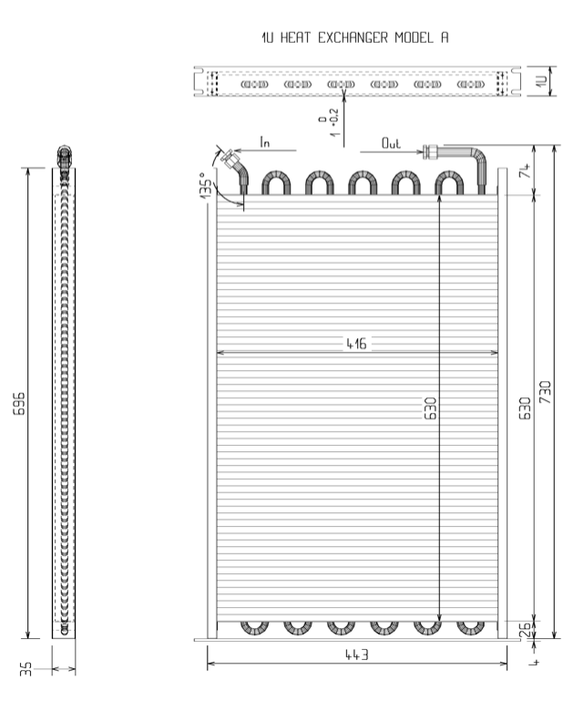
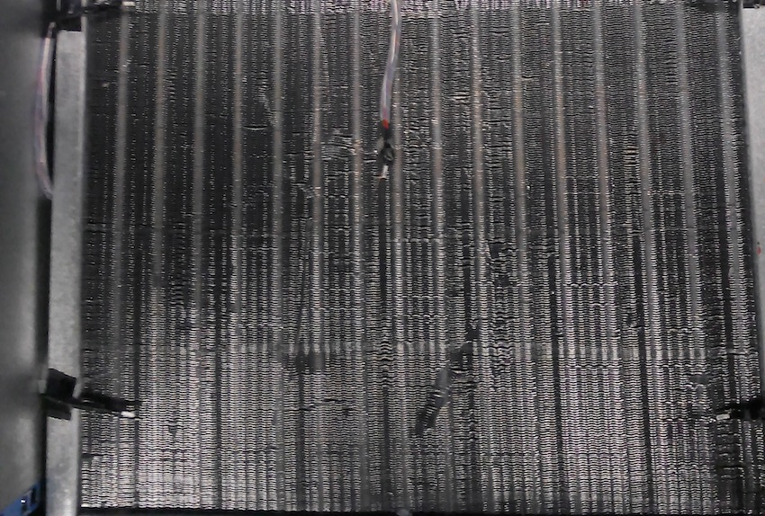
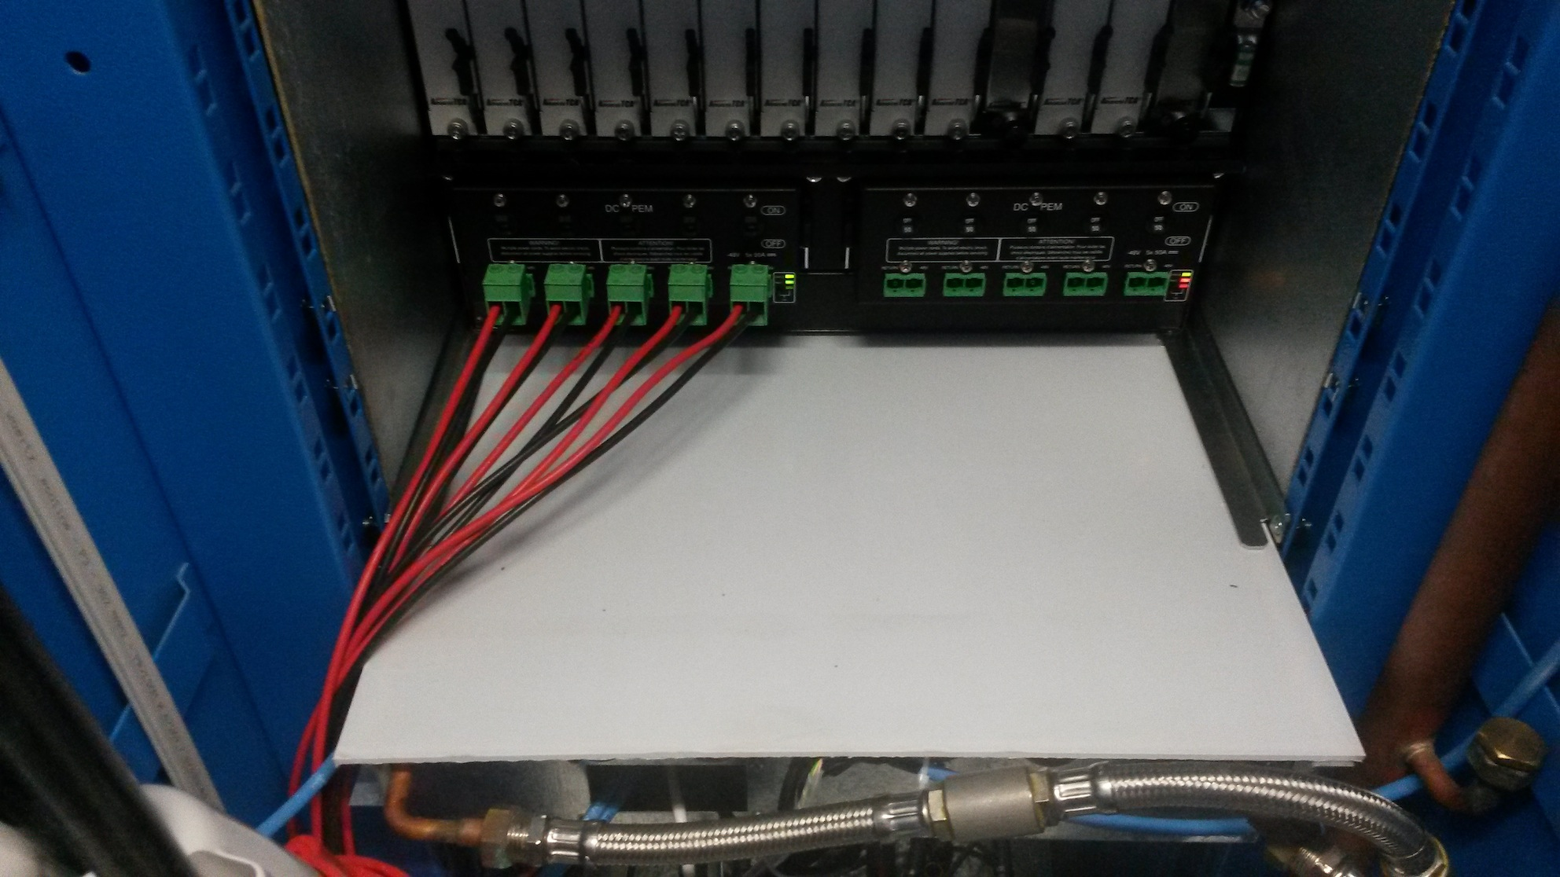
Vertical cooling configuration
Turbines– 4U
B. 4 Tdaq Lab
Heat exchanger -1U
30 T sensors were installed. Their layout was changed according to the kind of tests we were carrying out.
ATCA 2 – 14U
Plexiglas panel
Heat exchangers T sensors
2 Heat exchangers – 2U
2U
52U
Heat exchange area
ATCA 1 – 14U
Flow stopper
Back view of the heat exchanger
Air/water heat exchangers (1U), providing up to 3.8 kW of thermal capacity each
Heat exchanger – 1U
Air Deflector – 2U
Exchanged surface reduced (overlapping only 56%)
Power supply 2 – 3U
Plexiglas panel installed to improve the leak tightness
Power supply 1 – 3U

Slide 10
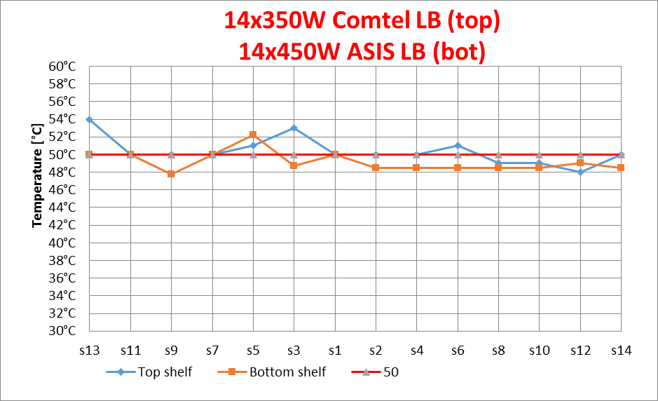
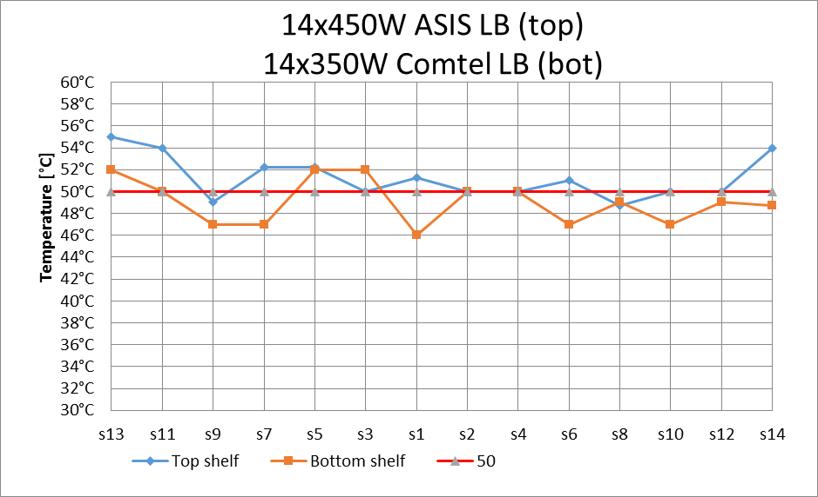
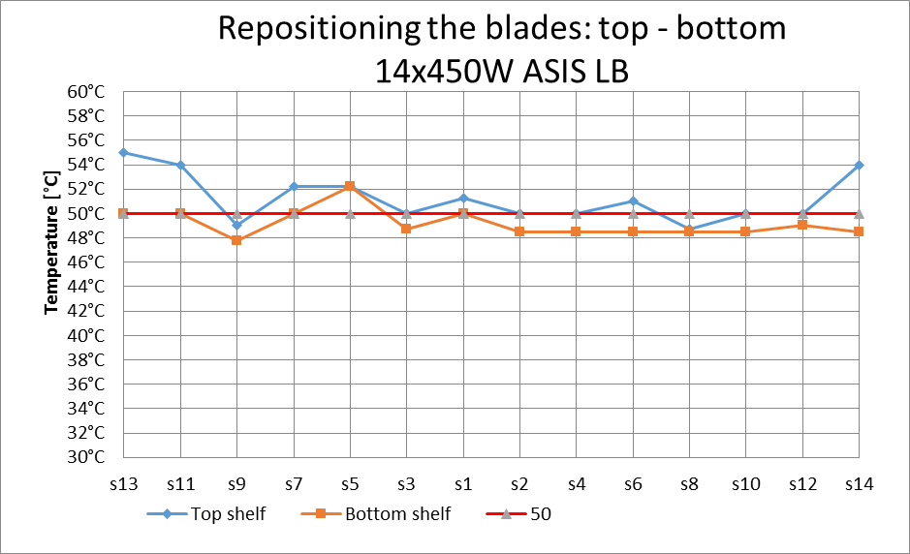
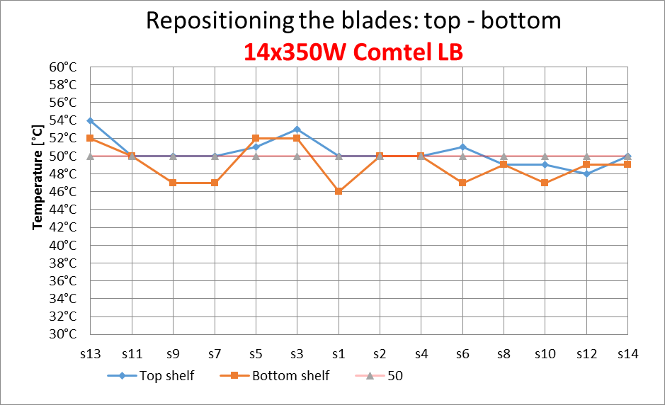
Vertical cooling performance (without bottom fans)
Average max T
Top [°C] | Bot [°C]
50.4 | 49.2
Average max T
Top [°C] | Bot [°C]
51.25 | 49.1
Average max T
Top [°C] | Bot [°C]
51.25 | 49.2
Average max T
Top [°C] | Bot [°C]
50.4 | 49.1
Boards average temperatures are matching the max target T (50°C)

Slide 11
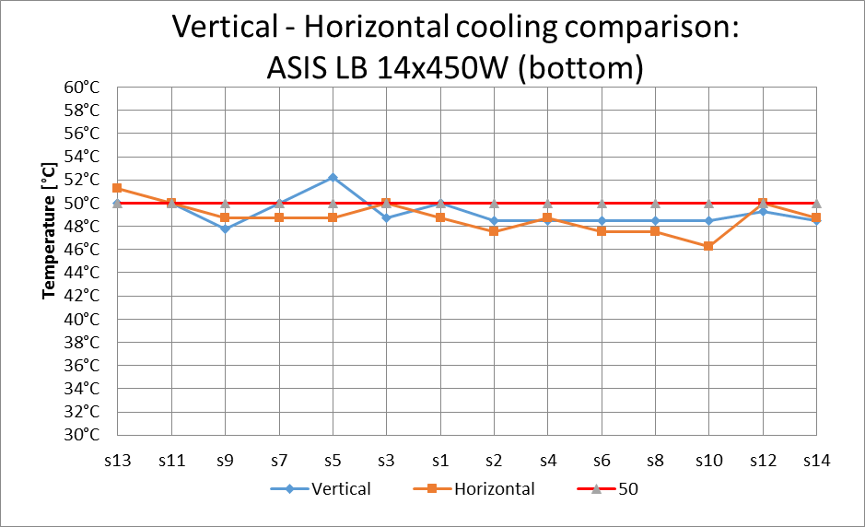
Vertical - Horizontal cooling comparison in b4
Configuration (in both cases only top fans were working on maximum speed):
Vertical: Top – 14x450W Comtel LB in ASIS crate, Bottom – 14x450W ASIS LB in ASIS crate. Water temperature 13°C.
Horizontal: Top – 14x350W Comtel LB in Schroff crate, Bottom – 14x450W ASIS LB in ASIS crate. Water flow 2.4m³/h, water temperature 13°C.
Average max T
Vertical [°C] | Horizontal [°C]
49.2 | 48.75
The cooling performance are very similar.

Slide 12
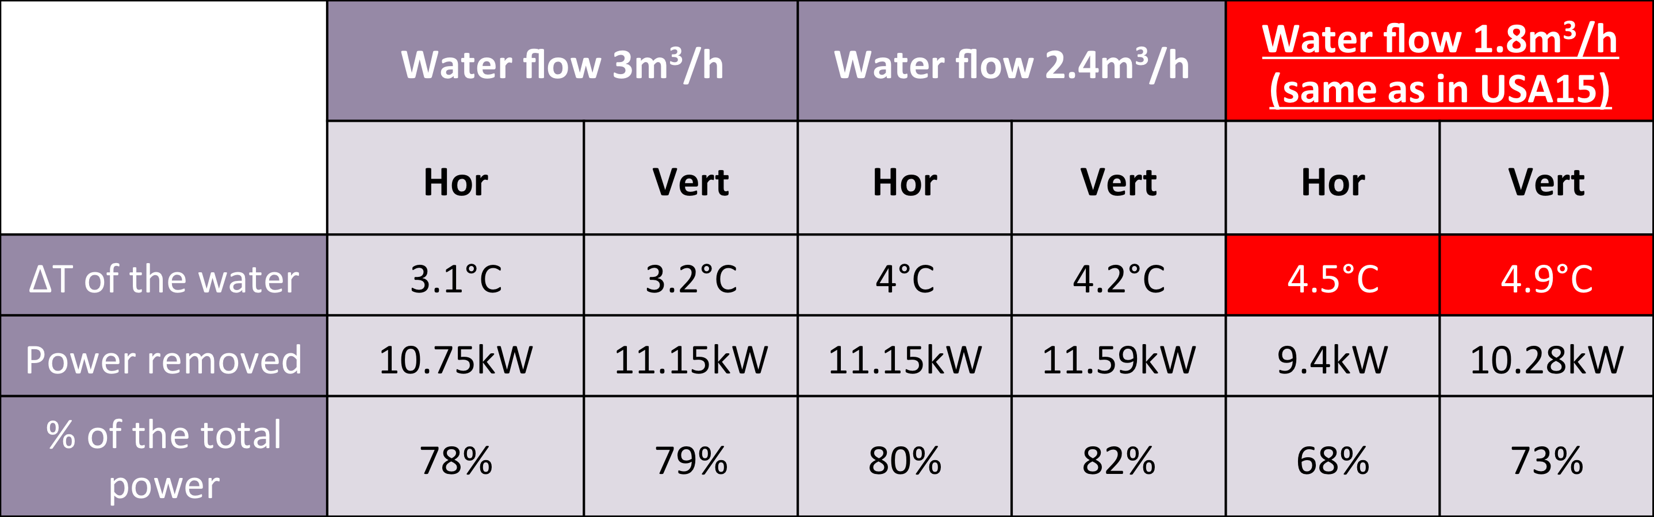
Comparison of heat removal for different water temperatures
T° / Hygrométrie à la reprise | Régime d'eau ( °C ) | Puissance ( kW ) | Débit d'eau ( m3/h ) | T° / Hygrométrie au soufflage | Perte de charge batterie ( mCE )
33°C / 10 g/Kg air sec | 13 / 18 | 14 | 2.4 | 22.5°C / 10 g/Kg air sec | 2.13
33°C / 10 g/Kg air sec | 14 / 19 | 13 | 2.24 | 23.2°C / 10 g/Kg air sec | 1.87
37°C / 10 g/Kg air sec | 13 / 18 | 18 | 3.09 | 23.5°C / 10 g/Kg air sec | 3.39
37°C / 10 g/Kg air sec | 14 / 19 | 17 | 2.93 | 24.2°C / 10 g/Kg air sec | 3.06
Many better products are available in the market
Cooling door specifications
Total power 13.9kW

Slide 13
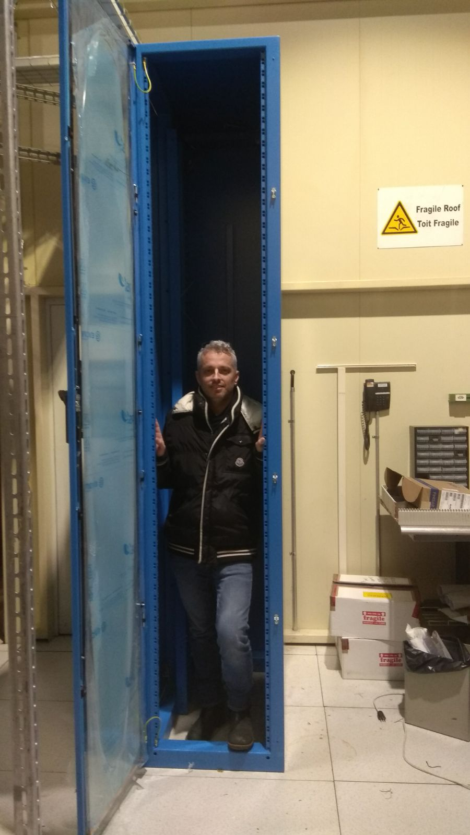
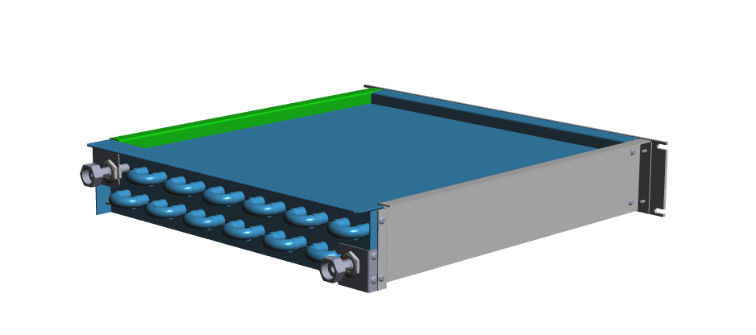
ATCA 63U rack: SR1 new test setup
“TwiceMe” rack
prototype in SR1
New 2U heat exchanger concept
Turbine– 4U
1 Heat exchanger -2U
Hardware
3x Vertically cooled ATCA shelves
3x 14 Load Blades
Target power capacity to test is 450W/blade=18.9 kW
New dedicated chiller with 25 kW cooling capacity
ATCA 3 – 14U
1 Heat exchanger -2U
  Main goals for the 2018 test cooling campaign:
  Assessing the cooling capabilities with 3 ATCA shelves
  Investigating efficiency of the new 2U heat exchangers: 7.7 kW cooling capacity, dimensions optimized for ATCA shelves
  Checking cross-shelf dependency in new layout – failure modes tests
  Noise assessment with 3 shelves and installing soundproofing material
  Investigating the influence of side gaps soundproofing material on the rack cooling performance
  Checking the different fans configuration influence on the cooling performance of new ATCA crates
  Ready to test new 14U vertical cooling Schroff shelves selected as standard at CERN
ATCA 2 – 14U
1 Heat exchanger -2U
ATCA 1 – 14U
Air Deflector – 2U
Power supply 2 – 3U
Power supply 1 – 3U
free–3U

Slide 14
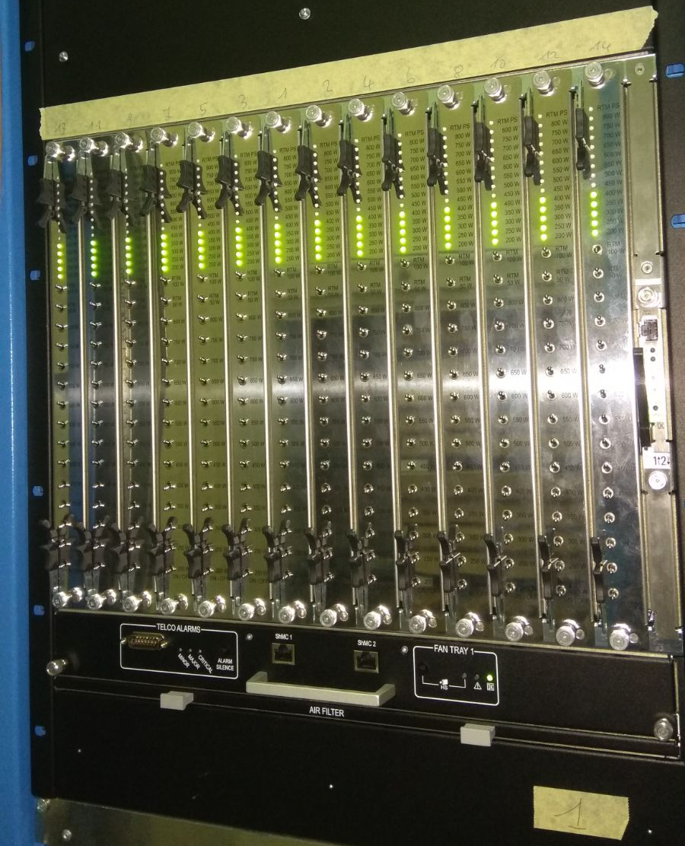
ATCA shelf and - 48V PSU procurement
Pentair/Schroff ATCA shelves
  14 ATCA slots w. RTM
  Vertical or Horizontal cooling
  DS or FM topology
  40 or 100G backplane
  Bussed IPMB
  1 Shelf man. included
-48Vdc rectifier system (UniPower)
  14 kW max output pwr
  11 kW with N+1 redund.
  Based on 5 pwr bricks
  Up to 12 CB output
  Ctrl module (SNMP over eth.)
Prices available upon request
The first prototype of the selected Schroff shelf is being installed in our 63U rack for tests
14

Slide 15
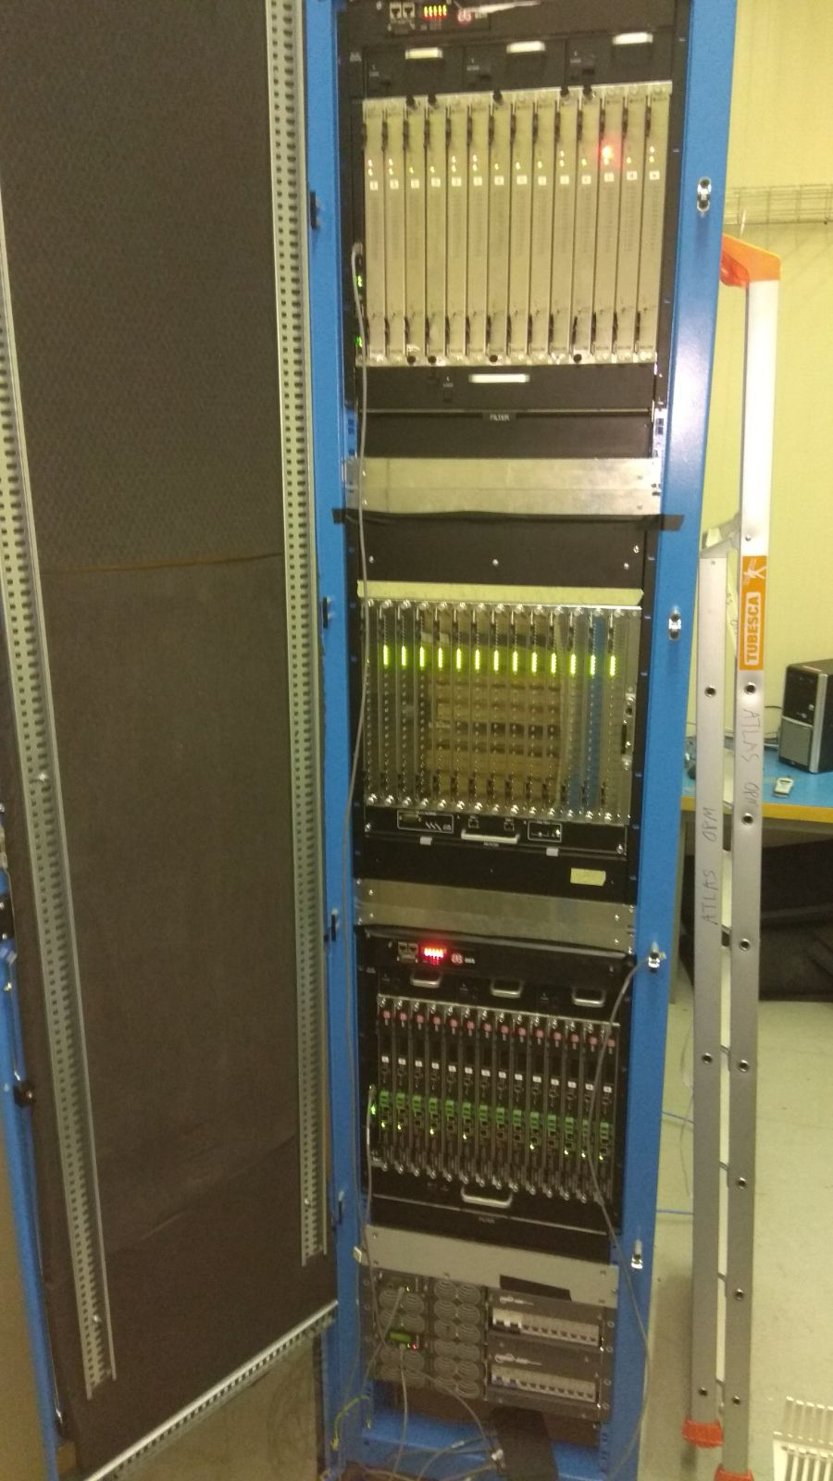
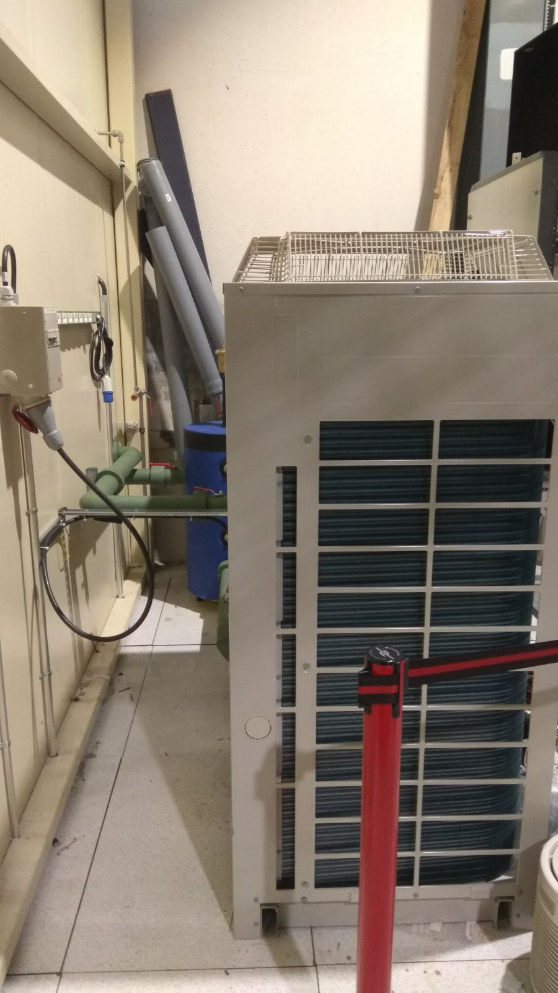
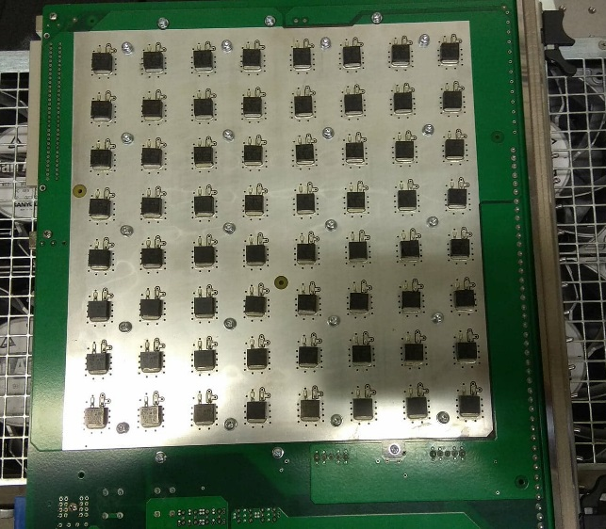
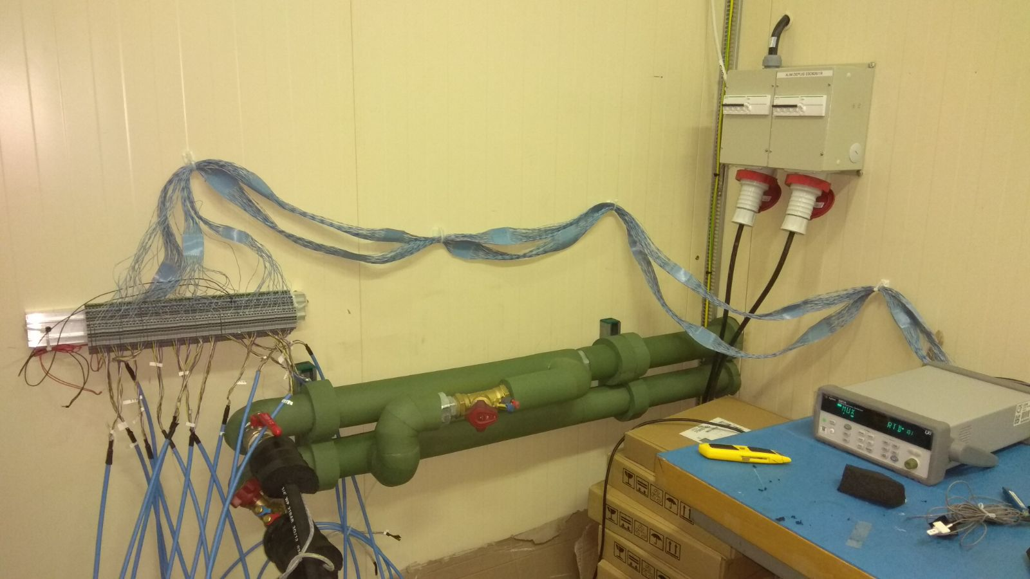
ATCA 63U rack installed in the laser room
Dedicated Chiller with 25kW cooling capacity installed outside the room
New Schroff shelf
Comtel new load blades maximum power 800W
Water piping are insulated for cold water tests
6x HXs (1U)

Slide 16
Cooling tests results (without bottom fans)
Water inlet T 15°C
Flow 4.5m³/h
The test was carried out in following configuration
  ATCA 3 (top crate) – 14xComtel LB (old type), top fan trays working on maximum speed
  ATCA 2 (middle crate) – 14xComtel LB (new type), top fan trays working on maximum speed
  ATCA 1 (bottom crate) – 14xASIS LB, top fan trays working on maximum speed
63U results!
Preliminary
Average max T
Top [°C] | Bot [°C]
52.64 | 53.75
With the inlet temperature of water at 15C, the average maximum temperature on the blades is slightly above 50C. Circuit breaker tripped when we tried to reach 450W.

Slide 17
Comparison between tests with and without bottom fans
63U results!
Preliminary
Water inlet T 15°C
Flow 4.5m³/h
The test was carried out in following configuration
  ATCA 3 (top crate) – 14x350W on Comtel LB (old type)
  ATCA 2 (middle crate) – 14x350W on Comtel LB (new type)
  ATCA 1 (bottom crate) – 14x350W on ASIS LB
WBF – without bottom fans
BF – with bottom fans
Average max T
WBF [°C] | BF [°C]
50.27 | 46.34
Average max T
WBF [°C] | BF [°C]
51.93 | 54.43
On the less air resistive blades (Comtel – old type), it can be seen that the airflow is much less homogeneous and the overall average max T is higher by 2.5K when the bottom fans are in use.
In case of LB with high air resistance (ASIS) we can see that the cooling performance is better when the bottom fans are used.

Slide 18
ATCA 63U rack first issues and limitations
Nominal shape
Real shape (but not so dramatic)
The mechanical structure of the rack must be improved, shape of the front access is not rectangular. Cable trays are not sufficient to hold the door weight. Supplier being informed.
The external panels are quite thin (to save weight?), they vibrate easily and they become an additional source of noise. With soundproofing the effect is anyway reduced.
- Shelves fans dissipate 6.1kW (≈150W/fan) at the maximum speed
User power = 42 boards at 375W (average power) = 15.75 kW
2 PS (Power-One GND.S.48.M27) can provide up to 14.5kW/each (with 5 rectifiers).
Circuit breakers are not well power balanced because of different power demand of each socket of the shelves…we need time to solve the problem.
User max power available per rack with 400W/board is 16.8kW
Chiller water outlet temperature still oscillating too much. PID to be tuned.

Slide 19
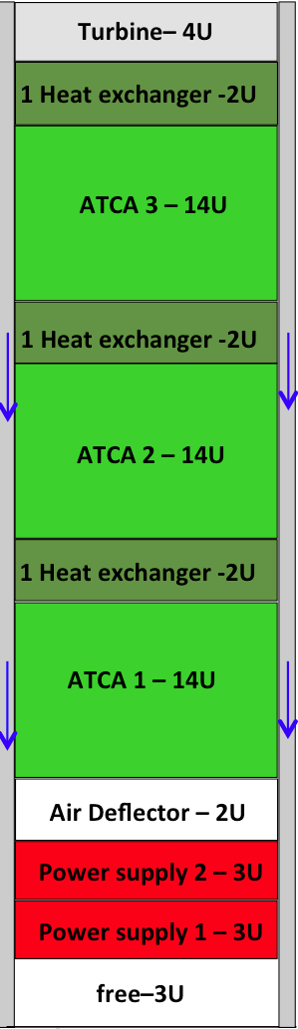
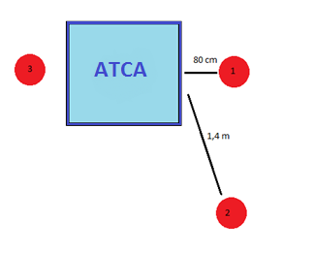
Noise reduction: measurements (horizontal shelves)
Masse lourde
Noise suppression material: Acoustic foam
 | 1 | 2 | 3
Doors open | 97.2 | 92.7 | 92.4
Doors closed | 85 | 83.1 | 92.4
Delta dBA | 12.2 | 9.6 | 0
All values in dBA
Fig.1. Test with only top fans working at maximum speed.
 | 1 | 2 | 3
Doors open | 99.4 | 96.4 | 94.2
Doors closed | 86.9 | 85.7 | 94.2
Delta dBA | 12.5 | 10.7 | 0
New sound suppression material: Masse lourde
Fig.2. Test with top and bottom fans maximum speed.
Noise suppression material: Masse lourde
Discussion with an external company is on-going in order to upgrade the counting rooms including a sound proof area for the ATCA racks and active noise reducers.
 | 1 | 2 | 3
Doors open | 97.2 | 92.7 | 92.4
Doors closed | 87.8 | 84.1 | 92.4
Delta dBA | 9.4 | 8.6 | 0
Fig.1. Test with only top fans working at maximum speed.
Side gaps insulated (air gaps reduction in vertical) with panels and rear door to check the noise reduction and how it affects the cooling efficiency.
 | 1 | 2 | 3
Doors open | 99.4 | 97.4 | 94.3
Doors closed | 90.1 | 87.8 | 94.3
Delta dBA | 9.3 | 9.6 | 0
Fig.2. Test with top and bottom fans maximum speed.

Slide 20
Soundproofing: Influence of the soundproofing material on the T distribution
Here below you can see the comparison between the cooling performance of the rack equipped with soundproofing material and the rack without soundproofing material:
WS – With Soundproofing
WOS – Without Soundproofing
Vertical
Average max T
WOS [°C] | WS [°C]
49.2 | 51.8
Average max T
WOS [°C] | WS [°C]
53.1 | 49.4
ASIS load blades
Comtel load blades
Comtel load blades average maximum temperature difference is 3.7K in favour of soundproofed rack while ASIS load blades the temperature difference is 2.6K in favour of not soundproofed rack.

Slide 21
Heat removal with soundproofing: 52U vs 63U
 | Water flow 3m³/h |  | Water flow 1.8m³/h (same as in USA15)
 | 52U (4HX) | 63U (6HX) | 52U (4HX) | 63U (6HX)
∆T of the water | 3.2°C | 5.0°C | 4.9°C | 8.4°C
Power removed | 11.15kW | 17.42kW | 10.28kW | 17.56kW
% of the total power | 79% | 85% | 73% | 85.5%
52U total power 13.9kW
63U total power 20.5kW
In May 2018 we will start testing with new 2U Heat exchanger…let’s see if we can do better.

Slide 22
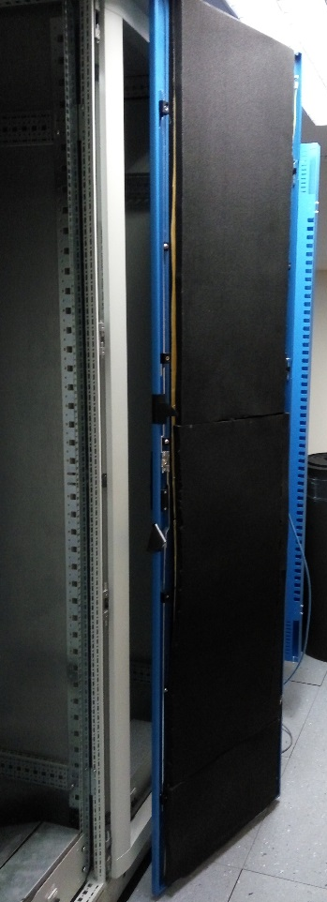

Noise on Vertical cooling: doors and side air gaps insulated (52U)
Vertical air flow
Noise measurement points
2
1
rack
Noise measurements (52U) | Pos. 1 Door open [dB(A)] | Pos. 1 Door closed [dB(A)] | Pos. 2 [dB(A)] | Av. max T on ASIS LB [°C] | Av. max T on Comtel LB [°C]
Without insulation | 102.8 | 90 | 87.5 | 49.2 | 53.1
With insulation |  | 86.3 | 84 | 51.8 | 49.4
Difference |  | -3.7 | -3.5 | 2.6 | -3.7
2
A reduction of 3 dB(A) is quite significant considering the total number of racks will be operative in the counting room (>50)
63U noise measurements coming soon….

Slide 23
Conclusions
The mixed water used in the counting rooms for both, ATLAS and CMS, are working at lower performance than the design one.
While the the mixed water flow is nominal the ΔT is significantly lower than the design. Cooling capacity available in ΔT is 50% for ATLAS and 80% for CMS.
ATCA tests: In both configurations, horizontal and vertical, the load boards temperature at the maximum power is very close and sometime above to 50C: the tests were carried out with an average power on the rack of 400W/board
The cooling capacity in vertical and horizontal configurations is very similar (about 80%), at lower water flow the vertical solution is slightly more efficient
Equipping the rack with soundproofed materials does not affect in a significant way the temperatures distribution, it increases the cooling efficiency reducing the thermal losses through the rack walls and it lowers the noise in a significant way
A new 63U ATCA rack is operative in SR1, new 2U heat exchangers will be delivered soon
  Water chiller must be tuned, power distribution to the circuit breakers must be equalized.
  New 2U heat exchangers prototype were delivered today. Common interest/effort of ATLAS and CMS.

