Slide 1
New HEL parameters
Here is a set of proposed parameters. Given the present knowledge, I think they are a good conservative baseline. Of course we need numerical simulations, including the bends -- more comments on this later.
5 T in main solenoid
S shape, with dipole corrector
rout = 1.94 mm, rin = rout/2, as it is now. Increasing the proton beam size would help a lot, but at this point I assume we don't have much freedom in the choice of beta functions.
0.2 urad max kick in continuous mode (where we can tolerate more profile distortions), 0.1 urad max kick in pulsed mode (when we need a more symmetric e-beam). This may imply a reduction of performance compared with the present 0.4 urad. Of course, the translation from maximum kick to cleaning rate is complex, because it depends on the details of halo population and machine configuration (lattice, nonlinearities, diffusion, etc.). This has always been a tricky point, and we need to decide with Stefano if the specifications should be in terms of the range of kicks or halo removal rates, or both.
e-beam 15 keV, 2.9 A. We have some freedom in the choice of the combination (V, I), with the constraint that V should be high enough to ensure transmission of the dense e-beam through the beam pipe. Even if we decide to eventually go to a lower perveance, the cathode development program still makes sense, because we need to know the current-density reach and to demonstrate the required current. We can have a fixed, high-perveance gun and lower the cathode-anode voltage for extraction, while keeping the full kinetic energy in the overlap region where the beam pipe is grounded, as it done in RHIC (e.g., cathode at -15 kV, anode pulsed between -15 kV and -5 kV, beam pipe grounded).

Slide 2
Measure of slipping between layers?
Measure of exchanges
between layers

Slide 3
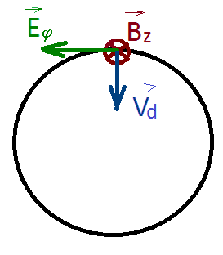
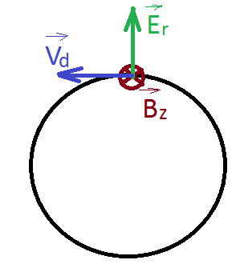
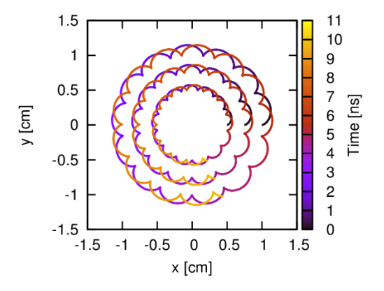
Effect of drift velocity
Larmor motion: electrons rotating along the magnetic line
with longitudinal velocity
Drift velocity derives from the ExB (e-beam electric field
significant for large e-currents)
Rotation velocity, larger at larger radius
Circular beam frequency
In case of non azimuthally uniform beam there could be an angular component of the electric field causing beam to tilt by Φ.
Courtesy of Daniel Noll
International Review on the e-lens concept readiness for integration into the HL-LHC baseline 19 Oct. 2017

Slide 4
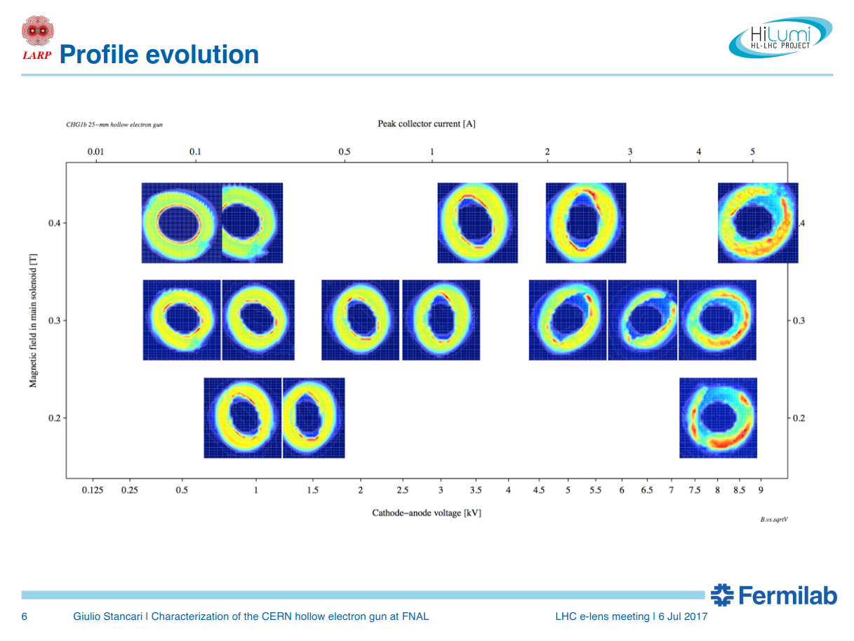

Slide 5
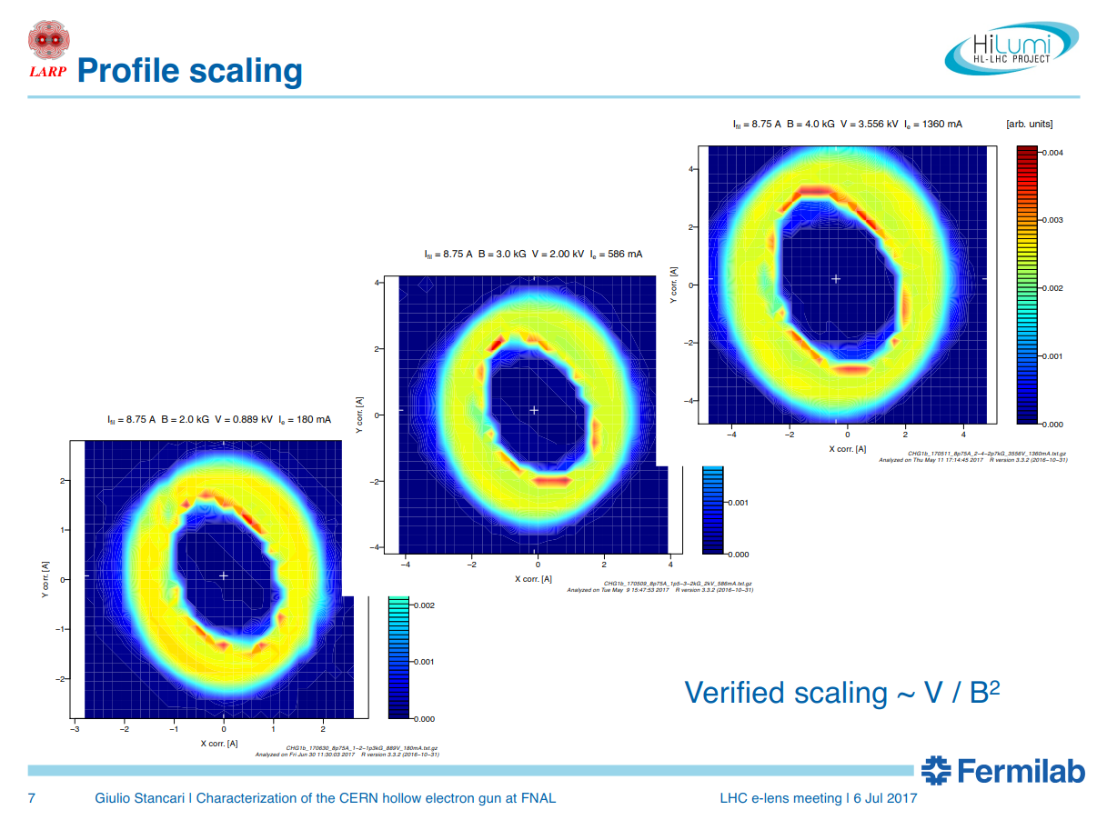
Fraction of a turn over the length L

Slide 6
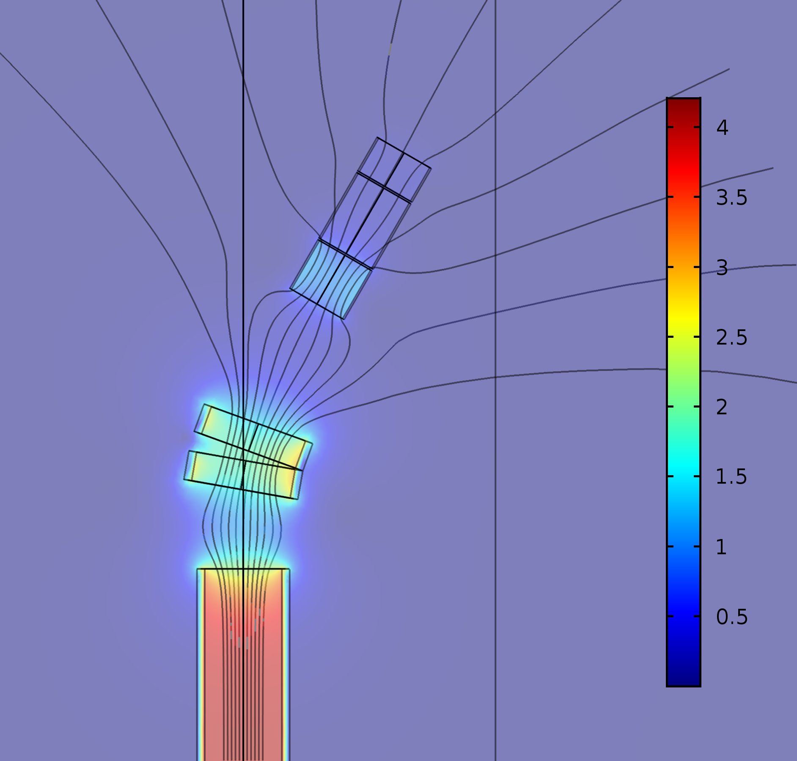
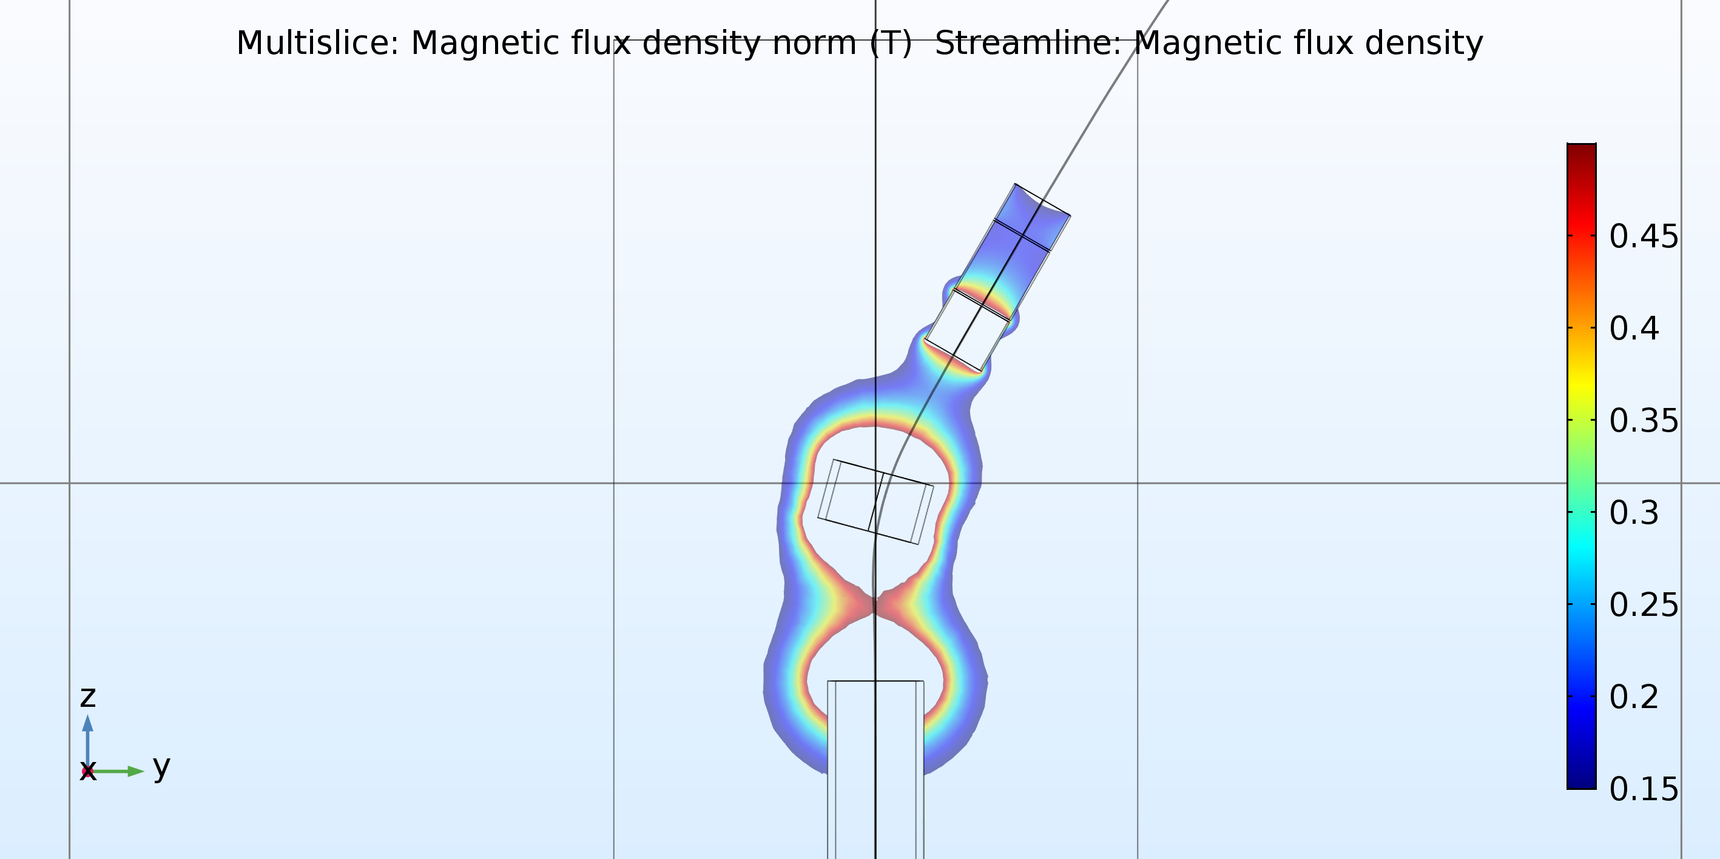
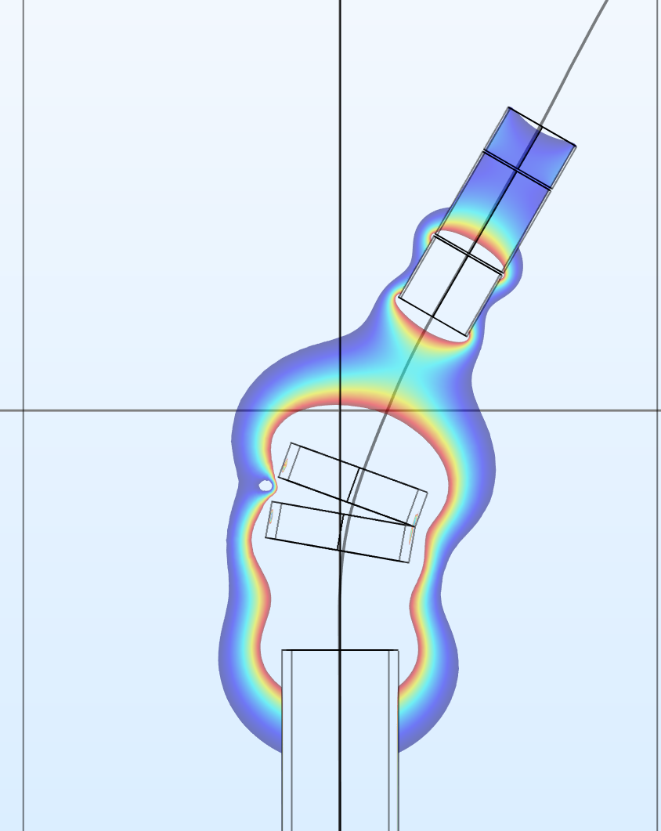
Improving magnetic field at injection
Make the filed on the injection arm more uniform (to minimise deformations and transfer from longitudinal to transverse velocity)
Courtesy of Carlo Zanoni
Drawback: loose space for diagnostics (gas monitor)
  Beam imaging only on the collector side
White is off scale, high B
International Review on the e-lens concept readiness for integration into the HL-LHC baseline 19 Oct. 2017

