Slide 1

BHZ151 vacuum chambers
Jose A. Ferreira, Jan Hansen

Slide 2
BHZ15
Project baseline reuse old vacuum chambers:
  2 new vacuum chambers (paid by LIU) and 3 old spares (old BHZ151 configuration) → Operational spares old vacuum chambers
New set of drawings → EN-MME found the magnet aperture has been reduced

Slide 3
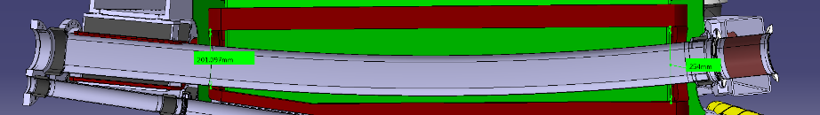
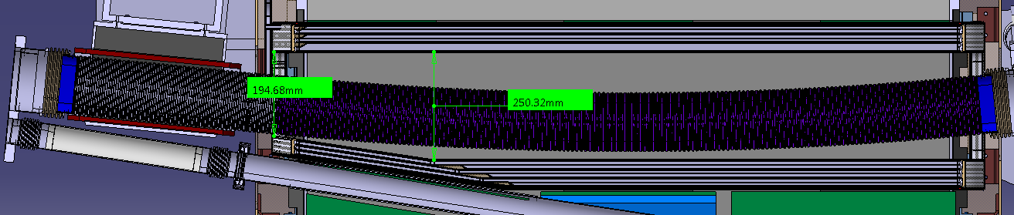
BHZ151
New set of drawings to order new vacuum chambers → EN-MME found the magnet aperture has been reduced
Impossible to use same supporting system (not included in integration model).
Concerns about how to install BSW magnets

Slide 4
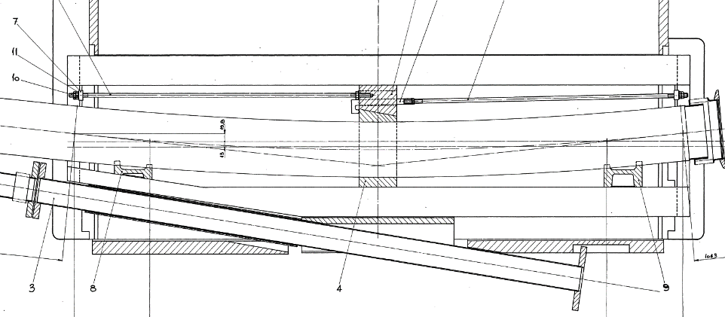
BHZ151

Slide 5
BHZ151 Proposal
Same Inconel chamber inside bending like BHZ11 and BHZ162 (share spares and tooling)
Split BSW and BHZ chamber if possible
Simplify supporting (similar to BHZ162)
Modifications of BT.BVT10 chambers

Slide 6
New flange
Beam envelope

Slide 7
Modification of covers to let space for clamp

Slide 8
BT1.BVT10, BT4.BVT10 old configuration

Slide 9
Modification of pick-up transitions
Bellows moved to extraction chamber

Slide 10
BHZ151: draft proposals
Spare chambers
2 + 2 spares dipole chambers (30kCHF/p)
4 + 2 spares BSW chambers (20kCHF/p)
4 + 2 extraction chambers (15 kCHF/p)
Cost: 330 kCHF
Spare BHZ151 unit
2 + 4 spares dipole chambers (30kCHF/p)
4 + 4 spares BSW chambers (20kCHF/p)
4 + 4 extraction chambers (15 kCHF/p)
Cost: 460 kCHF

