Slide 1
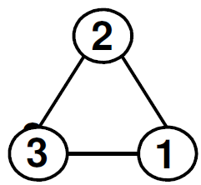





W. G. Scott (PPD/RAL)
NEXT-Meeting 9 May 2018
“MANIFEST BOSONIC DEMOCRACY”
THE SU(3) ALGEBRA IN A CYCLIC BASIS
“The SU)3) Algebra in A Cyclic Basis” P.F. Harrison, R. Krishnan and
W. G. Scott, Phys. Rev. D 90 (2014) 017302. ArXiv:1407.8360[hep-ph]
Please first consider – already familiar - :
su(2) A₁
THE SU(2) ALGEBRA IN A CYCLIC BASIS:
U
ALL ON
EQUAL
FOOTING
Just the old
3-d vector product rule
for orthogonal
unit vectors
Defn. of Lie Algebra:
Lie Product is Anti-Symmetric, i. e. : (1 x 2) = - (2 x 1) etc.
And obeys Jacobi identity: 1 x (2 x 3) + 2 x (3 x 1) + 3 x (1 x 2) = 0

Slide 2
The (complex) algebra A₁ in the “Chevalley Basis”
- perhaps better aligned to the SM context (3' = 2 I₃ ):
3' x 1' = +2 . 1'
3' x 2' = -2 . 2'
sl(2,R)
≈ su(1,1)
A₁
1' x 2' = 3'
U
Basis 1', 2', 3' related to the cyclic basis 1, 2, 3
by the (complex) basis transformation:
( ) = ( )( )
1' i -‪‪‪‪1 0 1
2' i +1 0 2
3' 0 0 2i 3
SM Lagrangian remains invariant
with re-defined (complex)
fields proportional to:
W ⁺ = (W₁ – iW₂)/√2
W ⁻ = (W₁ + iW₂)/√2
W⁰ = W₃

Slide 3
Outline:
Introduction: su(2) cyclic non-cyclic
su(3) Gell-Mann non-cyclic
Computer Search : 280 Bn 972 2
case-1 case-2
case-1 3x3 rep: an aside on: ”Tri-Maximal Mixing”
case-1 case-2 : circulant- assertion,
transformations conjecture
Referee’s Report : “a good turn” proof ??
“By-The-Way” : TSCs = Trigonometric su(2,1)
Structure Constants “case-3”
GUTS : su(5) “bi-cyclic” TSC version
Challenge: su(5) £1000,000 Glory!

Slide 4

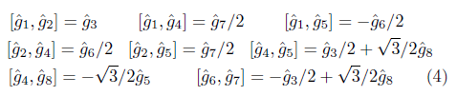
In a perhaps more acceptable notation
(as in our paper):
su(2) (cyclic basis):
A₁ Chevalley basis (non-cyclic):
A₂ (Gell-Mann basis - non-cyclic):
U
su(3) A₂
So the question arises - can su(3) be put in cyclic form…..????

Slide 5
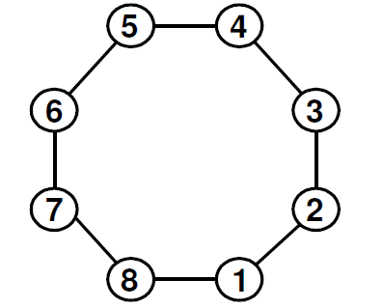
After >100hrs running on the RAL-PPD linux farm we found:
Phys. Rev. D 90 (2014) 017302;
arXiv:1407.8360[hep-ph]
1 x 2 = 3 + 4 - 7 + 8
1 x 3 = - 2 - 4 - 6 + 8
1 x 4 = - 2 + 3 - 6 - 7
1 x 5 = 0
Structure Constants all unit modulus
and totally anti-symmetric
Killing Form is diagonal:
κ_{ab} = -24 δ_{ab}
Metric Signature : (-24)⁸
su(3) A₂
U

Slide 6
After >100hrs running on the RAL-PPD linux farm we found:
Phys. Rev. D 90 (2014) 017302;
arXiv:1407.8360[hep-ph]
1 x 2 = 3 + 4 - 7 + 8
1 x 3 = - 2 - 4 - 6 + 8
1 x 4 = - 2 + 3 - 6 - 7
1 x 5 = 0
Cartan
Subalgebra
Structure Constants all unit modulus
and totally anti-symmetric
Killing Form is diagonal:
κ_{ab} = -24 δ_{ab}
Metric Signature : (-24)⁸
su(3) A₂
U

Slide 7
After >100hrs running on the RAL-PPD linux farm we found:
Phys. Rev. D 90 (2014) 017302;
arXiv:1407.8360[hep-ph]
1 x 2 = 3 + 4 - 7 + 8
1 x 3 = - 2 - 4 - 6 + 8
1 x 4 = - 2 + 3 - 6 - 7
1 x 5 = 0
Cartan
Subalgebra
Structure Constants all unit modulus
and totally anti-symmetric
Killing Form is diagonal:
κ_{ab} = -24 δ_{ab}
Metric Signature : (-24)⁸
su(3) A₂
U
Any Opposite Pair!

Slide 8
The Fundamental (3 x 3) Representation in Cyclic Form:
b = (x₋ ω + x₀ + x₊ ϖ) / 3
ƃ = (x₋ ϖ + x₀ + x₊ ω) / 3
(where x₋ = 1/√3- 1, x₀ = -2/√3, x₊ = 1/√3+1
with ω , ϖ complex Cube-roots of unity )
λ₁ = ( ) λ₂ = ⁻( ) λ₃ = ( )
x₋ 0 0
0 x₀ 0
0 0 x₊
0 bω ƃ
ƃϖ 0 bϖ
b ƃω 0
0 bϖ ƃ
ƃω 0 bω
b ƃϖ 0
λ₄ = ⁻( ) λ₅ = ( ) λ₆ = ⁻( )
0 ƃ b
b 0 ƃ
ƃ b 0
x₊ 0 0
0 x₀ 0
0 0 x₋
0 ƃω b
bϖ 0 ƃϖ
ƃ bω 0
λ₇ = ( ) λ₈ = ⁻( )
“Tri-Maximal Mixing”:
Harrison & Scott
PLB 333 (1994) 471
hep-ph/9406351; see
also: hep-ph/9909431
0 ƃϖ b
bω 0 ƃω
ƃ bϖ 0
0 b ƃ
ƃ 0 b
b ƃ 0
Any choice of “non-opposite” pair λ_{i}, λ_{j} are maximally non-commuting !!!

Slide 9
P. F. Harrison, D. H. Perkins, W.G. Scott
Phys. Lett. B 349 (1995) 357 – No Arxiv.
Also: hep-ph/9702243, hep-ph/9904297
hep-ph/0402006 (BHS), hep-ph/0511201
“Threefold-Maximal Mixing”
“Tri-Maximal Mixing”
HPS: hep-ph/9601346
“Tri-Bi-Maximal Mixing”
Tri-Bi-Maximal Mixing (hep-ph/0202074)
dominated phenomenology for a decade

Slide 10
We also found (“Case-2”):
Phys. Rev. D 90 (2014) 017302;
arXiv:1407.8360[hep-ph]
1 x 2 = 4 - 7 + 8
1 x 3 = - 2 - 4 - 6
1 x 4 = - 2 + 3 - 6
1 x 5 = 0
Structure Constants all unit modulus
but are not totally anti-symmetric
Killing Form is off-diagonal
but circulant:
κ_{ab} = circ(-12,0,0,0,6,0,0,0)
Metric Signature : (-18)⁴ , (-6)⁴
su(3) A₂
U

Slide 11
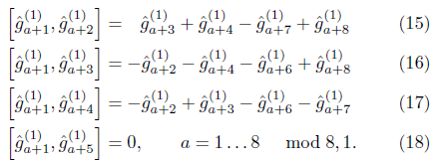
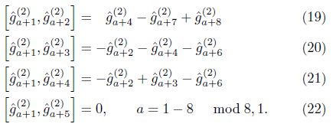
Again - as presented
in our paper:
Phys. Rev. D 90 (2014) 017302;
arXiv:1407.8360[hep-ph]
Cyclic su(3) – case-1:
Cyclic su(3) – case-2:

Slide 12
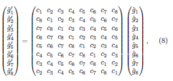
The transformations back and forth between the two forms 1 <–> 2:
where `circ’ denotes a `circulant’ matrix: (a cyclic transformation)
We assert that all cyclic bases are accessible by such cyclic transformations
and conjectured that cyclic bases exist for other lie algebras, e.g. su(n), n>3.

Slide 13
Our PLB referee was clearly `rattled’ by our paper:
“I urge the editors to reject this contribution……..
it is quite easy to show that such a basis exists for any finite-dimensional complex
semisimple Lie algebra by combining the expression of the structure constants
in a basis orthogonal with respect of the Killing form and the existence of an
orthogonal automorphism of the Lie algebra of order dimension of the Lie algebra.
(Such an automorphism can even be chosen to be inner.) ….”
Our response to the editor was highly non-confrontational
requesting only a copy of the referee’s proof::
“We accept the referee's judgement….
However….would it be asking too much that he/she kindly passes us his/her proof in a little more detail (anonymously via the editor) for our edification?”
While we prepared our paper for submission to PRD
(where it was accepted after only minor modifications !!!)
Incredibly we received the PLB referee’s `proof’:
His/her latex is beautiful …. but is the `proof’ valid??

Slide 14
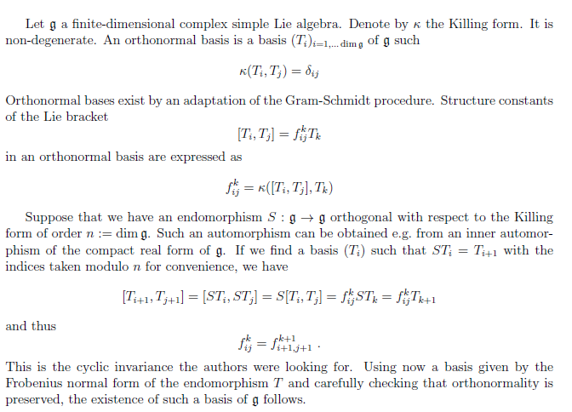

Slide 15
?
?
?

Slide 16
BTW:
We also found
In our search
c.f.“Trigonometric Structure Constants”
e.g. Fairlie, Zachos, Vershik….
- and rejected:
1 x 2 = 3
This is A₂
1 x 3 = 8
but is
NOT
strictly
su(3) !!!
1 x 4 = - 7
1 x 5 = 0
Structure Constants all unit modulus
but are not totally anti-symmetric
Killing Form is off-diagonal
but circulant:
κ_{ab} = circ(0,0,0,0,-6,0,0,0)
Metric Signature : (-6)⁴ , (+6)⁴
- So actually SU(2,1) !!!

Slide 17
Trigonometric Structure Constants (TSCs)
In particular for SU(N):
^ ^ ^
[ G_{m} , G_{n} ] = sin( 2π/N (n x m) ) G_{m + n}
where: m = ( m₁ , m₂ ) , n = ( n₁ , n₂ ) mod N
“sine algebras”, “cross-product algebras”
- mostly infinite dimensional
In a wider context:
J. Patera and H. Zasseninaus J. Math Phys. 29 665 (1988).
D. Fairlie, P. Fletcher and C. K. Zachos, PLB 218 203 (1989).
D. Fairlie and C. K. Zachos, PLB 224 (1989) 101.
M. V. Saveliev and A. M. Vershik, PLA 143 (1990) 121.
D. Fairlie, P. Fletcher and C. K. Zachos JMP 31 (1990) 1088.
D. Fairlie and C. K. Zachos PLB 620 (2005) 195. hep-th/0505053
D. Fairlie and C. K. Zachos PLB 637 (2006) 123. hep-th/0603017

Slide 18

For SU(5) - from the TSC version of A₄ -
we found only this ‘bi-cyclic’ form:
13
12
11
14
10
1 x 3 = ( - 4 + 6 - 16 – 18 )
2 x 4 = η ( - 5 + 7 – 17 – 19 )
15
9
16
8
1 x 9 = η ( - 5 - 8 + 17 – 20 )
2 x 10 = ( - 6 + 9 + 18 + 21 )
17
7
1 x 5 = η ( 9 - 12 + 21 + 24 )
2 x 6 = ( 10 + 13 + 22 – 1 )
18
6
19
5
1 x 11 = ( - 2 + 4 + 14 + 16 )
2 x 12 = η ( - 3 + 5 + 15 + 17 )
20
4
1 x 1 = 1 x 7 = 1 x 13 = 1 x 19 = 0
21
3
Structure constants are modulus unity or golden ratio η = (1+ √5 )/2
and are totally anti-symmetric.
22
2
23
1
24
Killing Form is diagonal: κ_{ab} = - 40 η√5 δ_{ab}

Slide 19
For SU(5) - from the TSC version of A₄ -
we found only this ‘bi-cyclic’ form:
13
12
11
14
10
1 x 3 = ( - 4 + 6 - 16 – 18 )
2 x 4 = η ( - 5 + 7 – 17 – 19 )
15
9
16
8
1 x 9 = η ( - 5 - 8 + 17 – 20 )
2 x 10 = ( - 6 + 9 + 18 + 21 )
17
7
1 x 5 = η ( 9 - 12 + 21 + 24 )
2 x 6 = ( 10 + 13 + 22 – 1 )
18
6
19
5
1 x 11 = ( - 2 + 4 + 14 + 16 )
2 x 12 = η ( - 3 + 5 + 15 + 17 )
20
4
1 x 1 = 1 x 7 = 1 x 13 = 1 x 19 = 0
21
3
Structure constants are modulus unity or golden ratio η = (1+ √5 )/2
and are totally anti-symmetric.
22
2
23
1
24
Killing Form is diagonal: κ_{ab} = - 40 η√5 δ_{ab}

Slide 20
TSC version of A₄ is only `quad-cyclic’:
(0,4)
(2,4)
(2,1)
(3,3)
(4,0)
13
12
11
1 x 2 = - η^{½} 4
1 x 3 = η^{-½} 10
1 x 4 = - η^{½} 18
1 x 5 = η^{½} 6
1 x 6 = η^{½} 16
1 x 7 = 0
1 x 8 = η^{-½} 24
1 x 9 = η^{½} 5
1 x 10 = η^{-½} 23
1 x 11 = - η^{-½} 22
1 x 12 = - η^{-½} 20
1 x 13 = 0
(2,3)
14
10
(4,1)
15
9
(4,4)
(3,0)
16
8
(1,3)
17
7
(0,3)
(1,2)
18
6
(4,3)
19
5
(0,2)
(4,2)
20
4
(2,0)
(1,1)
All structure constants values
are `quad-cyclic’ in the cyclic sequence …. - η^{½} , η^{-½} , η^{½} , - η^{-½} …
21
3
22
2
(3,2)
(1,4)
1
23
24
(1,0)
(2,2)
(0,1)
(3,4)
(3,1)
Killing Form is circulant:
κ = circ(0,0,0,0,0,0,0,0,0,0,0,-50,0,0,0,0,0,0,0,0,0,0,0,0)

Slide 21
The “Harrison-Krishnan-Scott” Challenge:
c,f. Millenium Prize Problems
Hilbert’s 23 Problems
Riemann Hypothesis ….
etc. etc.
P. Harrison, R. Krishnan, W. Scott
arXiv:1407.8360[hep-ph]
Find a (mono-) cyclic basis for SU(5) !!
If you believe the PLB referee’s proof you know it is possible/trivial !!!
Win 1 Million Pounds GBP !!!
£1,000,000
£1000
Just Glory!

Slide 22
From the same Authors:
Fully Constrained Majorana Neutrino Mass Matrices Using ∑ (72 × 3)
R. Krishnan, P. F. Harrison, W. G. Scott
Eur. Phys. J. C (2018) 78: 74 arXiv:1801.10197 [hep-ph]
Deviations from Tribimaximal Neutrino Mixing using a Model with
∆(27) Symmetry P. F. Harrison, R. Krishnan, W. G. Scott
IJMPA 29 (2014) 1450095 arXiv:1406.2025 [hep0ph]
Simplest Neutrino Mixing from S4 Symmetry
R. Krishnan, P. F. Harrison, W. G. Scott
JHEP, 087, 2013 arXiv:1211.2000 [hep-ph]
Exact One-Loop Evolution Invariants in the Standard Model
P. F. Harrison, R. Krishnan, W. G. Scott
Phys. Rev. D82:096004, 2010 arXiv:1007.3810 [hep-ph]
See also: R. Krishnan arXiv:1211.3364, arXiv:1402.0857 [hep-ph]

