Slide 2
PSB injection BSW power converters intervention scenarios and spare policy
D. Aguglia
TE-EPC-FPC
6th of March 2018

Slide 3
Outlook
The BSW powering
Spare policy
Intervention scenarios
A small note on improvements
conclusion

Slide 4
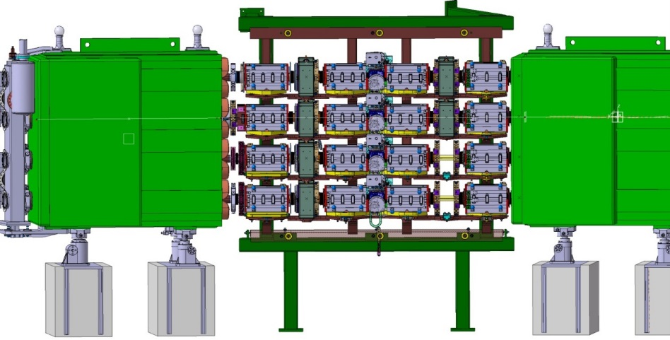
BSW powering
16 new BSW magnets
  2 types: 4 x BSW1s & 12 BSW2,3,4s
16 + 2 spare = 18 converters to be installed in BRF2 (13) and BAT(5) of bld. 361;
12 + 2 spare = 14 pulse transformers installed in the new alcove
4 pulse transformers installed in the tunnel for BSW1s
Connection/integration scheme overview:
Power converters in BRF2 + BAT
New Alcove
PSB Tunnel

Slide 5
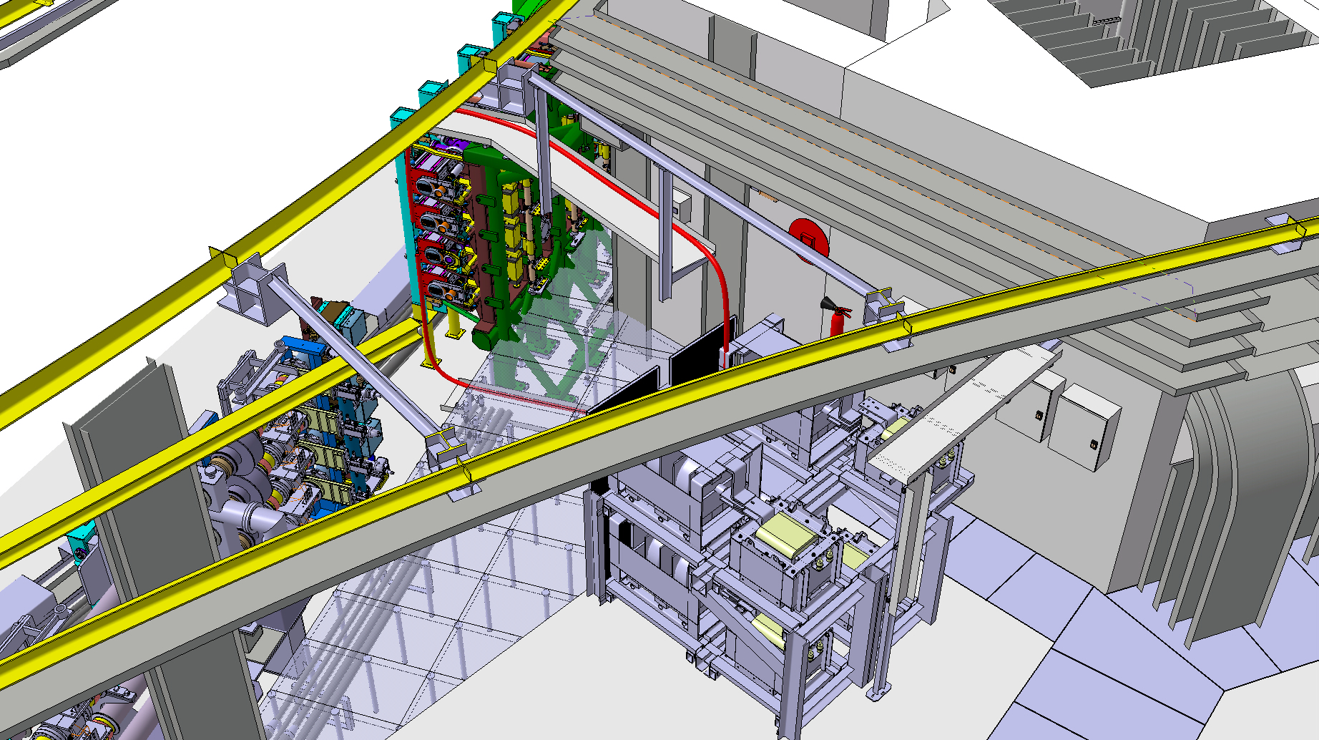
BSW powering
View of the 4 BSW1’s pulse transformers to be installed in LS2

Slide 6
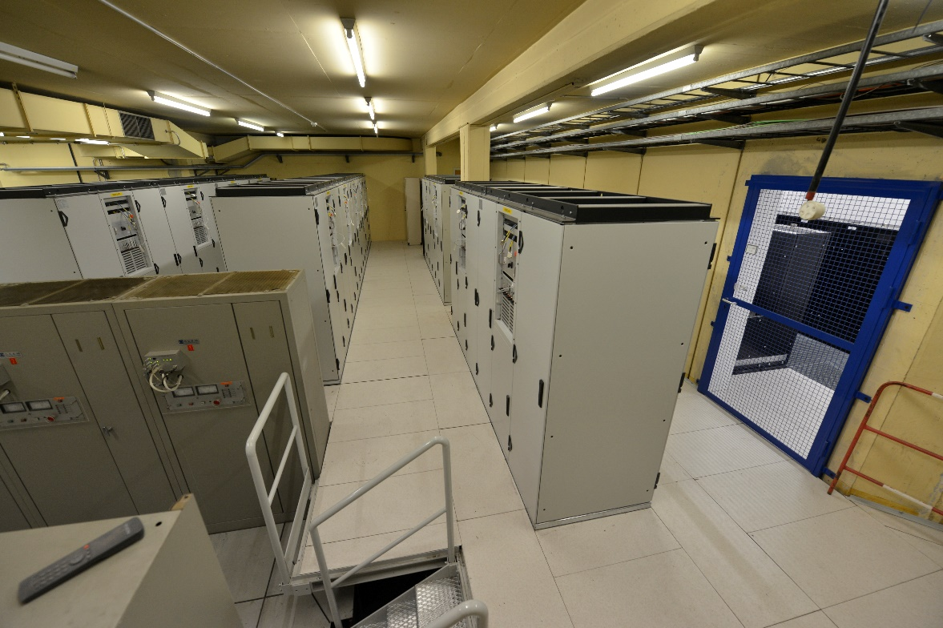
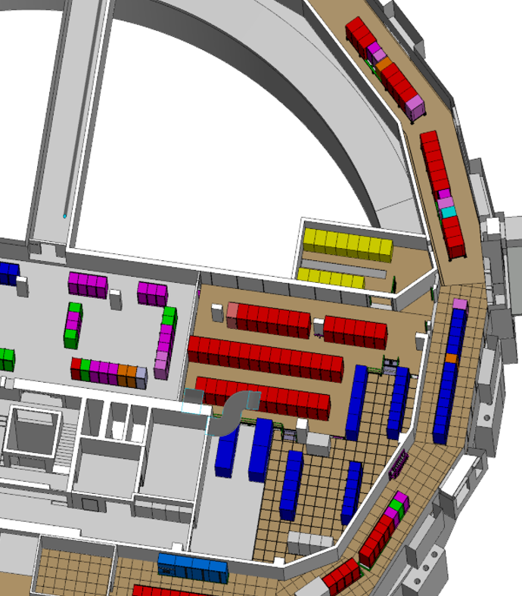
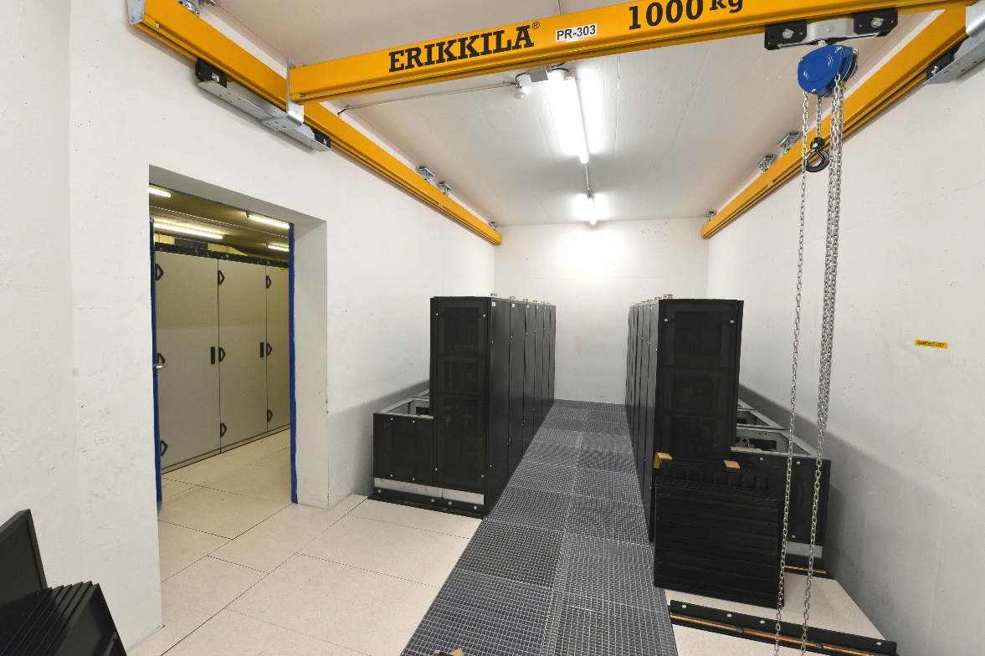
BSW powering
Integration in BRF2 and BAT
Alcove with 12 + 2 pulse transformers (3.4 kA for BSW2,3,4s)
5 converters in BAT
13 converters in BRF2

Slide 7
Spare policy
2 x spare power converters installed in BRF2
2 x spare BSW2,3,4s pulse transformer (with DCCTs) installed in the alcove
1 x spare BSW1 pulse transformer (with DCCTs) not installed!
Any power converter can supply any of the 16 circuits
Spare power converter’s components available in EPC (standard modules used)
The 2 spares pulse transformers in the alcove can supply any of the BSW2,3,4s
Spare elements
Spare converter and transformers normally remain associated (cabled)
Only derogation: BSW1 PC in fault

Slide 8
Intervention scenarios
Usual fault quickly cleared via replacement of small components such as electronics cards
Here we analyze major faults where a full power converter or a transformer is faulty and needs to be replaced
From experience: fault on pulse transformer is highly unlikely – no faults in 25 year in the tunnel (radioactive environment)
We proceed only with “bretelles” / cables extensions to minimize downtime & mistakes
If a major intervention requires to put a spare into operation, two procedures only
  For faulty BSW2,3,4 powering
  For faulty BSW1 powering
BSW2s
BSW3s
BSW4s
BSW1s

Slide 9
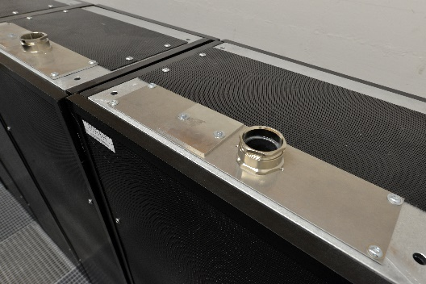
Intervention scenarios
Intervention for faulty BSW2,3,4 (severe fault needing full spare)
No difference whether it is a power converter, or pulse transformer failure, procedure is the same
Can be carried out by “EPC piquet injecteurs” (2 people)
The full spare set (PC + pulse transformer) will replace the set in fault
Procedure limited to few actions, estimated accelerator downtime: 2h30
Example with major actions:
Consign faulty converter
Pull bretelles/extensions for:
  Pulse transformer secondary
  WIC
Transfer FGC3 dongle (circuits parameter)
Start with spare

Slide 10
Intervention scenarios
Intervention for faulty BSW1 (severe fault needing full spare)
Can be carried out by “EPC piquet injecteurs” (2 people)
If pulse transformer (in tunnel) is faulty, downtime of 1-2 days (as for any other pulse transformers in the tunnel)
If power converter is faulty, procedure limited to few actions, estimated accelerator downtime: 2 h
Example with major actions:
“Cosnsigne” faulty converter / close water
Pull bretelles/extensions for:
  Pulse transformer primary
  WIC
Transfer FGC3 dongle (circuits parameter)

Slide 11
A small note on improvements
Thanks to the new reg. FGC3 electronics, EPC can implement a load impedance tracking (from output voltage and current). Deviation will imply a change in impedance and a possible issue on cables or magnet.
  Only a proposal, not discussed internally to EPC

Slide 12
Conclusion
Standard operation for EPC, no particular issues in the operation of these converters.

