Slide 1
Report on the LS2 schedule (5 min)
LIU-PSB working group meeting 06-03-2018
D. Hay EN-ACE
Acknowledgments: Julie Coupard

Slide 2
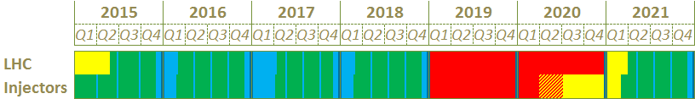
Timeline
Today
Long Shutdown
Commissioning
Operation
Technical Stop
YETS 2015
EYETS 2016
YETS 2017
LS2
Extended YETS 2016-2017 is completed
YETS 2017-2018 is completed
LS2 will start at the PSB in 8 months

Slide 3
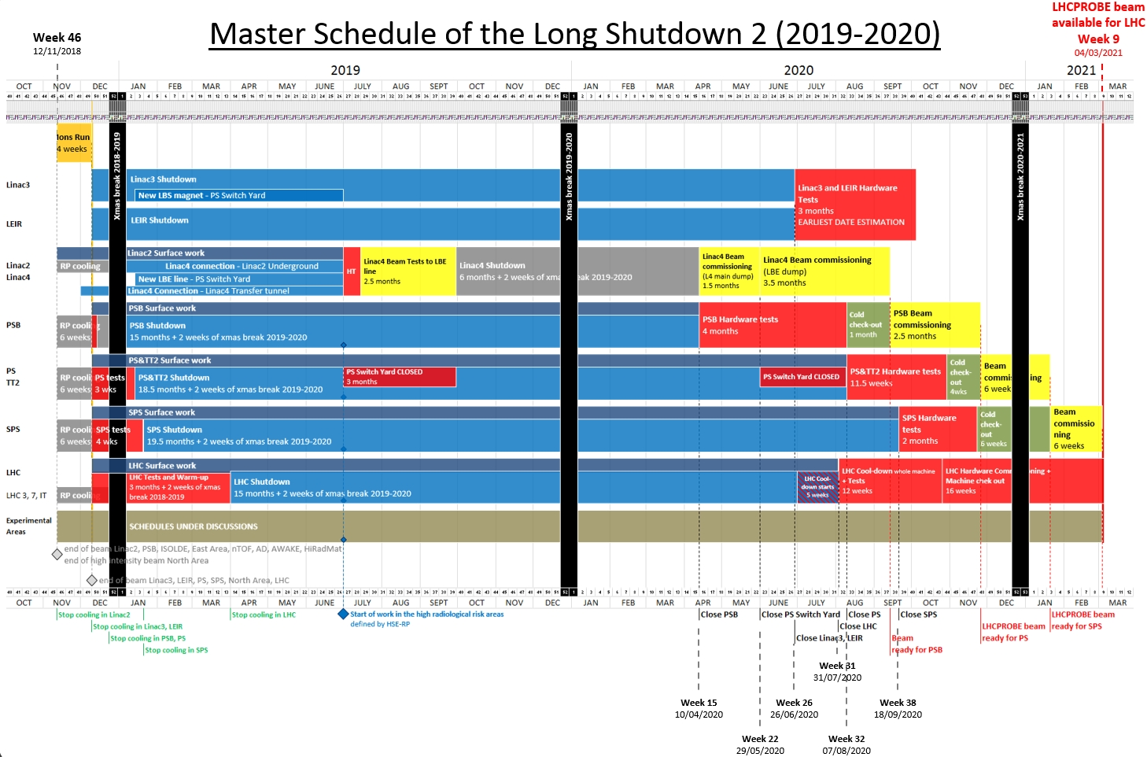
LS2 Schedules
Master Schedule EDMS 1687788
Ions run
4 wks
Full electrical lock out
Subject to a risk assessment.
BE-RF commissioning to start week 46.
Require some general services operational
Cooling water.
Power.
Machine access.
RF
PASS
Mods
POPS
B
RF commissioning
The PS Booster installation activities start on 12th November 2018
TE-MSC HV magnet diagnostics tests
BE-ICS to modify the personnel access safety system (PASS) security chain for future POPS-B operation.. Followed by DSO tests.
TE-EPC POPS-B powering tests with MPS on.
Subject to a risk assessment: BE-RF to remove their equipment located in BRF1 and BRF2.

Slide 4
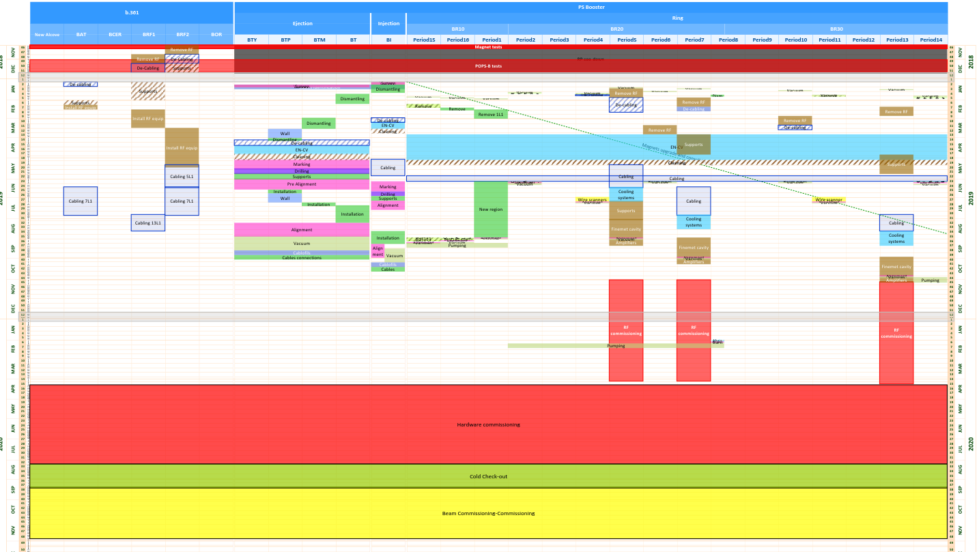
LS2 Schedule
PS Booster EDMS 1810496
A dedicated equipment testing period remains to be defined.
Very optimistic planning, not resource loaded with no contingency.
2018
b.361
PS Booster machine
2019
New Inj region 1L1
2020
Upgrade and consolidation of the inj and ext
New RF Finemet cavities
Hardware commissioning tests
Cold check-out
Beam commissioning

Slide 6
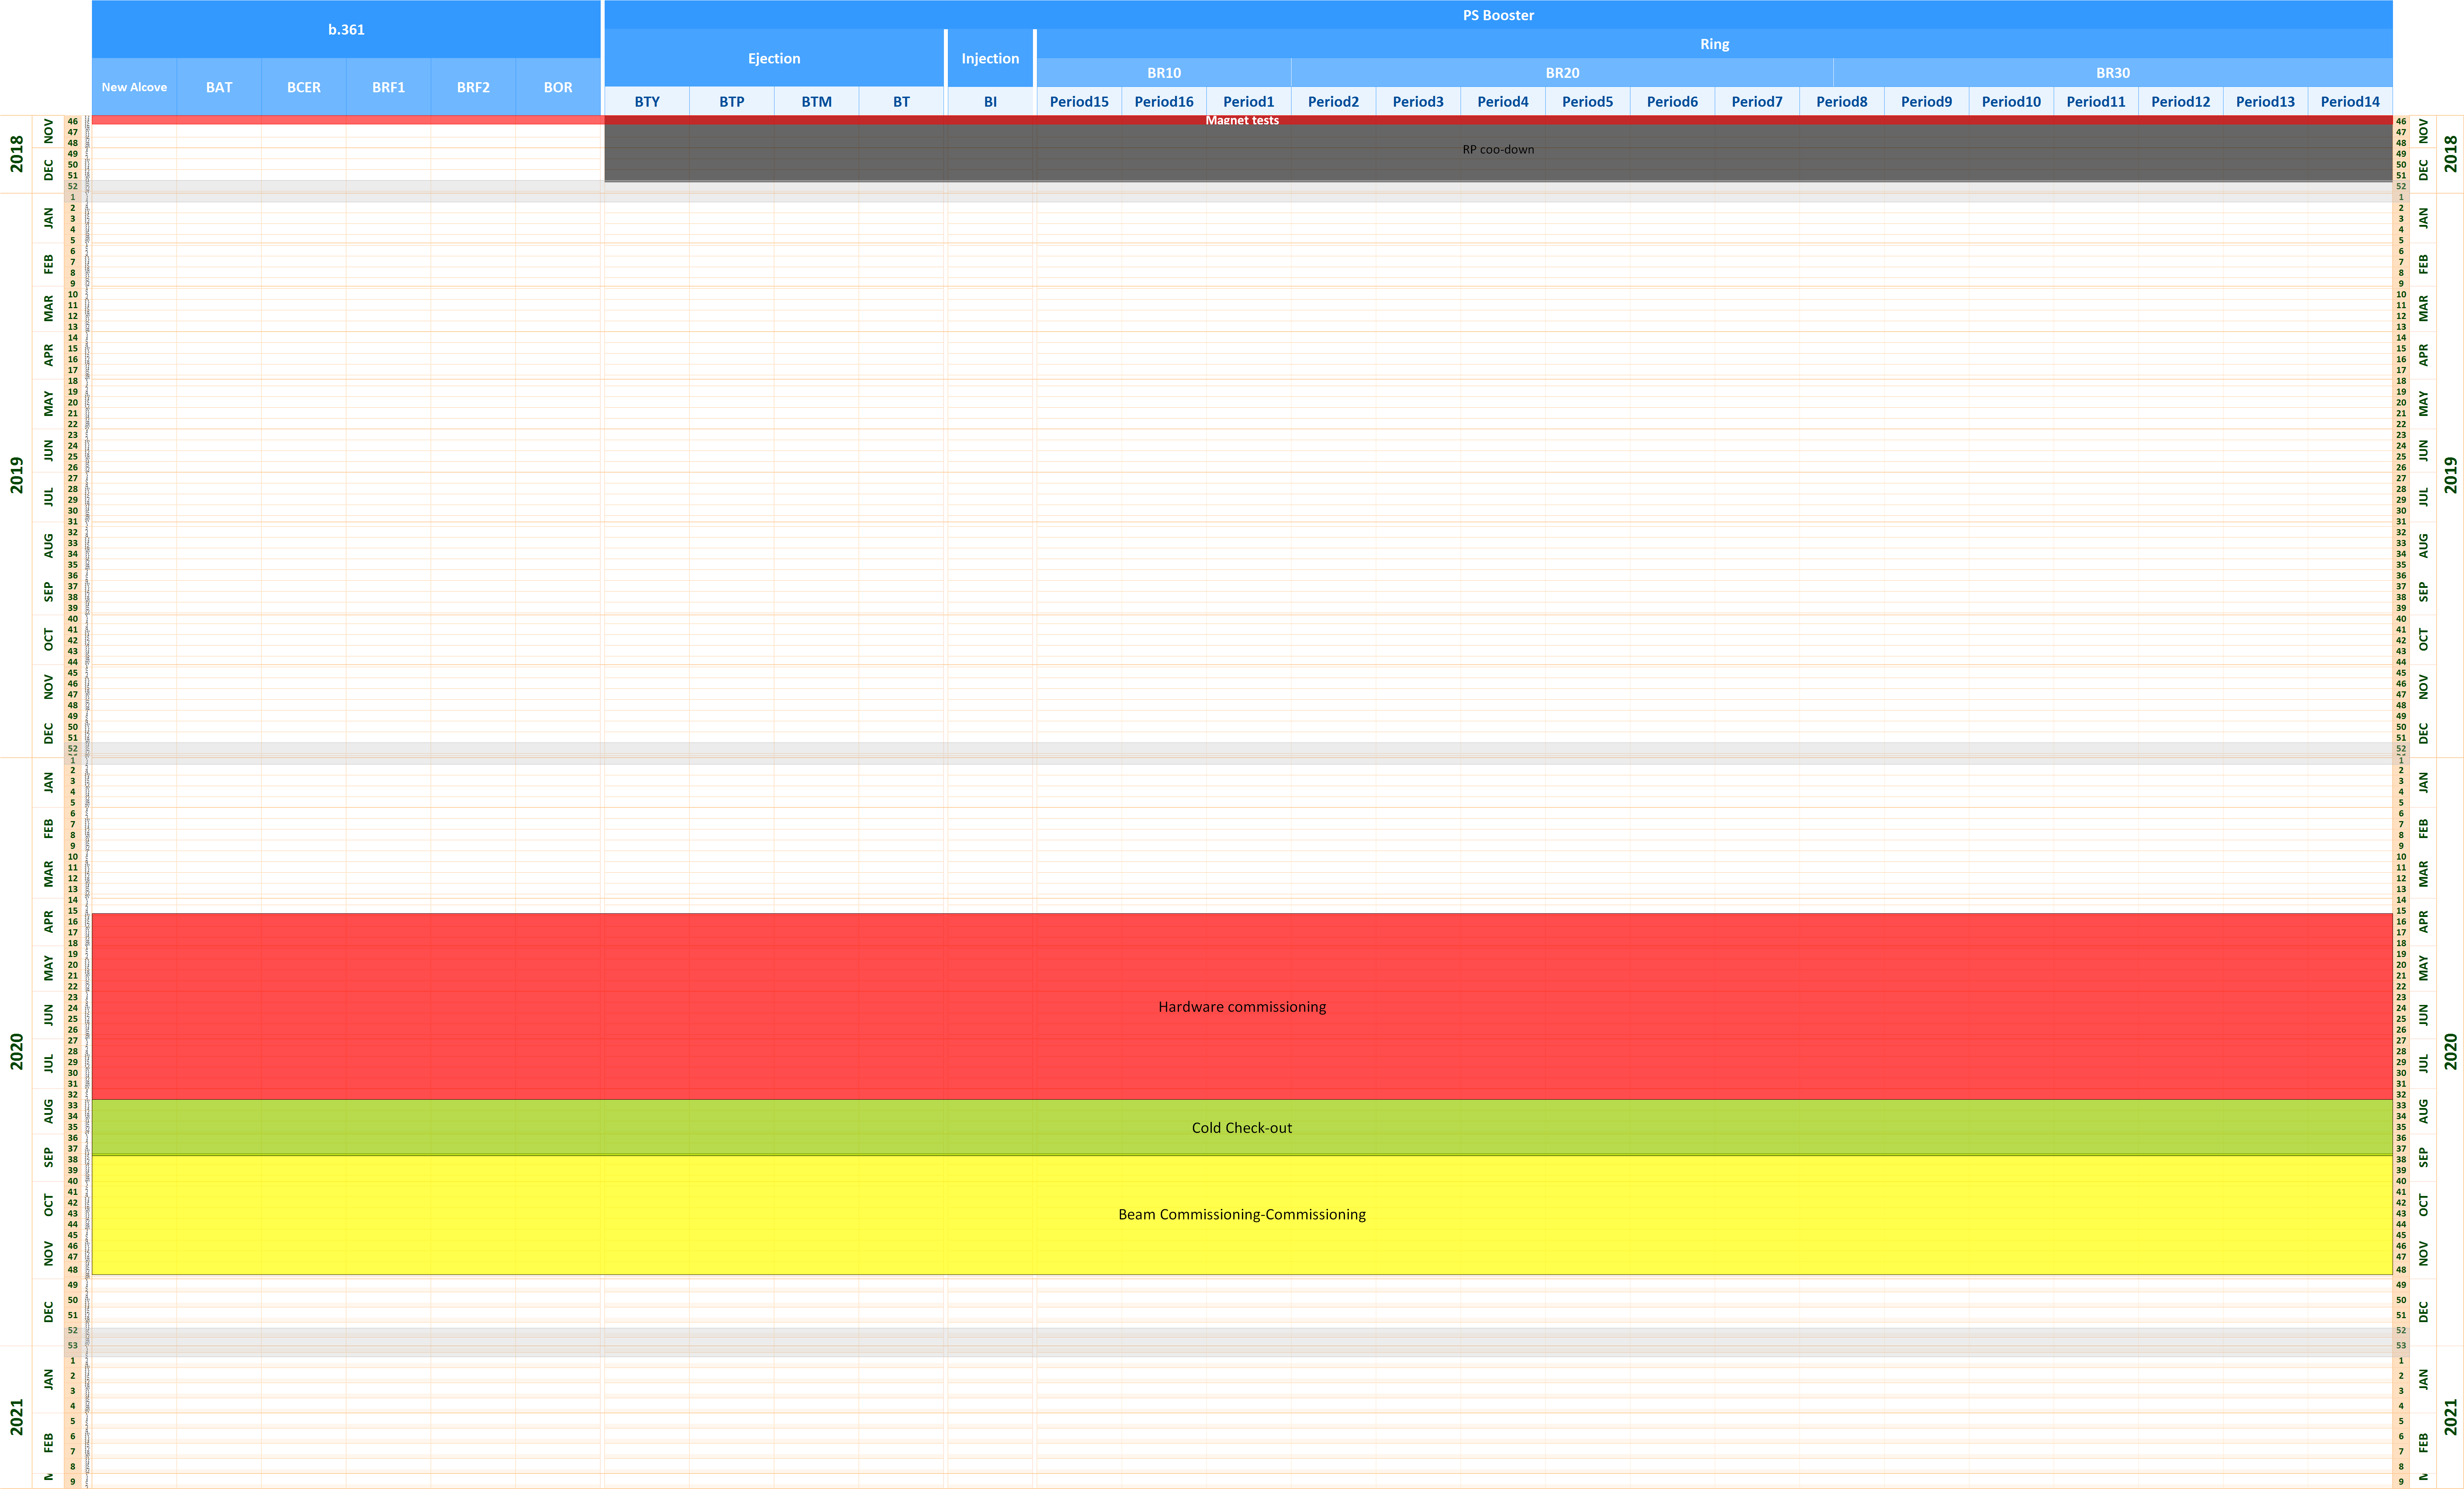
LS2 Schedule
PS Booster EDMS 1810496
b.361
PS Booster machine
RP cool-down
2019
2020
Hardware commissioning tests
Cold check-out
Beam commissioning
2021

Slide 7
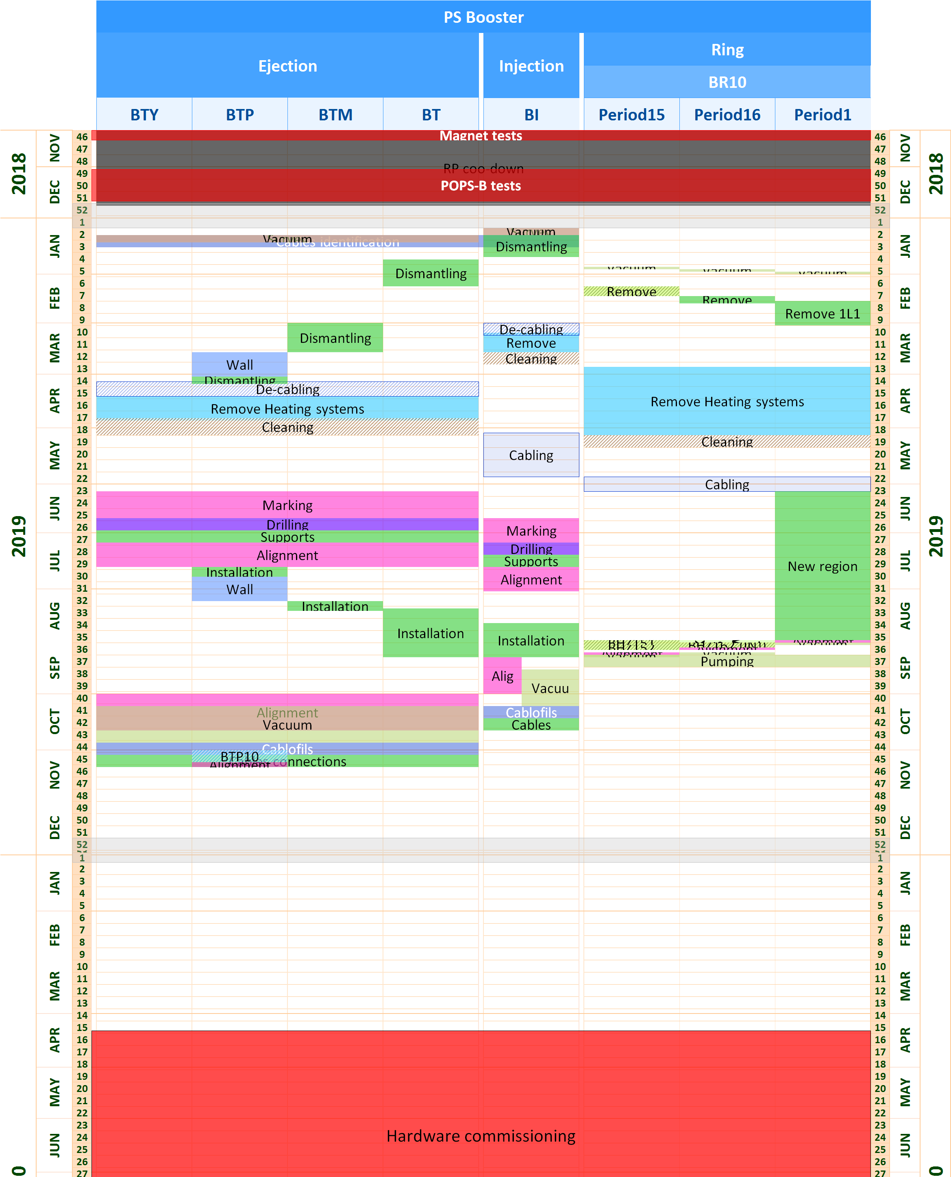
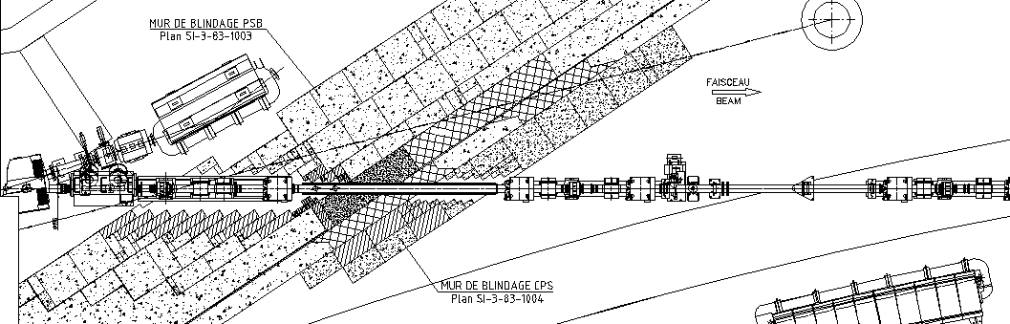
LS2 Schedule
PS Booster
Upgrade and Consolidations of the injection and extraction
The removal of the transfer lines and injection region will be carried out at the early start of the LS2 when the access is authorized by the radioprotection team
There is a late installation readiness of the upgraded beam stopper in November 2019. This could impact the sequencing of re-installation of the extraction lines
The removal and re-installation of the equipment located in the shielding wall between the PS Booster and the PS remain to be defined. This will generate heavy handlings

Slide 8
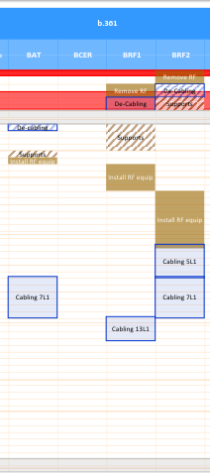
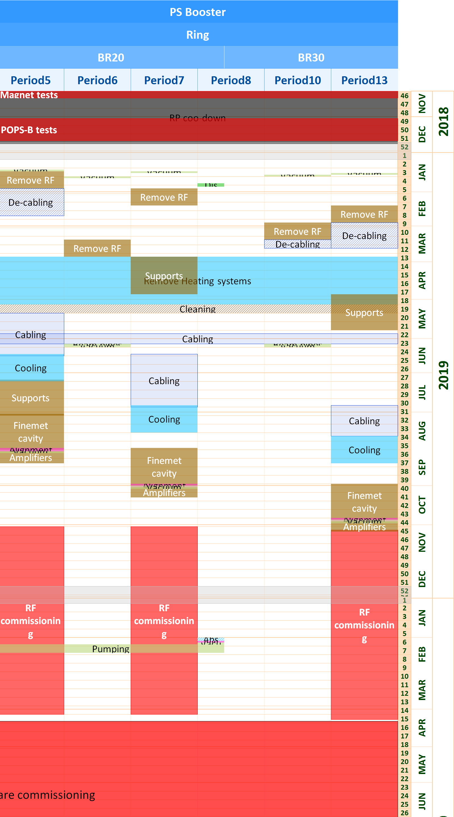
LS2 Schedule
PS Booster
New RF Finemet cavities
The schedule is based on the limited resources availability from the BE-RF team (one team in underground)
The cabling campaigns have been estimated but the schedule remains to be validated with EN-EL according to their resources availability
The RF commissioning (individual system test) shall be compatible with the electrical hazard mitigation
The cooling system shall be available mid-November 2019 to start the RF commissioning
The ME9 consolidation will be in progress. BE-RF shall estimate the necessary electrical powering so that EN-EL organize the electrical suplply
The schedule for the installation of the new absorber/scraper has been reduced to end of 2019

Slide 9
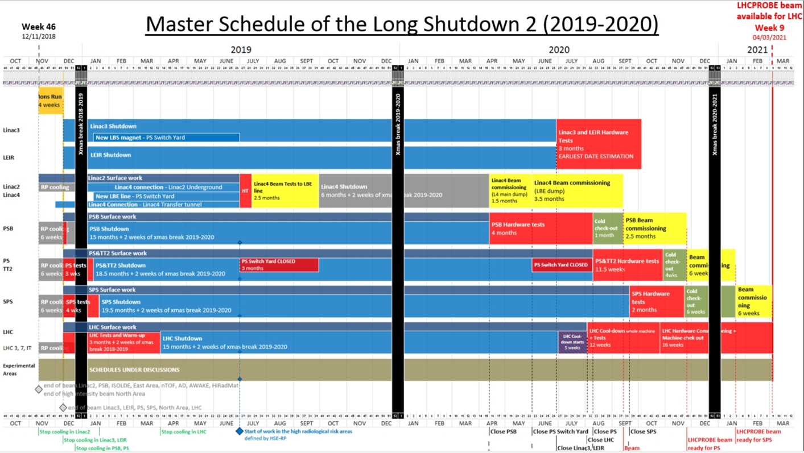
Early availability @ nominal of MEYRIN infrastructure
PP 2
Maintenance 66 kV
Power limitation to 90 MVA
PP 3.a
Maintenance & consolidation
400 kV
MEYRIN and LHC
PP 4
Consolidation ME9
Start of PSB IST
Start of SPS RF IST
PP 3.b
Maintenance & consolidation 400 kV
SPS
PP1
Maintenance LHC
Power reduction to 90 MVA
8 weeks
Auto transfer not available
8 weeks
30 weeks

Slide 10
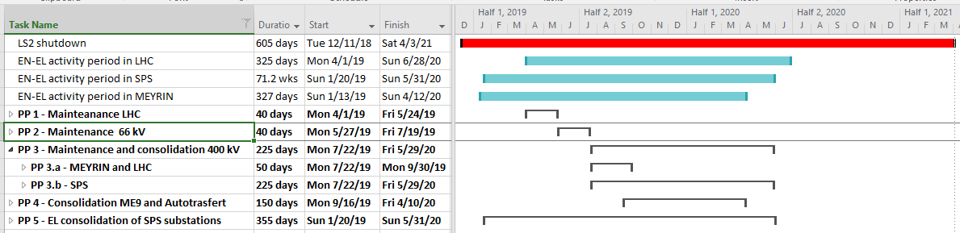
EN-EL Consolidation of upstream electrical infrastructure
No Auto-transfer
No Auto-transfer
Major EN/EL consolidation of upstream electrical infrastructure impacting all CERN site and accelerators
No need for power supply from SIG (CH)
1 period of 8 weeks at reduced power of 90 MVA
2 periods of respectively 8 and 30 weeks without auto transfer
Second source of supply always available manually
Secured network always available at nominal configuration
Requirements
  8 weeks of power limitation at 90 MVA during 66 kV maintenance
  8 weeks of CERN wide 66 kV unavailability (reduced power at 90 MVA)
  10 weeks for maintenance and consolidation of 400 kV supplying Meyrin and LHC
  45 weeks for maintenance and consolidation of 400 kV and BE substation supplying SPS
  30 weeks for the Meyrin primary substation ME9 consolidation

Slide 11
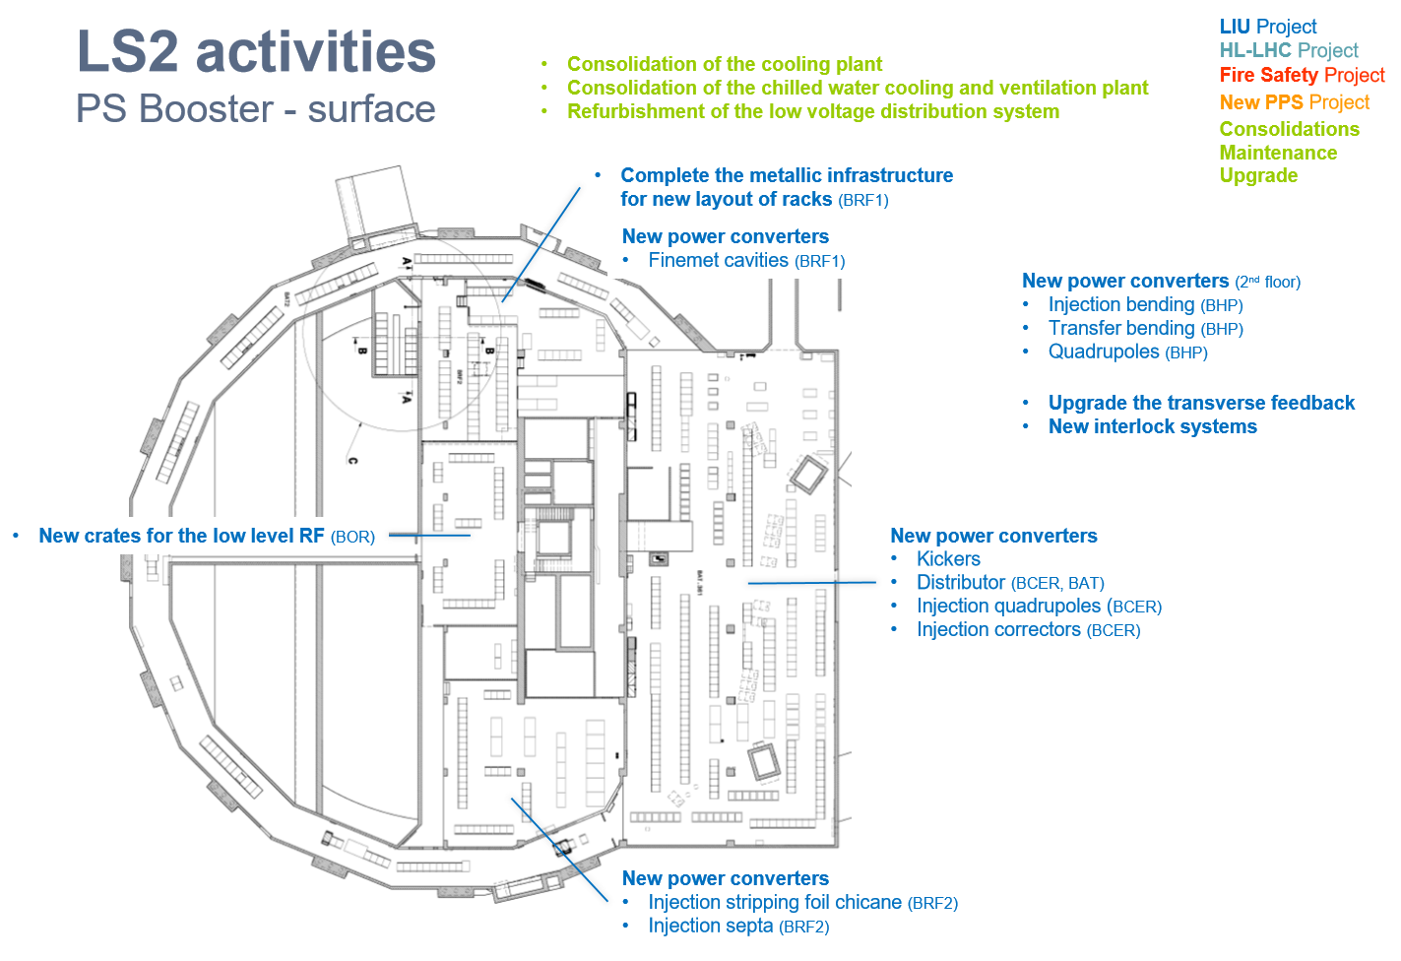
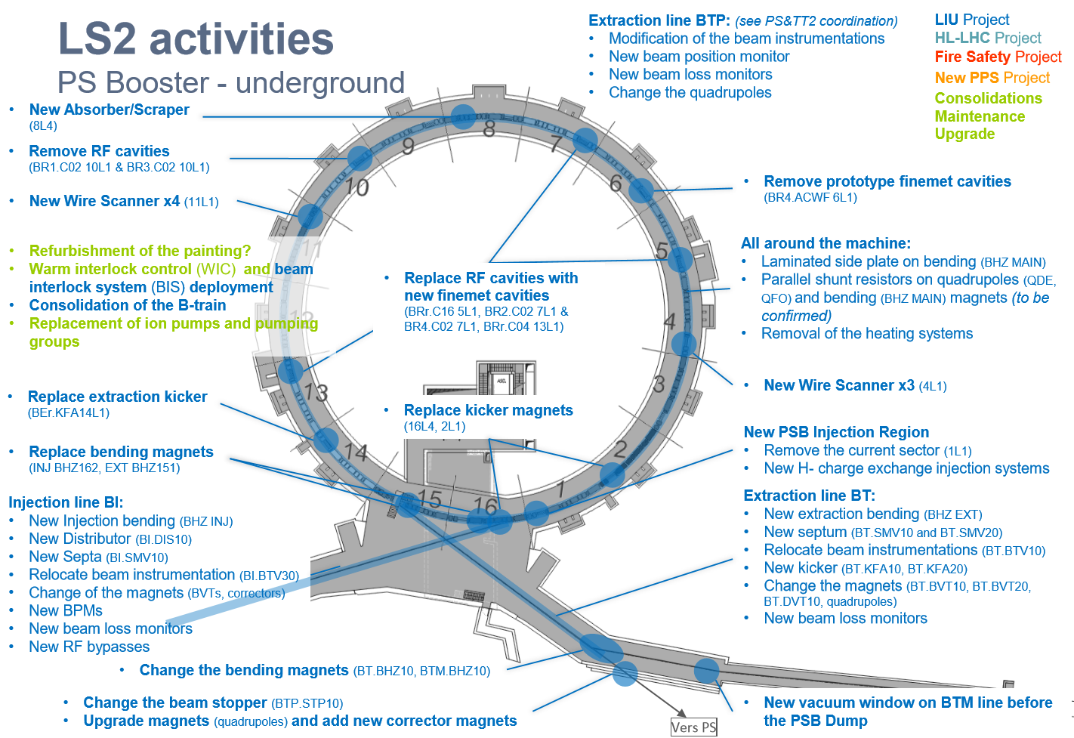
LS2 Schedule
PS Booster

Slide 12
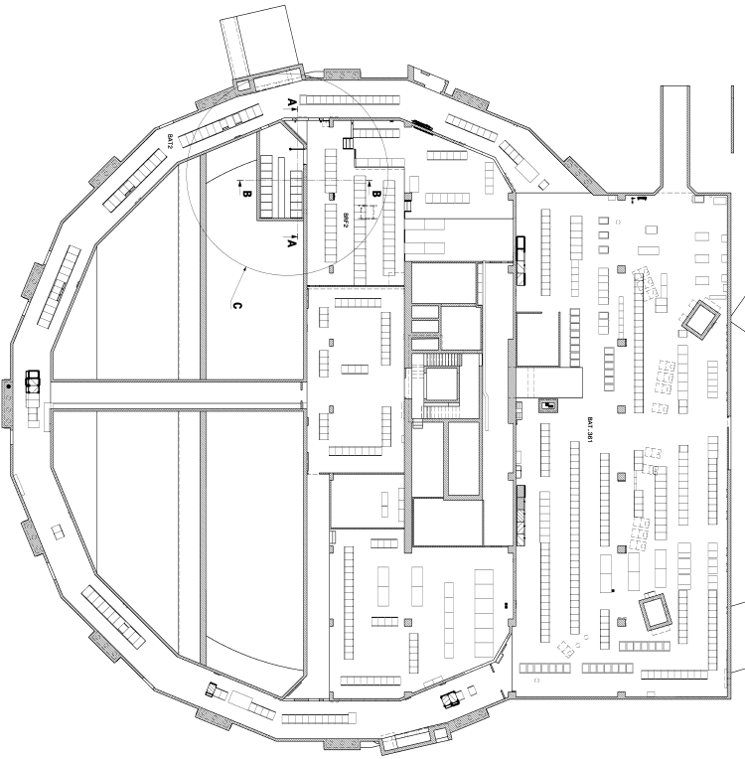
LS2 activities
PS Booster - surface
LIU Project
HL-LHC Project
Consolidation of the cooling plant
Consolidation of the chilled water cooling and ventilation plant
Refurbishment of the low voltage distribution system
Fire Safety Project
New PPS Project
Consolidations
Maintenance
Upgrade
Complete the metallic infrastructure for new layout of racks (BRF1)
New power converters
Finemet cavities (BRF1)
New power converters (2nd floor)
Injection bending (BHP)
Transfer bending (BHP)
Quadrupoles (BHP)
Upgrade the transverse feedback
New interlock systems
New crates for the low level RF (BOR)
New power converters
Kickers
Distributor (BCER, BAT)
Injection quadrupoles (BCER)
Injection correctors (BCER)
New power converters
Injection stripping foil chicane (BRF2)
Injection septa (BRF2)

Slide 13
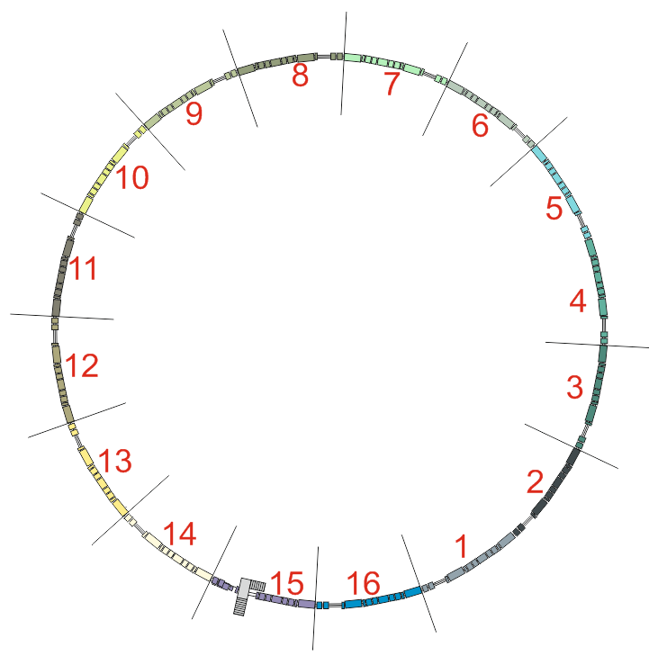
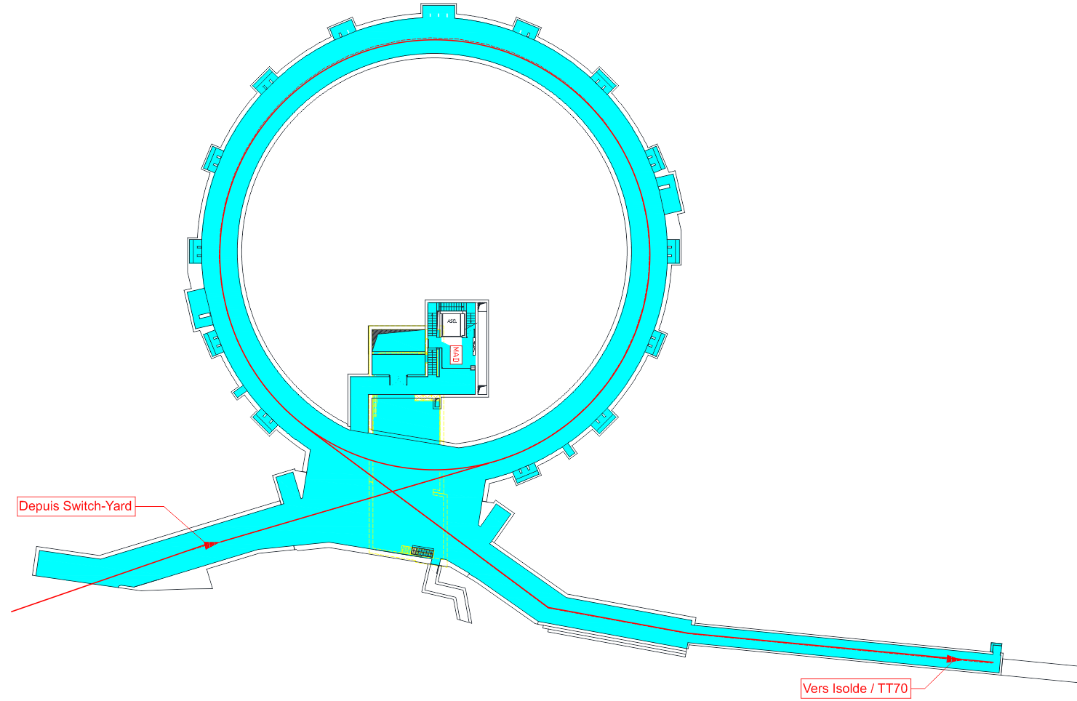
LS2 activities
PS Booster - underground
Extraction line BTP: (see PS&TT2 coordination)
Modification of the beam instrumentations
New beam position monitor
New beam loss monitors
Change the quadrupoles
LIU Project
HL-LHC Project
Fire Safety Project
New PPS Project
New Absorber/Scraper
(8L4)
Consolidations
Maintenance
Upgrade
Remove RF cavities (BR1.C02 10L1 & BR3.C02 10L1)
Remove prototype finemet cavities (BR4.ACWF 6L1)
New Wire Scanner x4 (11L1)
Refurbishment of the painting?
Warm interlock control (WIC) and beam interlock system (BIS) deployment
Consolidation of the B-train
Replacement of ion pumps and pumping groups
All around the machine:
Laminated side plate on bending (BHZ MAIN)
Parallel shunt resistors on quadrupoles (QDE, QFO) and bending (BHZ MAIN) magnets (to be confirmed)
Removal of the heating systems
Replace RF cavities with new finemet cavities (BRr.C16 5L1, BR2.C02 7L1 & BR4.C02 7L1, BRr.C04 13L1)
Replace extraction kicker
(BEr.KFA14L1)
New Wire Scanner x3 (4L1)
Replace kicker magnets (16L4, 2L1)
New PSB Injection Region
Remove the current sector (1L1)
New H- charge exchange injection systems
Replace bending magnets (INJ BHZ162, EXT BHZ151)
Injection line BI:
New Injection bending (BHZ INJ)
New Distributor (BI.DIS10)
New Septa (BI.SMV10)
Relocate beam instrumentation (BI.BTV30)
Change of the magnets (BVTs, correctors)
New BPMs
New beam loss monitors
New RF bypasses
Extraction line BT:
New extraction bending (BHZ EXT)
New septum (BT.SMV10 and BT.SMV20)
Relocate beam instrumentations (BT.BTV10)
New kicker (BT.KFA10, BT.KFA20)
Change the magnets (BT.BVT10, BT.BVT20, BT.DVT10, quadrupoles)
New beam loss monitors
Change the bending magnets (BT.BHZ10, BTM.BHZ10)
Change the beam stopper (BTP.STP10)
Upgrade magnets (quadrupoles) and add new corrector magnets
New vacuum window on BTM line before the PSB Dump
Vers PS

