Slide 1
POPS-B project follow-up
LIU-PSB Meeting 211 20 march 2018
Fulvio Boattini TE/EPC

Slide 2
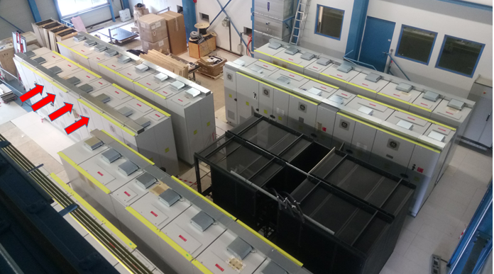
Main Power Converters

Slide 3
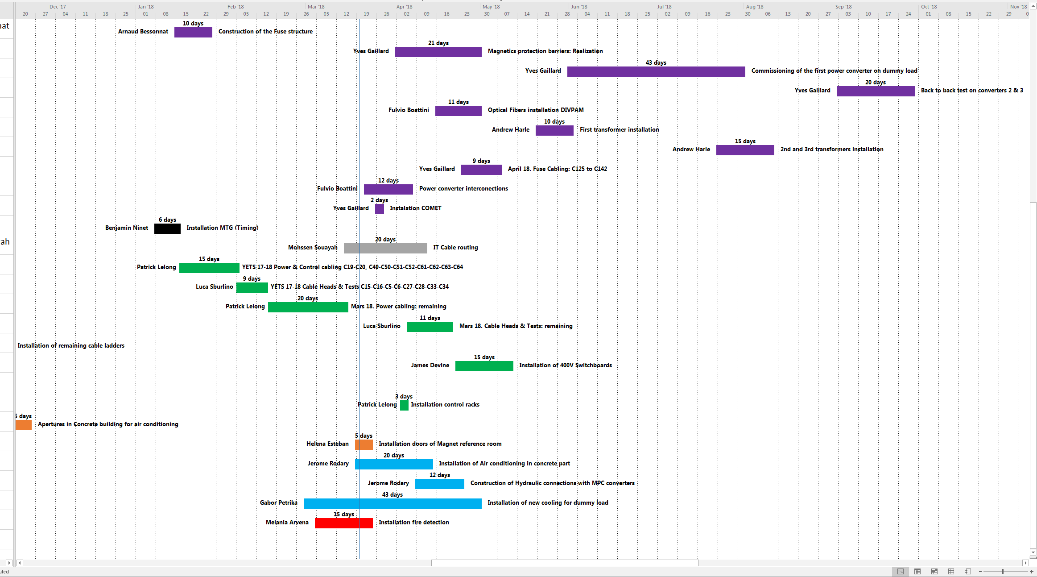
Global plan
IT Cabling
Switch Gears and LV cabling
Hydraulic connections
WL4 in Concrete parcel
Fire Detection OK
See POPS-POPSB_Nov2017 to Dec 2018.mpp → EDMS 1562105

