Slide 1
PSB Transmission Line Measurement: Preliminary Results
Andrew Harle, Antony Newborough & Frank Schmidt

Slide 2
Measurements
PSB Dipole
  4 in Series
  With and without Vacuum Chamber
  RD = { ∞, 4*(10/20/40) } [Ω]
PSB Quad
  QF
  QDD
  Vacuum Chamber
  RD = ∞ [Ω]

Slide 3
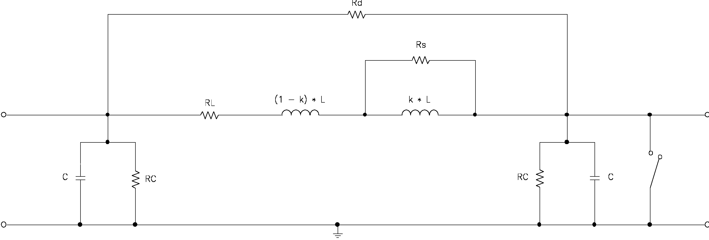
4-Pole Model

Slide 4
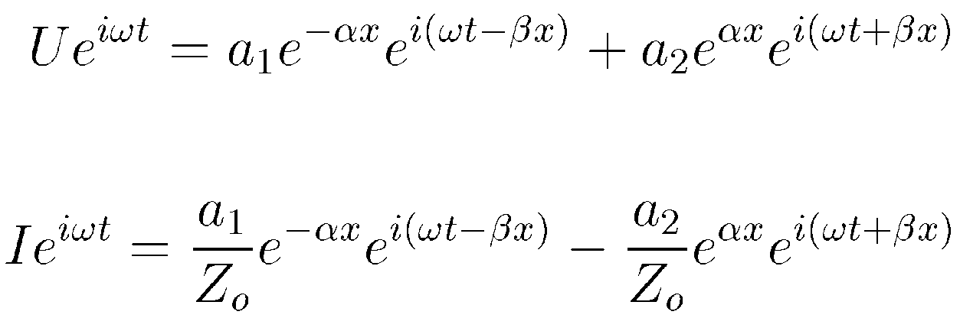
Transmission Line Model

Slide 5
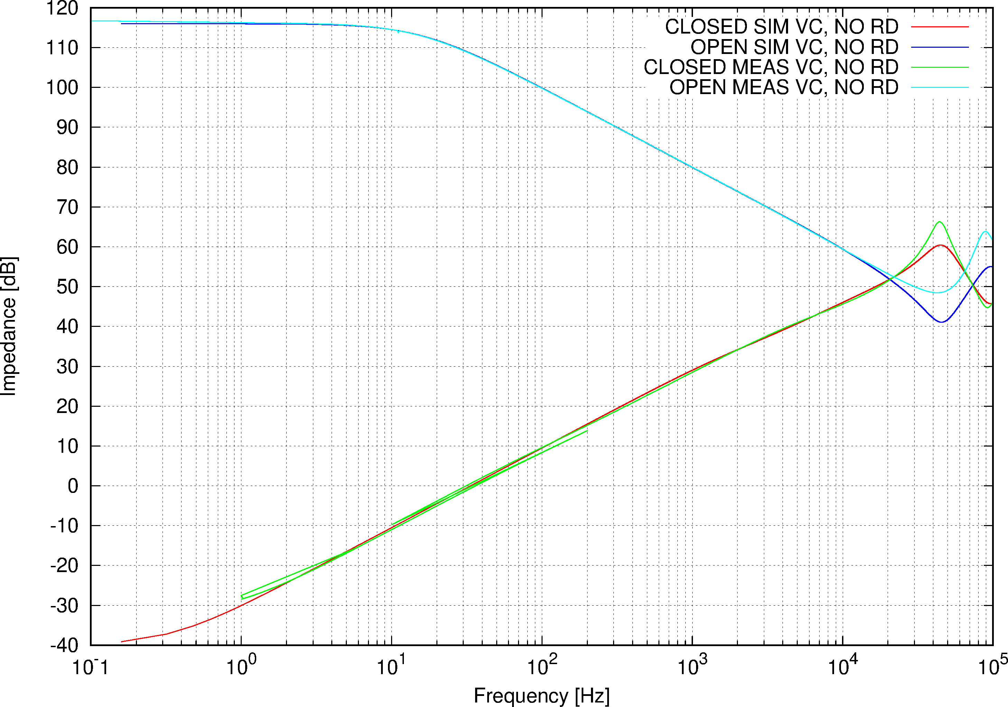
Dipole, VC RD = ∞

Slide 6
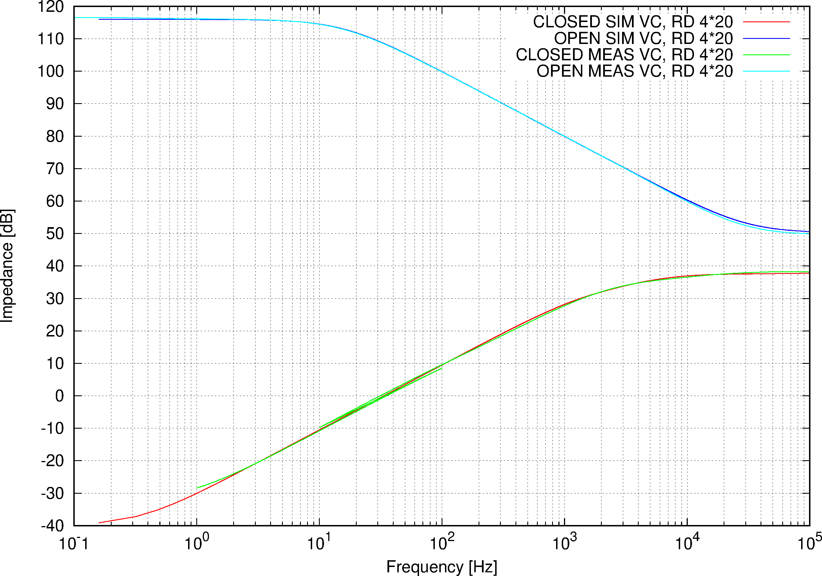
Dipole, VC RD = 4*20 Ω

Slide 7
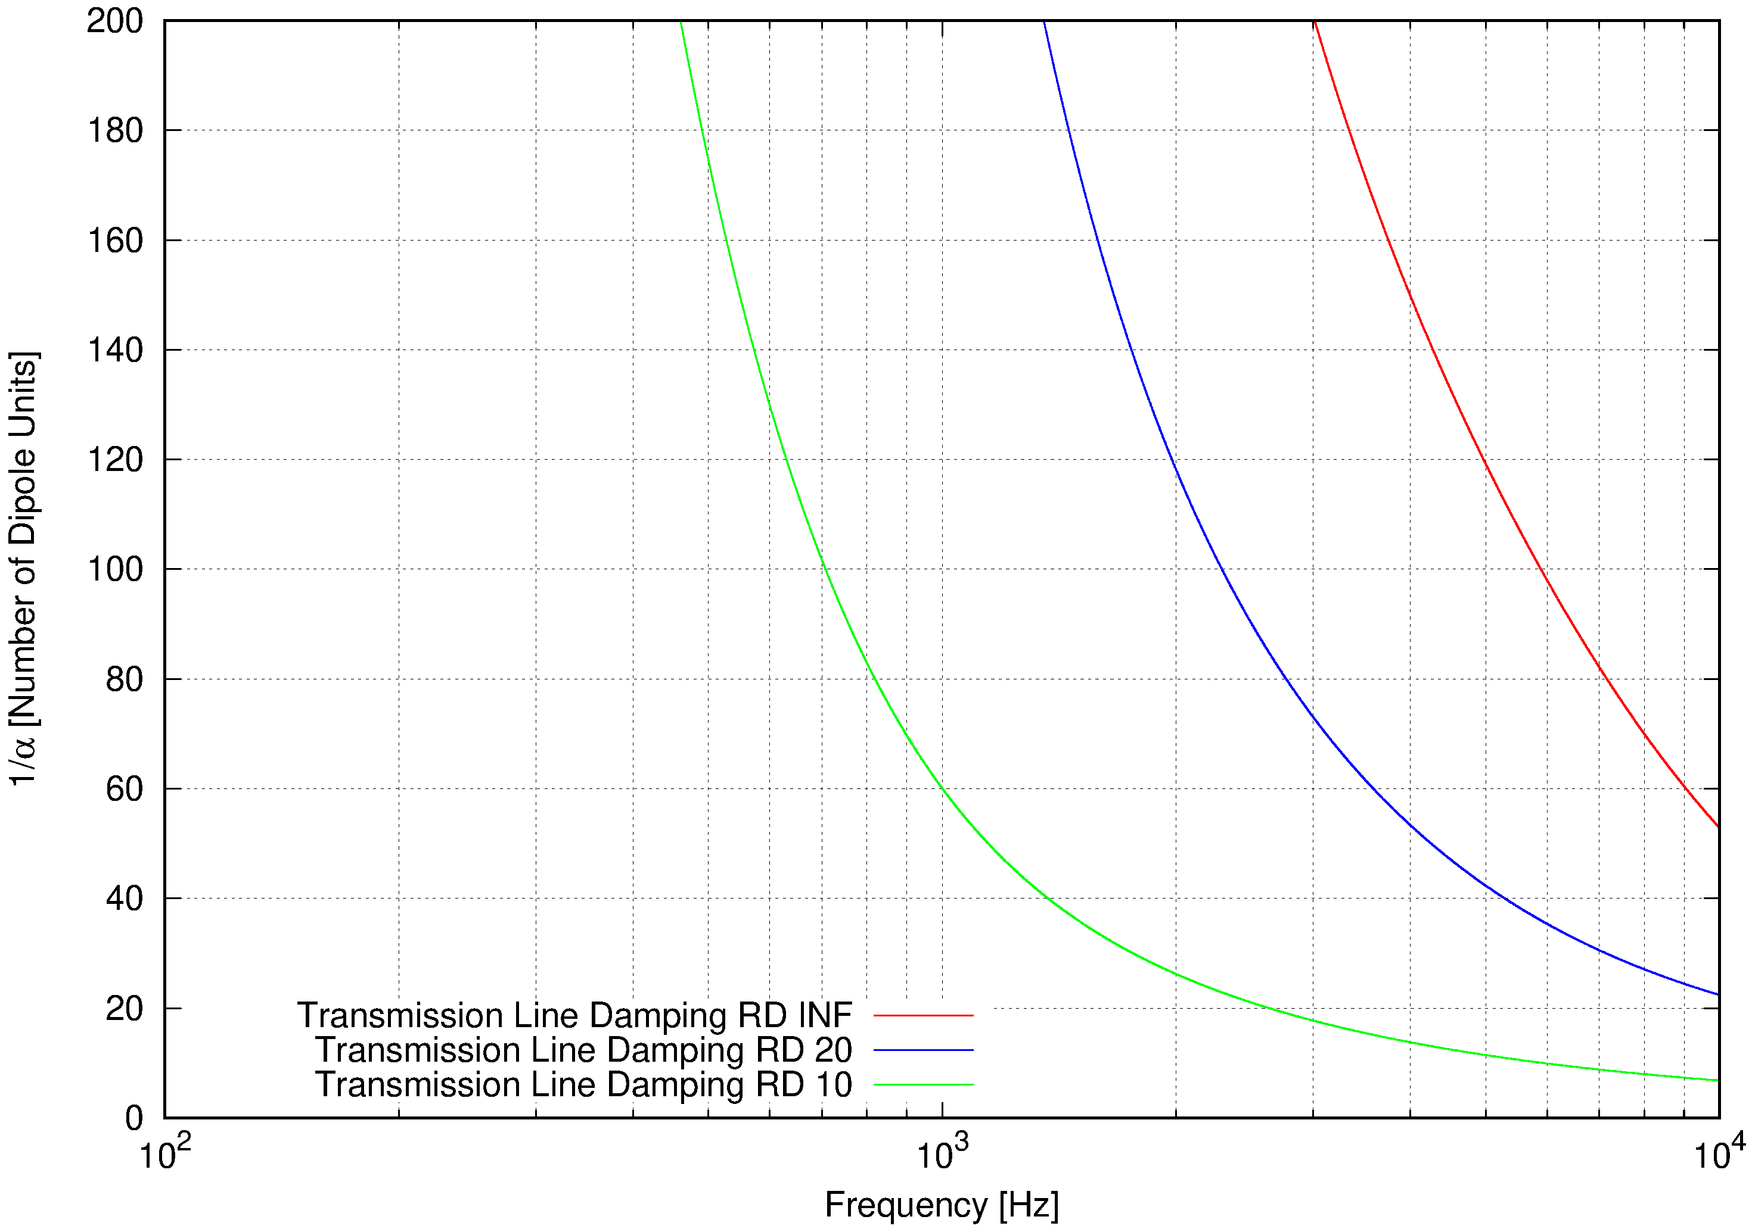
Dipole, VC Damping

Slide 8
Todo List
Finish PSB Dipole
Analyze PSB Quads
Full Magnet Chains
Measurement of Full Chain in 19th of June
Proper Documentation missing from the early Days!

