Slide 1
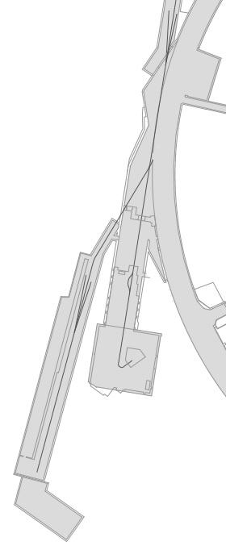
Linac 4 to PSB
Connection Project
A. Berjillos EN/ACE/OSS
167850

Slide 2
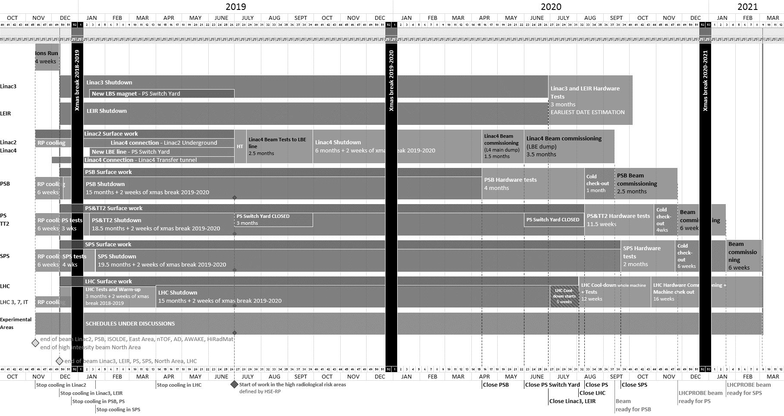
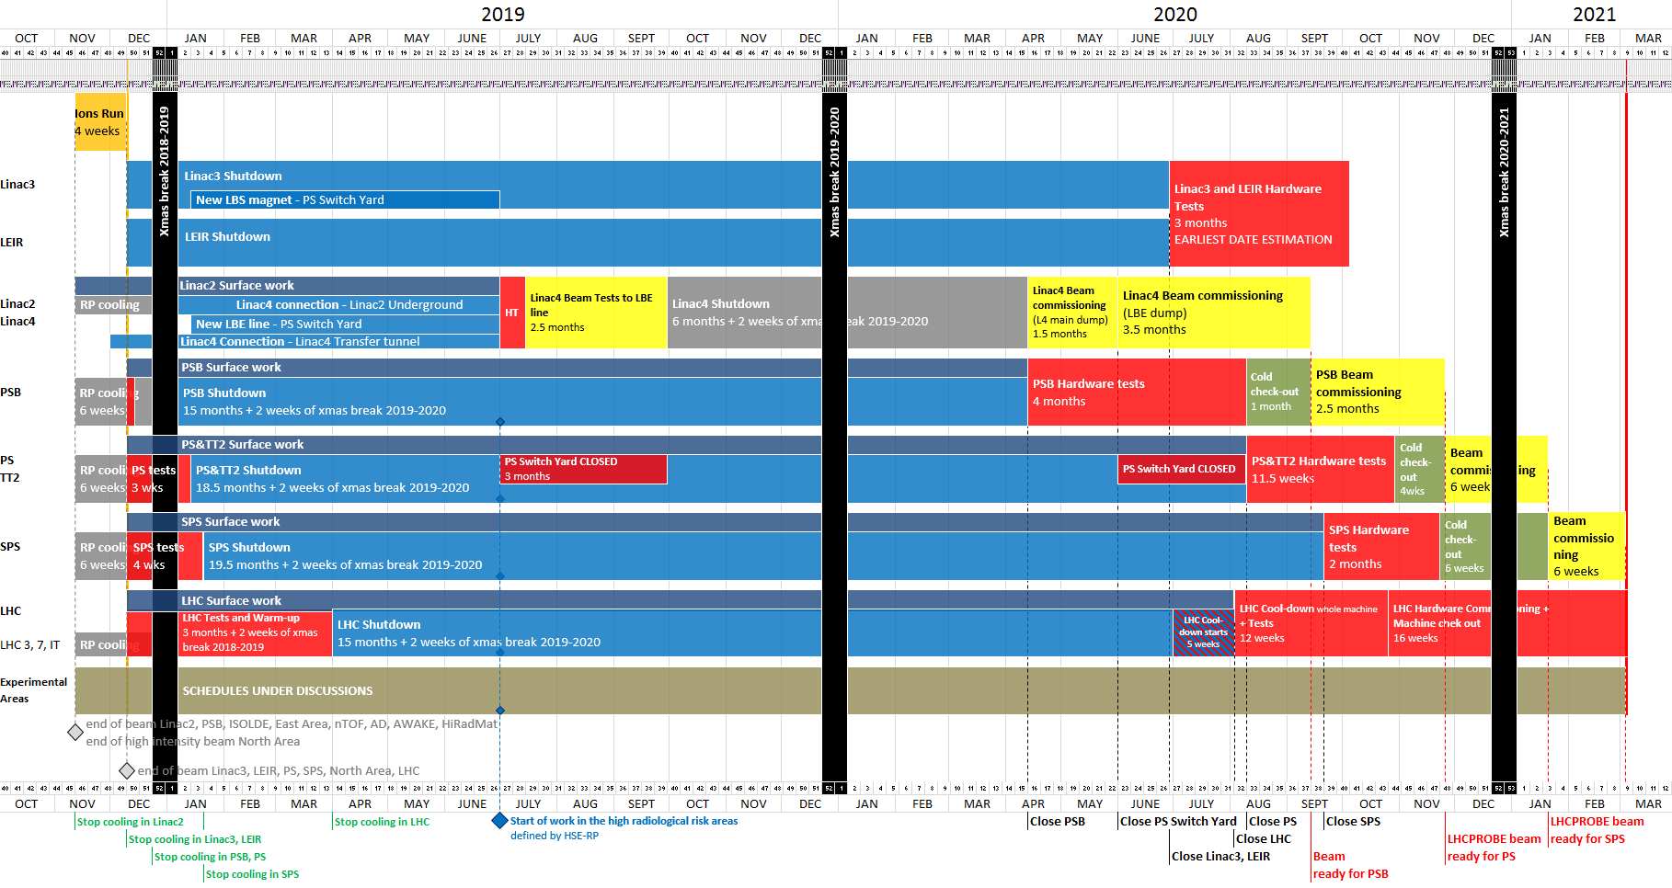
EDMS: 1687788
LHCPROBE beam
available for LHC
Week 9
04/03/2021
Master Schedule of the Long Shutdown 2 (2019-2020)
Week 46
12/11/2018
Week 31
31/07/2020
Linac 4 is not on the critical path of LS2
Week 15
10/04/2020
Week 26
26/06/2020
Week 38
18/09/2020
Week 22
29/05/2020
Week 32
07/08/2020

Slide 3
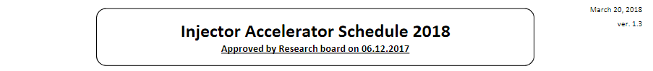
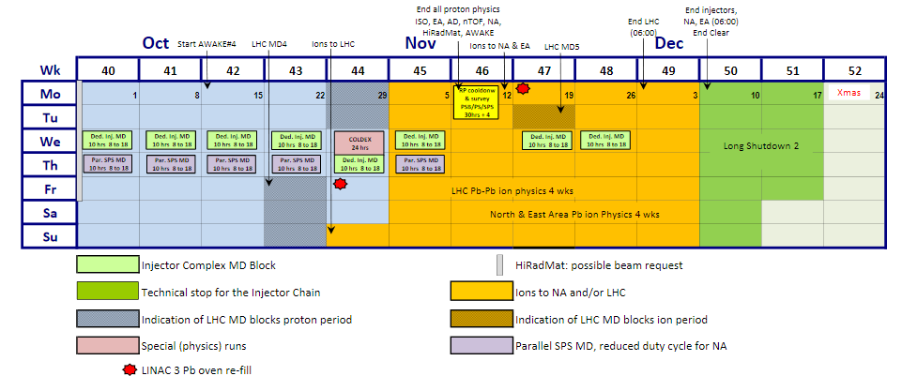
Key-date to start the connection:
  12th November 2018 for L2 activities outside of the access controlled area
  7th January 2019 for L2 activities inside of the access controlled area

Slide 4
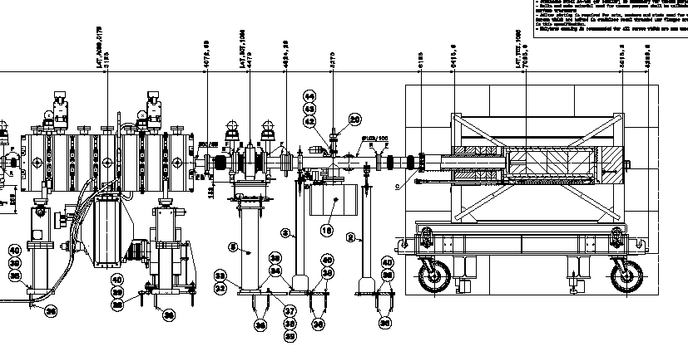
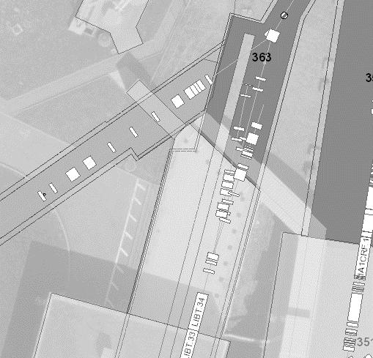
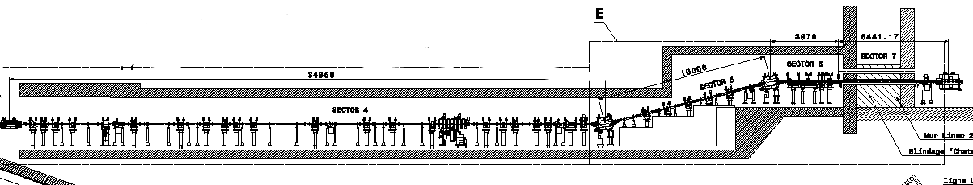
Linac 4 Connection
Main Activities for the completion of the Linac4 transfer line, L4T,(bldg.410)
  Removal of the temporary beam dump for the de-buncher
  Removal of the equipment on the platform to finalize the infrastructure work (civil engineering holes, cables trays, cabling and piping works)
  Completion of the line and relocation of the BSM
Activities planned from Dec’2018 to April 2019
L4T.ACDB.1075
Reference: SPLLJLTL0029
Reference: SPLLJ___0005

Slide 5
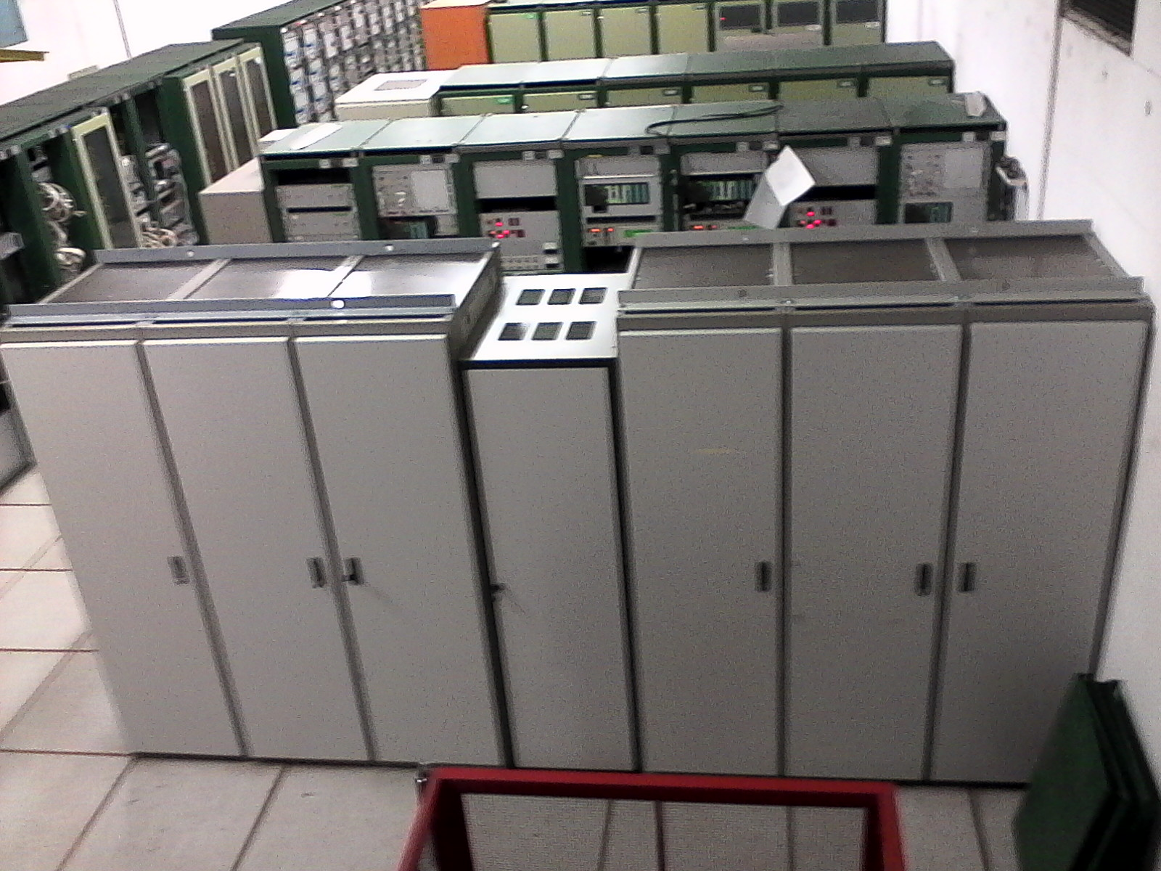
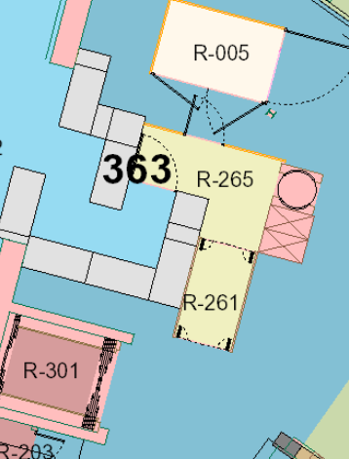
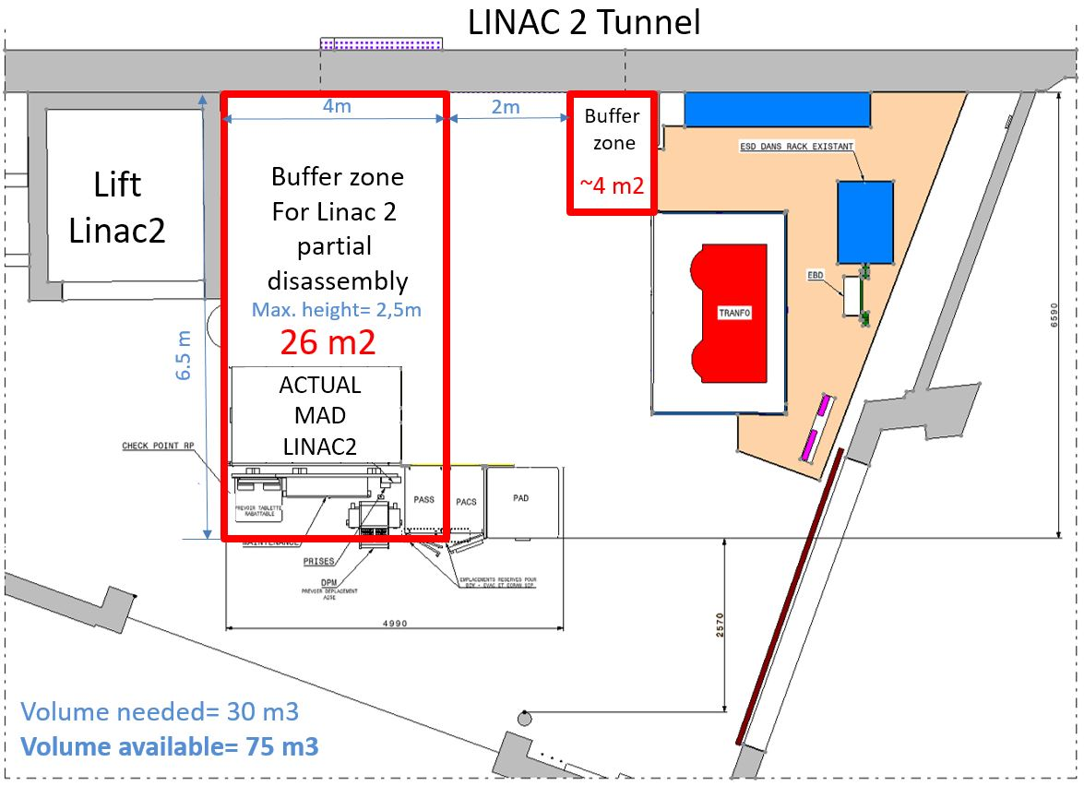
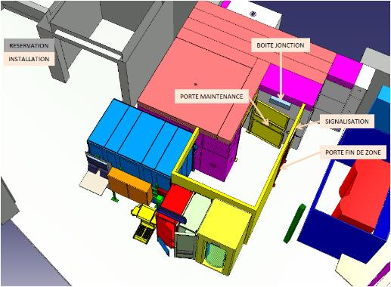
Linac 4 Connection
Main Activities OUTside of the Linac 2 access controlled area
Re-configuration of the Linac 2 rack room in 363/1-001 → Nov’2018 - … Tbc
Cabling/Decabling activities → Dec’2018 ? Tbc
Removal of the Linac2 access system → Nov’2018
  Removal of access chicane → Nov’2018 – Dec’ 2018
  Installation of temporary access point with a SUSY system and a guard → Dec’2018 up to the end of the installation
Electrical power consolidation, outside and inside of L2 tunnel → Dec’2018
  This activity is out of L4 project scope → James Devine, EN-EL

Slide 6
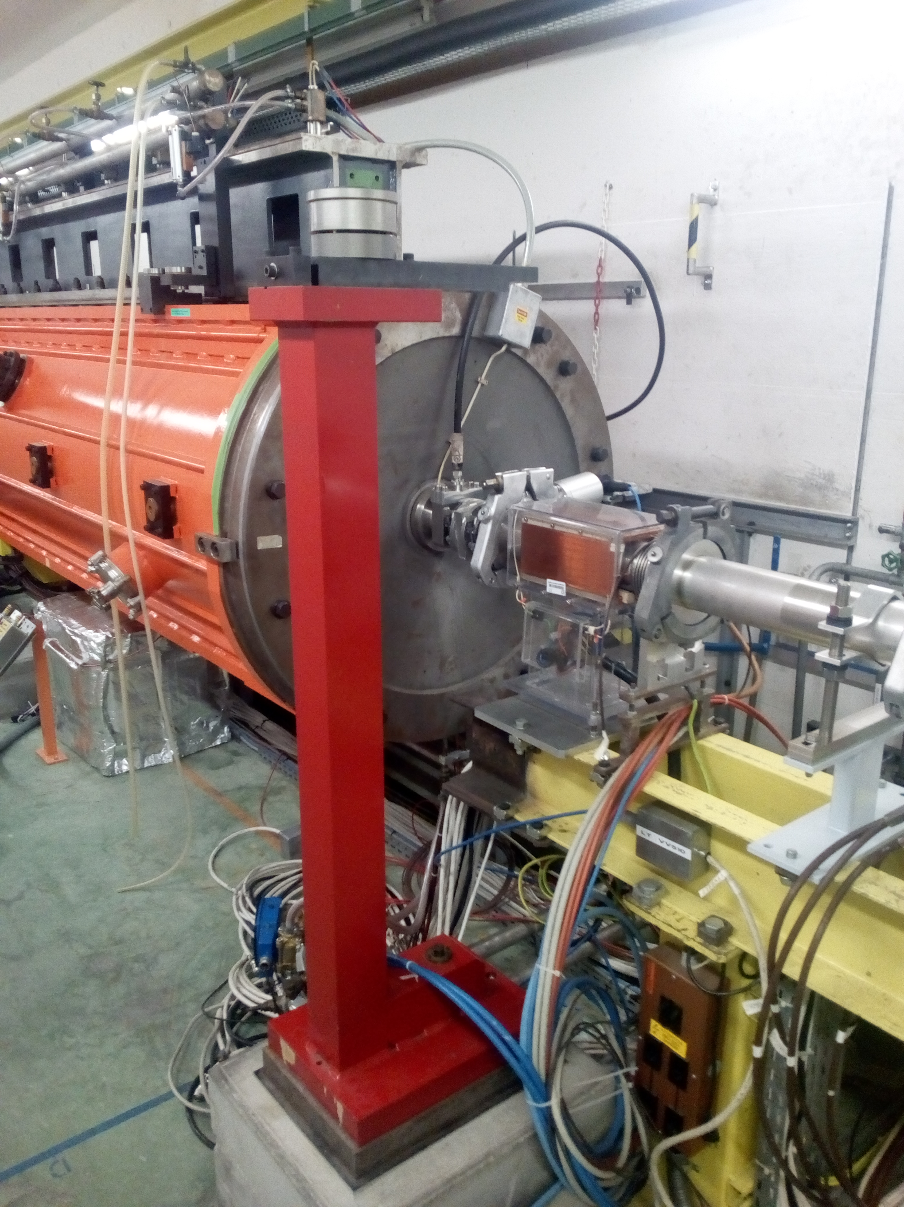
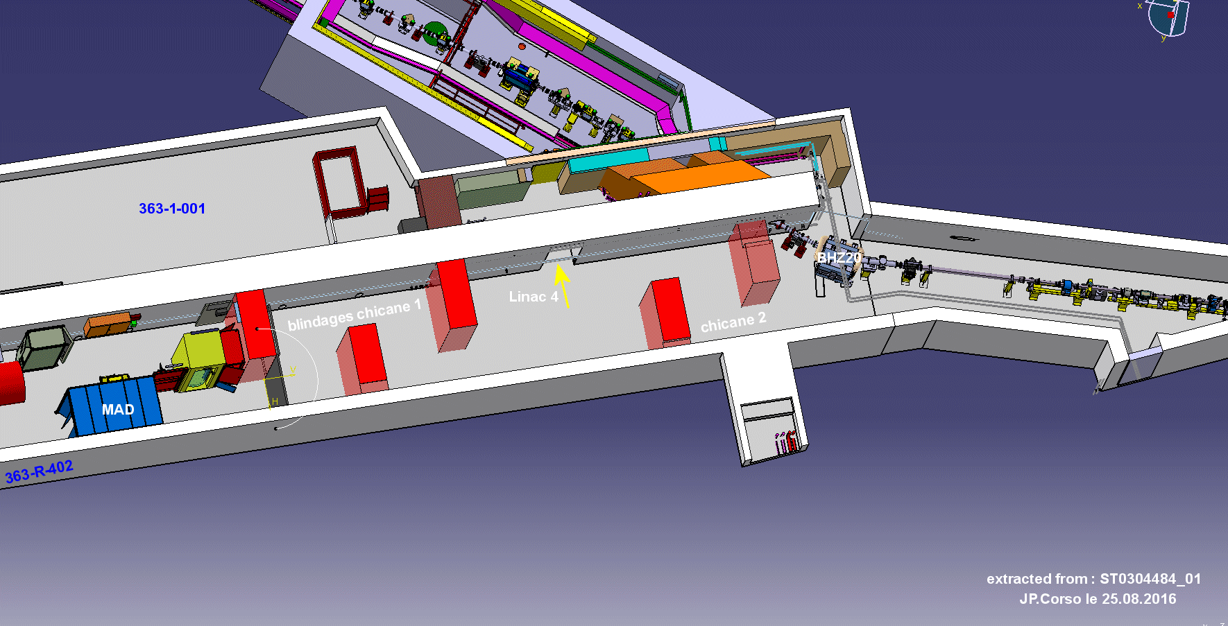
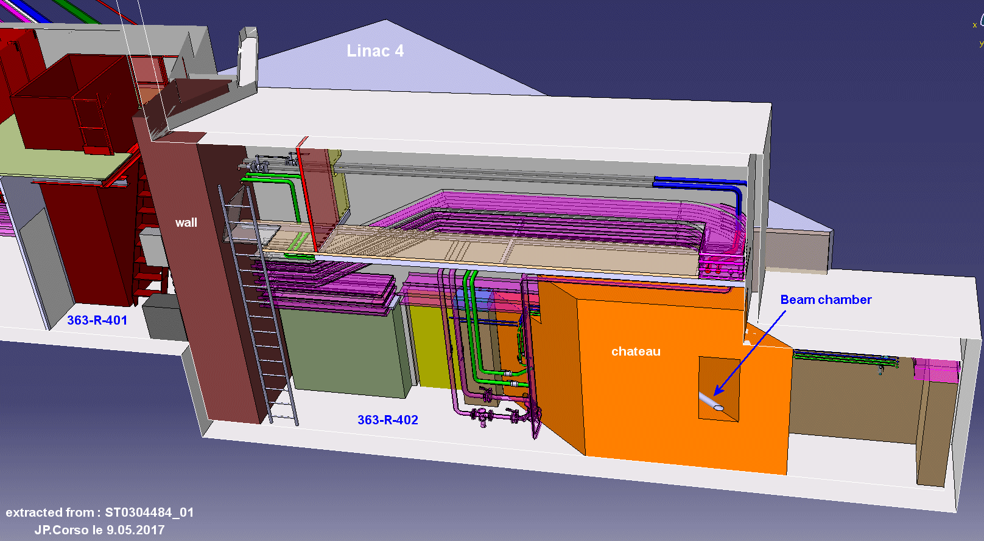
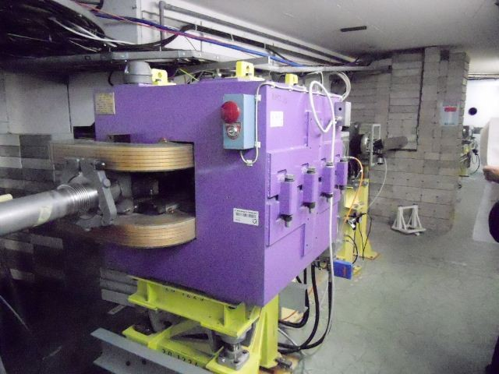
Linac 4 Connection
Main Activities INside of the Linac 2 access controlled area
Removal of the beam lines, LT-LTE-LTL (former LTS) lines→ January-February 2019
Removal/Modification of infrastructures
  Chateau shielding area → February to April 2019
    Removal of the existing bricks shielding
    Make the passage from L4 to L2
    Build the ‘chateau’ shielding
    Build the new shielding between R207-R208
  EN-CV activities → March – April 2019
  EN-EL activities → April 2019
Installation of the new LT.BHZ20 and completion of the beam line → March 2019
Installation of the chicanes → April 2019
Installation and commissioning of the access system in the tunnel → May-June 2019

Slide 7
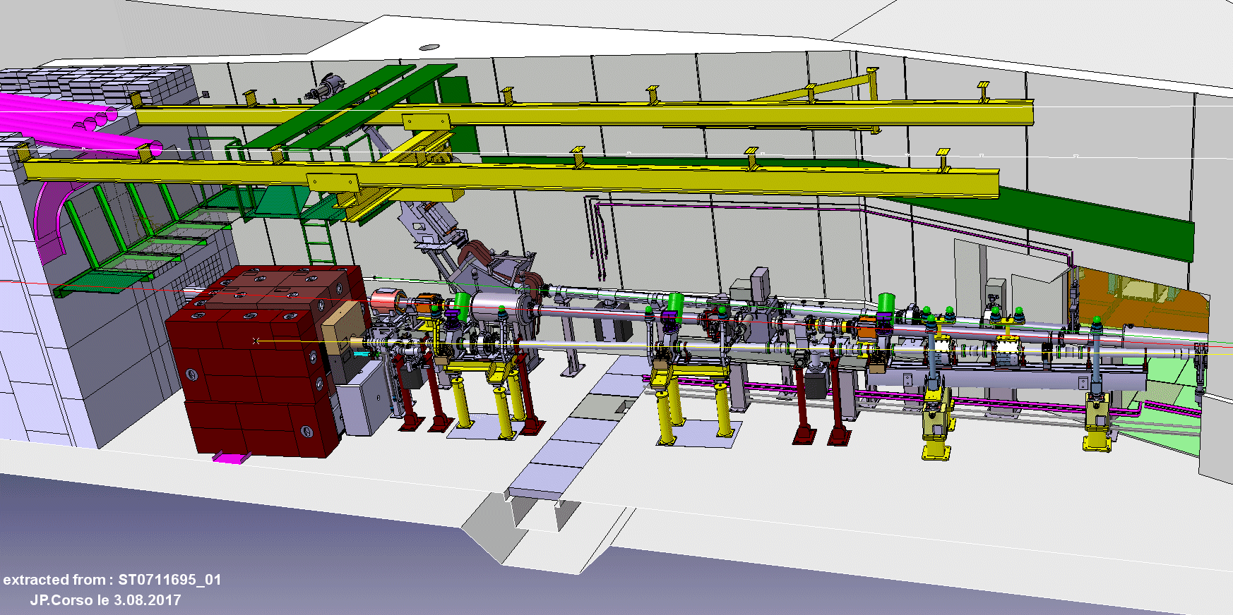
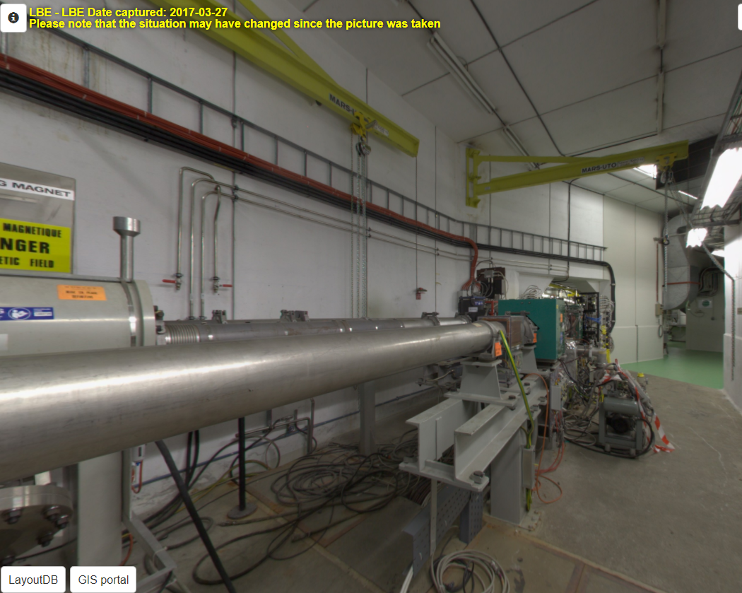
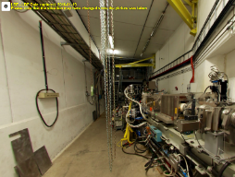
Main Activities INside of the SWY area
Removal of the LBE-LBS- BI, from LTB.BHZ40 up to the wall shielding → Feb’2019
Removal of metal platform and partially the wall shielding (decreasing the thickness from 6 to 4 m) → February-March 2019
Installation a new crane and a new platform → March 2019
Re-installation of BI and new LBE lines → March to May 2019
  Temporary shielding instead of the BI stoppers
Re-installation of the LBS line is out of the L4 connection project scope, it could be done after L4 test → Ideally, at the same time of LBE installation, if the magnet LBS.BVT10 is ready

Slide 8
Activities after the L4 test to LBE line
Installation of the vacuum chamber in BI line instead of the temporary shielding
Highlights:
Some equipment have been identified as orphan:
  LTS.KVT10, LTS.KVT15, LTE.KVT10, LTE.KHZ10, K1V, K1H →These Kickers will be kindly removed by TE-MSC who will request an extra budget for this activity
  LT.BHZ10 is declared as an orphan equipment → who will take care of the removal?
After the L2- LBE areas disassembly a refurbishment of the area will be necessary ( floor defects reparation, painting work) → The cost is being evaluated by SMB
A dedicated person to follow the activities on-site, would guarantee the right disassembly/installation of the supports, infrastructures and equipment

Slide 9
Roadmap of the coordination:
Linac 4 connection coordination 2018 Kick-off meeting → 7th May 2018
If needed, a meeting on 28th May 2018 with the groups’ feedback included on the planning for discussion → Detailed updated planning will be ready for end of May
Since June onward, Linac 4 connection project will be included in the PS/PSB/Linac2-3 coordination meeting, on Thursdays at 10:30.
Main ECR documents of this project:
CPS-LJ-EC-0002, Connection of the Linac 4 to LT.BHZ20 → It’s already approved at the LIU-PLI meeting and waiting for the approval of CPS-LJ-EC-0003 to be presented at the same time at IEFC
CPS-LJ-EC-0003, Partial Disassembly of Linac 2 → Version 0.3 will be launched for approval at the end of this week
CPS-LJ-EC-0005, LBE line and infrastructure upgrade for the Linac 4 → The integration is being finalized a new version will be launched for approval

Slide 10
Thank you for your attention.
Q’s?

