Slide 1
LIU-PSB EVM Status
8 May 2018

Slide 2
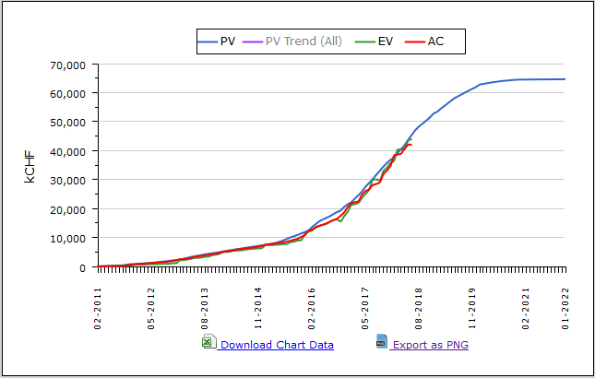
LIU-PSB Dashboard
Cost Variance : 1,794 kCHF
Schedule Variance : -0.39 months

Slide 3
LIU-PSB Crosstab by Group

Slide 4
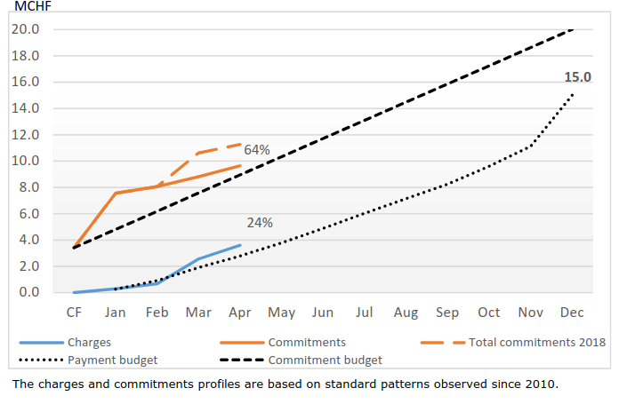
LIU-PSB Budget Situation 2018

Slide 5
Spare Slides

Slide 6
LIU-PSB Crosstab – BE Department

Slide 7
LIU-PSB Crosstab – EN Department

Slide 8
LIU-PSB Crosstab – HSE, SMB Departments

Slide 9
LIU-PSB Crosstab – TE Department

