Slide 1






WG Report: Experimental Group
Suzanne GASCON-SHOTKIN
IPN Lyon (IN2P3-CNRS)/Université Claude Bernard Lyon 1
Seema SHARMA
IISER-Pune
IISR-Pune
February 26, 2018

Slide 2

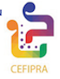
The Experimental WG: Current/potential members (30!)
Lyon Node:
  Senior: M. Lethuillier, S. Gascon-Shotkin, M. Gouzevitch
  Postdoc: L. Finco Students: C. Camen, S. Zhang
Saclay Node:
  Senior: M. Besançon, P. Gras
Bangalore/Chennai Node:
  Senior: J. Komaragiri
  Students: P. Chandra, L. Panwar
Mumbai/Pune Node:
  Senior: S. Dube, S. Sharma, A. Thalapillilil, (IISER) M. Guchait, G. Majumder, K. Mazumdar , R. Sharma (TIFR)
  Students: S. Chauhan, V. Hegde, B. Kansal, A. Kapoor, K. Kothekar, S. Pandey, A. Rane, A. Rastogi (IISER)
Kolkata Node:
  Senior: S. Bhattacharya (SINP), P. Mal, B. Mohanty (NISER)
  Students: A. Purohit, P.K. Rout (SINP)

Slide 3
Activities of the Experimental WG since the Bangalore kickoff (May 2016)
Initial brainstorming in Bangalore…
Informal coffee meeting during June 2016 CMS Week @ CERN→Planning of INFRE-HEPNET ‘satellite’ meeting for Nov. 2016 CMS Week @TIFR…

Slide 4
Activities of the Experimental WG since the Bangalore kickoff
The ‘satellite’ meeting including:
  guest talks by TIFR theory colleagues in the AM
  CMS internal session in the PM
took place on Nov. 19 2016

Slide 5
Status of concrete projects in the Experimental WG
One project begun during the Nov. 2016 CMS Week @Mumbai: SINP group joins IPN Lyon/IHEP-Beijing collaboration on the CMS low-mass (m<125 GeV) h→γγ search
  Team: IPN Lyon: S. G-S, M. Lethuillier, L. Finco, C. Camen IHEP-Beijing: G. Chen, J. Tao, A. Shahzad, S. Zhang SINP Kolkata: S. Bhattacharya, K. Mondal, A. Purohit, P. K. Rout
  Team leads/holds responsibility for this field in CMS since 2013: Public Run 1 (CMS-HIG-14-037) and Run 2 preliminary results (2016 13 TeV data + combination with 2012 8 TeV data) released Sept. 2017 (CMS-HIG-17-013), paper in preparation (internal CMS review)[see next slide]
  Without the SINP-IPNL partnership we would still probably not have public Run 2 results today. Only LHC results to date using 13 TeV data
One project in its infancy stage: TIFR Mumbai joins IPN Lyon and other CMS groups on HH→bbγγ
  Team: IPN Lyon: M. Gouzevitch TIFR Mumbai: K. Mazumder, N. Sahoo, A. Ray
  Leading role in most sensitive HH results to date (2 publications)

Slide 6


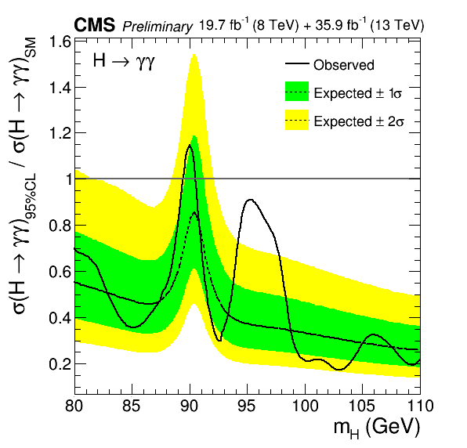
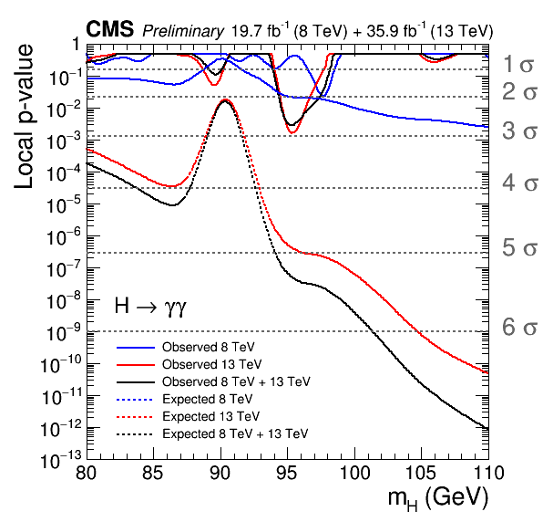
Low-mass h-->γγ (70/80-110 GeV)
CMS PAS HIG-17-013
Public preliminary result Sept. 2017, paper in preparation (internal CMS review)
8TeV+13 TeV Combination: Excess with ~2.8 σ local (1.3 σ global) significance at m=95.3 GeV
More data are required to ascertain the origin of this excess. No 13 TeV ATLAS result yet
See following dedicated talk by Arnab Purohit (SINP)
Combined 8 TeV+13 TeV σ X BR limit normalized to SM expectation (production processes assumed in SM proportions ).
Expected and observed local p-values for 8 TeV, 13 TeV and their combination

Slide 7
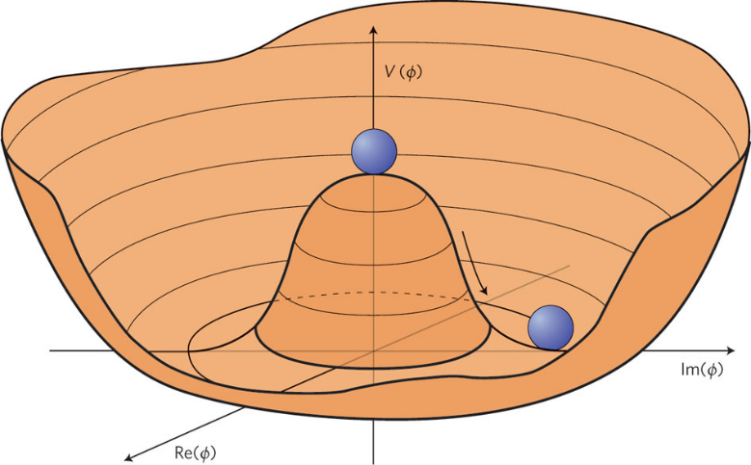
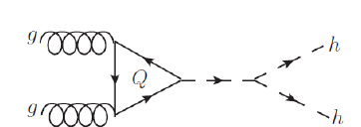


HH→bbγγ (1)
Shape of the Higgs potential
  postulated not taken from first principles.
  indirectly constrained within SM.
HH production sensitive to the quartic term, but the cross section is too small.
Since Run I we have searched for anomalous production and try to provide a precise estimate of what HL-LHC can bring us:
  The HH channel appears in almost all the HL-LHC TDR of CMS.
  ~ 10 publications from the different channels

Slide 8
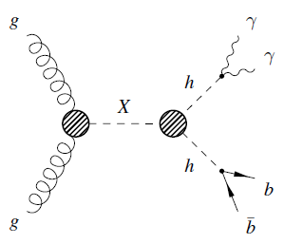
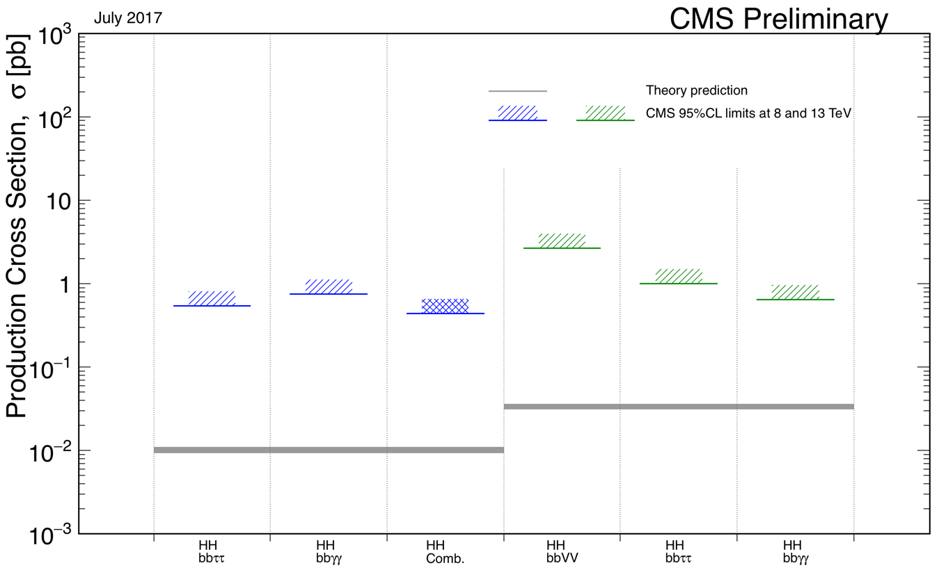
HH→bbγγ (2)
The most sensitive channel is HH→ 2b2γ.
  Excellent H→ resolution and high H→ bb branching.
Below an example of the sensitivity to SM-like production.

Slide 9
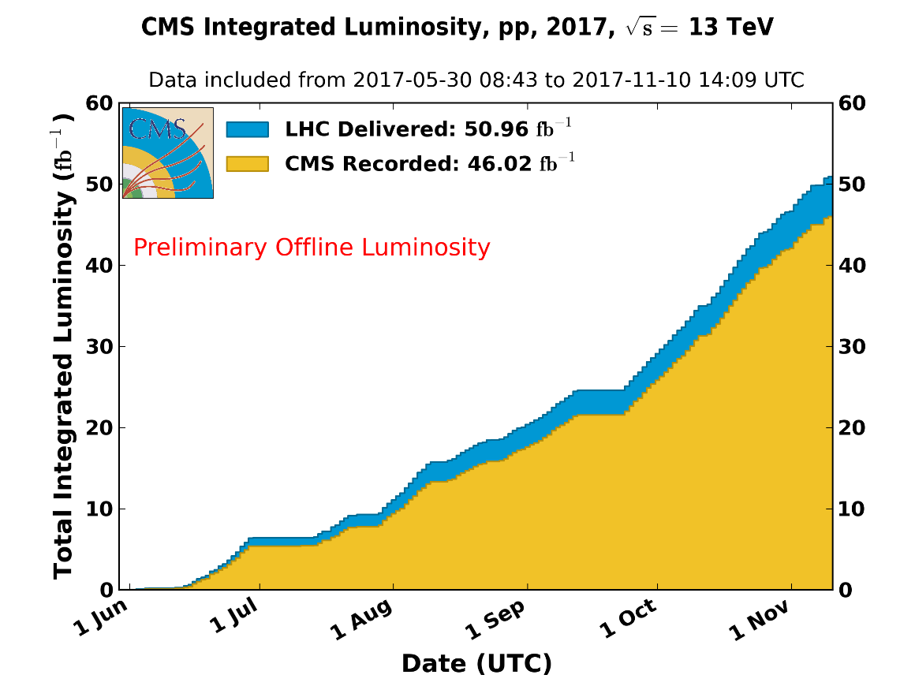
Short-term (<=2019) perspectives: Current projects
Priority: Analyze the 2017 data (>40 fb-1, slightly bigger dataset than 2016) and then the 2018 data (last year of Run 2): ~70fb-1 expected
For low-mass H→γγ, this data could be conclusive. New publications for both projects
Both projects will participate in HL/HE LHC ‘CERN Yellow Report’ for end of 2018 (input to European Strategy)
Will discuss plans for 2018 visit requests (current call) during the parallel session
Try to develop additional new projects
Continue efforts for exp-th collaborations (next slide)
Notes:
very important channel for Run 3 + HL/HE LHC

Slide 10
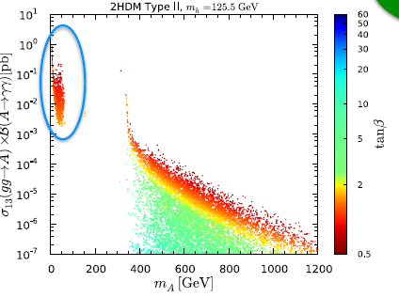
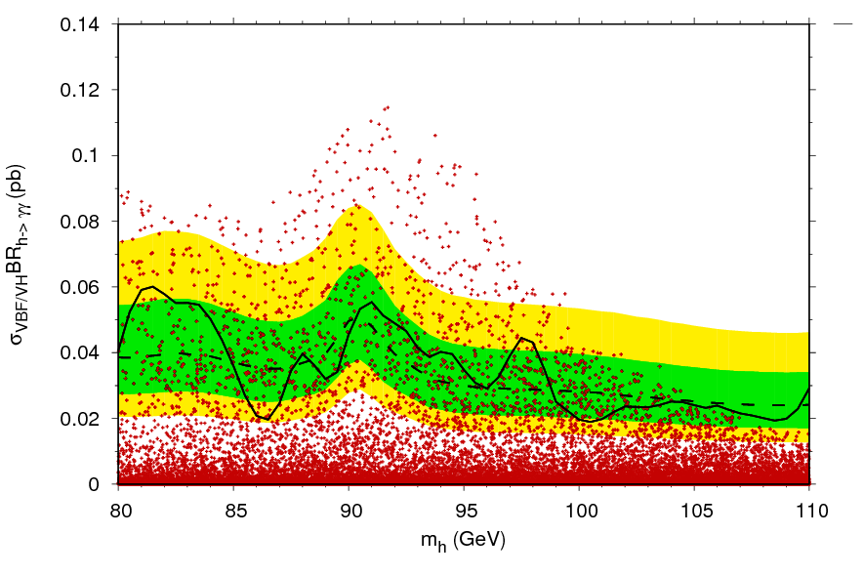
Short-term (<=2019) perspectives: Potential new projects/synergy with theorists/other WG
~Example: h-->γγ with m_{h}< 110GeV: Many network members already working on cases of:
A of 2HDM Type 2 (Alignment Lim)[Bernon, Gunion, Haber, Jiang, Kraml]
h of 2HDM Type 1 [Deandrea,Cacciapaglia, G-S, LeCorre, Lethuillier, Tao ]
A₁ of NMSSM [Guchait, J. Kumar]
1507.00933, Phys. Rev. D 92, 075004 (2015)
1607.0865,JHEP12(2016)068
1608.05693, Phys. Rev. D 95, 035036
Also light radion [ S. Bhattacharya, G. Moreau..], h₁ of NMSSM [Bélanger, Ellwanger, Djouadi..], DM[Bannerjee, Bélanger et al], Higgs Compositeness [Cacciapaglia et al] ➔ DM, ExtraDimensions, Tools/reinterpretation/presentation of results [Kraml, Boudjema] WG

Slide 11
Global/long-term perspectives and Conclusions
Possible areas for new projects (inter-exp and exp-th): CMS Phase 2 Upgrades (example: HGCAL), Run 3 and HL/HE LHC preparation
The Experimental working group still has a vocation, needs to increase synergy with theorists/other WG
Thank you for your attention!

Slide 12
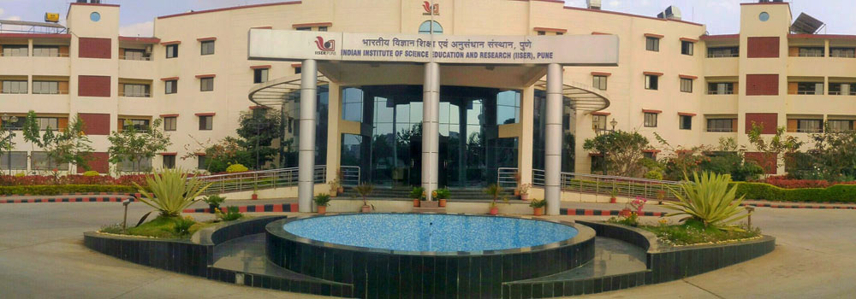
Acknowledgements
A big THANK YOU to S. Sharma, S. Dube, and the other members of the organization staff of the Pune meeting!
CEFIPRA INFRE-HEPNET

Slide 13
Additional Material

Slide 14
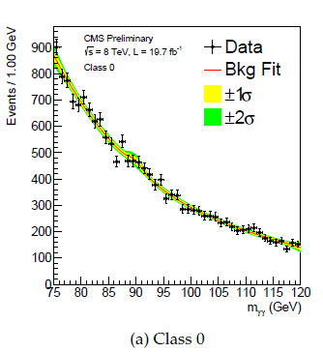
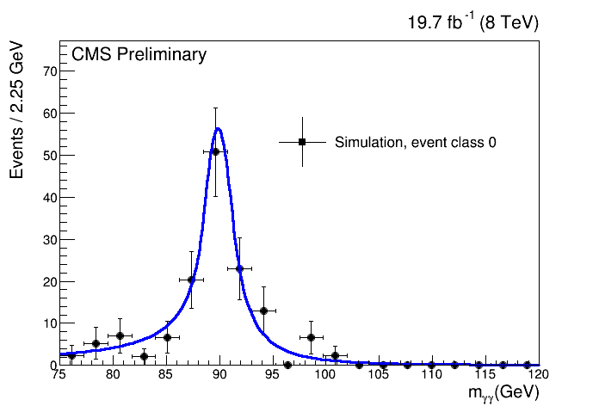
Run 1 h-->γγ Search(80-110 GeV) Run 1
Joint effort by the IPN Lyon (C. Carrillo, B. Courbon, J. Fan, S. G-S, M. Lethuillier, D. Sabes, L. Sgandurra) and IHEP-Beijing (G. Chen, M. Chen, Y. Shen, J. Tao, S. Zhang) teams
Many analysis elements inherited from the SM H→γγ ‘legacy’ analysis (see Arnab’s talk)
Analysis specifics wrt SM analysis:
  Search range: 80 GeV<m_{h}<110 GeV (cut on m_{γγ} at Trigger-level)
  4 inclusive event classes (output of diphoton boosted decision tree [BDT] with photon identification and kinematic inputs)
  Background model: Two-component background model (relic Z peak modeled by double-sided Crystal Ball (DCB) function on top of monotonically decreasing polynomial)
CMS PAS HIG-14-037
More stringent electron veto applied (no hits in pixel detector)
DCB shape parameters determined from Drell-Yan Monte Carlo, contributes additional systematic error
Relic Z→ee normalization left floating

Slide 15

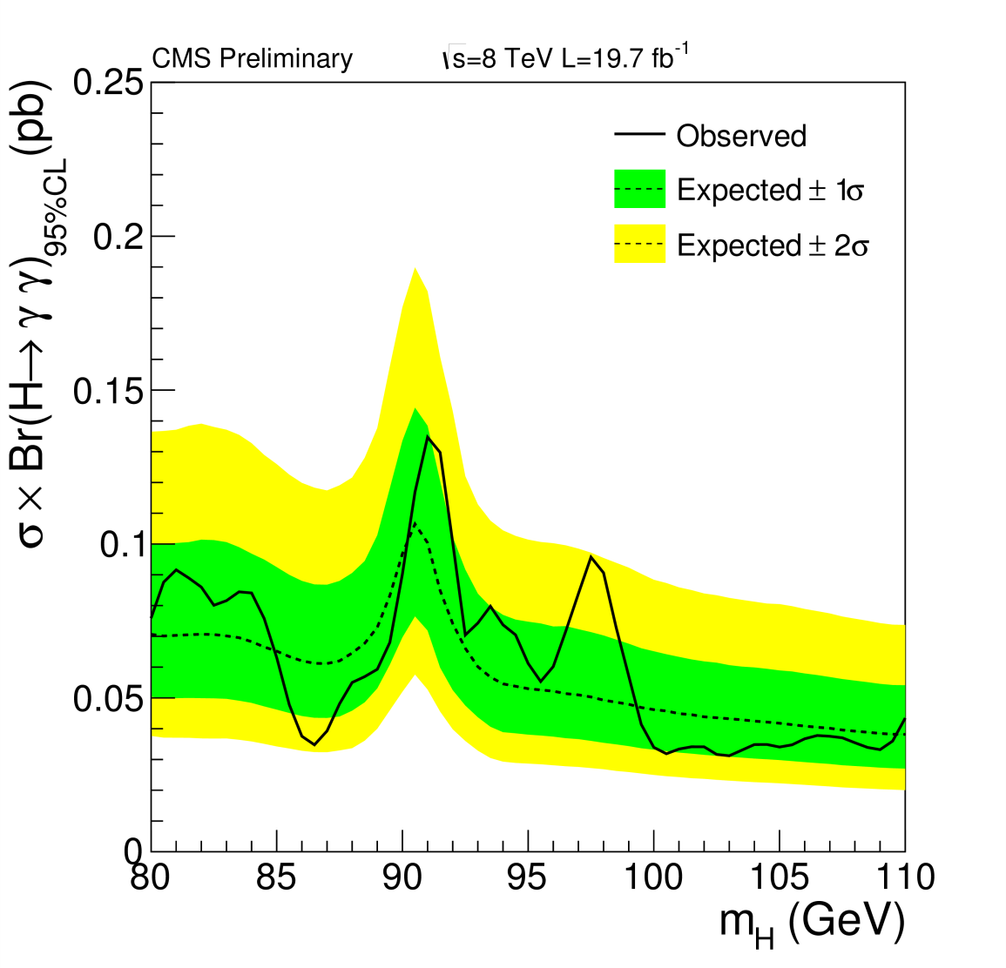
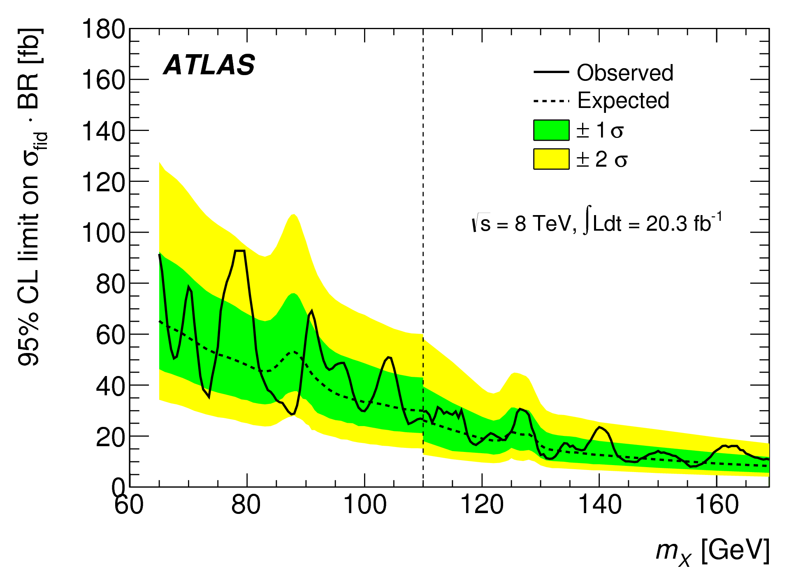
h-->γγ Run 1: CMS and ATLAS
CMS PAS HIG-14-037
PRL 113 171801 (2014)
~2σ excursion @~97.5 GeV
~2σ excursion @~80 GeV

Slide 16
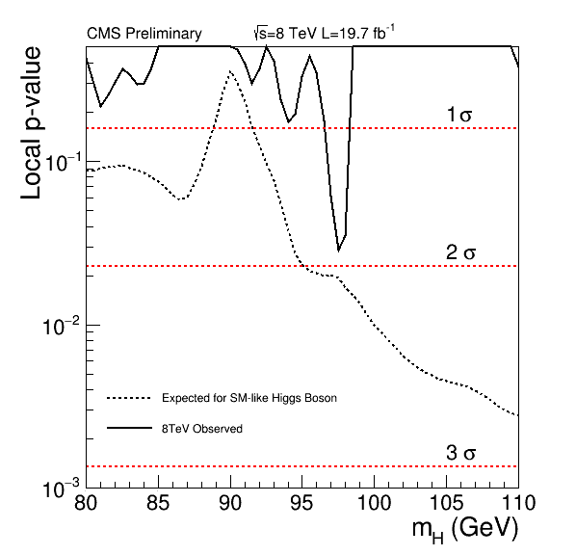
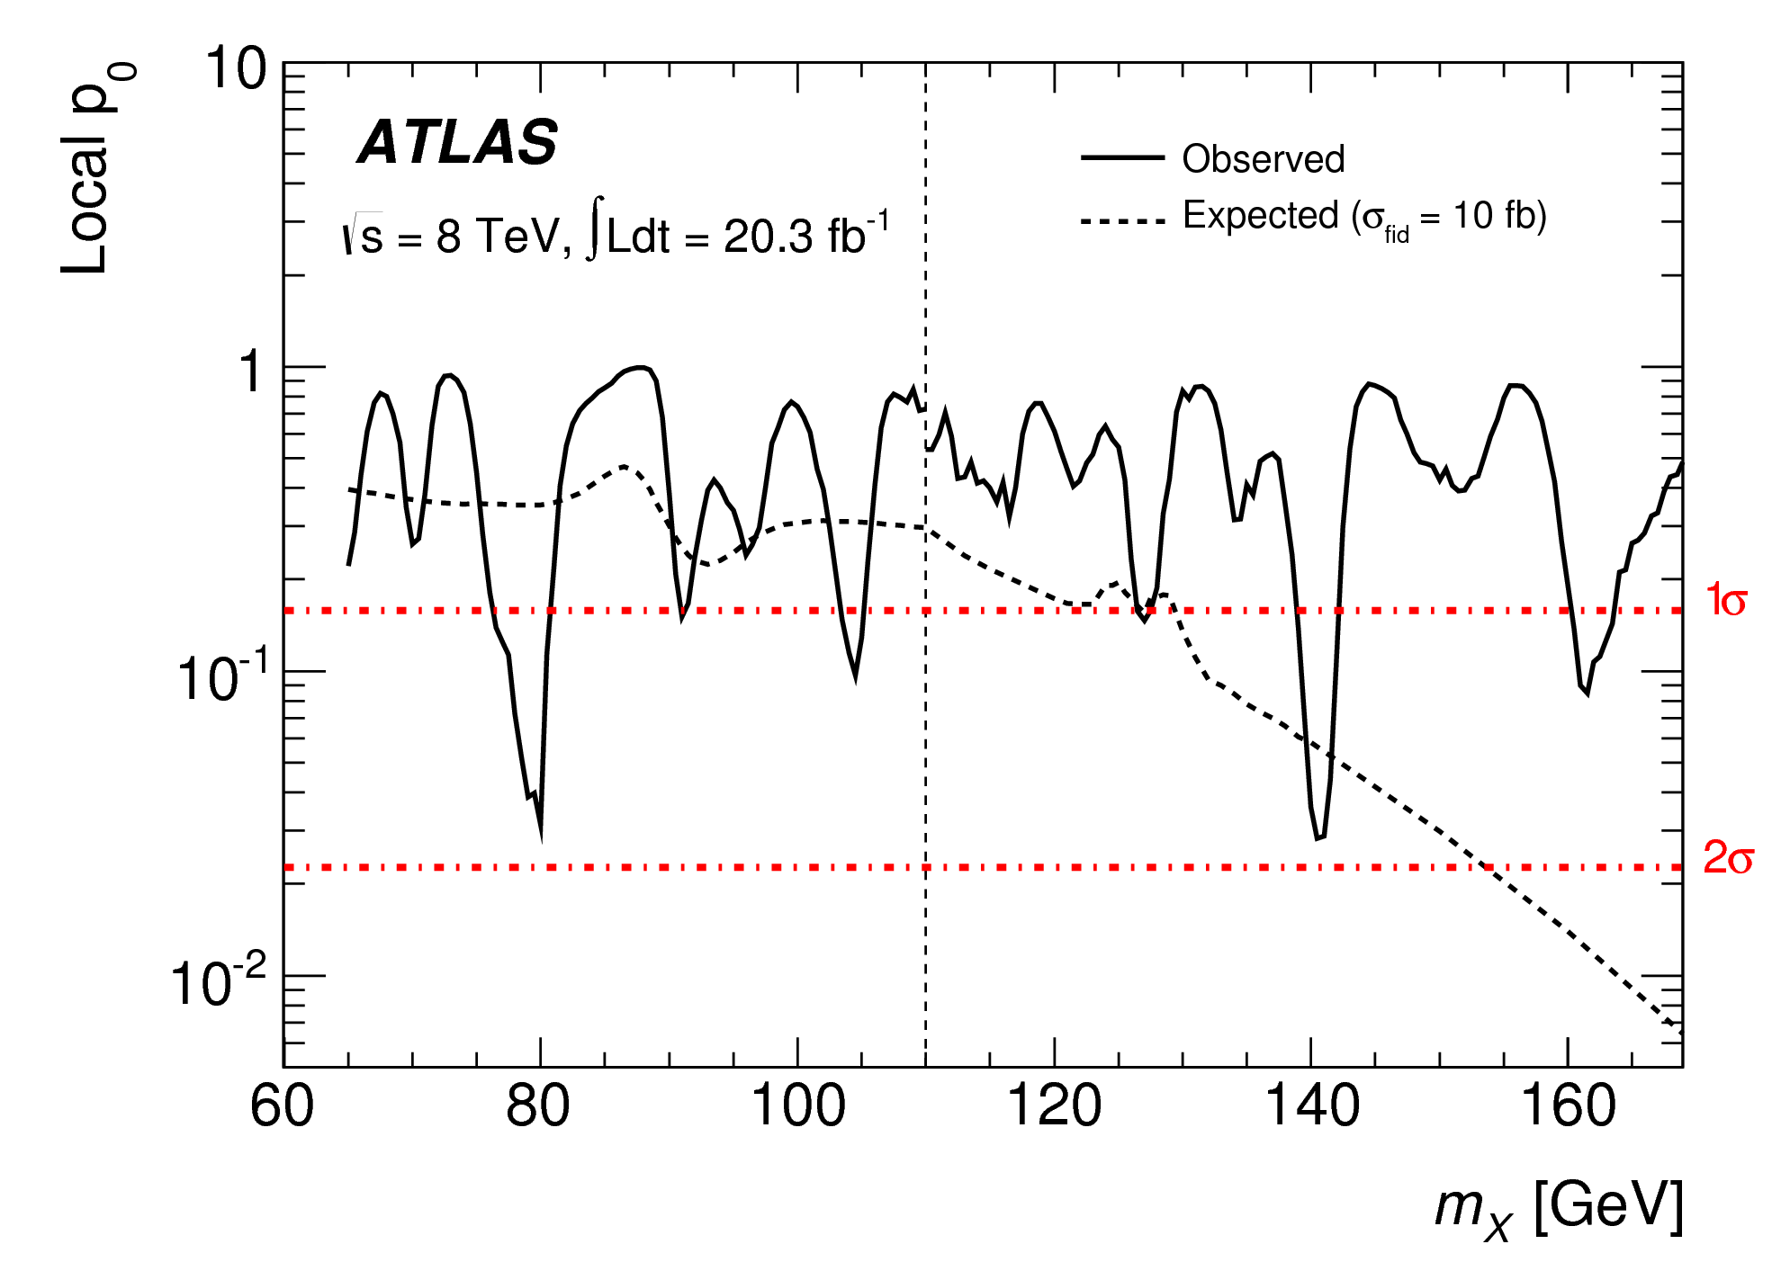
h-->γγ Run 1: CMS and ATLAS
CMS PAS HIG-14-037
PRL 113 171801 (2014)
Local p-values

Slide 17
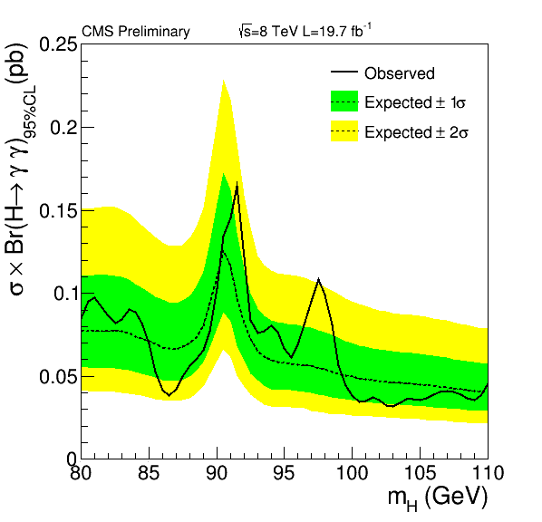
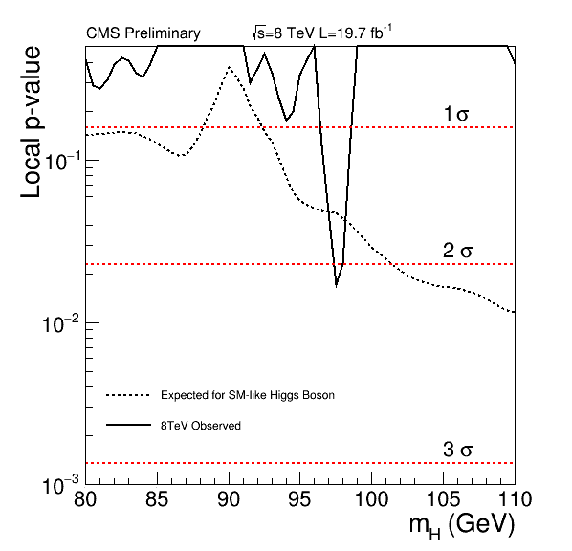
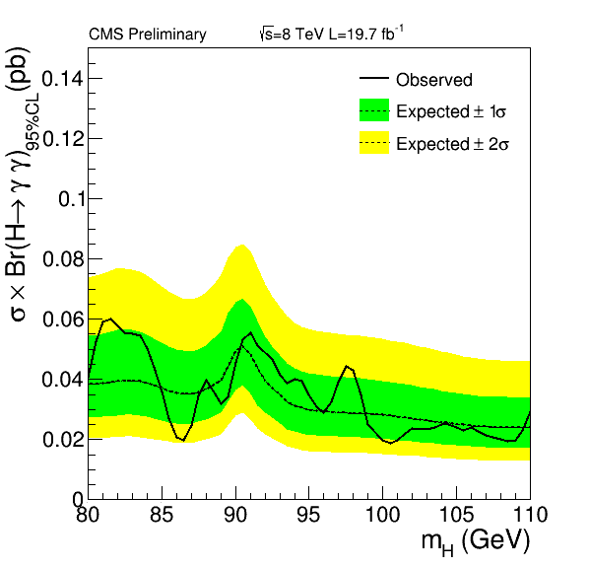
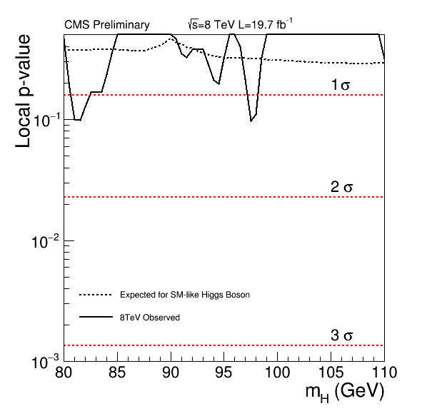
h-->γγ Run 1: by production process
CMS PAS HIG-14-037
Gluon fusion+ttbarh
VBF + VH

Slide 18
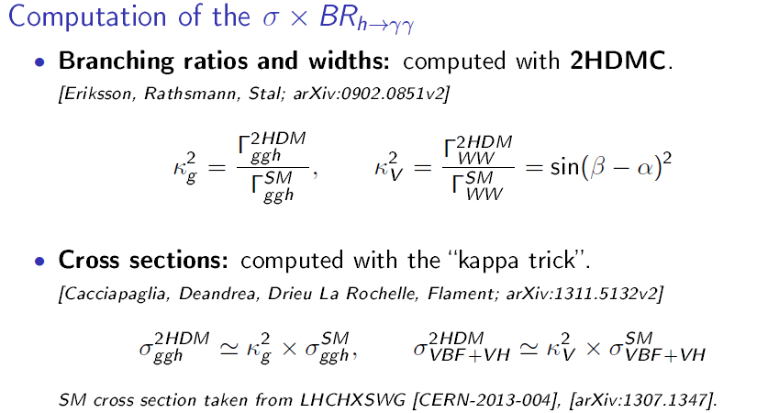
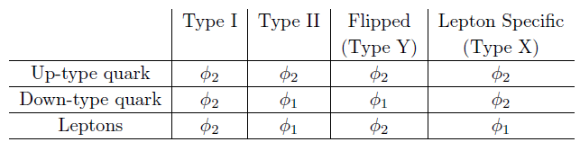
h-->γγ: 2HDM Interpretation of CMS Run 1 results
arXiv:1607.08653, subm. JHEP
Work done with IPNL theorists: G. Cacciapaglia , A. Deandrea, S. Le Corre
  2HDM
Cross-checked with SusHi [Harlander, Liebler, Mantler; sushi.hepforge.org/manual/SusHi150.pdf] for gluon fusion mode, agreement at ~3% level

Slide 19

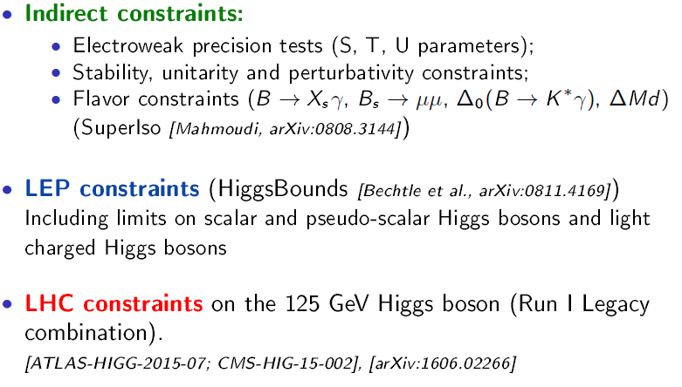
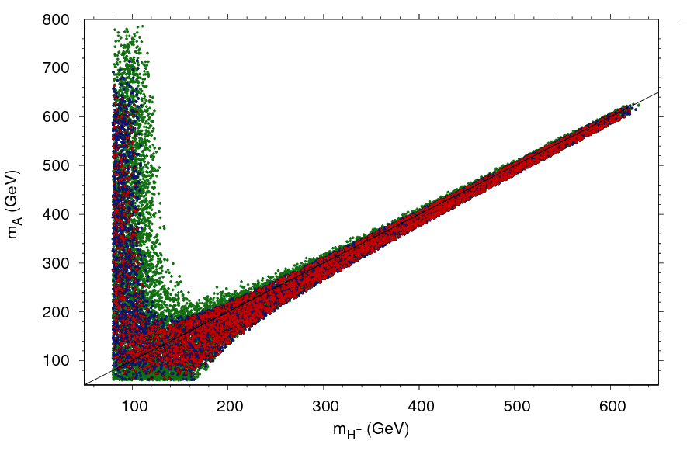
h-->γγ (65-110GeV): 2HDM Interpretation of CMS Run 1 results
arXiv:1607.08653, subm. JHEP
(Cacciapaglia , Deandrea, G-S, Le Corre, Lethuillier , Tao)
Initial 1M-point scan, apply cumulative constraints:
Type 1

Slide 20



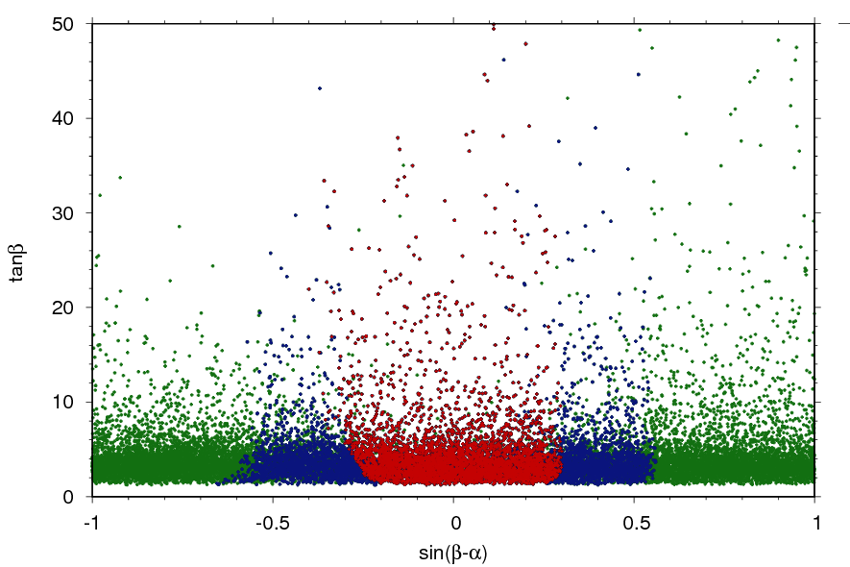
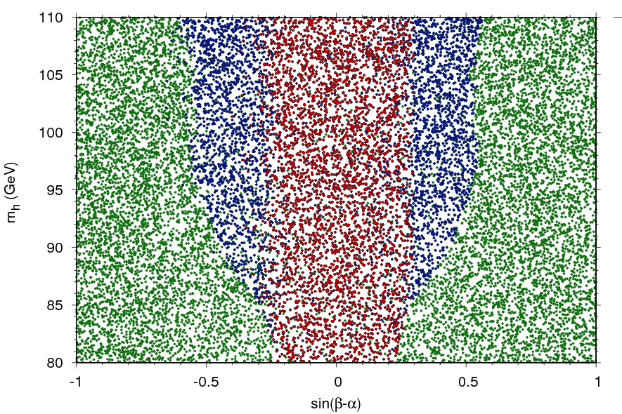
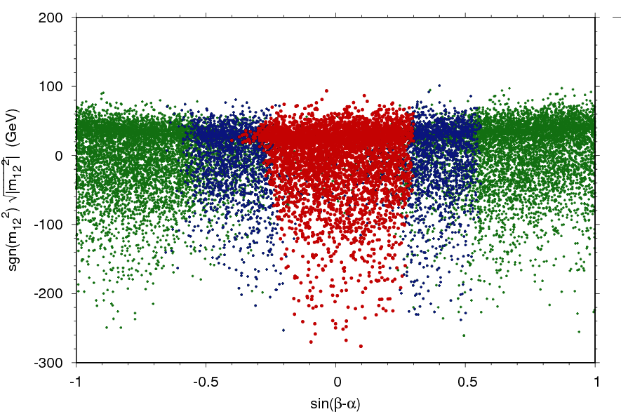
h-->γγ (65-110GeV): 2HDM Interpretation of CMS Run 1 results
arXiv:1607.08653, subm. JHEP
(Cacciapaglia , Deandrea, G-S, Le Corre, Lethuillier , Tao)
Initial 1M-point scan, apply cumulative constraints to refine ranges (shown: Type 1):

Slide 21

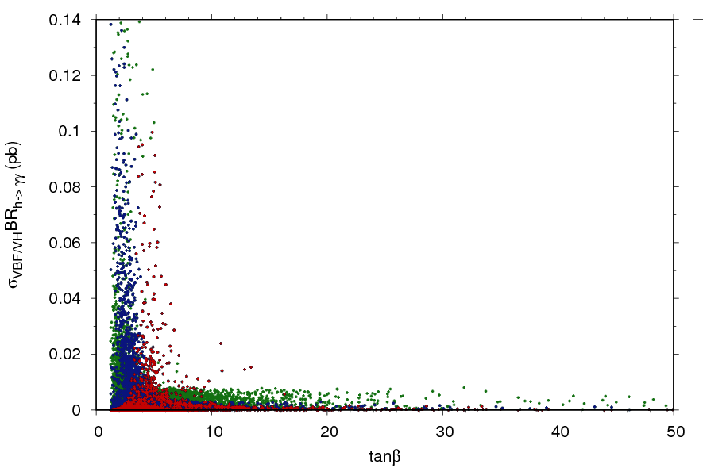
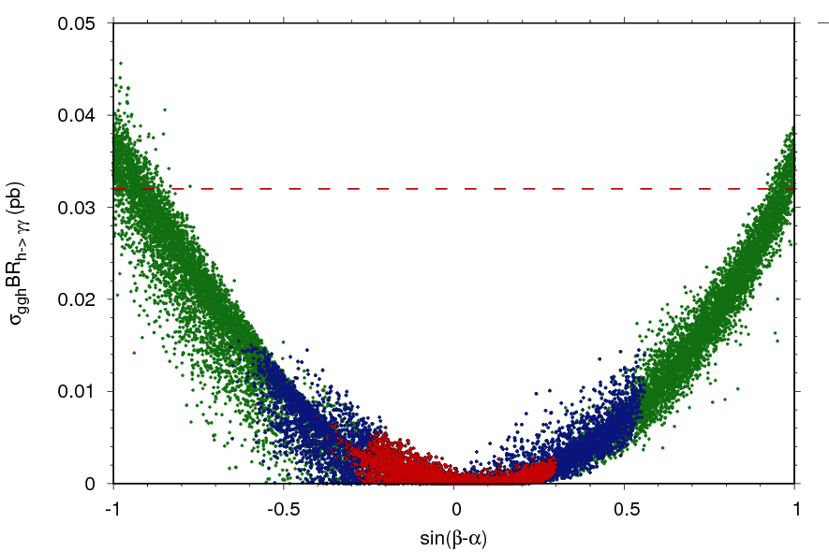
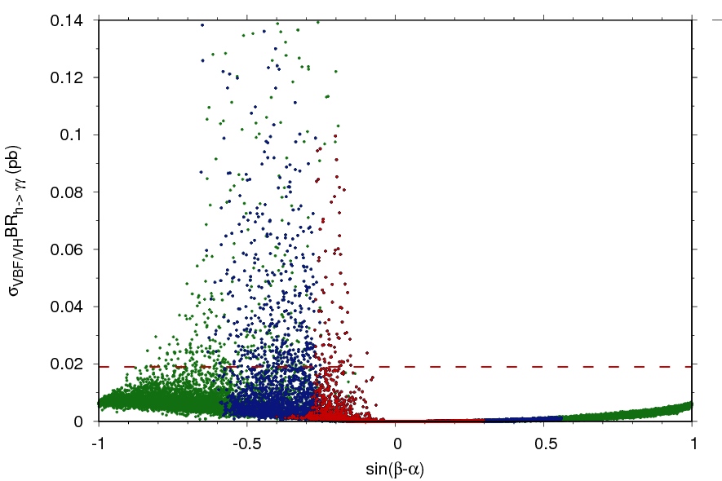

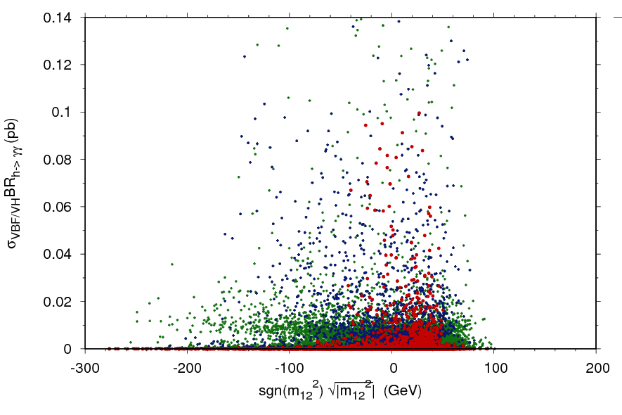
h-->γγ (65-110GeV): 2HDM Interpretation of CMS Run 1 results
arXiv:1607.08653, subm. JHEP
(Cacciapaglia , Deandrea, G-S, Le Corre, Lethuillier , Tao)
Initial 1M-point scan, apply cumulative constraints:
Gluon fusion
VBF+VH
Further refine ranges targeting points within ‘shooting distance’ of CMS maximal sensitivity (>0.01pb)

Slide 22
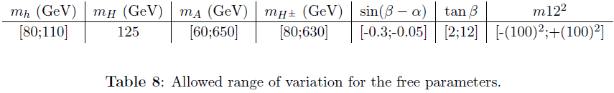
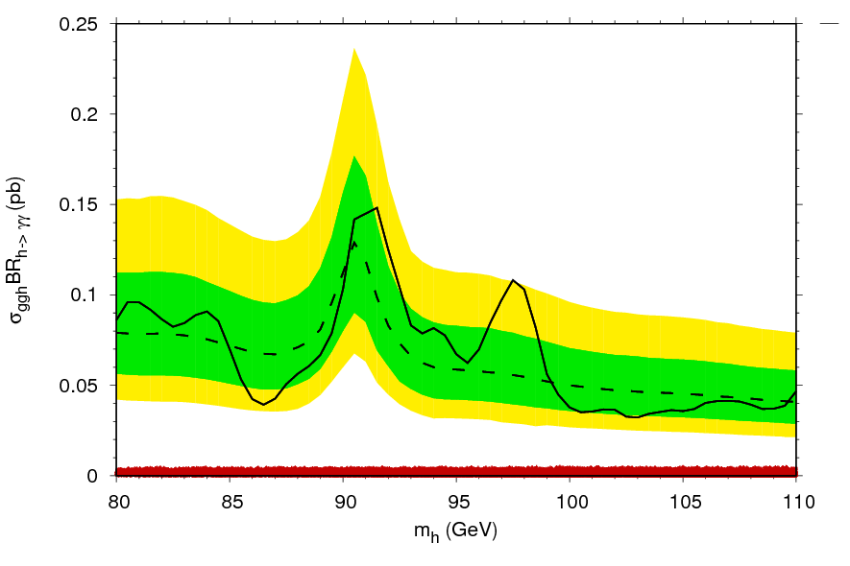
h-->γγ (65-110GeV): 2HDM Interpretation of CMS Run 1 results
arXiv:1607.08653, subm. JHEP
Gluon fusion
VBF+VH
Results of new 1M-point scan with new ranges: Some exclusion possible with VBF + VH, m_{h} ~<105 GeV

Slide 23

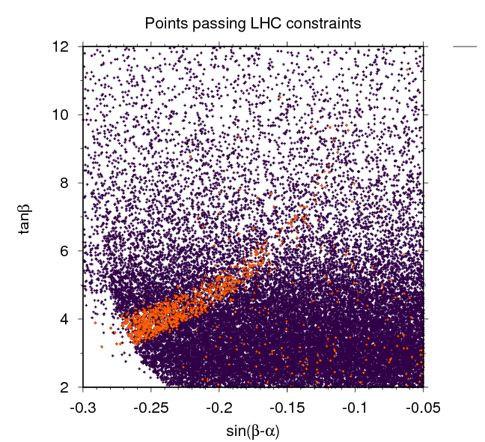
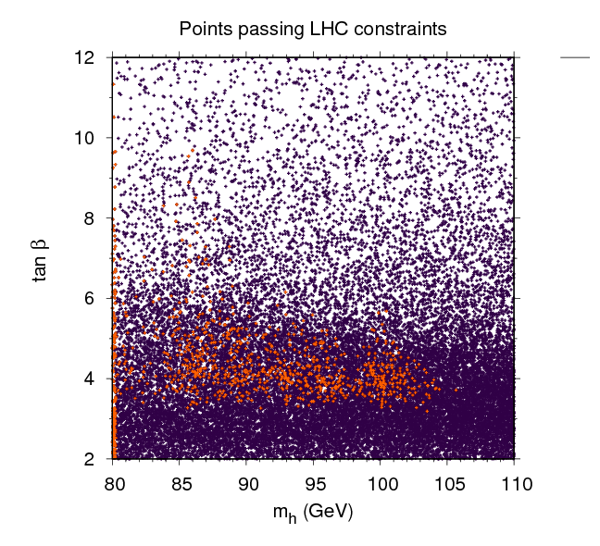
h-->γγ (65-110GeV): 2HDM Interpretation of CMS Run 1 results
arXiv:1607.08653, subm. JHEP
Projections of red points on previous slide→orange if σXBR>CMS observed limit←→excluded (violet otherwise) [but caveat…]

Slide 24
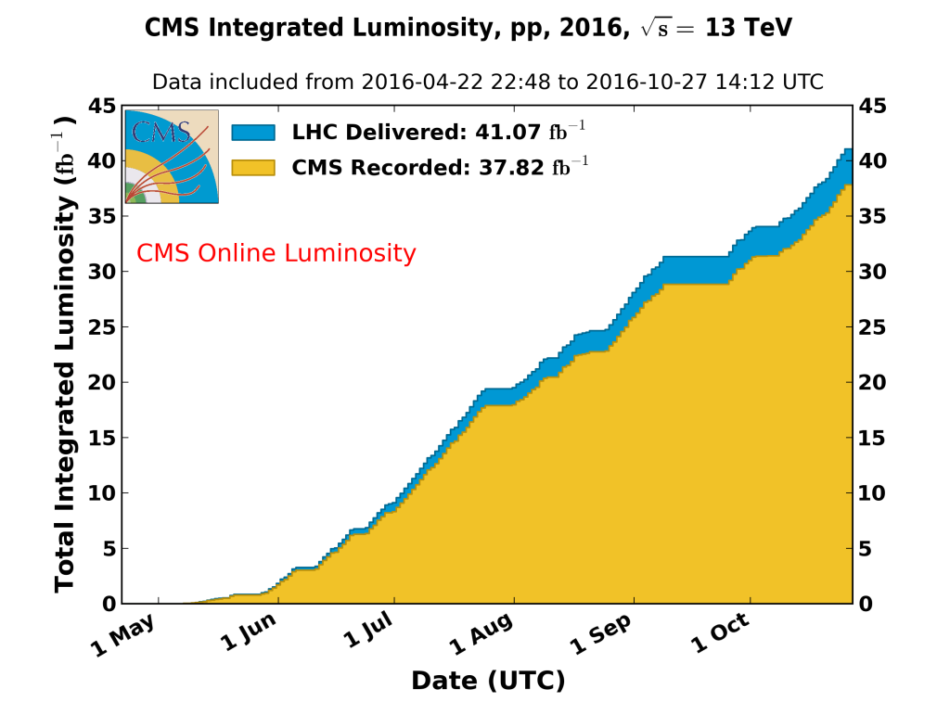
h-->γγ with m_{h}< 110GeV: Conclusions/Perspectives
Run 2: Analysis of 2015, 2016 data in progress (>35fb⁻¹) with new IPNL group members L. Finco and B. Marques
New trigger paths have been developed to extend lower bound of search range below m_{γγ}<80 GeV
We are very pleased to be able to start a collaboration with the SINP group (S. Bhattacharya, K. Mondal, A. Purohit, P. K. Rout) beginning with some crucial elements for the analysis (see Arnab’s talk): Photon preselection + identification efficiency scale factors and associated systematics
Later possibility: Fix rather than float normalization of relic Z→ee background for increased sensitivity near m_{Z} (requires detailed dielectron to diphoton fake rate study.)
Another ~45fb⁻¹ hoped for 2017, ~100fb⁻¹ by end Run 2

Slide 25
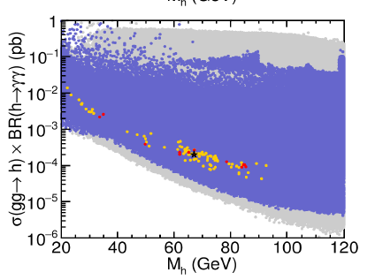
h-->γγ with m_{h}< 110GeV:Perspectives on interpretations
Continuation with interpretations as h₁ in NMSSM and 2HDM on future Run 2 results (already some exclusion in Run 1)
Interpretations as pseudoscalar a (~50 GeV<m_{a} <100 GeV) :
  NMSSM A₁ (M. Guchait, J. Kumar 1608.05693, see Jacky’s talk earlier)
  S. Bhattacharya et al.
  2HDM Type II in gg→ H,A→γγ in alignment limit (J. Bernon, J. Gunion, H. Haber, Y. Jiang, S. Kraml)
Interpretations as h in MSSM still possible (Bechtle et al, 1608.00638)
(Bechtle, Haber, Heinemeyer, Stal, Stefaniak, Weiglein, Zeune)
arXiv:1608.00638
arXiv:1507.00933

Slide 26
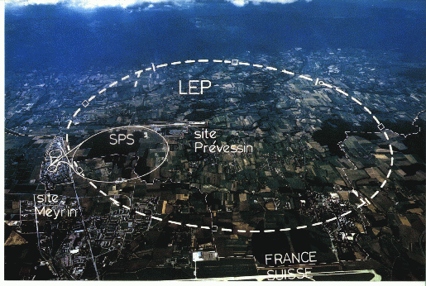
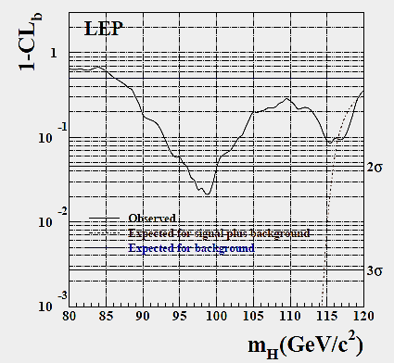
Introduction/Motivation:Is there a second Higgs boson with m<125 GeV?
Final LEP SM Higgs boson search results: >2σ excess at mH= GeV. Has contributed to sustained interest by both theorests and experimentalists in the possibility of additional low-mass (pseudo-) scalars
The LHC Standard Model H→gg discovery analyses explored a mass range between 110 and 150 GeV
Several models like the NMSSM or in general Two-Higgs-Doublet-Models (2HDM) postulate the existence of additional light Higgs bosons and even admit the possibility that the observed H(125) is only the next-to-lightest
Subject of this talk: CMS searches during LHC Run 1 for additional scalars/pseudoscalars with m<110 GeV, in the diphoton decay channel by definition in a BSM context.
Perspectives for Run 2 and interpretations
LEPHWG, Phys. Lett. B565:61-75,2003
S. Gascon-Shotkin CEFIPRA-CMS, Mumbai, IN Nov. 19 2016

