Slide 2
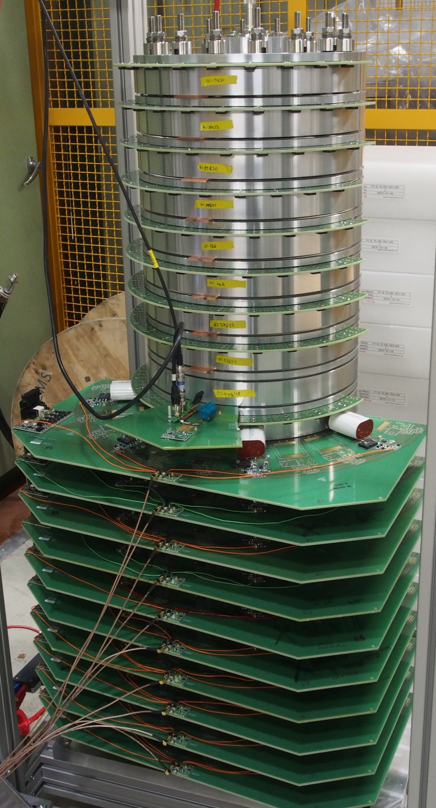



Overview of the:
PULSED POWER for KICKER SYSTEMS 2018 workshop
12–13 March 2018, CERN, Geneva, Switzerland
International Organising
Committee:
Local Organisation Committee
Janne Holma (Technical Chair)
Lucie Mainoli (Local organisation)
Miroslav Georgiev Atanasov (Visit)
Christoph Wiesner (Visit)
Patrick Alexandre SOLEIL
Mike Barnes CERN
Marc Dubrulle ESRF
Olaf Dressler BESSY-II
Laurent Ducimetière CERN
Thomas Kramer CERN
Martin Paraliev PSI
Montse Pont ALBA
Jonny Ranner STFC
Piergiorgio Tosolini ELETTRA
https://indico.cern.ch/event/682148

Slide 3

Many Thanks to:
CERN and especially to the management of the Technology Department for all their support during the organization, preparation and running of the workshop.
Workshop sponsors:
ARIES: Accelerator Research and Innovation for European Science and Society
ARIES is an Integrating Activity project which aims to develop European particle accelerator infrastructures, co-funded under the European Commission's Horizon 2020 Research and Innovation programme.
https://aries.web.cern.ch/
FCC: Future Circular Collider
FCC is an international collaboration to explore concepts for the most powerful particle collider and develop enabling technologies. https://fcc.web.cern.ch/Pages/default.aspx

Slide 4
A Few Statistics
Forty participants;
Representing 14 labs/institutes in 9 countries:
  ALBA, Spain
  CERN, Switzerland
  DESY, Germany
  Diamond, UK
  Elettra Sincrotrone, Italy
  ESRF, France
  Fermilab, USA
  GSI, Germany
  HZB, Germany
  Institute of Electrophysics, Russia
  ISEL, Portugal
  PSI, Switzerland
  Soleil, France
  STFC, UK

Slide 5
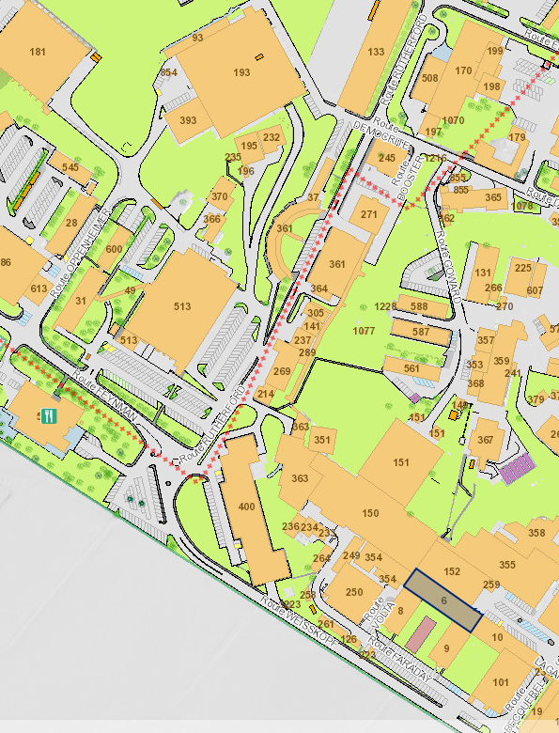
Logistics - 1
Coffee Breaks: outside this room;
Lunch: Restaurant 2. Self-service (self-pay !). Reserved table(s) for workshop;
Group photograph: TBD …..
R2
Visit: meet at
9:00hrs in AD (in front of new building 393);
10:00hrs (LEIR) in front of building 150 (transport entrance next to the power converters).

Slide 6
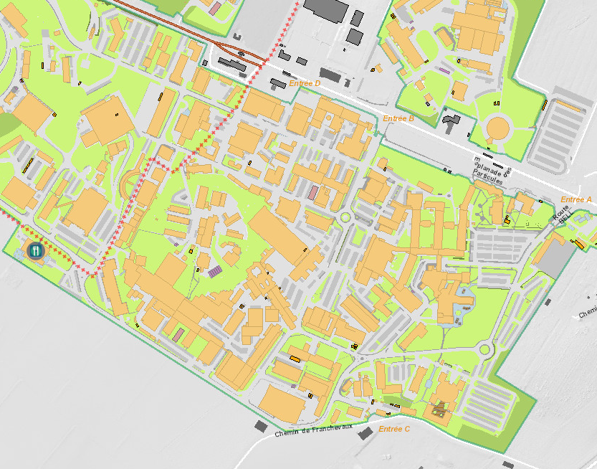
Logistics - 2
SMASH
393
R2
6
R1
Workshop dinner (SMASH Restaurant, Chemin de la Berne 5, Meyrin)

Slide 7
Egroup / Mailing List
Egroup: PULPOKS-participants@cern.ch
Self-subscription policy for this egroup (mailing list), with administrator approval.
Subscriber can send questions or interesting information.
Idea is similar to the “POCPA-participants” mailing list, e.g. to be able to also request unbiased information on commercial products.

Slide 8
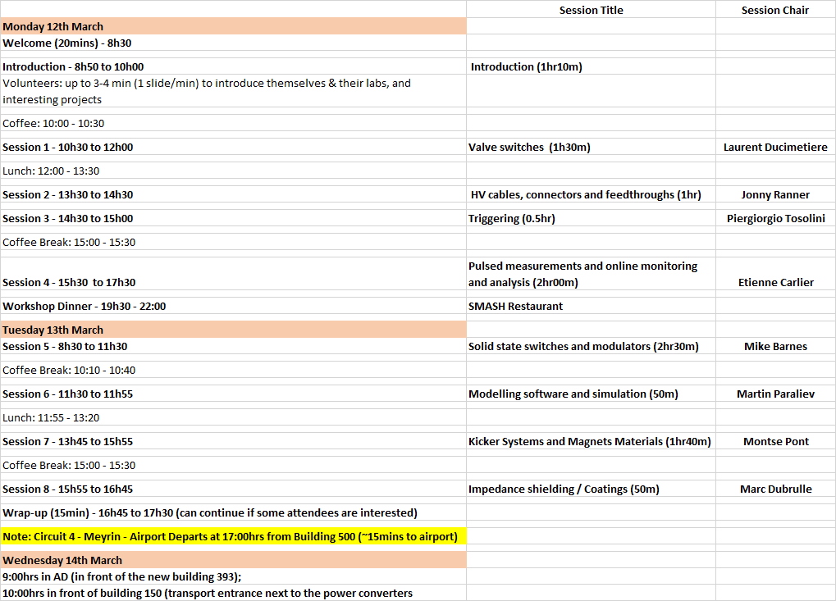
Workshop Overview

Slide 9
I’m looking forward to an interesting workshop - with much discussion.
Thank you for your attention !

