Slide 1
Accelerator Division
EE Support Department
Chris C. Jensen
March 12, 2018

Slide 2
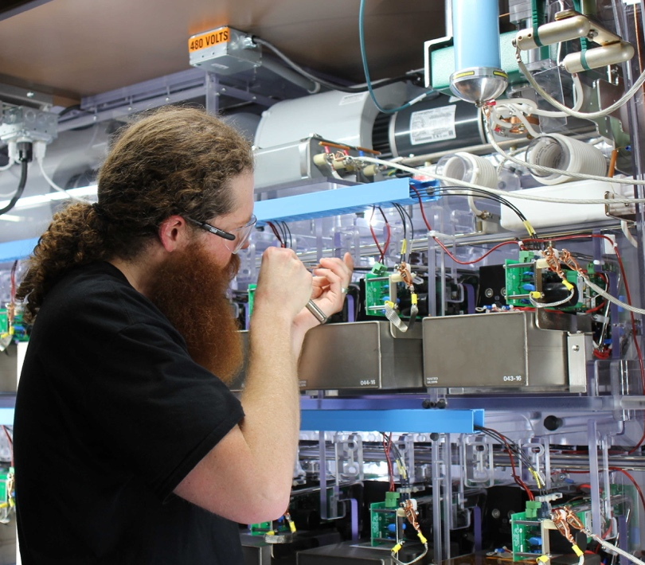
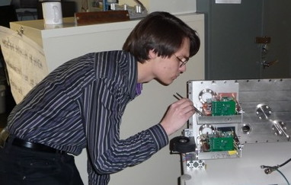
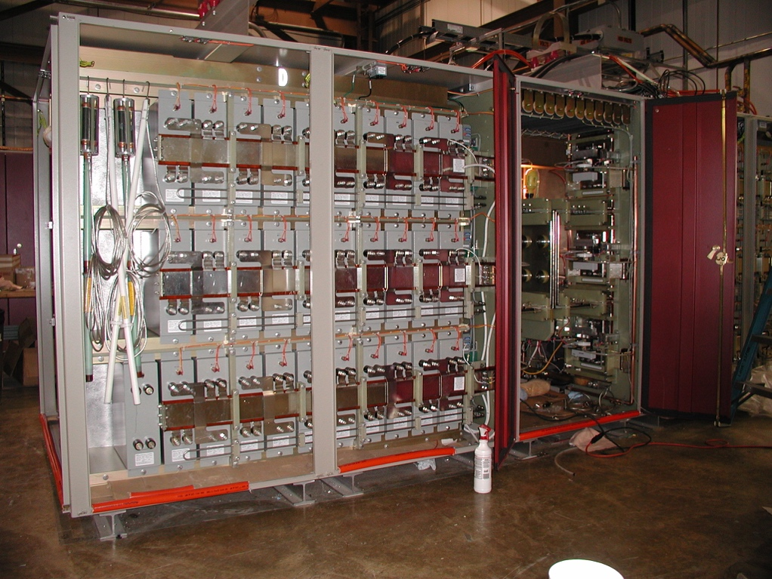
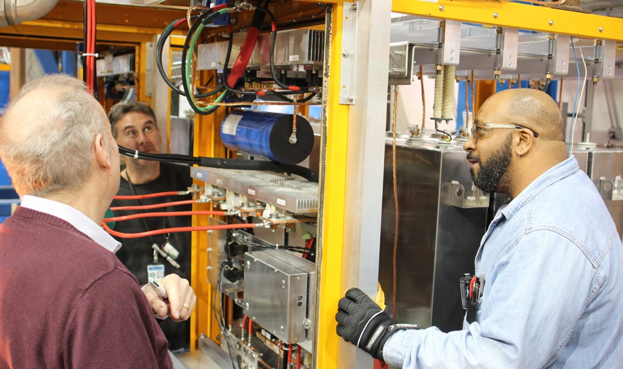
Power Supplies from DC to ns, W to MW
Marx Modulator provides a 30 kV, 300 A,
200 us wide pulse 15 times a second to RF amplifier tube to accelerate beam
PIP II Chopper provides 500 V, 2 ns rise and fall time arbitrary pulse pattern at 38 MHz repetition rate to deflect beam
NuMI horn provides 700 V, 200 kA, 2 ms wide pulse every 1.33 seconds to focus beam
Pbar lens provides 1 kV, 25 kA, 400 us wide pulse 8 times in 80 ms to drive focusing and collecting lens after target

Slide 3
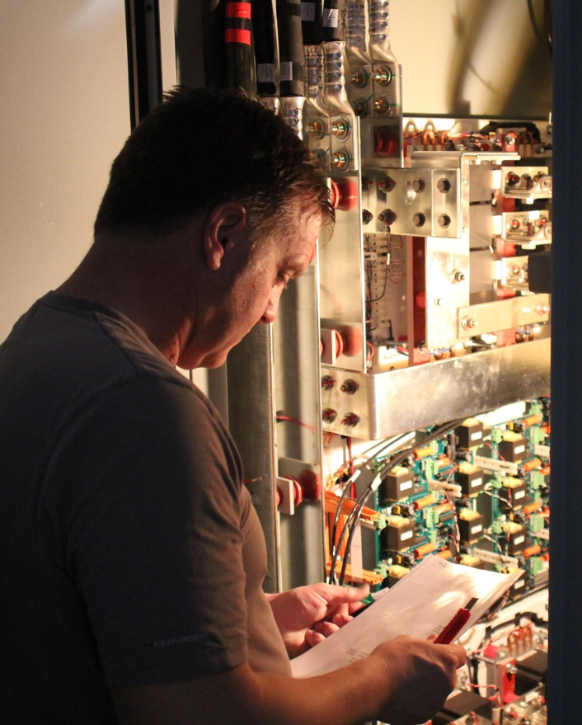
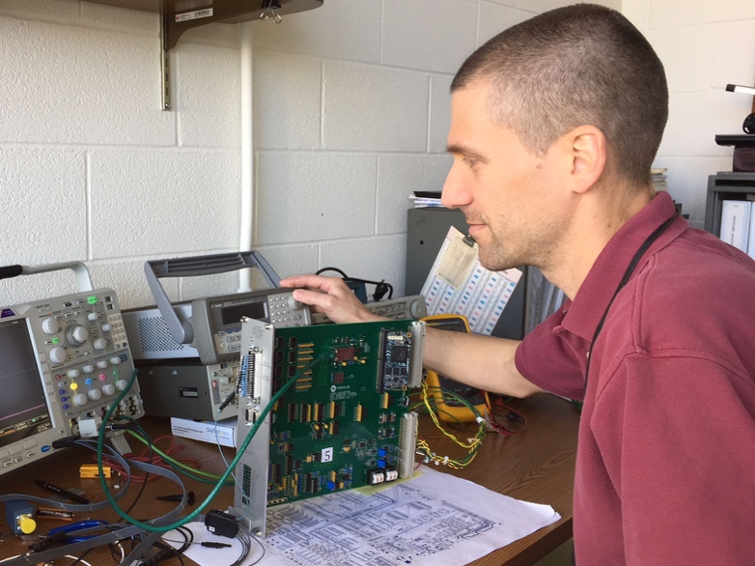
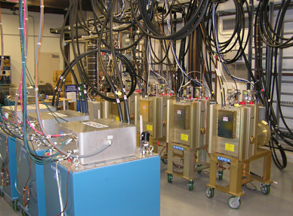
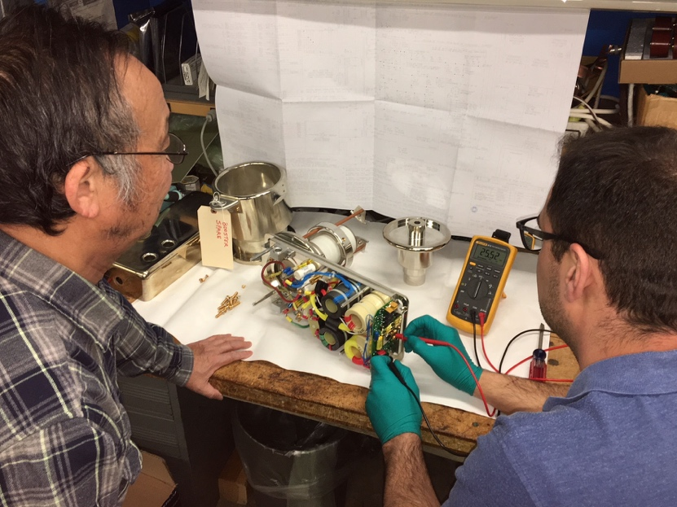
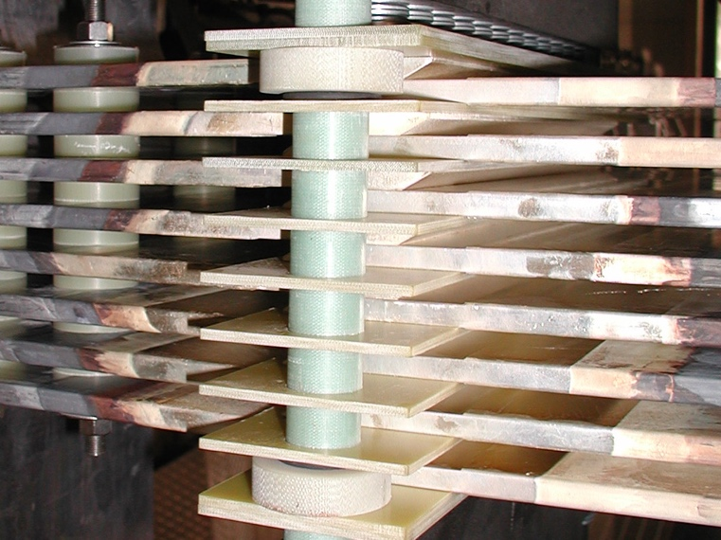
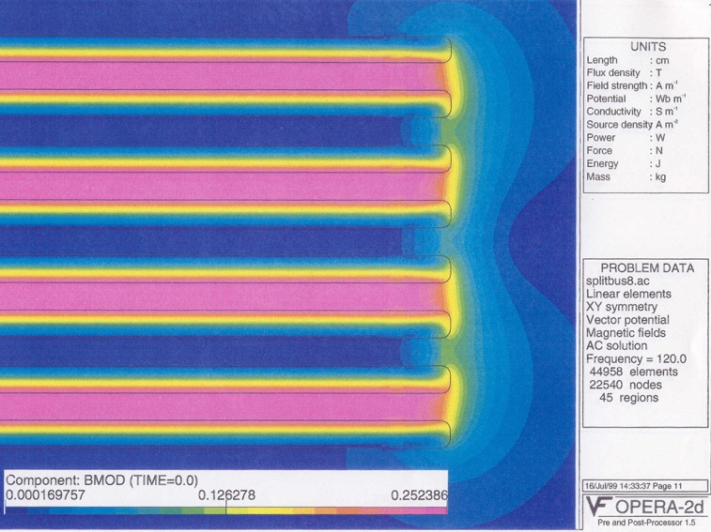
Power Supplies from DC to ns, W to MW
Kickers provides 30 kV, 1000 kA, 1.6 us wide pulses to deflect beam onto orbit. Hydrogen gas switch voltage rise is 30 kV in 20 ns into 50 Ohm resistor
Computer and FPGA control of large power supplies, 50 ppm regulation of 1200 A, learning systems
Converse with various other groups wrt high voltage, high current and high speed power supplies
Circuit Simulation and EM field simulation
(NuMI Stripline, 200 kA, low inductance )

Slide 4
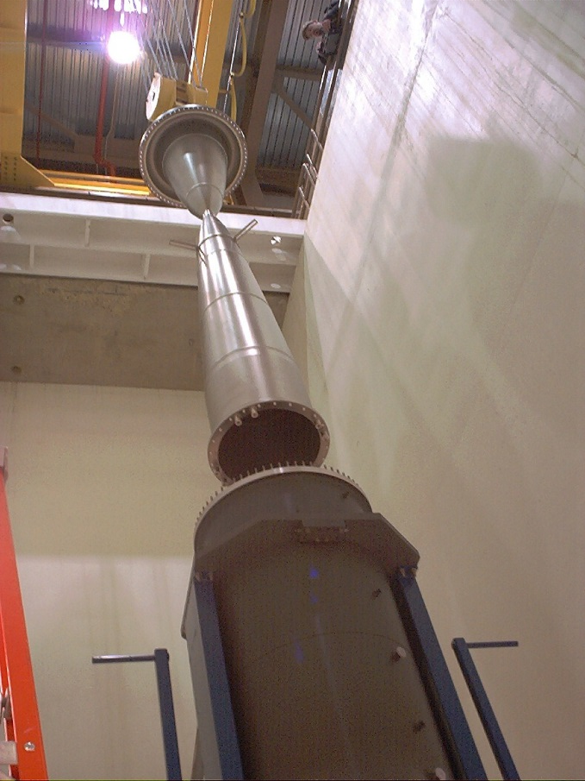
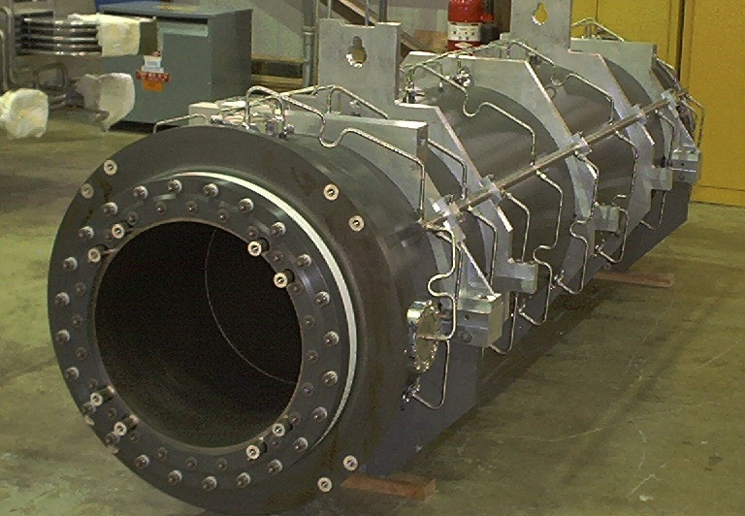
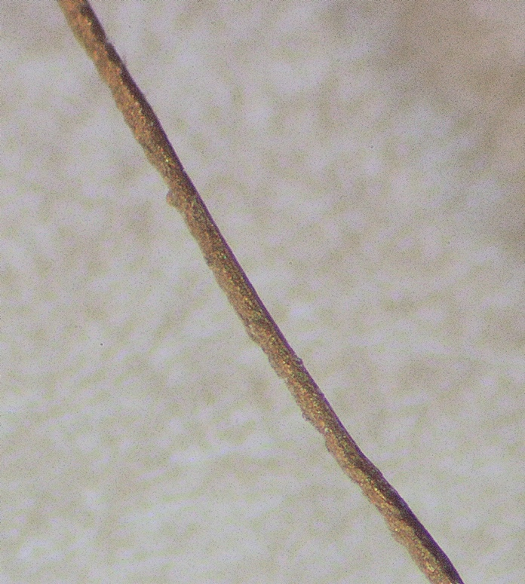
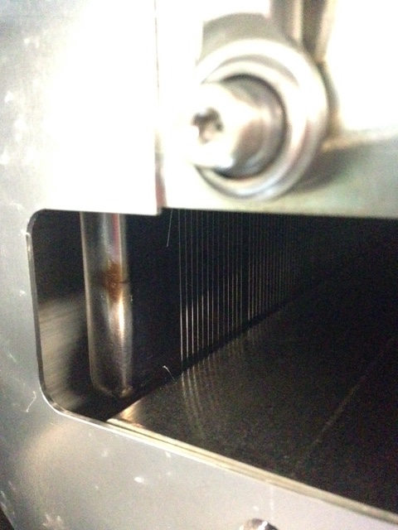
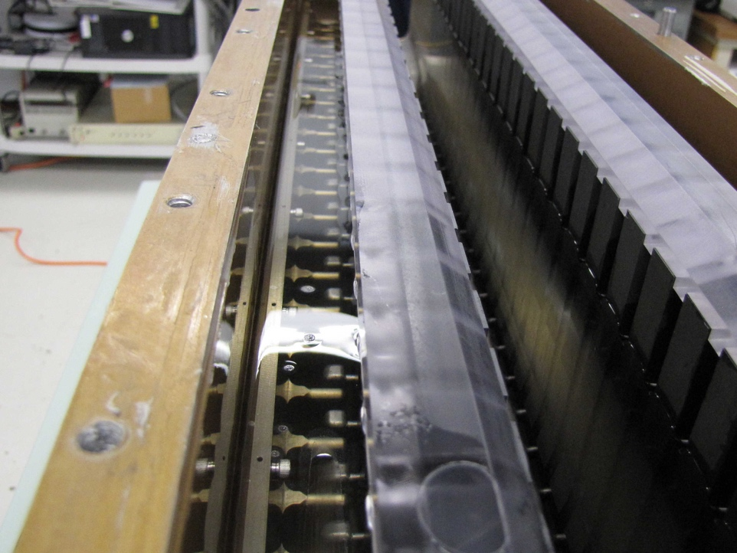
Kicker Magnets, Horns and Septa (Electric and Magnetic)
EE Support collaborates with other departments and divisions within Fermilab on specialty loads
AD – Target Systems NuMI Horn 2
700 V, 200 kA, 2 ms
TD – Magnet Systems
Injection Kicker Magnet
50 Ohm, 50 ns field rise
AD – Mechanical Support
Electrostatic Septa Wire Failures (100 µm) after 20 years in beam
120 kV, 14 mm

Slide 5
Power Supplies from DC to ns, W to MW
Current Projects
  Completing Marx Modulators for Linac Upgrade
    15 pps, 30 kV, 300 A, 250 µs pulse driving tetrode amplifier
  Ramped power supplies for slow spill and RF cavity tuning
    300 V, 100-600 A , 20-60 A/ms
Future Large Scale Projects
  LBNF Horn Power Supply
    4 kV, 300 kA, 800 µs wide pulse every 0.7 seconds
      3 µH, 800 µOhm load including connecting stripline
    The LBNF/DUNE collaboration is looking for partners for the design and construction of this challenging supply.
  PIP II – New Linac – Various small pulsed power supplies
    International contribution for RF power sources and power supplies
      Collaboration with India

