Slide 1
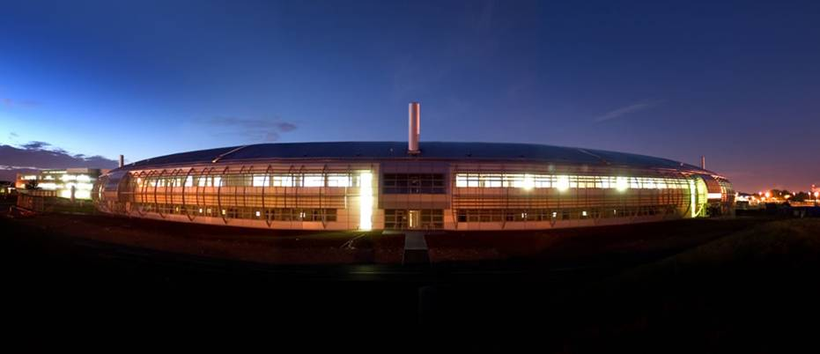
Diamond Light Source
Colin Abraham
Snr Power Supply Engineer

Slide 2
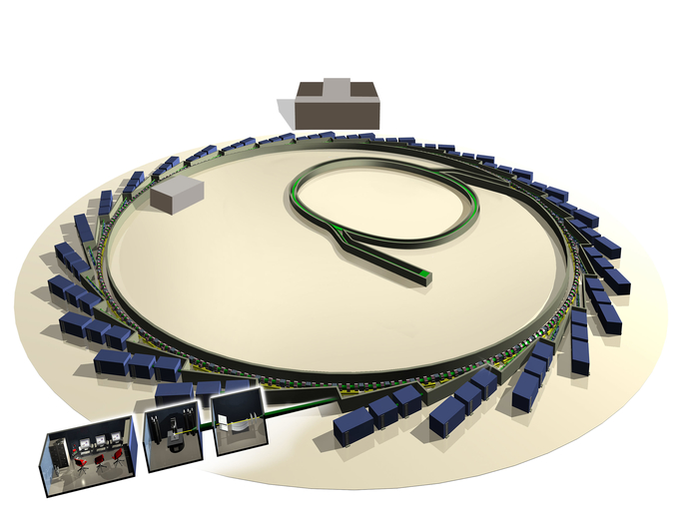
Diamond – 3rd Generation Light Source
Injector: 100MeV Linac + 3Gev 5Hz Booster
Storage Ring: 24 DBA Cells, 560m, 300mA
30 Beam lines, including
22 I.D. Beam lines
7 Dipole Beam lines
C Abraham – Snr Power Supply Engineer

Slide 3
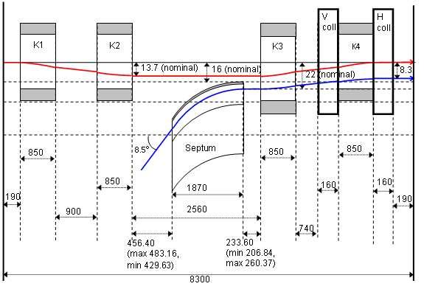
Diamond SR Injection
Four kickers bump in one straight sections (8.3 m flange-to-flange)
2007-15: septum at -16mm and injection point at -8.3 mm
- 8.3 mm
2015-now septum moved at -12 mm to have the injection
point at -6.5 mm and lower the strength of the kicker bump

Slide 4
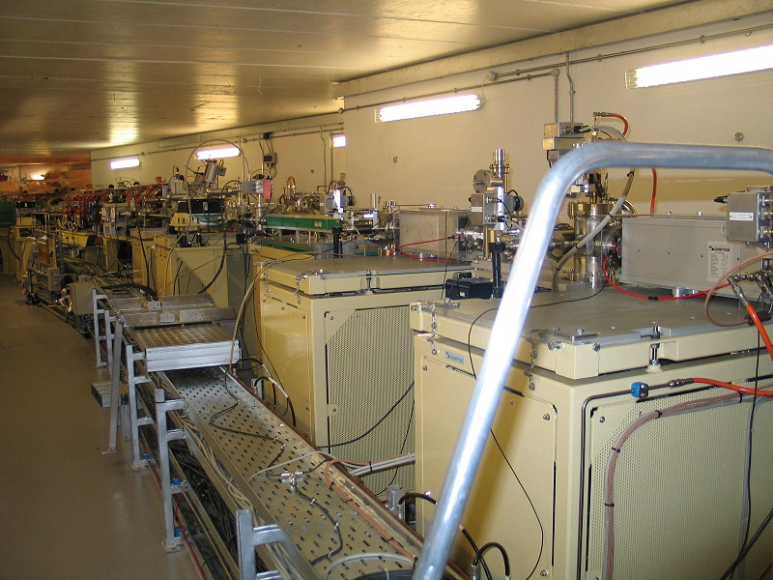
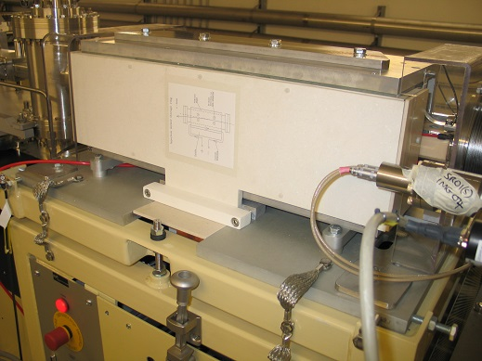
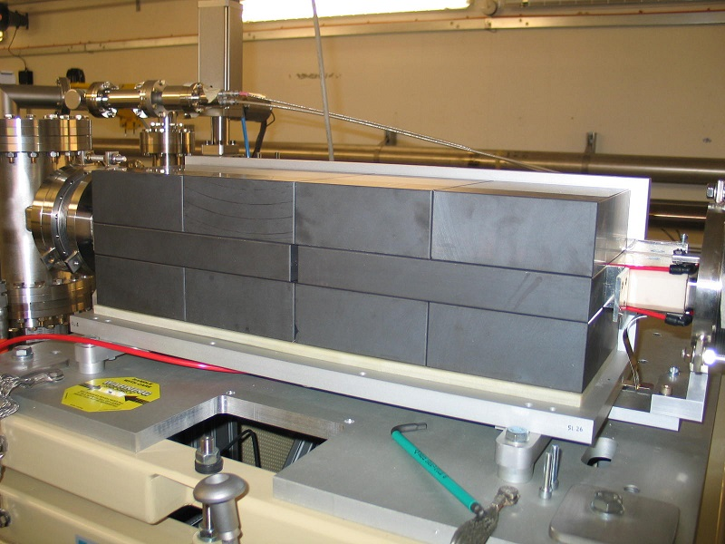
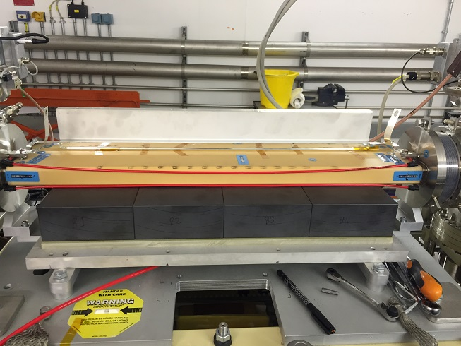
Kickers assembly overview

Slide 5
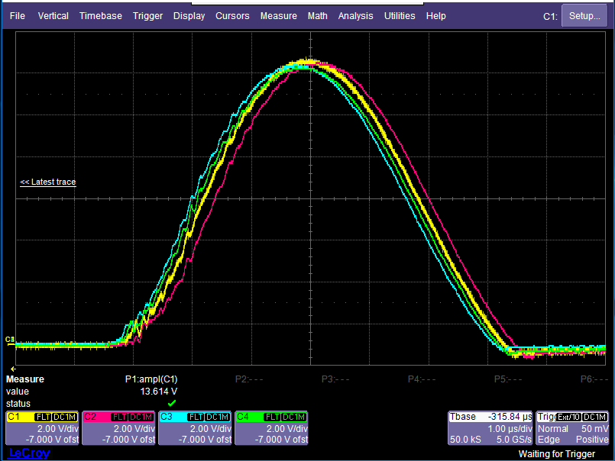
Kicker Poor Matching

Slide 6
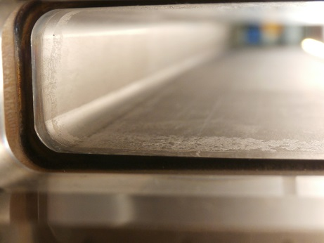
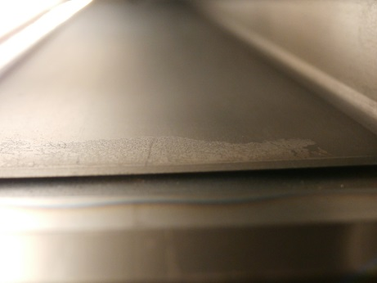
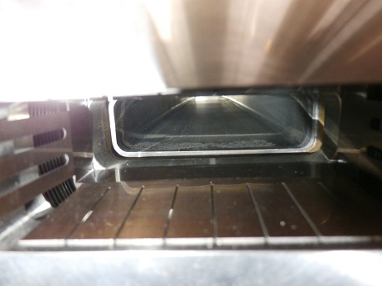
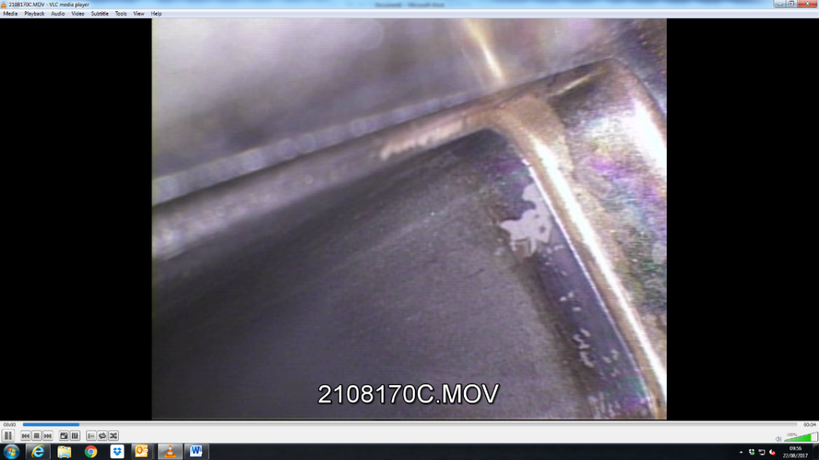
Kicker vessel coating damage
Existing kickers coating and tune kicker coating
coating damage appears at the ends
SIK-03
SIK-01
Tune kicker
SIK-01

Slide 7
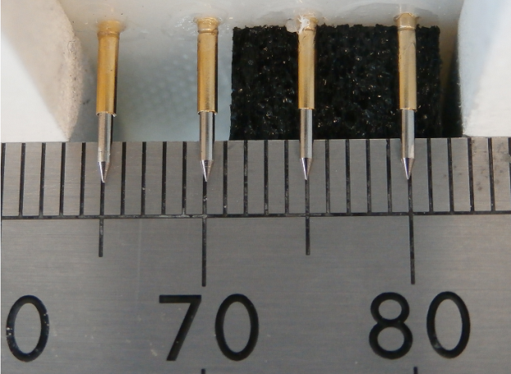
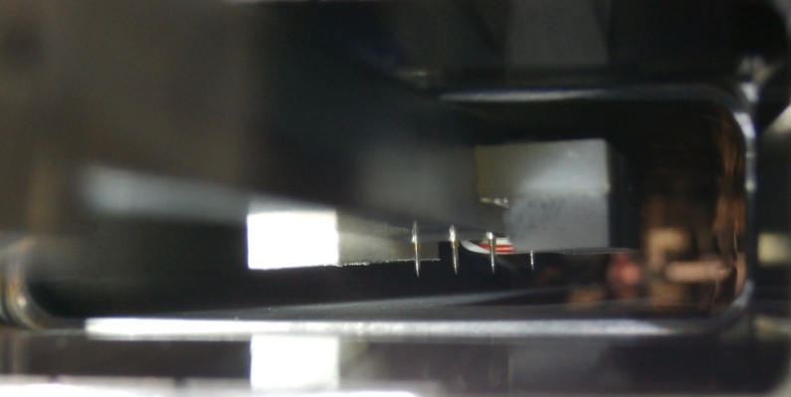
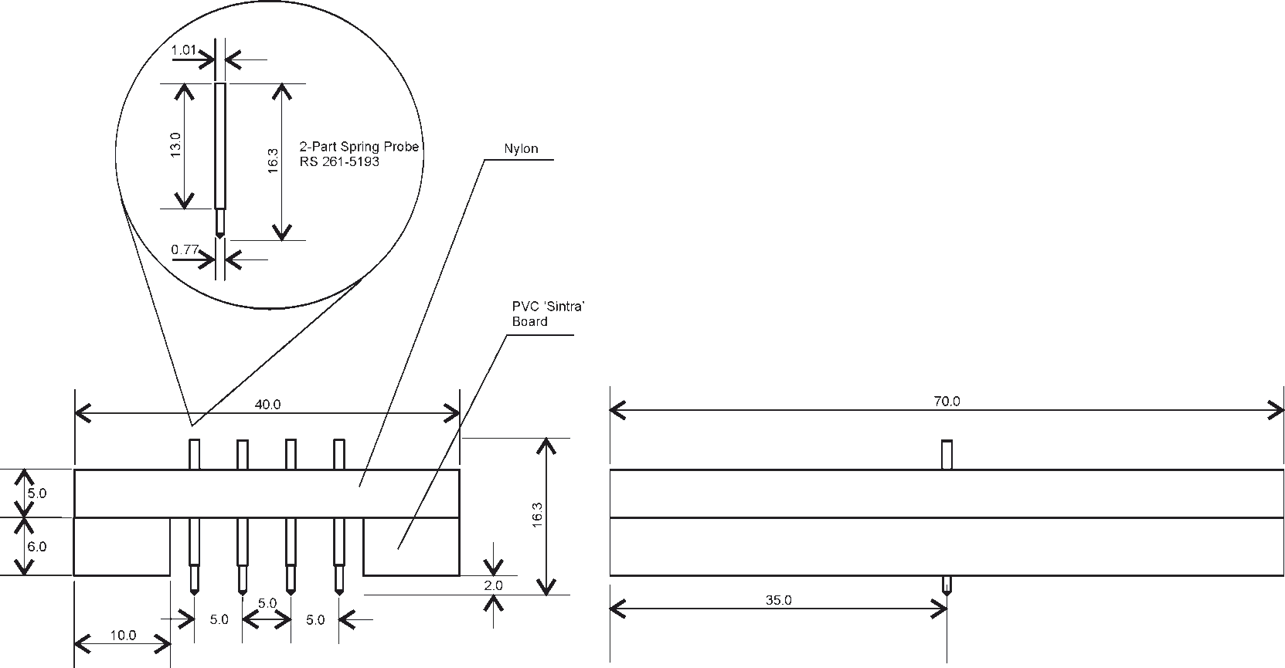
Coating thickness measurements
4-Point Probe setup

Slide 8
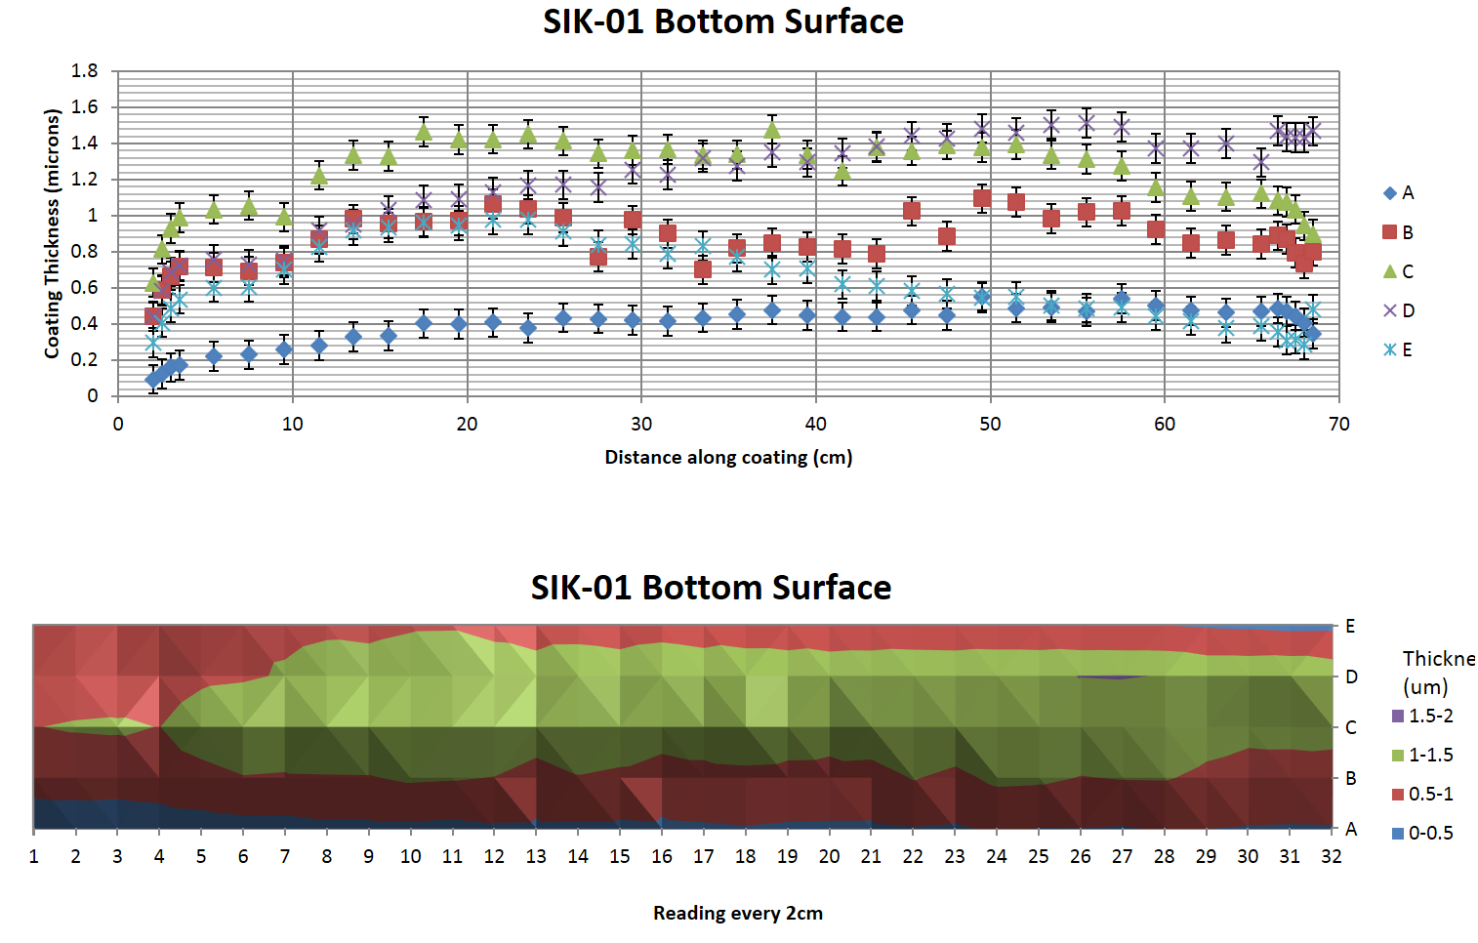
Coating thickness measurements

Slide 9
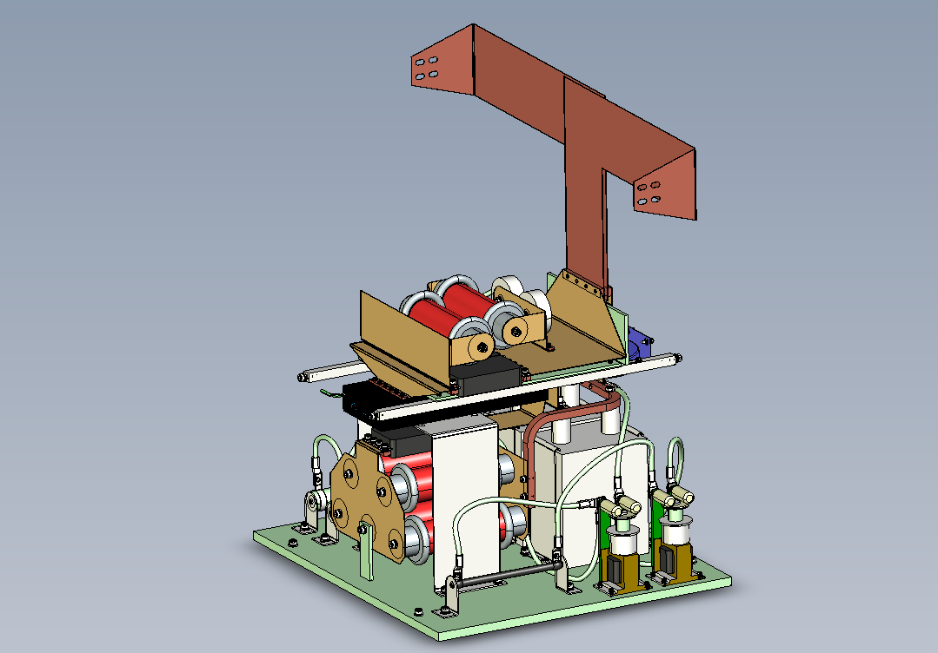
Kicker Test Stand

Slide 10
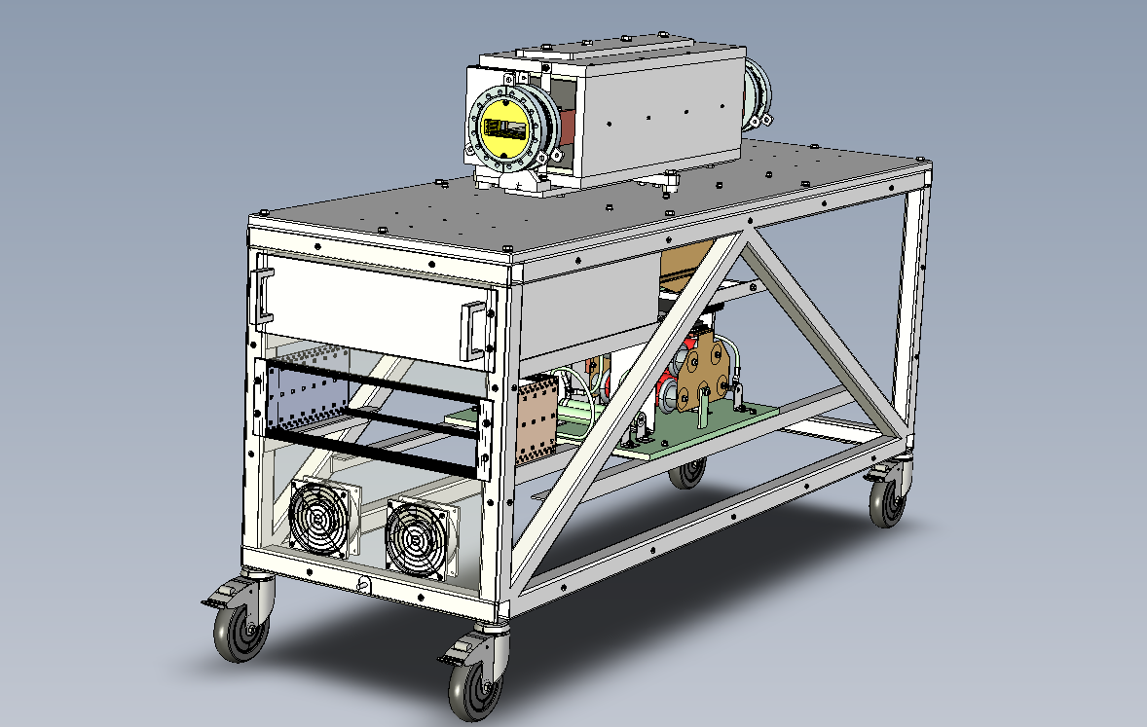
Kicker Test Stand

Slide 11
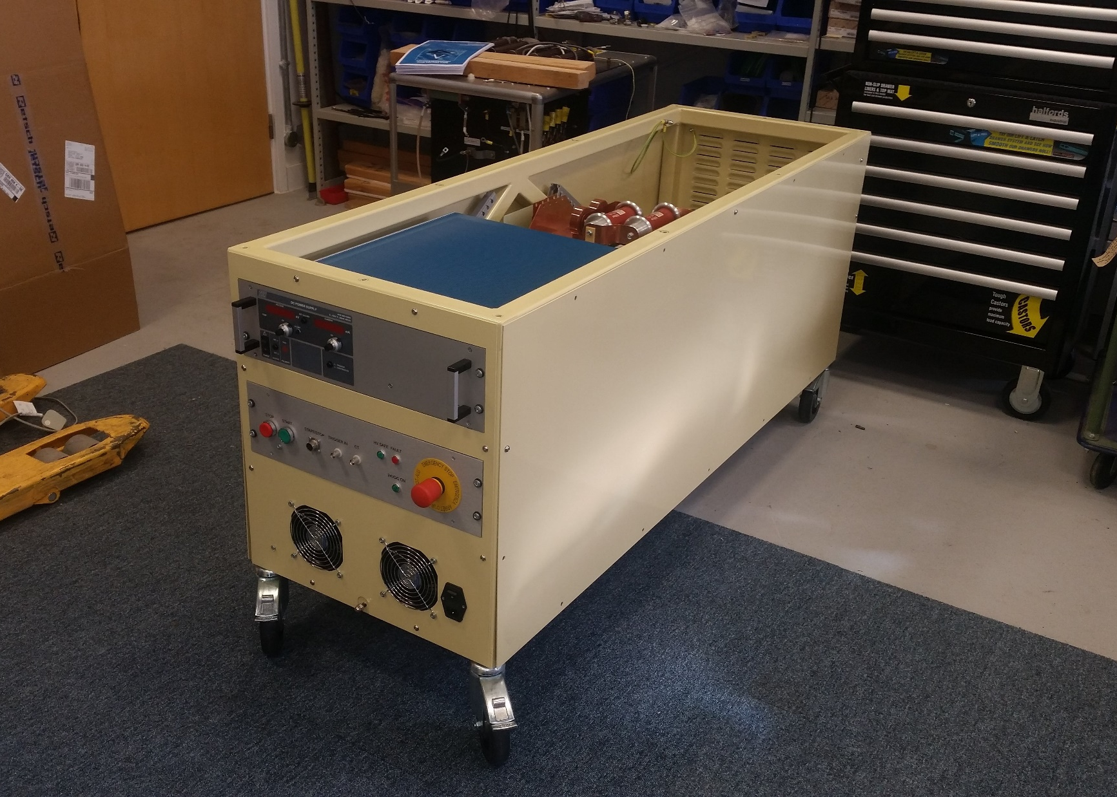
Kicker Test Stand

Slide 12
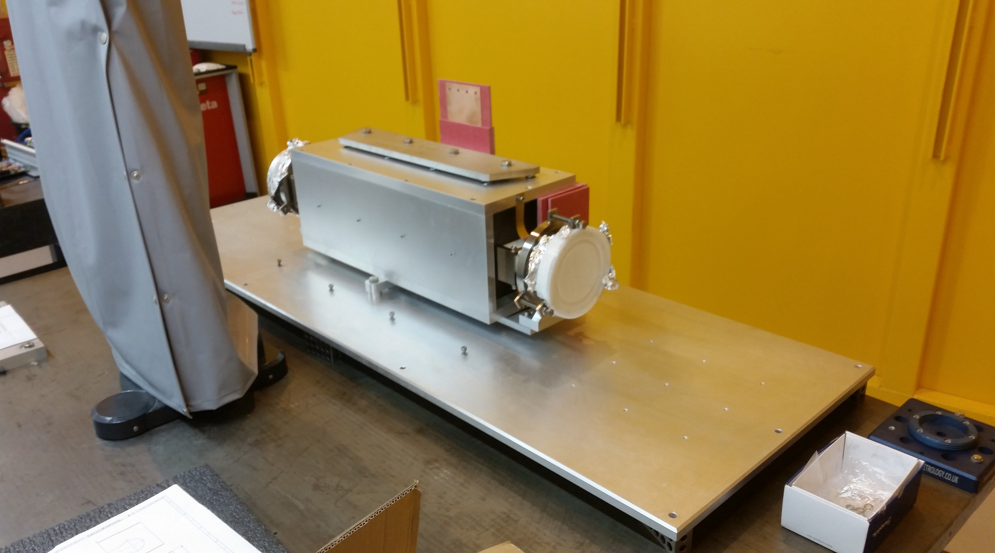
Kicker Test Stand

Slide 13
Thank you for your
Attention.
Colin Abraham
Snr Power Supply Engineer

