Slide 1
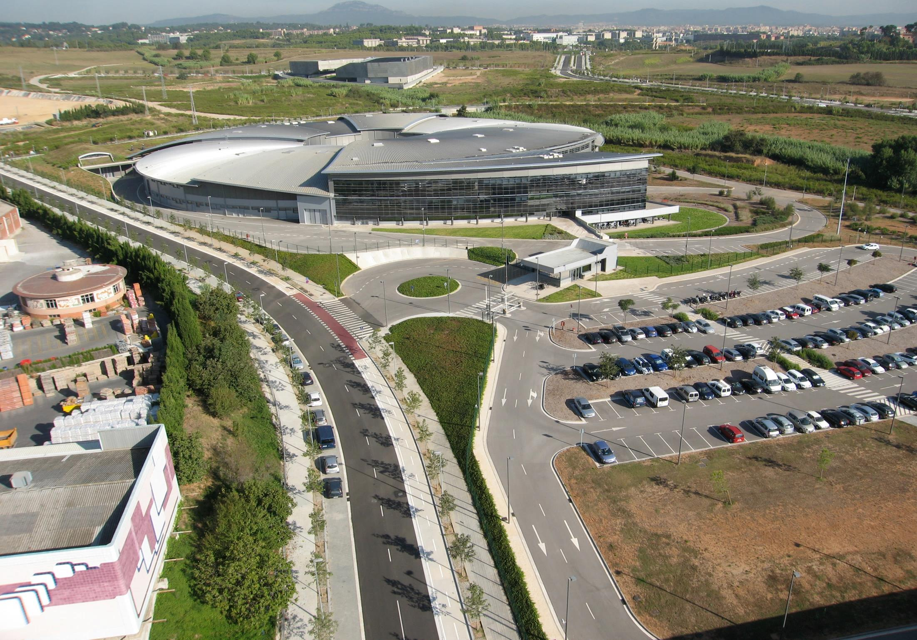
ALBA Synchrotron Light Source
Montse Pont & Nuria Ayala

Slide 2
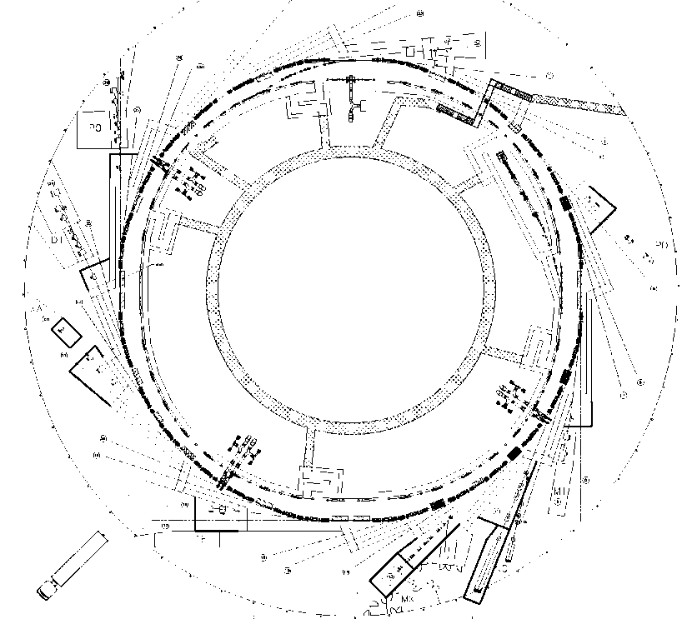
Layout
LINAC
100 MeV
BOOSTER
100 MeV ->
3 GeV
STORAGE RING
3 GeV

Slide 3
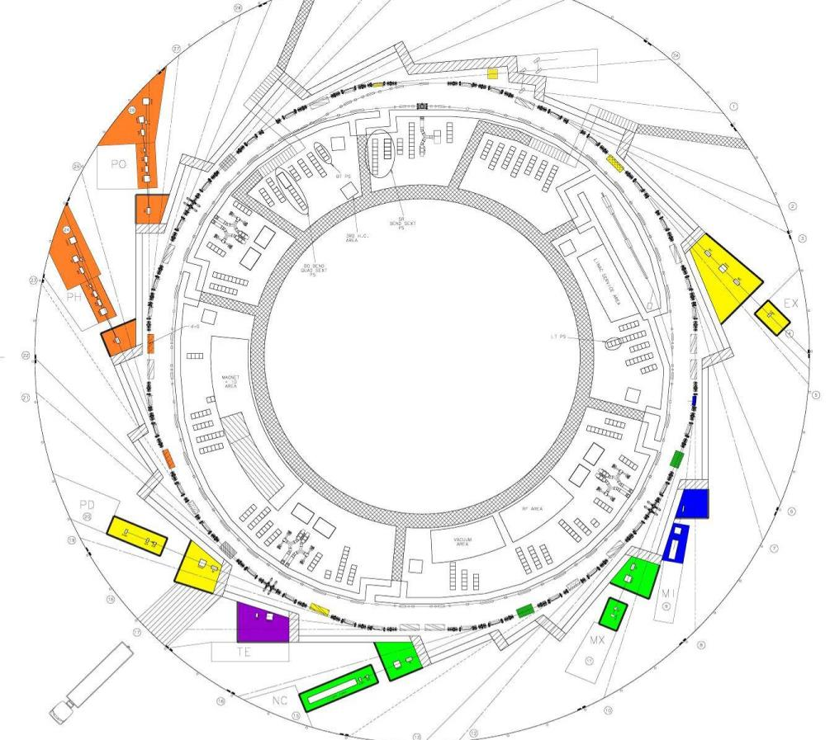
Beamlines
BL29: BOREAS
EU71– (0.08-3 keV)
Resonant Absorption
and Scattering
Bending: e⁻ Diagnostics
BL01: MIRAS
Bending – (0.4-100 µm)
IR Spectroscopy
BL24: CIRCE
EU62– (0.1-2 keV)
Photoemission
spectroscopies
BL04: MSPD
SCW31 – (8-50 keV)
HP/HR
Powder Diffraction
BLXX: FaxTor
ID: 3 pole wiggler
Hard x-ray tomography
In operation (8)
In construction (4)
BL06: XAIRA
IVUXX (~5-25 keV)
Macromolecular Cristallography
BL22: CLÆSS
MPW80– (2-63 keV)
Absorption &
Emission Spectroscopies
BL09: MISTRAL
Bending– (0.27-2.6 keV)
X ray Microscopy
BL20: LOREA
EU125 – (10-450 eV)
ARPES
BL11: NCD
IVU21– (6-13 keV)
Non Cristalline Diffraction
SAXS/WAXS
BL16: NOTOS
Bending
Metrology, XAS
BL13: XALOC
IVU21 – (5-22 keV)
Macromolecular Cristallography

Slide 4
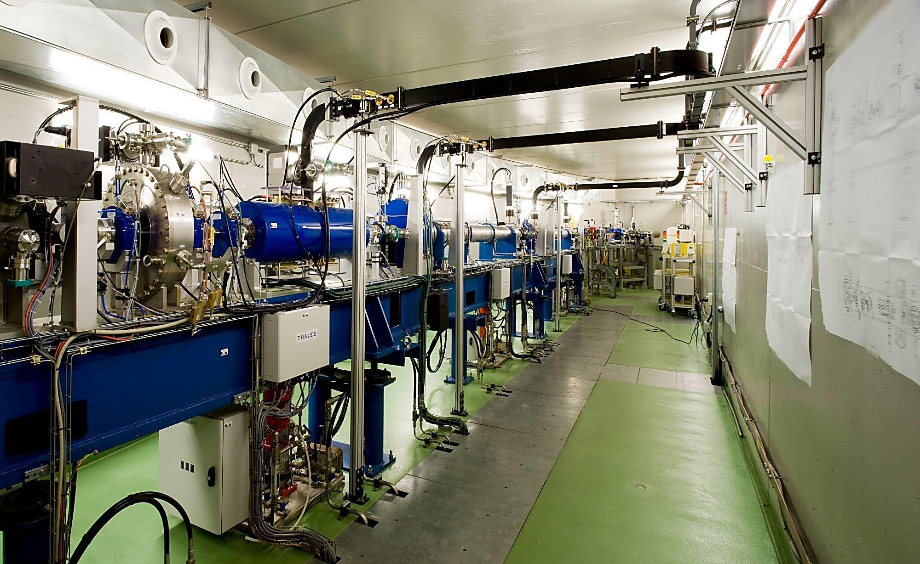
100 MeV LINAC
Linac
LINAC @ 100 MeV
Charge: 1 nC
Rep rate 3.125 Hz
Flexible e-gun: flexible filling patterns

Slide 5
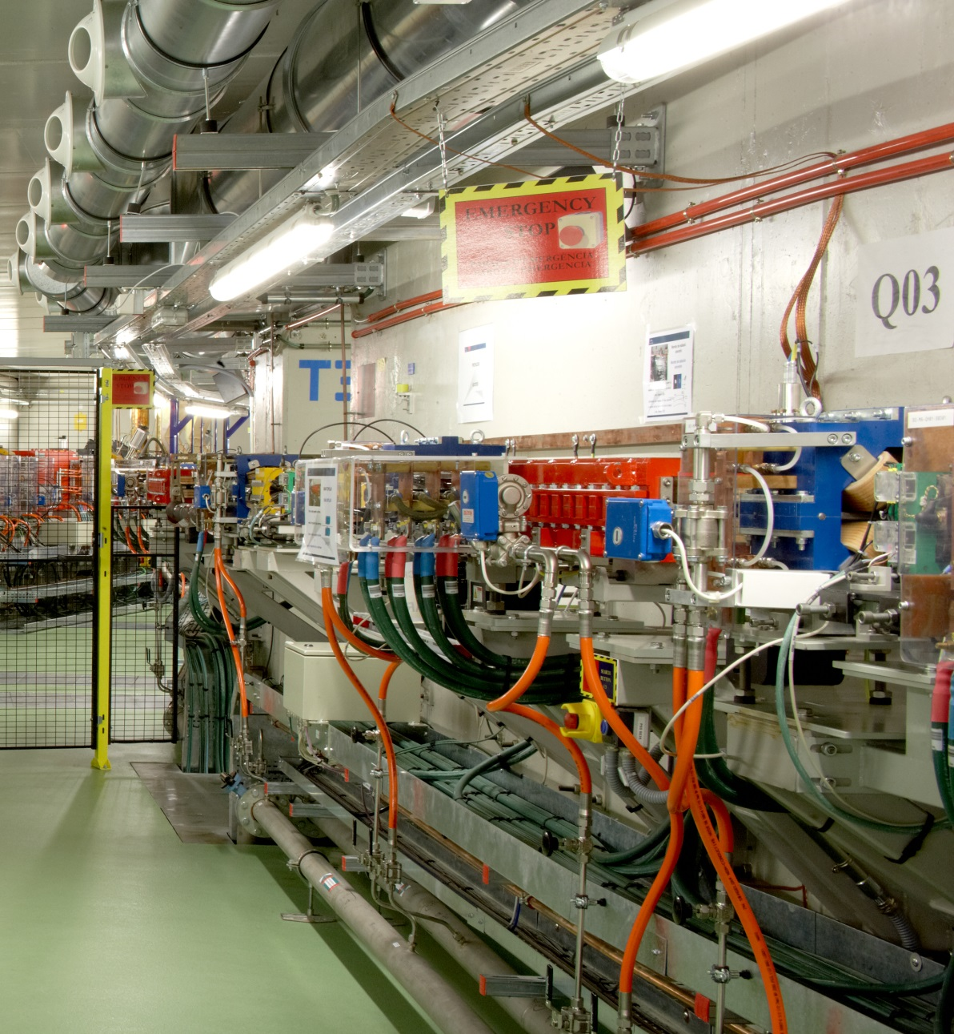
BOOSTER
Booster
Parameter | Value
Nominal inj E | 100 MeV
Minimum inj E | 60 MeV
Nominal ext E | 3 GeV
Circumference | 249.6 m
Emittance | 10 nm·rad
Nominal Current | 1 mA
Rf frequency | 500 MHz
# cavities | 1
In the same tunnel as the SR
Extraction

Slide 6
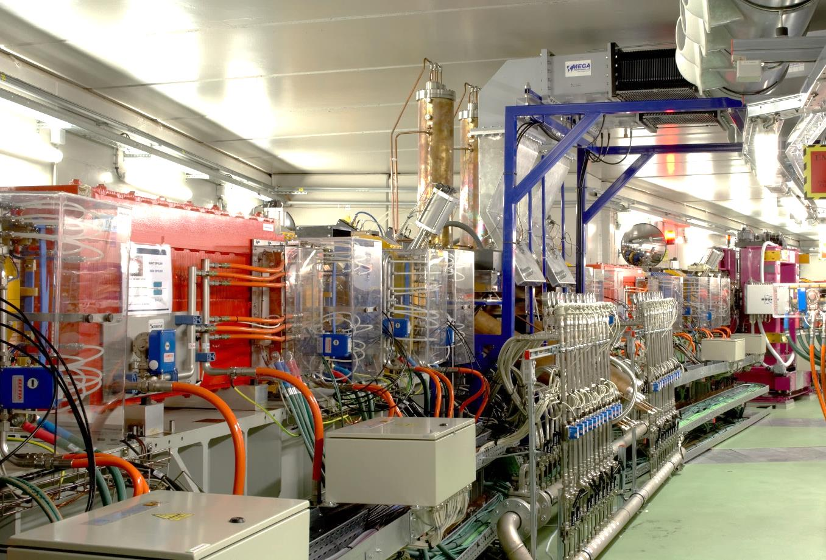
STORAGE RING
Storage Ring
Parameter | Value
Energy | 3 GeV
Circumference | 269.9 m
Emittance | 4.5 nm·rad
Nominal Current | 250 mA
Rf frequency | 500 MHz
# cavities | 6
Long straights | 4 (8 m)
Medium straights | 12 (4 m)
Short straights | 8 (2 m)

Slide 7
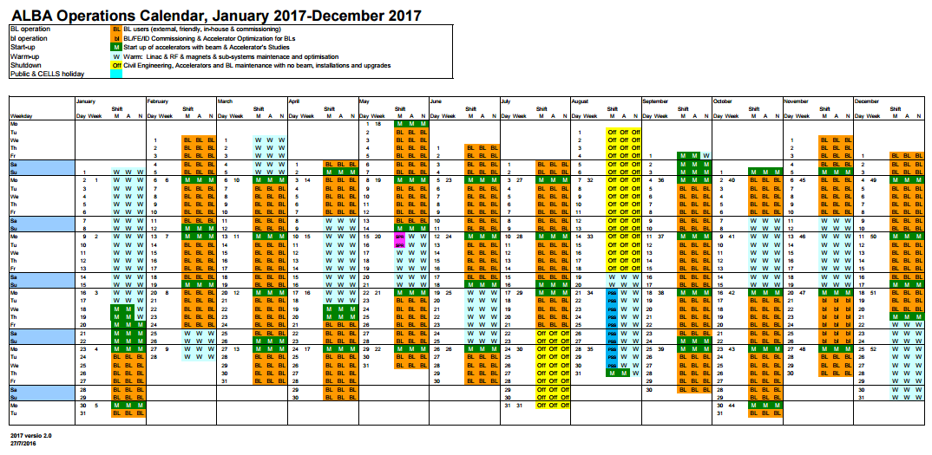
Operational performance
5888 hours of operation
Beam for Users
Accelerator Development and Maintenance
Shutdown Systems off
Shutdown - Basic systems on

Slide 8
Operational performance
Beam availability and MTBF

Slide 9
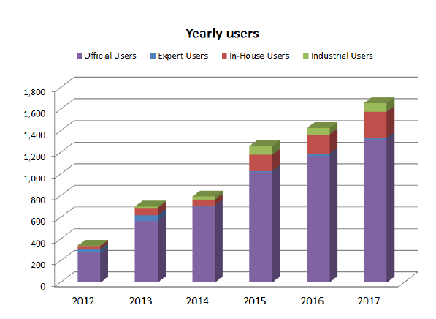
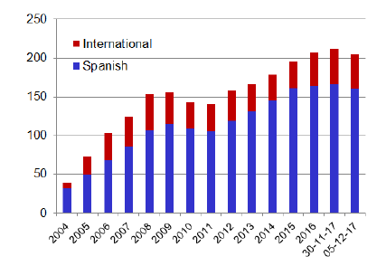
Users & Staff
Users
Staff

