Slide 1
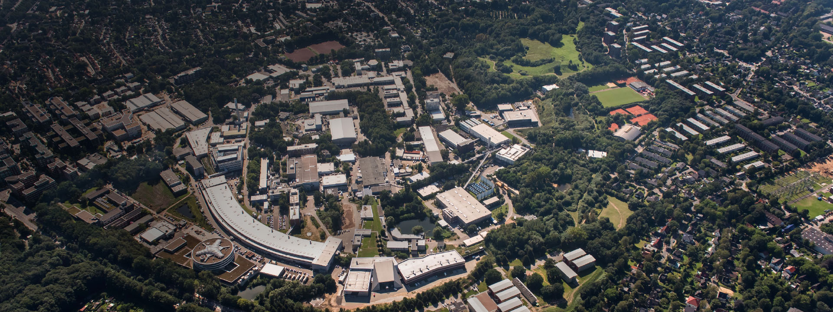
Kickers at DESY
Just a Glimpse
Markus Hüning
Geneva, 12.03.2018

Slide 2
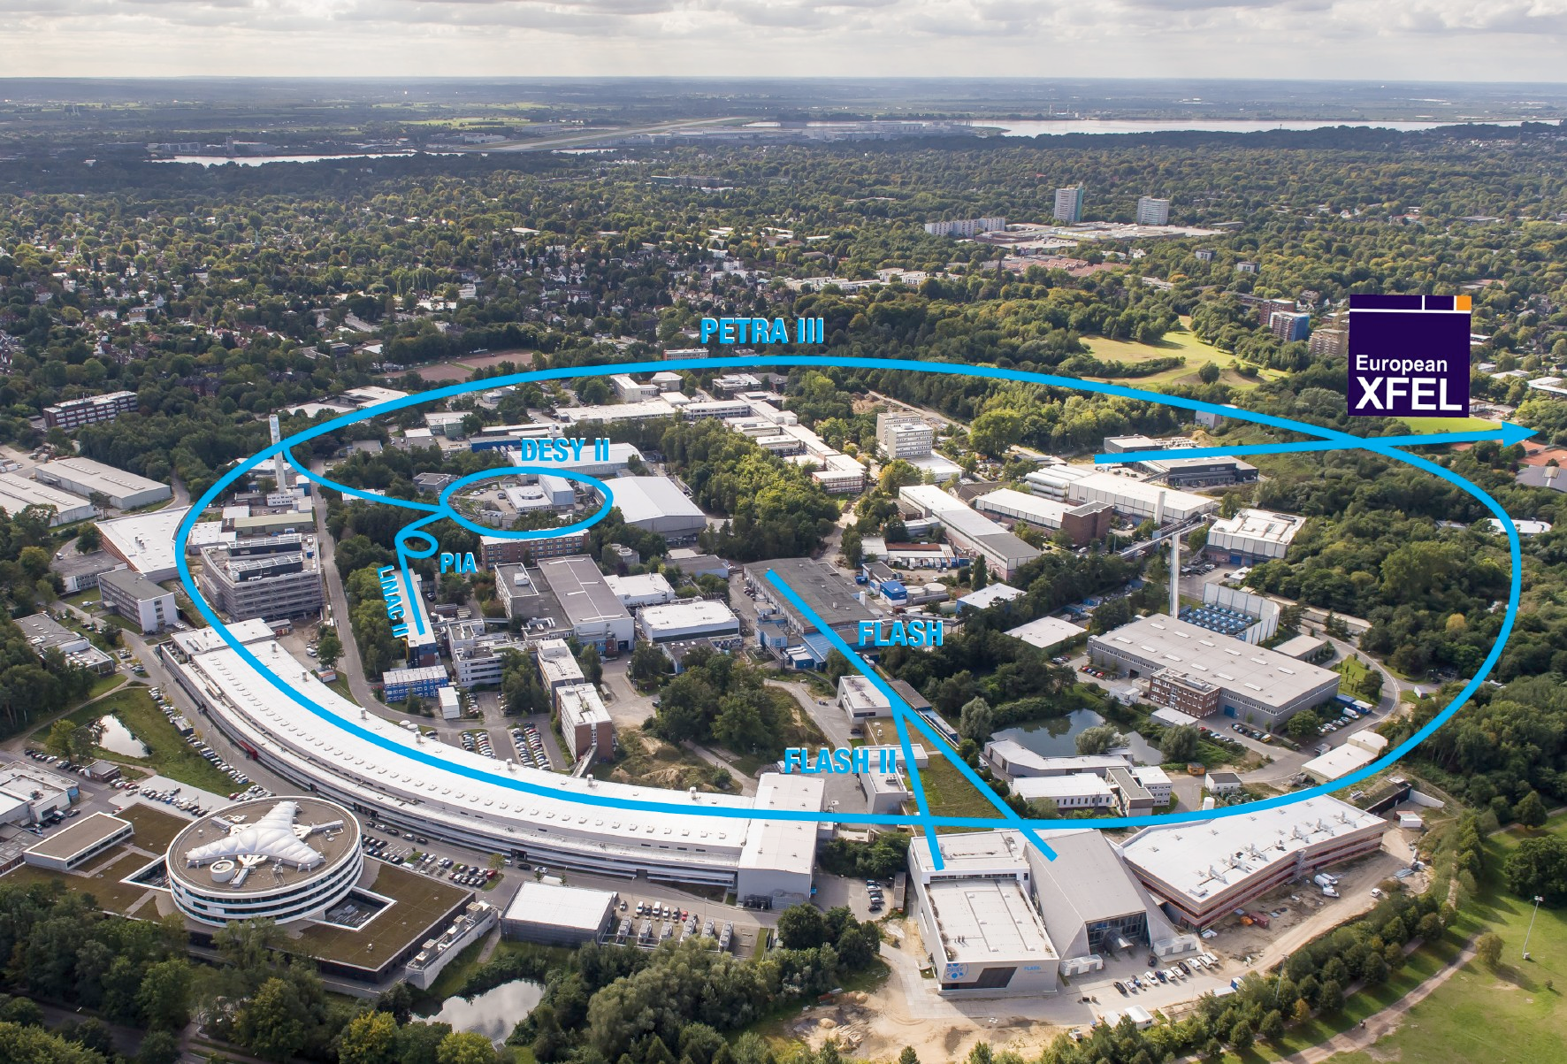
Accelerators at DESY
We have 3 individual accelerator complexes

Slide 3
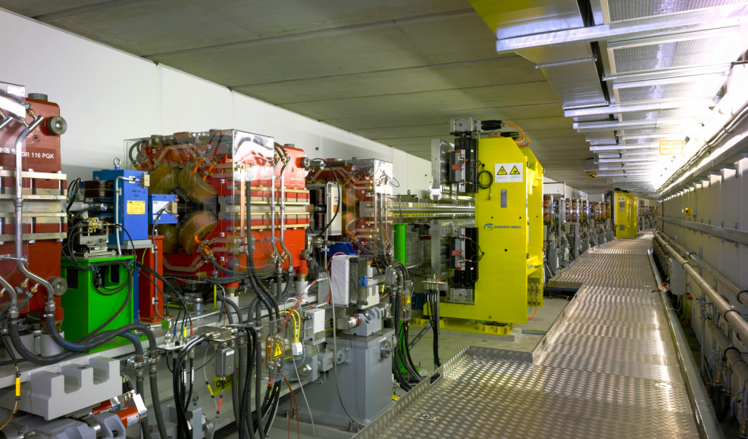
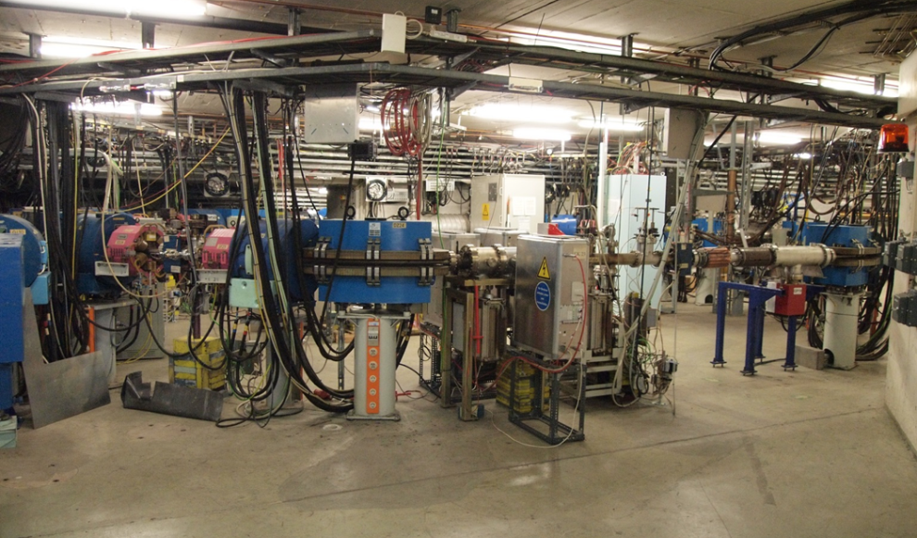
PETRA III
To date the brighttest synchrotron radiation source for hard X-rays
Three experimental halls with up to 22 undulator beamlines
+ 1 beamline from damping wigglers
Operated at 6GeV in top-up mode
Chain of accelerators
  Linac II
  PIA
  DESY II
  PETRA III
Each with a set of injection, ejection and feedback kickers

Slide 4
PETRA IV
Aim for an Ultimate Storage Ring
Currently in the Conceptual Design Phase
Diffraction limited for X-rays around 10keV
Horizontal emittance in the range of 10-30 pm rad
Injection Scheme unclear as of now,
might require on-axis injection

Slide 5
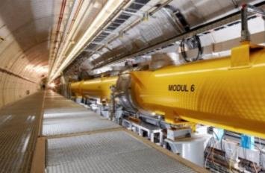
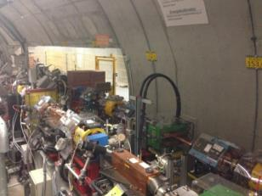
FLASH
Superconduction Soft X-Ray FEL
RF Stations
Accelerating Structures
Photon Diagnostics
sFLASH
FLASH1
THz
RF Gun
Bunch Compressors
FLASH2
Albert Einstein
Lasers
Variable Gap
5 MeV
150 MeV
450 MeV
1250 MeV
FLASHForward
Kai Siegbahn
FEL Experiments
315 m
Kickers for
  Dark current removal
  Diagnostics (TDS)
  Feedback
  Beam Distribution

Slide 6
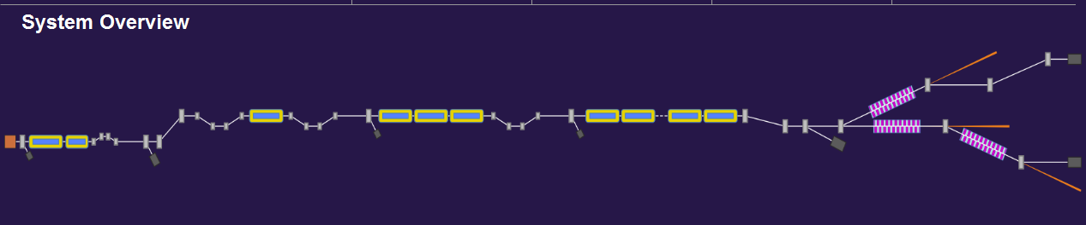
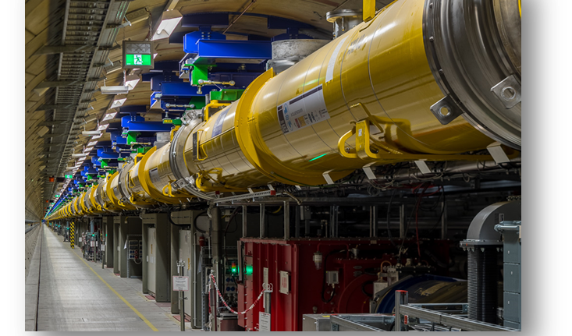
European XFEL
Superconducting Hard X-Ray FEL
L1
L2
L3
0m 30m 230m 480m 1430m 2100m 3100m
Kickers for
  Dark current removal
  Diagnostics (TDS)
  Feedback
  Beam Distribution
  FEL Suppression
  Arbitrary Pattern Generation

Slide 7
Thank you

