Slide 1
Statistical Lifetime Analysis of Thyratrons in CERN Kicker Systems
PULPOKS, 12 March 2018
L. Sermeus (with data inputs from ABT colleagues)
CERN/TE/ABT

Slide 2
Contents
Reminder about thyratron devices.
Thyratrons used in CERN kicker systems.
Operating mode in CERN kicker systems.
Lifetime statistics.
Conclusion.

Slide 3
Reminder about thyratron devices
Tube containing H₂ or D₂ (deuterium) gas at low pressure (~0.5 torr).
Cathode heated for e⁻ emission.
High density plasma in glow mode when on.
Voltage controlled switching.
Unidirectional in standard model.
Gas pressure adjustable using heated titanium hydride reservoir.
High voltage and high current capabilities (200 kV, 100 kÂ).
Fast switching (tens of ns). Low jitter (2 ns typical).
Closing switch only. Needs zero current + recovery time ~50 µs to stop.

Slide 4
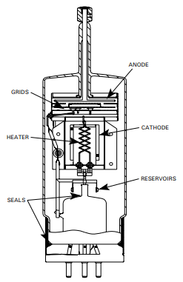
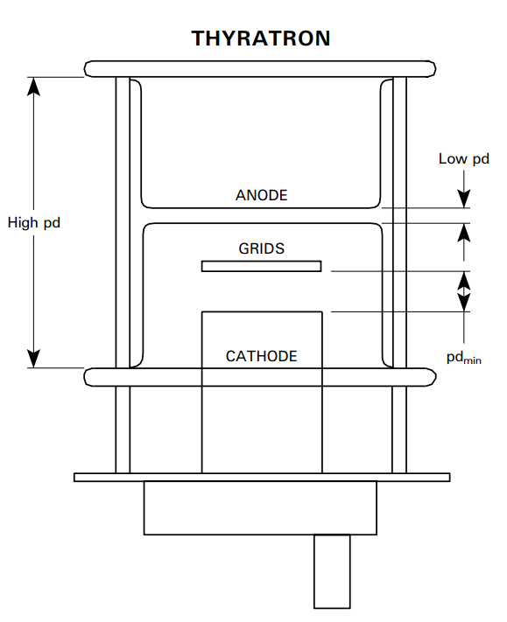
Reminder about thyratron devices
For the kickers, we use glass (H₂ filled) and ceramic (D₂ filled) envelope tubes from E2V (now Teledyne).
2-3 mm gap for 40 kV hold-off at 0.5 Torr
G0, G1 priming grids,
G2 trigger grid
Glass envelope
Ceramic envelope (1 gap)

Slide 5
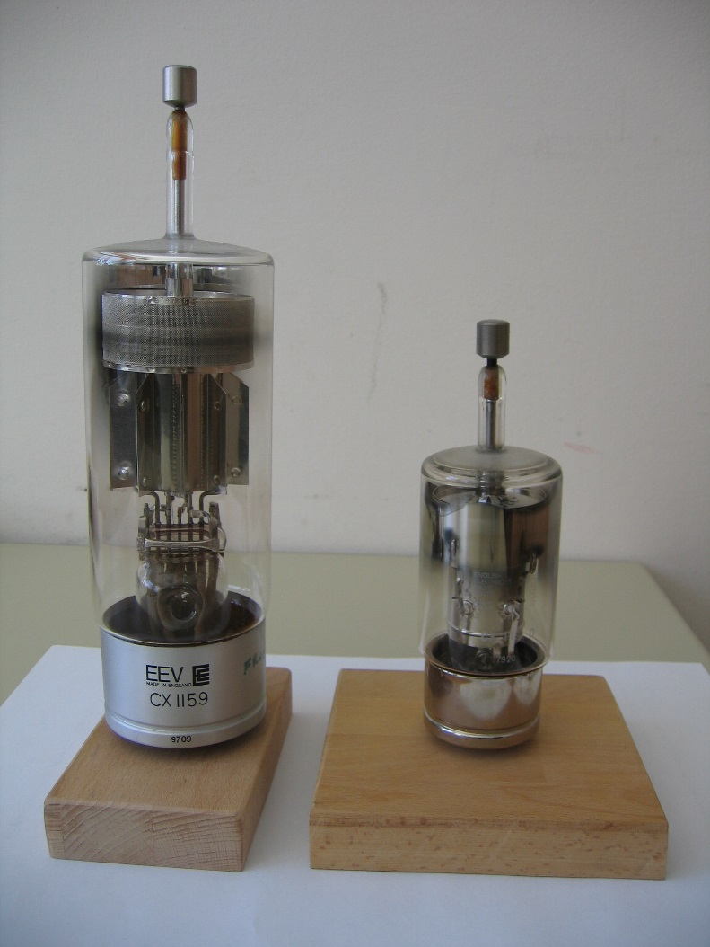
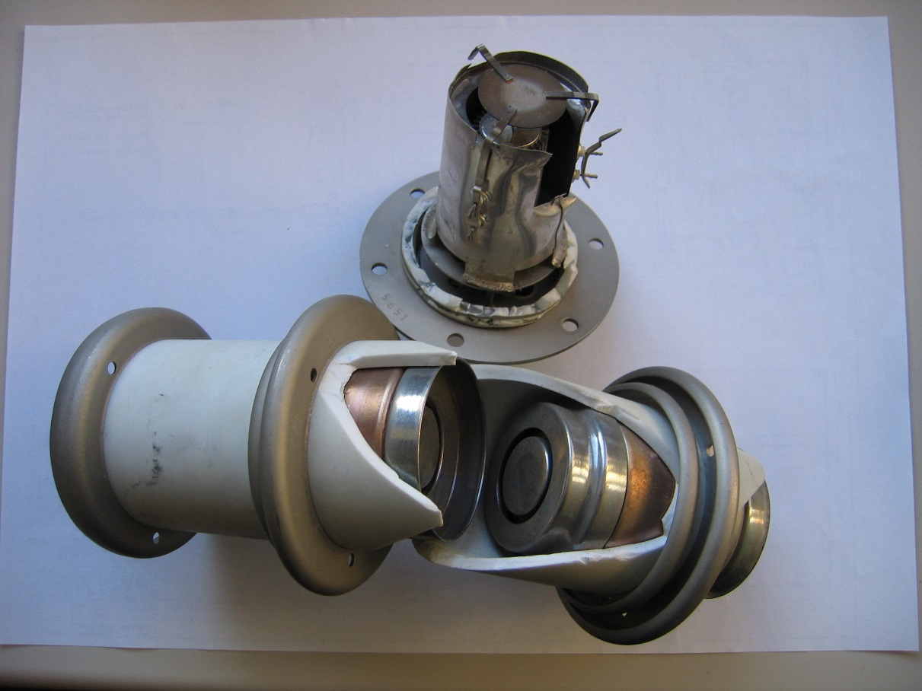
Reminder about thyratron devices
Anode
Cathode heater
Cathode
connection
G1 priming grid
2-3 mm gap for 40 kV hold-off at 0.5 Torr
Reservoir
Glass envelope
Ceramic envelope (multi-gap)

Slide 6
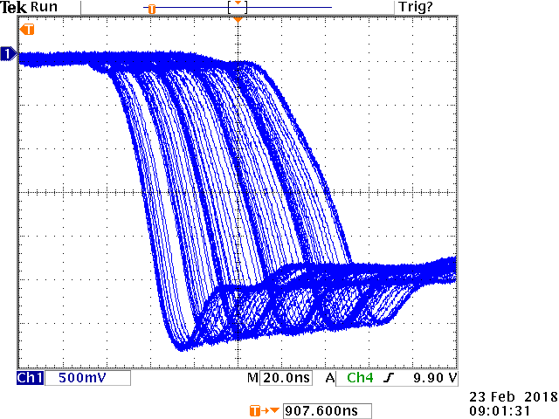
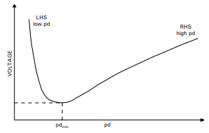
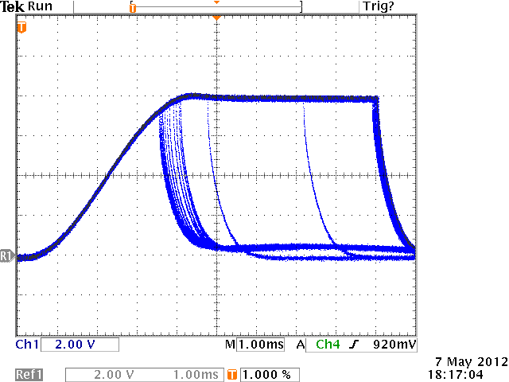
Reminder about thyratron devices
Reservoir voltage management
Operating zone (left side)
Increasing Vres
Vres too low,
long switching time,
high switching losses,
risk of quenching.
Paschen curve for H₂
Vres optimised,
short switching time,
minimum switching losses,
reduced anode delay time.
PFN voltage
Erratic switching due to wrong reservoir settings (resonant charging case)

Slide 7
Reminder about thyratron devices
Special tube types
Double Cathode (DC) ceramic: symmetric tube allowing bi-directional current. Needs two heater systems. Longer than the single cathode standard tube (more inductance, slower switching).
Hollow Anode ceramic (HA): designed to conduct reverse current after forward current conduction if the plasma is still present in the tube. Same length as the standard tube.
Ceramic metal envelope (X): tube with large reservoir and fixed reservoir voltage along its lifetime. An internal circuit assures the self adjustment of the gas pressure when the tube ages.

Slide 8
Thyratrons used in CERN kicker systems
Thyratron types used at Cern:
Glass up to 30 kV, 1.8 kÂ.
Standard ceramic up to 100 kV (3 gaps), 6 kÂ.
Hollow Anode ceramic up to 100 kV (3 gaps), 6 kÂ.
Double Cathode ceramic up to 100 kV (3 gaps), 6 kÂ.
Metal envelope X up to 100 kV (3 gaps), 6 kÂ.

Slide 9
Operating modes in CERN kicker systems
Triggering techniques used:
G1 DC priming (100 to 150 mA), G2 negative bias, G2 fast trigger pulse of 1 kV minimum.
G1 DC priming (100 to 150 mA), G2 negative bias, G2 fast trigger pulse of 1 kV minimum, RC coupling of G2 pulse to G1 without delay.
No G1 DC priming. G1 pulsed with 1 Â picked from G2 trigger pulse which is then delayed by ~550 ns. Negative bias on G2. Needs only one trigger unit.
G1 DC priming (100 to 150 mA) + minimum 10 Â/1 µs pulse ~550 ns before G2 fast trigger pulse of 1 kV minimum. G2 negative bias. Needs two separate trigger units and trigger transformers.
Methods 3) and 4) give the best results in terms of jitter and lifetime.

Slide 10
Operating modes in CERN kicker systems
Good practises:
try to match the system to avoid reflections which may lead to reverse currents in unidirectional tubes. This is not possible with lumped inductance magnets.
operate tubes at their optimum gas pressure in order to reduce losses and avoid quenching or internal arc.
use stabilised heater supplies.
use hollow anode tubes only if you can switch forward current during a minimum of 100 ns before reverse current arrival. If this is not guaranteed, a double cathode switch is necessary.
use hollow anode or double cathode tubes as Dump Switches to avoid damage (arc) in case of short-circuit in a normally terminated magnet circuit.
Use an efficient fault detection system to immediately stop operation in case of problem.

Slide 11
Lifetime Statistics
Glass tubes
System | Tube Type | Qty | PFN Volt (kV) | Switch current (kA) | Pulse duration (µs) | Trigger method | Switch use | Life Time (h) | Life Time (Shots)
PSB Distributor BI.DIS10 | CX1159 | 5 | 25 | 0.5 | 130 | 1 | MS | 7·10³ | 20·10⁶
PS Pedestal PG | CX1159 | 3 | 30 | 1.8 | 12 | 1 | MS | 10·10³ to 20·10³ | 3·10⁶
PS Staircase NSG | CX1159 | 12 | 38 | 1.52 | 12 | 1 | MS | 10·10³ to 20·10³ | 3·10⁶
TT2 ERD1 | CX1159 | 2 | 30 | 1.2 | 2.2 | 1 | MS | 25·10³ | 4.5·10⁶
TT2 ERD2 | CX1191D | 12 | 30 | 1.2 | 12 | 1 | MS | 25·10³ | 4.5·10⁶
Failure modes: metallisation, short circuit G2-cathode, erratics, gas leak.

Slide 12
Lifetime Statistics
Ceramic Tubes
System | Tube Type | Qty | PFN Volt (kV) | Switch current (kA) | Pulse duration (µs) | Trigger method | Switch use | Life Time (h) | Life Time (Shots)
PSB extraction BE.KFA14L1 | CX1575G (2 gaps, HA) | 4 | -42.5 | 6.8 | 1.516 | 3 | MS | >110·10³ still ok | >180·10⁶
 | CX1175G (2 gaps) | 4 | -42.5 | 3.4 | 1.516 | 1 | Diode | >110·10³ still ok | >180·10⁶
PSB Transfer BT.KFA10 | CX1575G (2 gaps, HA) | 2 | -42.5 | 6.8 | 1.516 | 3 | MS | >120·10³ still ok | >200·10⁶
 | CX1175G (2 gaps) | 2 | -42.5 | 3.4 | 1.516 | 1 | Diode | >120·10³ still ok | >200·10⁶
PSB Transfer BT2.KFA20 | CX1574G | 1 | -28 | 4.48 | 2.717 | 3 | MS | 75·10³ | 125·10⁶
 | CX1175G (HA) | 1 | -28 | 3.4 | 2.717 | 1 | Diode | >120·10³ still ok | >200·10⁶
Failure modes: erratics.

Slide 13
Lifetime Statistics
Ceramic Tubes
System | Tube Type | Qty | PFN Volt (kV) | Switch current (kA) | Pulse duration (µs) | Trigger method | Switch use | Life Time (h) | Life Time (Shots)
PS Proton Injection KFA45 | CX1171A (3 gaps) | 4 | 80 | 1.52 (3 if SC) | 2.86 | 1 | MS | 70·10³ | 100·10⁶
 | CX1671A (3 gaps, HA) | 4 | 80 | 1.52 (± if SC) | 0.2 (3 if SC) | 1 | DS | 70·10³ | 100·10⁶
PS Ion Injection KFA28 | CX1154A | 2 | 28 | 2.24 | 2 | 1 | MS | >20·10³ still ok | >3·10⁶
 | CX1573 (HA) | 2 | 28 | ±1.12 | 2.1 | 1 | DS | >20·10³ still ok | >3·10⁶
PS Extraction KFA71/79 | CX1171A (3 gaps) | 12 | 80 | 2.667 | 2.1 | 1 | MS | 50·10³ | 70·10⁶
 | CX1671A (3 gaps, HA) | 12 | 80 | 2.667 | 0.2 | 1 | DS | 50·10³ | 70·10⁶
Failure modes: mainly erratics, not triggering.

Slide 14
Lifetime Statistics
Ceramic Tubes
System | Tube Type | Qty | PFN Volt (kV) | Switch current (kA) | Pulse duration (µs) | Trigger method | Switch use | Life Time (h) | Life Time (Shots)
PS MTE extraction KFA13-21 | CX1192G (3 gaps) | 3 | 75 | 6 | 12.5 | 3 | MS | >46·10³ still ok | >9·10⁶
PS MTE extraction KFA4 | CX1171A (3 gaps) | 2 | 81 | 2.7 | 2.1 | 1 | MS | >20·10³ still ok | >3·10⁶
 | CX1671A (3 gaps HA) | 2 | 81 | 2.7 | 0.2 | 1 | DS | >20·10³ still ok | >3·10⁶
AD Injection KFI | CX1171A (3 gaps) | 7 | 80 | 5.3 | 0.6 | 1 | MS | >100·10³ | >2·10⁶
 | CX1671A (3 gaps HA) | 7 | 80 | ±2.67 | 0.7 | 1 | DS | >100·10³ | >2·10⁶
AD Extraction KFE & ELENA Injection | CX1171A (3 gaps) | 1 | 80 | 2.67 | 0.6 | 1 | MS | >100·10³ | >2·10⁶
 | CX1671A (3 gaps HA) | 1 | 80 | 2.67 | 0.1 | 1 | DS | >100·10³ | >2·10⁶
Failure modes: erratics, not triggering.

Slide 15
Lifetime Statistics
Ceramic Tubes
System | Tube Type | Qty | PFN Volt (kV) | Switch current (kA) | Pulse duration (µs) | Trigger method | Switch use | Life Time (h) | Life Time (Shots)
SPS Injection MKP | CX1171B (3 gaps, DC) | 6 | 52 | 3.1 | 11.5 (0) | 1 | MS | 35·10³ | 10·10⁶
 | CX1171B (3 gaps, DC) | 6 | 52 | 6.2 | 0.2 (0) | 1 | CL | >50·10³still ok | >10·10⁶
 | CX2503X (3 gaps, X) | 6 | 52 | ±3.1 | 2 (11.5) | 4 | DS | >30·10³still ok | >8·10⁶
 | CX2503X (3 gaps, X) | 2 | 38 | 3 | 3 | 4 | MS | new | new
SPS MKQV MKQH | CX1154B (DC) | 2 | 25 | 2 | <23 | 1 | MS | 80·10³ | 10·10⁶
 | CX1154B (DC) | 2 | 25 | ±2 | <23 | 1 | DS | 80·10³ | 10·10⁶
 | CX1154B (DC) | 2 | 25 | 4 | 1 | 1 | CL | 80·10³ | 10·10⁶
Failure modes: switching too slow, erratics, cathode heater.

Slide 16
Lifetime Statistics
Ceramic Tubes
System | Tube Type | Qty | PFN Volt (kV) | Switch current (kA) | Pulse duration (µs) | Trigger method | Switch use | Life Time (h) | Life Time (Shots)
SPS DUMP MKDV | CX1171B (3 gaps, DC) | 3 | 47 | ~7.5 | ~2 | 1 | MS | 55·10³ | 10·10⁶
SPS ExtractionMKE6 | CX2003X (3 gaps, X) | 1 | 31 | 3.1 | 8 | 4 | MS | >60·10³still ok | >10·10⁶
SPS ExtractionMKE4 | CX2003X (3 gaps, X) | 1* | 33 | 3.3 | 8 | 4 | MS | >60·10³still ok | >10·10⁶
 | CX2503X (3 gaps, X) | 0* | 33 | 3.3 | <8 | 4 | CL | >60·10³ | >10·10⁶
* Prior to December 2015, we had 5 systems.
Failure modes: erratics.

Slide 17
Lifetime Statistics
Ceramic Tubes
System | Tube Type | Qty | PFN Volt (kV) | Switch current (kA) | Pulse duration (µs) | Trigger method | Switch use | Life Time (h) | Life Time (Shots)
LHC Injection MKI | CX2003X (3 gaps, X) | 8 | 54 | 5.4 | 7.5 | 4 | MS | >45·10³still ok | >3·10⁶
 | CX2503X (3 gaps, X) | 8 | 54 | 5.4 | 0.5 | 4 | DS | >45·10³still ok | >3·10⁶
MKI8D
MKI8C
MKI8B
MKI8A
MKI2D
MKI2C
MKI2B
MKI2A
Blue: during injection
Yellow: during soft start
Main concern: erratics to be avoided to prevent loss of the beam

Slide 18
Conclusion
Thyratron lifetime in normal operating conditions depends mainly on product: peak current × pulse duration × shots.
For extended life, G1 trigger before G2 is highly recommended.
Filament failures are very rare.
For the best tubes without erratic problems, end of CERN life is decided when the rise time becomes out of specification due to gas depletion. A large reservoir voltage supply dynamic from ~3 to 8V is recommended for extended use of non X tubes.
Thyratrons are reliable devices in kicker systems if they are properly operated by well trained people.

Slide 19
Extra Slides

Slide 20
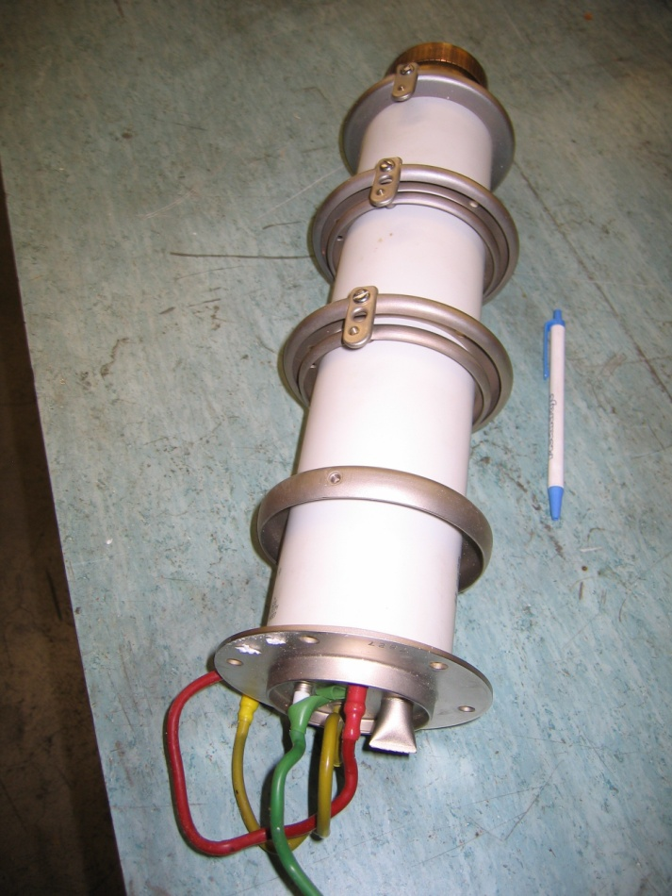
Thyratron CX1171A
Features
deuterium filled switch (gas discharge technology)
deuterium pressure adjustable (reservoir)
100 kV max operating voltage
3 kA max current
switching time ~ 30 ns (10-90)%, jitter <5 ns
triggered with ~1 kV pulse
single supplier (E2V technologies)
cost ~11000 GBP ( ~17000 CHF)
lifetime from 50000 to 100000 filament hours (more
than 10⁷ shots)
for the time being no equivalent switch in other
technologies (semi-conductors or else)
Main concerns
long term availability (the supplier has recently reduced his catalog offer)
continuous optimization of gas pressure necessary for a good compromise between voltage hold-off (low pressure) and rise-time (high pressure)
inherent self firing

Slide 21
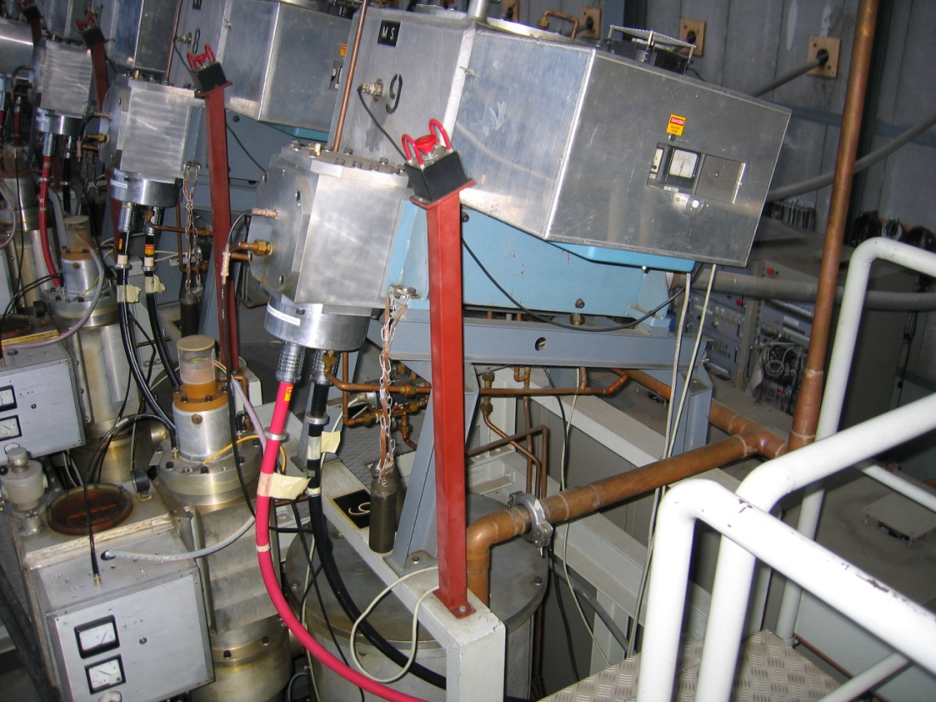
KFA71-79 system description
100 kV Thyratron
SF₆ filled Pulse Forming Line
Generators in B359

