Slide 1
Light Triggering of Thyristors
Pulse Power for Kicker Systems workshop at CERN
Janusz Rodziewicz et al.
CERN TE-ABT R&D Working group

Slide 2
Outline
Solid-state devices challenges in segmented extraction kicker systems
Basics of Optical Absorption
Few examples of light activated pulsed power devices:
  Light-Triggered Thyristor (LTTs © Infineon)
  Laser Pumped Silicon Thyristor (LPST © APP Inc.)
  Laser Gated and Pumped Thyristor
About the investigations at CERN

Slide 3
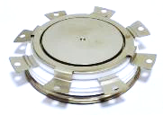
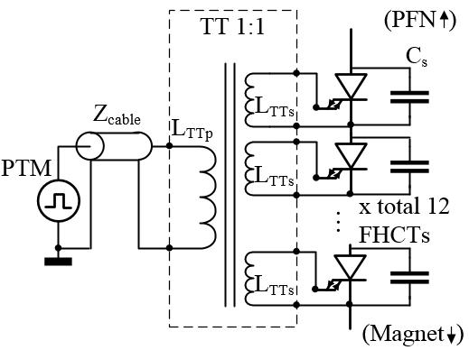
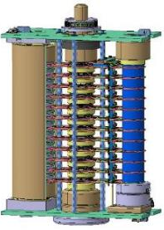
Solid-state switches challenges in segmented extraction kicker systems
Low turn-on delay – The necessity of immediate switch re-triggering and asynchronous beam abort requests from switch a low turn-on delay as during this time the uncontrolled beam energy can damage the accelerator downstream equipment;
Easy maintenance/accessibility aseptically in replacements of thyratron/ ignitron based systems, regular cables can not be used to connect the PTM;
Extremely stringent requirements reliability, availability and fault-tolerance;
Gate pulse requirements most of pulsed power semiconductors (bipolar technologies) follow the trend of increasing request on gate current, FHCT: 2e³A in peak and rise rate of 5e³ A/µs;
Triggering system robustness to EMI- erratic coupling, the noise of less than 1% of the nominal gate pulse can set the switch into an uncontrolled conduction, possibly destructive. Case aseptically of easy-triggerable devices.
Operating voltage de-rating limited radiation hardness of semiconductor switches implies the necessity of stacking of multiple switches;
Sourcing aspect of selected switch;
Discrete Fast High Current Thyristor (FHCT)
Simplified view of the power triggering circuit (Power Triggering Module (PTM), triggering cable and Triggering Transformer (TT)
Main switch of future SPS Beam Dumping System, 3D Model

Slide 4


Basics of Optical Absorption
Optical absorption is fundamental process which is exploited when optical energy is converted into electrical energy.
(Si) indirect
semiconductor
E_{C}
The energy has to be conserved
The momentum has to be conserved
E_{g}
E_{V}
k
CONDUCTION BAND
Wavelengths over 1100nm are ineffective because photon energy is insufficient for the electron-hoe pair generation. Light effectiveness goes down too, when wave length becomes less than 1000nm due to low light penetration into silicon and electron-hole pair recombination close to surface.
1 Photon
BAND GAP
VALENCE BAND

Slide 5
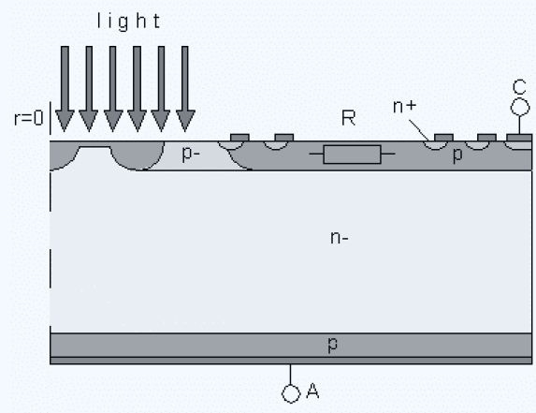
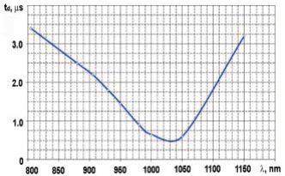
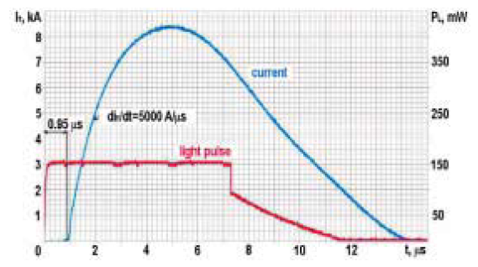
Light-Triggered Thyristor (LTTs)
Light pulse parameters example:
40mW, 10us long, 0.4uJ,
850nm-1000nm wavelength
The central area of the LTT consist of a Break-over Diode (BoD) and a multiple Amplifying Gate structure.
The BoD is located inside the light sensitive area.
Cross-section of the center of the light-triggered thyristor.
Simulated LTT turn-on delay time versus laser diode wave
length (P_{LM} = 200 mW, V_{A} = 100 V)
Anode current turn-on example waveforms.

Slide 6
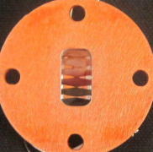

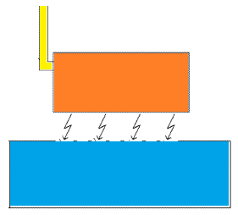
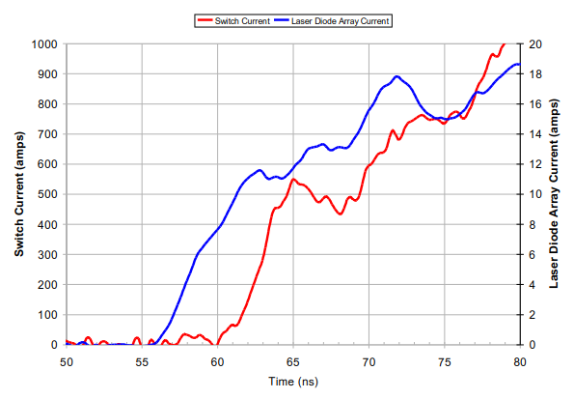
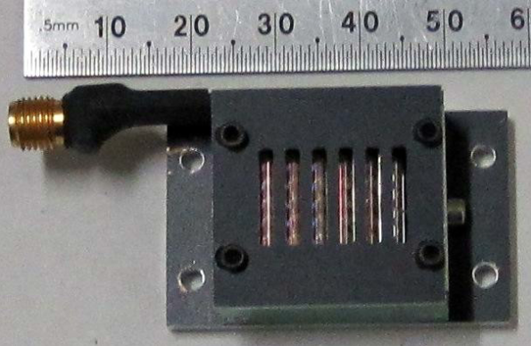
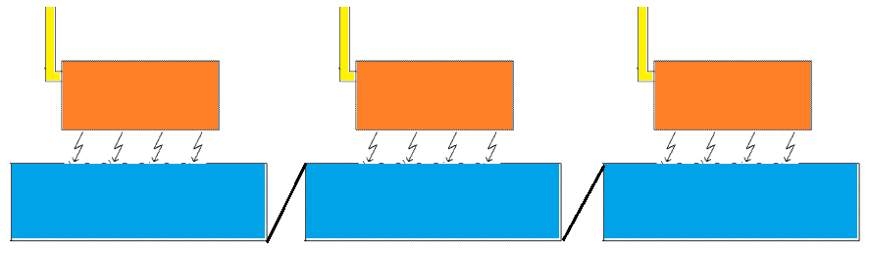
Laser Pumped Silicon Thyristor © APP Inc.
Light pulse parameters example:
650W in peak, 170uJ, 400ns FWHM, 1000nm wavelength
LASER DRIVER CABLE
Demonstrated performance:
2500A in less than 40ns
Commercially available APP Inc. switch modified for laser pumping – with openings windows patterned in the anode metallization.
LASER DIODE ARRAY
THYRISTOR
WITH OPENING
One switch embodiment view.
Series connected stacks, each device has it separate photon source. Each of the thyristors are coupled together with stage to stage connection.
1kW Laser diode array
5ns of turn-on delay measured between the switch current and laser driver current.

Slide 7
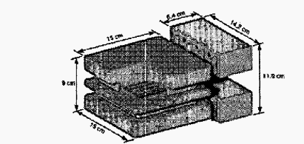
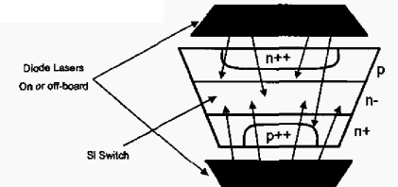
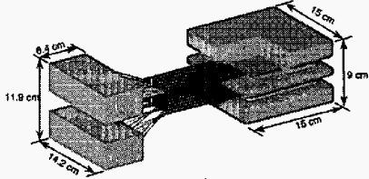
Laser Gated and Pumped Thyristor
First developed for Electra, a Krypton Fluoride (KrF) laser. Primary energy transfer time of 800 us for a
Marx-charged one-stage magnetic pulse compressor
LGTP concept illustration, two-sided pumping
On-Board (Direct Illuminating) Conceptual Embodiment.
Light pulse parameters example:
5kW/cm² over 50ns followed by continuous illumination levels 500, 1000, 2000, 5000 W/cm² in order to reduce forward dissipation.
Off-Board (Indirect Illuminating) Conceptual Embodiment.
Demonstrated performance of 16.4kV devices:
Single shot operations at 3kA/cm² , 30kA/µs/cm²

Slide 8
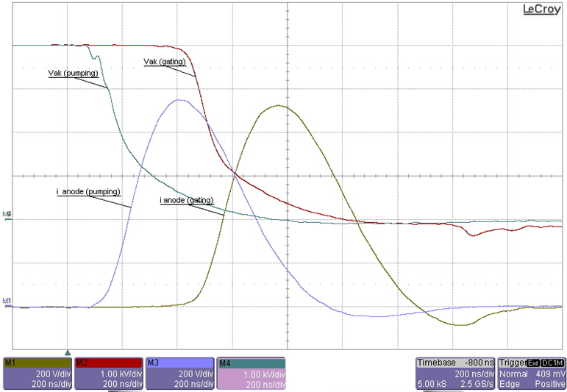
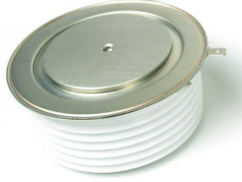

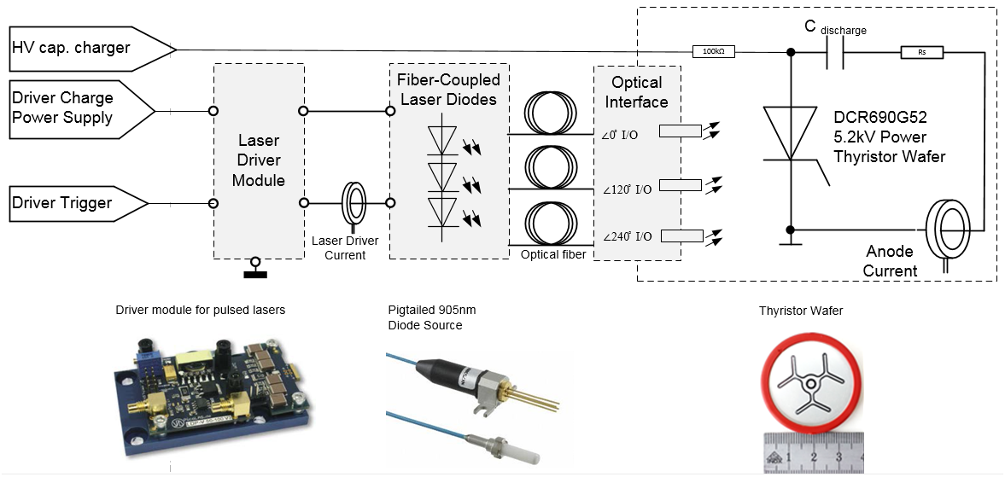
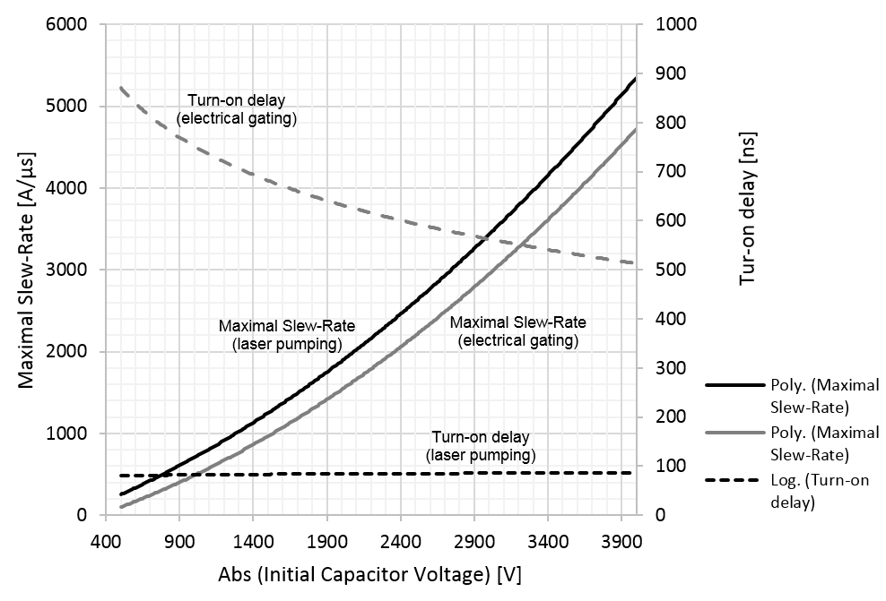
Investigations at CERN
So far in our investigations we use market available Low Cost SCR Phase Control Thyristors. Activation is being achieved through gate distribution illumination with an appropriate light source.
Comparison of electrical gating and light activation (1μm source) methods characteristics.
Example view of electrical test setup.

Slide 9
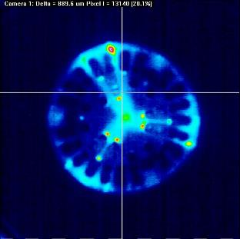
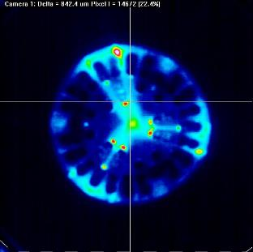
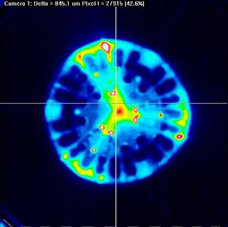
Wafer illumination profile imaging with a CCD camera, 905nm light source
E_{pulse} 12 µJ
E_{pulse} 27 µJ
E_{pulse} 49 µJ

Slide 10
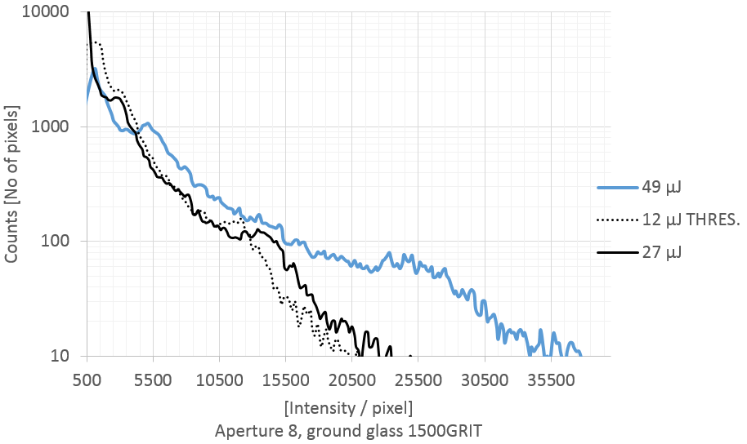
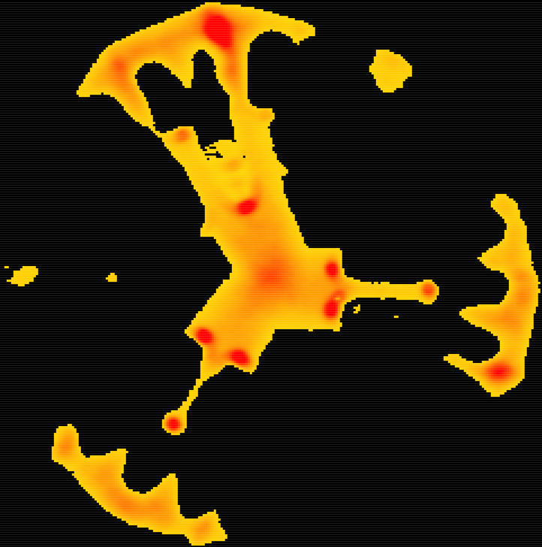
Wafer illumination profile imaging with a CCD camera, 905nm light source
In electrical test 12µJ pulse energy defines a threshold where the SCR thyristor starts turning-on (very slowly)
If the threshold intensity is known, one can rad-out the initial conductive area A(t) at the very beginning of the thyristor turn-on. This area is directly linked to maximum allowable di/dt capability of the device. Cv is the specific heat of silicon, t_{f} is the falling time of the blocking voltage.
Mapping of the area illuminated above the threshold intensity. 49uJ light pulse.

Slide 11
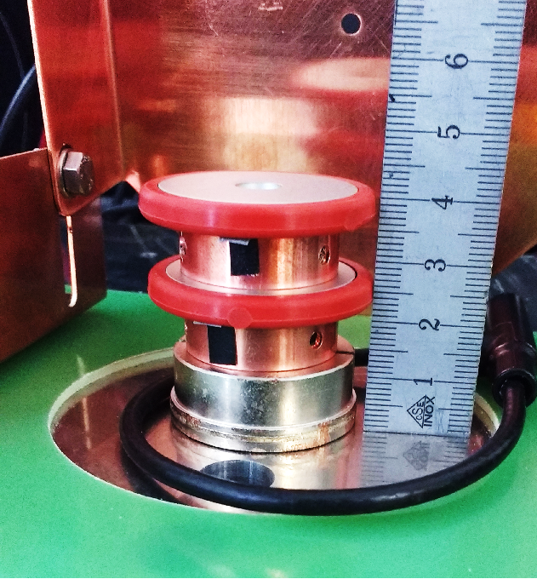
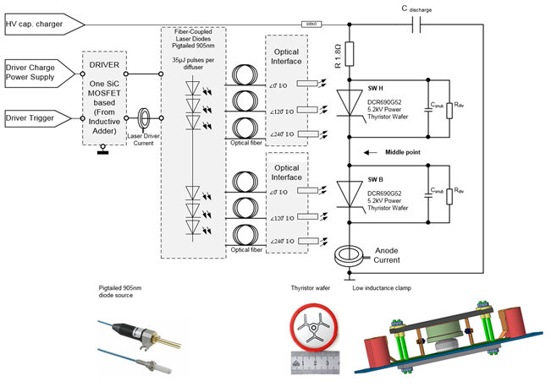
Tests with a series of two connected SCR thyristor devices
Two stacked wafers placed in the low inductance clamp
Fiber-coupled light source limitation;
A correct balance of the total voltage between series connected switches is curtail for the performance;
Small differences in commutation characteristics between the switches can be compensated by means of a snubber circuit

Slide 12
Thank you for your attention
Questions ?

Slide 13
REFERENCES
“Integrated Silicon Optoelectronics”, “Basics of Optical Emission and Absorption”, Zimmermann H., Springer, (2010)
“Laser Pumping of 5kV Silicon Thyristors for Fast High Current Rise-Times”, Howard D. Sanders, Steven C. Glidden, Daniel M. Warnow, Applied Pulsed Power, Inc., (2011)
“Direct Light-Triggered Solid-State Switches For Pulsed Power Applications”, J. Przybilla, R. Keller, U. Kellner, H.-J. Schulze, F.-J. Niedernostheide, T. Peppel, PPC-2003. 14th IEEE International, Volume: 1
“Novel Light Triggering Thyristor for phase control and Pulse Power Applications”, A.V.Grishanin, V.A.Martynenko, A.A.Khapugin, S.A. Tundykov and S.A. Safronenkov, JSC Electrovipryamitel, Saransk, Russia and A.V.Konuchov, All-Russian Electrotechnical Institute, Moscow, Russia, Published in Bodos Power, (June 2012)
United States Patent ,Glidden et al. “LASER PUMPING OF THYRISTORS FOR FAST HIGH CURRENT RISE-TIMES”, US 8,461,620 B2, Jun. 11, (2013)
“Technological Breakthroughs in Light-Activated Thyristors for Pulsed Power”, Douglas M. WeidenheimerS, David Giorgi',Titan Pulse Sciences Division, (2004)
W.C. Nunnally, R.B. Hammond, “Photoconductive Power Switches”, Los Alamos N.L., New Mexico, (1983)
Yeh, Chai, “Handbook of Fiber Optics: Theory and Applications”, Elsevier Science, Saint Louis, (2013)
N. Mohan, T. M. Undeland, “Power Electronics and Devices”, Second Edition, John Wiley & Sons, Inc., (1995)

