Slide 1
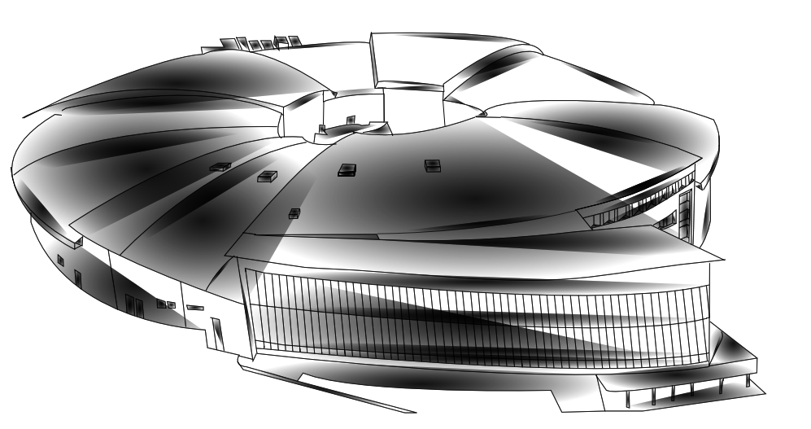
Measurement and diagnostic of Kickers pulses through ADC systems
Source: Javier Sanchez Rios
Nuria Ayala
Notes:
Good afternoon, my name is Nuria and I’m going to present a summary of our injection system and how we do a diagnostic of the injection kicker pulses.

Slide 2
Table of contents
Introduction
Diagnostic hardware & software
First measurements
Summary
Notes:
This presentation will be divided in different steps. First I will do a small introduction of ALBA synchrotron and the injection and extraction processes.
Then I will pass to explain the diagnostic hardware and software used until now and the new proposal we are implementing. Next I will show you the first measurements done. And finally a summary of the presentation.

Slide 3
Table of contents
Introduction
Diagnostic hardware & software
First measurements
Summary

Slide 4

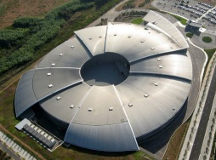


ALBA Accelerator
ALBA is a 3rd generation Synchrotron Light Source located in Barcelona
Notes:
ALBA is a 3rd generation synchrotron, it means it use Insertion devices to extract a powerful light and more focused. It is located close to Barcelona and its performance started in 2012.

Slide 5
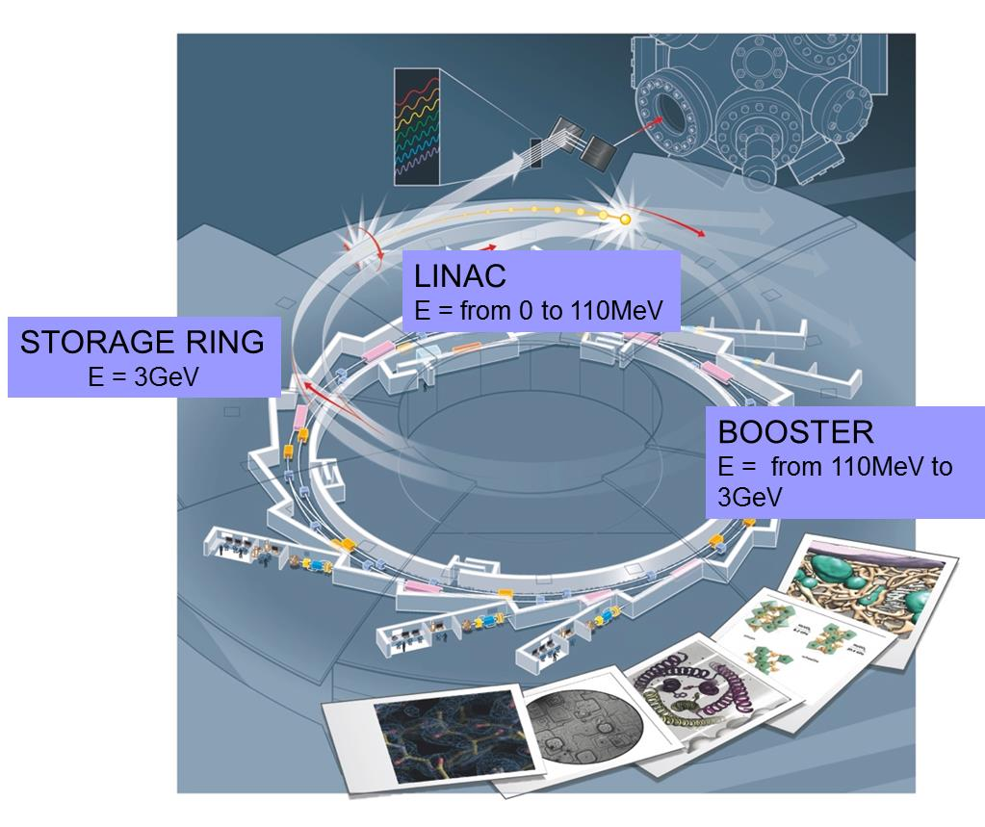
ALBA Accelerators
3 Accelerators
  Linac
  Booster
  Storage Ring (SR)
Beam stored at 3GeV
Top-up mode up to 200mA
  Injection every 20min
8 BLs running
4 BLs in construction
6000 h of operation/year
Notes:
The complex has 3 accelerators, a linac that accelerates the electrons from 0 to 110MeV. The Booster that increases the energy from 110MeV to 3GeV. And the storage ring, were the electrons are stored at 3GeV. Nowadays we work up to 200mA in top-up mode, it means we inject automatically every 20min to keep a constant current in the ring. 8 beamlines are running and 4 more are in construction. The synchrotron is operating for 6 thousand hours per year.

Slide 6

Pulsed elements at ALBA
Processes that required pulsed elements at ALBA
Injection from Linac to Booster
Extraction from Booster
Injection to Storage Ring
Notes:
To transfer the electrons from one accelerator to the next one, from linac to booster and from booster to SR, we need the help of pulsed magnets.

Slide 7
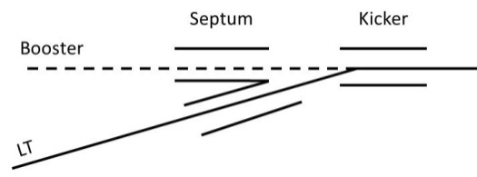
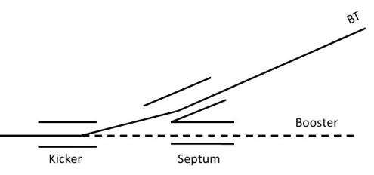
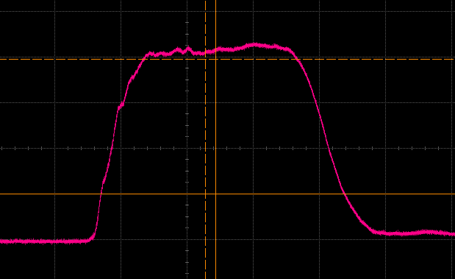
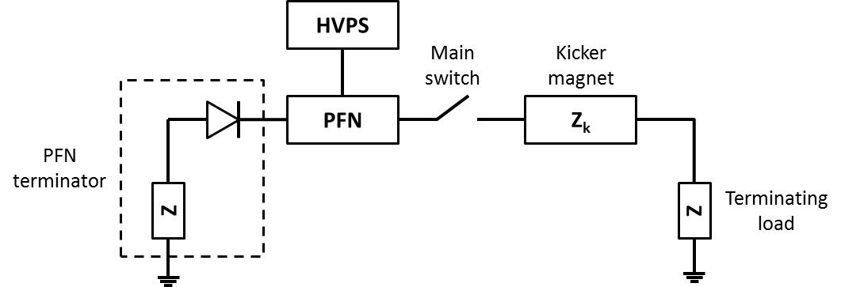
Booster pulsed elements
Injection to Booster & Extraction from Booster:
Injection to Booster
Extraction from Booster
On-axis processes
Fast switching kickers are needed to keep the beam after one turn
Pulse forming circuit: PFN, Thyratron CX2610 from E2V and kicker magnet (Z_{k} < 20Ω)
Ripple (flat top): ±5%
Flat top ≈ 400ns
Fall time ≈ 125ns
Notes:
The injection and extraction processes in booster consist on a couple of septum and kicker. The kickers’ pulses have to be fast enough to keep the beam after one turn and large enough in the flat top to allow the bunch on it. In both cases we use a pulse forming circuit with a pulse forming network, a fast switch, in our case a thyratron and the kicker magnet.

Slide 8
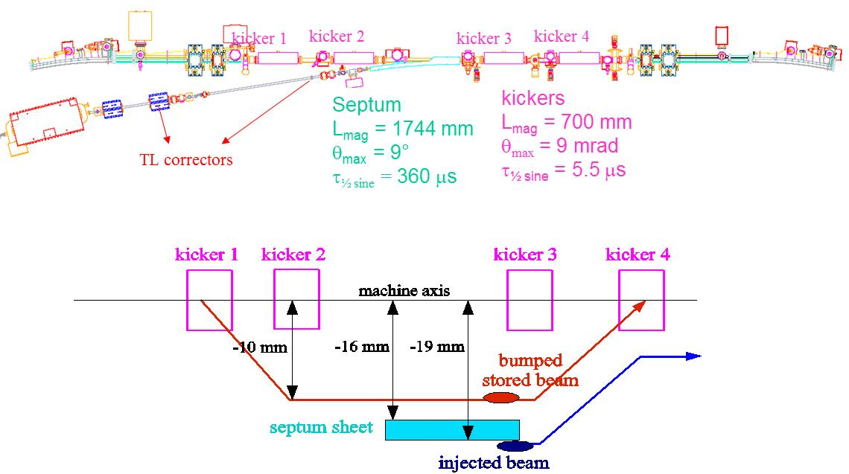
SR Injection Process
Injection to Storage Ring:
Because of the stored beam on-axis injection cannot be used
A set of 4 kickers create a local bump and the injected beam oscillates around this new orbit.
Notes:
The injection to storage ring cannot be an on-axis process, like in booster. In this case, due to we have a stored beam we have to use a set of 4 kickers to create a local bump and the injected beam oscillates around this new orbit. The second couple of kickers return the stored beam and the injected to the normal orbit.

Slide 9
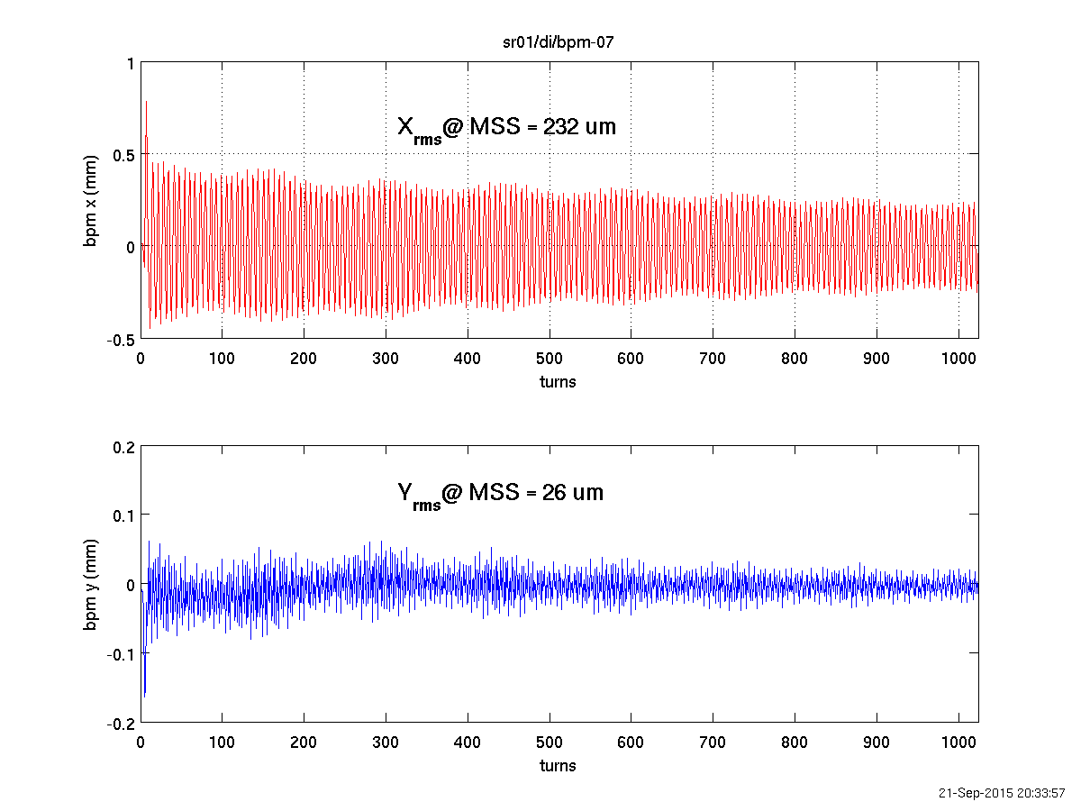
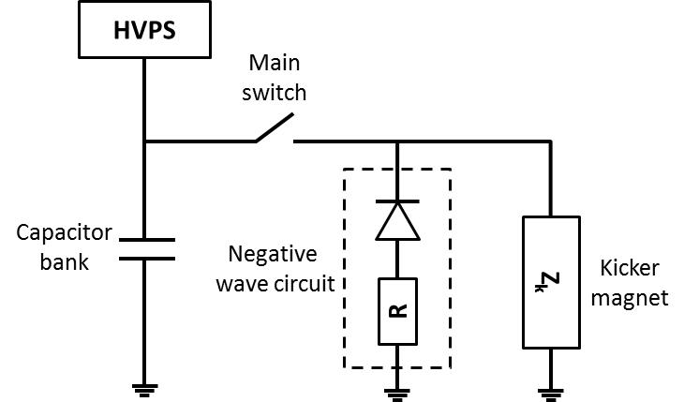
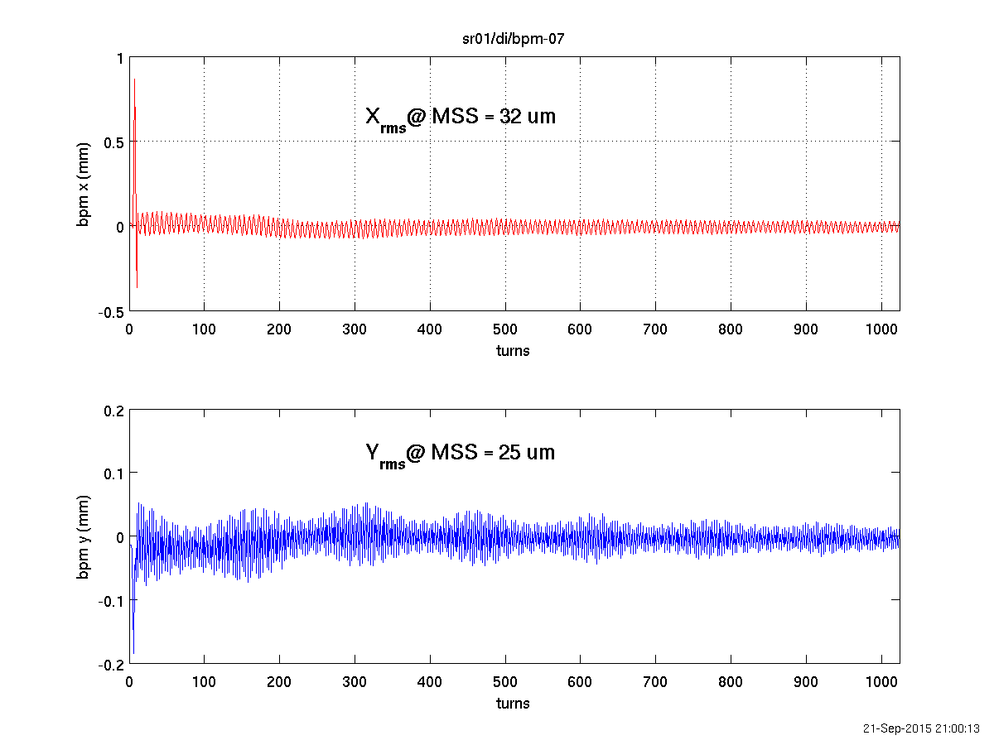
SR Injection Process
Injection to Storage Ring:
Resonant discharge LC circuit: Uses GCT switches, a capacitor bank, and kicker magnet (Z_{k} < 2Ω).
5.7μs
Injection bump has to be as closed as possible to avoid residual orbit distortions that can affect the stored beam
Notes:
In this case, the technology used is an oscillator LC circuit were the negative side of the wave will pass for a discharge circuit. The circuit has a capacitor bank, 4 GCT switches in series and the magnet. As I commented in the previous slide, the 4 kickers create a closed bump. To do it four kickers have to have similar amplitude and shape and they have to be synchronized. Otherwise, we will have a residual bump that can affect to the experiments of the beamlines. As we can see, in this example after the injection we had a bump of 175um, after optimizing the injection we could reduce it down to 60um.

Slide 10
Table of contents
Introduction
Diagnostic hardware & software
First measurements
Summary
Notes:
Now I will explain the hardware and software used to diagnose the kickers pulses.

Slide 11
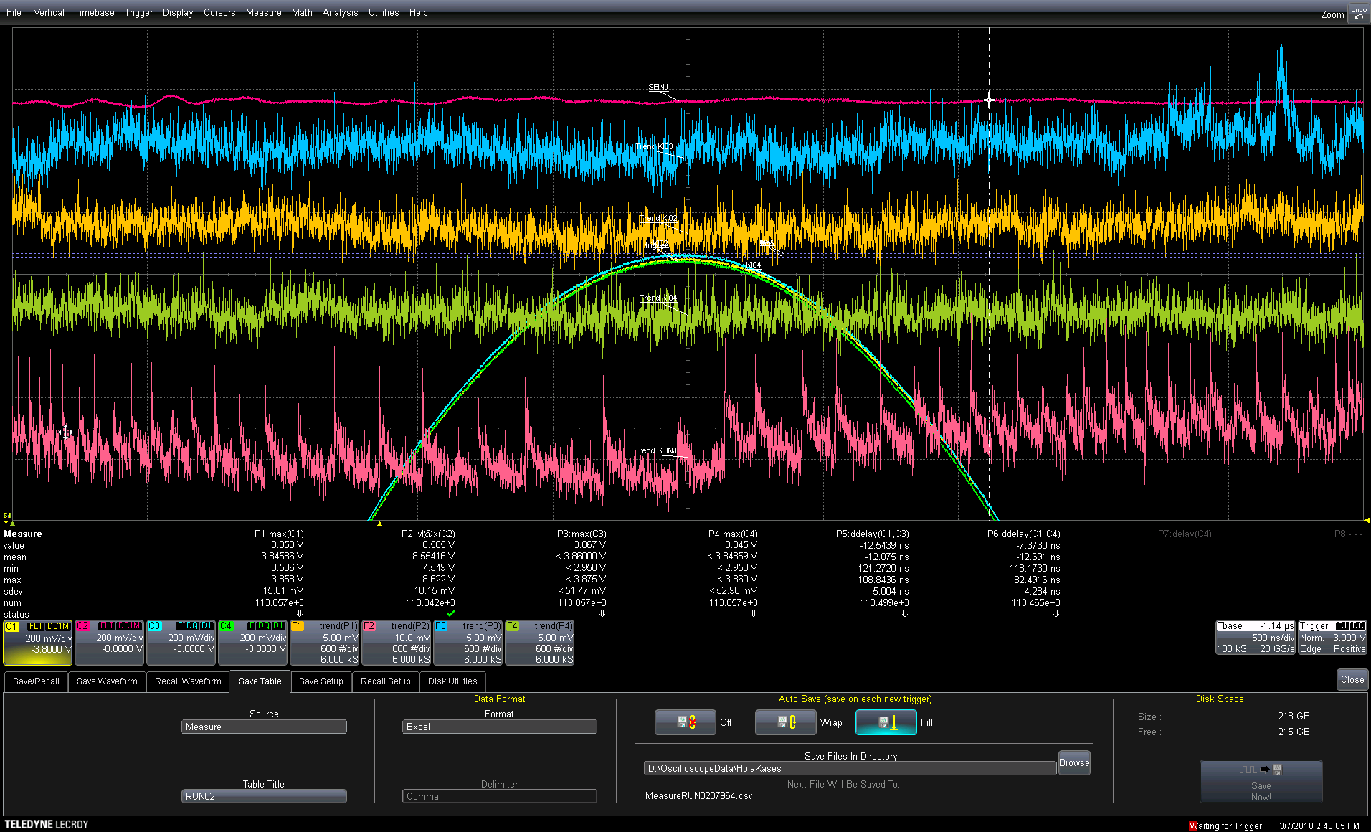
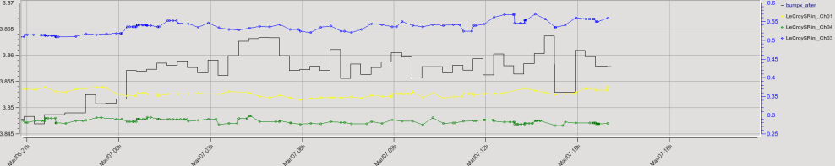
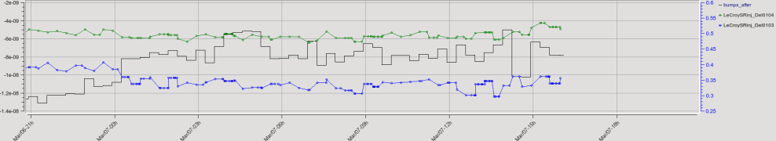
Present diagnostic hardware
LeCroy 425Zi scope with 20GS/s and 8 bits resolution
Configured to measure the peak amplitudes and pulses delay
Data saved as attributes in TANGO control system
BUT depends on operator to start recording
Notes:
Nowadays we are using a scope LeCroy with a sampling rate of 20GS per second and resolution of 8 bits. It is configured to measure the pulses peak, plot their evolution per trigger and save the measures. Moreover, we did a script to read those files and save the average of the measures per injection as attributes in tango control system. However, it has an inconvenient. This system depends on the operator to start recording and a change in the menu window stop saving data.

Slide 12



Diagnostic hardware
 | Scopes | AD Converters
Speed
Resolution
Price
Flexibility
User friendly
Notes:
So we started thinking in alternatives. Analog-digital converters are a good alternative to the scopes due to its flexibility, you can program a customized script and measure only what you want, when you want and independent of the operator.

Slide 13

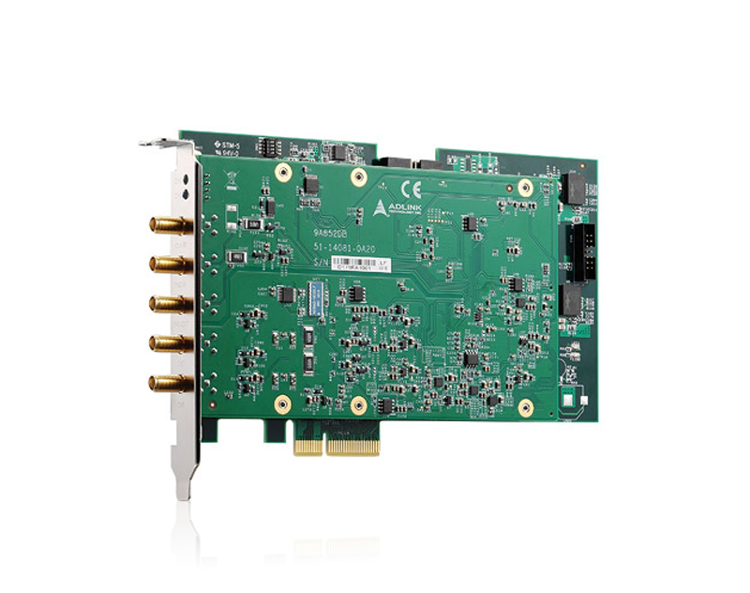
Diagnostic hardware
ADLINK PCIe-9852 Digitizer
14-bit resolution
Sampling rate 200MS/s
Up to 90MHz Bandwidth
50Ω or 1MΩ impedance
Offset error ±1mV
2 channels per card
Notes:
We choose the this adlink digitizer with 14 bits resolution a sampling rate of 200MS/s, it means a time resolution of 5ns and 2 channels per card.

Slide 14
Resolution
Parabolic fit
Linear fit
Notes:
To do it, once we wave our pulse acquired we select two windows, one in the peak and the other in the rise time. Then we adjust the peak to a parabolic fit and the rise time to a linear fit. With them we are able to know the voltage peak and the time at a fixed voltage.

Slide 15

Resolution
Comparable resolution to the LeCroy scope
Vertical resolution: 0.03%
Time resolution: 1ns
10V
5V
2V
1V
5ns
3ns
2ns
1ns
Notes:
With those fits we obtain a resolution comparable to the scope LeCroy. We are able to see changes of the voltages setpoint down to 0.03% and time resolution over 1ns.

Slide 16
Table of contents
Introduction
Diagnostic hardware & software
First measurements
Summary
Notes:
Now we will show you the first measures we obtained.

Slide 17
Measurements during operation
Top-up
YES
Injecting?
NO
Kickers ON
Wait 1s
Data capture:
<V_{max}>; <delay>
σ(V_{max}); σ(delay)
30 pulses per MBM_injection and per magnet
Data averaging per injection and per magnet of pulse peak and delay
Notes:
remember to you we work in Top-up mode. It means, we only shot the kickers during the injection, the rest of time they are off and we don’t need to capture data. So, the script I did ask every second to the device if it is injecting. When it is, and kickers are ON the script starts to capture pulses

Slide 18
Measurements
Delay (μs)
I_{MON} (kA)
Time
Time

Slide 19
Measurements
Changes in KI03’s amplitude caused a bump increment
KI03 changes amplitude (1‰)
Operator recovers the usual value
With the help of D. Yepez

Slide 20
Table of contents
Introduction
Diagnostic hardware & software
First measurements
Summary

Slide 21
Summary
A new diagnostic system is proposed to measure the SR Kickers in the ALBA synchrotron.
The system is based on ADCs: ADLINK PCIe-9852 Digitizer.
The resolution is 0.03% in amplitude and 1ns in time.
The ADCs will allow continuous monitoring of the kickers and correlation with the injection bump.
Integration into TANGO control system under development.
Next step: allow automatic correction of kickers amplitudes & delays

Slide 22

Thanks!
Questions?

