Slide 1
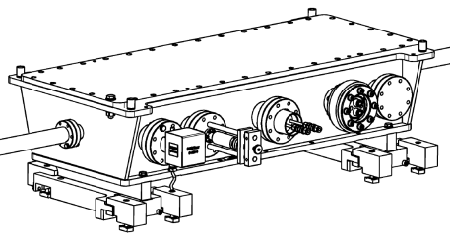
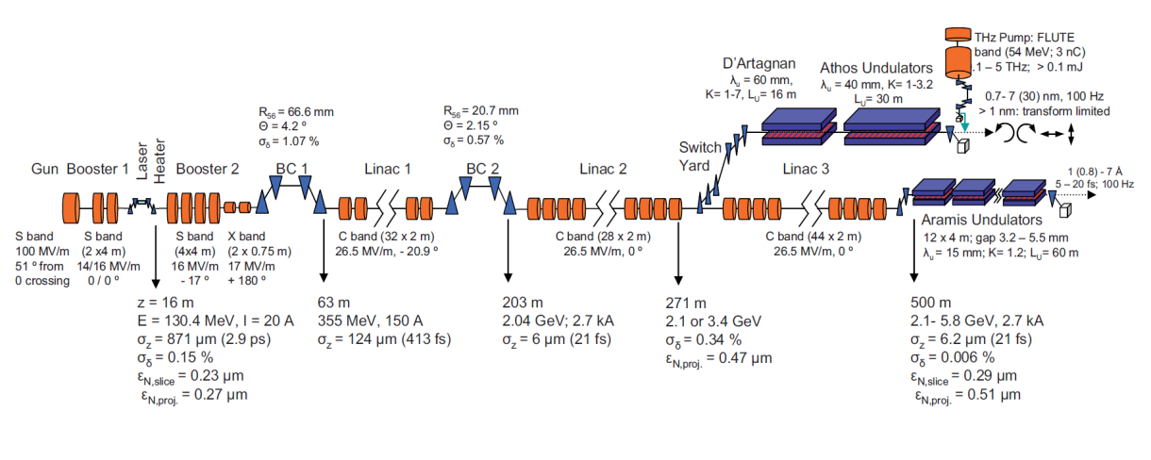
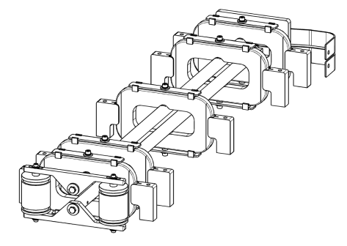
High stability resonant kicker system for SwissFEL at Paul Scherrer Institute
M. Paraliev, C. Gough, S. Dordevic
Switchyard
Kicker chamber (in-vacuum magnet)
SwissFEL layout
A
t
Current build-up in the kicker magnet and bunch extraction positions
Kicker resonator

Slide 2
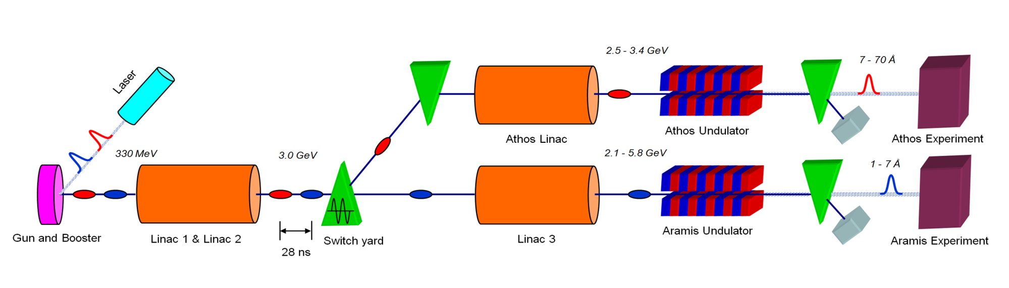
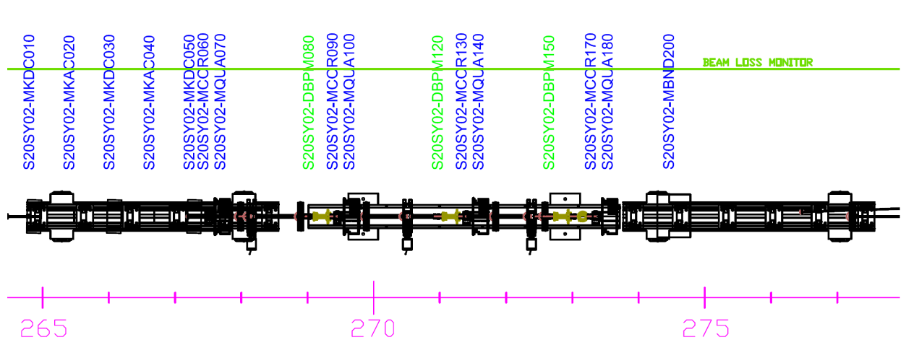
Overview
SwissFEL layout
Kicker 1 Kicker 2
Septum
Kicker system key parameters
Beam energy – 3 GeV
Bunch separation – 28 ns
Total deflection angle – 1.8 mrad
Number of Kickers – 2
Deflection angle error – 80 ppm
Total magnets length – 1.5 m
Line field integral – 10 mT.m
Deflecting current – 590 App
Switchyard

Slide 3



Resonant Kicker Concept
Athos
Linac 2
I
L/2
Aramis
$$\vec{B}$$
$$\vec{B}$$
C
L/2
Illustration of bunches separation using a resonant deflecting system
Vacuum
L
C
Resonant technology
No RL transient slope
No skin effect slope
Lower voltages (HV is enclosed in vacuum)
Solid state technology
Compact design
New driver technology
Complex amplitude measurement (ppm)
Demanding synchronization
Resonance frequency control
LL ctrl
Driver
Simplified electrical circuit
56 ns
1st bunch
I (B)
500 Ap-p
t
Ref.: M. Paraliev, C. Gough, “Development of High Performance Electron Beam Switching System for Swiss Free Electron Laser at PSI”, Proc. IPMHVC 2012, p. 691, San Diego, CA, USA, 2012
2nd bunch
Resonance build-up

Slide 4
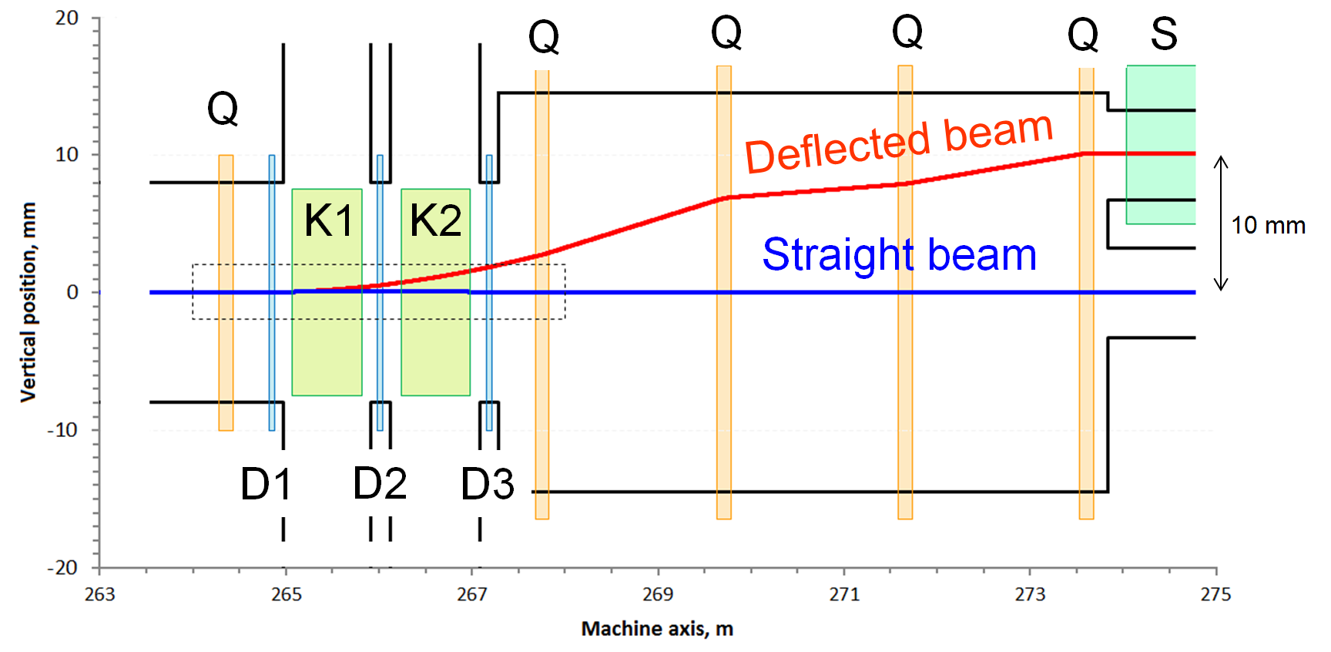
Beam trajectory
Switch Yard
The two kickers K1 and K2 (together with the accompanying dipoles D1, D2 and D3) provide about 1.8 mrad deflection.
Adding the quads contribution the effective deflection is reduced to about 1 mrad.
Beam separation at the entrance of the septum magnet is nominal 10 mm.
Field regions and beam trajectory in SwissFEL switch yard
  Color rectangles represent the corresponding field regions
  Q – Quadrupole magnet
  Kx – Kicker magnet
  Dx – Dipole magnet
  S – Septum magnet

Slide 5
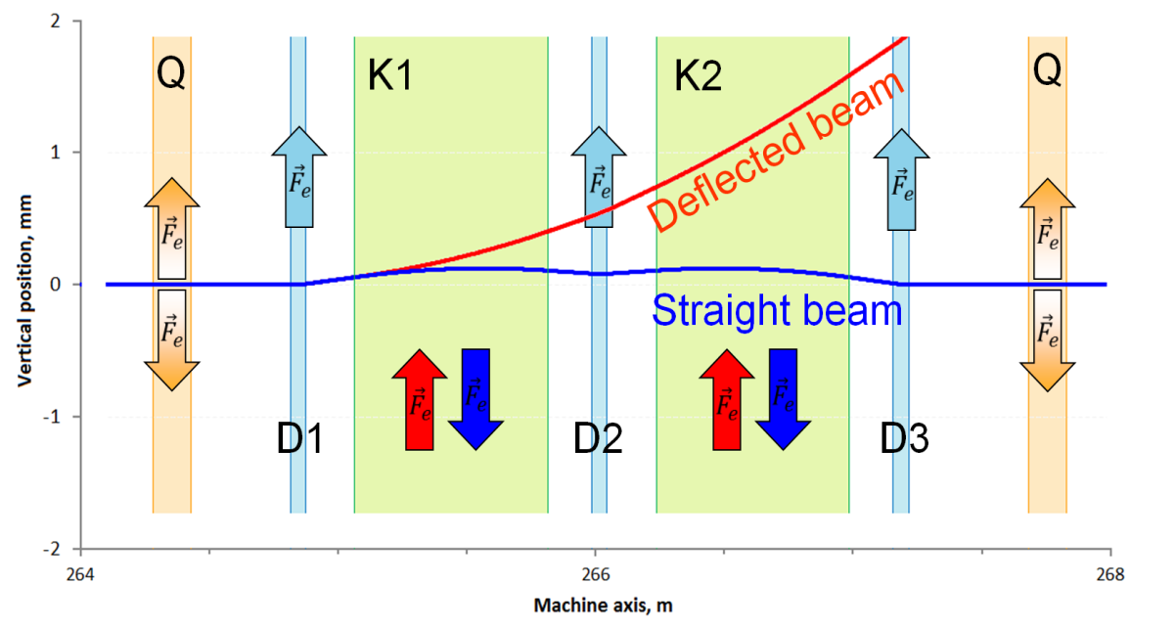
Beam trajectory
Kickers’ region
The kickers K1 and K2 deflect both bunches (“straight” and “deflected”) vertically but in the opposite direction.
Deflecting both beams results in 50% reduction of the required magnetic field strength (respectively the current in the magnets)
The three dipole magnets get the “straight” beam back to its original trajectory and increase deflection angle of the deflected beam.
Beam trajectory in the kickers’ region
  Color rectangles represent the corresponding field regions
  Q – Quadrupole magnet
  Kx – Kicker magnet
  Dx – Dipole magnet

Slide 6
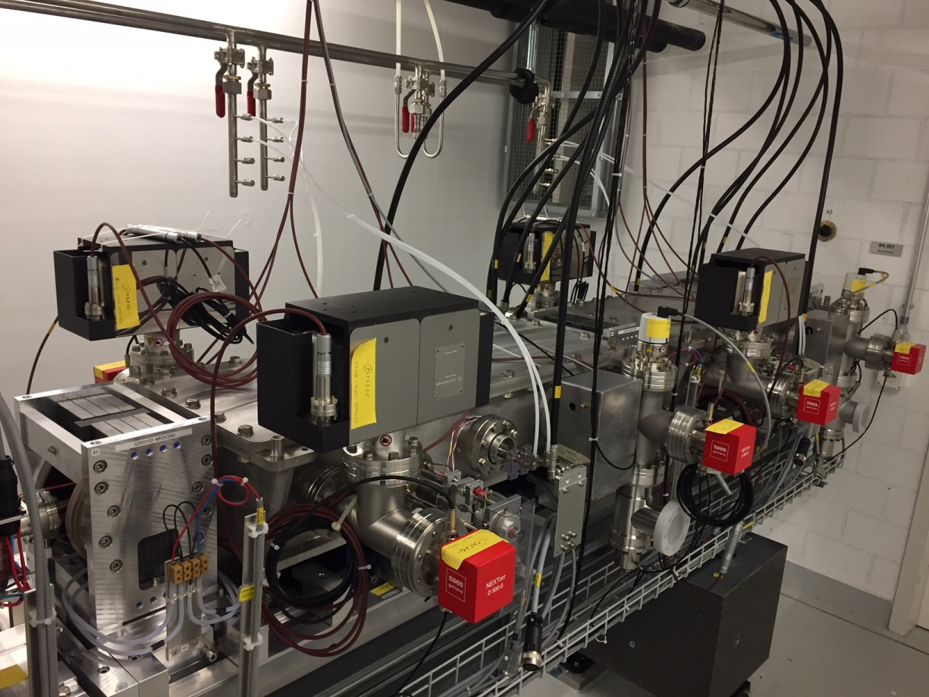
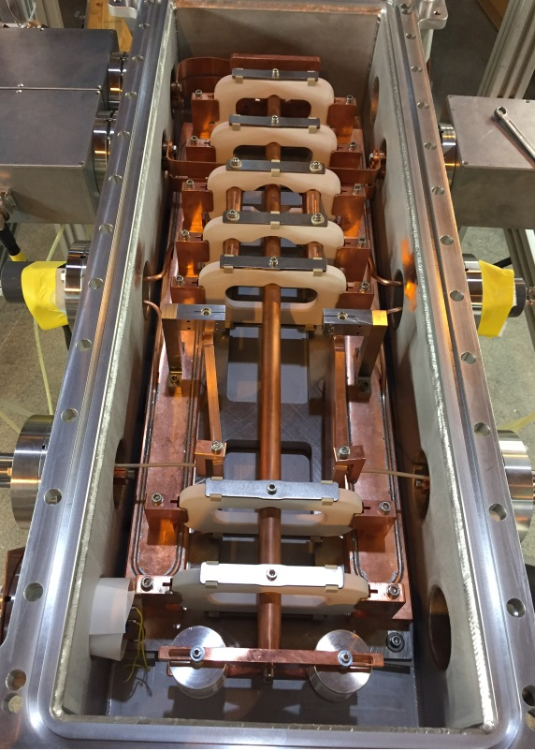
Resonant Kicker (RK)
Construction
Prototype kicker in vacuum chamber
Two kickers installed in SwissFEL tunnel

Slide 7
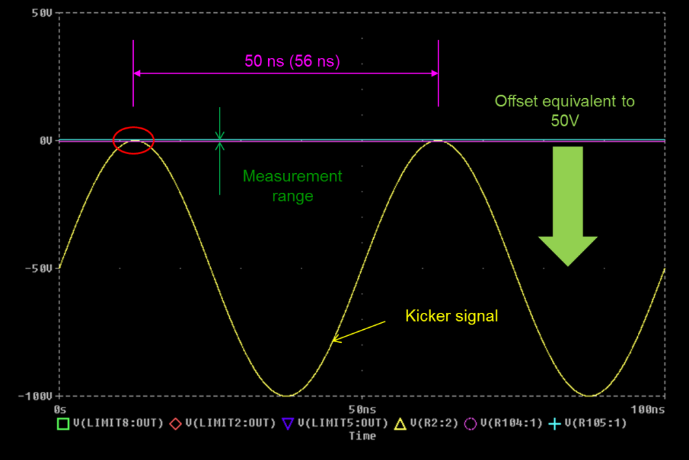
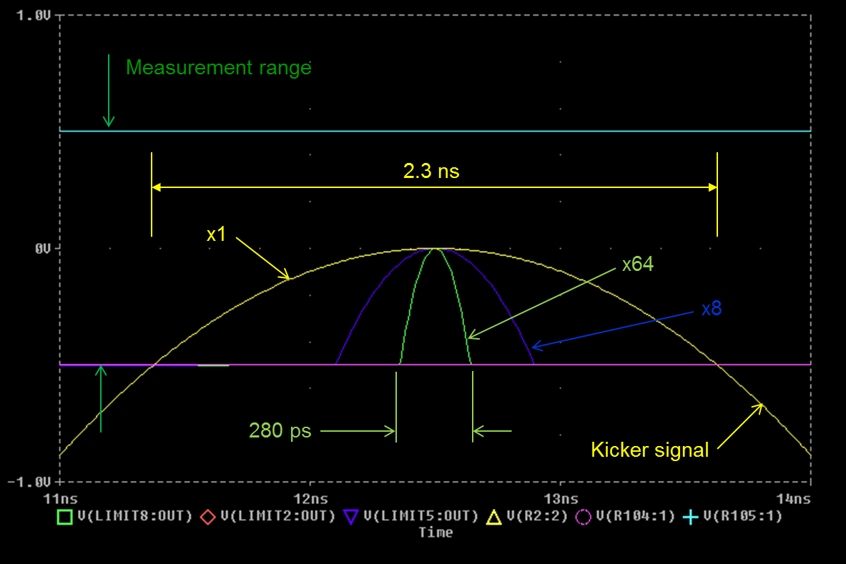
Precision amplitude measurement system for RK
Balanced measurement
+
Limiter
Amp. & Det.
Heavy overload (10000%)
Fast recovery x1 ns
6 stages matrix amplifier-detectors
10 bit, 40 Ms/s ADC
FPGA peak detector
ADC
FPGA
~
Ref
μC
Prototype kicker in vacuum chamber
Waveform offset (pSpice)
Signal before and after amplification (x8 and x64, pSpice)

Slide 8
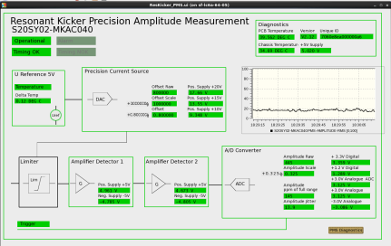
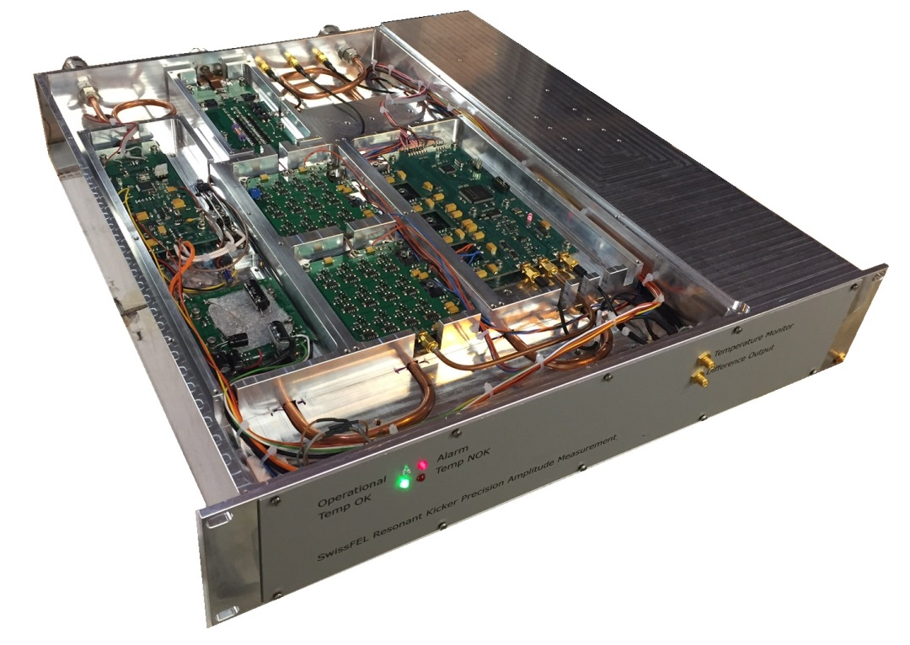
Precision amplitude measurement system for RK
Expert panel
Hardware
Low noise difference matrix amplifier/detector
10 bit 40 Ms/s ADC and FPGA module
Balancing unit and input limiter
Power supply
(Bottom side)
Precision 20 bit programmable current source
Temperature controlled reference voltage source
DC/DC converters, regulators, filters and self diagnostics module
(Bottom side)
Resolution ~0.3 ppm, noise floor ~0.6 ppm, range ± 150 ppm
Fast recovery (<10 ns) analogue input limiter – withstanding 10000% overload
Actively thermo-stabilized voltage reference source (0.35 ppm rms)
High stability programmable (20 bit resolution) current source - 2 A (for balancing)
Self diagnostics module – device status (internal temperatures, supply voltages and etc.)
2U rack mount water cooled chassis

Slide 9
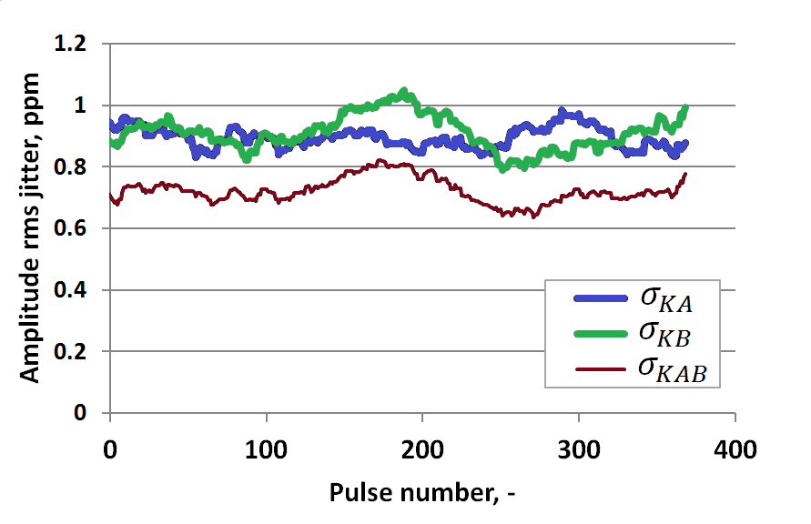
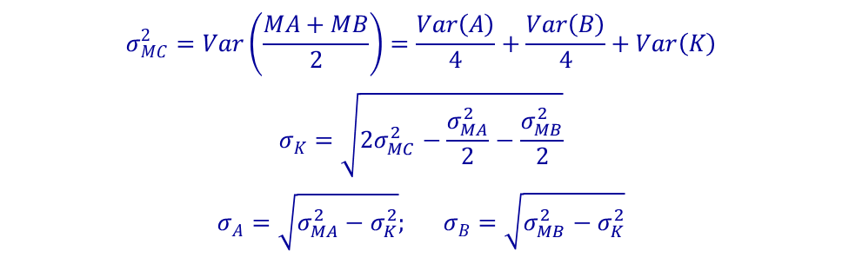
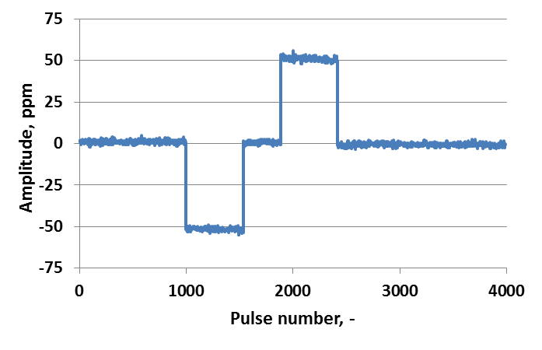
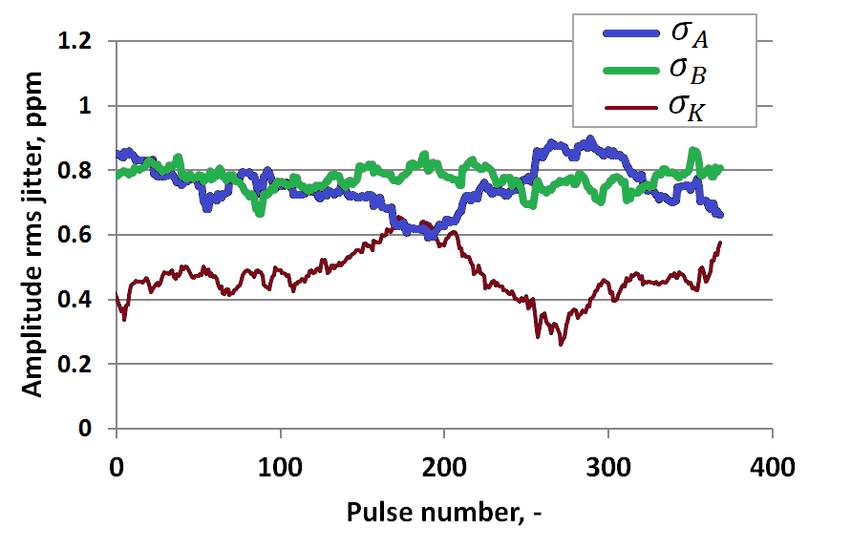
Precision amplitude measurement system for RK
Calibration and measurements
A
K
B
Measurement configuration – two simultaneous amplitude measurement systems (A and B)
Jitter of measured amplitude by meas. system A, B and average of A and B
Calibration
Calculated jitter of meas. system A, B and the kicker

Slide 10
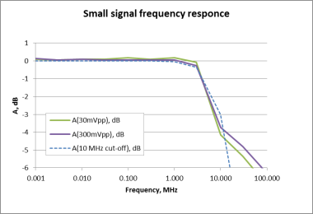

Pulse amplitude measurement
Different methods comparison
MOSFET switch
Low inductance MOSFET based pseudo-rectangular pulse generator with exponentially decaying plateau was used to compare* different pulse measurements with exponentially decaying synthetic pulse.
Measurement configurations:
Direct scope measurement (signal is attenuated 40 dB and measured directly with the scope)
Offset scope measurement (signal is attenuated 40 dB and scope offset function is used to increase precision)
Offset scope measurement (signal is attenuated 35 dB and scope offset function is used to increase precision.) This is to produce maximum signal using ~scope offset limits.
Balanced measurement (with PMS3)
Mathematical exponentially decaying pulse.
1000 μF
U
$$U\left(t\right)=Ae^{−\frac{t}{RC}}$$
U
50 Ω
t
MOSFET based pseudo-rectangular pulse generator with exponentially decaying plateau
+
Limiter
Scope
Ref
Precision offset measurement and its frequency responce
*The following variables are adjusted to overlap at the end of the pulse where the influence of limited bandwidth and skin effect should be least pronounced: offset of 2., gain of 3., gain (2.05 used instead 2.19 calculated) and offset of 4

Slide 11
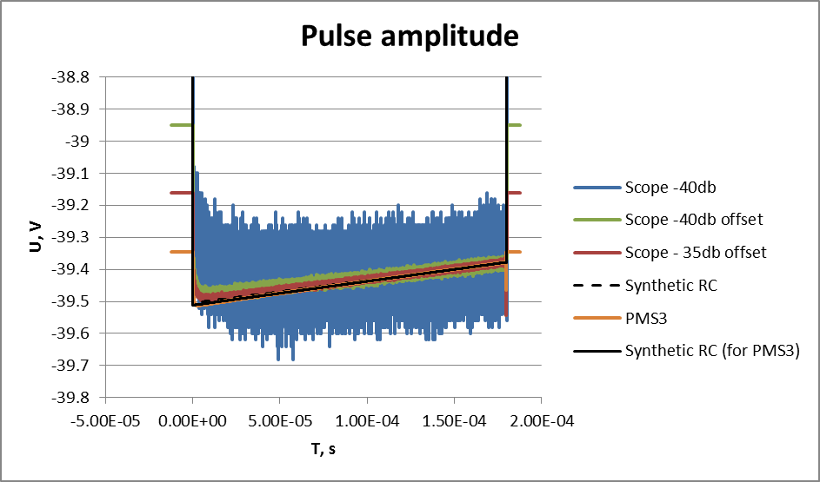
Pulse amplitude measurement
Different methods comparison
~ 0.26%
Pulse waveform measured with the different methods compared with synthetic 180 us exponentially decaying pulse
Due to small difference in the load impedance two different synthetic pulses are shown – with time constant 56.1 ms (“attenuated”) and 52.9 ms (“PMS3”)

Slide 12
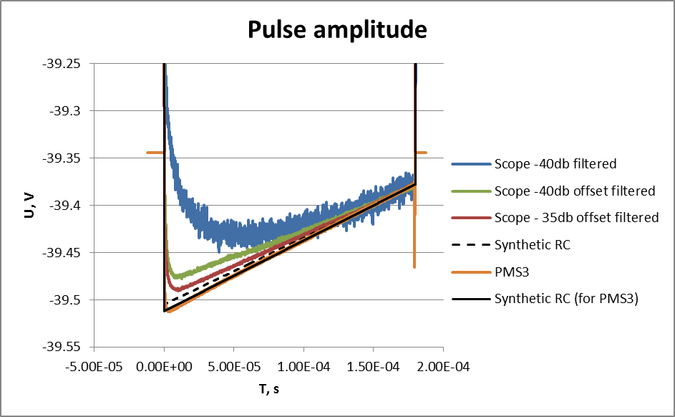
Pulse amplitude measurement
Different methods comparison
~ 0.13%
Pulse waveform measured with the different methods (smaller vertical scale) – for better comparison measurements 1., 2. and 3. are filtered to reduce noise (running average of 100 samples)

Slide 13
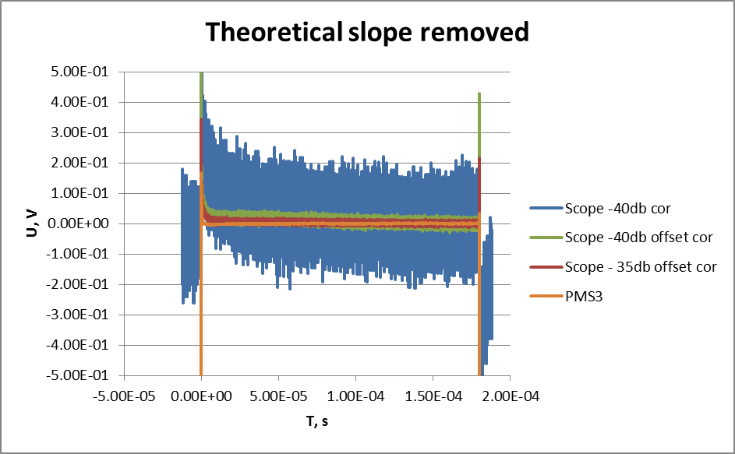
Pulse amplitude measurement
Different methods comparison
~ 0.26%
Theoretical pulse slope is removed for noise evaluation
(difference from ideal pulse)

Slide 14
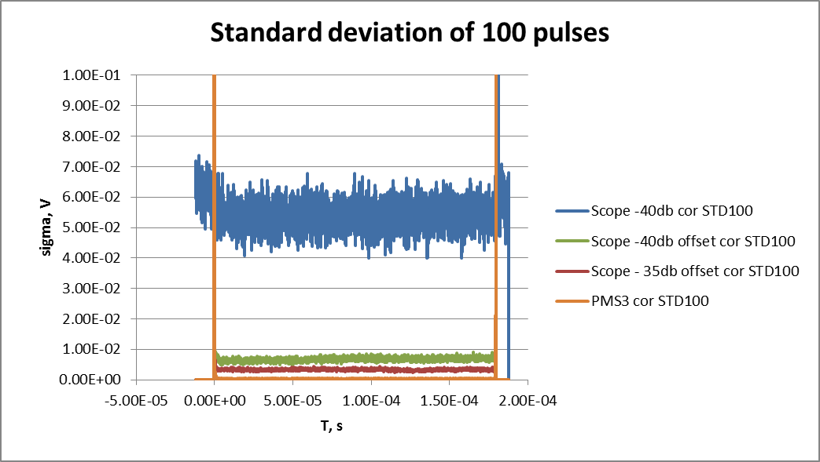
Pulse amplitude measurement
Different methods comparison
~ 0.026% rms
Noise floor evaluation - running standard deviation of 100 samples
The averaged relative rms noise floor of the different measurements is as following:
Scope direct (-40db) – 1400 ppm
Scope offset (-40db) – 173 ppm
Scope offset (-35db) – 85 ppm
PMS3 – 9 ppm

Slide 15
Conclusion
A novel concept for bunches separation using a resonant kicker magnet was developed and evaluated. A prototype of the resonant kicker was designed and built together with dedicated driver and precision amplitude measurement system.
Since the shot-to-shot stability is crucial for this novel concept to work, the stability of the prototype system was extensively evaluated:
Shot-to-shot amplitude stability (feedback ON): ~1.5 ppm rms
Shot-to-shot amplitude stability (feedback OFF): ~0.8 ppm rms
Shot-to-shot phase stability: RF pulse average ~5 mdeg ( instantaneous <24 mdeg)
The precision amplitude measurement system (based on “balanced method”) is useful not only for sin waves but for pulses as well.
Several different pulse measurement methods were comparted
Balance method gave ~9 ppm noise floor
Thank you for your attention!

Slide 16
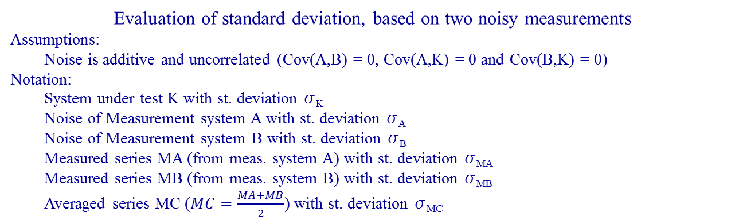

Additional material

Slide 17
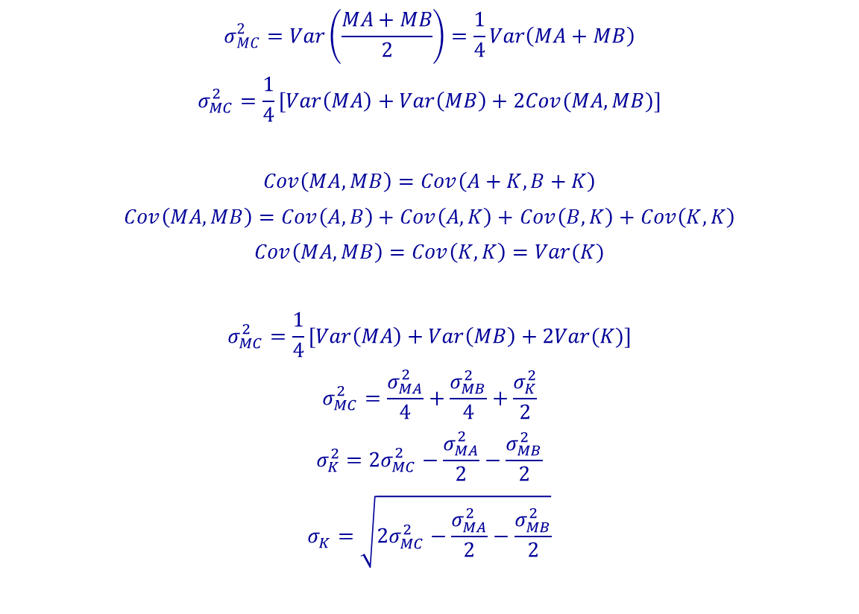
Additional material
Derivation

