Slide 1
Inductive Adder for FCC Injection Kicker Systems

Slide 2
Requirements for the FCC injection Inductive Adder
Parameter | Unit | Value
Pulse flat top length | [µs] | 2.00
Flat top tolerance | [%] | ±0.50
Field rise time | [µs] | 0.425
Voltage | [kV] | 15.70
Current | [kA] | 2.50
System impedance | [Ω] | 6.25
Pulse frequency | [Hz] | 115
Challenges of the inductive adder design:
→ 0.350 µs of kicker magnet fill time
→ 0.075 µs remain for pulse current rise time
Relatively high current
Low impedance

Slide 3
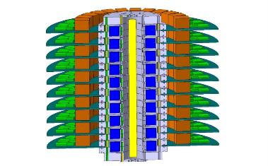





One layer of the Inductive Adder
Pulse capacitor
Magnetic core
MOSFET
switch
PCB
$$D$$
$$L_{p}$$
$$d$$
$$ε$$
Secondary
$$h$$
Content
Impedance matching of the stack
Layer design for fast rise times
Biasing of magnetic cores

Slide 4





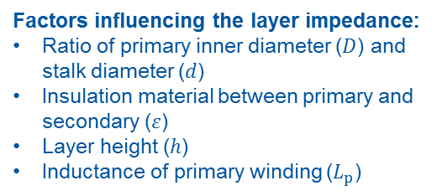




Impedance matching of the stack
Factors influencing the layer impedance:
Ratio of primary inner diameter ($D$) and stalk diameter ($d$)
Insulation material between primary and secondary ($ε$)
Layer height ($h$)
Inductance of primary winding ($L_{p}$)
Examples for insulation materials:
Air
Oil
Water
Epoxy
FC-77
SF6
Vacuum
Electric field in insulation:
$$E(r)=\frac{V_{out}}{r∙\ln{\frac{D}{d}}}$$
$$E_{max}=\frac{V_{out}}{\frac{d}{2}∙\ln{\frac{D}{d}}}$$
Outer diameter D over inner diameter d for different $Z_{IA}$
$$D\left(d\right) =d∙e^{−\frac{L_{p1}∙π}{hμ}+\sqrt{{\left(\frac{L_{p1}∙π}{hμ}\right)}^{2}+Z_{IA}^{2}∙\frac{4π^{2}ε_{0}ε_{r}}{μ}}}$$
$$D$$
$$D$$
$$L_{p}$$
$$d$$
$$ε$$
$$h$$
$$E$$
Impedance of IA:
$$d$$
stalk
$$L_{layer}=\frac{μ∙h∙ln{\frac{D}{d}}}{2π}$$
$C_{layer}=\frac{2πεh}{\ln{\frac{D}{d}}}$
insulation
$$Z_{IA}=\sqrt{\frac{L_{p}+L_{cell}}{C_{cell}}}=\sqrt{\frac{L_{p}}{2πεh}\ln{\frac{D}{d}}+\frac{μ}{4π^{2}ε}\ln^{2}{\frac{D}{d}}}$$
inner primary winding
Low impedance -> small insulation gap

Slide 5
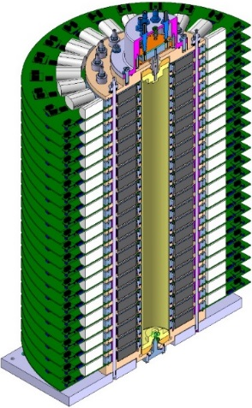


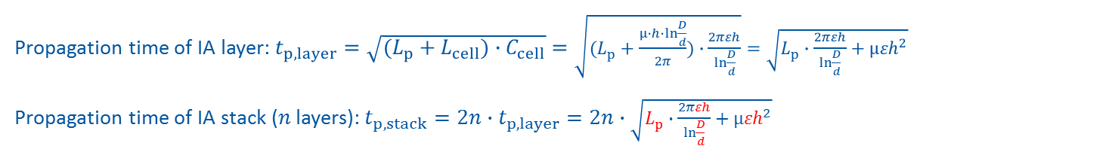


Layer design for fast rise time
Propagation time of IA layer: $t_{p,layer}=\sqrt{(L_{p}+L_{cell})∙C_{cell}}=\sqrt{(L_{p}+\frac{μ∙h∙ln{\frac{D}{d}}}{2π})∙\frac{2πεh}{\ln{\frac{D}{d}}}}=\sqrt{L_{p}∙\frac{2πεh}{\ln{\frac{D}{d}}}+μ{εh}^{2}}$
Propagation time of IA stack ($n$ layers):$t_{p,stack}=2n∙t_{p,layer}=2n∙\sqrt{L_{p}∙\frac{2πεh}{\ln{\frac{D}{d}}}+μ{εh}^{2}}$
$$L_{cell}=\frac{μ∙h∙ln{\frac{D}{d}}}{2π}$$
$C_{cell}=\frac{2πεh}{\ln{\frac{D}{d}}}$
Factors influencing the rise time:
Layer height
Insulation material
Primary inductance
Output voltage, layer voltage
Switching time of switching device (SiC MOSFET)
$$D$$
$$L_{p}$$
$$d$$
$$ε$$
$$h$$
The inductance of the secondary circuit should be low to not limit the rise time!

Slide 6


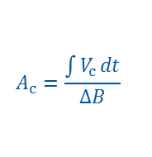
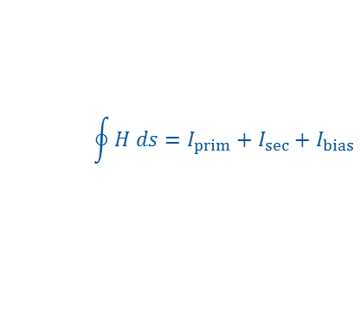




Biasing of magnetic core
$$I_{bias}$$
$$I_{sec}$$
$$A_{c}=\frac{\int{V_{c}}dt}{∆B}$$
$$∆t=\frac{A_{c}∙∆B}{V_{c}}$$
$$\oint{H ds=I_{prim}+I_{sec}+I_{bias}}$$
$$I_{prim}$$
V
C
$$B$$
switch
L
V
$B_{sat}$ Saturation
I
$B_{r}$ Remanence
switch
C
$$∆B$$
4V
Linear
Region
I
V
$$H$$
primaries
$${−H}_{c}$$
$$H_{c}$$
C
$${∆B}_{bias}$$
switch
I
V
$${−B}_{r}$$
switch
C
$${−B}_{sat}$$
Biasing circuit
Biasing of the magnetic core can reduce the required core material and therefore reduce the layer height.
magnetic core
secondary

Slide 7
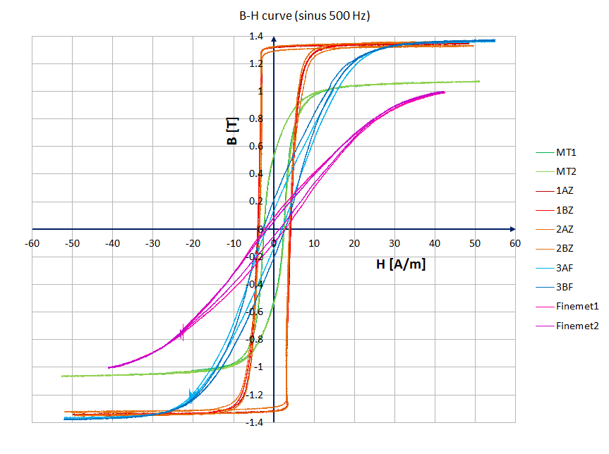
Biasing of magnetic core
Square shaped
linear

Slide 8
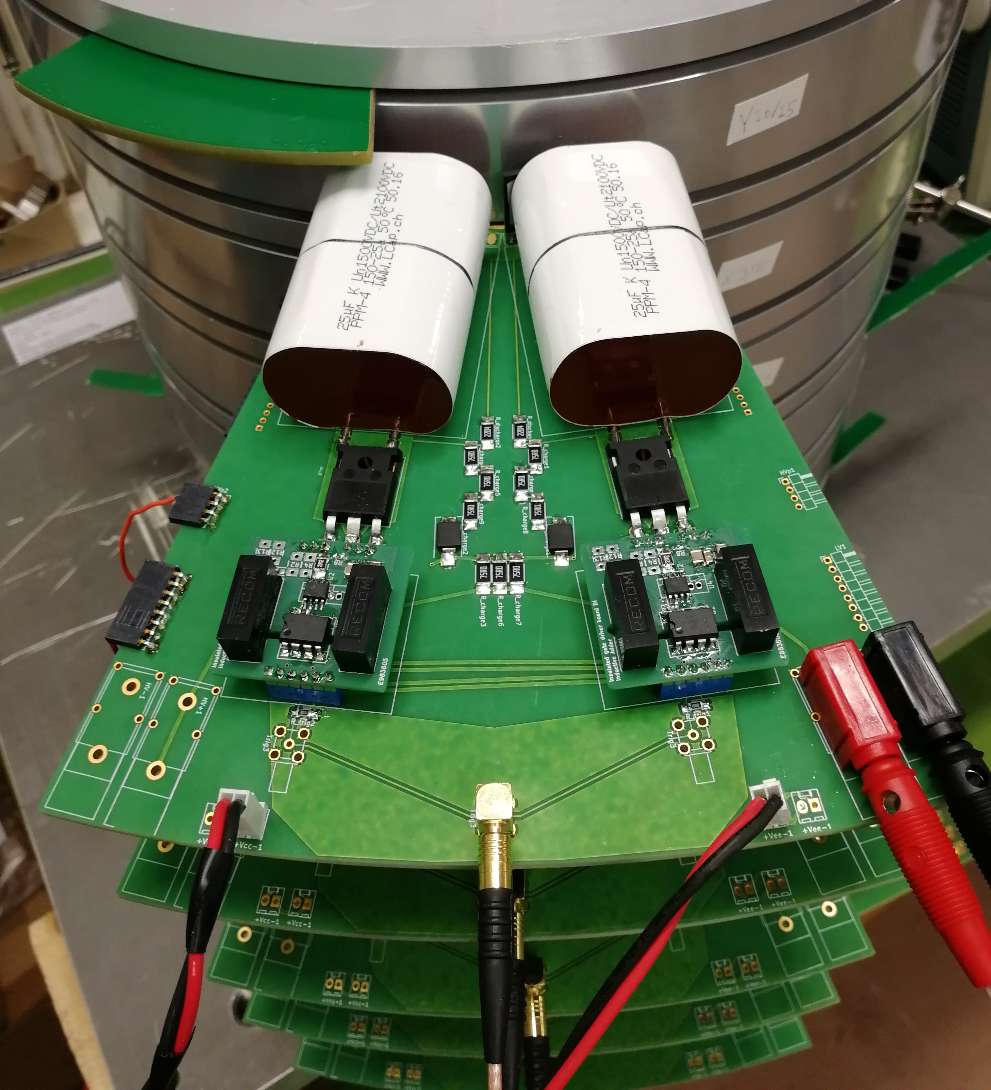
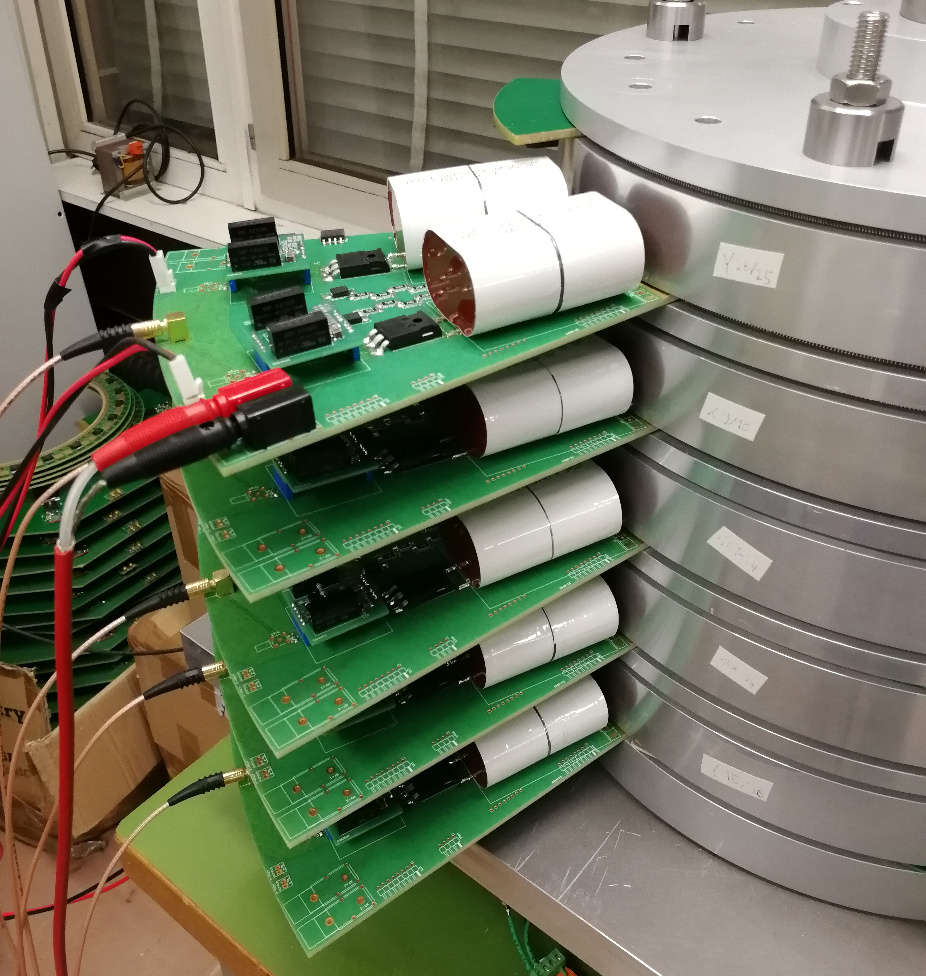
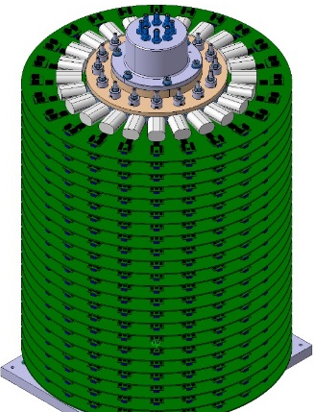
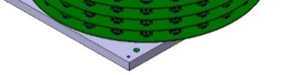
Summary
Capacitors
System impedance of 6.25 Ohm (2.5 kA, 15.7 kV)
Oil insulation required
Use of a biasing circuit
  reduce magnetic material
  Shorter layer height possible
  Faster rise time achievable
SiC MOSFETs
22 layers
1,2m
Insulated gate driver

Slide 9
Thank you
for your attention!
Questions?

Slide 11

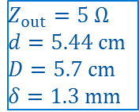

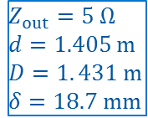
Evaluation of Dielectricum
$$Z_{out}=5 Ω$$
$$d=1.405 m$$
$$D=1. 431 m$$
$$δ=18.7 mm$$
Big diameters result in high costs for the magnetic cores.
Small insulation gaps are difficult to manufacture.
$$E_{max,Air}=0.4∙2.5 \frac{kV}{mm}$$
$$ε_{r,Air}=1$$
Example for insulation materials:
Air
Oil
Water
Epoxy
FC-77
SF6
Vacuum
$$Z_{out}=5 Ω$$
$$d=5.44 cm$$
$$D=5.7 cm$$
$$δ=1.3 mm$$
$$E_{max,Oil}=0.4∙25.7\frac{kV}{mm}$$
$$ε_{r,Oil}=2.7$$

Slide 12
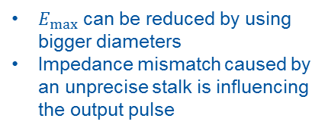
Tolerances in stalk
Precise manufacturing and adjustment of stalk and core is necessary!
$E_{max}$ can be reduced by using bigger diameters
Impedance mismatch caused by an unprecise stalk is influencing the output pulse
PSpice simulations showed that the error needs to be <0.06 mm, what is a reasonable value.
However, very precise production and alignment of the primary and secondary windings is necessary.

Slide 13
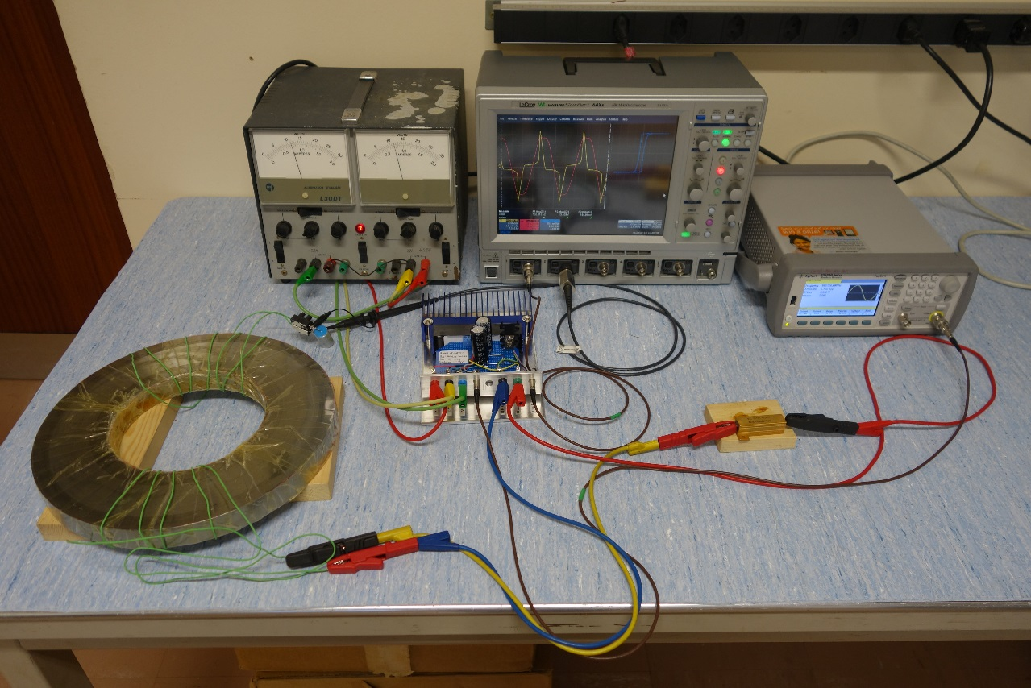


BH curve measurement test setup from BE-BI-PI
Power supply
Oscilloscope
RC integrator to measure $\int{U_{sec}}dt \sim B$
Function generator
Test core
Current limiting resistor
Other required parameters:
Core dimensions, weight, fill factor, no of windings
Amplifier, incl. 1 Ω Shunt to measure $I_{prim}\sim H$
Thanks to S. Aguilera and M. Krupa

