Slide 2
PSpice and Opera-2d modelling: a very brief review
M.J. Barnes
CERN TE-ABT
Acknowledgements:
L. Ducimetiere and L. Sermeus

Slide 3
Outline
PSpice simulation of skin and proximity effect:
  Derivation and modelling of frequency dependence of resistance and inductance – for use in, e.g. PSpice AC and transient simulations
PSpice simulation of thyratron turn-on:
  Non-linear switching for use in transient simulations

Slide 4
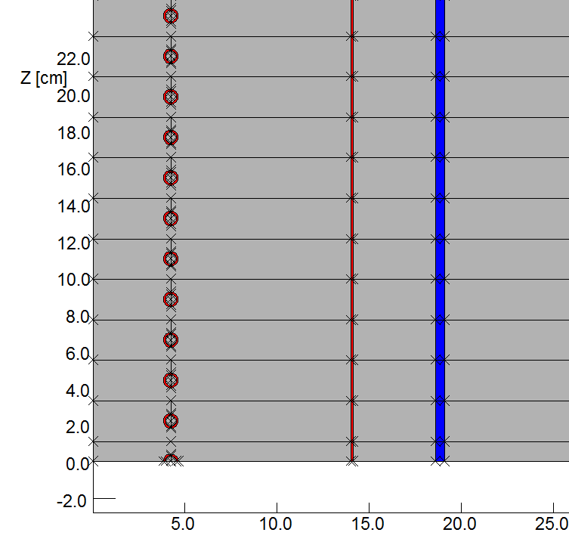
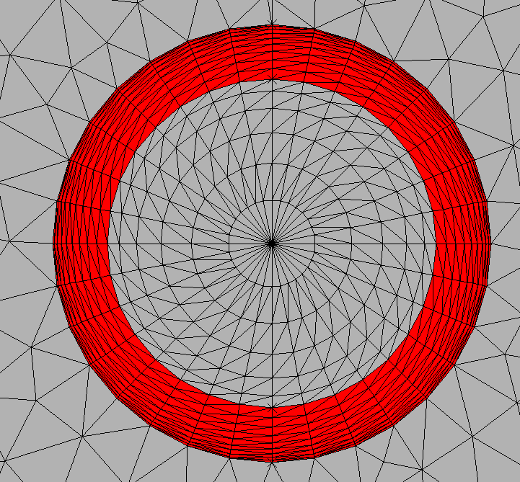
Skin and proximity effect – example application
Frequency dependence of resistance and inductance has important effects on the performance of many circuits. For example, for the LHC Injection PFN:
Opera-2d AC model:
Axi-symmetrical
Ω Shield (Aluminium)
7 turns (b)
Steel tank
~4.3m
7 turns (a)
Suitably fine mesh in conductors (biased towards the outer surface)
3.5 turns
Longitudinal symmetry
PFN coil

Slide 5
Skin and proximity effect – example application (2)
Opera-2d AC predictions:
Inductance derivation* (from stored energy, per unit length) ⇨ inductance per unit length :
Current in only 3.5 turns ⇨ self-inductance of one-cell (7-turns);
Current in only 7 turns (a) ⇨ self-inductance of two-cells + Mutual13;
Current in 3.5 turns + 7 turns (a) ⇨ self-inductance of three-cells + Mutual13 + 2∙Mutual12.
Resistance derivation* (from power, per unit length) ⇨ resistance per unit length:
Current in only 3.5 turns ⇨ resistance of one-cell (7-turns).
*: be careful of geometry, i.e. stored energy/power is in “visible geometry”.

Slide 6
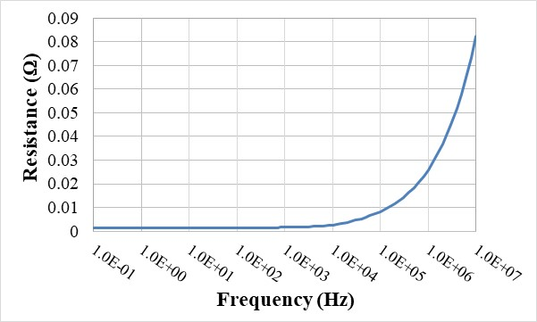
Skin and proximity effect – example values
From Opera-2d AC simulations inductance (self and mutual) and resistance are derived, for the PFN, at each frequency (for a 7-turn cell):
Notes:
As a crosscheck on the Opera2D predictions, the publication of F.W. Grover[11] has been used. Equation 118 on page 143 was used to calculate the low frequency inductance of a current sheet of mean radius 41.5 mm. The result is 2163 nH per cell. Equation 135 on page 163 was then used to correct the inductance calculated from equation 118 for insulation space for a coil of 175 turns. The correction per cell is 45 nH, giving a total inductance of 2208 nH/cell. This value is shown on Fig. 2 as “Grover Upper Limit#1”. The Grover limits assume that the flux return path can be out to a radius of infinity, and that there is uniform current distribution in a solid conductor.
Any long straight conductor, with uniform current distribution, has an internal inductance of 50 nH/m. A long straight tubular conductor with inside and outside diameters of 6 mm and 8 mm, with uniform current distribution, has an internal inductance of 16.5 nH/m. “Grover Upper Limit#2” on Fig 2 has been derived from Upper Limit#1 by subtracting a correction for the internal inductance of an equivalent length (1.8 m per cell) of straight conductor. “Grover Upper Limit#2” is 1% greater than the predicted inductance at 0.1 Hz; this is attributable to the current density towards the axis of the coil being 10% greater than the uniform distribution value.
At higher frequencies the equivalent mean radius of the coil is less than 41.5 mm because the current is further concentrated towards the axis of the coil. The minimum equivalent radius of the nominal coil is 37.5 mm which, according to the current sheet formula, would give an inductance of 1766 nH per cell cell (Fig. 2). This value is reduced by a further 175 nH, to 1591 nH, to account for internal inductance of an equivalent length of tubular straight conductor (55 nH), and screen shielding (120 nH). The 1591 nH is 260 nH less than the predicted inductance at 10 MHz; this difference is due to the current free regions. The current distribution in each turn, away from the ends of the coils, does not affect the effective pitch at high frequencies[11]. However the ratio of the effective cross sectional diameter to pitch is reduced, leading to a larger correction for “insulation” space[11].

Slide 7


Methods of modelling frequency dependency
Various approaches could be used to simulate frequency dependent inductance and resistance:
E.g. Laplace transforms:
  Not straightforward to “fit” a Laplace transform to data;
  PSpice needs to carry out an “impulse response” of (each) Laplace transform before the transient analysis – frequency resolution and maximum frequency are not easily controllable (e.g. only by 1/Tstop and RELTOL)
Passive components:
  Relatively straightforward to “fit” component values to reproduce Opera data over a limited frequency range;
  Applicable in both frequency and time domain, provided “fit” covers complete frequency range of interest (e.g. Max. frequency ≥ 10MHz for 30ns rise time) -- PSpice does not need to carry out an “impulse response” before the transient analysis.

Slide 8
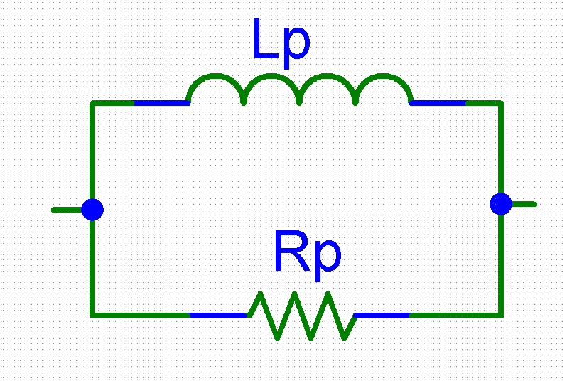
Skin and proximity effect – example steps
Effective series resistance (R_{s}) and series imaginary impedance (X_{s}) are given by:
1) Create a frequency-dependent cell using, standard, Spice elements whose values are frequency-independent:
Where:
2) To determine approximate values for the R_{p} and L_{p}, over an appropriate frequency range:
When inductance is reducing and series resistance is fairly constant (e.g. < 10 kHz):
When series resistance is increasing (e.g. > 10 kHz) and inductance is fairly constant:
3) Use the PSpice Optimizer (Advanced Analysis Option) to find the best values of R_{p} and L_{p} to “fit” the curves of series resistance and series inductance, as a function of frequency:
a) Can weight curve-fit of, e.g., inductance more than resistance.
Where: X_{s1} and X_{s2} are the values of the cell’s imaginary impedance at the lower (f₁) and upper (f₂) values of frequency, respectively.
and
and

Slide 9
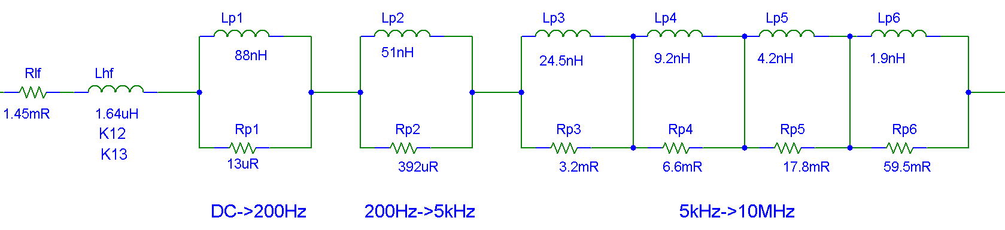
Equivalent L(f) and R(f) circuit for one PFN cell
Lhf={Llf-Lp1-Lp2-Lp3-Lp4-Lp5-Lp6}
Lhf (& coupling coefficients) represents the high-frequency inductance;
Rlf represents the low-frequency inductance.
Notes:
At low frequency, current flows through the parallel inductors, bypassing all the parallel resistors: hence, the sum of the values of the parallel inductors and the series inductor must equal the low-frequency value of required inductance.
Each cell represents a variation of resistance and inductance with frequency and not the absolute values of resistance and inductance. Hence subtract the series resistance and inductance from the absolute values before using the equations; on the previous slide, to calculate Lp and Rp.
Also used to represent L(f) and R(f) of screen conductors in the aperture of a kicker magnet (see next slide).

Slide 10
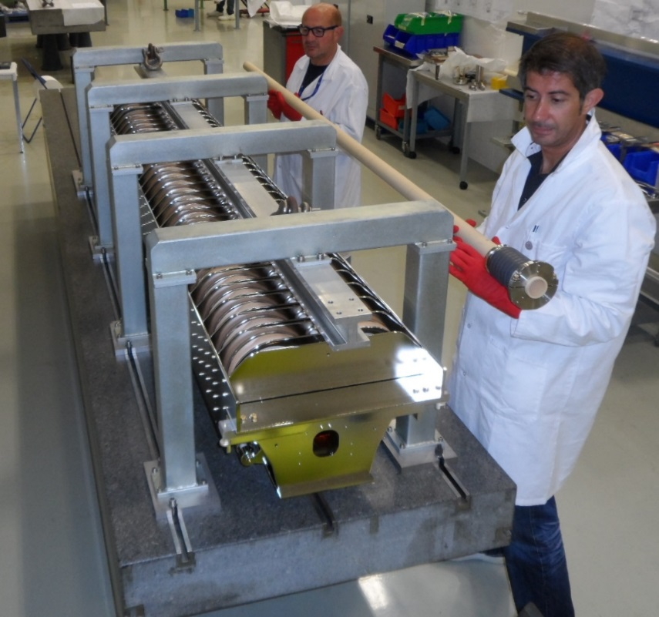
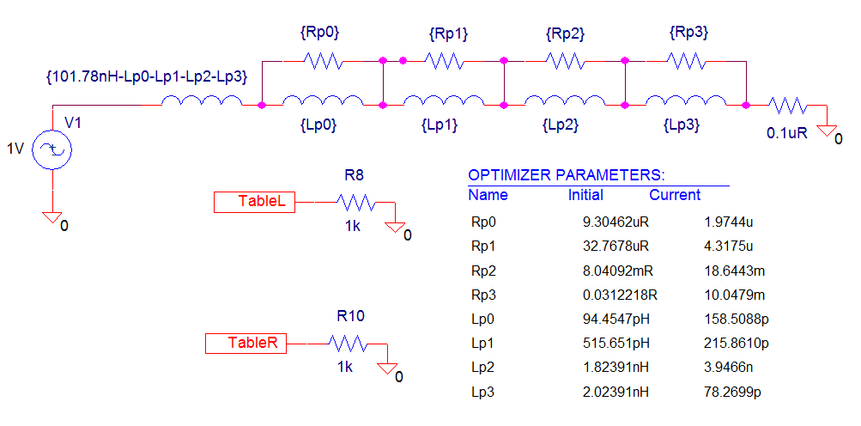
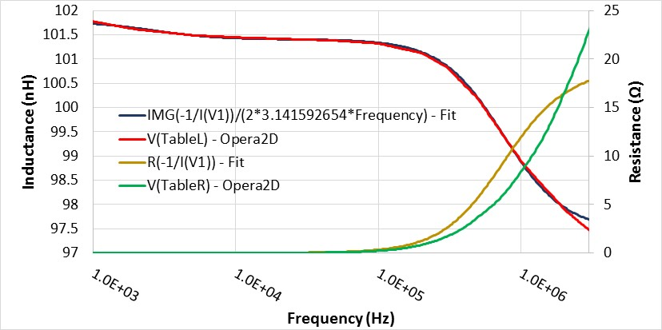
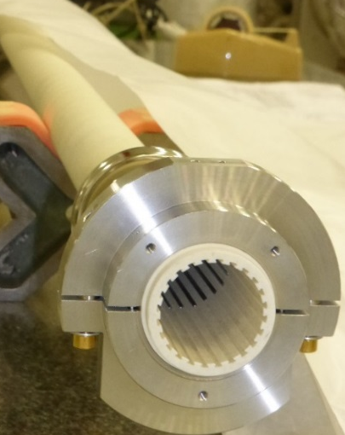
Example: kicker magnet cell inductance
Alumina tube
A better “fit” to resistance could likely be obtained with more cells.
Screen conductors.

Slide 11
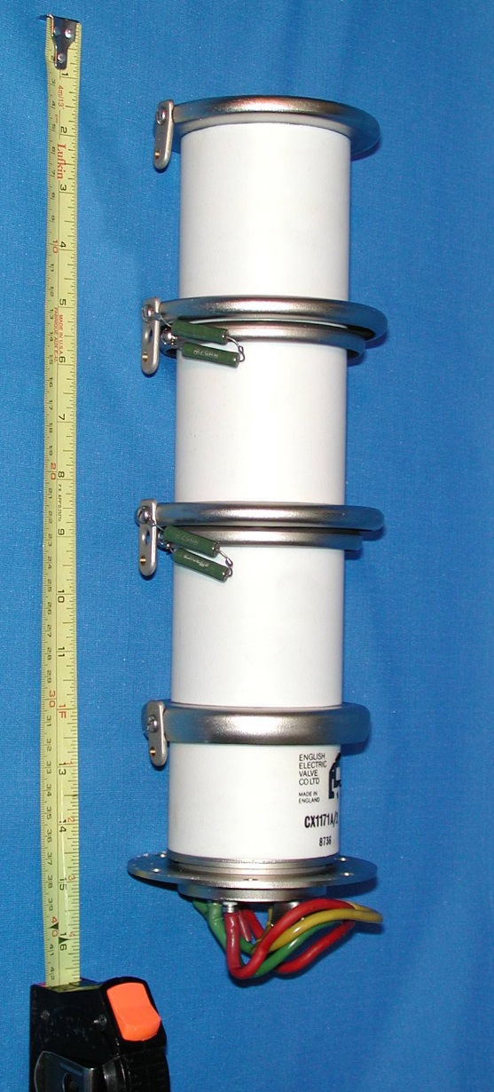
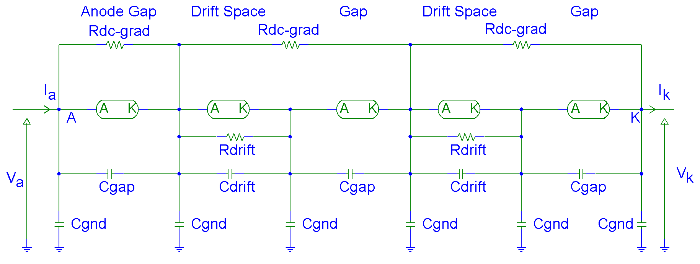
Modelling a Turn-on of a Multi-Gap Thyratron
~340mm
Example values for CX1171A in a CERN coaxial housing:
Total parasitic inductance: ~80 nH
Cgap (inter-electrode capacitance of each of each gap): 15 pF to 20 pF;
Cdrift (drift space capacitance): 25 pF to 30 pF;
Cgnd (parasitic capacitance from the grading ring to ground): ~11 pF.

Slide 12
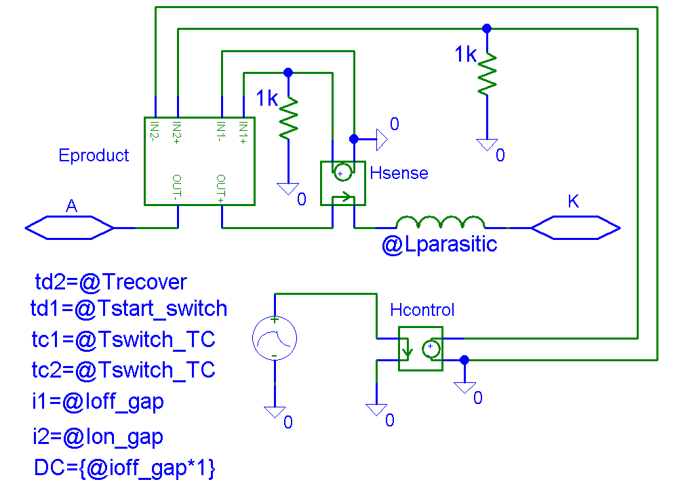
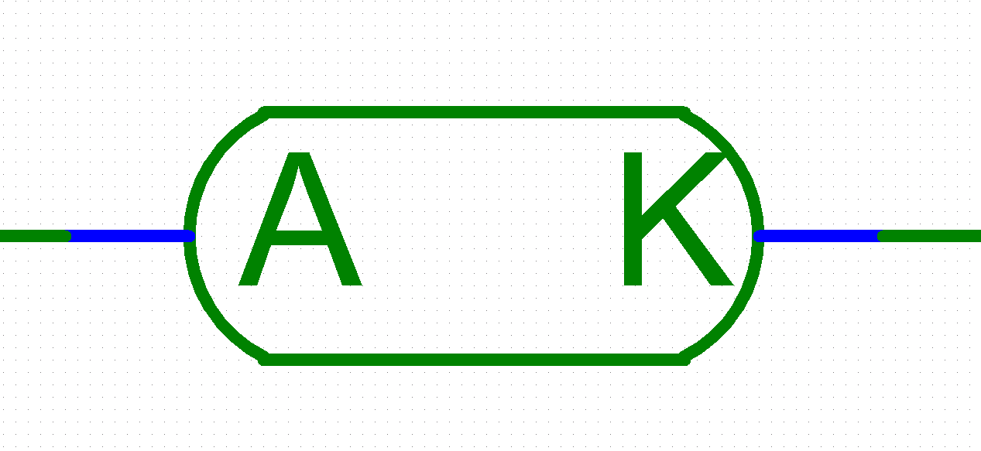
Modelling Thyratron Turn-on
A non-linear turn-on switching characteristic for a thyratron may be represented using the following equivalent circuit.
Lparasitic ⇨ parasitic inductance of a gap and/or drift space;
Hsense and Hcontrol ⇨ both current-controlled voltage sources with unity gain, which are used for controlling voltage source Eproduct: the potential difference across the output terminals of Eproduct ⇨ product of the current through Hsense and Hcontrol.
ISA is a current source whose current decays exponentially, with time-constant tc1, from a high-current (e.g. 50kA) to a low current (e.g. 20mA). The low current value is chosen to give a representative conduction voltage drop at the required load current.
7ns for tc1 ⇨ predicted 10% to 90% current rise-time of ~32ns.

Slide 13
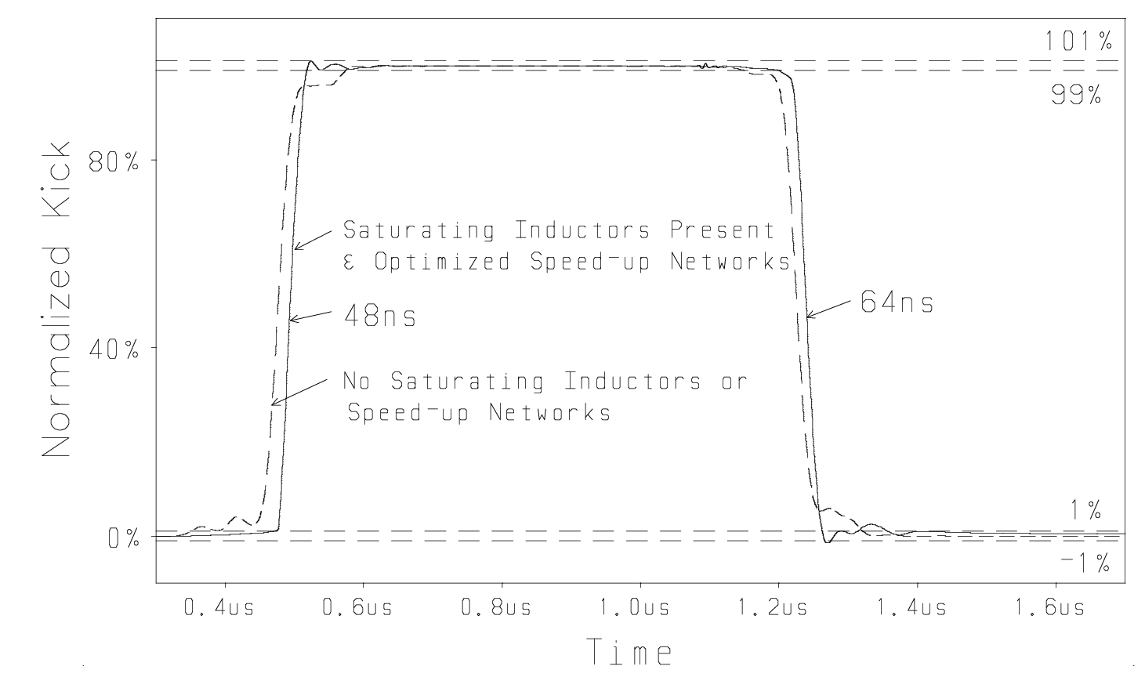
Predicted current from a multi-gap thyratron model
Pre-pulse displacement current, resulting from turn-on of the individual gaps and drift spaces, can be predicted using the multi-gap thyratron model:

Slide 14
Thank you for your attention !
Questions, comments, etc …

Slide 15
References
Cobham, Opera-2d, http://www.cobham.com/communications-and-connectivity/antenna-systems/specialist-technical-services-and-software/design-simulation-software/opera/opera-2d/
Grover, FW, “Inductance Calculations: Working Formulas and Tables”, Special edition prepared for Instrument Society of America, 1973. Originally published by Van Nostrand (New York), 1946.
M.J. Barnes, G.D. Wait, L. Ducimetière, “Inductance Calculations and Measurements for the CERN LHC Injection Pulse Forming Network”, proc. of 7th European Particle Accelerator Conf. (EPAC’00), Vienna, Austria, June 26-30, 2000, pp2355-2357.
M.J. Barnes, G.D. Wait, “A Mathematical Model of a Three-Gap Thyratron Simulating Turn-On”, proc. of 9th International Pulse Power Conf., Albuquerque, USA, June 21-23, 1993, pp293-296.
D. Fiander, K. Metzmacher and P. Pearce, Kickers and Septa at the PS
Complex, CERN. Proc. of the KAON PDS Magnet Design Workshop, October 1988, pp 71-79.
L. Ducimetière, D.C. Fiander, “Commutation Losses of a Multigap High Voltage Thyratron''. IEEE Conf. Record of the 1990 19th Power Modulator Symposium, June 26-28, 1990, San Diego, pp248-253.
R.L. Cassel, T.S. Mattison, “Kicker Prepulse Canceller". IEEE Conf. Record of the 1991 Particle Accelerator Conference, May 6-9, 1991, pp3162-3164.
E2V Technologies, Hydrogen Thyratrons Preamble, available at https://www.tayloredge.com/reference/Electronics/VacuumTube/thyratron_preamble.pdf.
M.J. Barnes, G.D. Wait, “Effect of Saturating Ferrites for the 30Ω Resistively Terminated, Prototype Kicker Magnet". TRI-DN-91-K192.

Slide 17
Spare Slides

Slide 18
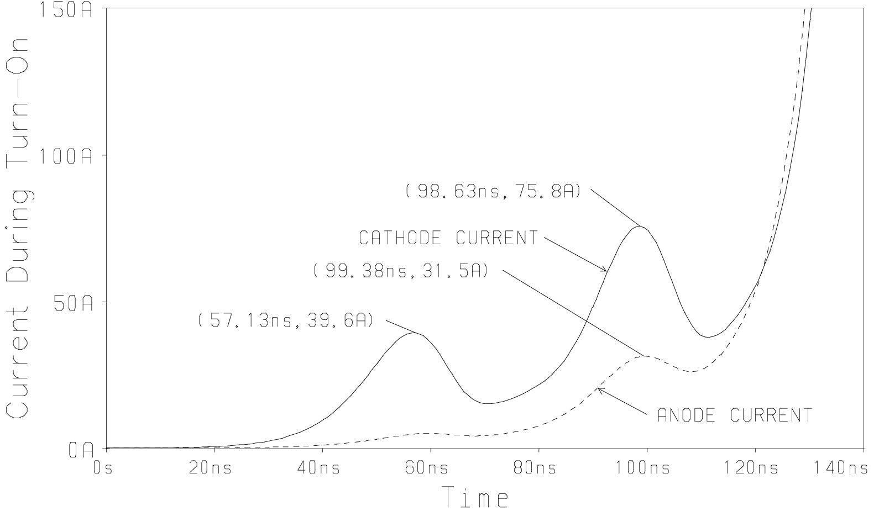
Predicted pre-pulse displacement current from a multi-gap thyratron model

Slide 19
