Slide 1
Beam screening and coating experience at CERN for fast pulsed magnets
Laurent DUCIMETIERE, Mike BARNES
Acknowledgements to all the kicker team

Slide 2
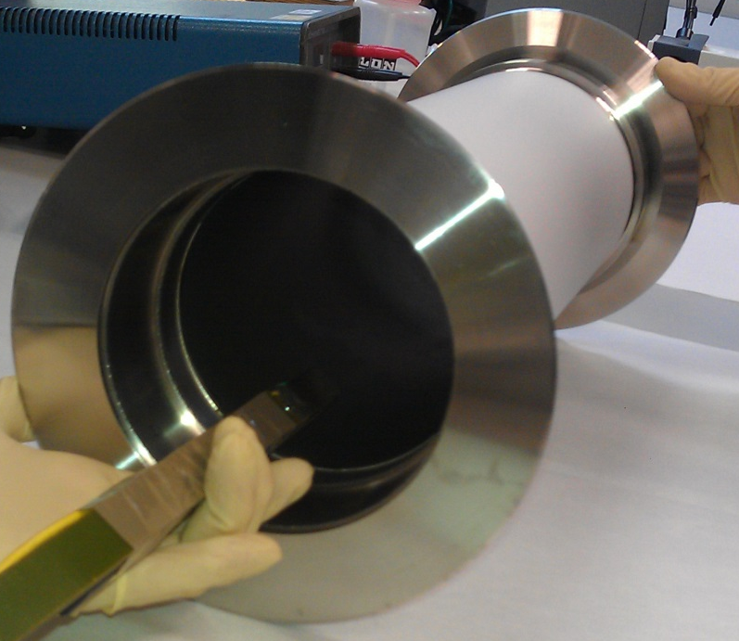
Outline
Beam heating effect
Beam screening
  Uniform resistive coating
  Screen conductors
  Serigraphy on ferrite
  Serigraphy on ceramic
Electron cloud
  Reduction of SEY
Conclusion and outlook
L. Ducimetière, M. Barnes - PULPOKS, 13 March 2018
2

Slide 3
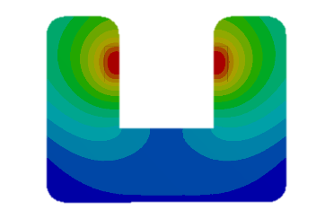
Beam heating effect
Kicker magnet (installed in circulating beam)
Injected beam
Circulating beam
Courtesy: L. Vega Cid
Fast pulsed magnets, so called kicker magnets, are widely used at CERN for fast, single-turn, injection and extraction
Typical field rise/fall-times range from tens to hundreds of nanoseconds
During operation with high intensity beams, the real longitudinal beam-coupling impedance of kicker magnets can provoke significant heating of the ferrite yoke
The induced heat is a function of :
  magnet aperture geometry
  beam intensity
  beam structure
  ferrite losses at beam frequencies
  resonances caused by geometrical features
L. Ducimetière, M. Barnes - PULPOKS, 13 March 2018
3

Slide 4
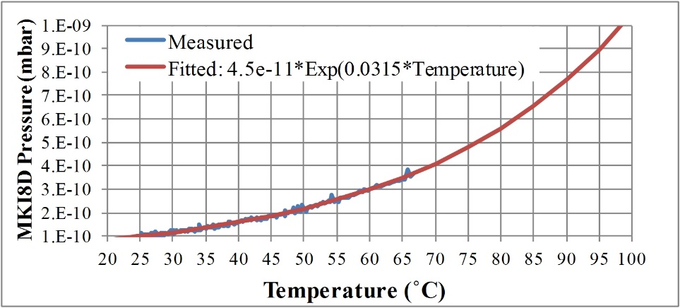
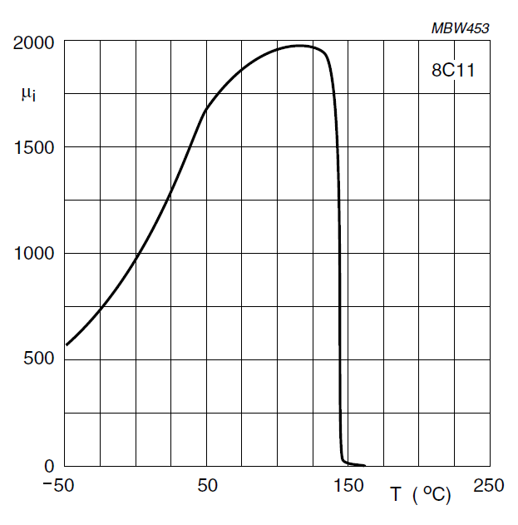
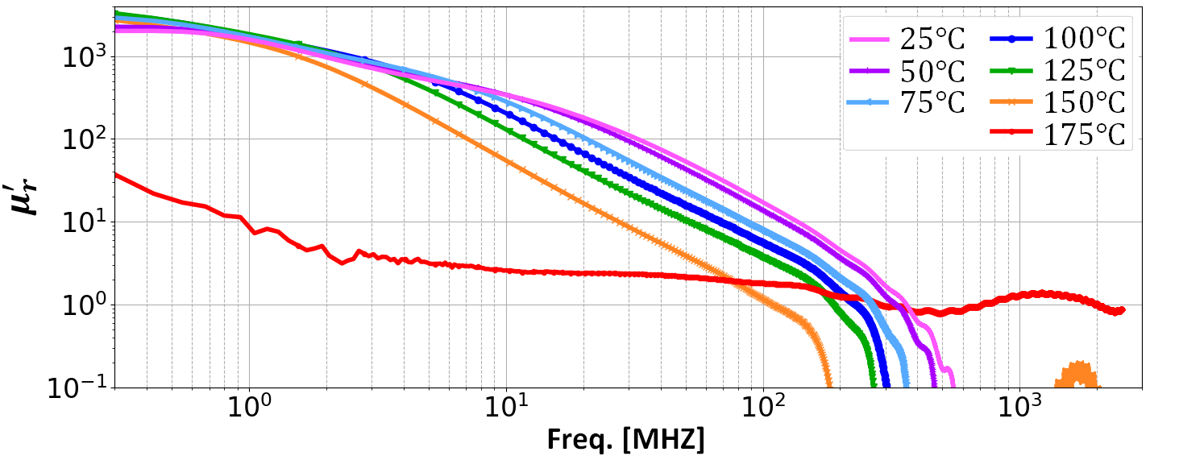
Beam heating effect
The heating of the ferrite can result in :
  local degradation of the vacuum
  loss of the magnetic properties
    (Curie point exceeded)
Curie Temperature
CMD5005
Courtesy: A. Chmielinska
Note temperatures are “set” – actual ferrite temperature is lower.
Above the Curie Temperature the ferrite temporarily looses its permeability.
L. Ducimetière, M. Barnes - PULPOKS, 13 March 2018
4

Slide 5
Beam screening
The beam coupling is reduced by providing a path for the beam image current, which screens the ferrite yoke from the wakefields
Such a screen should be installed between the beam and the ferrite yoke
Courtesy: L. Vega Cid
The transverse and imaginary longitudinal beam-coupling impedance of kicker magnets can provoke beam instabilities
In addition to the beam impedance, high-impedance resonances usually occur when the image path of the beam is not continuous, for example, a gap between the end of the kicker magnet and the vacuum tank
L. Ducimetière, M. Barnes - PULPOKS, 13 March 2018
5

Slide 6
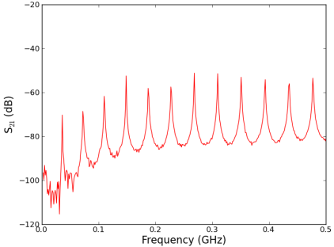
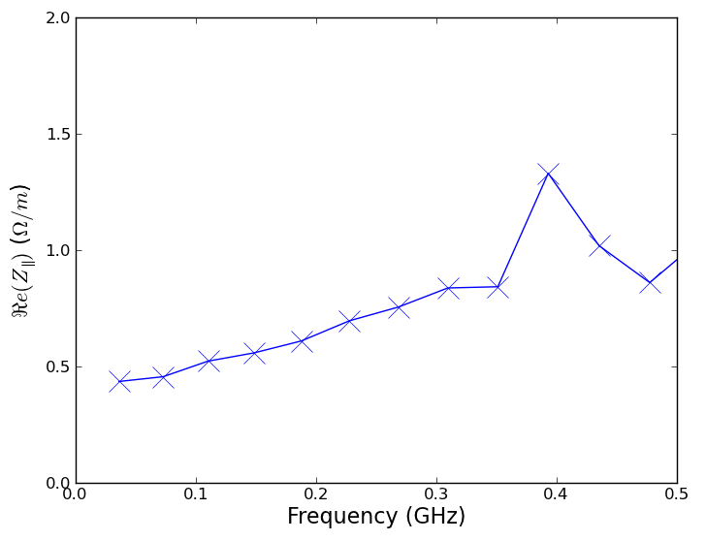


Beam Impedance Measurements
Method: resonant coaxial wire measurement → high sensitivity to low impedances
direct coaxial wire measurement → continuous data, but less sensitive
The device under test is turned into a coaxial resonator --> Q-factors can be accurately measured
Each resonance gives a data point : resonant frequency and the Q-factor (loaded, modify to find unloaded)
Q-factor gives losses which gives the real longitudinal impedance
DUT
$$50 Ω$$
$$50 Ω$$
Vector Network Analyser
Data points
Δf = nc/2L_{DUT}
Example L_{MKI} = 3m : Δf = 41MHz
Can be improved by artificially lengthening the device
L. Ducimetière, M. Barnes - PULPOKS, 13 March 2018
6

Slide 7
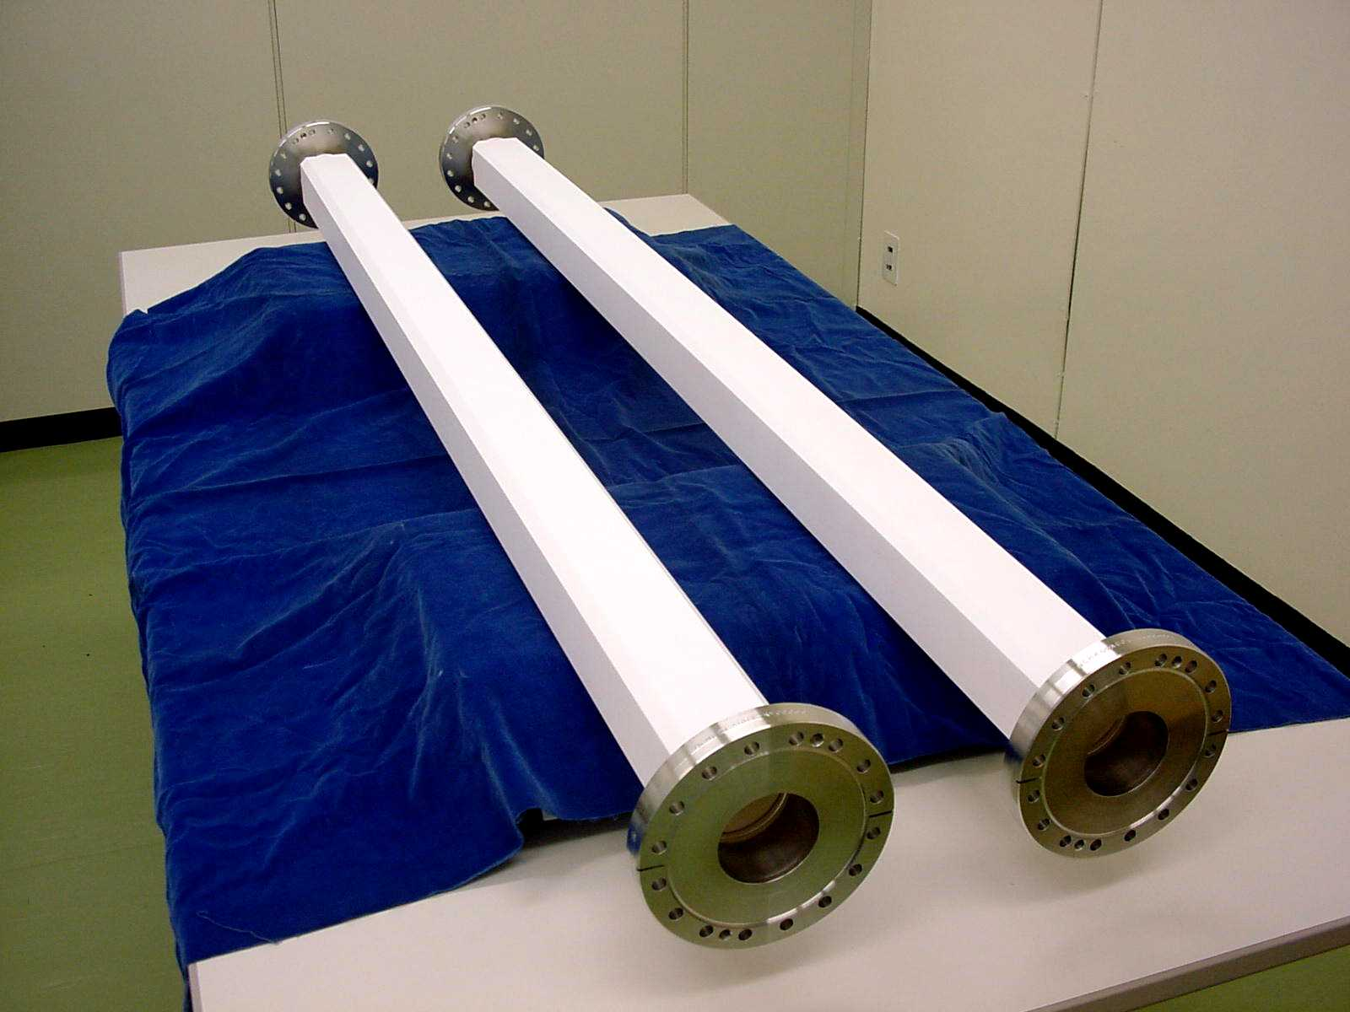
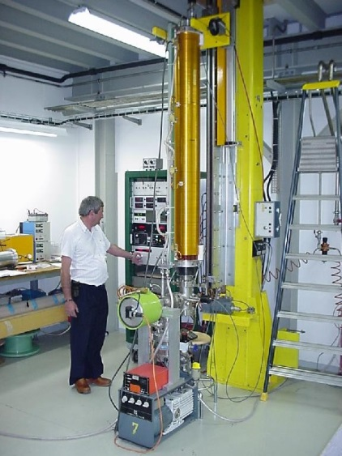
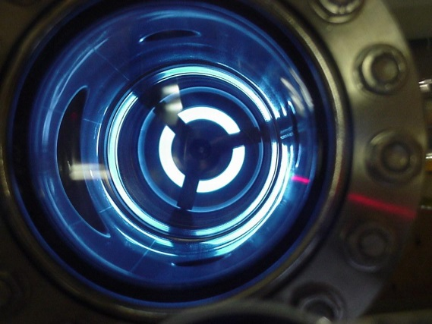
Resistive coating
An uniform resistive layer is the easiest way to provide beam screening when the field rise time is in the microsecond range
However a ceramic chamber or plates are required on which to apply the layer, which requires an increase in the aperture of the magnet
LHC beam dump extraction kicker MKD
Magnetron sputtering
L. Ducimetière, M. Barnes - PULPOKS, 13 March 2018
7

Slide 8
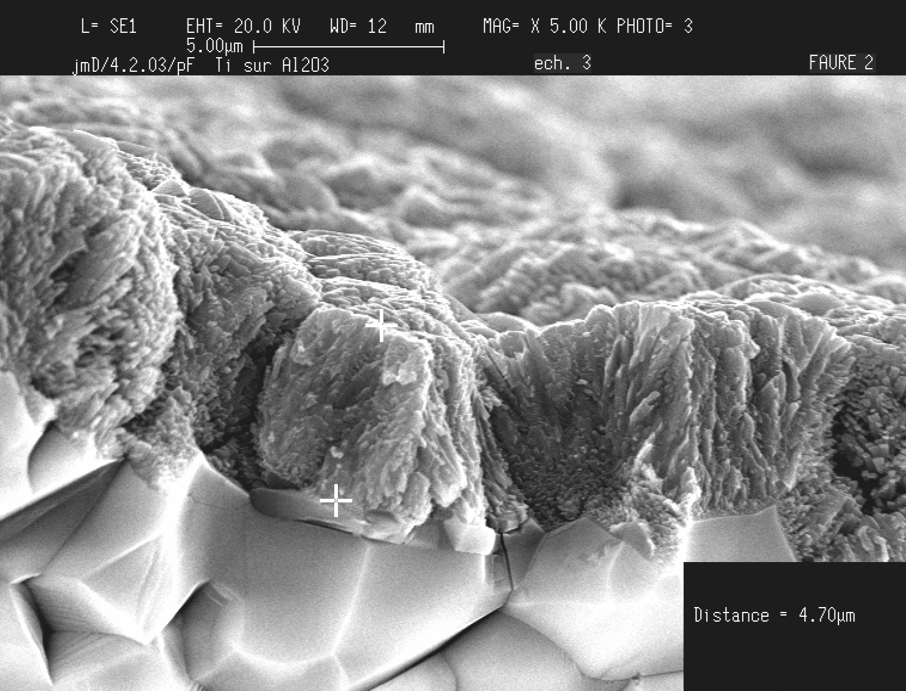
Resistive coating
The LHC beam dump extraction kicker MKD is equipped with a 1.5 m long ceramic vacuum chamber, which has been metallized with Titanium at 0.15 Ω/.
The field rise time is 3 μs.
The time shift introduced by the metallization is about 100 ns
L. Ducimetière, M. Barnes - PULPOKS, 13 March 2018
8

Slide 9

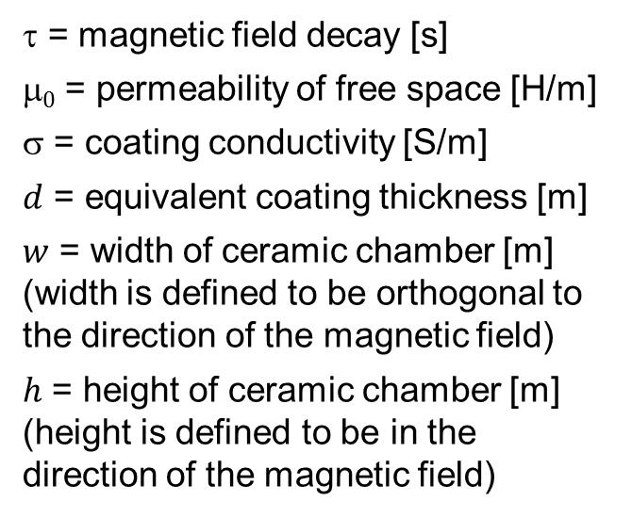

Resistive coating
An analytic model has been proposed by S.H. KIM, APS, USA and was refined by Mike BARNES and Tobias STADLBAUER, who introduced a correction factor Δ_{corr}
The formula gives the time constants τ of magnetic field decays for different chamber geometries, assuming a half-sine field pulse and spatially uniform coating over the chamber
τ = magnetic field decay [s]
$0$ = permeability of free space [H/m]
$$ = coating conductivity [S/m]
$d$ = equivalent coating thickness [m]
$w$ = width of ceramic chamber [m]
(width is defined to be orthogonal to the direction of the magnetic field)
$h$ = height of ceramic chamber [m]
(height is defined to be in the direction of the magnetic field)
$=$μ₀ σ $d$ Δ_{corr}
Δ_{corr}$=$k₁ $w$^{1.995} + k₂ $h$^{1.646} – k₃
k₁, k₂ and k₃ are constant:
k₁ = 3.498 [m^{-0.995}]
k₂ = 1.3 [m^{-0.646}]
k₃ = 2.97⋅10⁻³ [m]
For round chambers the width and the height are both set equal to the diameter
L. Ducimetière, M. Barnes - PULPOKS, 13 March 2018
9

Slide 10
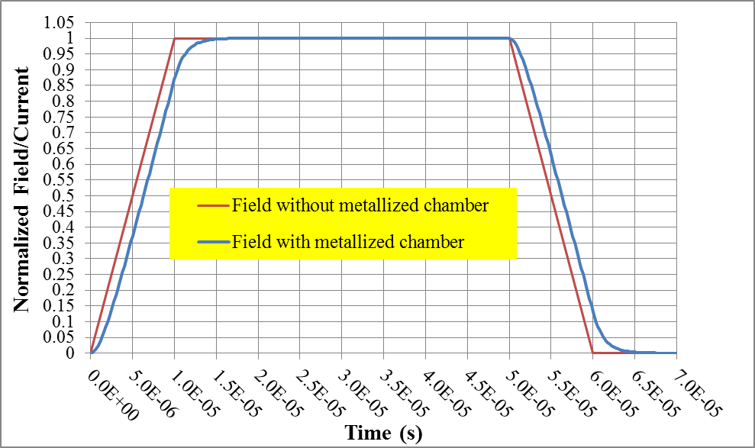
Resistive coating
The calculated time constant τ can be use for analytical calculations:
Analytical equations for trapezoidal field
τ = time constant, including correction factor [s]
B₀ = maximum applied field [T]
B₁, B₂ = magnetic field at centre of vacuum chamber [T]
t_{rise} = rise time, 0% to 100%, of the ramped current [s]
for
for
L. Ducimetière, M. Barnes - PULPOKS, 13 March 2018
10

Slide 11

Resistive coating
The calculated time constant τ can also be use for analogue simulation for any pulse shape :
The effect of the metallization is then modelled by a resistor R in parallel with the magnet inductance
R
Lm
R = Equivalent resistance [Ω]
τ = time constant, including correction factor [s]
Lm = magnet inductance [H]
R =
Lm
τ
L. Ducimetière, M. Barnes - PULPOKS, 13 March 2018
11

Slide 12
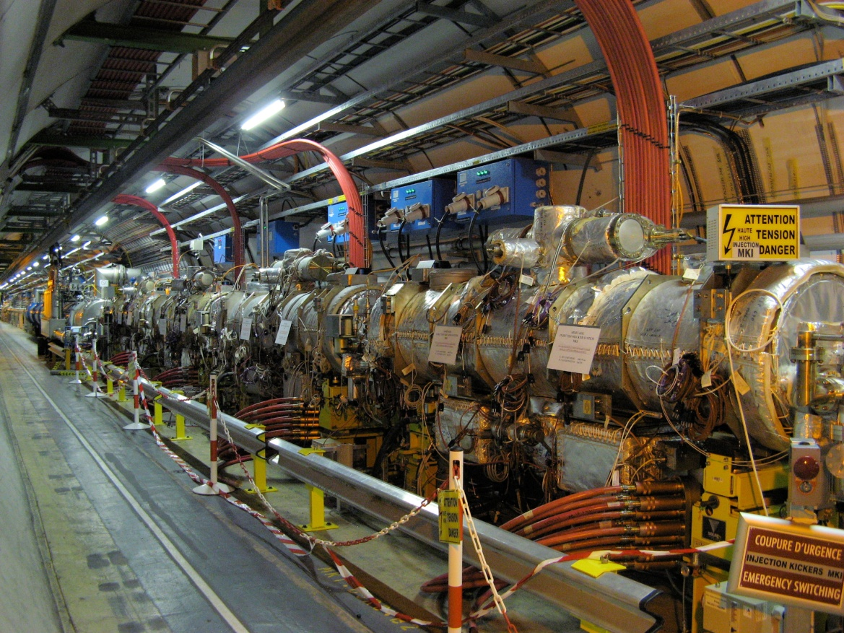
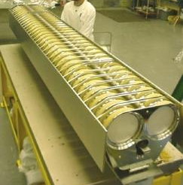
Screen conductors
LHC injection kicker magnets MKI - 4 MKIs per injection point
Bake-out jackets
MKI8D
MKI8A
MKI8B
MKI8C
Delay line type magnet with 33 cells, 5 Ω imp.
Ceramic plate decoupling capacitors
2.7 m long magnet, ~ 50 kV PFN, 900 ns rise
Ferrite magnet yoke (Curie temp. ~120°C)
Baked out to 300°C to reach ~10⁻¹¹ mbar
54 x 54 mm ferrite aperture of kicker
Designed with a ~3m long ceramic tube with 42 mm inside diameter to hold beam screen conductors
12

Slide 13
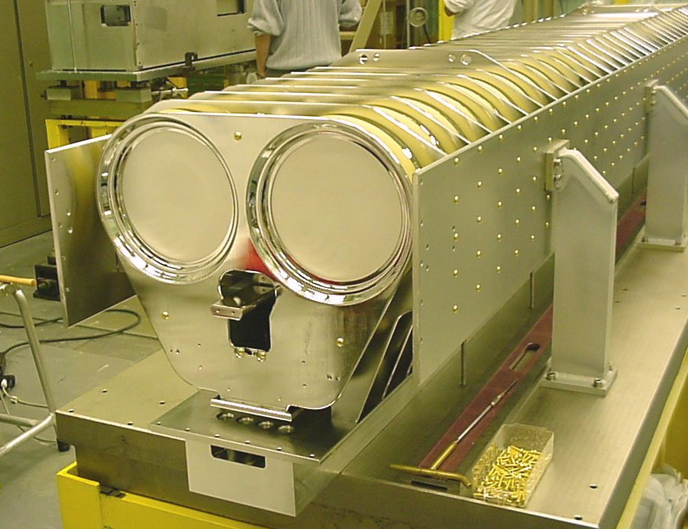
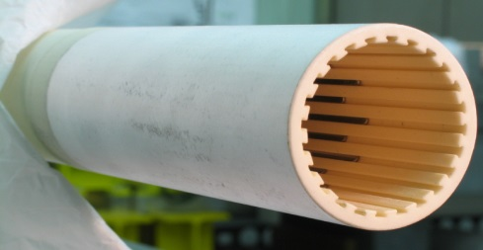
Screen conductors
The screening is provided by conductors lodged in the inner wall of a ceramic support tube.
The conductors are made of nickel-chrome (80/20) stripes 0.7 mm x 2.7 mm with rounded corners
On one end, all conductors are connected together to the grounded beam pipe
On the other end, all conductor are open, but capacitively coupled to the beam pipe through the ceramic tube that is metalized on its outside over 200 mm
~1x10⁻⁹ Pa
L. Ducimetière, M. Barnes - PULPOKS, 13 March 2018
13

Slide 14
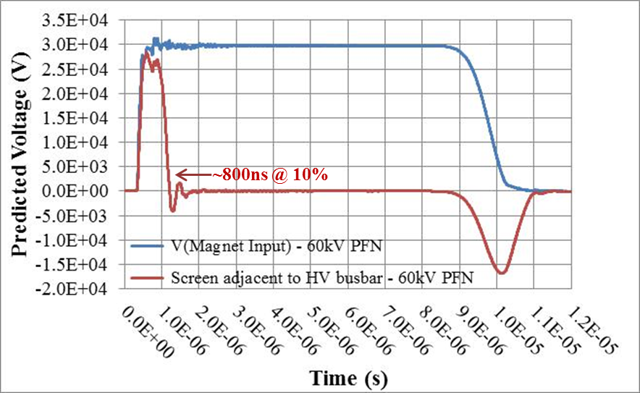
Screen conductors
Voltage is induced on a screen conductor mainly by mutual coupling with the cell inductance. The voltages at the open end of the screen conductors show a positive peak (max.) during field rise and a negative peak during field fall.
The conductors closest to the HV busbar were initially removed to avoid flashovers: from the 24 stripes foreseen, only 15 stripes were installed up to 2012.
42kV
37kV
31kV
Extensive studies have been carried out to successfully reduce the flashovers.
The geometry of the tube end has been modified so that the predicted electric field was reduced by a factor 3
Subsequently all 24 screen conductors were reintroduced.
L. Ducimetière, M. Barnes - PULPOKS, 13 March 2018
14

Slide 15
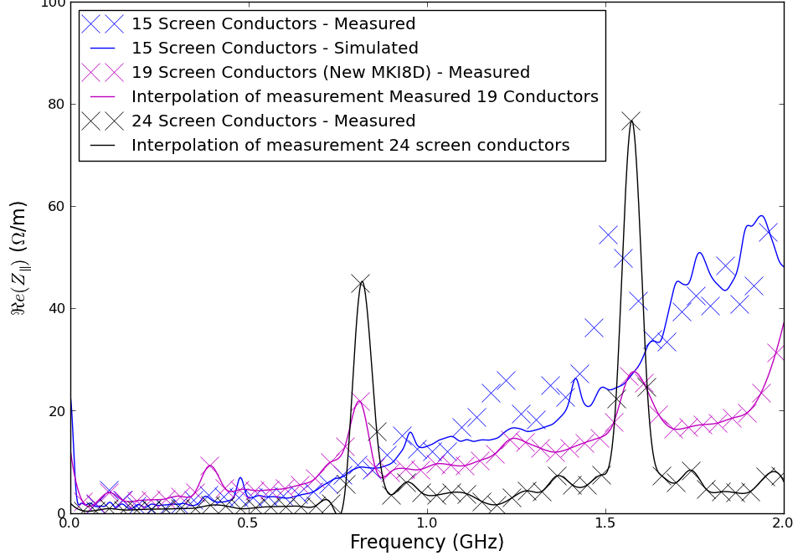
Screen conductors
Beam impedance and expected losses deposition in ferrite yoke
In 2012 with nominal power and 15 conductors:
~70 W/m;
Improved screening (15  24 conductors) reduces power deposition by a factor of 2 to 3;
For the future high-luminosity LHC version : ~200 W/m with 24 conductors.
L. Ducimetière, M. Barnes - PULPOKS, 13 March 2018
15

Slide 16
Serigraphy on ferrite
During scrubbing runs, the SPS extraction kicker magnet MKE went above about the Curie temperature of 120˚C. The 8C11 ferrite yoke temporarily lost its magnetic properties.
The MKE is a delay line type kicker magnet made of 7 cells
Each cell has a length of 230 mm
A beam screen had to be implemented as retrofit
The aperture is limited and does not allow for any insert
L. Ducimetière, M. Barnes - PULPOKS, 13 March 2018
16

Slide 17
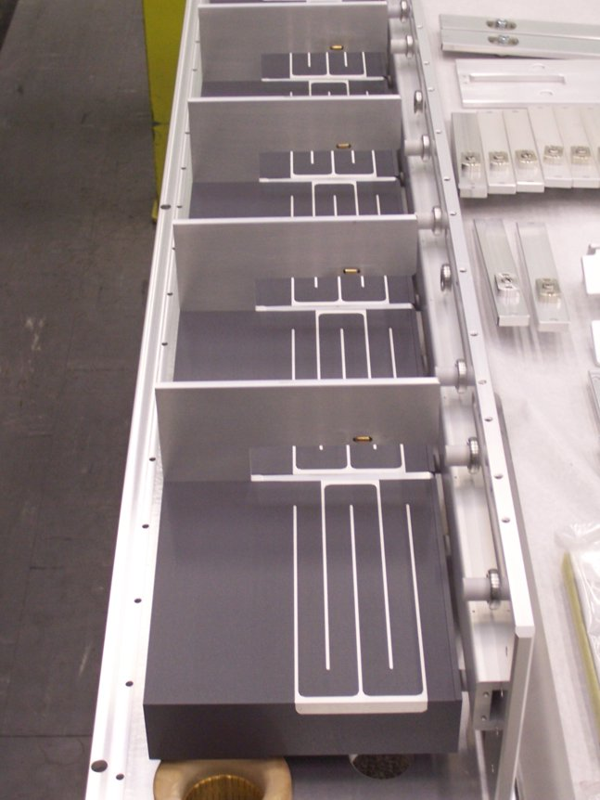
Serigraphy on ferrite
Interdigitated comb structure 20 mm spacing
Beam coupling impedance has been reduced using conductive stripes (serigraphy), i.e. interleaved comb structure, directly printed onto the ferrite blocks, with a reliable contact to the metallic HV plates at either side
The capacitive coupling between stripes carries the beam image current
No impact on the beam aperture
L. Ducimetière, M. Barnes - PULPOKS, 13 March 2018
17

Slide 18
Serigraphy on ferrite
Comparison between the two extreme cases:
  MKE-L8, without any serigraphy on ferrites;
  MKE-L10, serigraphy on all seven ferrite cells.
Significant reduction of real longitudinal beam-coupling impedance from serigraphy.
Low frequency resonance directly linked to geometry of serigraphy (length of stripes).
Real part of Z
Imaginary part of Z
L8
L8
L10
L10
L. Ducimetière, M. Barnes - PULPOKS, 13 March 2018
18

Slide 19
Serigraphy on ferrite
Power Deposition in Ferrite Yoke : comparison between fully shielded (L10 magnet) and unshielded (L8 magnet)
Calculated using beam spectrum measured during 2004 SPS scrubbing run
  2*72 LHC bunches in SPS at 450 GeV;
Serigraphy (painted stripes) reduces calculated power deposition by a factor of >4, for LHC beam
L8
L10
L. Ducimetière, M. Barnes - PULPOKS, 13 March 2018
19

Slide 20
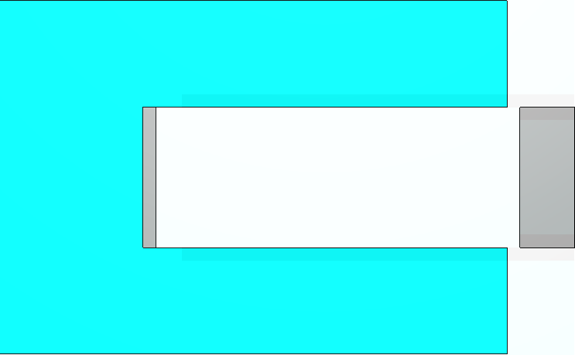
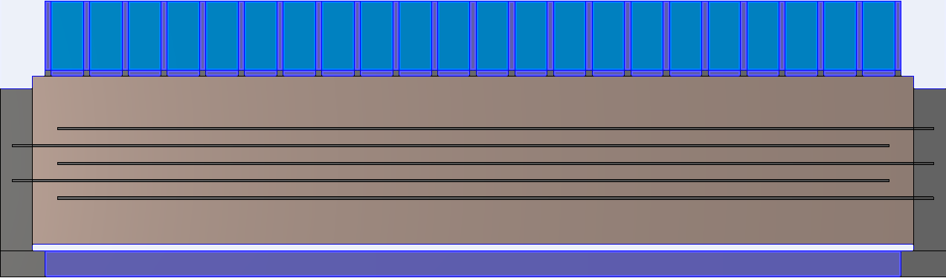
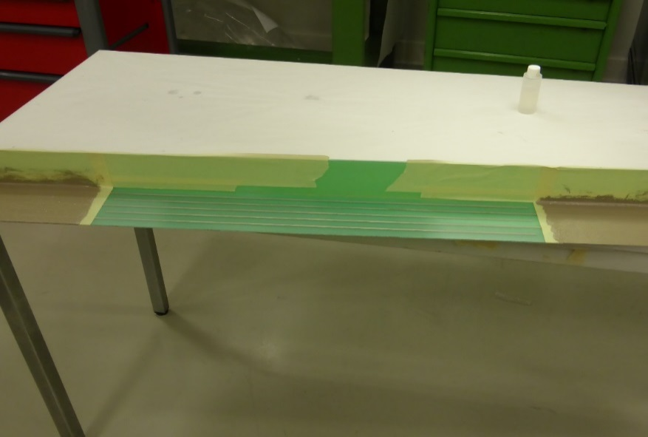
Serigraphy on ceramic plate
Alternative for delay line type kicker magnet with short cells :
Injection kicker magnet for SPS : MKPL 22 cells, 700 mm total lenght
Serigraphy over full length of module, applied onto a ceramic thin plate
Connected to the transition plates
~700mm
Ceramic plate with serigraphy
Currently under development …
L. Ducimetière, M. Barnes - PULPOKS, 13 March 2018
20

Slide 21
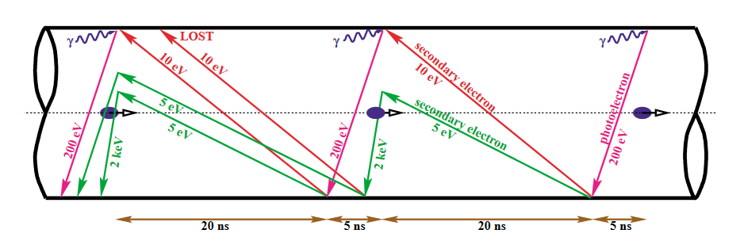
Electron Cloud
Schematic of electron cloud build-up mechanism in LHC (courtesy of F. Ruggiero)
Due to the close bunch spacing of 25 ns, in the LHC, a significant number of electrons can accumulate in the LHC beam pipe.
Seed electrons are accelerated by the beam electric field and can impact on the side of the vacuum chamber → if the Secondary Emission Yield (SEY) is greater than 1, it can create a large number of secondaries.
SEY of alumina is in the range 5 to 10 !
L. Ducimetière, M. Barnes - PULPOKS, 13 March 2018
21

Slide 22
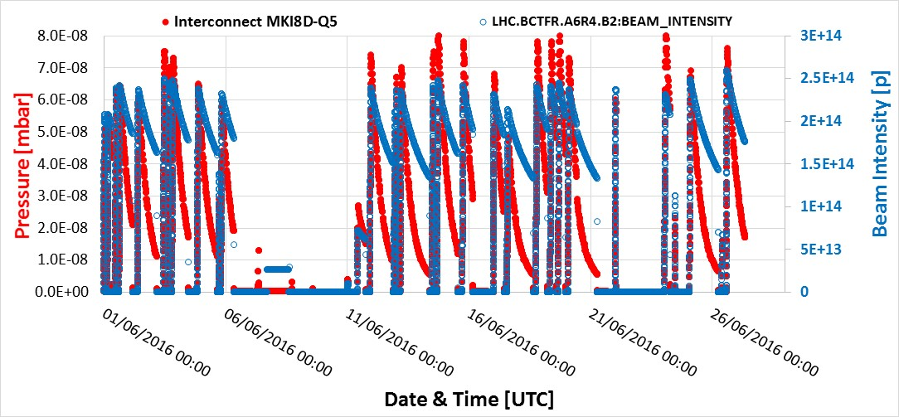
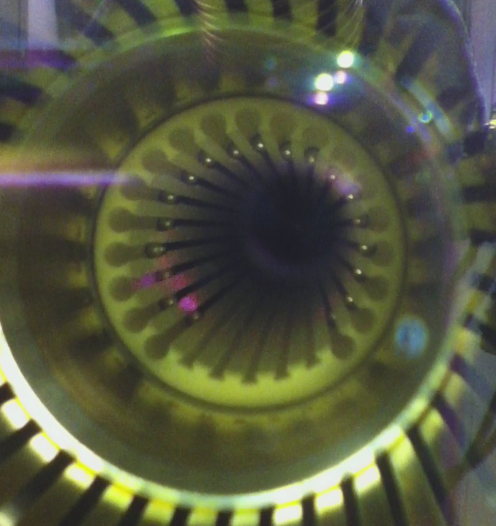
Electron Cloud
In 2016 dynamic pressure rise attributed to high Secondary Electron Yield (SEY) of alumina tube, by a factor of ~20 to 1000 in MKI interconnects
→ it limited injection of high-intensity bunches into the LHC.
SIS threshold
Electrical discharge could occasionally be observed (in lab) on “naked” alumina, at end of screen conductors, due to high induced voltage.
The SEY of the ceramic is also responsible for the surface flashover of the MKI beam screen conductors
→ Highly desirable to reduce SEY
L. Ducimetière, M. Barnes - PULPOKS, 13 March 2018
22

Slide 23
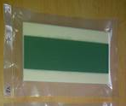
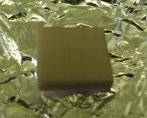
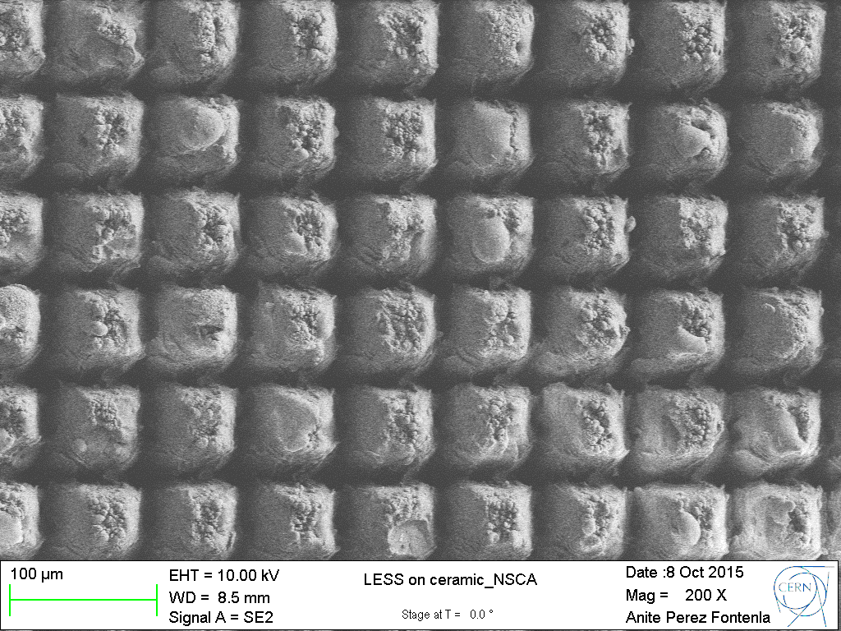

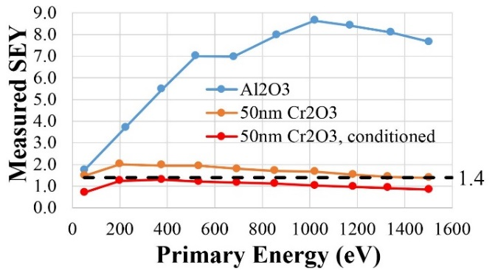

Reduction of SEY
Laser Engineered Surface Structures (University of Dundee, UK):
Trap electrons in “wells”
Cr₂O₃ coating applied by painting or spraying (Friatec, Germany):
Cr₂O₃ coating applied by magnetron sputtering (Polyteknik, Denmark):
+ Measured maximum SEY reduced to ~1.7;
+ Further conditions in lab to less than 1.4;
- Very dusty finish: surface can be sealed with Silicone ⇨ SEY increases to ~3.
Measurements courtesy of:
E. Valdivieso & H. Neupert
+ Measured maximum SEY reduced to ~1.6
- Due to high resistivity, alumina charges up.
+ No dust.
L. Ducimetière, M. Barnes - PULPOKS, 13 March 2018
23

Slide 24
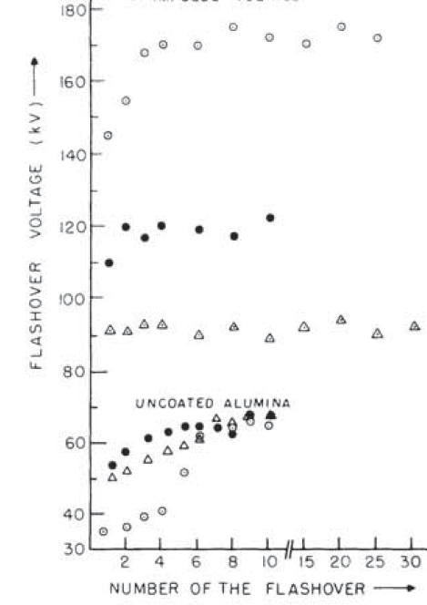
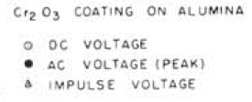
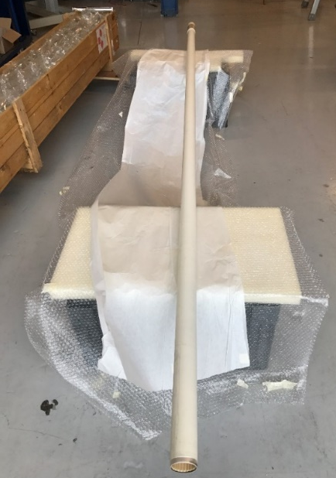
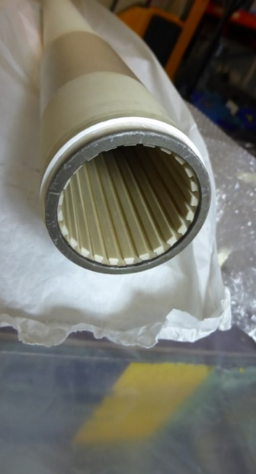
Surface flashover
Cylinder: 12.7mm long
Cr₂O₃ was originally studied for coating of MKI alumina tube in order to increase the voltage of flashover in vacuum by ~30% (based on papers by Sudarshan and Cross (1976), and by T. Shioiri (2006)) :
    reducing secondary electron avalanche;
    reducing surface charging due to decreased surface resistance (10¹⁰ – 10¹¹ Ω∙cm).
Flashover Voltage (kV)
Pulse: with Cr2O3
90
One MKI magnet was equipped with a Cr2O3 coated alumina tube.
went successfully through two extended high voltage conditioning processes, with voltages up to 10% above operational voltage,
Installed in LHC.
70
Pulse: without Cr2O3
L. Ducimetière, M. Barnes - PULPOKS, 13 March 2018
24

Slide 25
Conclusion and outlook
Beam screens with uniform resistive coating are easy to implement, especially for lumped kicker magnets with rise/fall time in the microsecond range:
  The field attenuation can be analytically predicted;
  Requires a larger aperture, but also allows to build the magnet outside vacuum.
Screen conductors are necessary for faster kicker magnets
  Induced voltages are to be carefully taken into account
Serigraphy combs on ferrite could be considered for retrofit solution when the cell length is large enough;
  The aperture is preserved; geometrical resonances need to be considered.
Retrofit solution with serigraphy on ceramic plate is under development
CERN has pursued development of Cr₂O₃, applied by magnetron sputtering, to:
  Reduce the SEY of the alumina surface facing the beam to limit electron cloud;
  Improve the surface flashover capability of the ceramic under vacuum.
L. Ducimetière, M. Barnes - PULPOKS, 13 March 2018
25

Slide 26
References
“Longitudinal and Transverse Wire Measurements for the Evaluation of Impedance Reduction Measures on the MKE Extraction Kickers”, T. Kroyer, F. Caspers, E. Gaxiola, CERN-AB-Note-2007-028.
“Effect of a Metallized Chamber upon the Field Response of a Kicker Magnet: Simulation Results and Analytical Calculations”, M.J. Barnes, T. Fowler, M.G. Atanasov, T. Kramer, T. Stadlbauer, IPAC’12, New Orleans, May 2012, THPPD074.
“Measurement and Analysis of SPS Kicker Magnet Heating and Outgassing with Different Bunch Spacing”, M.J. Barnes et al., proc. of PAC’09, Vancouver, May 2009.
“High Voltage Performance of the Beam Screen of the LHC Injection Kicker Magnets”, M.J. Barnes et al., proc. of IPAC’14, Dresden, June 2014.
“Beam Coupling Impedance of the New Beam Screen of the LHC Injection Kicker Magnets”, H. Day et al., proc. of IPAC’14, Dresden, June 2014.
“Cooling of LHC Injection Kicker Magnet Ferrite Yoke: Measurements and Future Proposals”, Z. Sobiech et al., proc. of IPAC’14, Dresden, June 2014.
“Novel Measurements of Electromagnetic Properties of Ferrites as a function of Frequency and Temperature”, A. Chmielińska et al., to be publ. in proc. of IPAC’18, Vancouver, May 2018.
“The Effect of Chromium Oxide Coatings on Surface Flashover of Alumina Spacers in Vacuum”, T.S. Sudarshan and J.D. Cross, IEEE Trans. on Electrical Insulation, Vol. EI-11, No. 1, March 1976, pp32-35.
“Effect of chromium oxide coating on surface flashover characteristics of ceramic in vacuum”, T. Shioiri et al., Jan. 2006 Proc. - International Symposium on Discharges and Electrical Insulation in Vacuum, DOI 10.1109/DEIV.2006.357251
“Influence of coating to surface flashover characteristics of alumina ceramics in vacuum”, N. Asari et al., Sept. 2016, Conf.: 2016 27th International Symposium on Discharges and Electrical Insulation in Vacuum (ISDEIV) , DOI 10.1109/DEIV.2016.7748689
“Emittance growth induced by electron cloud in proton storage rings”, E. Benedetto, PhD Thesis, 2006

Slide 27
Thank You !

