Slide 1
Magnetic Materials for Pulsed Power
Chris C. Jensen
March 12 2018

Slide 2
Outline
Magnetic Properties Overview
  permeability, saturation, losses
  B-H loop and initial conditions
Ferrite Specific
  Ferrite production
  Pulse measurement
Examples
  Considerations in choosing material
  Kicker magnet
  Kicker saturating ferrite
  Recent procurement experience

Slide 3
Magnetic Properties
Types of materials (typical, various parameters for all types)
  Nickel Zinc Ferrite
    B_{sat} ~ 0.3 T, f_{corner} ~ 1 MHz, µ_{r,initial} ~ 1 k, ρ ~ 10⁵ – 10⁸ Ohm cm
  Manganese Zinc Ferrite
    B_{sat} ~ 0.4 T, f_{corner} ~ 100 kHz, µ_{r,initial} ~5 k, losses ~ 0.5 W / cm³,
    ρ ~ 10¹ – 10³ Ohm cm
  Finemet tape wound steel (specialty alloy, special processing)
    B_{sat} ~ 1.2 T, f_{corner} ~ 10 kHz, µ_{r,initial} ~30 k, losses ~ 0.3 W / cm³
  Tape wound 3% silicon steel ( not special alloy, 250 µm thick )
    B_{sat} ~ 1.9 T, f_{corner} ~ 1 kHz, µ_{r,initial} ~2 k, losses ~ 8 W / cm³
B_{sat} and µ_{r,initial} at 1 kHz, losses at 100 kHz, B ~ 0.2 T, f_{corner} where real part of small signal µ_{r} starts to reduce, not maximum use

Slide 4
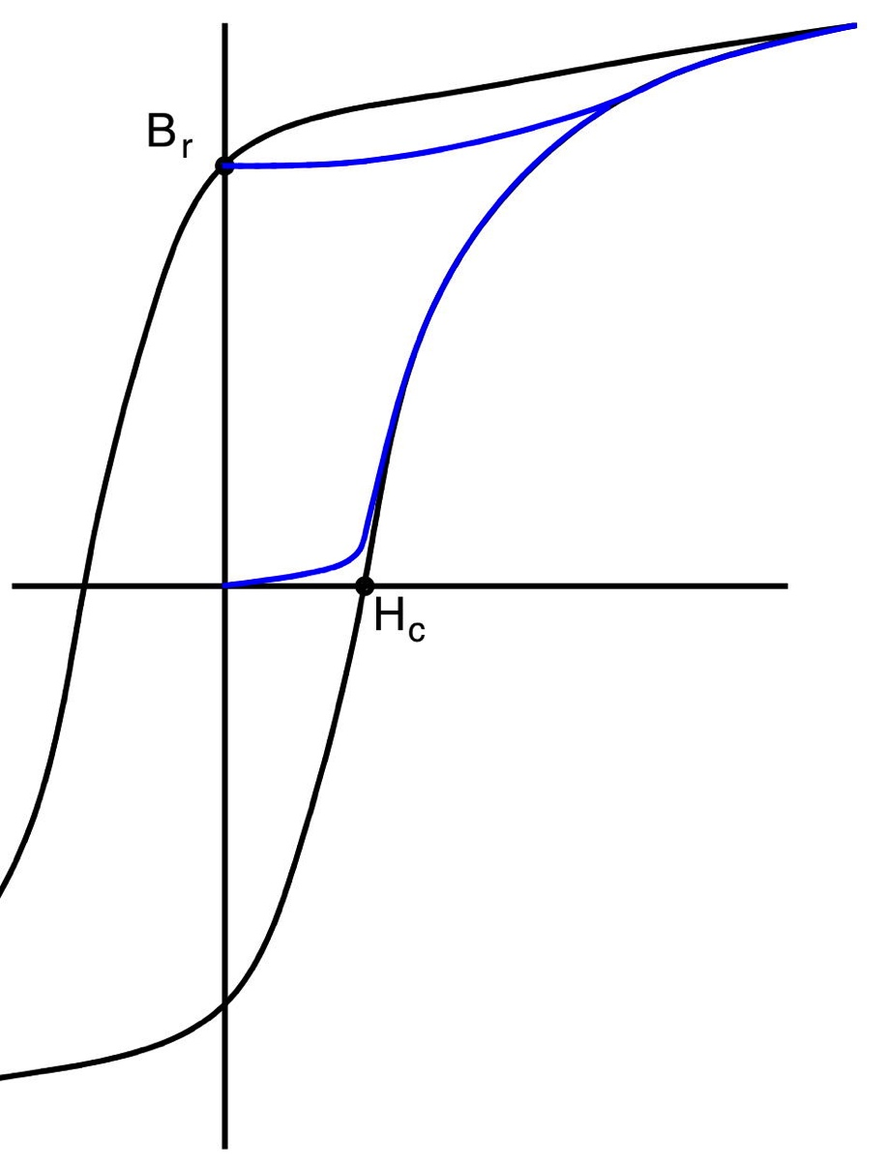
Magnetic Properties
Constituent Equations
  B = µ₀ H + M(H)
  B = µ H = µ_{r} µ₀ H
  No hysteresis
  No time dependence
Br dependent on drive level
Hc dependent on drive frequency
No negative drive applied, then remain at Br until next cycle, minor loop excursion
Area between curves has units of T / m² * A / m = Joules/m³ , loss per cycle

Slide 5
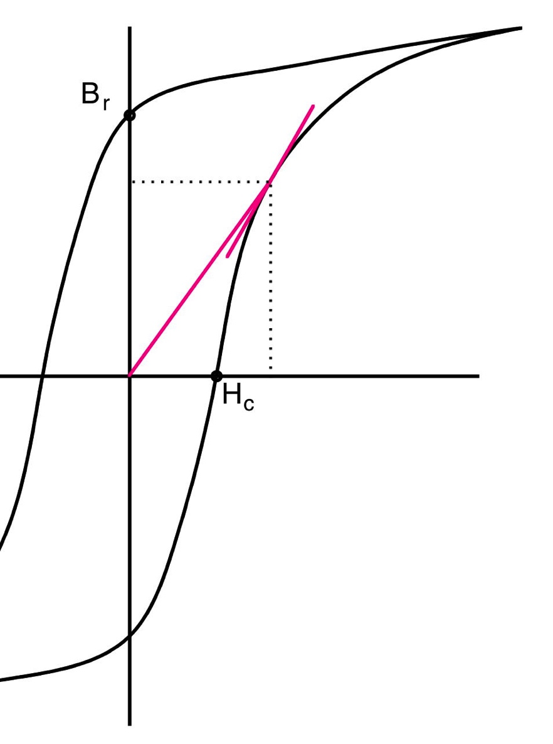
Magnetic Properties
How to define permeability?
  Pulse / Amplitude permeability
    Chord from 0,0
  Incremental permeability
    Slope at point
  Pulse power generally can’t consider simple, constant permeability if no or very small air gap
The amplitude of the excitation, the frequency and the applied waveform all effect the shape of the measured loop

Slide 6
Magnetic Properties
Equations relating circuits (loops) to geometry and fields
  Maxwell’s laws
  Integral [ E • dl ] = -d / dt Integral [ B • dS ]
    Assuming uniform E, B and non changing path / surface
      V = -dB/dt A_{surface} N_{turns}
  Integral [ B • dl ] = µ₀ Integral [ J • dS ] + 1/c² d / dt [ E • dS ]
    Assuming path not in magnetic material, uniform B, J, non changing path / surface and dE/dt small
      H l_{path} = J A_{surface} N_{turns} = N_{turns} I
    The last assumption of small dE/dt may be poor in fast pulsed systems
      Displacement currents may be appreciable
Circuit and field simulation makes many assumptions
  Understand what you are modeling and try to make predictions that you can check

Slide 7
Magnetic Materials / Other Properties
Dielectric Strength
  NiZn ferrite materials have higher dielectric strength than MnZn
  Tape wound material, need to know insulation strength for induced voltage per lamination
    Finemet, need to make sure have appropriate insulation
    Specialty steel may need impregnation
Relative Dielectric Constant / Resistivity
  NiZn typical range ε_{r} ~ 10-100, ρ ~ 10⁸ - 10⁵ Ohm cm
  MnZn typical range ε_{r} ~ 10²-10⁴, ρ ~ 10³ - 10¹ Ohm cm
  Tape wound steels are conductive along the tape
Magnetostriction (and inverse)
  Relationship between magnetic parameters and displacement
  A problem with some steel alloys and sometime MnZn

Slide 8
Ferrite Production
Control of raw materials important
  Ferrite is iron oxide with various amount of other oxides
  Mn, Ni and Zn are most common
    These replace some of Fe in the lattice
  Mix variations and impurities change ferrite properties
Raw materials are formed into small granules
  2 processes, wet vs dry, different approach, similar end result
Form into rough shape and compress
  Small toroids (~ 30 mm) generally formed by die stamping
  Press blocks using high pressure (100s atmospheres )
  Or very high pressure, isostatic (1000 atmospheres)

Slide 9
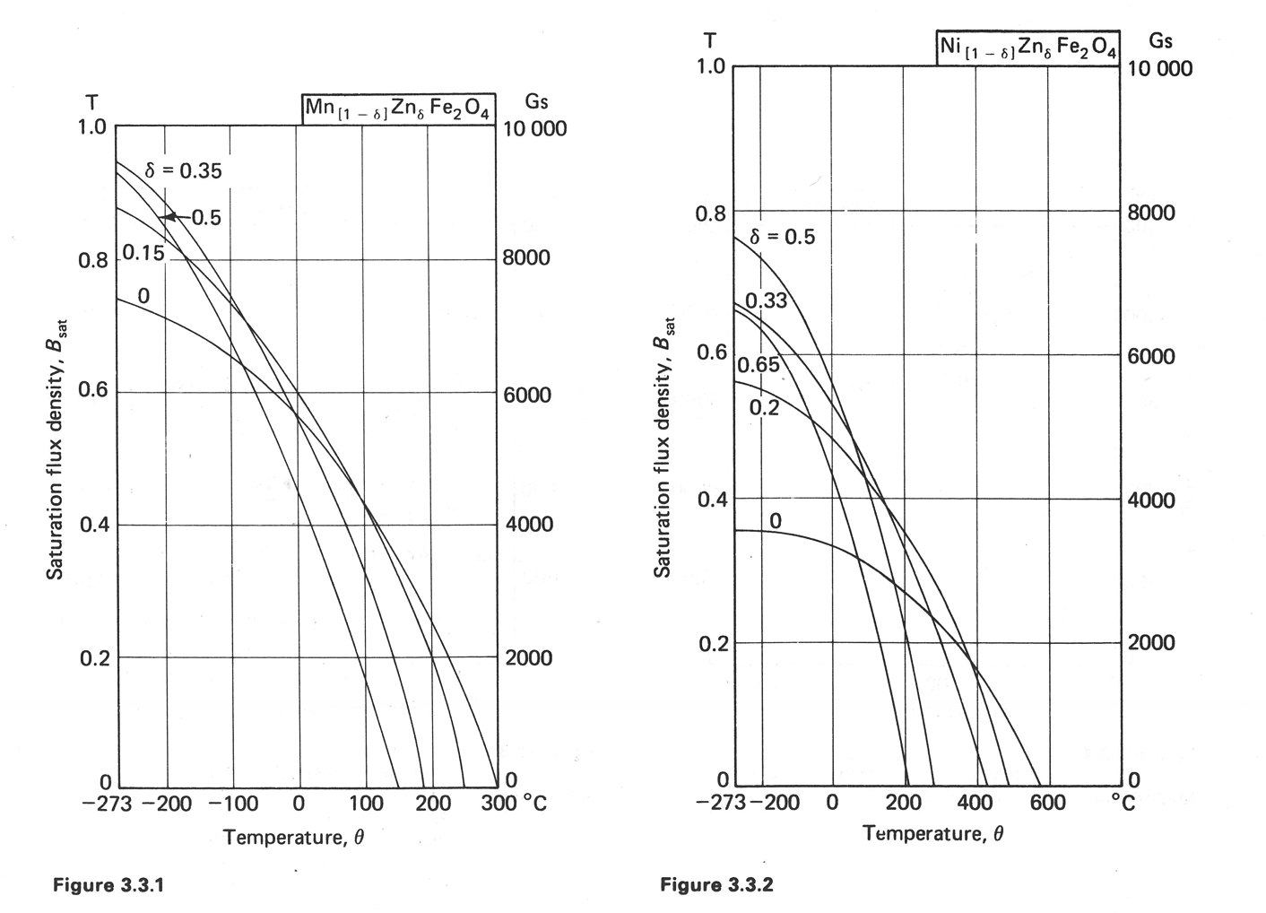
Ferrite Production
Effect of composition and temperature on
saturation flux density [1]

Slide 10
Ferrite Production
Sintering
  Controlled heating with controlled atmosphere to temperature on order of 1000 C
  Shrinkage on order of 10-20%, controlled within +/- few %
Final Finishing
  Grinding surfaces flat
  Some specialty ferrites have shapes which require special tooling and machining
    If special vacuum requirements are needed, this is the step where problems can occur; grinding solution must be water based
Gluing / Cementing
  Epoxy resins for joining ferrites, usually large air gap someplace
    Fermilab specifies use temp of > 150 C for radiation resistance

Slide 11
Material Measurements
The test waveform shape and rise time should be similar to application
  1 kHz sine wave measurements will give a B H loop which may not be useful for 1 µs pulse without reset field
The shape of the core should have similar size and shape to final
  Fabrication methods for small toroid samples are not the same as large blocks, use large toroid
  Toroids can be easier to analyze; make sure you understand where the highest fields are in an E-I or pot core
Sample test setup for high speed saturation application
  Actual size cores, small toroids
  Applied voltage was ~100 V, ~20 ns rise time with 50 Ohm source, but real voltage is ~30 kV, ~20 ns rise time
  Not the same waveform amplitude, hard to scale

Slide 12
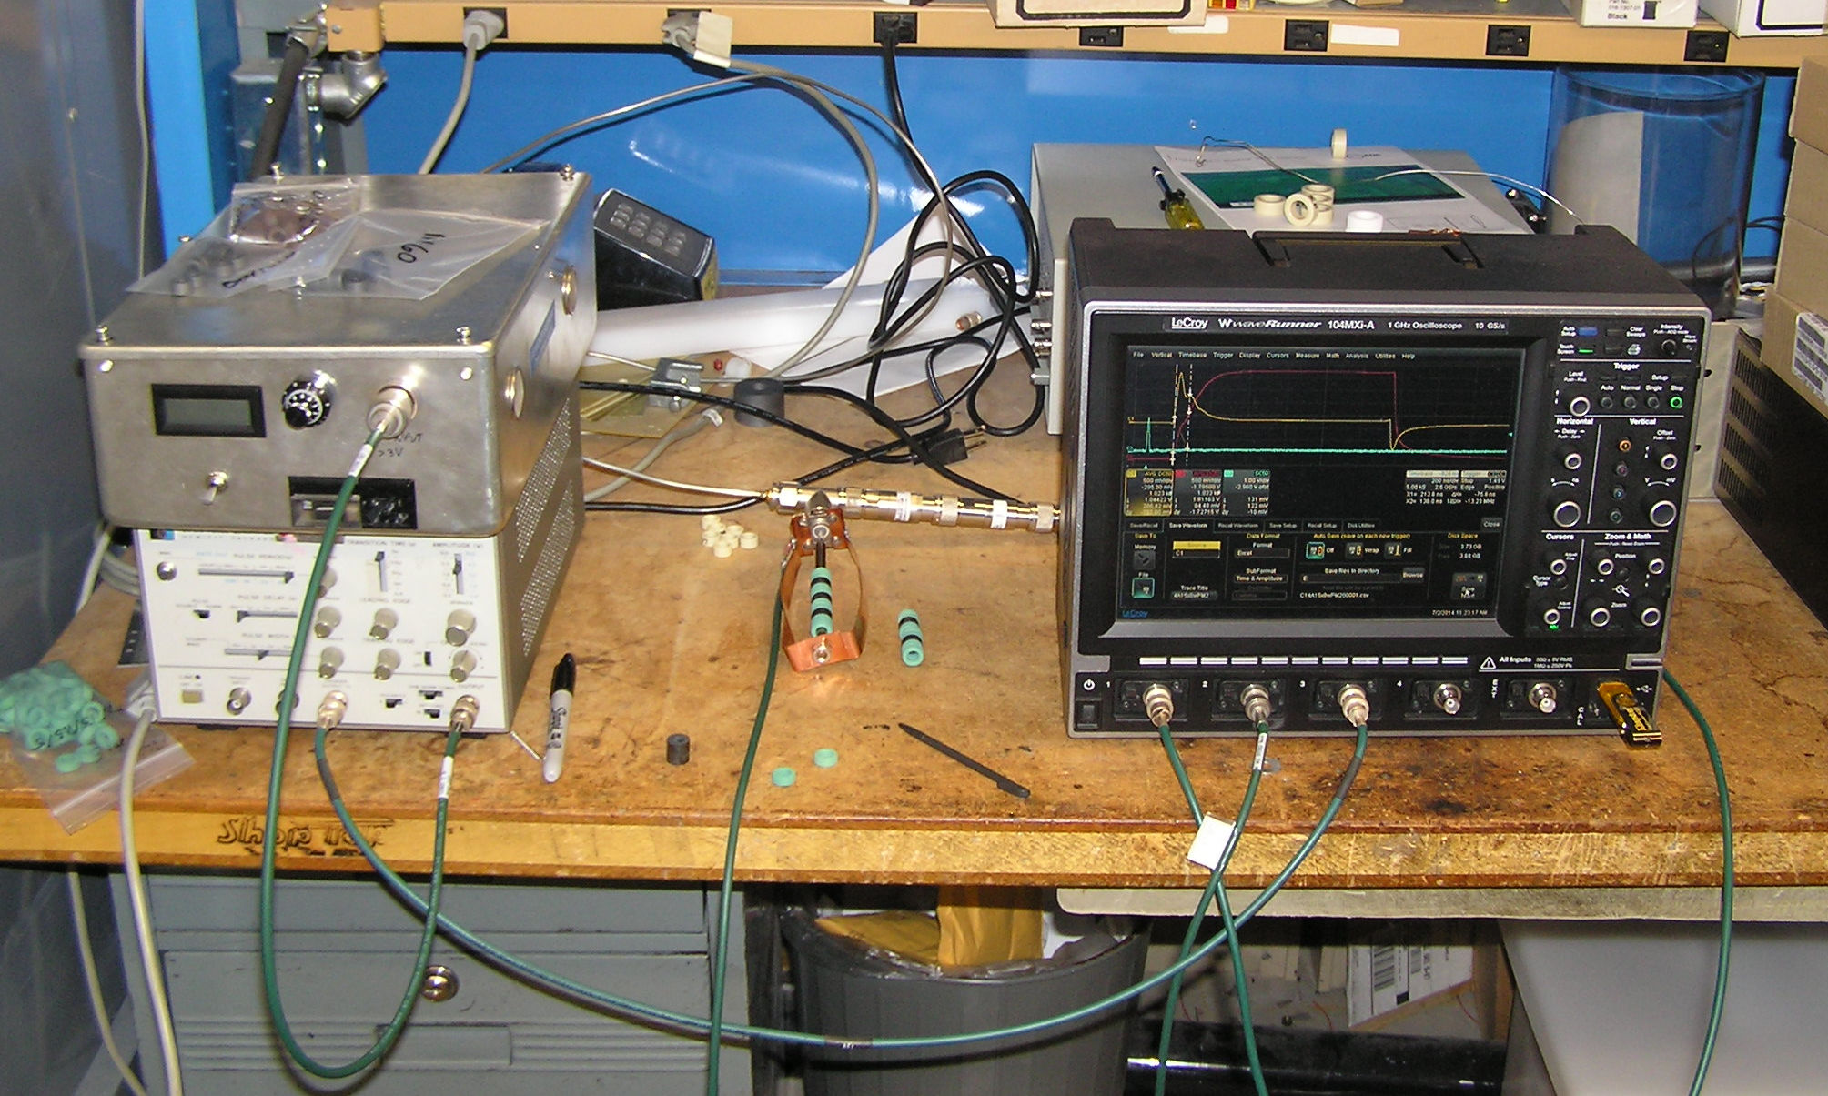
Material Measurements

Slide 13
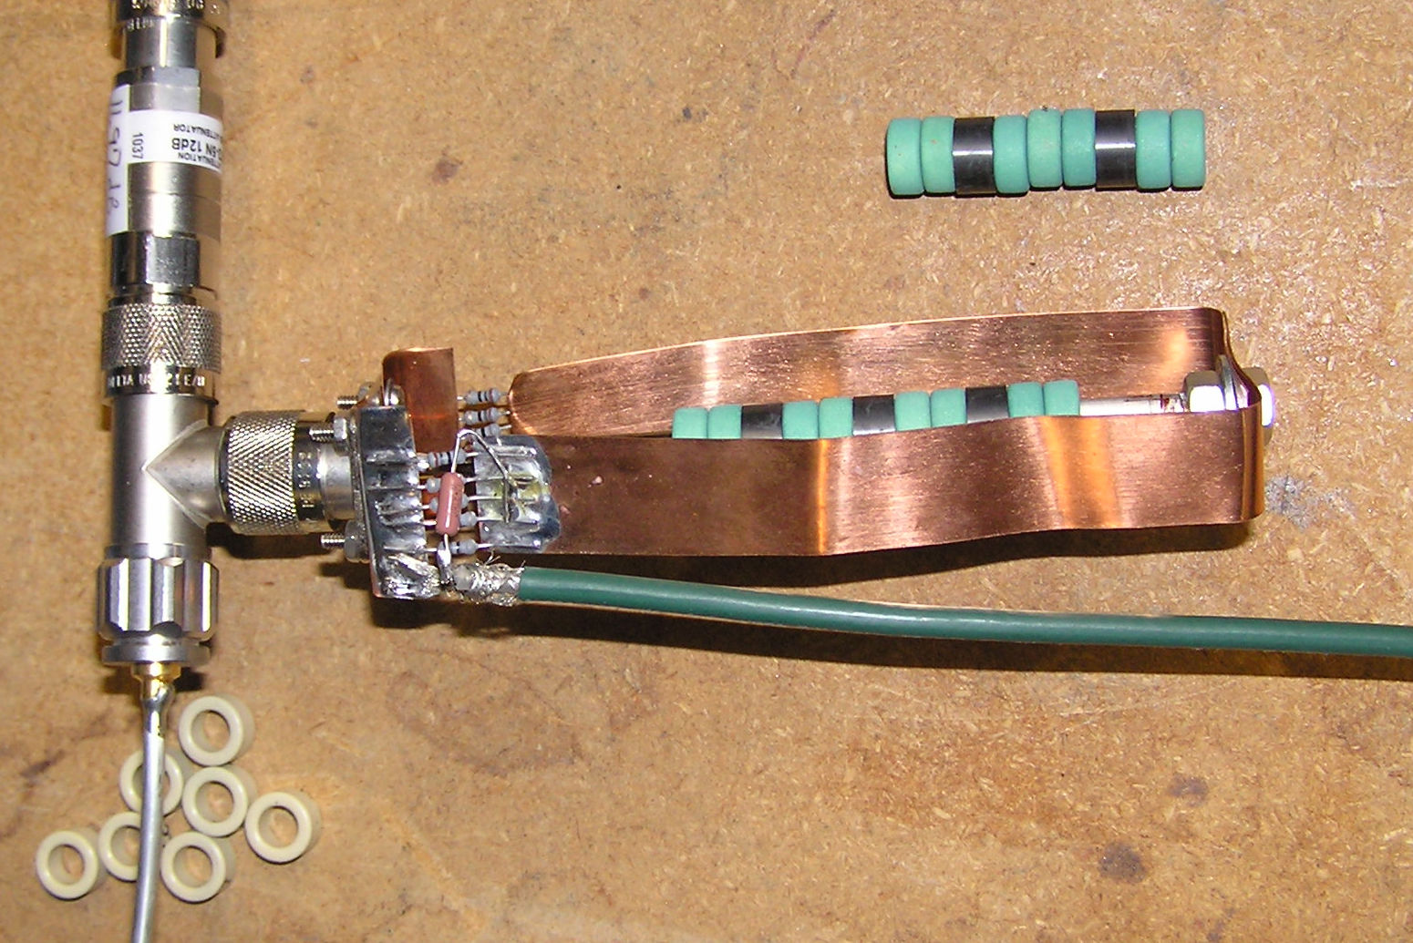
Material Measurements

Slide 14
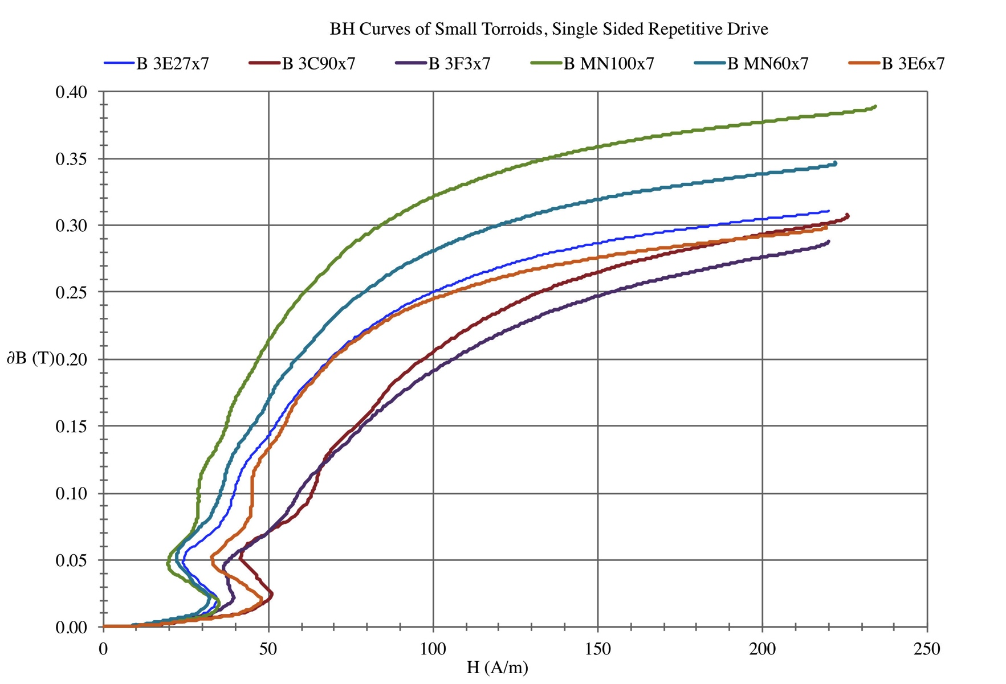
Material Measurements

Slide 15
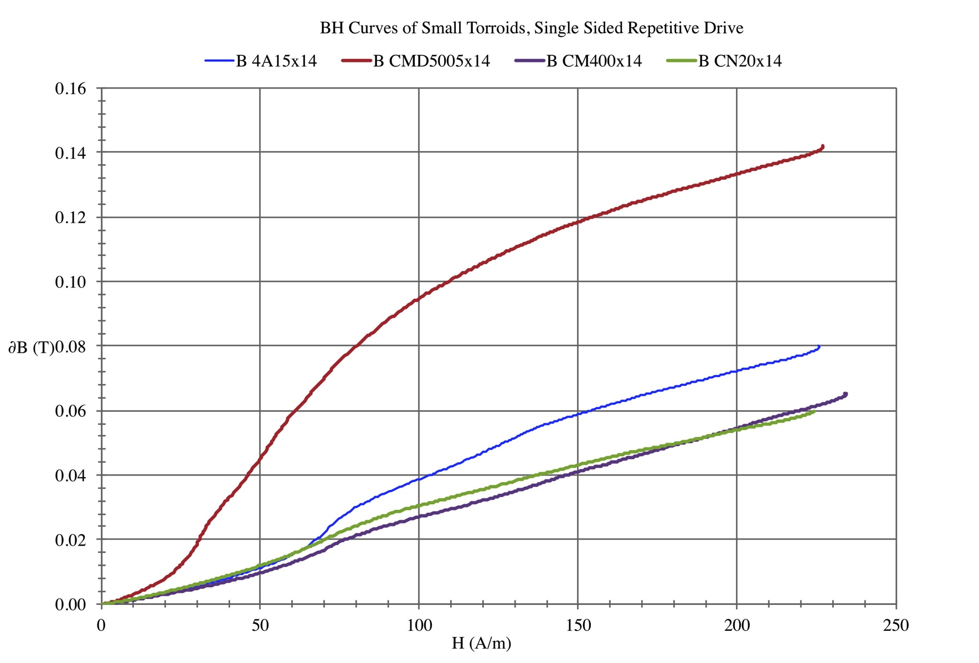
Material Measurements

Slide 16
Examples
Consideration in choosing material
  Is the space limited? Is the material available in size required?
  Will there be a way to reset field after pulse? Does cost and size mean field reset is a requirement? Can an air gap be used as part of reset mechanism?
  Does the field need to be uniform in an application that interacts with beam? Will saturation effect field uniformity? How much?
  Is a custom shape needed? Can it be fabricated using any material?
  Is this a fast repetition rate? What are losses in material?
  Is the voltage applied enough to dielectrically breakdown ferrite? Should laminations be used? Should ferrite be insulated?
  How much do material properties vary by lot? Is that a problem? Are there multiple manufacturers of similar material?
  Other mechanical properties (vacuum, heat conduction, radiation tolerance, toughness)

Slide 17
Example 1 – Injection Kicker Magnet
Considerations in choosing material
  Gap for beam in ferrite, will naturally reset to small residual field
  Fast rise time implies lower permeability ferrite required
  (NiZn, μ_{i} ~ 400, B_{sat} ~ 0.46 T, B_{r} ~ 0.25 T, ρ 10⁸ Ohm cm)
  f_{max} = γ M_{sat} / (3 π (μ_{i}-1) ) is location of maximum loss [2]
  Fast rise time also means limit cross section size to prevent resonance / standing wave
  Field uniformity requirement is +/- 1%, so can accept some saturation in corners, limited B in ferrite to about 0.2 T
  Repetition rate is low, duty factor low, some loss in ferrite can actually damp cell to cell resonances
  High applied voltage, but ferrite does not support voltage
  Ferrite is not in vacuum for Fermilab designs
See [3]

Slide 18
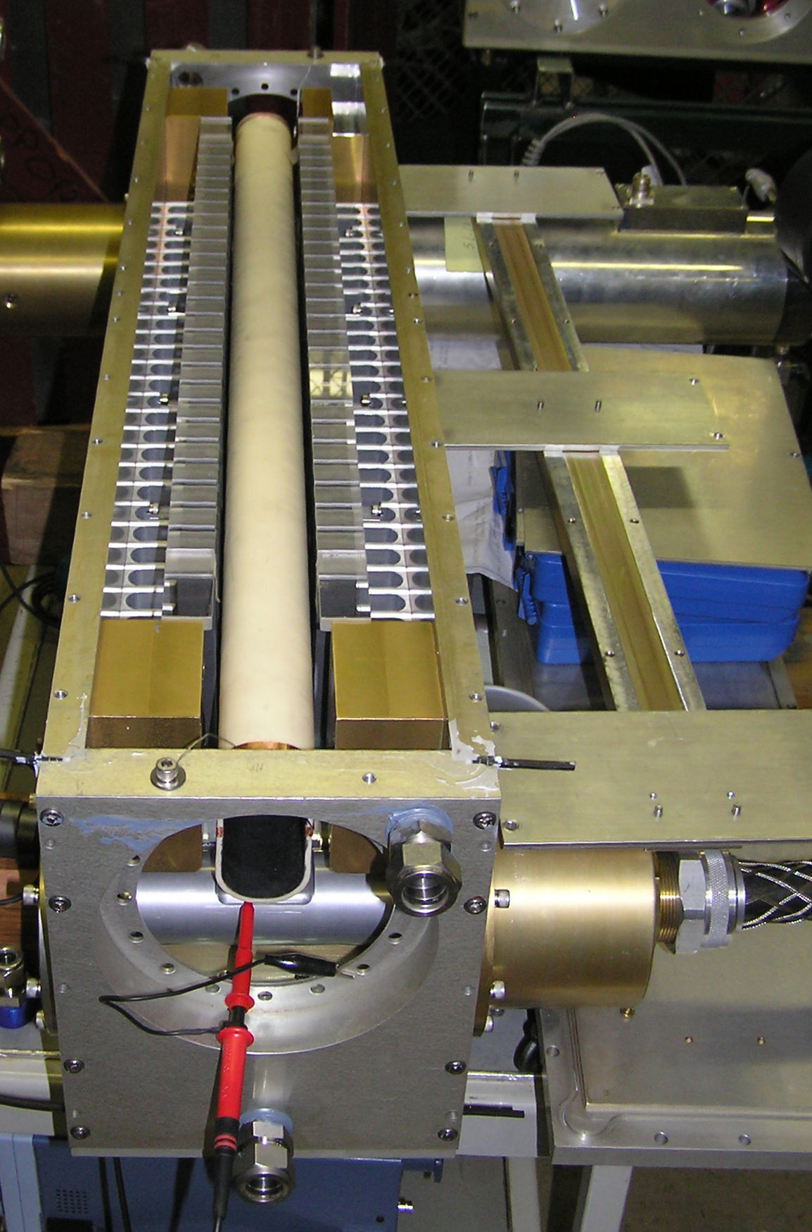
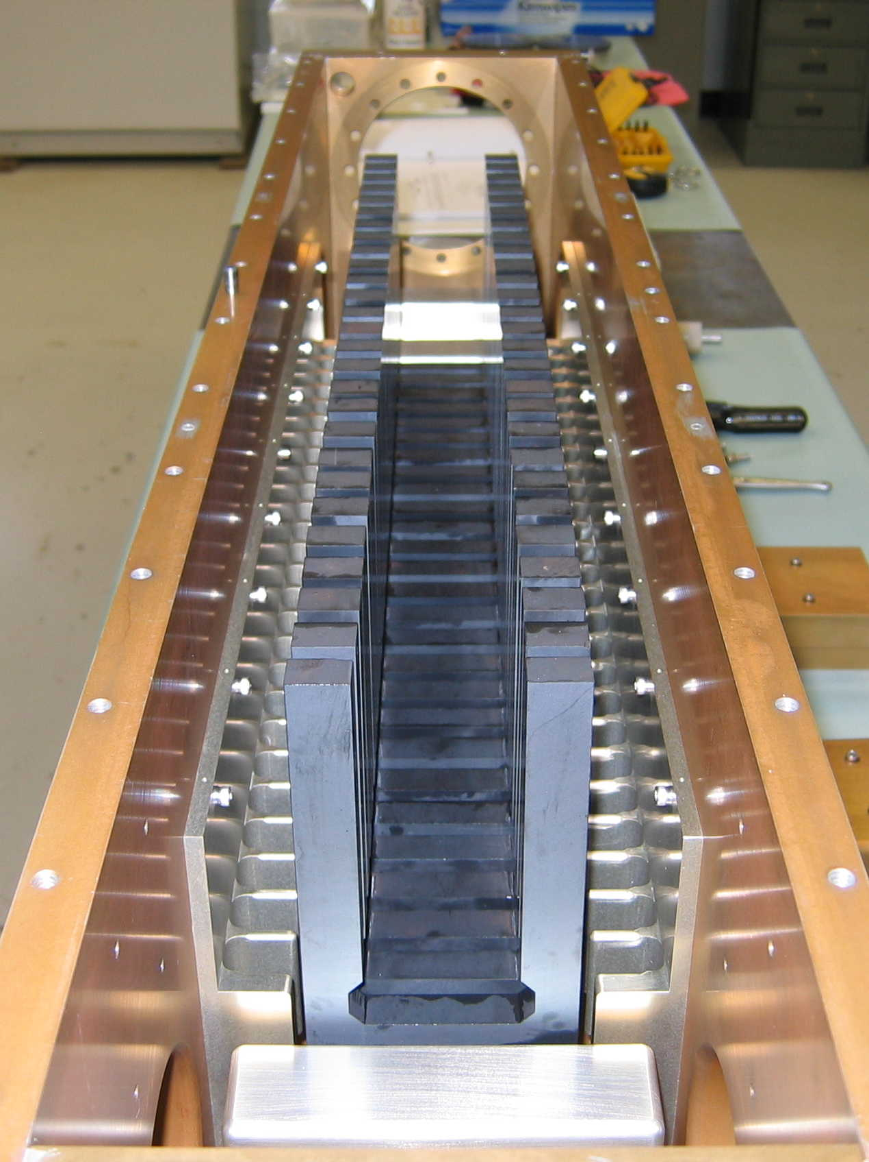
Example 1 – Kicker Magnet

Slide 19
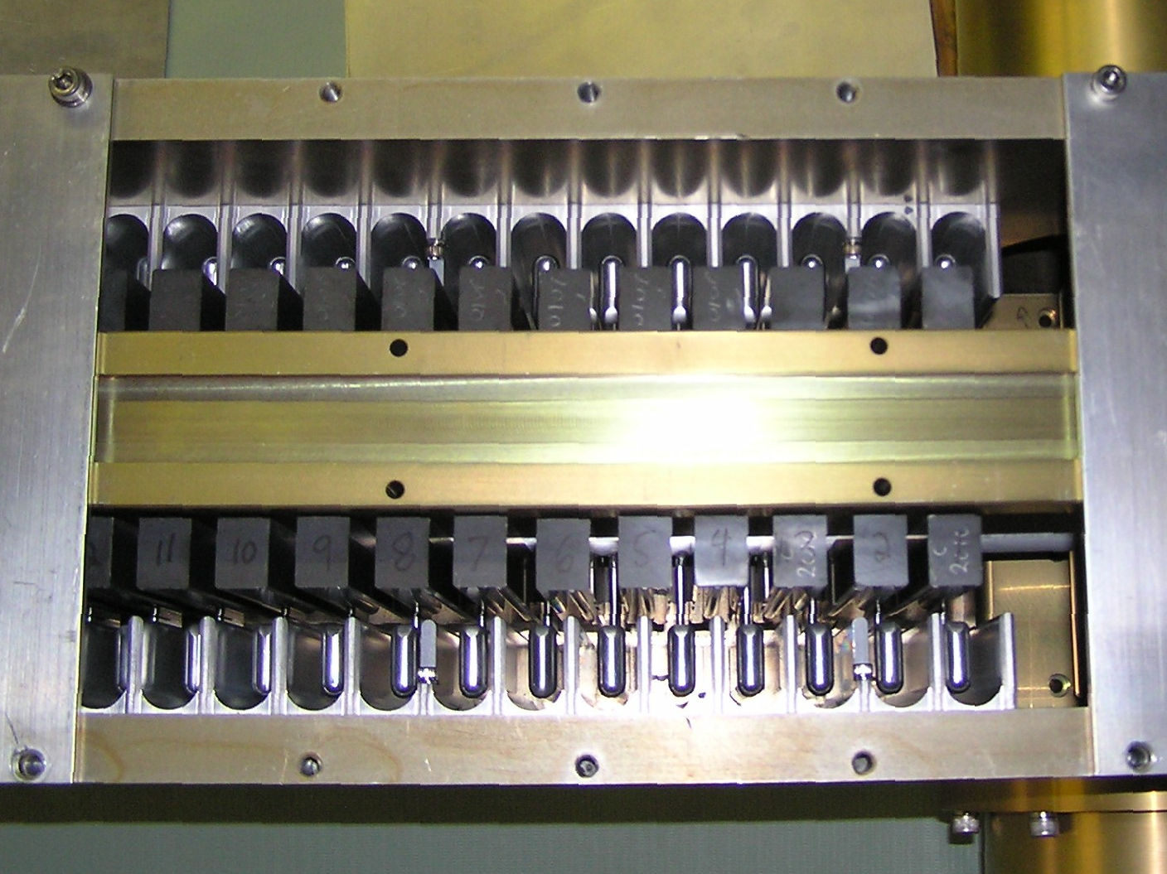
Example 1 – Injection Kicker Magnet

Slide 20
Example 2 – Saturating impedance for pulser
Consideration in choosing material
  No gap in core, but need 30 kV isolation and high impedance at very high speed, wont reset core
  Since no reset, need low Br material
  Unsaturated core needs to be high impedance, low Hc
  Want core to saturate all at same time, small OD to ID ratio
  Repetition rate is low, duty factor low, some loss in ferrite ok
  High applied voltage, but along core surface not through ferrite
See [4]

Slide 21
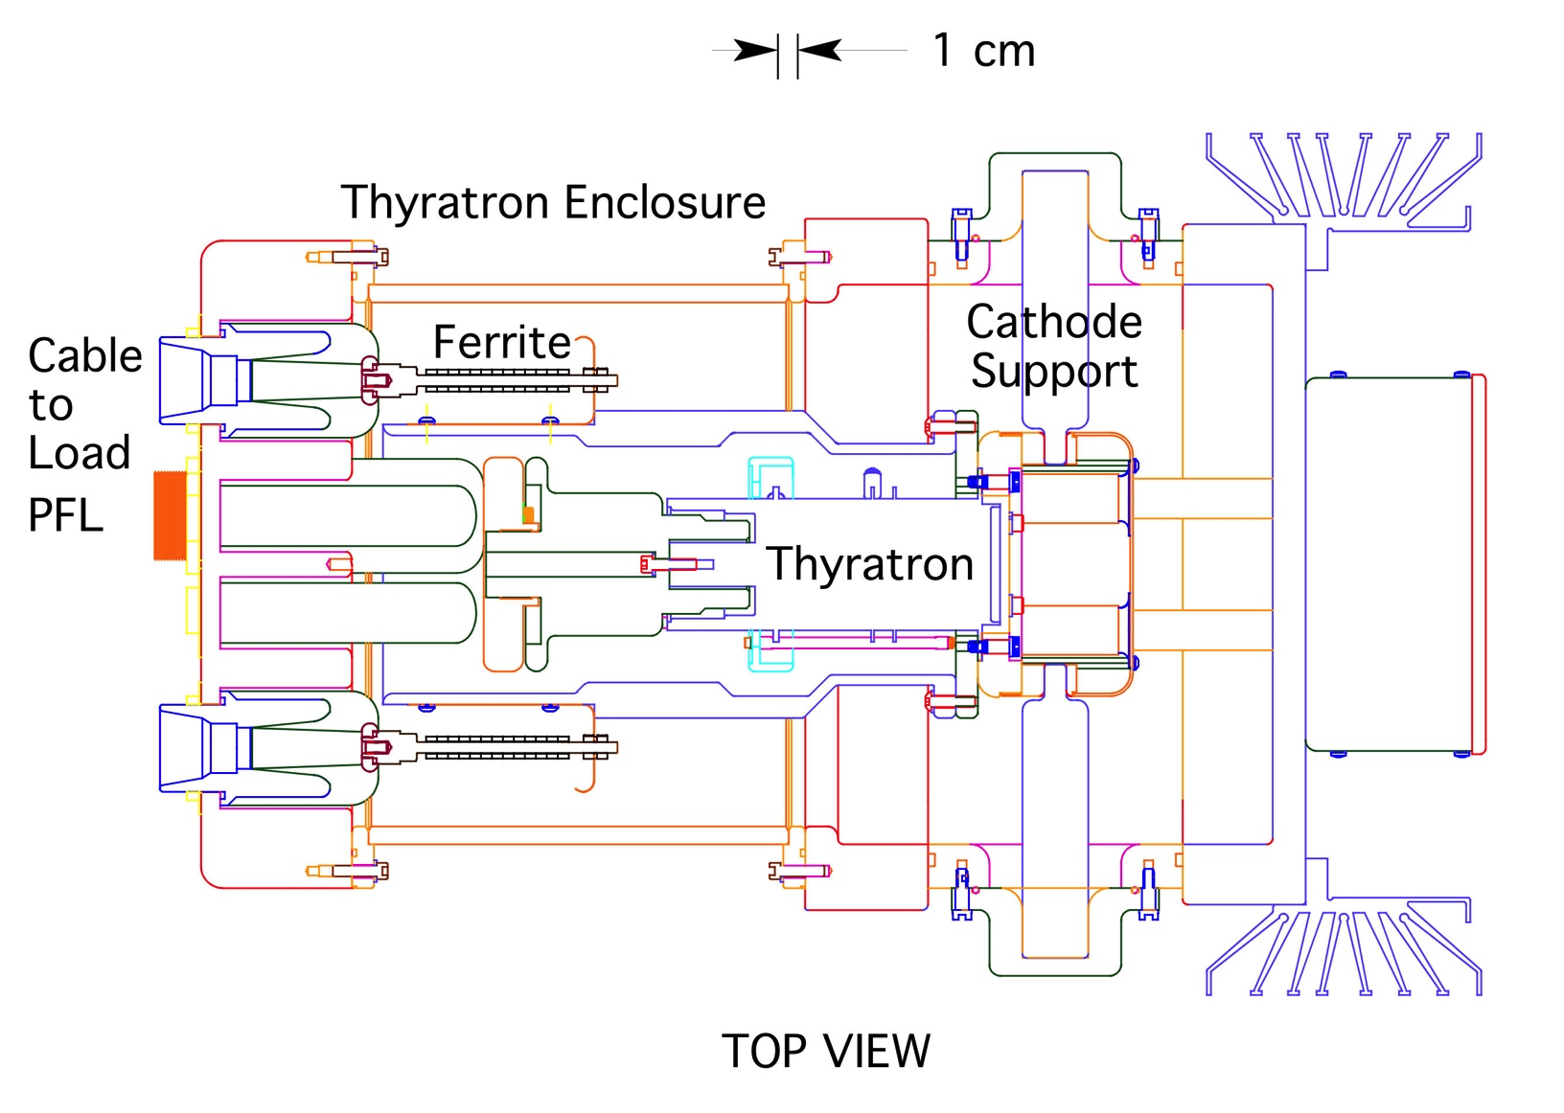
Example 2 – Saturating impedance for pulser

Slide 22
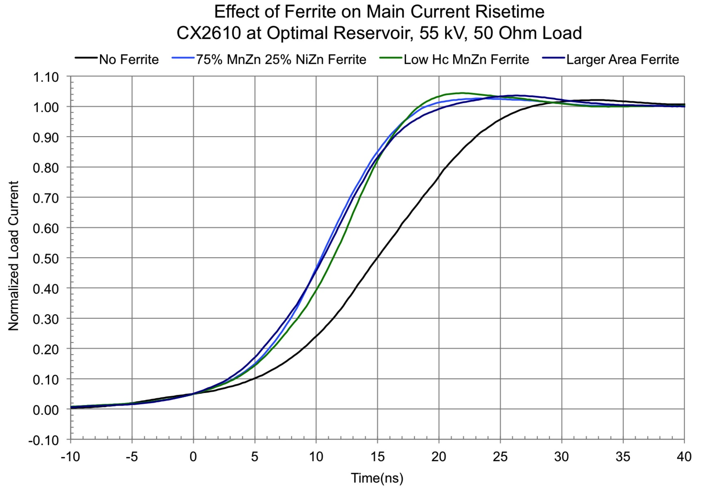
Example 2 – Saturating impedance for pulser

Slide 23
Recent Procurement Experience
Consolidation of 2 American Companies into 1
  Ceramic Magnetics bought by National Magnetics Group Inc. (Pennsylvania)
  These are only companies that make large, machined shape ferrites; other companies for small toroid's
  Lead times have been very long recently for CMD5005 and CMD10 (both NiZn kicker ferrites)
European Companies
  Ferroxcube (Poland and China), Others?
Asian Companies
  TDK, ?
  China ?

Slide 24
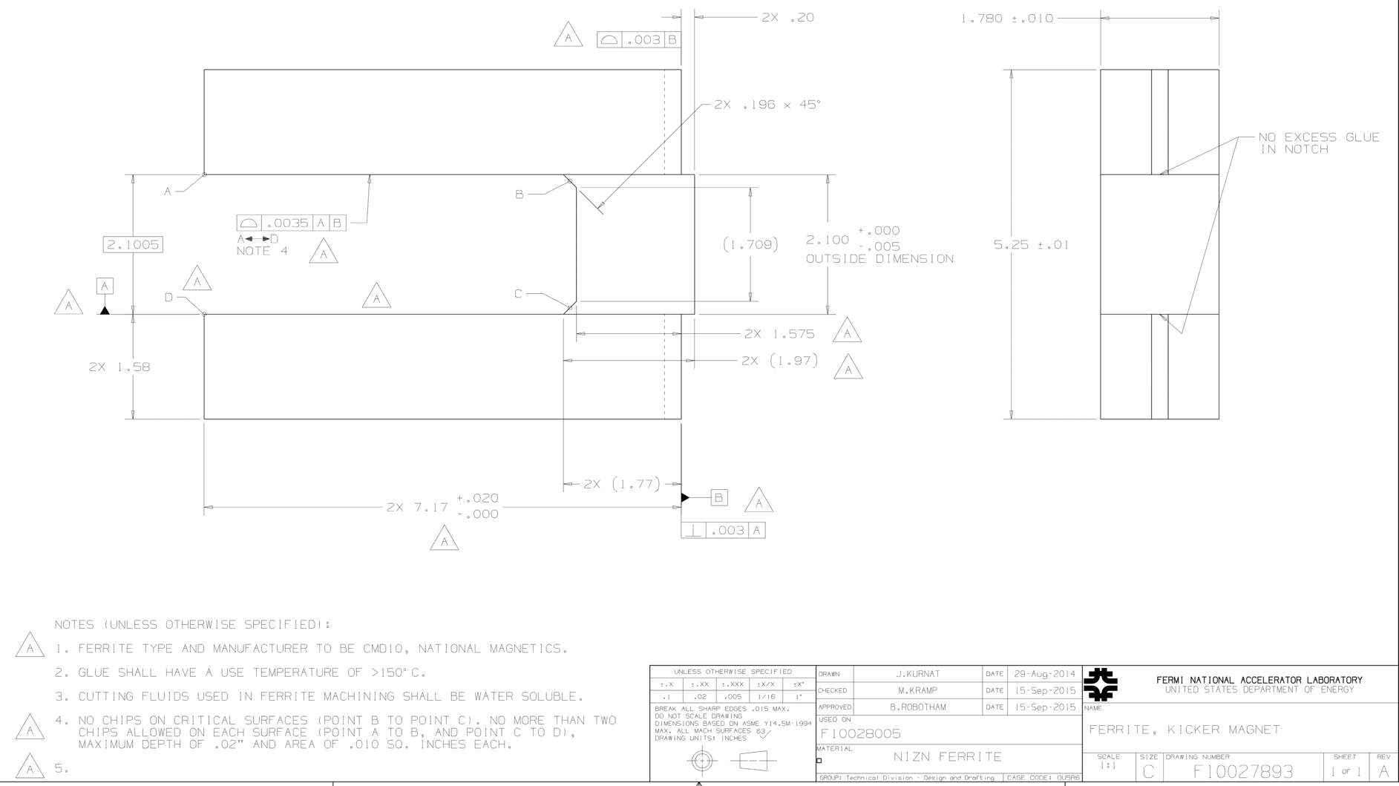
Sample 1 for kicker magnet, multiple glued pieces, CMD10
20 pieces ordered, Delivery ~ 15 months

Slide 25
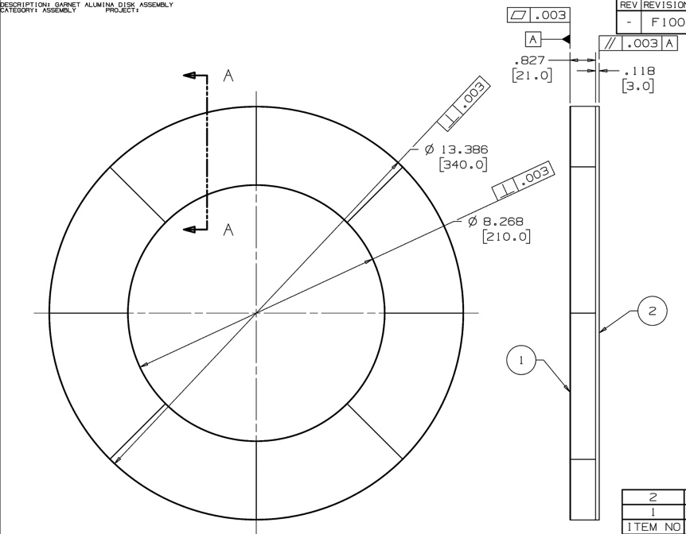
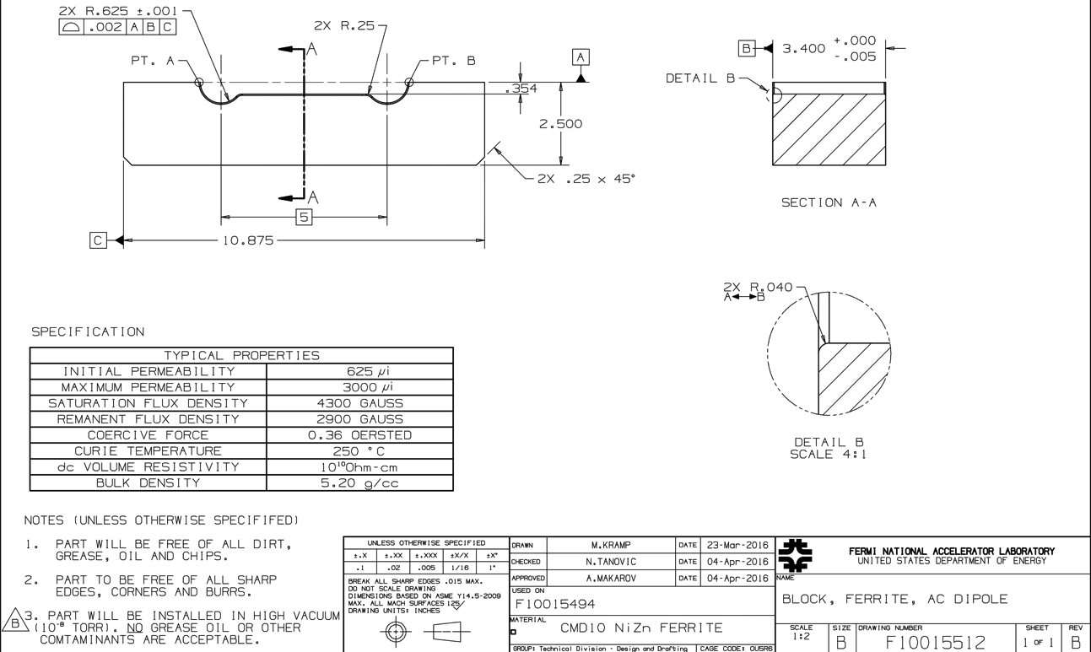
Sample 2 for RF tuner, 8 pieces glued onto alumina substrate, AL-8 garnet
5 assemblies ordered
Delivery ~ 9 months
Sample 3 for 3 MHz AC magnet, single piece machined profile, CMD10
20 pieces ordered
Delivery ~ 12 months

Slide 26
References
[1] E.C. Snelling, Soft Ferrites, Properties and Applications, 2nd Edition, 1988 Butterworth & Co
[2] J. L. Snoek, Dispersion and absorption in magnetic ferrites at frequencies above 1 Mc/s, Physica Amsterdam, Vol. 14, 1948
[3] C.C. Jensen, R. Reilly, I. Terechkine, Gap Clearing Kicker Magnet for Main Injector, PAC 2009, Vancouver, BC, Canada, pp 1729-1731
[4] C.C. Jensen, Kicker Pulsers for Recycler Nova Upgrades, IPAC 2015, Richmond VA, WEPTY027
[5] Richard M. Bozorth, Ferromagnetism, 1993 Wiley Press

