Slide 1
dE/dx USE at the CEPC TPC
2017.11.20

Slide 2
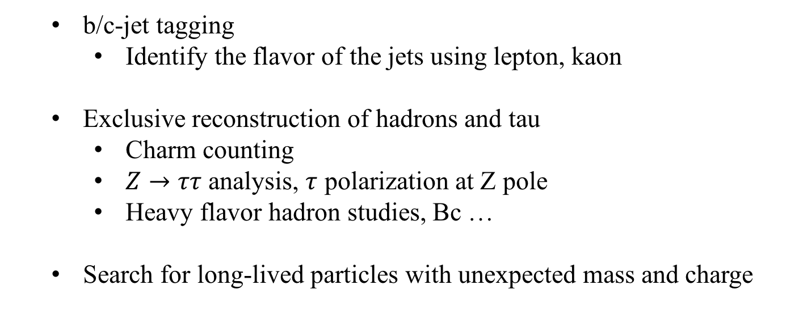
dE/dx use at Z pole
  b/c-jet tagging
    Identify the flavor of the jets using lepton, kaon
  Exclusive reconstruction of hadrons and tau
    Charm counting
    $Z→ττ$ analysis, $τ$ polarization at Z pole
    Heavy flavor hadron studies, Bc …
  Search for long-lived particles with unexpected mass and charge

Slide 3
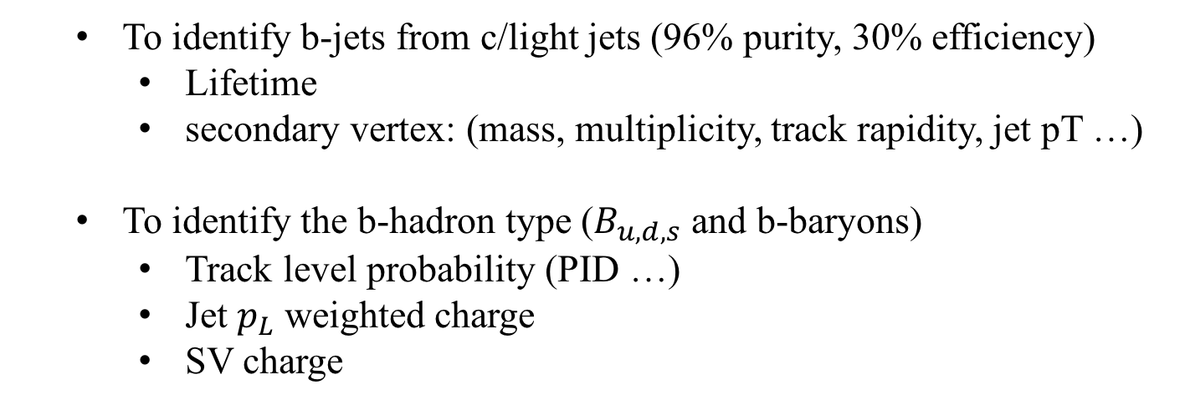
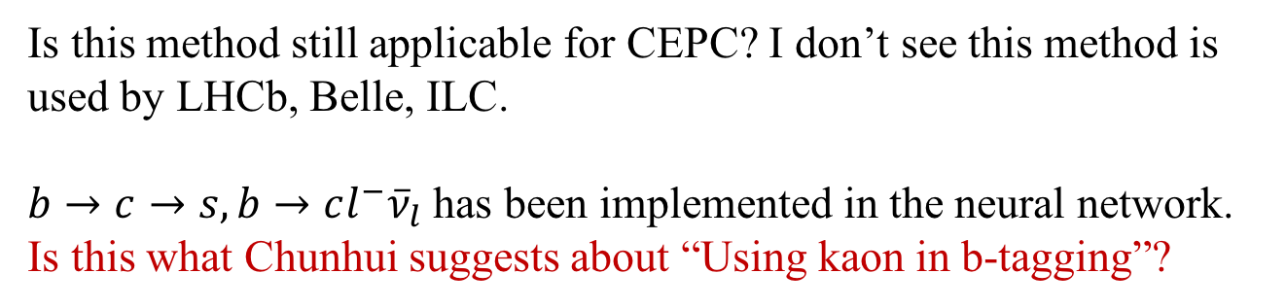
b-jets tagging (DELPHI)
Eur. Phys. J. C 40 (2005) 1
  To identify b-jets from c/light jets (96% purity, 30% efficiency)
    Lifetime
    secondary vertex: (mass, multiplicity, track rapidity, jet pT …)
  To identify the b-hadron type ($B_{u,d,s}$ and b-baryons)
    Track level probability (PID …)
    Jet $p_{L}$ weighted charge
    SV charge
Is this method still applicable for CEPC? I don’t see this method is used by LHCb, Belle, ILC.
$b→c→s, b→cl^{−}{\overline{ν}}_{l}$ has been implemented in the neural network. Is this what Chunhui suggests about “Using kaon in b-tagging”?

Slide 4
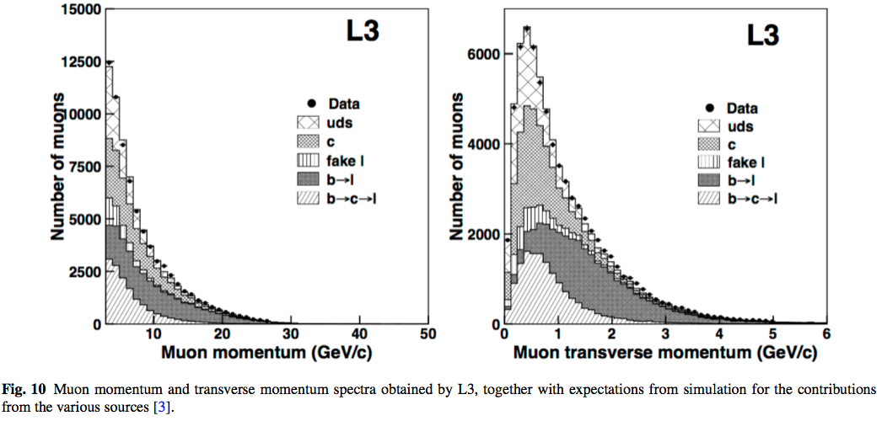
b-jets tagging using lepton
Old method simply based on lepton, no neural network
Just to show you the effect of lepton tagging

Slide 5
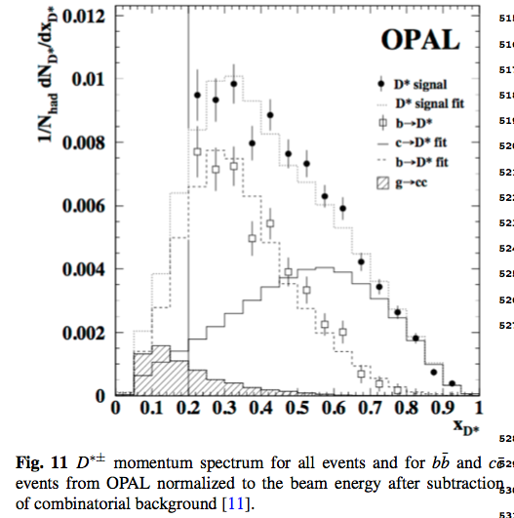
b-jets tagging using D
Eur. Phys. J. C 1 (1998) 439.
Old method simply based on D, no neural network
Just to show you the effect of PID

Slide 6
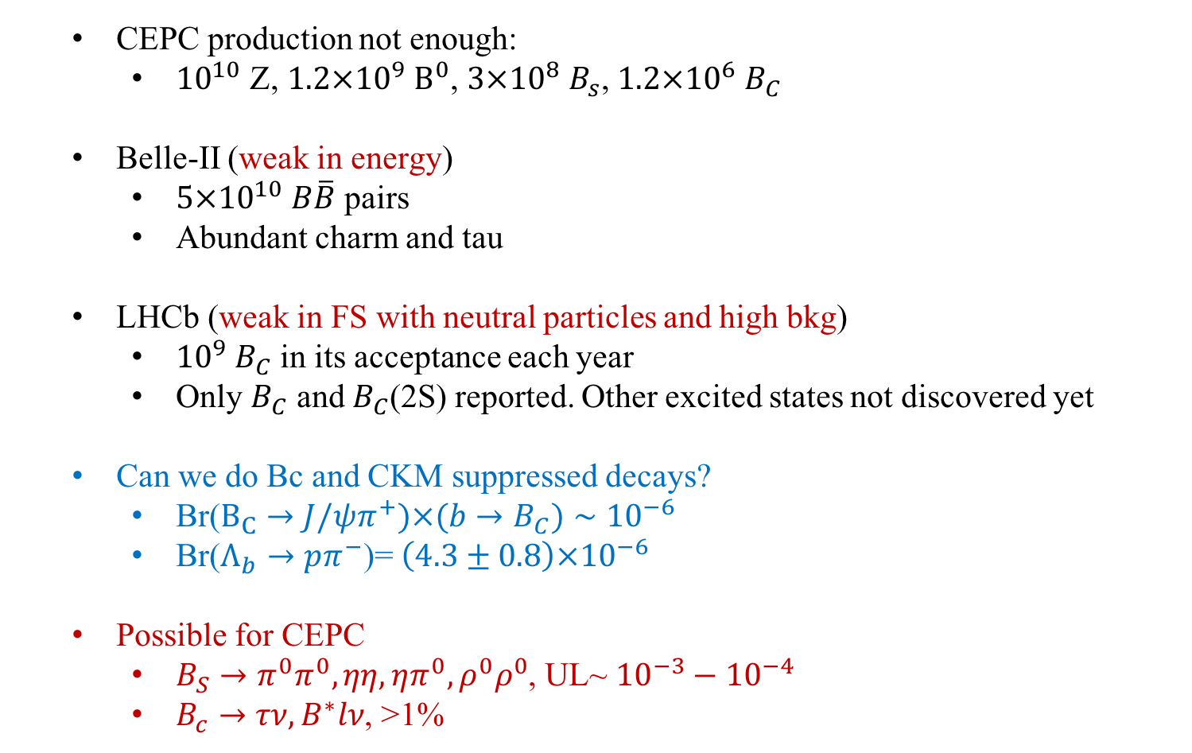
Heavy flavor hadrons
  CEPC production not enough:
    ${10}^{10}$ Z, ${1.2×10}^{9} B^{0}$, ${3×10}^{8} B_{s}$, ${1.2×10}^{6} B_{C}$
  Belle-II (weak in energy)
    ${5×10}^{10} B\overline{B}$ pairs
    Abundant charm and tau
  LHCb (weak in FS with neutral particles and high bkg)
    ${10}^{9} B_{C}$ in its acceptance each year
    Only $B_{C}$ and $B_{C}$(2S) reported. Other excited states not discovered yet
  Can we do Bc and CKM suppressed decays?
    Br($B_{C}→J/ψπ^{+})×(b→B_{C})∼{10}^{−6}$
    Br($Λ_{b}→pπ^{−}$)= ${\left(4.3±0.8\right)×10}^{−6}$
  Possible for CEPC
    $B_{S}→π^{0}π^{0}, ηη,ηπ^{0},ρ^{0}ρ^{0}$, UL~ ${10}^{−3}−{10}^{−4}$
    $B_{c}→τν, B^{∗}lν$, >1%

Slide 7
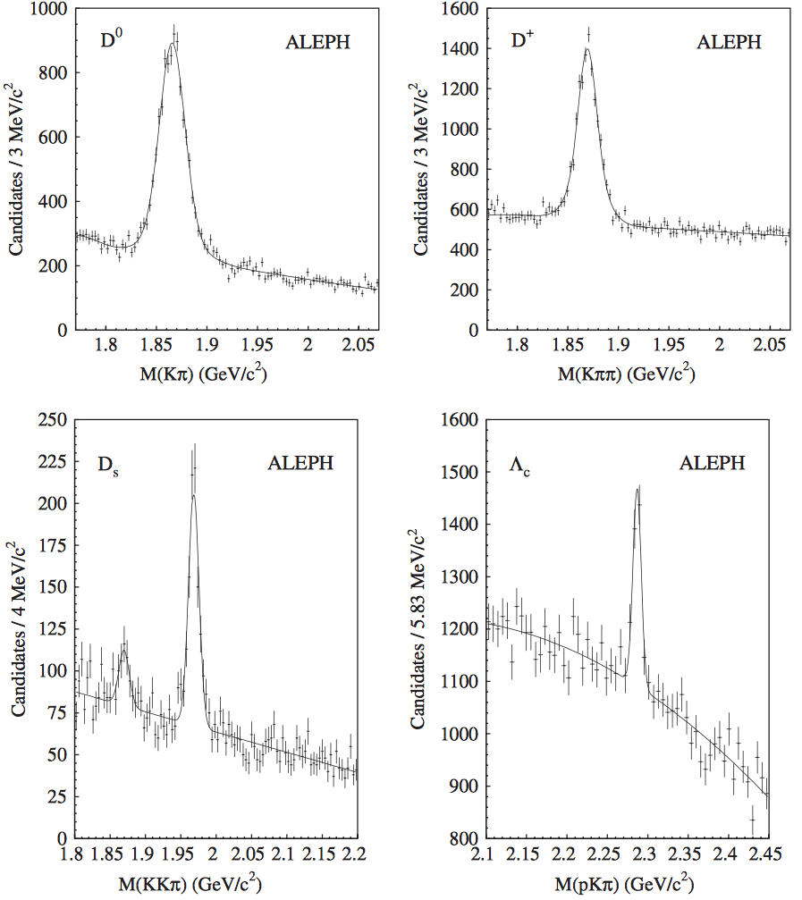
Charm counting
  D meson decays have low multiplicity and good BR. Show good peaks in LEP and ALICE
Eur. Phys. J. C 16 (2000) 597–611

Slide 8
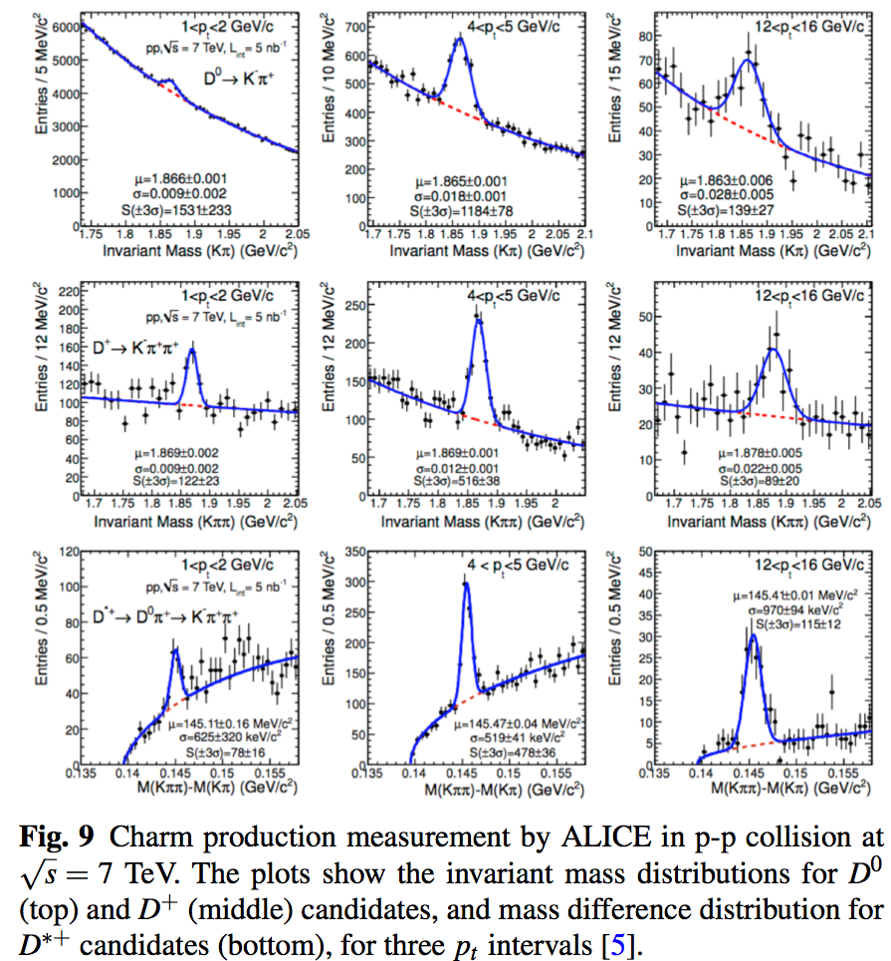
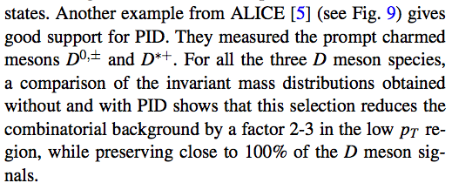
Charm counting at ALICE

Slide 9
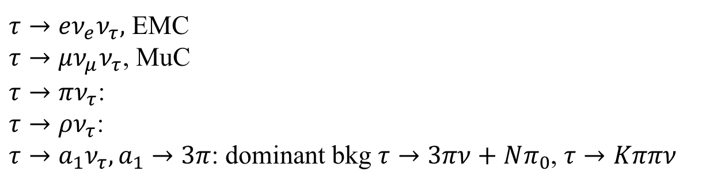
Tau reconstruction
Eur.Phys.J.C21 (2001) 1
$τ→eν_{e}ν_{τ},$ EMC
$τ→μν_{μ}ν_{τ}$, MuC
$τ→πν_{τ}$:
$τ→ρν_{τ}$:
$τ→a_{1}ν_{τ}, a_{1}→3π$: dominant bkg $τ→3πν+Nπ_{0}$, $τ→Kππν$
Not very sure the dE/dx use, should be helpful to suppress bkg to a1 channel

Slide 10
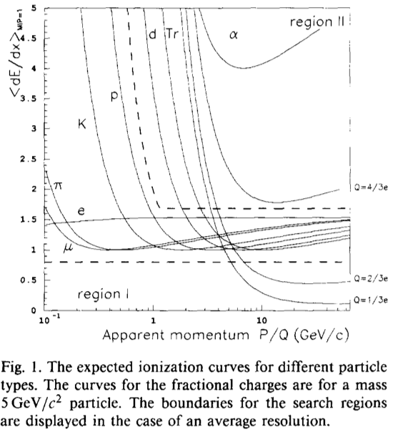
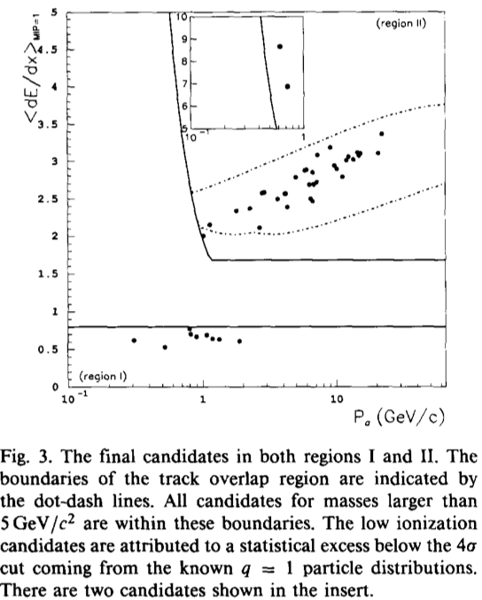
Quarks and massive particles
Phys. Lett. B 303 (1993) 198

Slide 11
Quarks and massive particles
In searched based on dE/dx, usually dE/dx resolution is not the bottle-neck.
It relates to sample size, and momentum resolution, two track separation ability.
A BRIEF REVIEW OF THE SEARCH FOR ISOLATABLE FRACTIONAL CHARGE ELEMENTARY PARTICLES (Modern Physics Letters A, Vol. 19, No. 35 (2004) 2595–2610)
Search for stable and long-lived massive charged particles in e⁺e⁻ collisions at 130-209 GeV (Phys. Lett. B 572 (2003) 8)

Slide 12
Question & Discussion
  Use kaon to tag b-jets, is that the same with DELPHI?
  In the paper, I think I should make all the bands with 25%-50% deterioration.
  From DELPHI’s experience, should we add a RICH counter?
  The efficiency loss of TOF caused by nuclear effects is negligible (>20%). Especially for K/p separation.

Slide 13
Detected

Slide 14
Backup

Slide 15
Detected

Slide 16
Detected

Slide 17
Detected

Slide 18
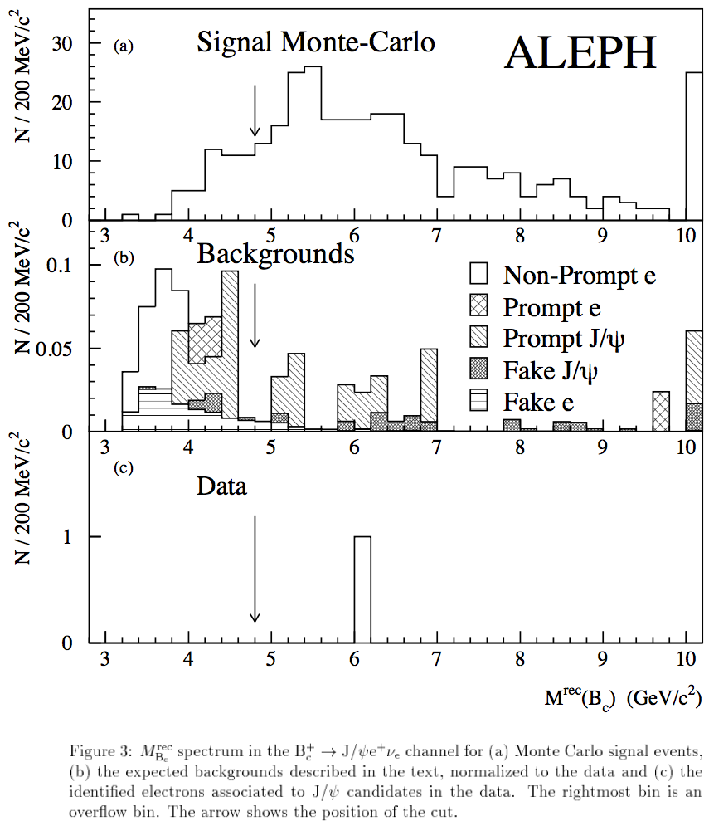
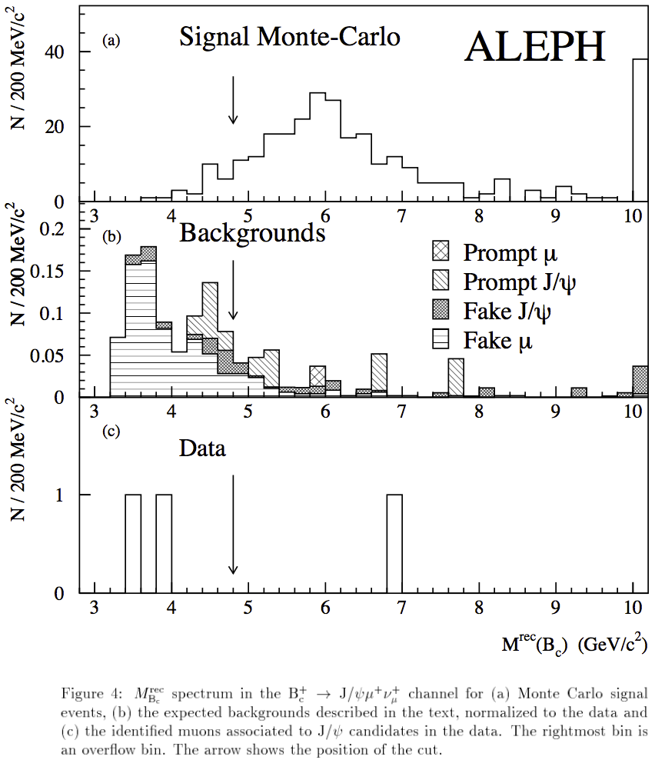
Bc search at ALEPH

Slide 19
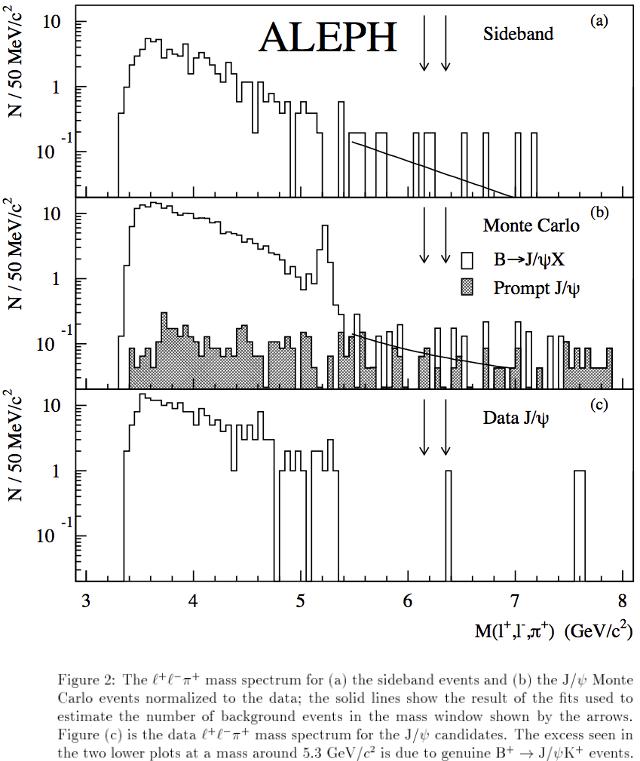
Bc search at ALEPH

