Slide 1
A “Toroidal Magnet” Superconducting Gantry Design
L. Bottura⁽¹⁾, E. Felcini^{(1,2)}, B, Dutoit⁽²⁾,
G, De Rijk⁽¹⁾, J. Van Nugteren⁽¹⁾, G. Kirby⁽¹⁾
Ions 2018, ESI Archamps, 19-21 June 2018
(1) CERN
(2) EPFL

Slide 2
Outline
Issues and opportunity
Development of an idea
Some outstanding issues
Development plan
Conclusions

Slide 3
Issues and opportunity
Hadron therapy gantries are massive, because of:
  Required integral bending field, limited by the performance of resistive electromagnets
  Stability requirements during rotation
Basic idea:
  Use superconductors to increase the bending field in large bore magnets (acceptance)
    More compact magnets, weight reduction, energy efficiency
  Devise a magnetic configuration which does not need to be rotated to focus on the patient
    Reduce the stability requirements on the gantry, hence mass and footprint

Slide 4
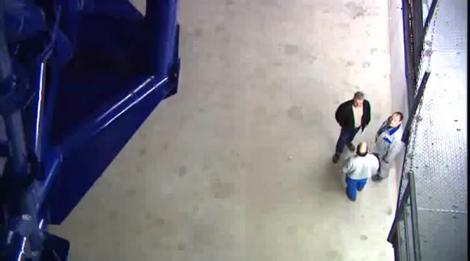
Heidelberg Ion-Beam Therapy (HIT) centre
Length = 25 m
Diameter = 13 m
Weight = 670 tons

Slide 5
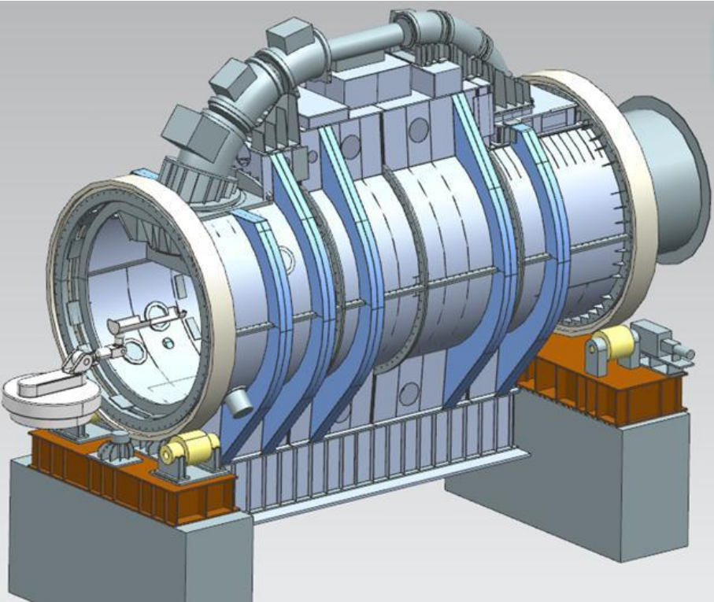
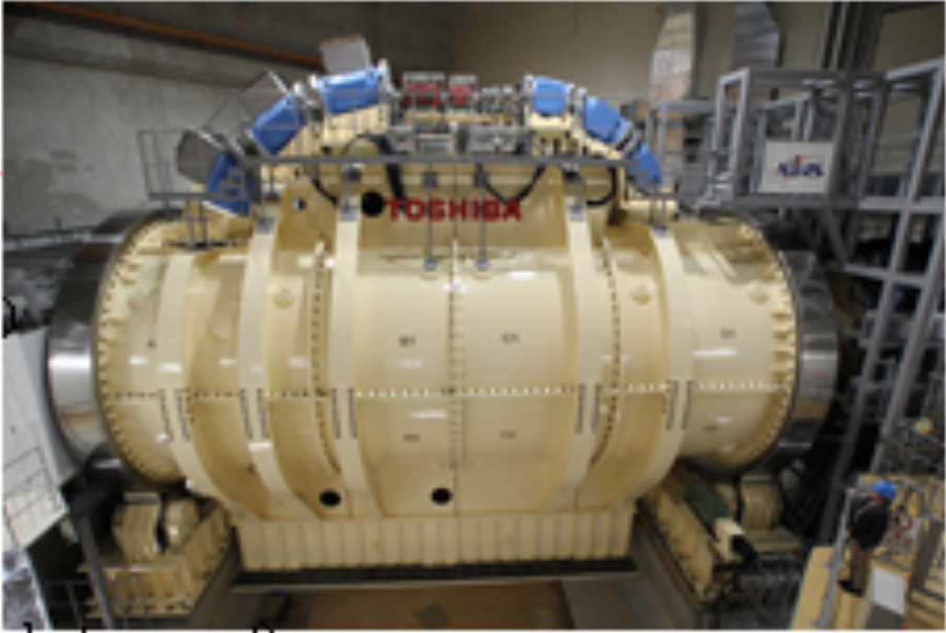
Chiba (NIRS)
Length = 13 m
Diameter = 10 m
Weight = 350 tons

Slide 6
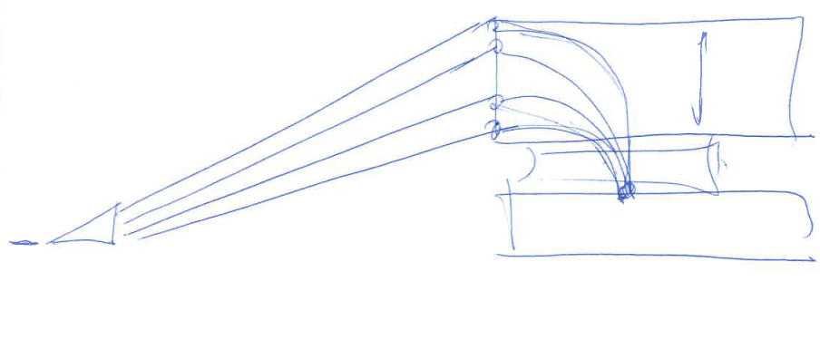
The idea
Large acceptance superconducting magnet with toroidal periodicity operated in steady-state
E
Beams of different energy
Accelerator beam delivery
Patient location
Vector magnet
L. Bottura, A Gantry and Apparatus for Focussing Beams of Charged Particles, European Patent Application EP 18173426.0, May 2018

Slide 7

Ideal coil profile
(R_{p},z_{p})
B = B₀
B = 0
α_{E}
ρ_{E}
R_{in}
α_{E}
R
z
(0,-z_{V})
(0,0)

Slide 8
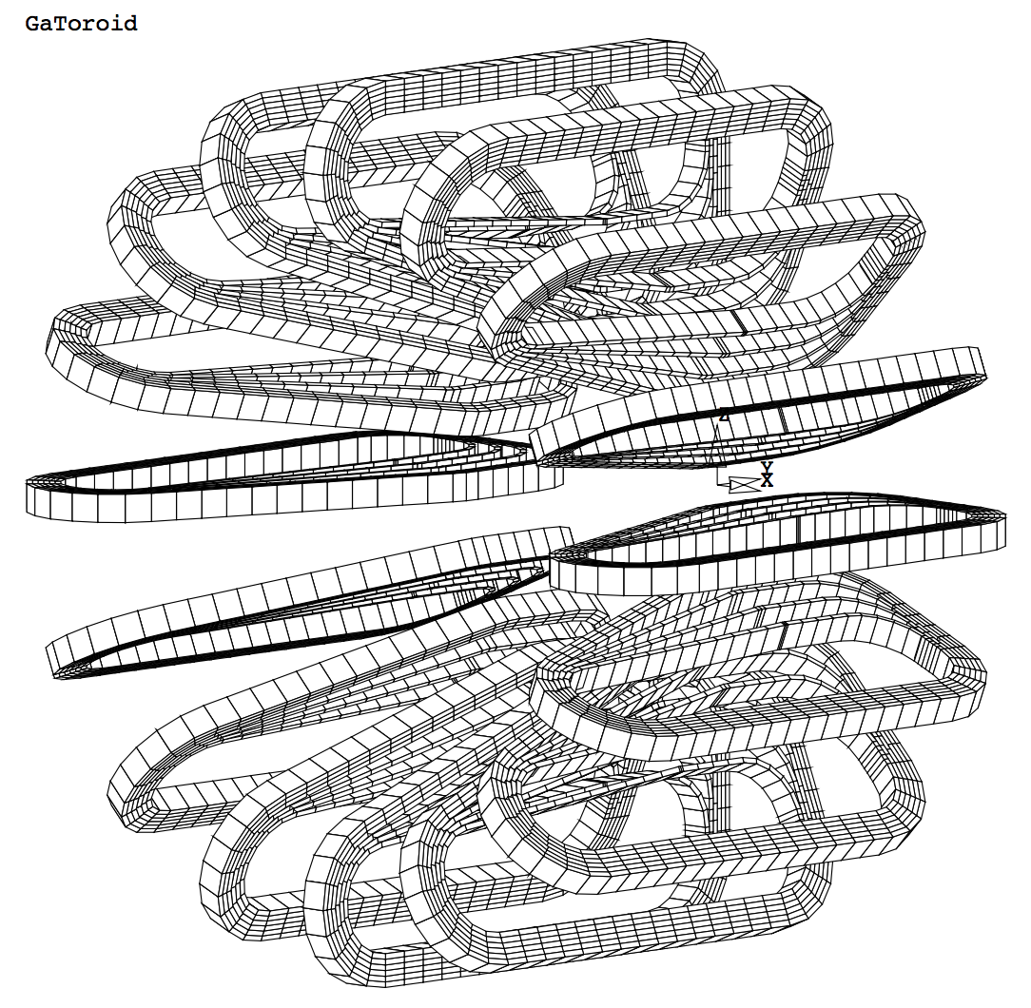
A first concept
Beam
Patient
Vector magnet
Toroidal gantry

Slide 9
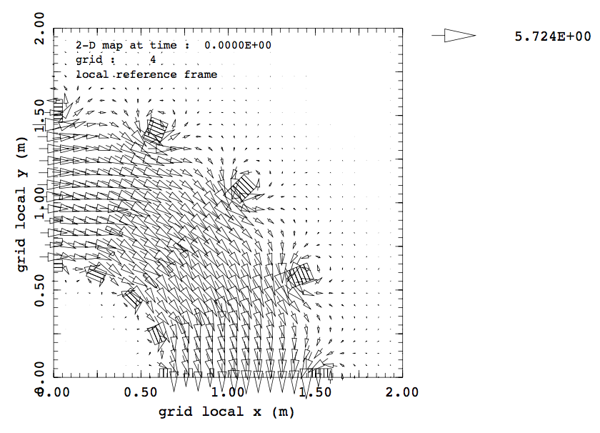
Toroidal field
Field module (T)
beam
force
The field at the outboard legs is curved and has an additional focussing component that adds to the natural quadrupole

Slide 10
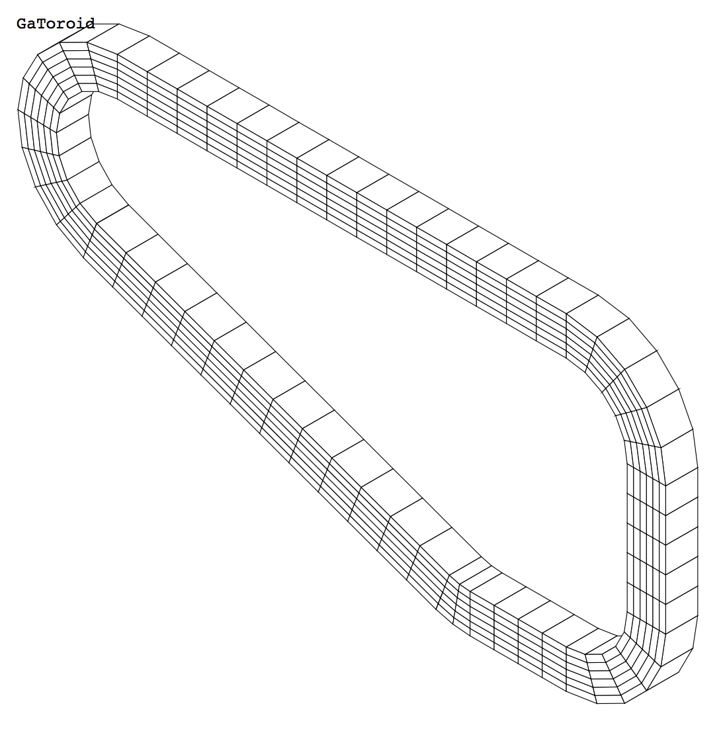
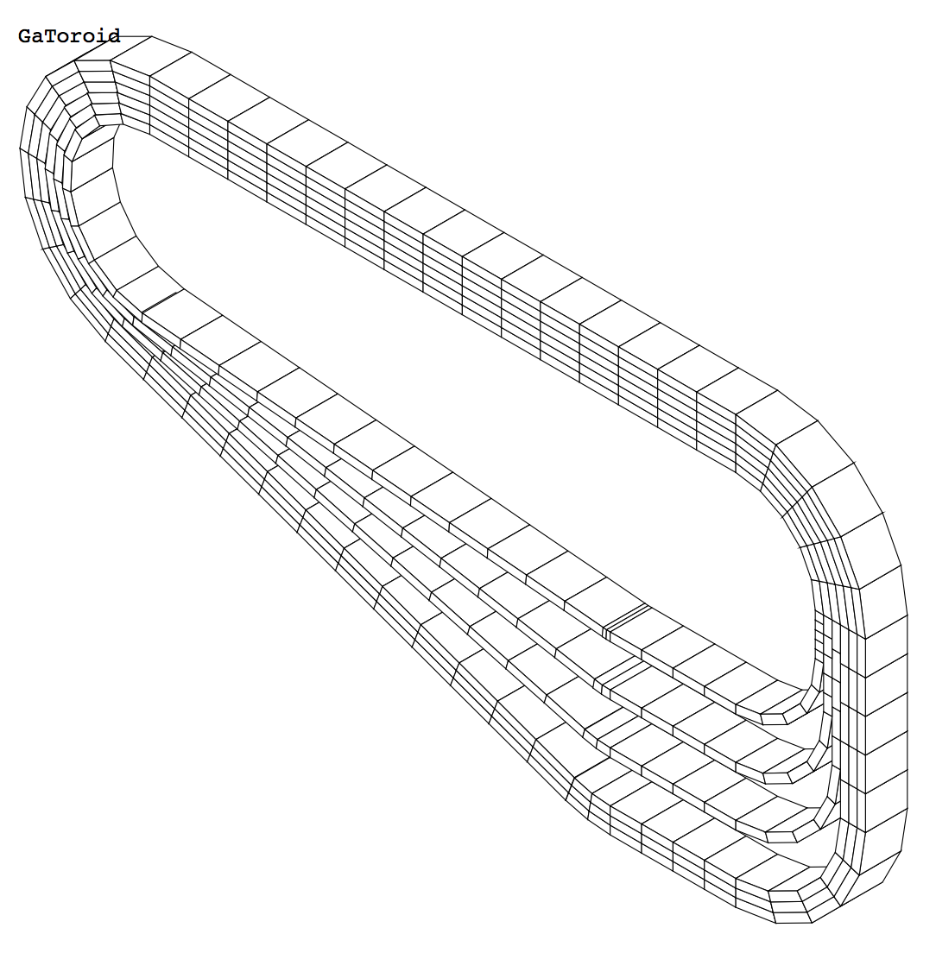
Graded coil design
Simple coil winding (no grading)
The field profile has a 1/R dependence
Graded coil winding with spaced inboard leg
The field profile can be modified to a 1/R^{n} dependence where n is the field index

Slide 11
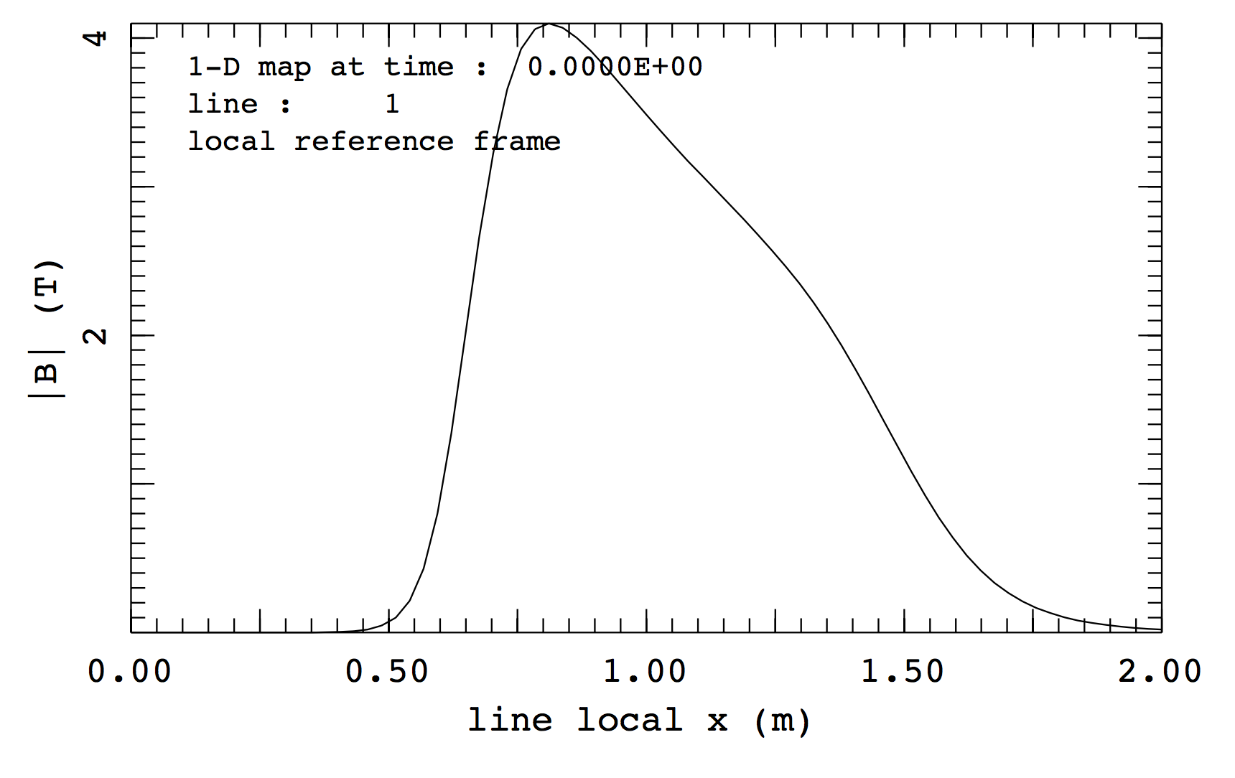
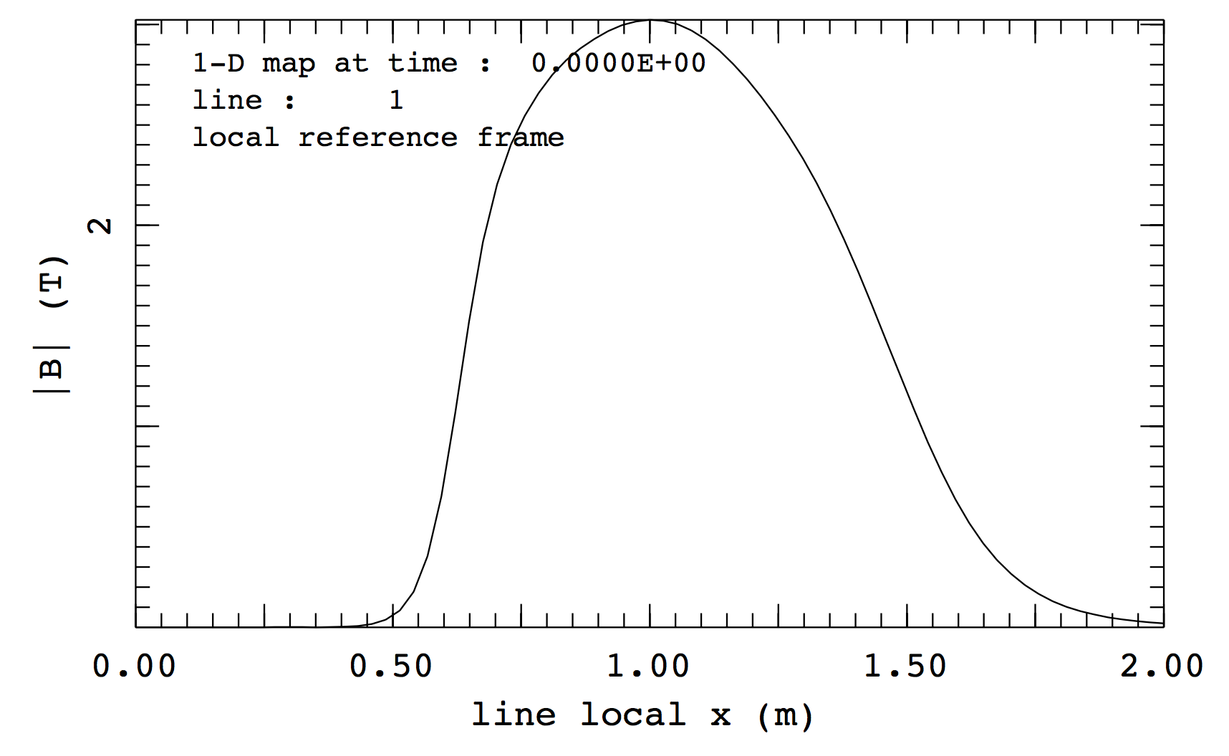
Effect of grading
Field profile on a line originating at the patient location and oriented radially outwards
x
x
The natural 1/R dependence of the field is much reduced in the case of simple grading
Further optimization possible by more refined geometry (geometric grading) and variation in the current density (current grading)

Slide 12
A couple of considerations – 1/3
The gantry operates in steady state, hence the speed of delivery only depends on the accelerator delivery rate (!?!)
X-Y kicker with fast switching capability to accommodate for direction and energy change
Beam
Patient
Vector magnet
Toroidal gantry

Slide 13
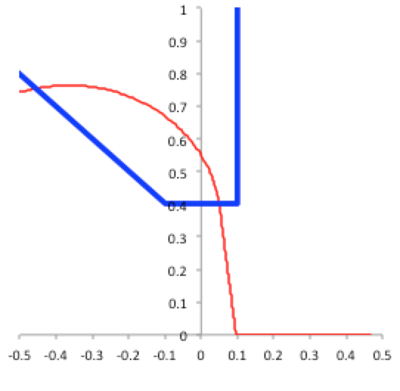
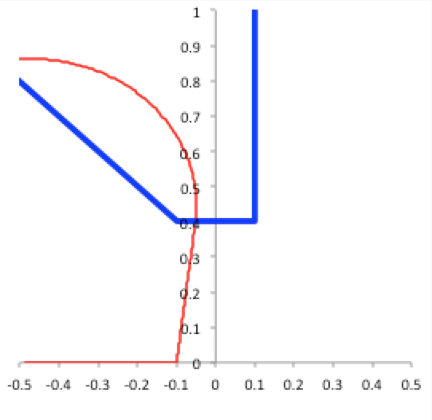
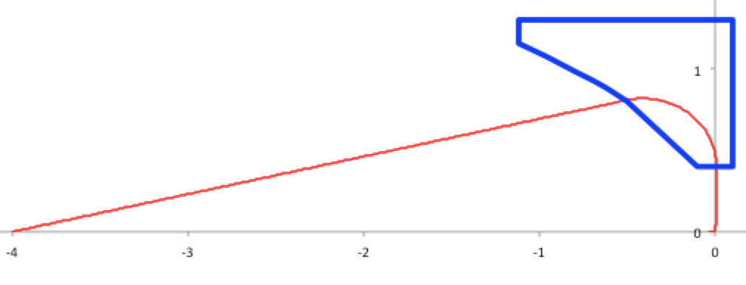
A couple of considerations – 2/3
Sagittal painting is feasible by making use of different kick angles at the vector magnet
70 MeV
13 deg
12 deg
13.9 deg
±10 cm

Slide 14
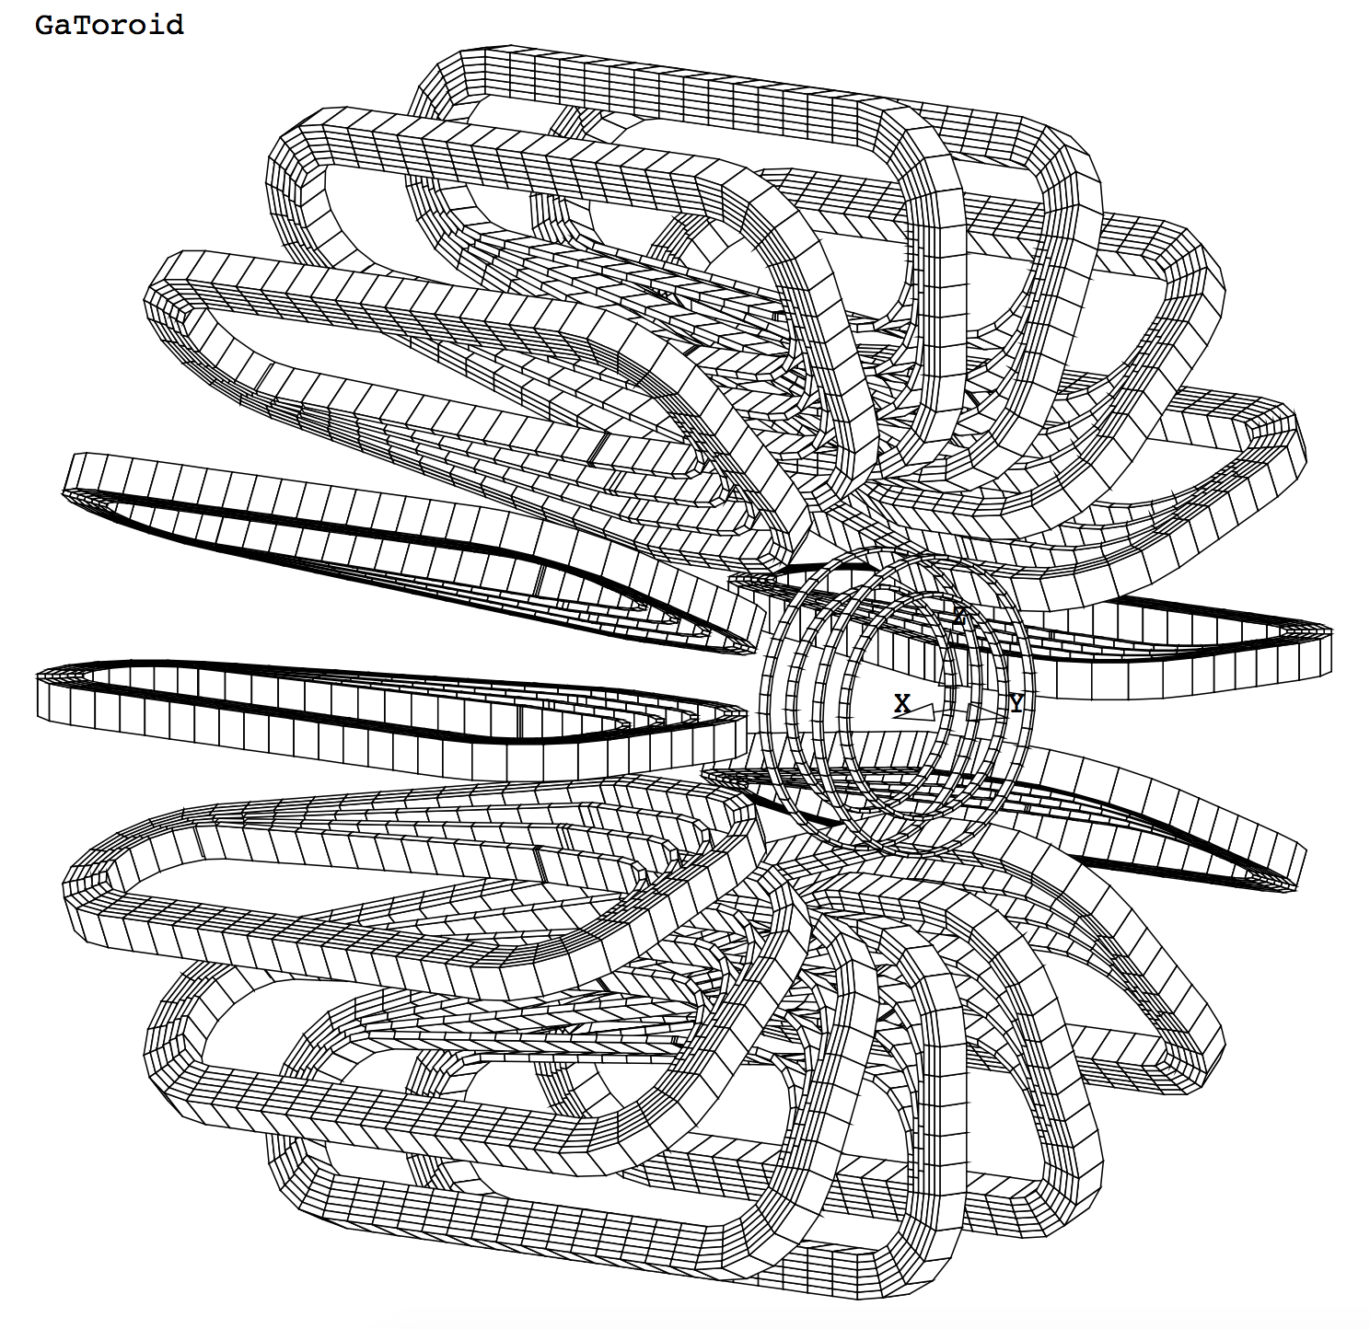
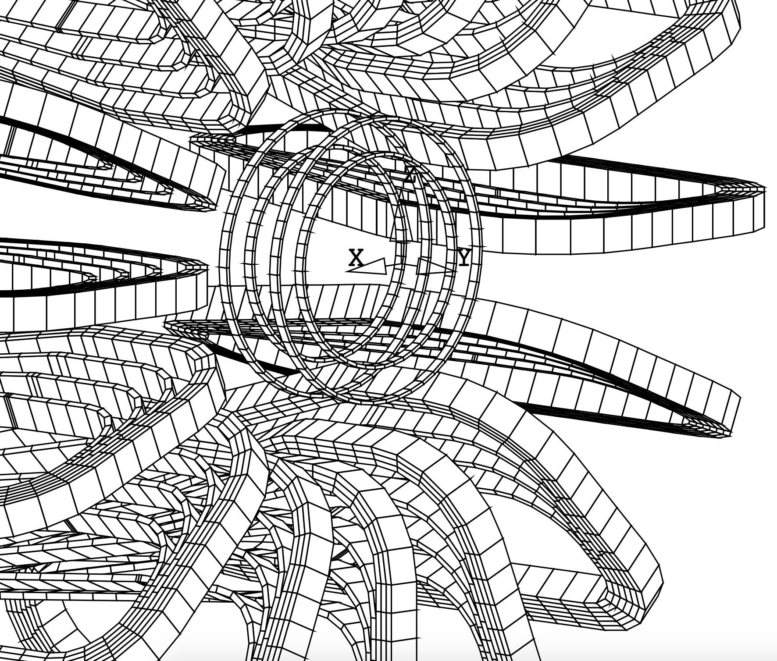
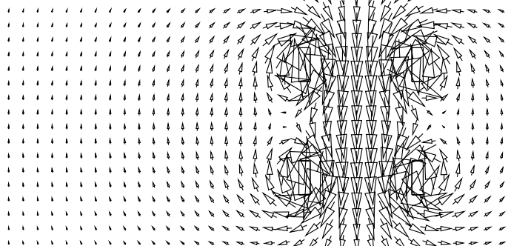
A couple of considerations – 3/3
Transverse painting is possibly done by a similar mechanism (off-plane trajectory) and/or a solenoid corrector in the bore
B
Additional steerer “solenoid” in the free bore of the toroid
Looks like an “MRI in the bore” ?

Slide 15
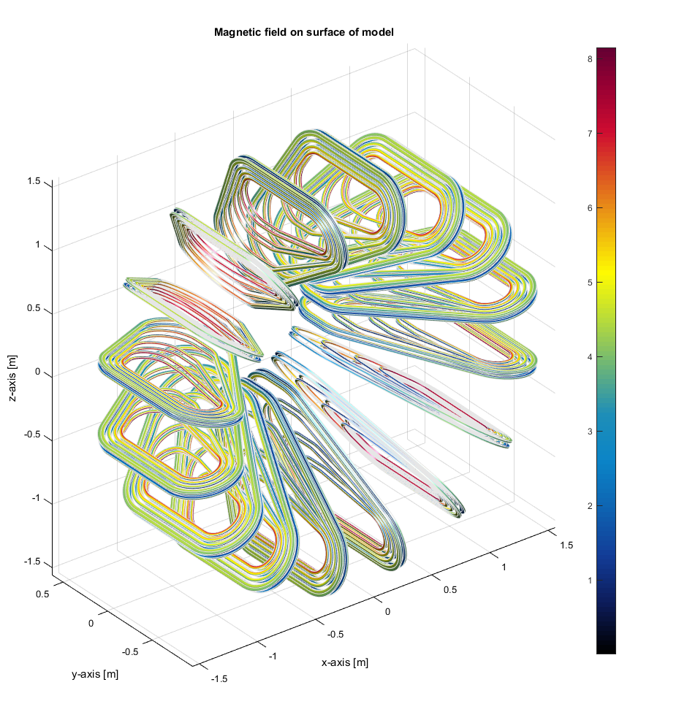

Design of a proton gantry
Number of coils: 16
Peak Field on coil: 8 T
Operating Temperature: 20 K (cryo-cooled)
Operating current: 620 A
Je = 520 A/mm2
Coil Inductance: 9.6 H
Total Stored energy: 30 MJ
(LHC dipole ~ 7 MJ)
Coil dimension: ~1.5 x 1 m
Torus dimensions: ~1.5 x 3 m
Estimated mass: 12 tons

Slide 16
Single particle tracking
250 MeV
70 MeV
Excellent acceptance and iso-centric properties

Slide 17
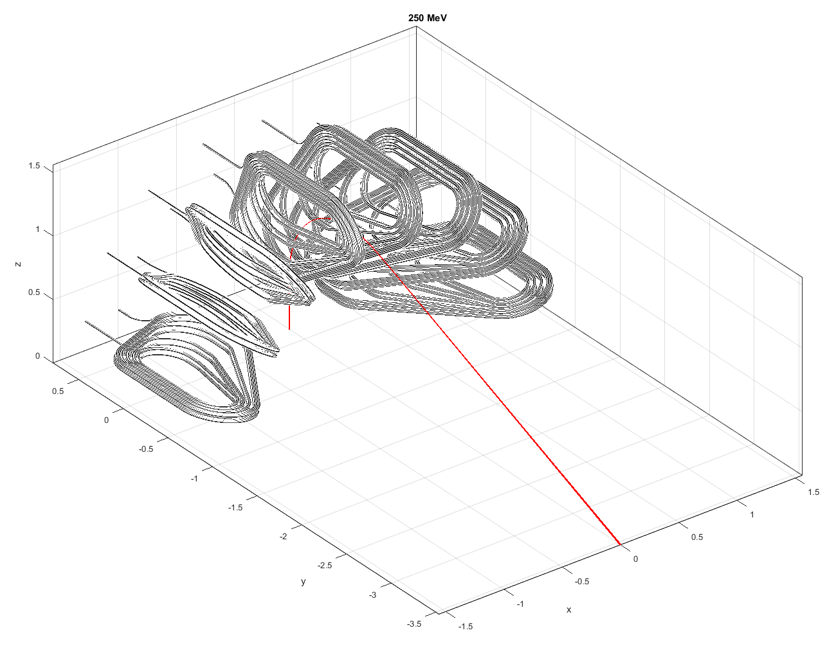
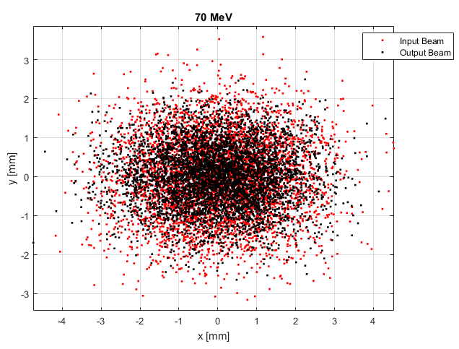
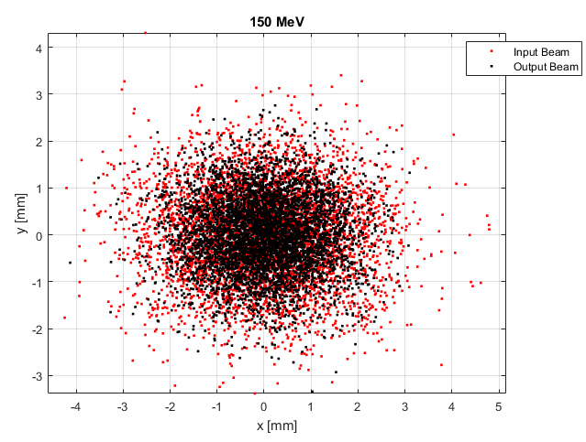
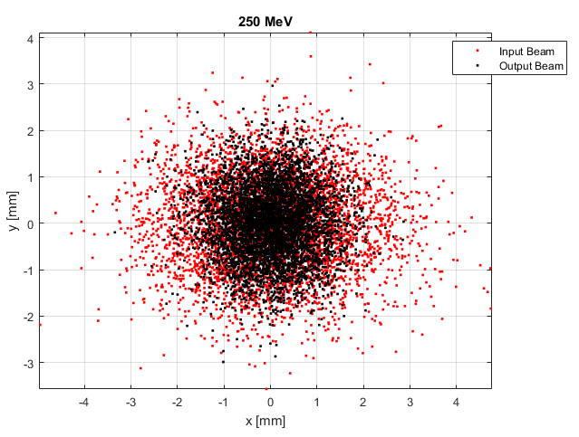
Beam tracking
70 MeV
150 MeV
250 MeV
Work in progress, but at first sight quite OK ?!?

Slide 18
Proof of principle of “painting”
±60 mm
±50 mm
Sagittal: ±60 mm with ±1 deg kick
Transverse: ±50 mm with ±0.3 deg kick

Slide 19
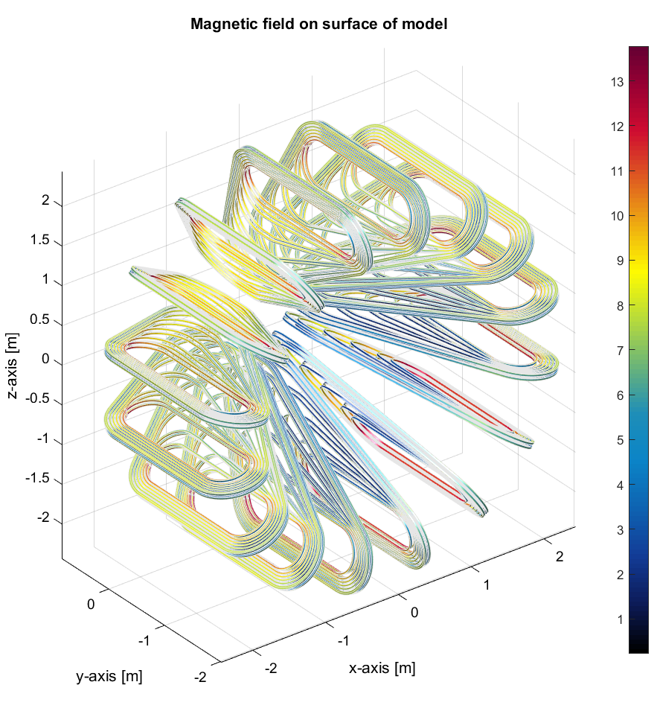
Design of a ion gantry
Number of coils: 16
Peak Field on coil: 13.8 T
Operating Temperature: 10 K (cryo-cooled)
Operating current: 620 A
Je = 520 A/mm2
Coil Inductance: 29 H
Total Stored energy: 370 MJ
Coil dimension: ~3 x 2 m
Torus dimensions: ~3 x 5 m
Estimated mass: ~50 tons (TBD)

Slide 20
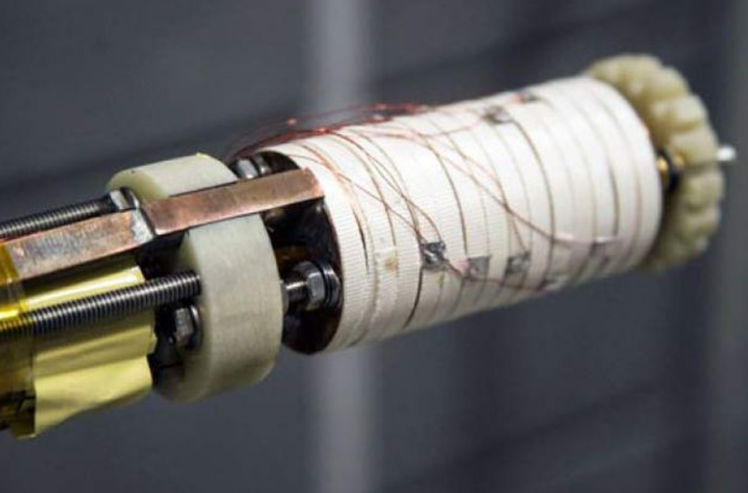
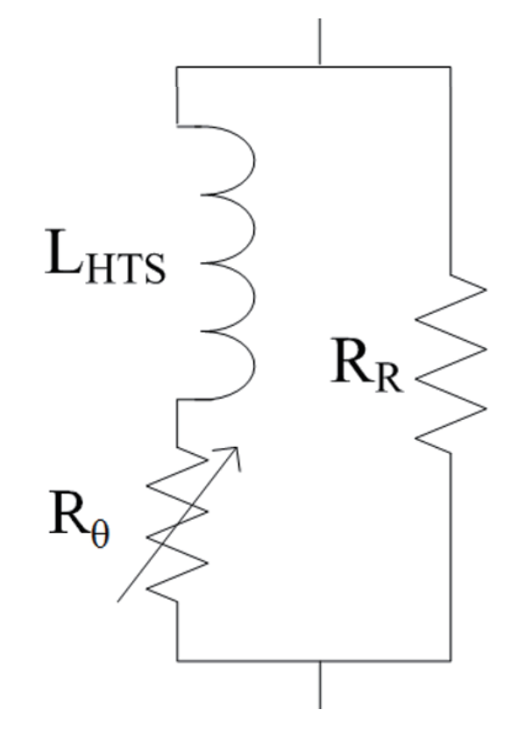
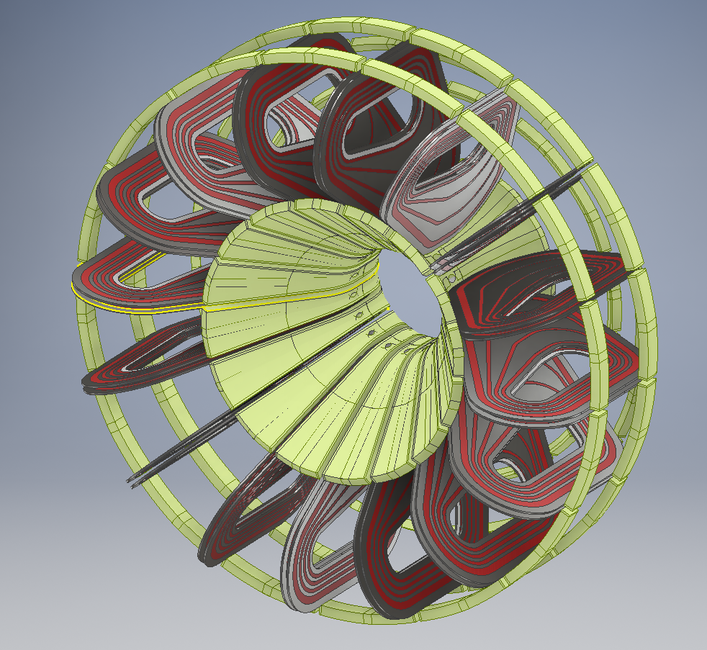
Some issues…
Quench protection
  Non-insulated or metal-insulated winding
Field quality and dynamics, and its relation to beam physics
  Beam transfer matrix and matching to accelerator
Mechanics and fabrication
  Coil structure, forces and stress
  Winding technology, joints
Thermal engineering
  Cooling technology
Material cost (HTS)
Qualification for therapy
…
NHMFL, 40.2 T, ≈1000 A/mm²

Slide 21
Development plan
Year 1
  Gantry conceptual design
  Beam transmission analysis and transfer matrix/matching
  Mechanical studies and demonstrator design
Year 2
  Protection, powering, cooling design
  Winding and assembly procedure, procurement of parts and tooling, tests
Year 3:
  Winding and test of HTS demonstrator
  Final evaluation and preliminary design of gantry system
CERN-KT supported effort taking place in TE department
1 fully financed PhD dedicated to this work (three cheers for Enrico)

Slide 22
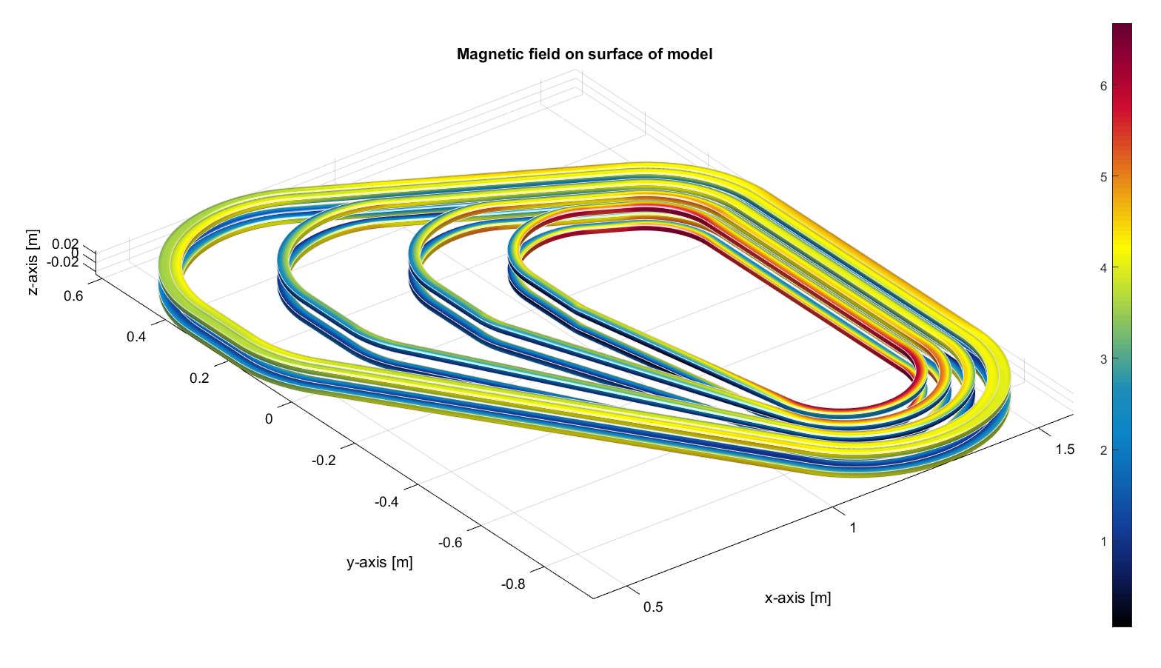
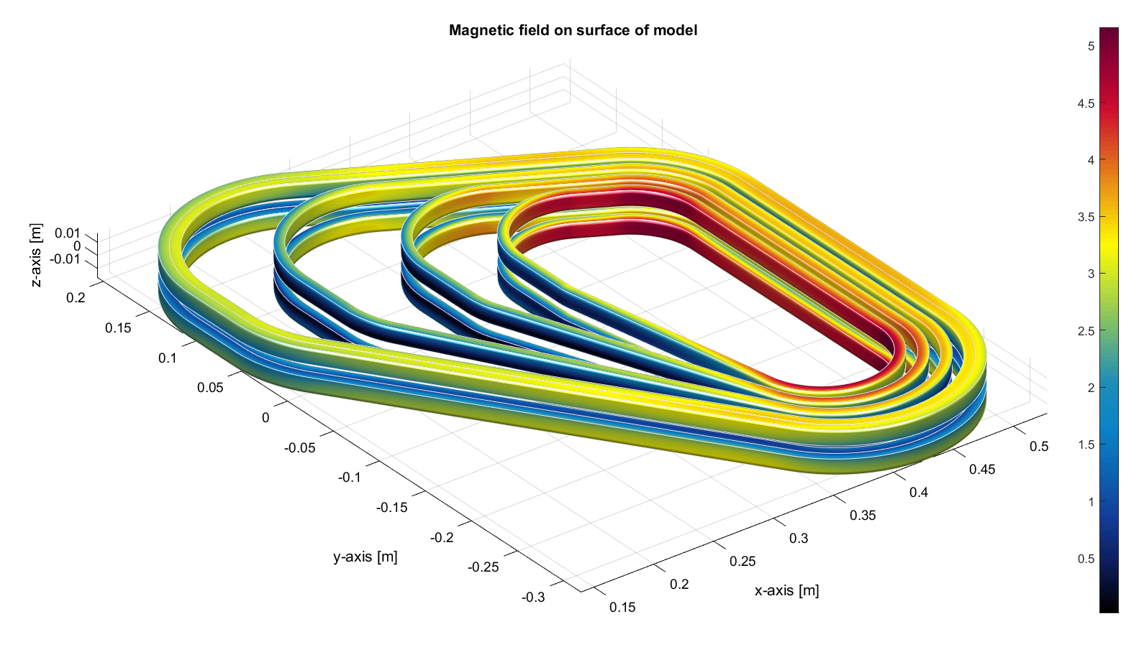
Demonstrator
Magnet performance
Quench protection
Field quality
Coil manufacturing
Full-size coil (p-gantry)
Scaled model

Slide 23
Conclusions
This idea has a touch of insanity, but…
… if it works it could result in a quantum step towards compact gantries and ease wide-spread application of hadron therapy:
  Single room facility (as for an MRI magnet !)
  Low consumption, steady operation, fast switching of energy and direction
We are looking forward to feedback from the design and prototyping work, as well as experts (we are the “rookies” in this room…)

Slide 25
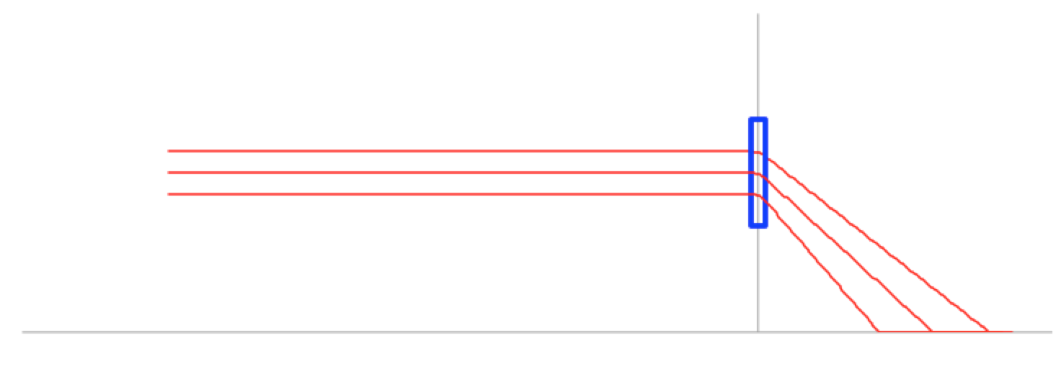
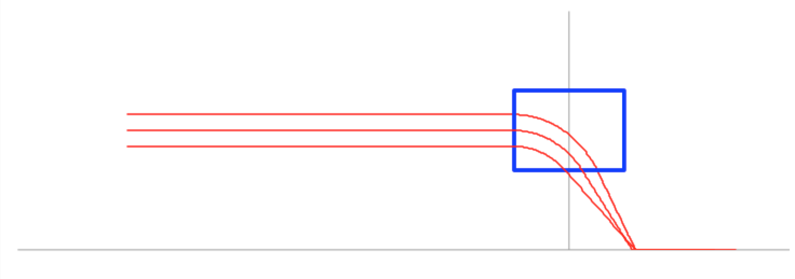
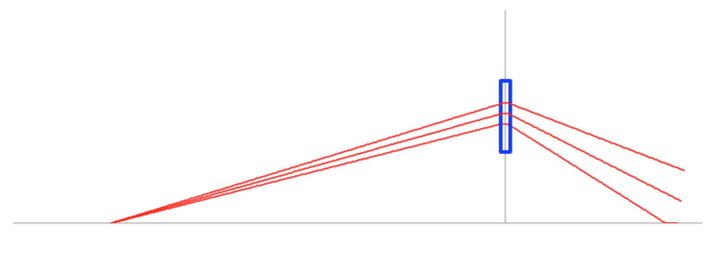
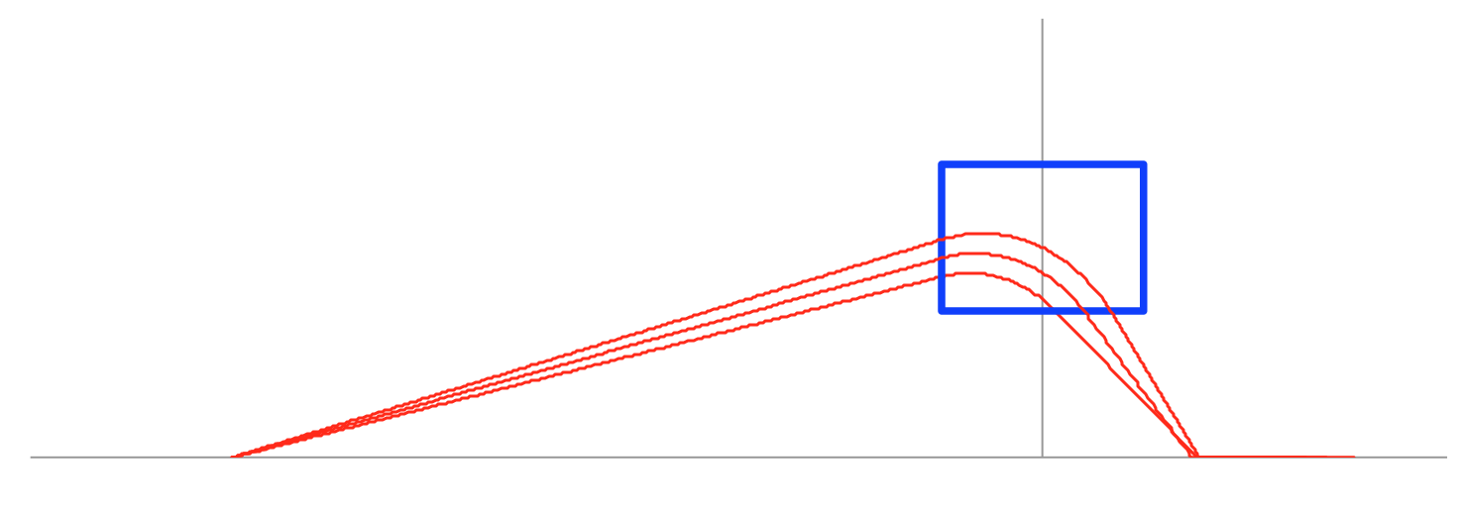
Focusing effect of a toroidal field
Parallel beam
Divergent beam
Thin lens
Thick lens

Slide 26
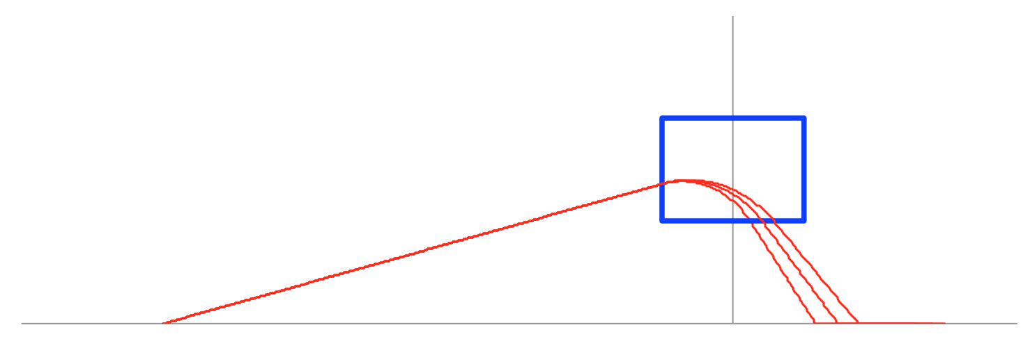
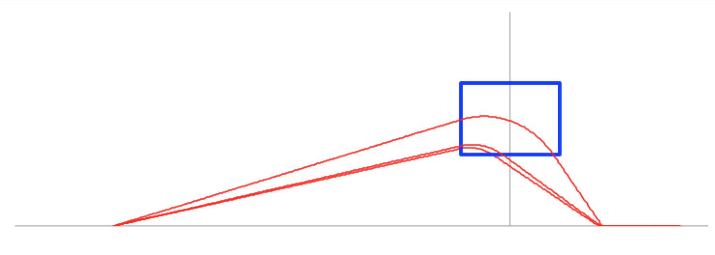
Focusing effect of a toroidal field
Beams of different p/q
Beams of different p/q originating at the same vertex and with identical angle are focused on different spots
It is possible to focus the beams on the same spot by choosing appropriately the initial angle of the beam

Slide 27
Focusing effect of a toroidal field
Particles traveling out of the (R,z) plane
y
B_{θ}
θ
x
Out-of-planes beam originating at the vertex with an angle θ with respect to the (R,z) plane experience a focusing field given by:

