Slide 1
BA6 Crab cavity test-stand
YETS sequencing
EDMS 1843665
SPS crab-cavity test stand activities in YETS2017-2018
Giovanna Vandoni

Slide 2
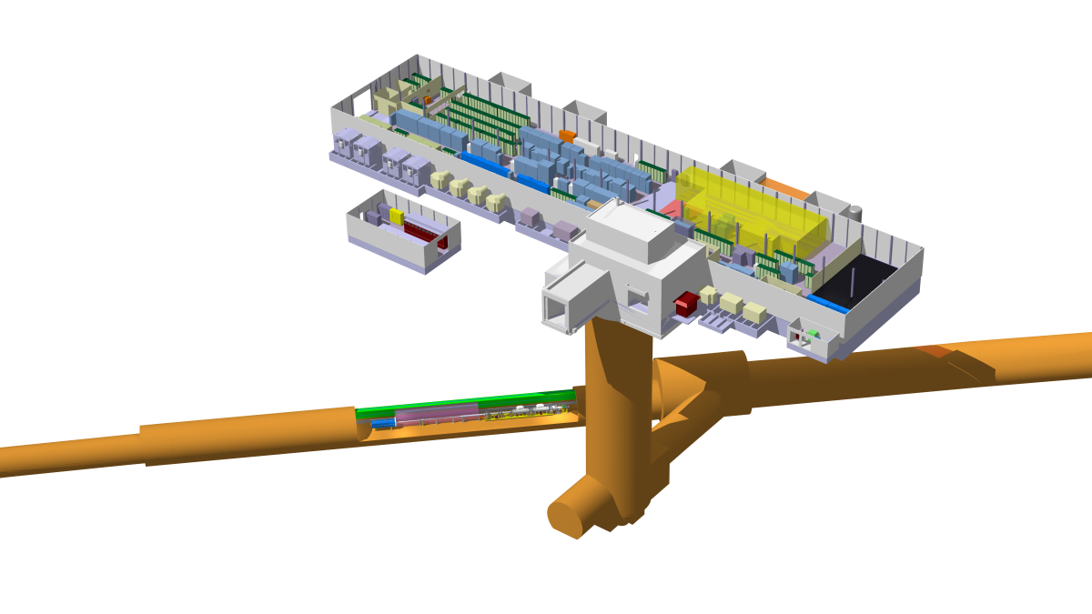
Worksite in BA6
BA6 – surface area
Cryogenic compressor skid
Oil removal skid
Helium pump zone
Cryogenic pipework
BA1
ODH and Alarms
From TS6- to TS6+
BA5
61739 Crab zone
ValveBox#2
Transfer Table
SB + cryomodule
RF equipment and waveguides
Vacuum beamline
TA6 - alcove
Cryogenic Cold-Box
ValveBox#1
LN2 phase separator
Connecting flexibles and pipework

Slide 3
Cryogenics layout
Compressor
Oil removal
LN₂ tank
Cryogenic transfer line
Warm pipework
LN₂ line
ValveBoxes #1 and #2
CCCM + Service Module
VB#2
80m
VB#1
Cold-box = the “fridge”

Slide 4
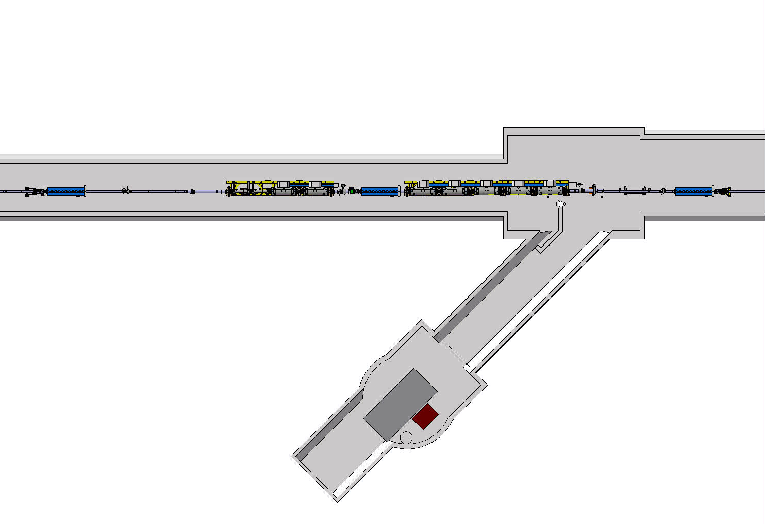
Activity zones
RAL
He pump zone
Crab cavity zone
TA6

Slide 5
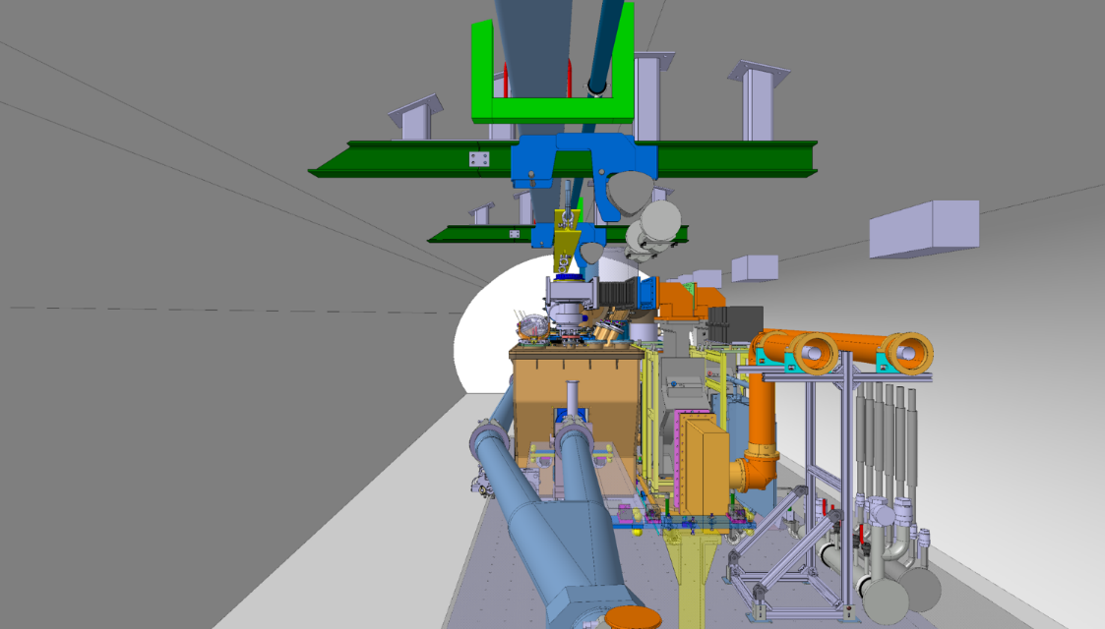
Crab-cavity test-stand
Cryogenic distribution line
Cryogenic distribution line
New handling rails
RF power waveguides
RF power waveguides
Crab-cavity cryomodule
Y-chamber
Moving Transfer table

Slide 6
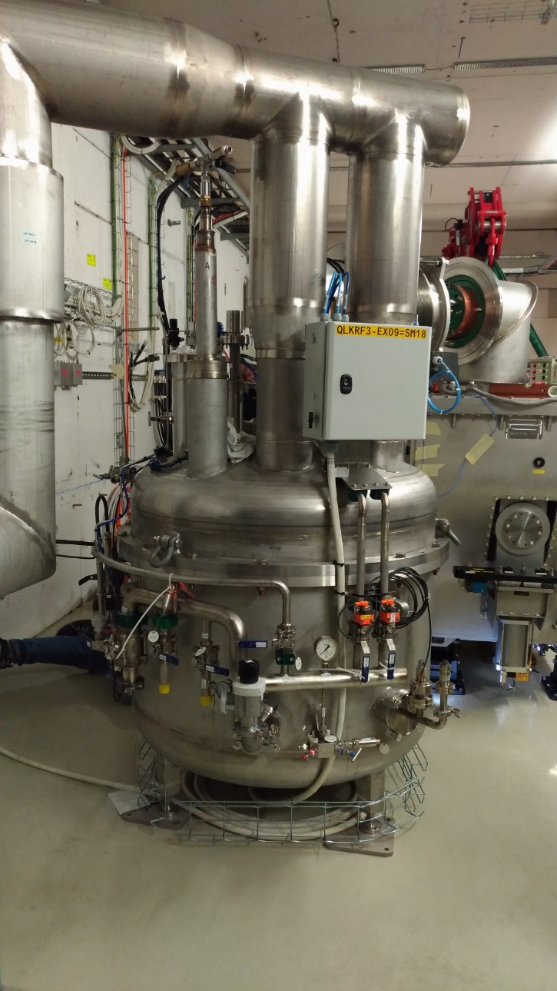
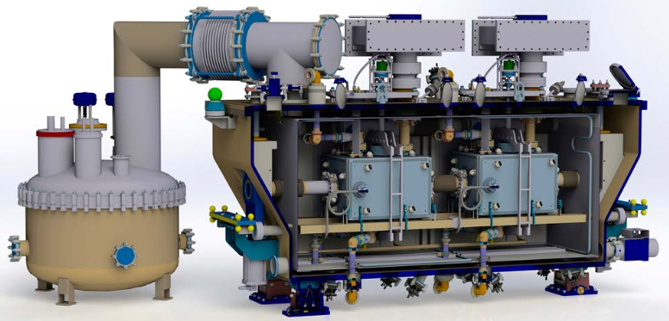
Cryomodule and Service Box

Slide 7
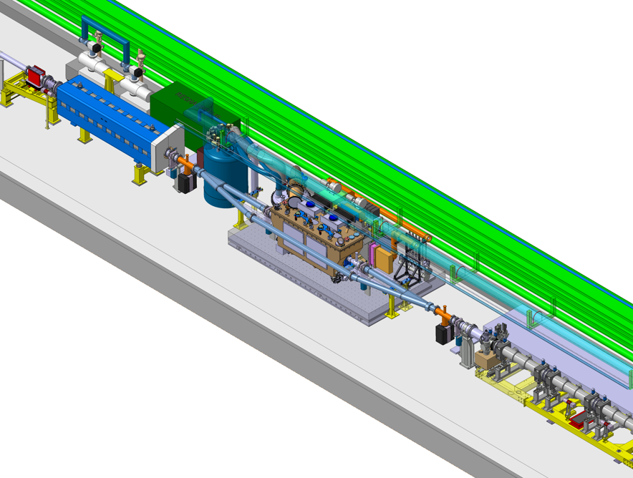
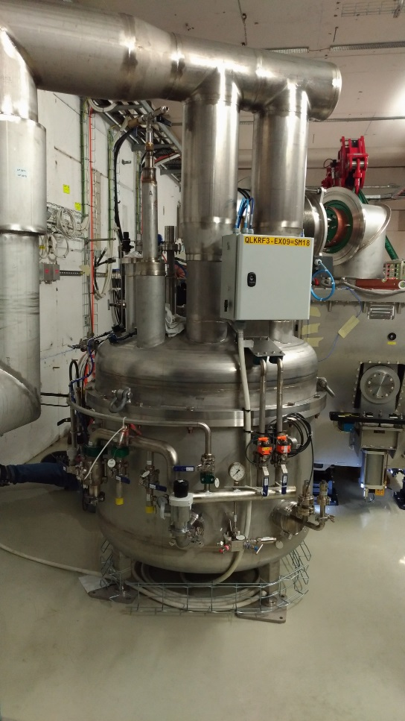
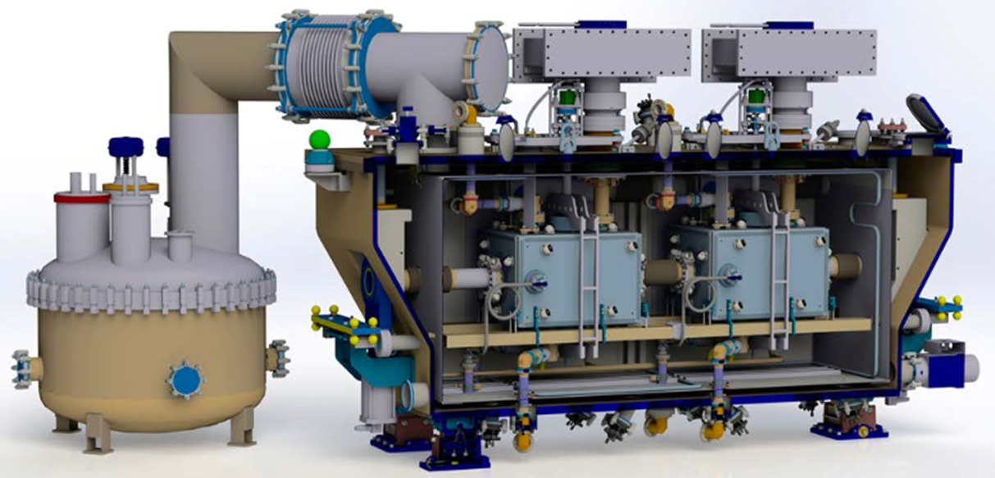
Crab cavity zone
Heater tank
ValveBox#2
RF Circulator & Load skids
Y-chamber
Y-chamber
Transfer Table

Slide 8
Crab cavity zone

Slide 9
Crab cavity zone
Transport Lane

Slide 10
Crab cavity zone
Helium pump zone

Slide 11
Crab cavity zone
ValveBox2 zone

Slide 12
Crab cavity zone
Crab-cavity zone

Slide 13
Crab cavity zone
RF-connections zone

Slide 15
19-20 Dec : MAGNET TESTS
Magnet transport week
8/1 Transfer Table arrival
9/2 Demi water off 22/12
15 Jan, 5am to 10am: AUG Tests
17/1 Cryogenic Refrigerator
15/1
Raw water available
22/1 Cryomodule in tunnel
27-28 Jan : Auto transfer tests EN/EL
1/2 Flushing of cryolines
7/2 Start commissioning at 20K
Gaseous
Helium
22 Feb : Global Access test
28/2 Start cooldown of cryomodule
Liquid
Helium
19 March Beam to SPS

Slide 16
3 large blocks
CABLING
A very important campaign with several clients
Priorities to be worked out together with EN/EL to distribute workload: new cables will NOT be available on day 1
Work partially at night to avoid coactivity and ensure efficient cabling activity
TA6
Tunnel
BA6 and ext
CRYOGENICS
BA6
TA6
+ all the rest around this
Tunnel
ODH
Water, raw and demi
And of course, the rest of the SPS activities
Kickers
Magnet campaign
Lift maintenance
AUG tests
Access tests
TEST STAND
Transfer Table
RF equipment
CRYOMODULE
D. Mcfarlane
Vacuum

Slide 17
Cabling for signals & power - DEADLINES
EN/EL/FC new cables and fibers |  | Deadline for use
Transfer Table | K.Artoos | 15/1 | week2
Mechanical instrumentation of CM | M.Guinchard | ? | ?
ODH | N.Broca | 14/2 | week 7
Cryogenics (to VB#2) | C.Fluder | 24/1 | week 4
Faraday cage LLRF | P.Baudrenghien | 9/2 | week 6
RF Powering | F.Killing | 9/2 | week 6
EN/EL/EIC Electrical distribution cabling and connections |  | Deadline for use
Energization of transformer | G.Velazquez | 15/1 | week2
Cryogenics | C.Fluder | 22/1 | week3
Transfer table | K.Artoos | 15/1 | week2
IOTs | F.Killing | 9/2 | week6
Faraday cage equipment | P.Baudrenghien | 15/2 | week7
….check, confirm, add

Slide 18
Other Deadlines
SYSTEM | Contact | Commissioning
Transfer Table | K.Artoos | 17th Jan
Cryogenics refrigeration + distribution | S.Claudet | 1st Feb to 21st Feb
Cryomodule pumpdown | C.Pasquino/ J.Perez Espinos | 8th Feb
Faraday cage LLRF | P.Baudrenghien | 15th Feb
RF Power IOTs | F.Killing | 15th Feb
Cryomodule cooldown | S.Claudet | 28th Feb
EN/CV
Demi-water off | 22nd Dec 2017 | 9th Feb
Ventilation Faraday cage | Station arrives on | 8th Jan
Raw water | Needed in BA6 | 15th Jan

Slide 19
Large Transports
DATES ARE INDICATIVE
Item | Contact | Date
Heater tank | J.Metselaar | 21st Dec
ValveBox#1 & VB#2 | J.Metselaar | 22nd Dec
Transfer Table | K.Artoos | 12th Jan
Circulator & Load skids | S.Calvo | 15th Jan
Service Box | G.Vandoni | 19th Jan
Cryomodule | G.Vandoni | 19th Jan
Cold-Box | J.Metselaar | 17th Jan
Compressor skid | J.Metselaar | 18th Jan
LN₂ tank | J.Metselaar | 12th Jan

Slide 20
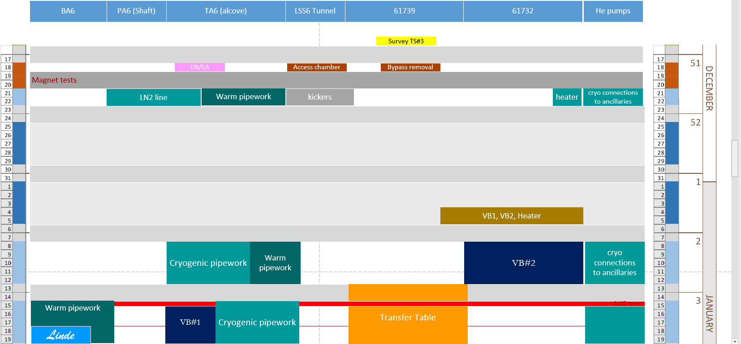

Slide 21
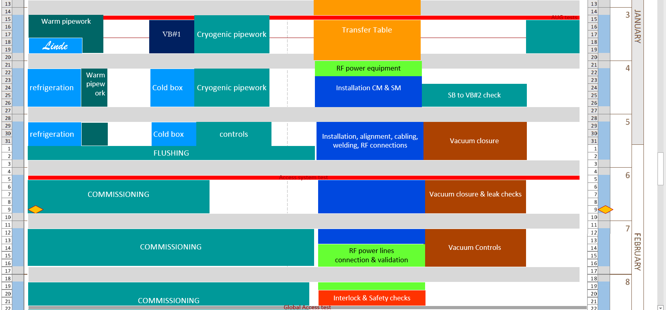

Slide 22
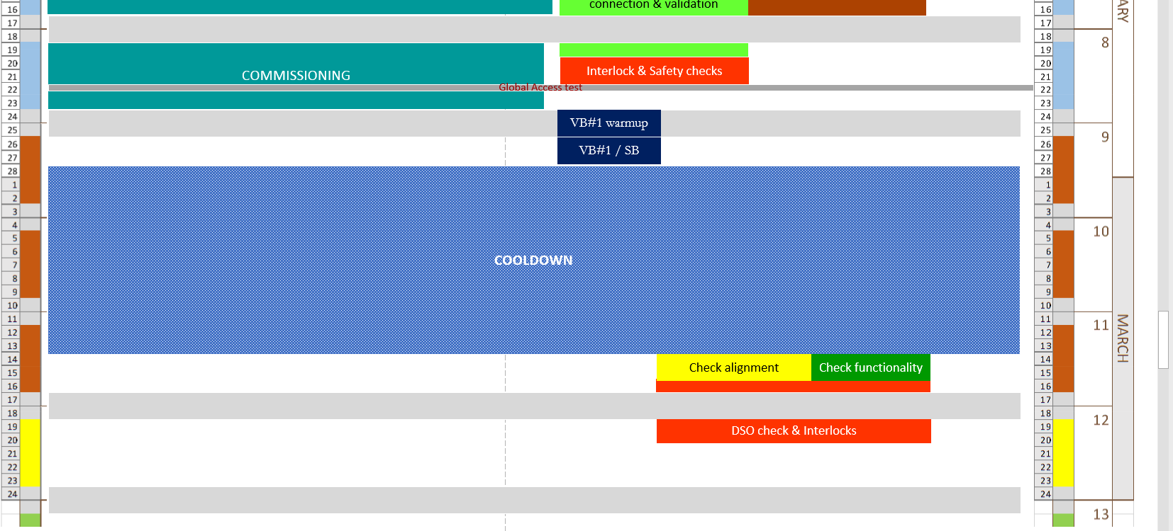

Slide 23
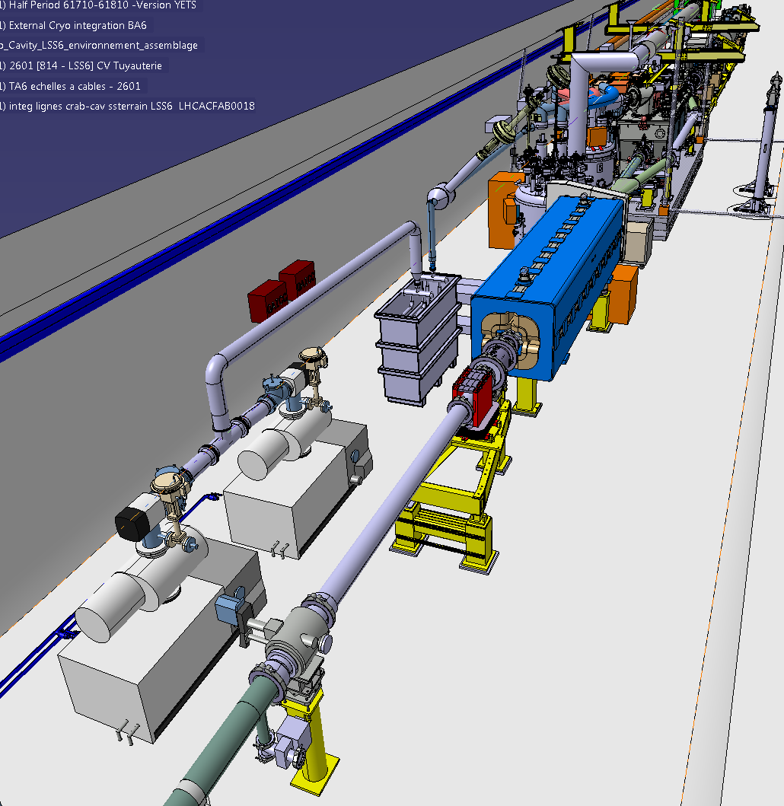
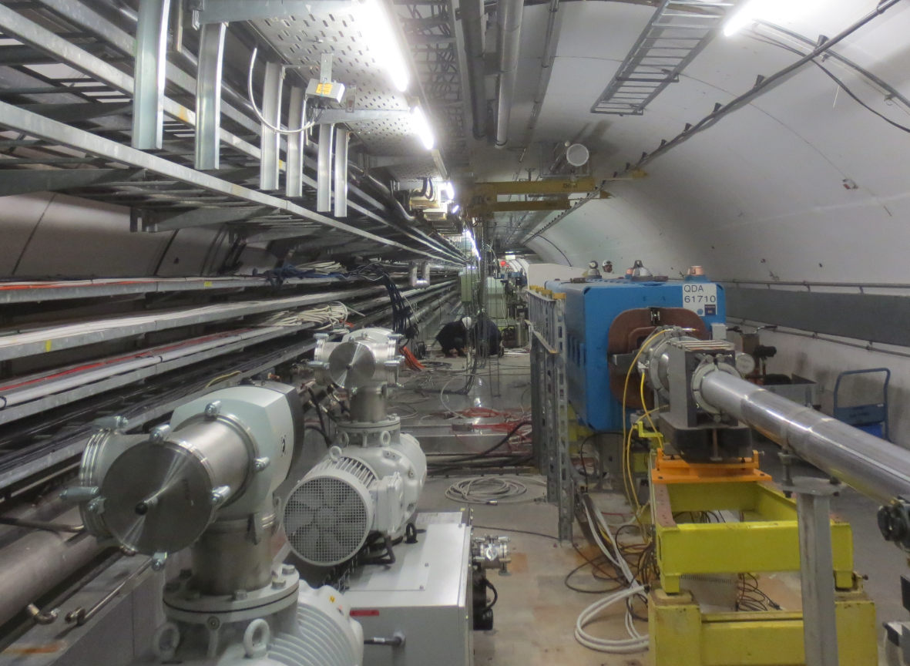
Helium pump zone
In this zone, CRG manages all activities
Installation of heater tank
Installation and welding of pipework

Slide 24
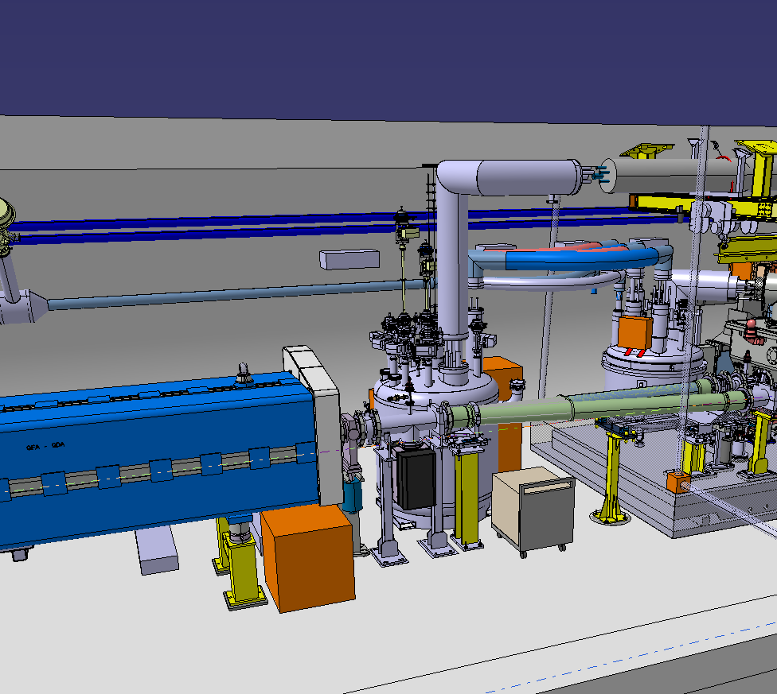
ValveBox#2 zone
61732
Installation of VB#2
and flexible lines
Connection to SB
Electrical racks
Vacuum lines
Cold Commissioning to 20K
is up to here

Slide 25
ValveBox#2 zone
61732
Installation of VB#2
and flexible lines
Connection to SB
Electrical racks
Vacuum lines
Cold Commissioning to 20K
is up to here
Flushing 1st Feb
Cold Commissioning 20K starts 7th Feb

Slide 26
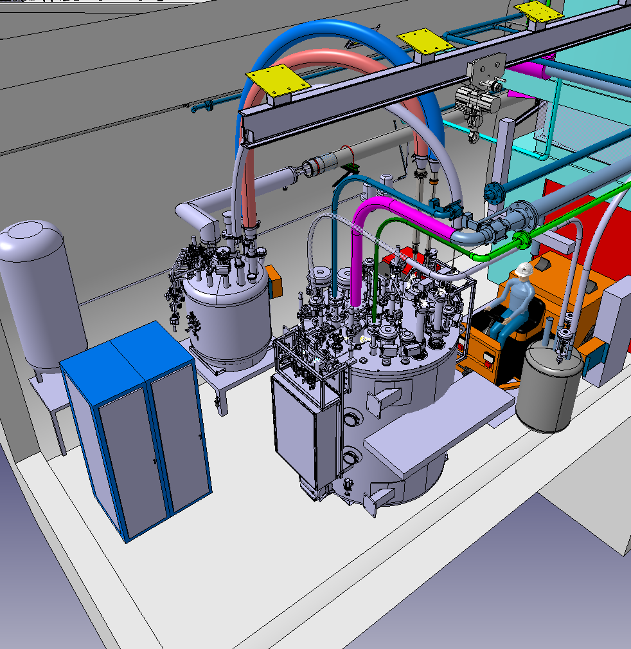
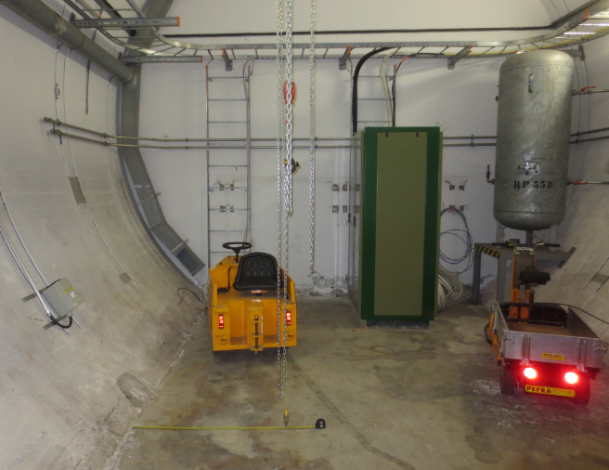
TA6 alcove, cryogenic installation
Rampower
Criotec
Linde

Slide 27
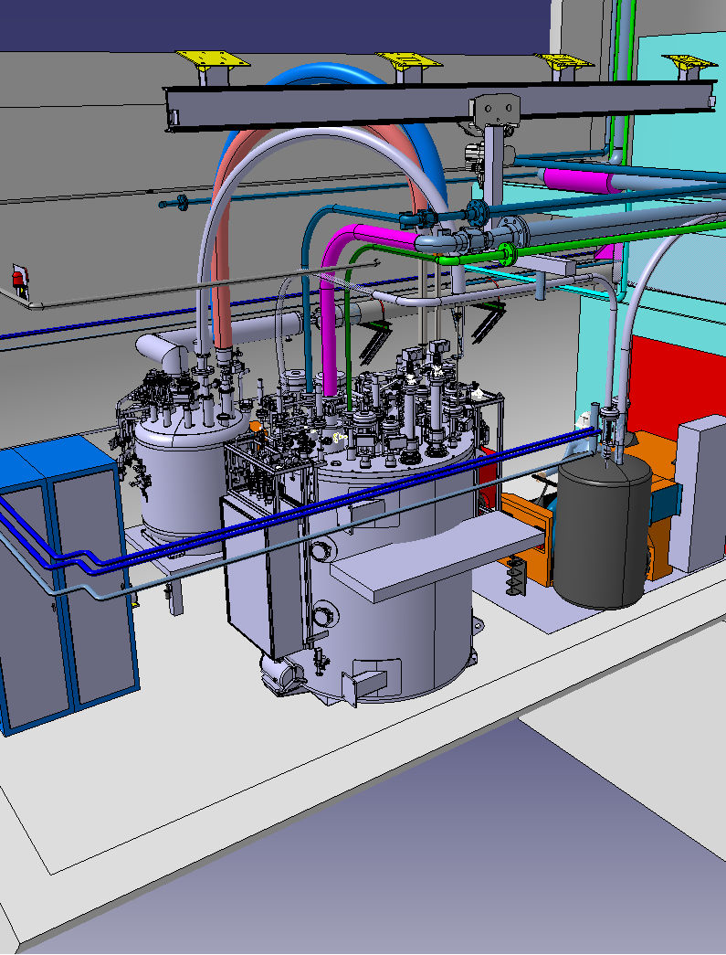
TA6 alcove, cryogenic installation
Rampower
Criotec
Rampower
Linde
TE/CRG/ME Mechanics
TE/CRG/TE Controls
Criotec
The LN2 line serves as reference for installation of phase separator and related lines
The LN2 phase separator is installed at height, in the shadow of the curb
Linde
This zone is entirely in the hands of TE/CRG
EN/EA: scaffold
EN/HE: cold box and VB#1
EN/CV: raw water
EN/MME X-rays
EN/EL/FC
EN/EL/EIC

Slide 28

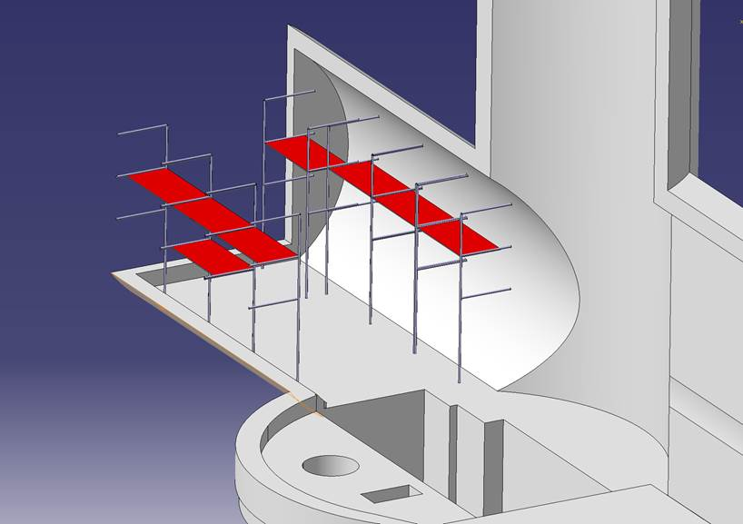
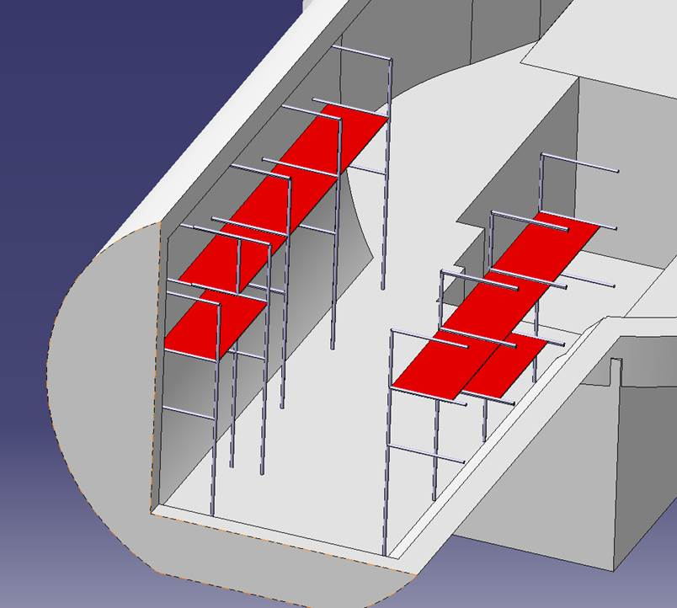
Scaffold on Day 1
Jos Metselaar

Slide 29
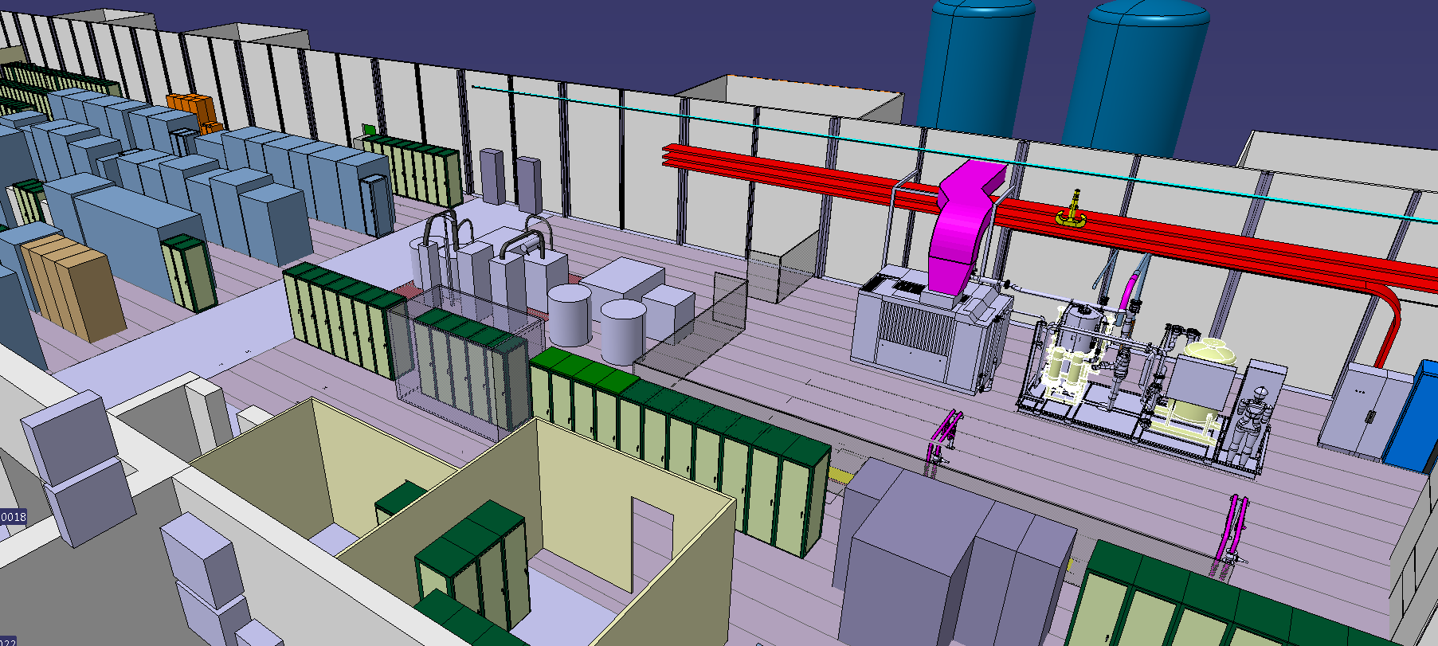
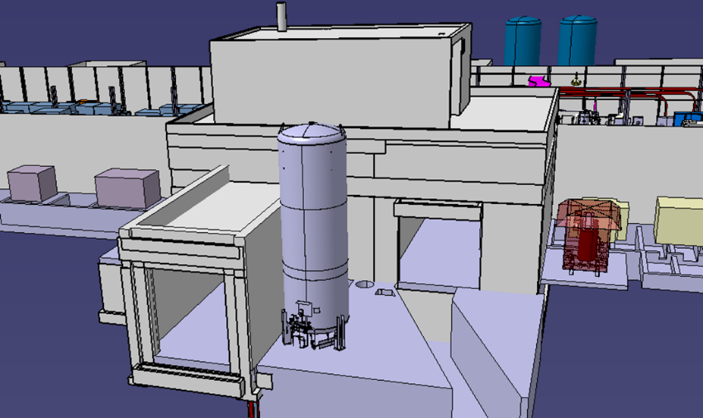
BA surface buidling
Compressor skid and Oil removal skid
17th Jan 2018
LN2 tank
12th Jan 2018

Slide 30
Cryomodule installation
…movie here…

Slide 31
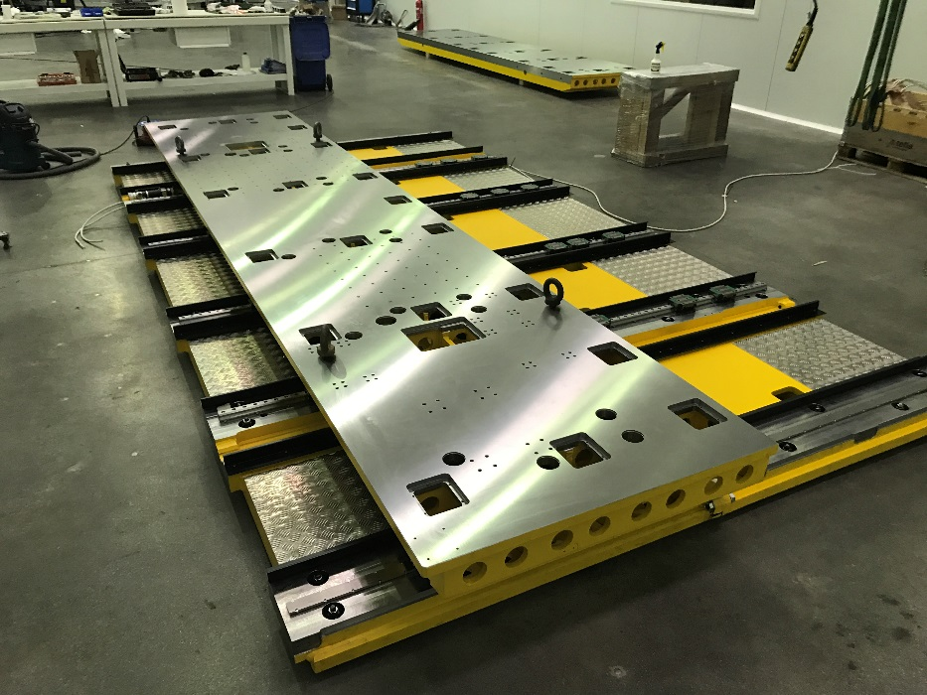
Transfer Table
8/1 | 9 | 10 | 11 | 12 | 13 | 14
Table delivery |  | VIC and trainings |  | Earliest start | Table installation
15/1 | 16 | 17 | 18 | 19 | 20 | 21
Cables & controls ready |  | Interlock tests | RF circulators and loads
22/1 | 23 | 24 | 25 | 26 | 27 | 28
CM + SB
Table movement under full load: 14-15 February

Slide 32
Cryomodule installation
Access and presence only of required actors and experts: no bystanders
Procedure to be written

Slide 33
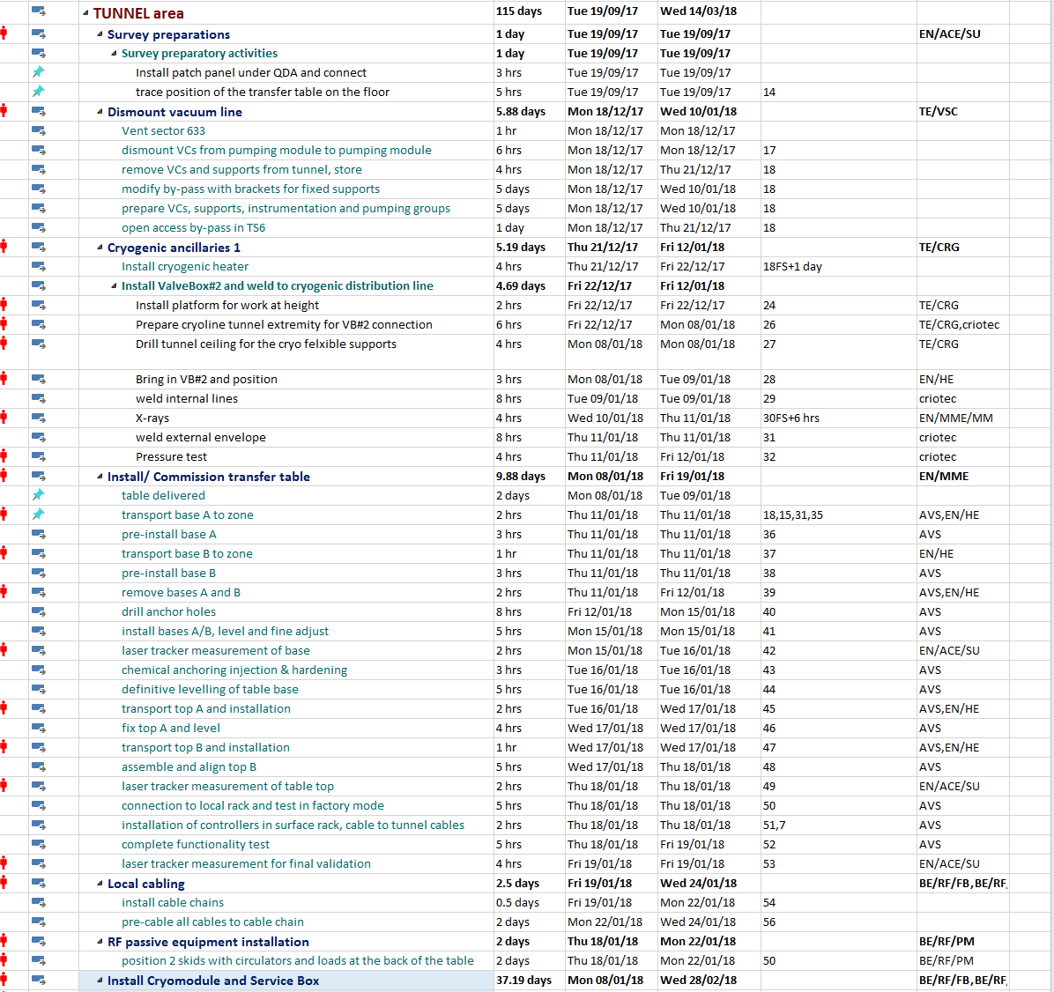

Slide 34
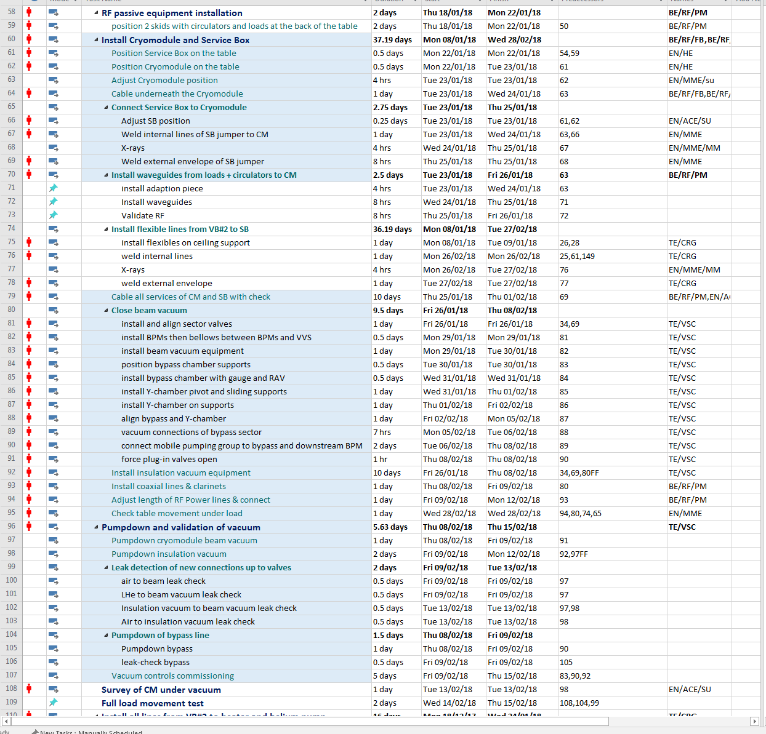

Slide 35
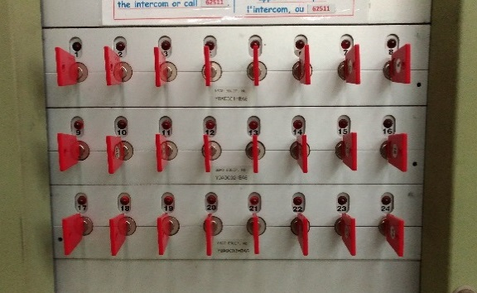
Week 51
MONDAY
Joint VIC for EN/EL (distribution, cables, fibers)
VSC Dismounting vacuum line in crab zone
EN/EA Installation of scaffold in TA6
Connectors (RAL zone) /el. distribution (shaft)
CONSTRAINTS
Tunnel access only by keys
Priority to EN/EL, VSC, EN/EA for keys
No work under false floor in active cable zones
(5 EN/EL/EIC)
10 EN/EL/FC
TE/VSC
EN/EA
4 EN/HE
TUESDAY to WEDNESDAY
24 keys only
Patrol at 6h30 in the morning
Underground areas unaccessible
until Wednesday afternoon (~17h00)
CONSTRAINTS REMOVED
WEDNESDAY
Tunnel access now free
Work under false floor in active cable zones becomes possible
Green light by J.Bauche for switching to open access
EN/EL/FC Connectors
EN/EL/EIC el. Distribution underground + 2 cables pulled under the false floors

Slide 36
Week 51
THURSDAY -FRIDAY
EN/EL/FC in the crab cavity zone
EN/EL/FC-fibers under the false floors and in crab cavity zone
Rampower in the TA6 alcove
Installation LN2 line in alcove
VIC Criotec
SMB/SE drilling of the wall for cryogenic pipework
Thursday: transport of the kickers for alignment & pumpdown Friday/ transport of heater tank
Friday: if kickers finished, installation of VB#1 and VB#2
If needed, can we install VB1 & VB2 on 4-5/1/2018?
THURSDAY -FRIDAY
EN/EL/FC in crab cavity zone and RAL
EN/EL/EIC continues underground

Slide 37
Who’s Who
S.Mehanneche/ F.Galleazzi | Integration
J.Dalla-Costa | Field coordination
D.McFarlane | SPS Coordination
F.Bais | TSO SPS
J.Etheridge | EROS
G.Vandoni | Work responsible/ Field coordination
M.Garlasche | Cryomodule linkperson
C.Pasquino | Vacuum linkperson
J.Metselaar | Cryogenics linkperson
T.Slettestol/ G.Gros/ J.Blanc | EN/EL cabling (cabling & fibers)
K.Artoos | Transfer Table
S.Calvo | RF power and cables
S.Fumey | Transports for crab-cavity

