Slide 1
MD2930: Asynchronous Beam Dump Test with Bunched Beam
W. Bartmann, C. Bracco, C. Hessler, C. Wiesner

Slide 2
Motivation
Idea: perform an asynchronous beam dump test with bunched beam in the abort gap
Goal: Verify our understanding of the beam-loss behaviour, and the current beam and FLUKA models under clearly defined conditions.
Asynch. dump test (2016-05-15): The detailed reconstruction of the event showed that the quench behaviour is not fully understood [1-3].
Magnet | T (K) | ρ_{energy} (mJ/cm³) | Quench expected? | Quench observed?
MQY.4R6 | 4.5 | 30 | Yes | No
MQY.5R6 | 4.5 | 50 | Yes | No
MB.A8R6 | 1.9 | 27 | Yes | Yes
MB.B8R6 | 1.9 | 5 | No | (Yes)*
MQML.8R6 | 1.9 | 1.5 | No | Yes
MB.A9R6 | 1.9 | < 0.1 | No | No
MB.B9R6 | 1.9 | < 0.1 | No | No
MQM.9R6 | 1.9 | 0.25 | No | Yes
*quenched due to heat propagation
no quench
no quench
quench (beam losses)
quench (heat propagation)
LHC design report, Fig. 17.1

Slide 3
Preparation of the MD (~2h)
Goal: Allow injection into the abort gap
  Modify variable AGK (procedure by N. Magnin) [4]
  Disable abort-gap cleaning
  Mask abort-gap interlocks in SIS that check [5]:
    LhcMkiAgkLength, AbtFib6Card, MKI kick length settings, LAST_LEGAL_INJECTION_BUCKET
  Disable steps in the injection sequencer that check [5]:
    if first bucket is not after LAST_LEGAL_INJECTION_BUCKET
    if last bucket is not after LAST_BUCKET
    MKI kick length
  Mask steps in SPS_BQM that check if last injected bunch would be in the abort gap [5]
  Mask in Injection BIS:
    MKI2/8 BETS/AGK/Erratic
[5] D. Jacquet, J. Wenninger, Injection sequencer and SIS protections against incorrect injection requests (into the AG), November 2017

Slide 4
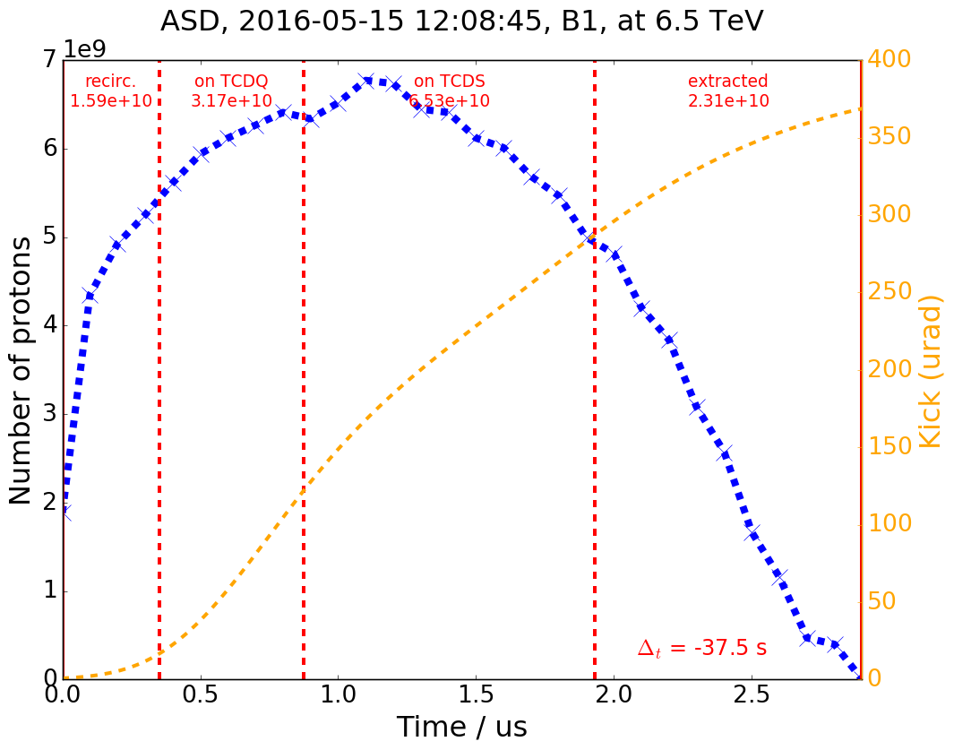
1) Probe abort gap (~2h)
Goal: Validate first bucket to hit the TCDQ
  Pilot bunches
  Injection energy
  Collimators, TCDQ, TCSP at nominal injection position
  Mask Post Mortem? (in case of long waiting time)
  No bump at TCDQ
  Inject one pilot into relevant regions of the abort gap (e.g. around the TCDQ edge). Manually dump beam. Check BLM response.
    a) Test for Beam 1
    b) Test for Beam 2
  Unmask Post Mortem
LHC Design Report, Chap. 17
Asynch. dump test, 2016-05-15, B1, 6.5 TeV
First beam
on TCDQ
MKD waveform

Slide 5
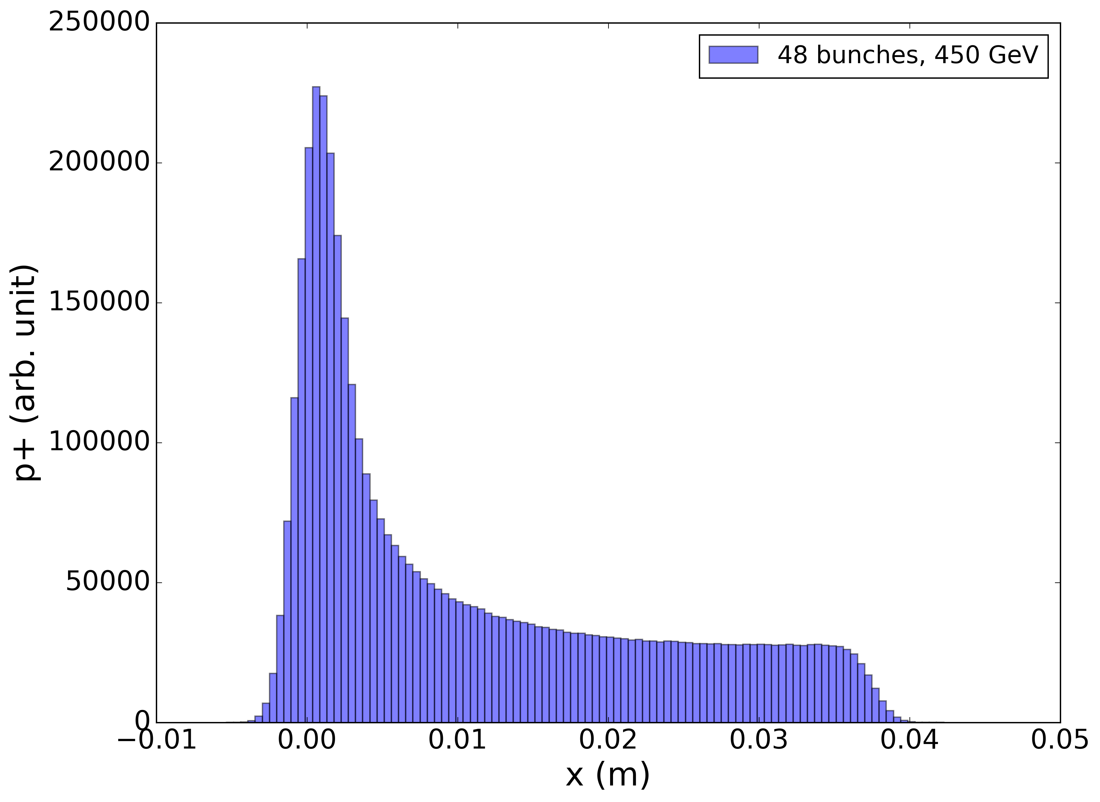
2a) Trains at 450 GeV (~2.5h)
Goal: Verify expectations for loss distribution and energy deposition at injection energy
BCMS (not 8b4e), injection optics
Inject one train of 48 bunches into the beginning of the abort gap. Dump manually.
For FLUKA validation, 2 intensity steps are desirable. The procedure of how to reduce the bunch intensity is under discussion between ABT, OP and MPE.
4 tests without bump at TCDQ:
a) ~6e10 p+/bunch (B1/ B2 separately)
b) ~1.25e11 p+/bunch (B1/ B2 separately)
Remark: No quench expected. FLUKA results expected shortly before MD.
Simulated particle distribution
for train of 48 bunches
TCDQ
No orbit bump
ε_{x} = 1.4 um, β_{x} = 488 m
13 bunches hitting TCDQ
4 bunches hitting TCDS.
Relatively uniform distribution due to overlapping bunches

Slide 6
2b) Trains at 450 GeV with bump (~1.5h)
Goal: Verify impact of orbit excursion on loss distribution (optional)
Mask IR6 excursion interlocks in SIS and BIC for both beams (maskable with unsafe beam?)
Put orbit bumps of 2 mm at TCDQ as for normal Asynch. Dump Tests [6]
2 tests with bump at TCDQ:
a) ~1.25e11 p+/bunch (B1/ B2 separately)
Simulated particle distribution
for train of 48 bunches
TCDQ
No orbit bump
ε_{x} = 1.4 um, β_{x} = 488 m
13 bunches hitting TCDQ
4 bunches hitting TCDS.
Relatively uniform distribution due to overlapping bunches

Slide 7
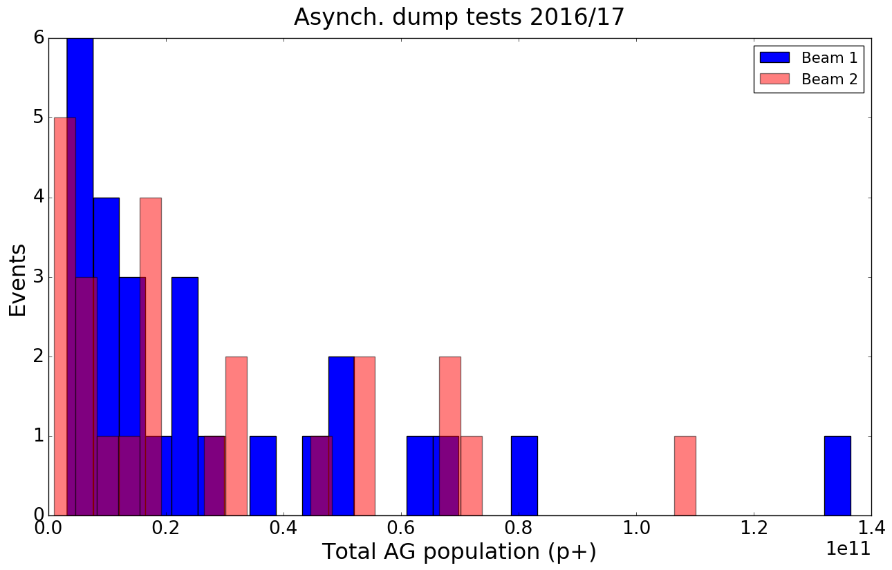
3) Single bunch at flat top (~2h)
Goal: Verify expectations for loss distribution and energy deposition at top energy
FLUKA results expected only shortly before the MD. Therefore, approach: stay below intensity of 2016-05-15 test
Inject one pilot bunch (~1e10 p+) in a bucket close to the TCDQ edge for each beam
No orbit bump
Ramp to 6.5 TeV
Optics: Flat top with 1m beta*
Manually dump beam
If time allows: repeat with adjacent bucket
Total AG Population
6.5 TeV
2016-05-15
no quench
quench

Slide 8
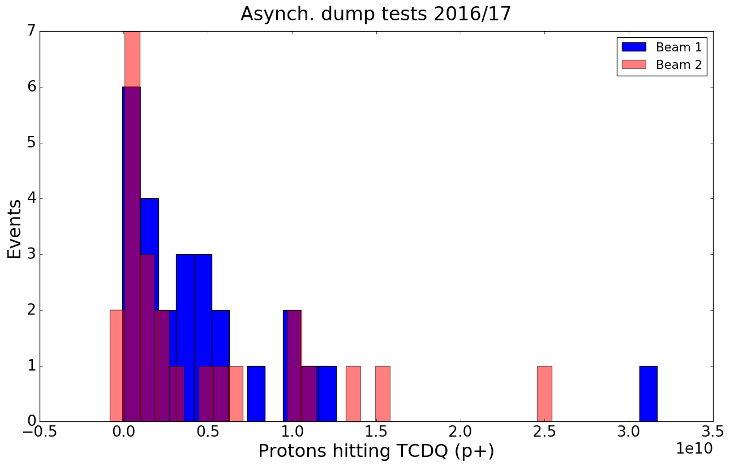
3) Single bunch at flat top (~2h)
Goal: Verify expectations for loss distribution and energy deposition at top energy
FLUKA results expected only shortly before the MD. Therefore, approach: stay below intensity of 2016-05-15 test
Inject one pilot bunch (~1e10 p+) in a bucket close to the TCDQ edge for each beam
No orbit bump
Ramp to 6.5 TeV
Optics: Flat top with 1m beta*
Manually dump beam
If time allows: repeat with adjacent bucket
p+ on TCDQ
6.5 TeV
2016-05-15
no quench
quench

Slide 9
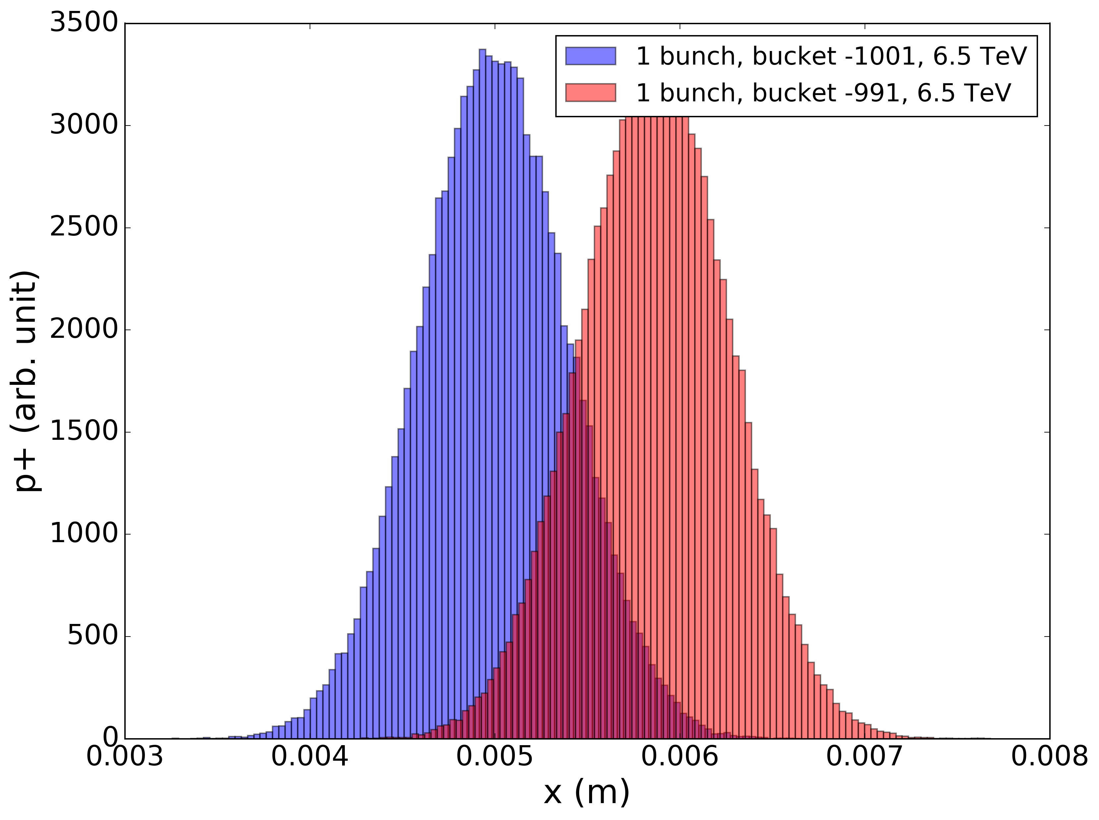
3) Single bunch at flat top (~2h)
Goal: Verify expectations for loss distribution and energy deposition at top energy
FLUKA results expected only shortly before the MD. Therefore, approach: stay below intensity of 2016-05-15 test
Inject one pilot bunch (~1e10 p+) in a bucket close to the TCDQ edge for each beam
No orbit bump
Ramp to 6.5 TeV
Optics: Flat top with 1m beta*
Manually dump beam
If time allows: repeat with adjacent bucket
Simulated particle distribution
for single bunches at 6.5 TeV
TCDQ
No orbit bump
ε_{x} = 2.3 um, β_{x} = 489 m

Slide 10
Recovery?
If last MD: reset settings of variable AGK
If not last MD before YETS: full revalidation with beam (see procedure)
Risk of magnet quenches in IR6. In this case, additional recovery time of an estimated 4-8 hours might be required.

Slide 11
MD Parameters: Summary
Specie | Protons
Category | Normal MD
Time required [h] | 10 hours
Beams required [1, 2, 1&2] | Both
Beam energy [GeV] | Part 1 and Part 2: 450 GeV / Part 3: 6.5 TeV
Optics (injection, squeezed, special) | Part 1 and Part 2: injection optics. Part 3: Flat top with 1m beta*
Bunch intensity [#p, #ions] and Number of bunches | Part 1: Pilots Part 2: Trains of 48 bunches (BCMS) with ~6e10 p+ and trains of 48 bunches (BCMS) with ~1.25e11 p+ Part 3: One pilot bunch
Transverse emittance [m rad] | Nominal values (exact value not critical).
Bunch length [ns @ 4s] | Nominal values.
Optics change [yes/no] | No
Orbit change [yes/no] | No
Collimation change [yes/no] | No
RF system change [yes/no] | No
Feedback changes [yes/no] | No
What else will be changed? | In order to inject into the abort gap, the variable AGK has to be modified before the measurement.
Are parallel studies possible? | No
Other info/requests | Risk of magnet quenches in IR6.

Slide 12
References
[1] C. Wiesner, Overview of asynch. dump tests 2016/17 and asynch. dump test with quench (2016-05-15), LIBD Meeting, 05.10.2017, https://indico.cern.ch/event/661534/
[2] D. Wollmann, Magnet quench characteristics and quench levels, LIBD Meeting, 05.10.2017, https://indico.cern.ch/event/661534/
[3] M. Frankl, A. Lechner, Energy-deposition studies, LIBD Meeting, 05.10.2017, https://indico.cern.ch/event/661534/
[4] N. Magnin, Operational Procedure, Procedure to change the length of LBDS Abort Gap Keeper, to be published
[5] D. Jacquet, J. Wenninger, Injection sequencer and SIS protections against incorrect injection requests (into the AG), November 2017
[6] LHC Operational Procedure, Asynchronous beam dump validation test, EDMS No. 1698830

Slide 13
Thank you for your attention!

Slide 14
Overview of AGK Parameters
N. Magnin, Operational Procedure, Procedure to change the length of LBDS Abort Gap Keeper, to be published

