Slide 1

Adjustment specification
H. Mainaud Durand, M. Sosin
112th HiLumi WP2 meeting, 05/12/2017

Slide 2
Outline
Types of adjustment:
  Manual/motorized jacks and associated requirements
  Manual / motorized standardized platform and associated requirements
Synoptic of adjustment capabilities in IT & MS sections

Slide 3
Scope & hypothesis
All HL-LHC components, located in the IT or MS area will be supported by an adjustment system, allowing manual (in-situ) or motorized (remote from the CCC) alignment of the components.
The adjustment system is used at the initial installation and then during the life time of the machine to maximise beam aperture and cover ground motion, jacks installation inaccuracies and components manufacturing non-conformities.
Hypotheses concerning adjustments in tunnel
  No adjustments in tunnel during Technical Stops due to radiations of the IT & MS sections
  Adjustments only if really necessary during YETS.
  Adjustment of intermediary components during Long Shutdown only

Slide 4
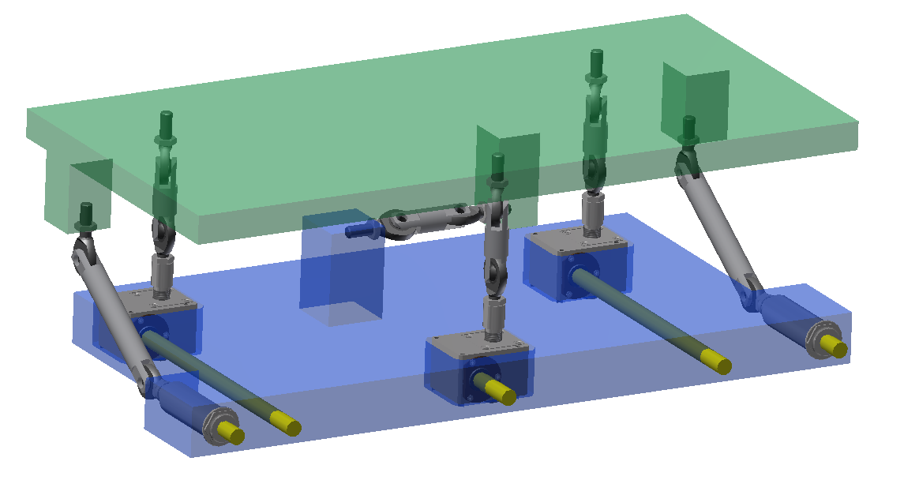
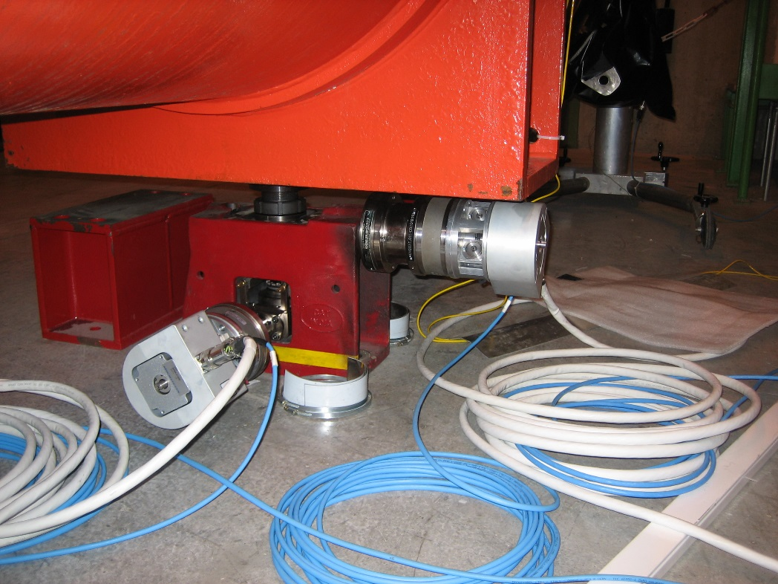
Types of adjustment
2 types of adjustment, depending of the size and weight of components:
  Using standard jacks, for cryostated magnet
  Using standardized platform (below 1-2 t)
Both can be motorized if needed.

Slide 5
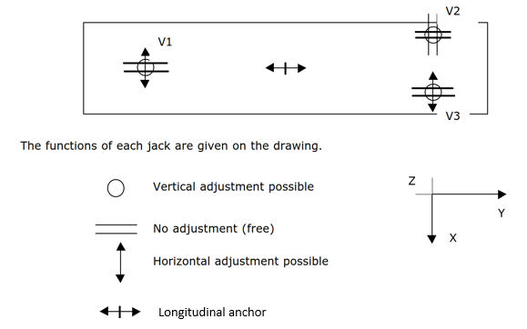
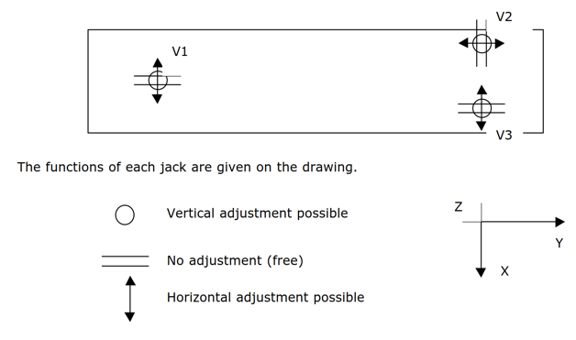
Adjustment using jacks
Solution of 3 isostatic jacks chosen by TE-MSC
Two layouts:
With pressure end effects (Q1, D1)

Slide 6
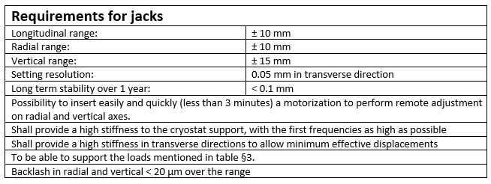
Requirements

Slide 7
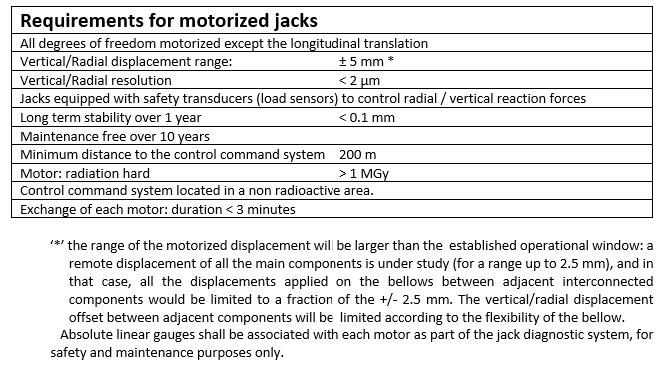
Requirements

Slide 8
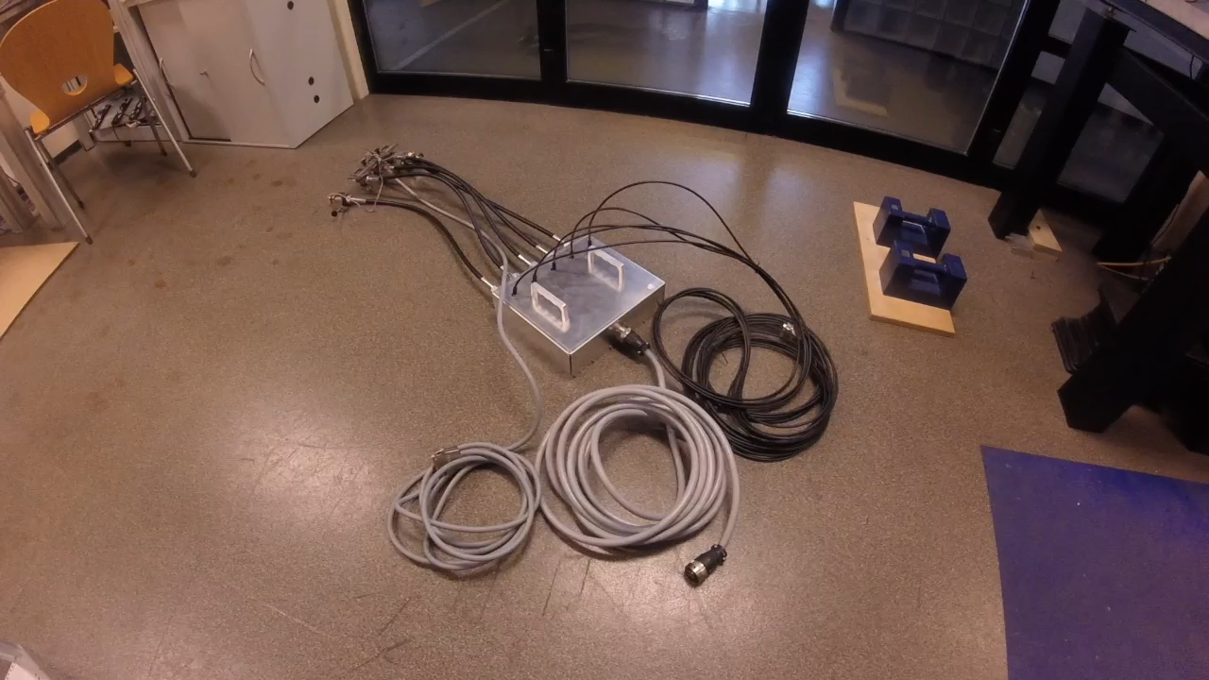
Standardized platform
For lighter and smaller components
Keep the same design for all the adjustment supports, with an easy access to the adjustment knobs on the transport side
All mechanical design proposed by WP15.4, to be integrated by the designer in charge of the equipment support.
3 types:
  Manual
  Plug-in motors
  Motors

Slide 9
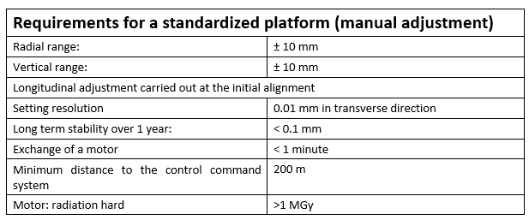
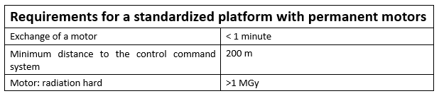
Requirements
Two sizes of platforms will be proposed and are under definition : small size for compact components (weight < 200 kg), medium size.
Plug-in motors shall be installed and dismounted in less than 1 minute.

Slide 10
Specific cases
BPM: they will be installed on a manual standardized platform, with the possibility to install a plug-in system. No possibility to perform displacements during TS and YETS.
Vacuum case under definition
  Analysis of aperture under way
  A table with estimated ground motion displacements between LS is under preparation (WP15.4)
Collimators case:
  Collimators between TAXN and D2: motorization under study
  Option 1: motorize the existing adjustment system
  Option 2: use a standardized platform equipped with permanent motors.

Slide 11
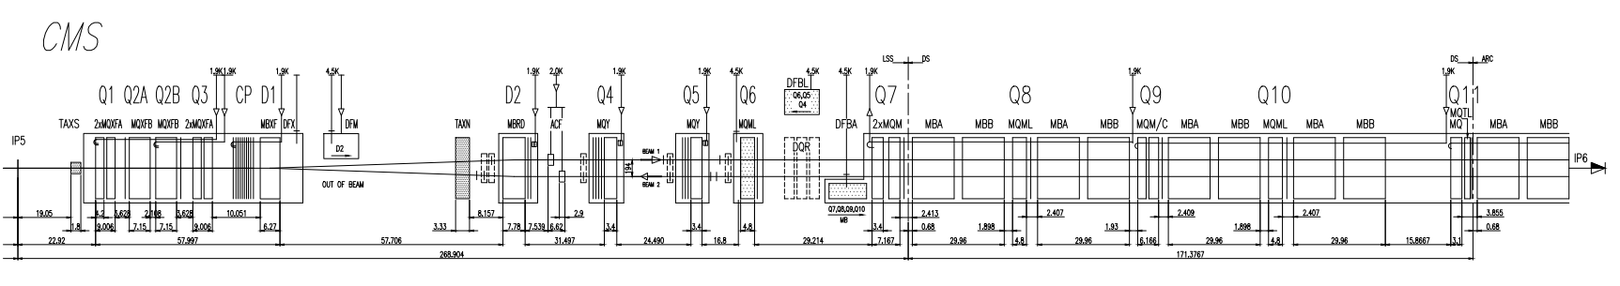
Synoptic of adjustment system
Manual adjustment system: adjustment during LS, in the tunnel
Motorized adjustment system (baseline): adjustment during run, from CCC
Motorized adjustment system (new request): adjustment during run, from CCC

Slide 12
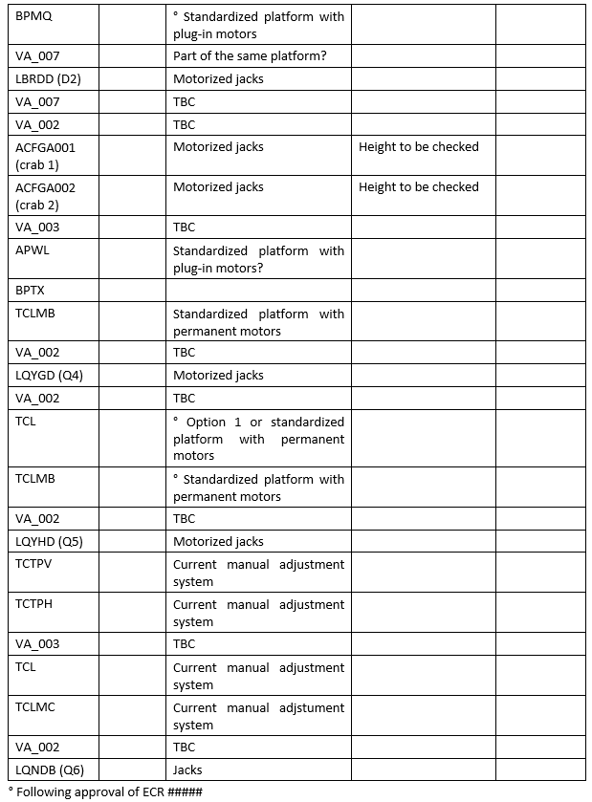
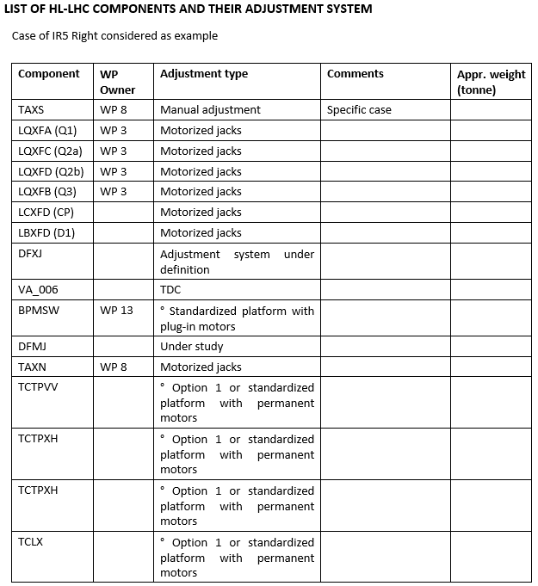
List of HL-LHC components & associated adjustment system

Slide 13
Summary
Functional specification of adjustment systems under preparation
Some discussions initiated for vacuum components and collimators.
Detailed analysis of aperture combined with estimated displacements between LS needed.

Slide 14
Thank you very much

Slide 15
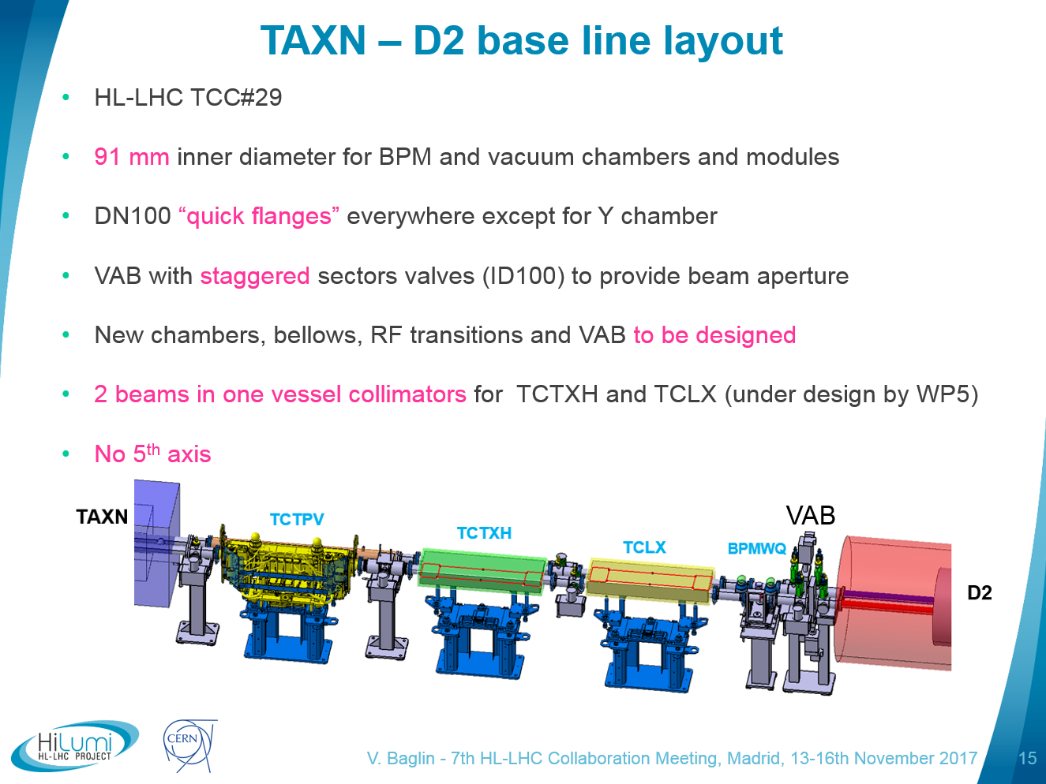

Slide 16
