Slide 1

Trying to reduce corrector strength and residual orbit by profiting of the alignment system capabilities.
D. Gamba, R. De Maria
112th HiLumi WP2 Meeting – 05/12/2017

Slide 2
Outline
Overview of present orbit correction scenario
Plans toward a realistic orbit correction strategy
Old knobs and new knobs
  Profit of the versatile alignment system
New orbit correction budgets
  Reduced number of correctors
Questions being investigated
Summary

Slide 3
Optics under consideration
Optics (slhc/opt_150_150_150_150_thin.madx)
  E = 7 TeV; σ_{E} = 1.08e-4; ε_{N} = 2.5 µm
  on_x1=295; on_x5=295; (note that 250 is nominal.)
  on_x8=0; on_x2=0;
  on_lhcb=0; on_alice=0;
  on_sep1=2;on_sep2=0;on_sep5=2;on_sep8=0;
  Considering only IP5
Errors:
  All square distributions
    (i.e. if ±0.5 mm, then sigma = 0.5/sqrt(3) = 0.2887 mm)
  Quadrupoles
    ±0.5mm DX/DY, ±10mm DS, ±0.002 DKR1, ±1 mrad DPSI.
  Dipoles
    ±10mm DS, ±0.002 DKR0, ±0.5 mrad DPSI.

Slide 4
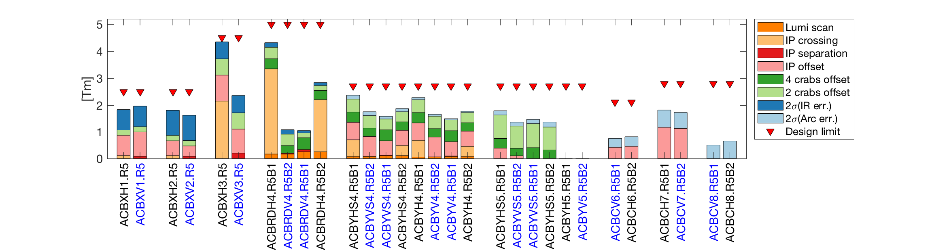
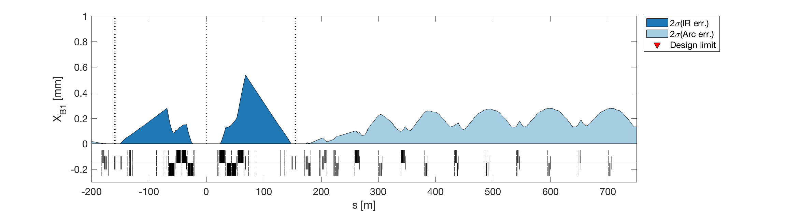
Where we are
Budget taken for orbit correction
To simplify analysis avoided using third corrector on Q5
Can we remove one corrector?
Using “non-observables”
Orbit with respect to ideal zero, not with respect to element centres.

Slide 5
Where we are: knobs
It is in the “other” plane, so they should not sum up.
It controls sloop between two pairs of CC:
- Can we get rid of it?
Circuit | Cros. [±295 µrad] | Sep. [±0.75 mm] | Off. [±2 mm] | 4 crab off. [±0.25 mm] | 2 crab off. [±0.5 mm] | Lumi scan. [±0.1 mm] | Sum | Budget
MCBX1 | 0.11 | 0.08 | 1.05 | 0 | 0.2 | 0 | 1.44 | 2.5
MCBX2 | 0.11 | 0.08 | 0.57 | 0 | 0.2 | 0 | 0.96 | 2.5
MCBX3 | 2.15 | 0.20 | 0.99 | 0 | 0.6 | 0 | 3.94 | 4.5
MCBRD4 | 3.18 | 0.10 | 0 | 0.44 | 0.42 | 0.25 | 4.39 | 5
MCBY4 | 0.64 | 0.02 | 0.74 | 0.41 | 0.46 | 0.07 | 2.34 | 2.7
MCBYS4 | 0.64 | 0.02 | 0.74 | 0.41 | 0.46 | 0.11 | 2.38 | 2.7
MCBY5 | 0 | 0 | 0 | 0 | 0 | 0 | 0 | 2.7
MCBYS5 | 0 | 0 | 0.39 | 0.42 | 0.89 | 0 | 1.7 | 2.7
MCBC6 | 0 | 0 | 0.47 | 0 | 0 | 0 | 0.47 | 2.1
MCBC7 | 0 | 0 | 1.17 | 0 | 0 | 0 | 1.17 | 2.8
MCBC8 | 0 | 0 | 0 | 0 | 0 | 0 | 0 | 2.8
MCBC9 | 0 | 0 | 0 | 0 | 0 | 0 | 0 | 2.8
MCB10 | 0 | 0 | 0 | 0 | 0 | 0 | 0 | 1.895
Means orbit at crab cavities
Require flexible bellows at CC -> more impedance
Quite some strength/orbit
Enough? Necessary?
The CC pairs (one per beam, per side) can be transversely moved independently.

Slide 6
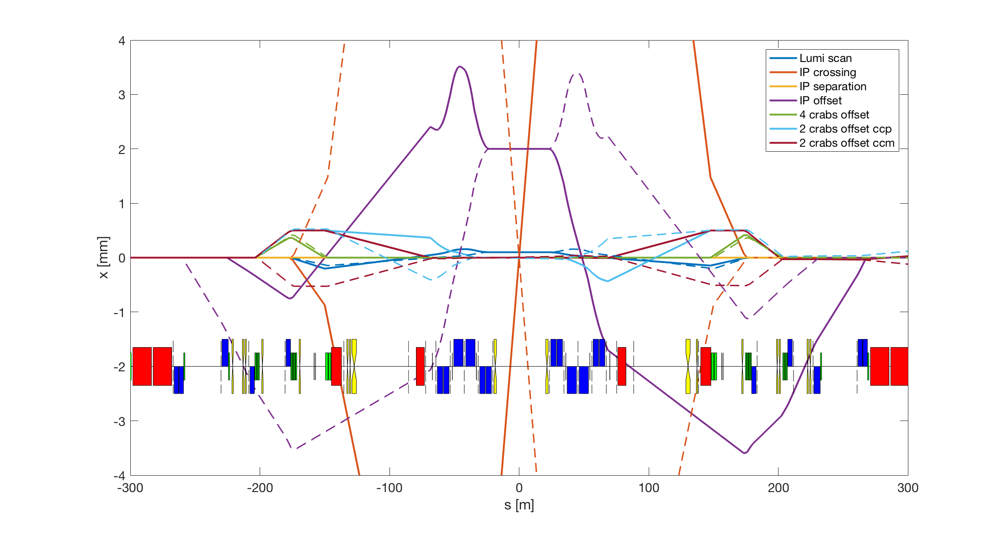
Where we are: knob effect on orbit
Solid is B1, dashed is B2
Q7 Q6 Q5 Q4 Q3 Q2 Q1

Slide 7
Plans
Use movers during a technical stop
- implement IP offset, but still have a residual alignment error of (0.5 mm or better if possible)
- less corrector in Q1-Q4, more in Q5-Q7, gain in aperture in Q1-Q4
Use movers during beam commissioning
- see if a procedure exists (e.g. k-modulation at injection to calibrate magnetic center with BPM center) to reduce the residual alignment errors to 0 mm with beam observations
- estimate the reduction of orbit corrector strengths 0.5, 0.0
Residual orbit at the crab cavities
- How much we are confident of the orbit at the crab cavities?
- That is how much do we have to move the beam to center the cavity or move the cavity (if possible) to center the beam.
How to do a good a crossing angle BPM (BI specification, K-modulation vs beta-error)

Slide 8
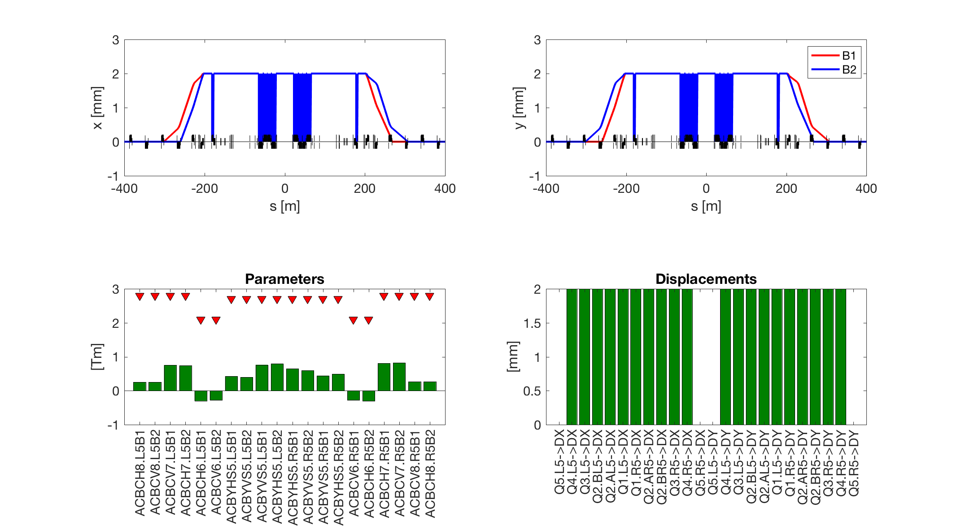
Getting rid of offset knob – far-medium
Orbit bump from Q10 to Q5
NOTE: Orbit w.r.t. quad offset
Q9 Q8 Q7 Q6 Q5 Q4
Moving of 2 mm all elements
from Q4.L to Q4.R:
Notes:
ACBCH8.L5B1 0.254
ACBCV8.L5B2 0.252
ACBCV7.L5B1 0.755
ACBCH7.L5B2 0.742
ACBCH6.L5B1 -0.297
ACBCV6.L5B2 -0.276
ACBYHS5.L5B1 0.427
ACBYVS5.L5B2 0.393
ACBYVS5.L5B1 0.762
ACBYHS5.L5B2 0.797
ACBYHS5.R5B1 0.644
ACBYVS5.R5B2 0.596
ACBYVS5.R5B1 0.442
ACBYHS5.R5B2 0.493
ACBCV6.R5B1 -0.279
ACBCH6.R5B2 -0.307
ACBCH7.R5B1 0.805
ACBCV7.R5B2 0.823
ACBCV8.R5B1 0.267
ACBCH8.R5B2 0.267
Q5.L5->DX 0.000
Q4.L5->DX 2.000
Q3.L5->DX 2.000
Q2.BL5->DX 2.000
Q2.AL5->DX 2.000
Q1.L5->DX 2.000
Q1.R5->DX 2.000
Q2.AR5->DX 2.000
Q2.BR5->DX 2.000
Q3.R5->DX 2.000
Q4.R5->DX 2.000
Q5.R5->DX 0.000
Q5.L5->DY 0.000
Q4.L5->DY 2.000
Q3.L5->DY 2.000
Q2.BL5->DY 2.000
Q2.AL5->DY 2.000
Q1.L5->DY 2.000
Q1.R5->DY 2.000
Q2.AR5->DY 2.000
Q2.BR5->DY 2.000
Q3.R5->DY 2.000
Q4.R5->DY 2.000
Q5.R5->DY 0.000

Slide 9
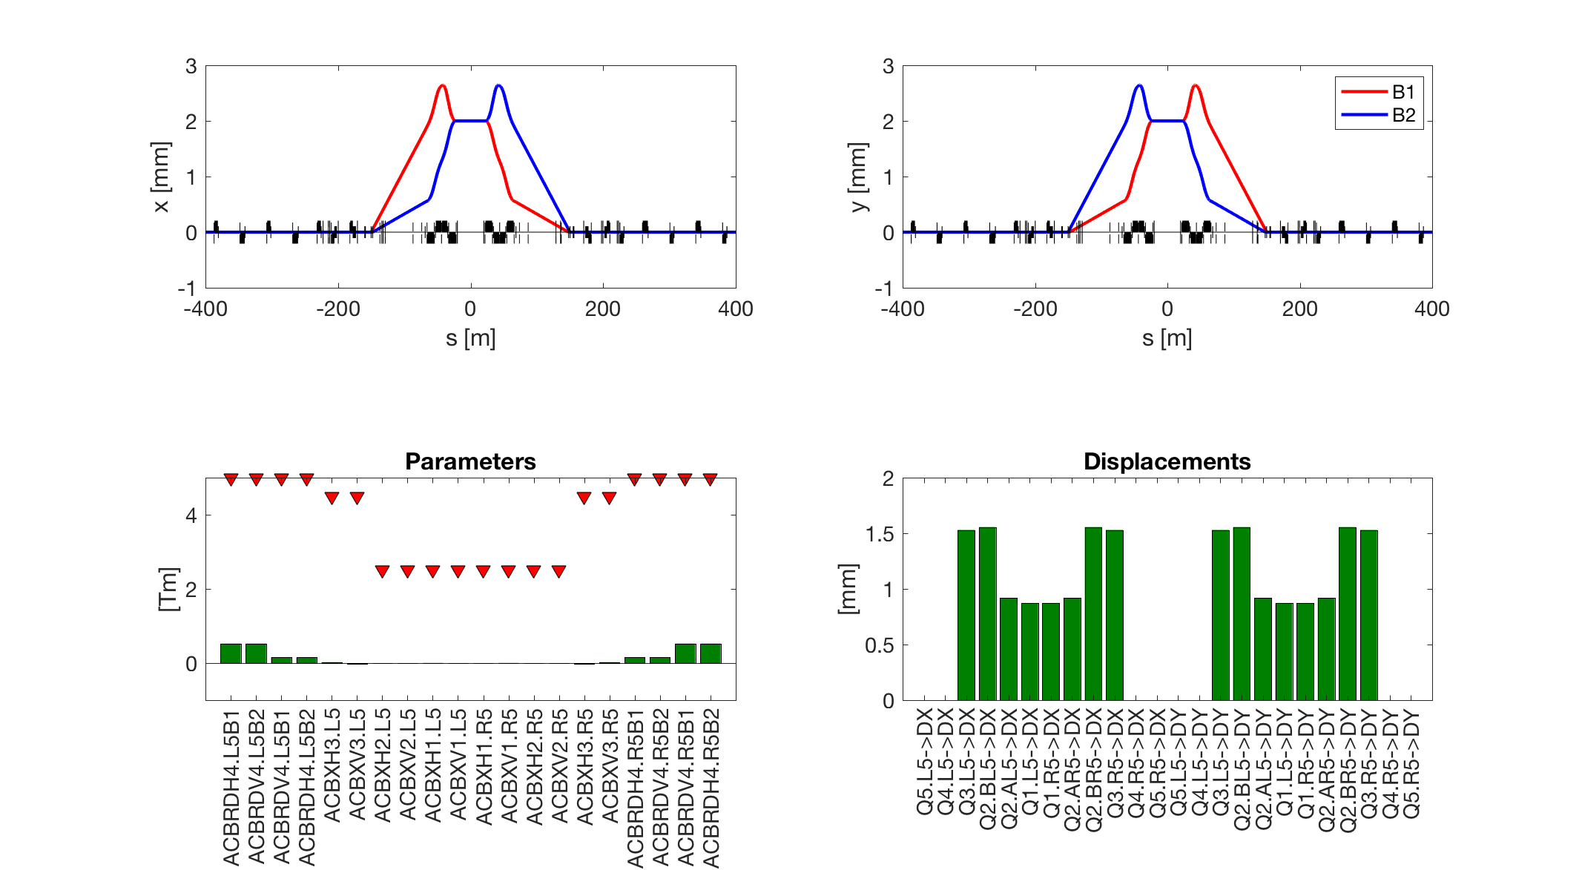
Getting rid of offset knob – nearV2
Loss of aperture
Orbit closed on D2
Q9 Q8 Q7 Q6 Q5 Q4
< 0.6 Tm ACBRD;
not using RCBX
Moving of ~1 mm the triplet
Notes:
weightOnAllowedErrors = 500; %
ACBRDH4.L5B1 0.525
ACBRDV4.L5B2 0.525
ACBRDV4.L5B1 0.159
ACBRDH4.L5B2 0.159
ACBXH3.L5 0.022
ACBXV3.L5 -0.022
ACBXH2.L5 -0.000
ACBXV2.L5 0.000
ACBXH1.L5 0.002
ACBXV1.L5 -0.002
ACBXH1.R5 -0.002
ACBXV1.R5 0.002
ACBXH2.R5 0.000
ACBXV2.R5 -0.000
ACBXH3.R5 -0.022
ACBXV3.R5 0.022
ACBRDH4.R5B1 0.159
ACBRDV4.R5B2 0.159
ACBRDV4.R5B1 0.525
ACBRDH4.R5B2 0.525
Q5.L5->DX 0.000
Q4.L5->DX 0.000
Q3.L5->DX 1.530
Q2.BL5->DX 1.556
Q2.AL5->DX 0.920
Q1.L5->DX 0.872
Q1.R5->DX 0.872
Q2.AR5->DX 0.920
Q2.BR5->DX 1.556
Q3.R5->DX 1.530
Q4.R5->DX 0.000
Q5.R5->DX 0.000
Q5.L5->DY 0.000
Q4.L5->DY 0.000
Q3.L5->DY 1.530
Q2.BL5->DY 1.556
Q2.AL5->DY 0.920
Q1.L5->DY 0.872
Q1.R5->DY 0.872
Q2.AR5->DY 0.920
Q2.BR5->DY 1.556
Q3.R5->DY 1.530
Q4.R5->DY 0.000
Q5.R5->DY 0.000

Slide 10
Getting rid of offset knob: resume
Far-Long/Med: Q1-Q4 of 2 mm
NearV2: about 1.5 mm on Q3+Q2B, 1 mm Q2A+Q1
Circuit | Off. [±2 mm] |  |  | Sum |  |  | Budget
 | Baseline | Far-Med | nearV2 | Baseline | Far-Med | nearV2
MCBX1 | 1.05 | 0 | 0 | 1.44 | 0.39 | 0.39 | 2.5
MCBX2 | 0.57 | 0 | 0 | 0.96 | 0.39 | 0.39 | 2.5
MCBX3 | 0.99 | 0 | 0.02 | 3.94 | 2.95 | 2.97 | 4.5
MCBRD4 | 0 | 0 | 0.53 | 4.39 | 4.39 | 4.92 | 5
MCBY4 | 0.74 | 0 | 0 | 2.34 | 1.6 | 1.6 | 2.7
MCBYS4 | 0.74 | 0 | 0 | 2.38 | 1.64 | 1.64 | 2.7
MCBY5 | 0 | 0 | 0 | 0 | 0 | 0 | 2.7
MCBYS5 | 0.39 | 0.80 | 0 | 1.7 | 2.11 | 1.31 | 2.7
MCBC6 | 0.47 | 0.31 | 0 | 0.47 | 0.31 | 0 | 2.1
MCBC7 | 1.17 | 0.82 | 0 | 1.17 | 0.82 | 0 | 2.8
MCBC8 | 0 | 0.27 | 0 | 0 | 0.27 | 0 | 2.8
MCBC9 | 0 | 0 | 0 | 0 | 0 | 0 | 2.8
MCB10 | 0 | 0 | 0 | 0 | 0 | 0 | 1.895
Interesting one

Slide 11
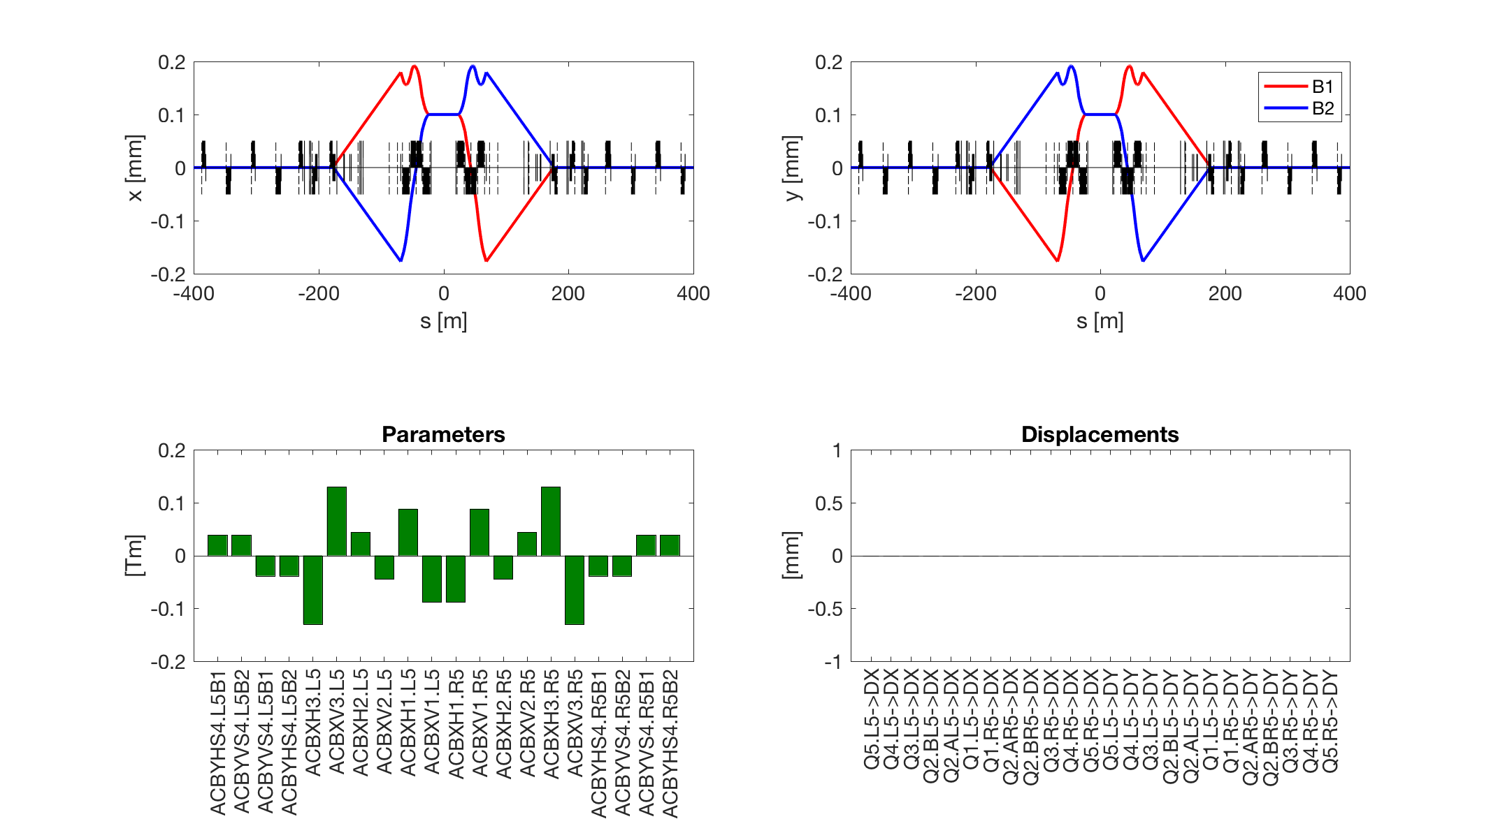
Improving lumi-scan knob
Q9 Q8 Q7 Q6 Q5 Q4
Without using MCBRD correctors.
Notes:
ACBYHS4.L5B1 0.039
ACBYVS4.L5B2 0.039
ACBYVS4.L5B1 -0.038
ACBYHS4.L5B2 -0.038
ACBXH3.L5 -0.130
ACBXV3.L5 0.130
ACBXH2.L5 0.044
ACBXV2.L5 -0.044
ACBXH1.L5 0.088
ACBXV1.L5 -0.088
ACBXH1.R5 -0.088
ACBXV1.R5 0.088
ACBXH2.R5 -0.044
ACBXV2.R5 0.044
ACBXH3.R5 0.130
ACBXV3.R5 -0.130
ACBYHS4.R5B1 -0.038
ACBYVS4.R5B2 -0.038
ACBYVS4.R5B1 0.039
ACBYHS4.R5B2 0.039
Q5.L5->DX 0.000
Q4.L5->DX 0.000
Q3.L5->DX 0.000
Q2.BL5->DX 0.000
Q2.AL5->DX 0.000
Q1.L5->DX 0.000
Q1.R5->DX 0.000
Q2.AR5->DX 0.000
Q2.BR5->DX 0.000
Q3.R5->DX 0.000
Q4.R5->DX 0.000
Q5.R5->DX 0.000
Q5.L5->DY 0.000
Q4.L5->DY 0.000
Q3.L5->DY 0.000
Q2.BL5->DY 0.000
Q2.AL5->DY 0.000
Q1.L5->DY 0.000
Q1.R5->DY 0.000
Q2.AR5->DY 0.000
Q2.BR5->DY 0.000
Q3.R5->DY 0.000
Q4.R5->DY 0.000
Q5.R5->DY 0.000

Slide 12
Improving lumi-scan knob: resume
Note that both versions introduce a small orbit at crab cavities (< 0.1mm)
Circuit | Lumi scan. [±0.1 mm] |  | Sum |  | Budget
 | Baseline | New | Baseline | New
MCBX1 | 0 | 0.09 | 1.44 | 1.53 | 2.5
MCBX2 | 0 | 0.05 | 0.96 | 1.01 | 2.5
MCBX3 | 0 | 0.13 | 3.94 | 4.07 | 4.5
MCBRD4 | 0.25 | 0 | 4.39 | 4.14 | 5
MCBY4 | 0.07 | 0 | 2.34 | 2.27 | 2.7
MCBYS4 | 0.11 | 0.04 | 2.38 | 2.31 | 2.7
MCBY5 | 0 | 0 | 0 | 0 | 2.7
MCBYS5 | 0 | 0 | 1.7 | 1.7 | 2.7
MCBC6 | 0 | 0 | 0.47 | 0.47 | 2.1
MCBC7 | 0 | 0 | 1.17 | 1.17 | 2.8
MCBC8 | 0 | 0 | 0 | 0 | 2.8
MCBC9 | 0 | 0 | 0 | 0 | 2.8
MCB10 | 0 | 0 | 0 | 0 | 1.895
Notes:
ACBYHS4.L5B1 0.039
ACBYVS4.L5B2 0.039
ACBYVS4.L5B1 -0.038
ACBYHS4.L5B2 -0.038
ACBXH3.L5 -0.130
ACBXV3.L5 0.130
ACBXH2.L5 0.044
ACBXV2.L5 -0.044
ACBXH1.L5 0.088
ACBXV1.L5 -0.088
ACBXH1.R5 -0.088
ACBXV1.R5 0.088
ACBXH2.R5 -0.044
ACBXV2.R5 0.044
ACBXH3.R5 0.130
ACBXV3.R5 -0.130
ACBYHS4.R5B1 -0.038
ACBYVS4.R5B2 -0.038
ACBYVS4.R5B1 0.039
ACBYHS4.R5B2 0.039
>>

Slide 13
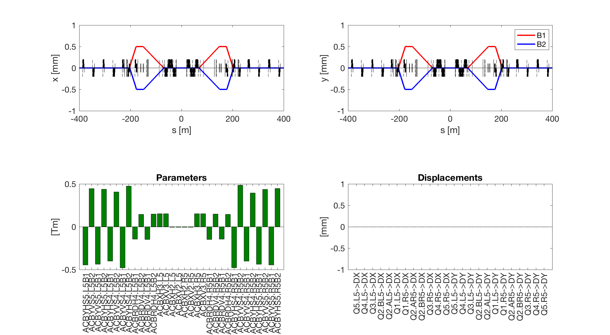
Simple beam separation at CC
Q9 Q8 Q7 Q6 Q5 Q4
Without using MCBRD correctors.
Notes:
My knob: -------
ACBYHS5.L5B1 -0.446
ACBYVS5.L5B2 0.445
ACBYVS5.L5B1 -0.437
ACBYHS5.L5B2 0.438
ACBYHS4.L5B1 -0.400
ACBYVS4.L5B2 0.406
ACBYVS4.L5B1 -0.480
ACBYHS4.L5B2 0.474
ACBRDH4.L5B1 -0.144
ACBRDV4.L5B2 0.144
ACBRDV4.L5B1 -0.148
ACBRDH4.L5B2 0.148
ACBXH3.L5 0.152
ACBXV3.L5 0.152
ACBXH2.L5 -0.006
ACBXV2.L5 -0.006
ACBXH2.R5 -0.006
ACBXV2.R5 -0.006
ACBXH3.R5 0.152
ACBXV3.R5 0.152
ACBRDH4.R5B1 -0.148
ACBRDV4.R5B2 0.148
ACBRDV4.R5B1 -0.144
ACBRDH4.R5B2 0.144
ACBYHS4.R5B1 -0.479
ACBYVS4.R5B2 0.485
ACBYVS4.R5B1 -0.401
ACBYHS4.R5B2 0.394
ACBYHS5.R5B1 -0.437
ACBYVS5.R5B2 0.436
ACBYVS5.R5B1 -0.446
ACBYHS5.R5B2 0.446

Slide 14
New CC adjustment knob
It only allows to “separate” the beams at CC.
  One should rely on rigid translation of both cryomodules.
Circuit | CC adjustment |  |  | Sum |  | Budget
 | 4 cc off. [±0.25 mm] | 2 cc off. [±0.5 mm] | New 2 CC separation [1 mm] | Baseline | New
MCBX1 | 0 | 0.2 | 0 | 1.44 | 1.24 | 2.5
MCBX2 | 0 | 0.2 | 0.01 | 0.96 | 0.77 | 2.5
MCBX3 | 0 | 0.6 | 0.15 | 3.94 | 3.49 | 4.5
MCBRD4 | 0.44 | 0.42 | 0.15 | 4.39 | 3.68 | 5
MCBY4 | 0.41 | 0.46 | 0 | 2.34 | 1.47 | 2.7
MCBYS4 | 0.41 | 0.46 | 0.48 | 2.38 | 1.99 | 2.7
MCBY5 | 0 | 0 | 0 | 0 | 0 | 2.7
MCBYS5 | 0.42 | 0.89 | 0.45 | 1.7 | 0.84 | 2.7
MCBC6 | 0 | 0 | 0 | 0.47 | 0.47 | 2.1
MCBC7 | 0 | 0 | 0 | 1.17 | 1.17 | 2.8
MCBC8 | 0 | 0 | 0 | 0 | 0 | 2.8
MCBC9 | 0 | 0 | 0 | 0 | 0 | 2.8
MCB10 | 0 | 0 | 0 | 0 | 0 | 1.895
Notes:
My knob: -------
ACBYHS5.L5B1 -0.446
ACBYVS5.L5B2 0.445
ACBYVS5.L5B1 -0.437
ACBYHS5.L5B2 0.438
ACBYHS4.L5B1 -0.400
ACBYVS4.L5B2 0.406
ACBYVS4.L5B1 -0.480
ACBYHS4.L5B2 0.474
ACBRDH4.L5B1 -0.144
ACBRDV4.L5B2 0.144
ACBRDV4.L5B1 -0.148
ACBRDH4.L5B2 0.148
ACBXH3.L5 0.152
ACBXV3.L5 0.152
ACBXH2.L5 -0.006
ACBXV2.L5 -0.006
ACBXH2.R5 -0.006
ACBXV2.R5 -0.006
ACBXH3.R5 0.152
ACBXV3.R5 0.152
ACBRDH4.R5B1 -0.148
ACBRDV4.R5B2 0.148
ACBRDV4.R5B1 -0.144
ACBRDH4.R5B2 0.144
ACBYHS4.R5B1 -0.479
ACBYVS4.R5B2 0.485
ACBYVS4.R5B1 -0.401
ACBYHS4.R5B2 0.394
ACBYHS5.R5B1 -0.437
ACBYVS5.R5B2 0.436
ACBYVS5.R5B1 -0.446
ACBYHS5.R5B2 0.446

Slide 15
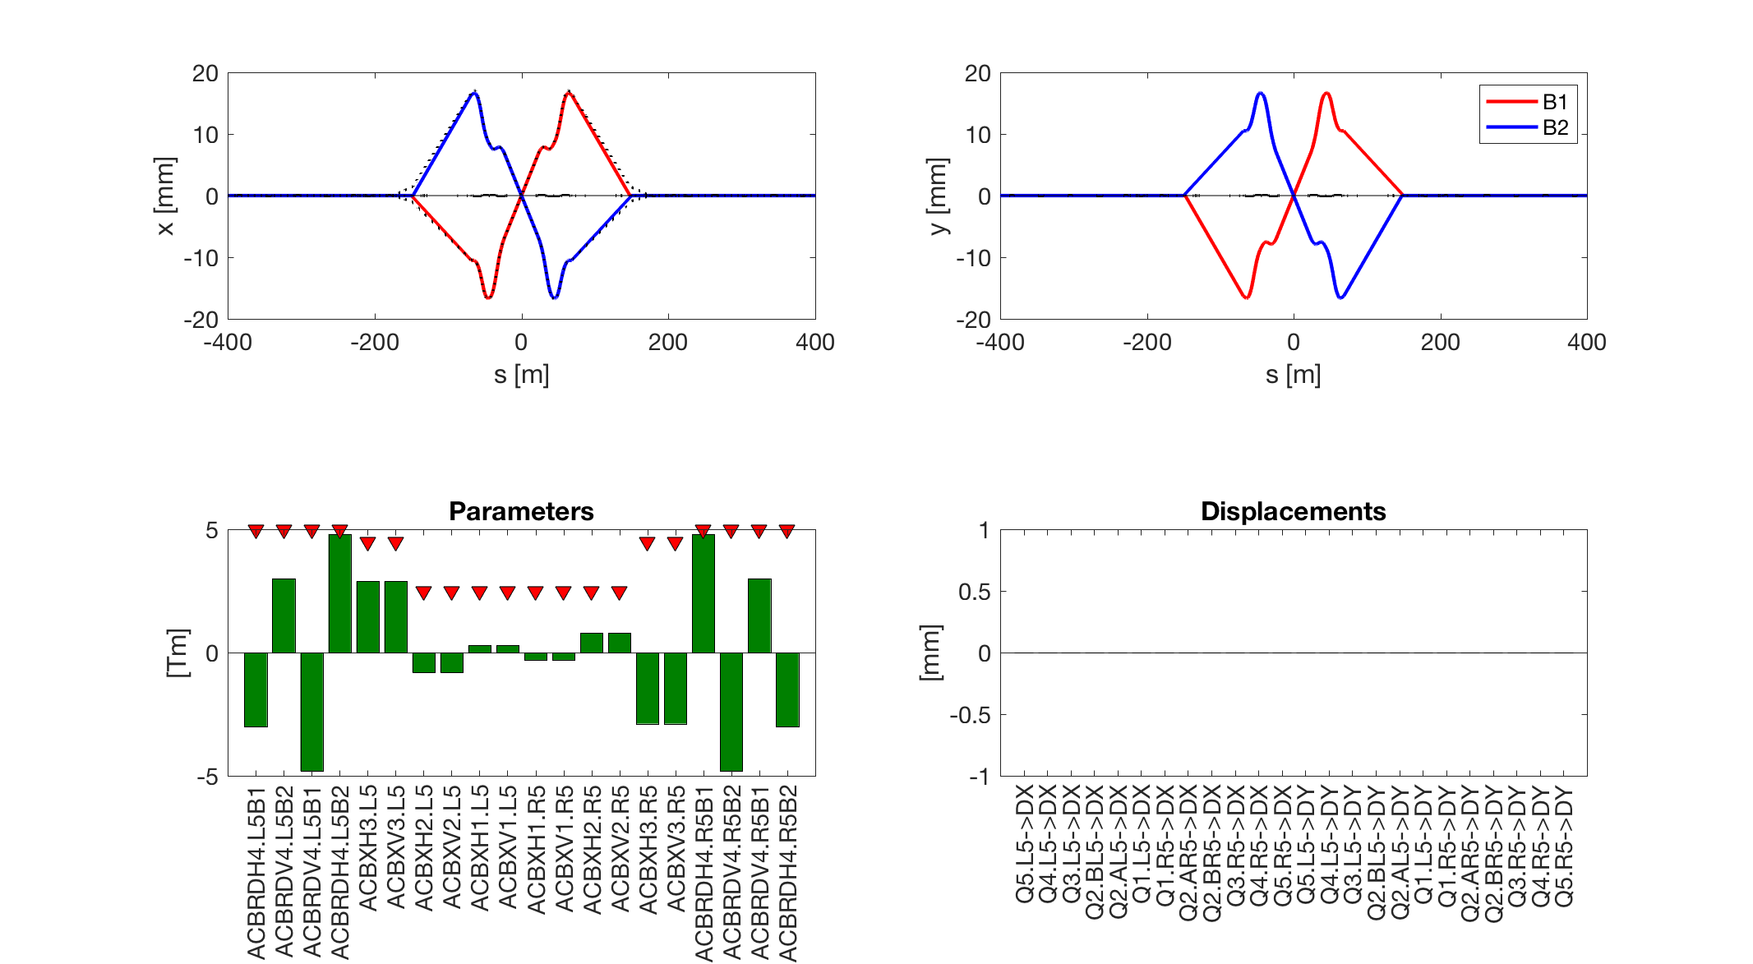
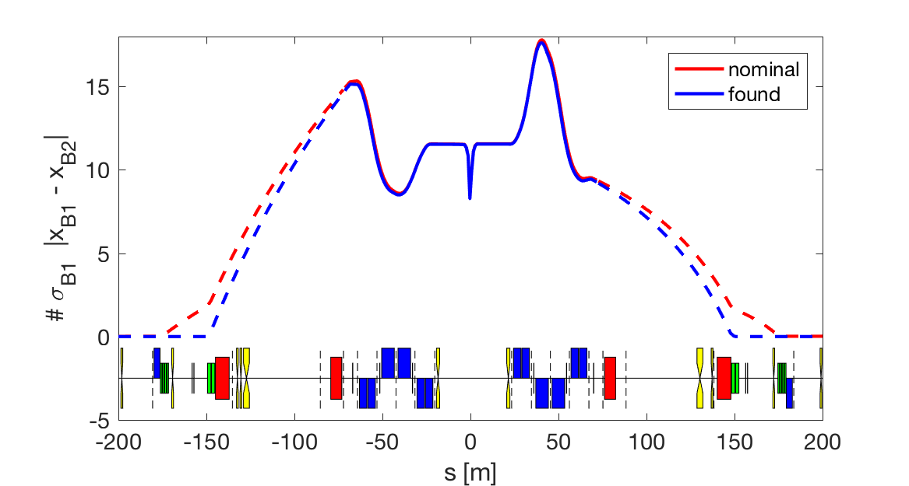
Improving crossing knob – No Q4
Orbit closed on D2 -> NO orbit at crab cavities
Q9 Q8 Q7 Q6 Q5 Q4
Using most of the strength on MCBRDs!
Not using quads
4.8 Tm at 7 TeV
Notes:
ACBRDH4.L5B1 -3.005
ACBRDV4.L5B2 3.005
ACBRDV4.L5B1 -4.803
ACBRDH4.L5B2 4.803
ACBXH3.L5 2.884
ACBXV3.L5 2.884
ACBXH2.L5 -0.801
ACBXV2.L5 -0.801
ACBXH1.L5 0.295
ACBXV1.L5 0.295
ACBXH1.R5 -0.295
ACBXV1.R5 -0.295
ACBXH2.R5 0.801
ACBXV2.R5 0.801
ACBXH3.R5 -2.884
ACBXV3.R5 -2.884
ACBRDH4.R5B1 4.803
ACBRDV4.R5B2 -4.803
ACBRDV4.R5B1 3.005
ACBRDH4.R5B2 -3.005
Q5.L5->DX 0.000
Q4.L5->DX 0.000
Q3.L5->DX 0.000
Q2.BL5->DX 0.000
Q2.AL5->DX 0.000
Q1.L5->DX 0.000
Q1.R5->DX 0.000
Q2.AR5->DX 0.000
Q2.BR5->DX 0.000
Q3.R5->DX 0.000
Q4.R5->DX 0.000
Q5.R5->DX 0.000
Q5.L5->DY 0.000
Q4.L5->DY 0.000
Q3.L5->DY 0.000
Q2.BL5->DY 0.000
Q2.AL5->DY 0.000
Q1.L5->DY 0.000
Q1.R5->DY 0.000
Q2.AR5->DY 0.000
Q2.BR5->DY 0.000
Q3.R5->DY 0.000
Q4.R5->DY 0.000
Q5.R5->DY 0.000

Slide 16
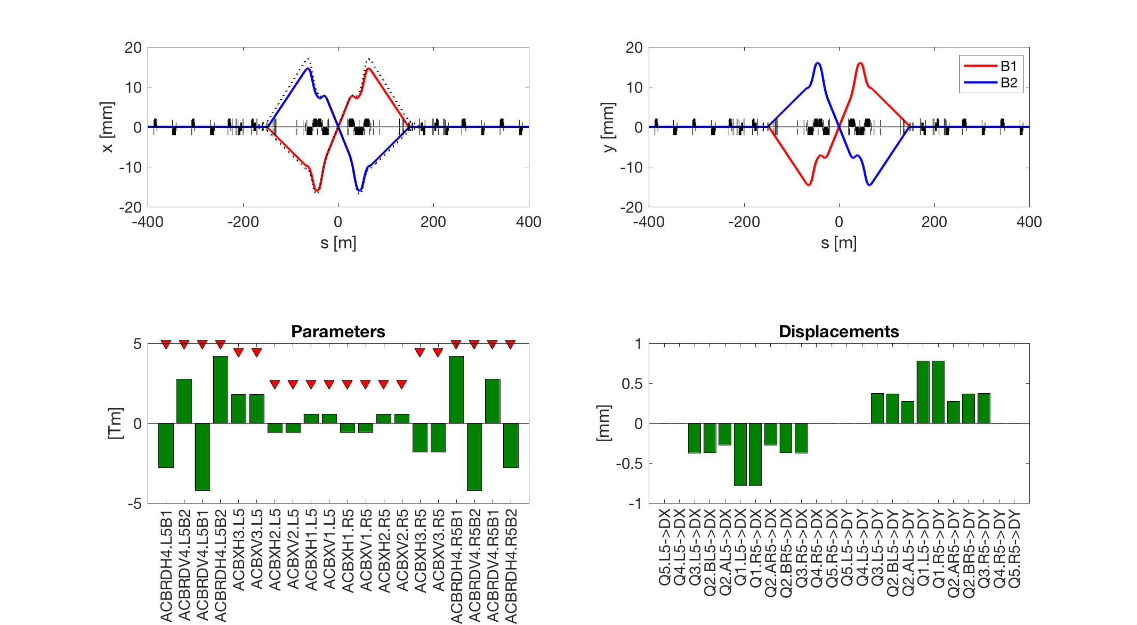
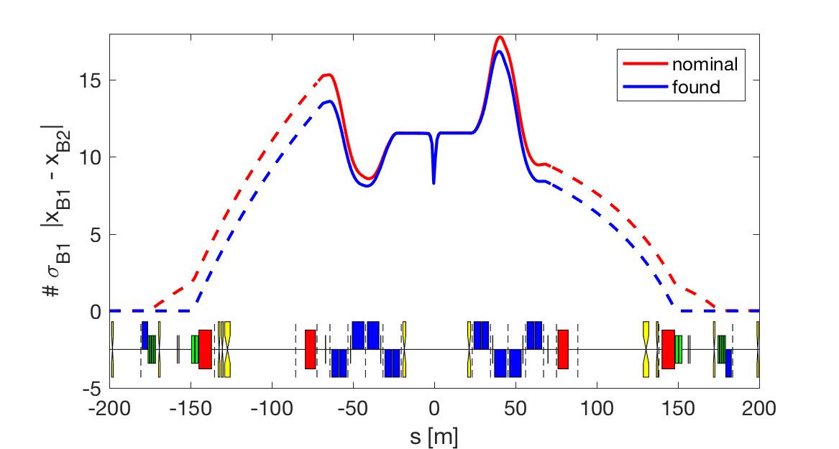
Improving crossing knob – No Q4 + quads
Loss of aperture
Orbit closed on D2 -> NO orbit at crab cavities
Q9 Q8 Q7 Q6 Q5 Q4
Using most of the strenght on MCBRDs!
Displacing the triplets
Notes:
My knob: -------
ACBRDH4.L5B1 -2.765
ACBRDV4.L5B2 2.765
ACBRDV4.L5B1 -4.186
ACBRDH4.L5B2 4.186
ACBXH3.L5 1.808
ACBXV3.L5 1.809
ACBXH2.L5 -0.568
ACBXV2.L5 -0.568
ACBXH1.L5 0.555
ACBXV1.L5 0.555
ACBXH1.R5 -0.555
ACBXV1.R5 -0.555
ACBXH2.R5 0.568
ACBXV2.R5 0.568
ACBXH3.R5 -1.808
ACBXV3.R5 -1.809
ACBRDH4.R5B1 4.186
ACBRDV4.R5B2 -4.186
ACBRDV4.R5B1 2.765
ACBRDH4.R5B2 -2.765
Q5.L5->DX 0.000
Q4.L5->DX 0.000
Q3.L5->DX -0.371
Q2.BL5->DX -0.368
Q2.AL5->DX -0.271
Q1.L5->DX -0.777
Q1.R5->DX -0.777
Q2.AR5->DX -0.271
Q2.BR5->DX -0.368
Q3.R5->DX -0.371
Q4.R5->DX 0.000
Q5.R5->DX 0.000
Q5.L5->DY 0.000
Q4.L5->DY 0.000
Q3.L5->DY 0.371
Q2.BL5->DY 0.368
Q2.AL5->DY 0.271
Q1.L5->DY 0.777
Q1.R5->DY 0.777
Q2.AR5->DY 0.271
Q2.BR5->DY 0.368
Q3.R5->DY 0.371
Q4.R5->DY 0.000
Q5.R5->DY 0.000

Slide 17
All “new” knobs together
It is in the “other” plane, so they should not sum up.
Circuit | Cros. [±295 µrad] | Sep. [±0.75 mm] | Off. (far med) [±2 mm] | 2 crab separation [1 mm] | Lumi scan. [±0.1 mm] | Sum (baseline) | Sum New | Budget
MCBX1 | 0.29 | 0.08 | 0 | 0 | 0.09 | 1.44 | 0.38 | 2.5
MCBX2 | 0.8 | 0.08 | 0 | 0.01 | 0.05 | 0.96 | 0.86 | 2.5
MCBX3 | 2.9 | 0.20 | 0 | 0.15 | 0.13 | 3.94 | 3.18 | 4.5
MCBRD4 | 4.8 | 0.10 | 0 | 0.15 | 0 | 4.39 | 4.95 | 5
MCBY4 | 0 | 0.02 | 0 | 0 | 0 | 2.34 | 0 | 2.7
MCBYS4 | 0 | 0.02 | 0 | 0.48 | 0.04 | 2.38 | 0.52 | 2.7
MCBY5 | 0 | 0 | 0 | 0 | 0 | 0 | 0 | 2.7
MCBYS5 | 0 | 0 | 0.80 | 0.45 | 0 | 1.7 | 1.25 | 2.7
MCBC6 | 0 | 0 | 0.31 | 0 | 0 | 0.47 | 0.31 | 2.1
MCBC7 | 0 | 0 | 0.82 | 0 | 0 | 1.17 | 0.82 | 2.8
MCBC8 | 0 | 0 | 0.27 | 0 | 0 | 0 | 0.27 | 2.8
MCBC9 | 0 | 0 | 0 | 0 | 0 | 0 | 0 | 2.8
MCB10 | 0 | 0 | 0 | 0 | 0 | 0 | 0 | 1.895

Slide 18
New knobs: orbit effects
Solid is B1, dashed is B2
Q7 Q6 Q5 Q4 Q3 Q2 Q1

Slide 19
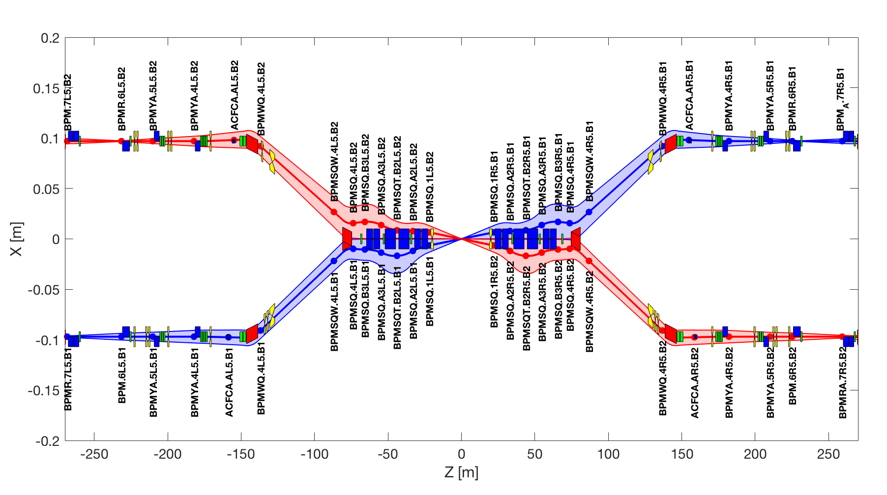
Where are the BPMs?
Baseline crossing orbit (taking into account of Survey) with 6σ beam size (taking into account beta and dispersion)
Warm -> they are not on movers
TAXS:
on mover
TAXN:
on mover
Warning: using only BPMs one cannot be sure of the orbit in crab cavities

Slide 20
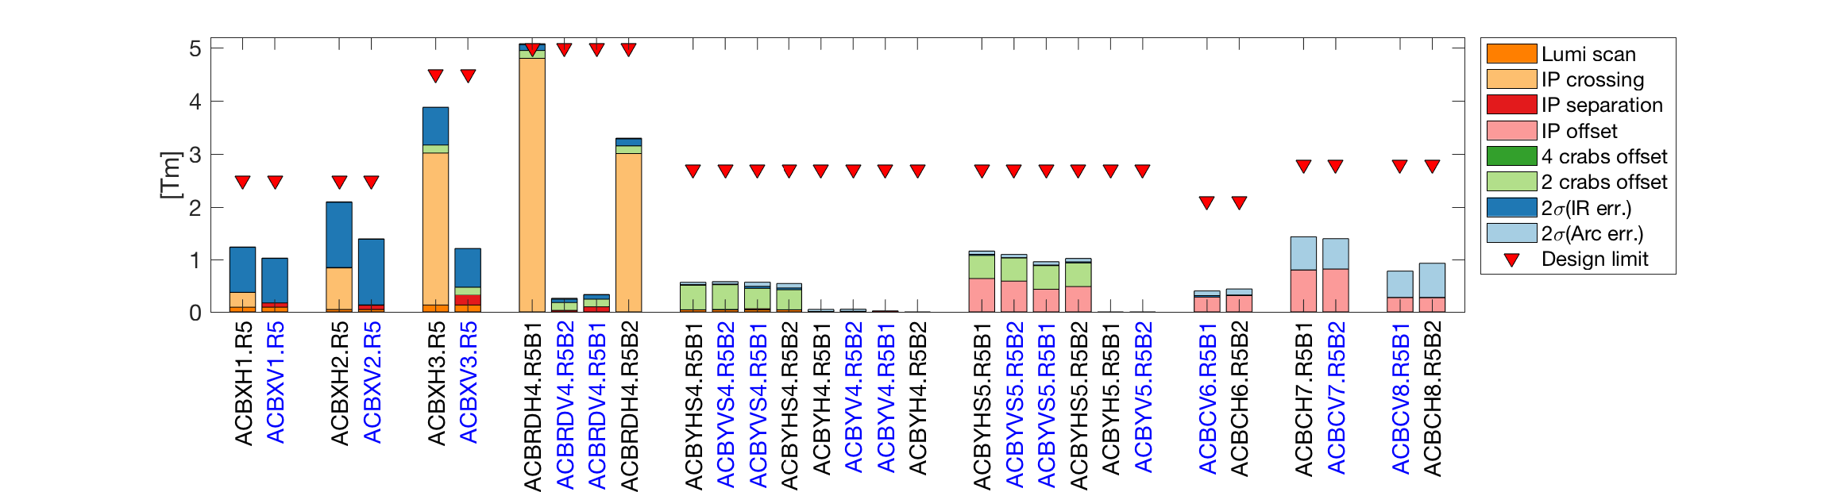
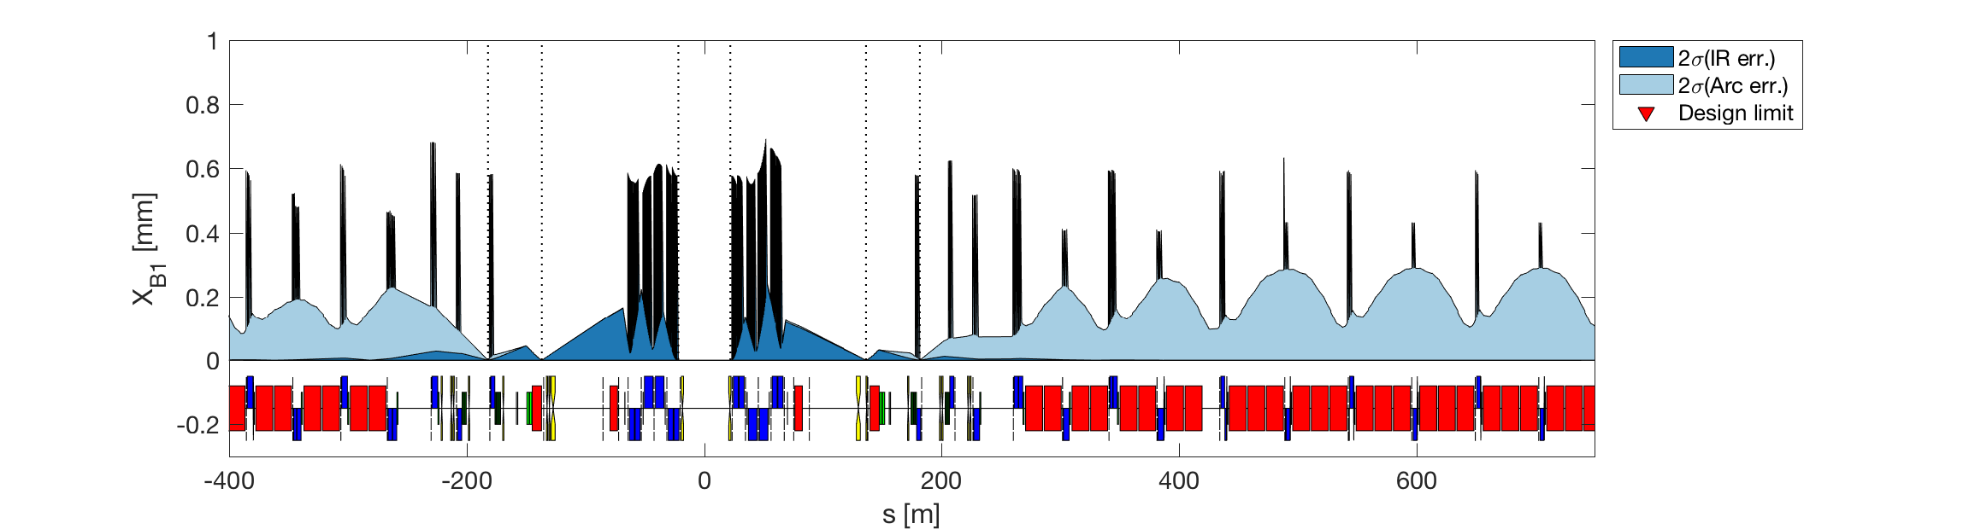
New orbit correction
Possible to remove those correctors
BPMs next to IP
First BPMs next to CC
W.r.t. quadrupole centre
Up to 0.05 mm orbit at CC
Notes:
printToFileName = 'version05Dec_noS5.csv';

Slide 21
Resumé: required budget correctors
Values in Tm at 7 TeV.
Circuit | IR err. [2*std] | Arc err. [2*std] | Lumi scan. [±0.1 mm] | Cros. [±295 µrad] | Sep. [±0.75 mm] | IP Off. [±2 mm] *** | sum | budget
ACBX1 | 0.86 | 0.01 | 0.09 | 0.3 | 0.08 | 0 | 1.25 | 2.50
ACBX2 | 1.26 | 0.01 | 0.04 | 0.8 | 0.08 | 0 | 2.1 | 2.50
ACBX3 | 0.73 | 0 | 0.13 | 2.88 | 0.2 | 0 | 3.74 | 4.50
ACBRD4 | 0.13 | 0.02 | 0 | 4.8 | 0.1 | 0 | 4.93 | 5.00
ACBY4 | 0.01 | 0.04 | 0 | 0 | 0.02 | 0 | 0.06 | 2.70
ACBYS4 | 0.04 | 0.08 | 0.04 | 0 | 0.02 | 0 | 0.15 | 2.70
ACBY5 | 0 | 0 | 0 | 0 | 0 | 0 | 0 | 2.70
ACBYS5 | 0.02 | 0.06 | 0 | 0 | 0 | 0.8 | 0.86 | 2.70
ACBC6 | 0.03 | 0.11 | 0 | 0 | 0 | 0.31 | 0.42 | 2.10
ACBC7 | 0 | 0.63 | 0 | 0 | 0 | 0.82 | 1.45 | 2.80
ACBC8 | 0.01 | 0.66 | 0 | 0 | 0 | 0.27 | 0.93 | 2.80
ACBC9 | 0 | 0.59 | 0 | 0 | 0 | 0 | 0.59 | 2.80
ACB10 | 0 | 0.65 | 0 | 0 | 0 | 0 | 0.65 | 1.90
ACB11 | 0 | 0.58 | 0 | 0 | 0 | 0 | 0.58 | 1.90
ACB12 | 0 | 0.62 | 0 | 0 | 0.02 | 0 | 0.64 | 1.90
ACB13 | 0 | 0.62 | 0 | 0 | 0 | 0 | 0.62 | 1.90
ACB14 | 0 | 0.62 | 0 | 0 | 0 | 0 | 0.62 | 1.90
ACB15 | 0 | 0.62 | 0 | 0 | 0 | 0 | 0.62 | 1.90
*** It requires to translate Q1-Q4 of 2 mm in the direction of the required offset.

Slide 22
Resumé: aperture loss/orbit [mm]
Circuit | IR err. [2*std] | Arc err. [2*std] | Lumi scan. [±0.1 mm] | Cros. [±295 µrad] | Sep. [±0.75 mm] | IP Off. [±2 mm] *** | sum
TAXS | 0 | 0 | 0.1 | 5.89 | 0.75 | 0 | 5.99
MQXFA.[AB]1 | 0.61 | 0 | 0.12 | 11.02 | 0.91 | 0 | 11.75
MQXFB.[AB]2 | 0.69 | 0 | 0.19 | 16.68 | 1.2 | 0 | 17.56
MQXFA.[AB]3 | 0.66 | 0.01 | 0.16 | 16.66 | 0.82 | 0 | 17.48
MBXF | 0.16 | 0.01 | 0.17 | 14.9 | 0.47 | 0 | 15.23
TAXN | 0.02 | 0 | 0.08 | 3.89 | 0.16 | 0 | 3.99
MBRD | 0.03 | 0 | 0.06 | 1.71 | 0.1 | 0 | 1.8
MCBRD | 0.04 | 0 | 0.05 | 0.29 | 0.06 | 0 | 0.38
MCBY[HV].[AB]?4 | 0.01 | 0.02 | 0.01 | 0 | 0 | 0 | 0.03
MQY.4 | 0 | 0.58 | 0 | 0 | 0 | 0 | 0.58
TCLMB.5 | 0.02 | 0.05 | 0 | 0 | 0 | 0 | 0.05
MCBY[HV].[AB]?5 | 0.02 | 0.07 | 0 | 0 | 0 | 0 | 0.07
MQY.5 | 0.02 | 0.62 | 0 | 0 | 0 | 1.96 | 2.58
TCLMC.6 | 0.03 | 0.14 | 0 | 0 | 0 | 1.79 | 1.93
MCBC[HV].6 | 0.03 | 0.17 | 0 | 0 | 0 | 1.74 | 1.91
MQML.6 | 0.03 | 0.69 | 0 | 0 | 0 | 1.76 | 2.45
MCBC[HV].7 | 0.01 | 0.22 | 0 | 0 | 0 | 0.55 | 0.77
MQM.[AB]7 | 0.01 | 0.61 | 0 | 0 | 0 | 0.57 | 1.18
MCBC[HV].8 | 0.01 | 0.23 | 0 | 0 | 0 | 0 | 0.23
MQML.8 | 0.01 | 0.61 | 0 | 0 | 0 | 0.06 | 0.67
MCBC[HV].9 | 0 | 0.19 | 0 | 0 | 0 | 0 | 0.19
MQMC.9 | 0 | 0.59 | 0 | 0 | 0 | 0 | 0.59
MQM.9 | 0 | 0.6 | 0 | 0 | 0 | 0 | 0.60
MCB[HV].10 | 0 | 0.26 | 0 | 0 | 0 | 0 | 0.26
MQML.10 | 0 | 0.59 | 0 | 0 | 0 | 0 | 0.59
*** It requires to translate Q1-Q4 of 2 mm in the direction of the required offset.

Slide 23
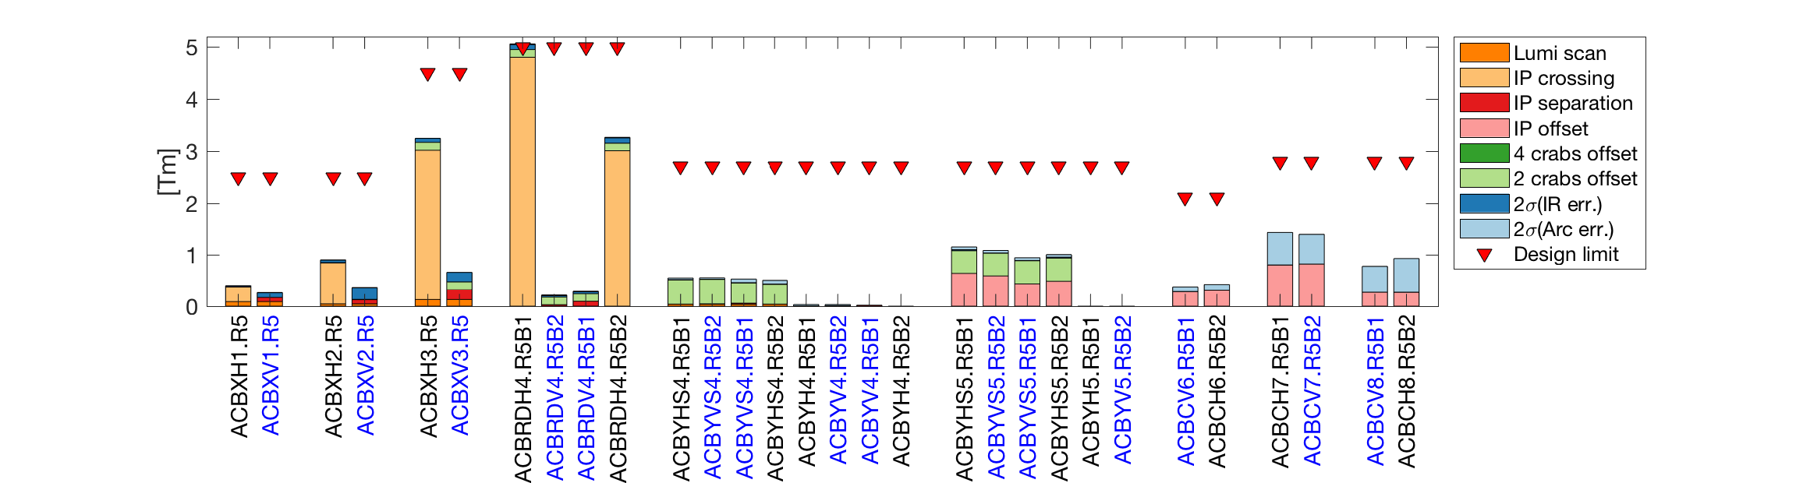
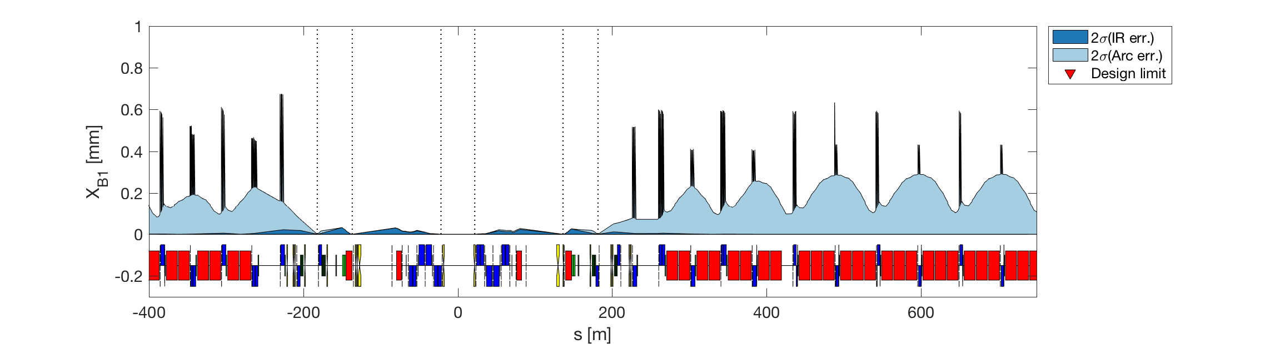
New orbit correction (no Q1-5 DX/DY)
Major impact
Still up to ~0.04 mm orbit at CC
Notes:
printToFileName = 'version05Dec_noS5_noQ15.csv';

Slide 24
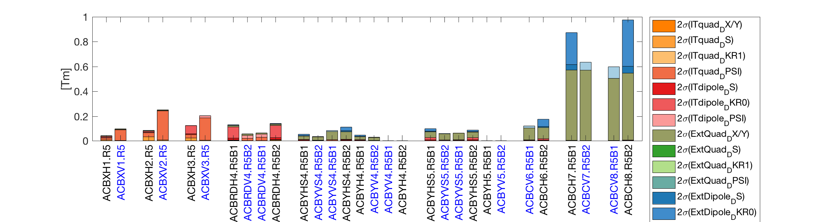
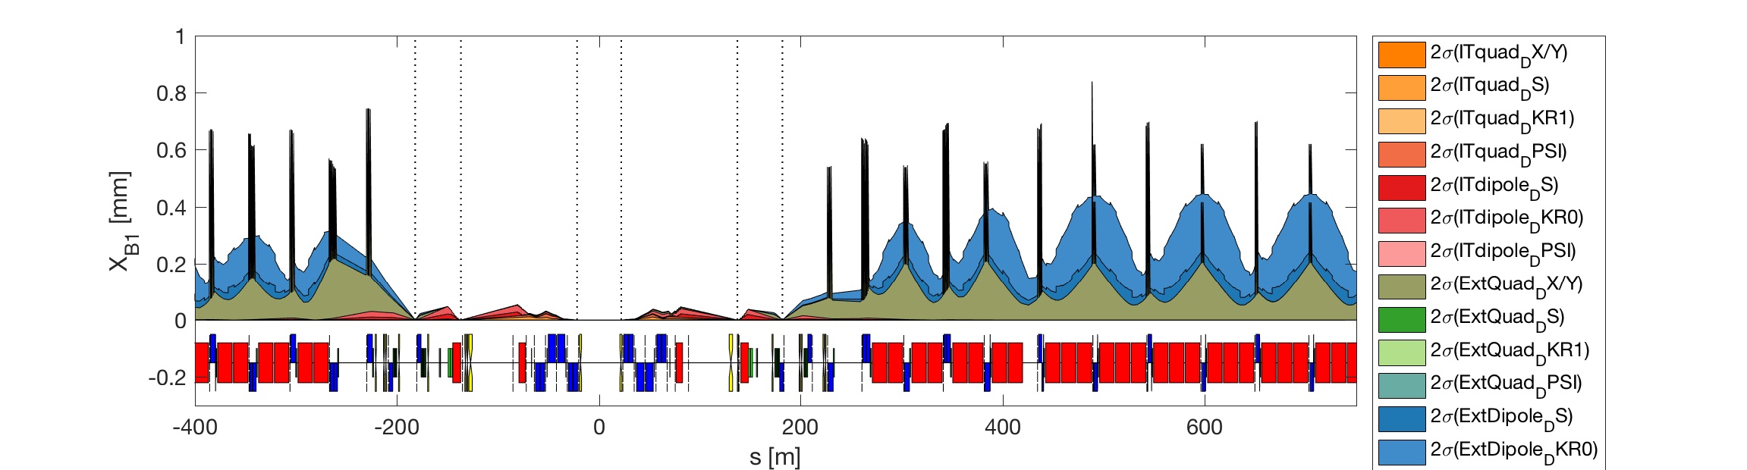
New orbit correction (no Q1-5 DX/DY) - split

Slide 25
Open question: how to align quads?
Possible procedure:
Identify centre of quads.
  Perform k-modulation on each single quad.
    Look at closed orbit perturbation.
  Modify orbit with corrector at best phase advance until no effect by k-modulation.
    Identify centre of quadrupole as “zero orbit” on the attached BPM.
Back to initial orbit.
  Measure orbit response by quadrupole offset.
  Measure orbit response of correctors.
Find best quadrupole movement that minimises orbit and correctors strength.
…

Slide 26
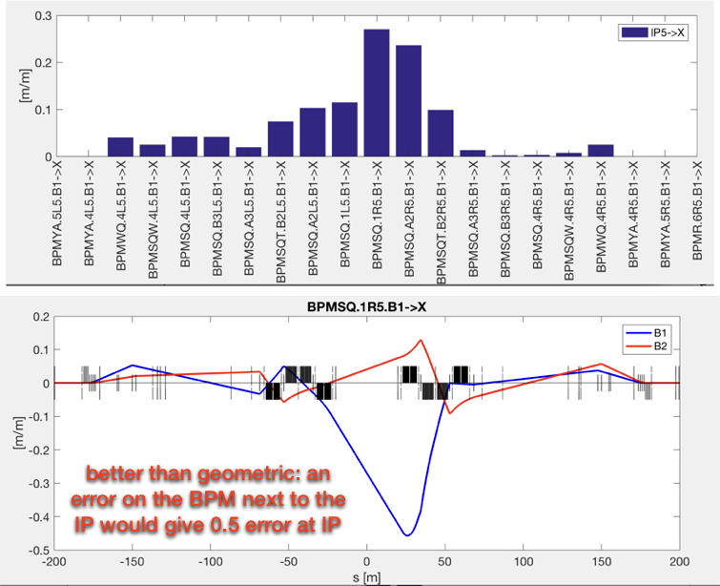
Open question: impact of BPM noise
Noise/offset on one BPM can induce an IP orbit shift.

Slide 27
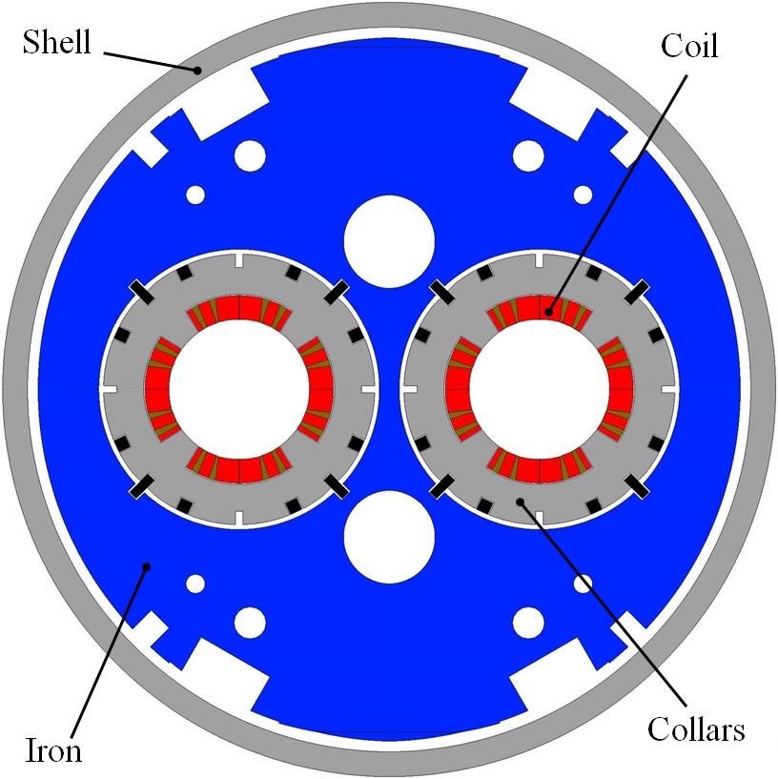
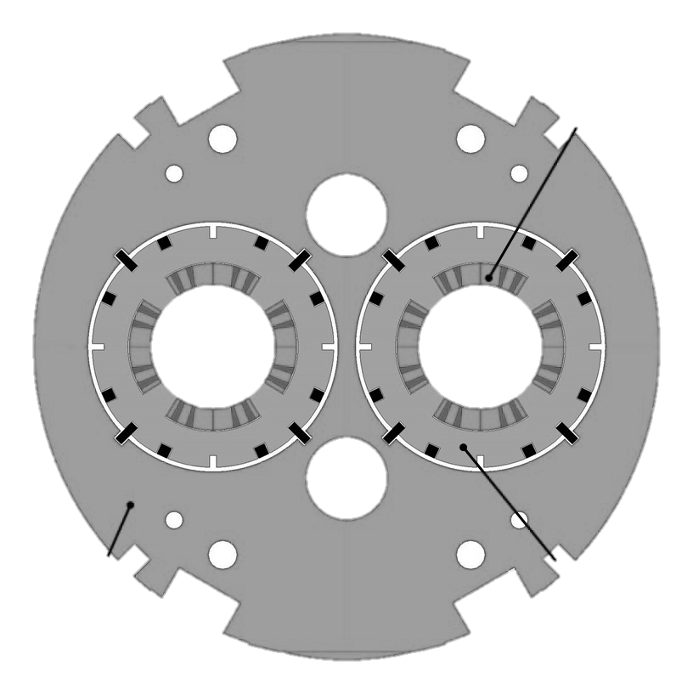
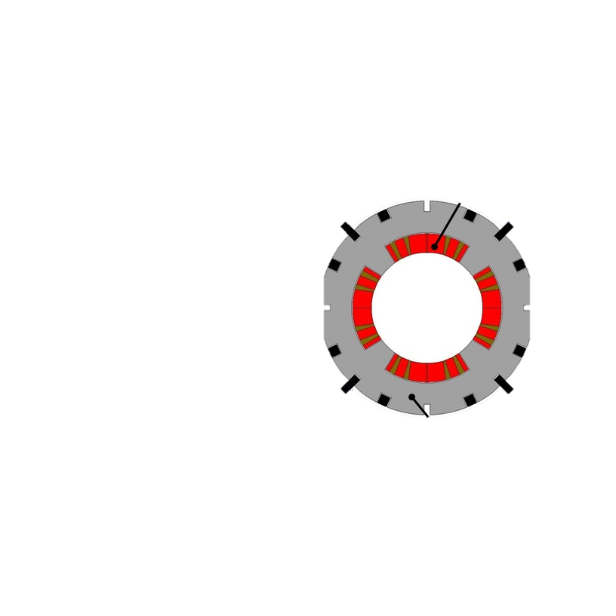
Additional remark: transverse errors
Not all quads are independent.
  e.g. if you move Q1A, you also move Q1B…
The two apertures are not independent…
For the time being we consider everything independent.
1 mrad roll over 194/2 mm aperture separation, means +- 0.1 mm correlated vertical displacement!
At the moment we are considering this case as the most generic one

Slide 28
Summary
The offset knob can be implemented profiting of the alignment system
The crossing knob can be closed on D2
  But minimum margin on MCBRD
We could remove 2 correctors on Q4 and Q5
  Strong assumption that CC can be easily moved, possibly during commissioning with beam
Alignment of the quadrupoles with beam could be beneficial for aperture optimisation
  A procedure needs to be properly implemented and verified (MD?)
The impact of BPM noise/error on the orbit correction procedure needs to be assessed
  Strongly depends on type of error, and orbit correction strategy
  Need to profit of LHC experience
Are all misalignment assumptions correct?

Slide 29
Plans
Use movers during a technical stop
- implement IP offset, but still have a residual alignment error of (0.5 mm or better if possible)
- less corrector in Q1-Q4, more in Q5-Q7, gain in aperture in Q1-Q4
Use movers during beam commissioning
- see if a procedure exists to reduce the residual alignment errors to 0 mm with beam observations
- estimate the reduction of orbit corrector strengths 0.5, 0.0
Residual orbit at the crab cavities
- How much we are confident of the orbit at the crab cavities?
- That is how much do we have to move the beam to center the cavity or move the cavity (if possible) to center the beam.
How to do a good a crossing angle BPM (BI specification, K-modulation vs beta-error)
OK
TO DO!
OK
To follow up
To follow up

Slide 30
Backup

Slide 31
Are all imperfections correctly treated by a linear approximation?
In section where strong non-linearities are present (e.g. nominal sextupoles), the linear approximation might not be correct!
In case of a pure linear lattice (only quadrupoles and bends):
Working hypothesis:
  All non-linear elements (e.g. arc sextupoles) are turned off in the model.
  We are looking for a solution in proximity of the ideal orbit. Non-linear and second order effects are supposed to be small.
Imperfection | Linear? | Explanation
Quad. incoming orbit (x_{e}) | yes | In first approximation one can write the orbit kick (Δx’) as:
Quad. misalignment (Δx_{Q}) | yes
Quad. field error (Δk_{Q}/k_{Q0}) | ni
Quad. roll | ni | Similar to field error (depends on x₀) + coupling.
Bend. roll (θ) | Yes (small θ)
Bend. field error (Δk_{B}/k_{B0}) | yes
Longitudinal misalignments | ni | Linear for bends, similar to field error for quads.

Slide 32
Treatment of errors
Before
  Always orbit with respect to ideal orbit (x/y = 0)
After
  Considering that if you move a quadrupole, then the “zero” aperture loss is when the beam is off-centre with respect to the ideal orbit…. i.e. it should pass in the middle of the quadrupole…

Slide 33
Simplified treatment of the problem (last year)
In first approximation the problem is linear and two are the main equations:
  Orbit variation along the a beamline (Δx) is linear with respect to misalignments/errors (Δe)
  And with respect to correctors strengths (Δc)
  The linear coefficients form the matrices RM_{e} and RM_{c}
The response matrices can be measured/extracted by exciting the MAD-X model and measuring the response on the relevant optics parameters.
One is interested only to correct some key* locations. E.g. in case of misalignments:
  Zero orbit variation at the boundaries of the line (to be “transparent” to the ideal machine)
  No variation of position and crossing angle at the IP
  No orbit excursion at the crab cavity location.
The problem is simplified to the following equation:
  Where the * matrices are a subset of the measured matrices RM_{e} and RM_{c} keeping only the important rows.
The residual orbit at other locations is simply:

Slide 34
Treatment of the problem small improvements
RM_{o} is sort of an Identity matrix
In first approximation the problem is linear and two are the main equations:
  Orbit variation along the a beamline (Δx) is linear with respect to misalignments/errors (Δe)
  And with respect to correctors strengths (Δc)
  The linear coefficients form the matrices RM_{e} and RM_{c}
The response matrices can be measured/extracted by exciting the MAD-X model and measuring the response on the relevant optics parameters.
One is interested only to correct some key* locations. E.g. in case of misalignments:
  Zero orbit variation at the boundaries of the line (to be “transparent” to the ideal machine)
  No variation of position and crossing angle at the IP
  No orbit excursion at the crab cavity location.
The problem is simplified to the following equation:
  Where the * matrices are a subset of the measured matrices RM_{e} and RM_{c} keeping only the important rows.
The residual orbit at other locations is simply:
New RM_{e} matrix
Use only nearby BPMs

Slide 35
New orbit correction (no ACBRD)
Same as before, but trying to remove orbit correction from MCBRD correctors.

Slide 36
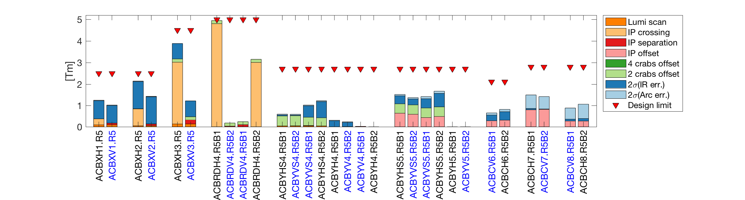
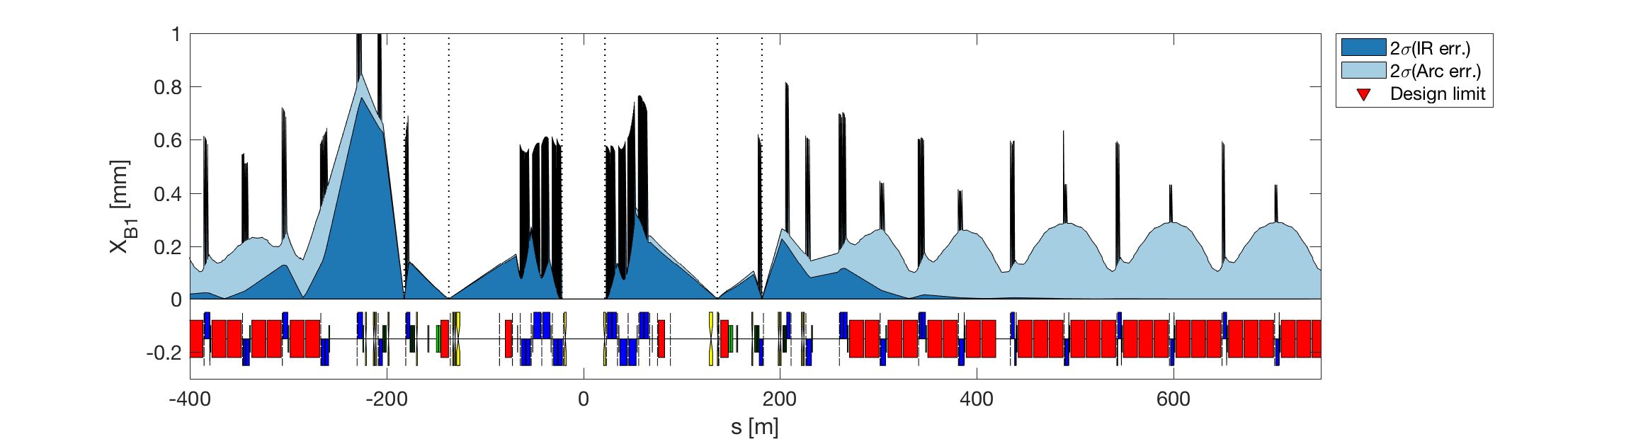
New orbit correction (no ACBRD)

Slide 37
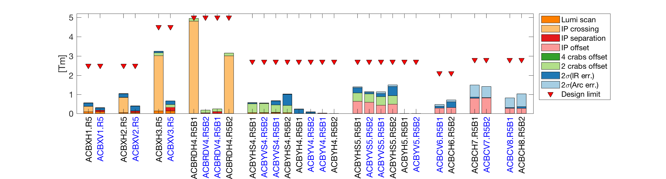
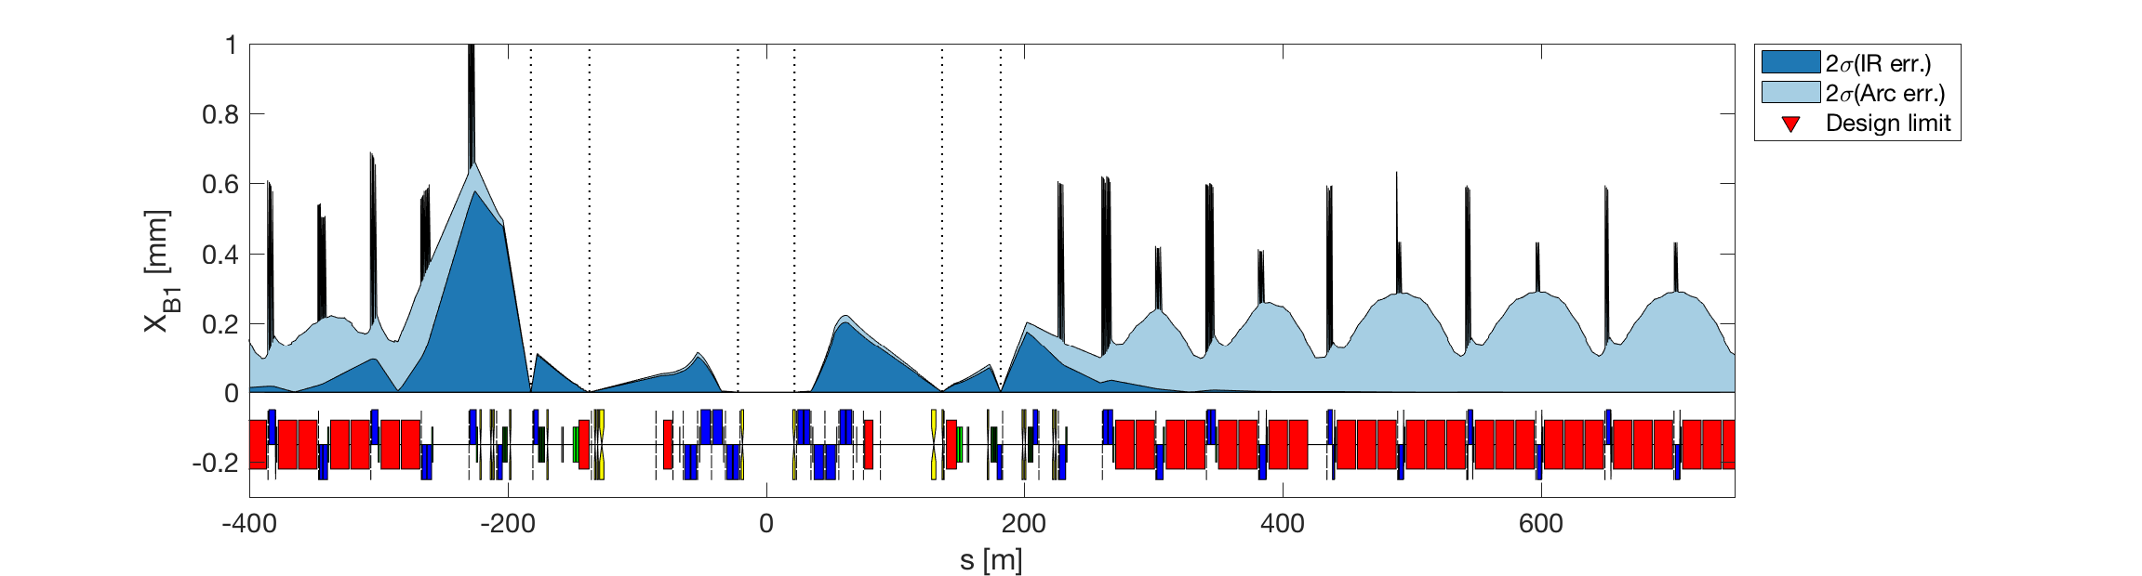
New orbit correction (no ACBRD; no Q1-5 DX/DY)

Slide 38
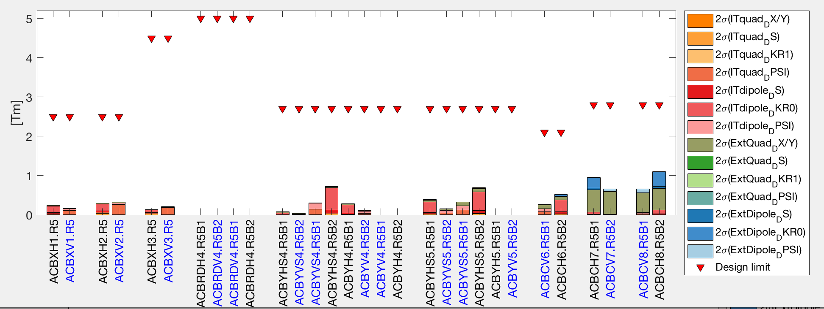
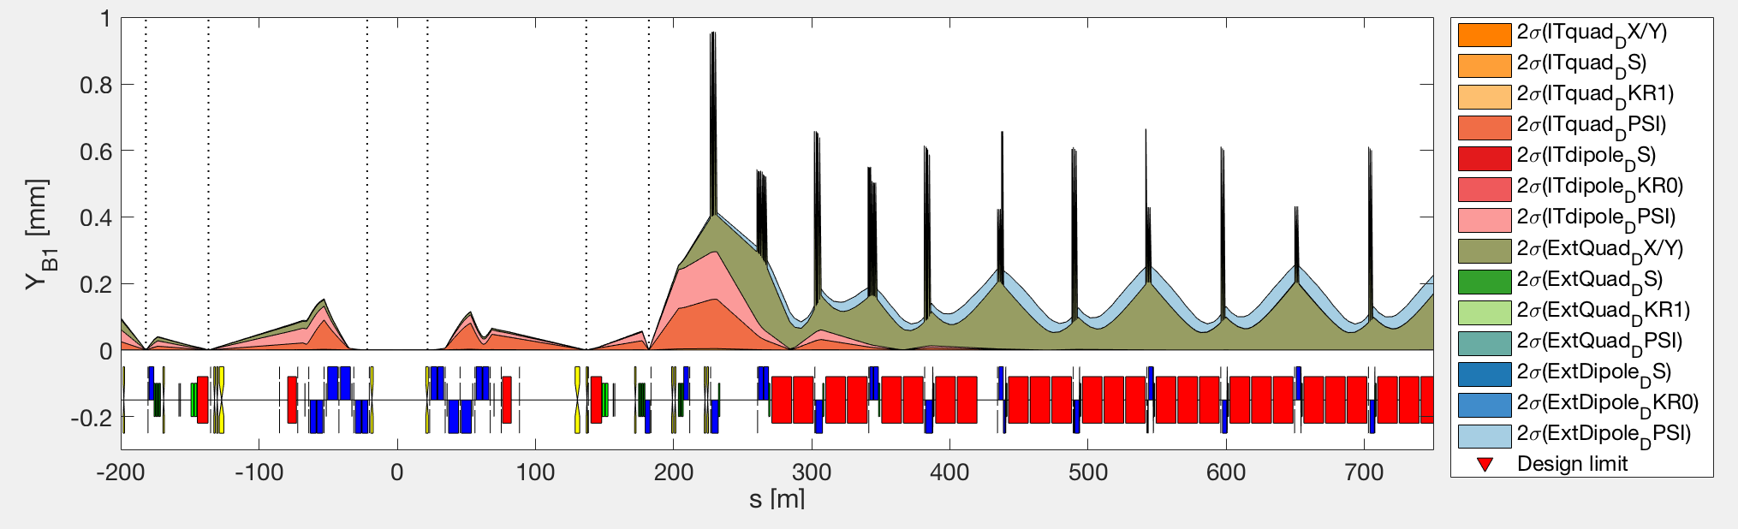
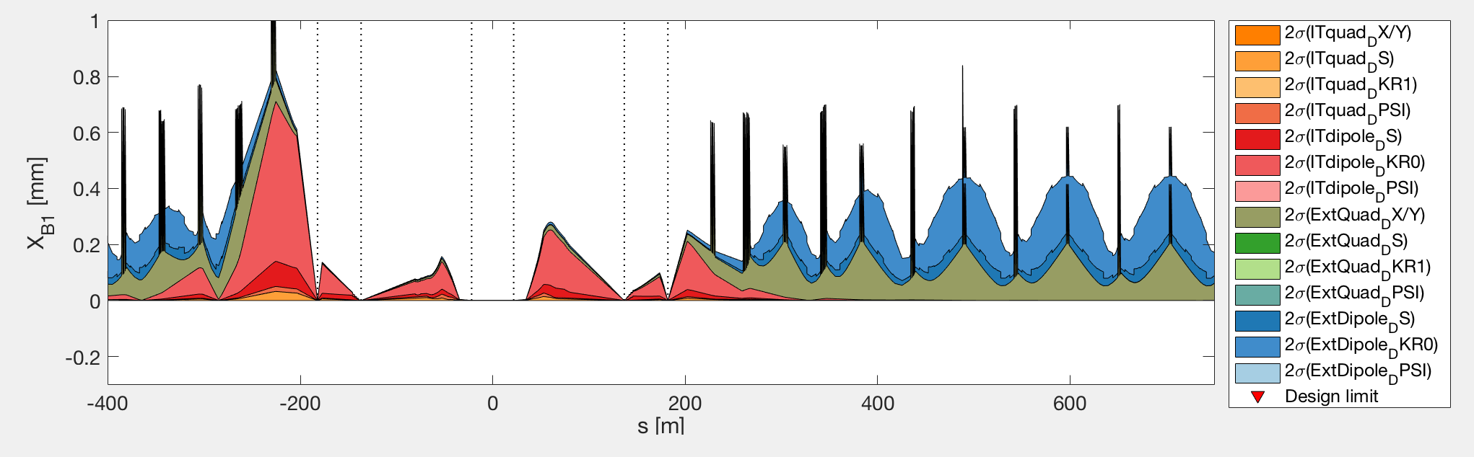
New orbit correction (no ACBRD; no Q1-5 DX/DY)
D1/D2 DKR0

Slide 39
CC alignment knobs
Assumptions from Miriam’s paper:
  residual orbit of ±0.5 mm can be tolerated in the crab cavities
    https://indico.cern.ch/event/307357/ (2014)
    https://indico.cern.ch/event/323860/ (2014)
  crab cavities represent very sensitive BPMs and one can assume that the orbit displacement at the location of the crab cavities would be known within 0.01–0.1 mm [R. Calaga – private com]
Additional investigations by Riccardo (24/11/2016):
  crabbing plane to max ±1mm per cavity, or up to ±2mm for transients of few ms. ±3mm if off.
Additional question: how precise one can measure the orbit? In both planes? With/without RF?
In the baseline only one pair of CC per beam per side. The two pairs are in two independent cryomodules that can be moved independently.

Slide 40
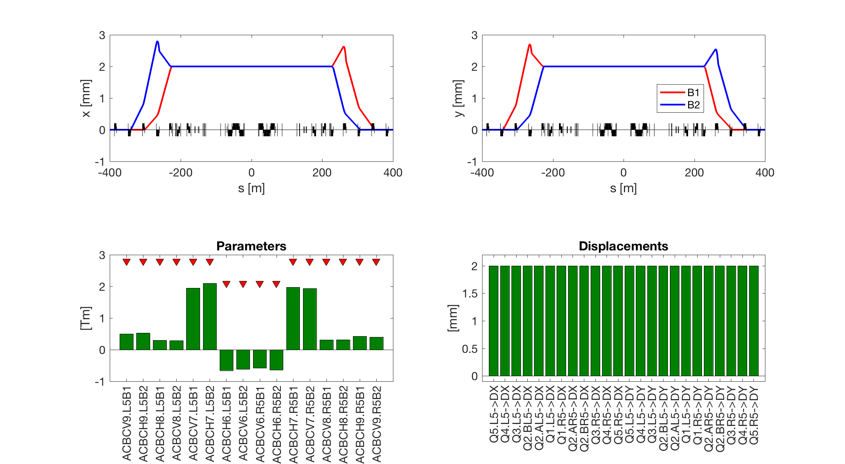
Getting rid of offset knob – far-short
Orbit bump from Q9 to Q6
Q9 Q8 Q7 Q6 Q5 Q4
Moving of 2 mm all elements
from Q5.L to Q5.R:
Notes:
ACBCV9.L5B1 0.501
ACBCH9.L5B2 0.531
ACBCH8.L5B1 0.295
ACBCV8.L5B2 0.290
ACBCV7.L5B1 1.947
ACBCH7.L5B2 2.100
ACBCH6.L5B1 -0.656
ACBCV6.L5B2 -0.618
ACBCV6.R5B1 -0.577
ACBCH6.R5B2 -0.642
ACBCH7.R5B1 1.975
ACBCV7.R5B2 1.938
ACBCV8.R5B1 0.312
ACBCH8.R5B2 0.316
ACBCH9.R5B1 0.426
ACBCV9.R5B2 0.396

Slide 41
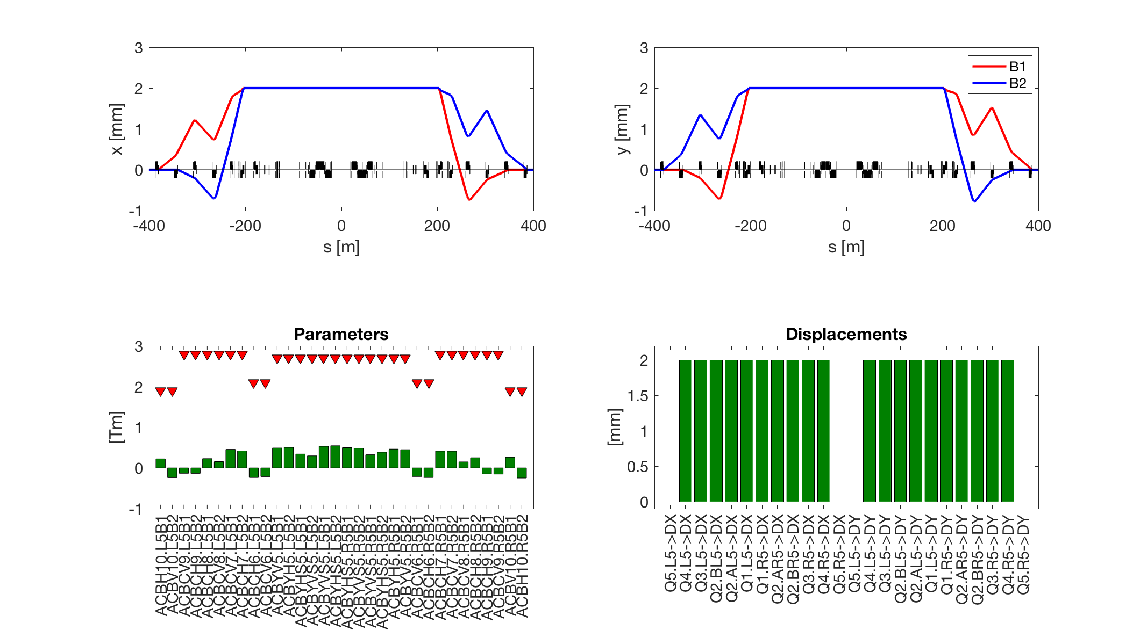
Getting rid of offset knob – far-long
Orbit bump from Q10 to Q5
Q9 Q8 Q7 Q6 Q5 Q4
Moving of 2 mm all elements
from Q4.L to Q4.R:
Notes:
ACBH10.L5B1 0.223
ACBV10.L5B2 -0.239
ACBCV9.L5B1 -0.132
ACBCH9.L5B2 -0.133
ACBCH8.L5B1 0.228
ACBCV8.L5B2 0.155
ACBCV7.L5B1 0.457
ACBCH7.L5B2 0.419
ACBCH6.L5B1 -0.235
ACBCV6.L5B2 -0.212
ACBYV5.L5B1 0.491
ACBYH5.L5B2 0.505
ACBYHS5.L5B1 0.342
ACBYVS5.L5B2 0.297
ACBYVS5.L5B1 0.532
ACBYHS5.L5B2 0.546
ACBYHS5.R5B1 0.498
ACBYVS5.R5B2 0.483
ACBYVS5.R5B1 0.324
ACBYHS5.R5B2 0.388
ACBYH5.R5B1 0.462
ACBYV5.R5B2 0.448
ACBCV6.R5B1 -0.211
ACBCH6.R5B2 -0.236
ACBCH7.R5B1 0.415
ACBCV7.R5B2 0.413
ACBCV8.R5B1 0.148
ACBCH8.R5B2 0.250
ACBCH9.R5B1 -0.147
ACBCV9.R5B2 -0.149
ACBV10.R5B1 0.265
ACBH10.R5B2 -0.248
Q5.L5->DX 0.000
Q4.L5->DX 2.000
Q3.L5->DX 2.000
Q2.BL5->DX 2.000
Q2.AL5->DX 2.000
Q1.L5->DX 2.000
Q1.R5->DX 2.000
Q2.AR5->DX 2.000
Q2.BR5->DX 2.000
Q3.R5->DX 2.000
Q4.R5->DX 2.000
Q5.R5->DX 0.000
Q5.L5->DY 0.000
Q4.L5->DY 2.000
Q3.L5->DY 2.000
Q2.BL5->DY 2.000
Q2.AL5->DY 2.000
Q1.L5->DY 2.000
Q1.R5->DY 2.000
Q2.AR5->DY 2.000
Q2.BR5->DY 2.000
Q3.R5->DY 2.000
Q4.R5->DY 2.000
Q5.R5->DY 0.000

Slide 42
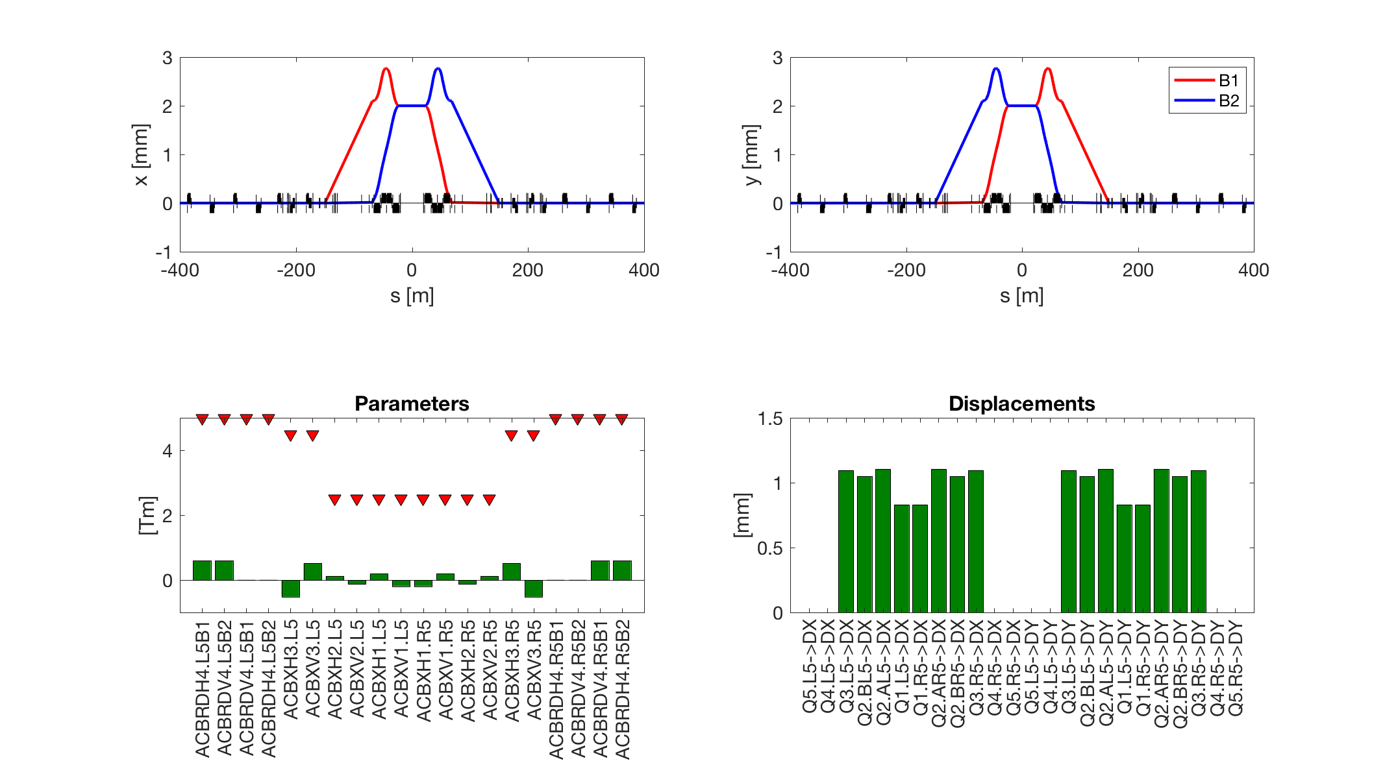
Getting rid of offset knob – nearV1
Loss of aperture
Orbit closed on D2
Q9 Q8 Q7 Q6 Q5 Q4
< 0.6 Tm per corrector.
Moving of ~1 mm the triplet
Notes:
weightOnAllowedErrors = 35;
ACBRDH4.L5B1 0.600
ACBRDV4.L5B2 0.600
ACBRDV4.L5B1 0.005
ACBRDH4.L5B2 0.005
ACBXH3.L5 -0.515
ACBXV3.L5 0.515
ACBXH2.L5 0.123
ACBXV2.L5 -0.123
ACBXH1.L5 0.191
ACBXV1.L5 -0.191
ACBXH1.R5 -0.191
ACBXV1.R5 0.191
ACBXH2.R5 -0.123
ACBXV2.R5 0.123
ACBXH3.R5 0.515
ACBXV3.R5 -0.515
ACBRDH4.R5B1 0.005
ACBRDV4.R5B2 0.005
ACBRDV4.R5B1 0.600
ACBRDH4.R5B2 0.600
Q5.L5->DX 0.000
Q4.L5->DX 0.000
Q3.L5->DX 1.096
Q2.BL5->DX 1.050
Q2.AL5->DX 1.105
Q1.L5->DX 0.831
Q1.R5->DX 0.831
Q2.AR5->DX 1.105
Q2.BR5->DX 1.050
Q3.R5->DX 1.096
Q4.R5->DX 0.000
Q5.R5->DX 0.000
Q5.L5->DY 0.000
Q4.L5->DY 0.000
Q3.L5->DY 1.096
Q2.BL5->DY 1.050
Q2.AL5->DY 1.105
Q1.L5->DY 0.831
Q1.R5->DY 0.831
Q2.AR5->DY 1.105
Q2.BR5->DY 1.050
Q3.R5->DY 1.096
Q4.R5->DY 0.000
Q5.R5->DY 0.000

Slide 43
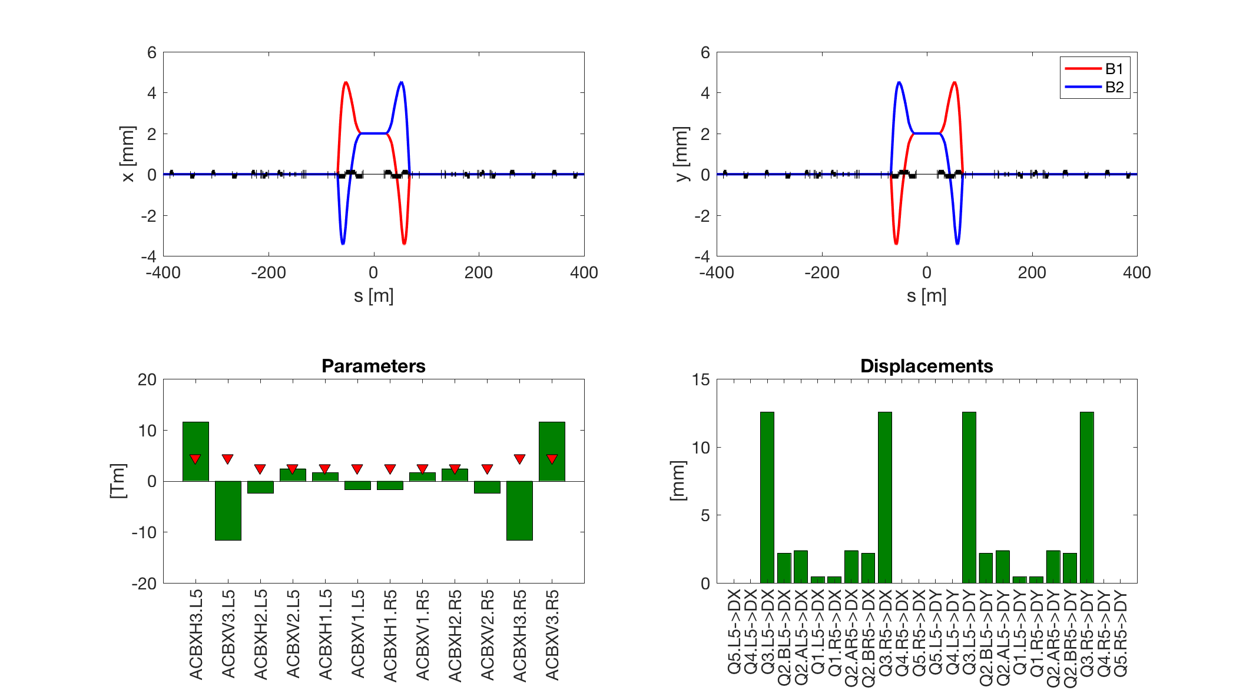
Getting rid of offset knob – extreme
Orbit closed on Q3
Q9 Q8 Q7 Q6 Q5 Q4
> 10 Tm.
Movements >10 mm

Slide 44
Getting rid of offset knob: resume
Far-Long/Med: Q1-Q4 of 2 mm
NearV2: about 1.5 mm on Q3+Q2B, 1 mm Q2A+Q1
Circuit | Off. [±2 mm] |  |  |  | Sum |  |  |  | Budget
 | Baseline | Far-Long | Far-Med | nearV2 | Baseline | Far-long | Far-Med | nearV2
MCBX1 | 1.05 | 0 | 0 | 0 | 1.44 | 0.39 | 0.39 | 0.39 | 2.5
MCBX2 | 0.57 | 0 | 0 | 0 | 0.96 | 0.39 | 0.39 | 0.39 | 2.5
MCBX3 | 0.99 | 0 | 0 | 0.02 | 3.94 | 2.95 | 2.95 | 2.97 | 4.5
MCBRD4 | 0 | 0 | 0 | 0.53 | 4.39 | 4.39 | 4.39 | 4.92 | 5
MCBY4 | 0.74 | 0 | 0 | 0 | 2.34 | 1.6 | 1.6 | 1.6 | 2.7
MCBYS4 | 0.74 | 0 | 0 | 0 | 2.38 | 1.64 | 1.64 | 1.64 | 2.7
MCBY5 | 0 | 0.51 | 0 | 0 | 0 | 0.51 | 0 | 0 | 2.7
MCBYS5 | 0.39 | 0.55 | 0.80 | 0 | 1.7 | 1.86 | 2.11 | 1.31 | 2.7
MCBC6 | 0.47 | 0.24 | 0.31 | 0 | 0.47 | 0.24 | 0.31 | 0 | 2.1
MCBC7 | 1.17 | 0.46 | 0.82 | 0 | 1.17 | 0.46 | 0.82 | 0 | 2.8
MCBC8 | 0 | 0.23 | 0.27 | 0 | 0 | 0.23 | 0.27 | 0 | 2.8
MCBC9 | 0 | 0.13 | 0 | 0 | 0 | 0.13 | 0 | 0 | 2.8
MCB10 | 0 | 0.27 | 0 | 0 | 0 | 0.27 | 0 | 0 | 1.895

Slide 45
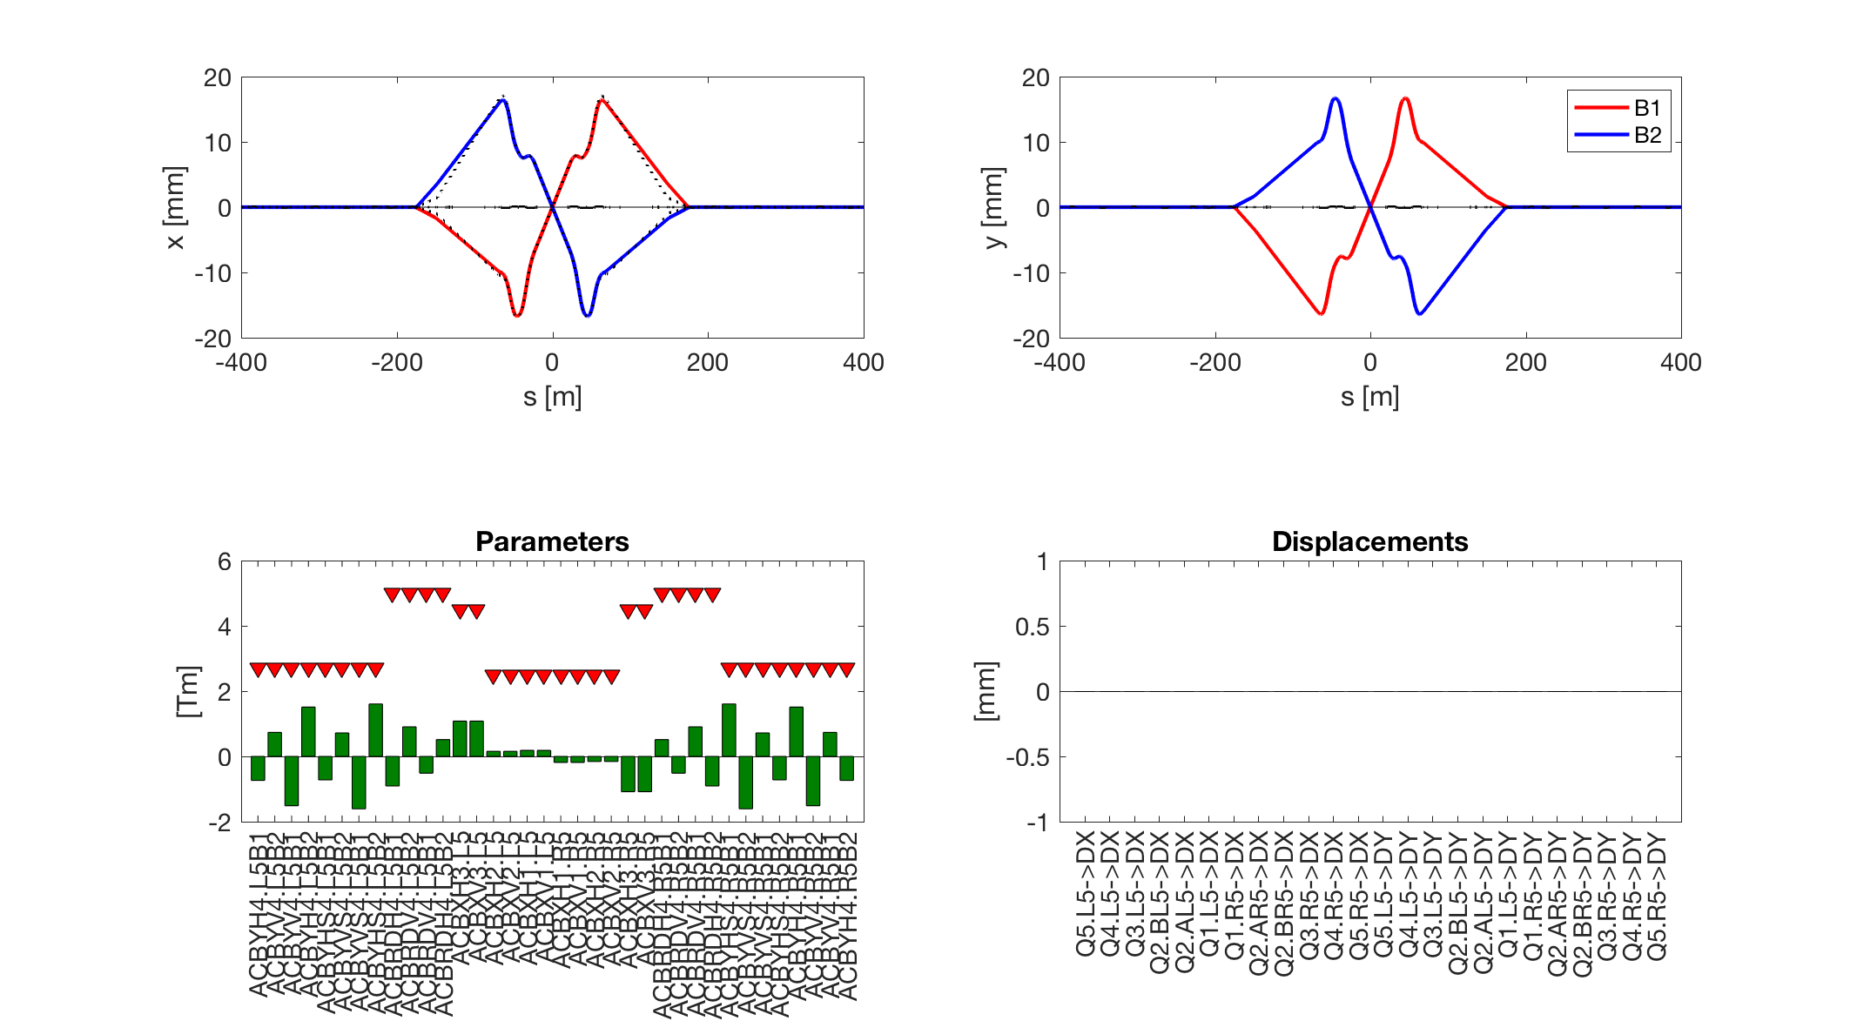

Improving crossing knob -- default
(here not as optimised as the baseline)
Orbit closed on Q4 -> orbit at crab cavities
Q9 Q8 Q7 Q6 Q5 Q4
Not using quads
Notes:
My knob: -------
ACBYH4.L5B1 -0.737
ACBYV4.L5B2 0.737
ACBYV4.L5B1 -1.511
ACBYH4.L5B2 1.511
ACBYHS4.L5B1 -0.721
ACBYVS4.L5B2 0.721
ACBYVS4.L5B1 -1.607
ACBYHS4.L5B2 1.607
ACBRDH4.L5B1 -0.906
ACBRDV4.L5B2 0.906
ACBRDV4.L5B1 -0.515
ACBRDH4.L5B2 0.515
ACBXH3.L5 1.081
ACBXV3.L5 1.081
ACBXH2.L5 0.158
ACBXV2.L5 0.158
ACBXH1.L5 0.185
ACBXV1.L5 0.185
ACBXH1.R5 -0.185
ACBXV1.R5 -0.185
ACBXH2.R5 -0.158
ACBXV2.R5 -0.158
ACBXH3.R5 -1.081
ACBXV3.R5 -1.081
ACBRDH4.R5B1 0.515
ACBRDV4.R5B2 -0.515
ACBRDV4.R5B1 0.906
ACBRDH4.R5B2 -0.906
ACBYHS4.R5B1 1.607
ACBYVS4.R5B2 -1.607
ACBYVS4.R5B1 0.721
ACBYHS4.R5B2 -0.721
ACBYH4.R5B1 1.511
ACBYV4.R5B2 -1.511
ACBYV4.R5B1 0.737
ACBYH4.R5B2 -0.737
Q5.L5->DX 0.000
Q4.L5->DX 0.000
Q3.L5->DX 0.000
Q2.BL5->DX 0.000
Q2.AL5->DX 0.000
Q1.L5->DX 0.000
Q1.R5->DX 0.000
Q2.AR5->DX 0.000
Q2.BR5->DX 0.000
Q3.R5->DX 0.000
Q4.R5->DX 0.000
Q5.R5->DX 0.000
Q5.L5->DY 0.000
Q4.L5->DY 0.000
Q3.L5->DY 0.000
Q2.BL5->DY 0.000
Q2.AL5->DY 0.000
Q1.L5->DY 0.000
Q1.R5->DY 0.000
Q2.AR5->DY 0.000
Q2.BR5->DY 0.000
Q3.R5->DY 0.000
Q4.R5->DY 0.000
Q5.R5->DY 0.000

