Slide 1
– Scope and Opportunities of InnovFin –
EU Finance for Innovators
@ACCELERATOR-INDUSTRY CO-INNOVATION WORKSHOP,
February 6, 2018
Samuël Maenhout, Policy Officer,
DG Research and Innovation

Slide 2
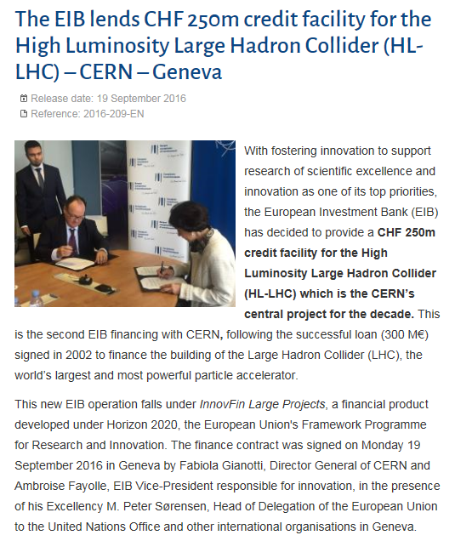
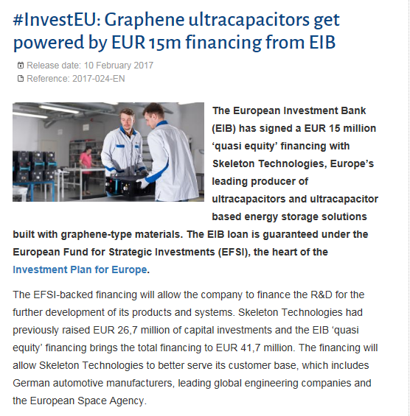
EIB's EU-backed RDI Financing Solutions
InnovFin
EFSI, IIW

Slide 3
Horizon 2020 Access to Risk Finance – Basics: InnovFin, EU Finance for Innovators
What support is on offer?
Risk-sharing in the form of loans and guarantees
Risk finance in the form of equity
For who or what?
  RDI-driven/ innovative SMEs & small midcaps
  Ambitious RDI projects carried out by a variety of recipients (companies, stand-alone projects etc.)
To serve which purpose?
  Stimulate more private sector investment in research and innovation
  No market distortion: intervention only to address financing gaps in the R&D&I delivery chain (notably due to high risk), and as such help translate R&D results to the market (/innovation)

Slide 4



Financial Instruments for Innovation & Growth: How Does It Work?
Debt (guarantees)
Equity
Mainly Larger Midcaps and large corporates*
Midcaps: Loan guarantee up to €25 m
SMEs and small midcaps
SMEs and small midcaps
Financial intermediary**
Financial intermediary**
Financial intermediary***
European Investment Bank (EIB)
EIB
European Investment Fund (EIF)
EIF
*All entities are eligible also PPPs, universities, research infrastructures etc., provided they can borrow
**Bank or a financial institution selected on the basis of the call for expression of interest that signed an agreement with the EIF
*** Fund selected on the basis of a call of expression of interest that signed an agreement with the EIF

Slide 5
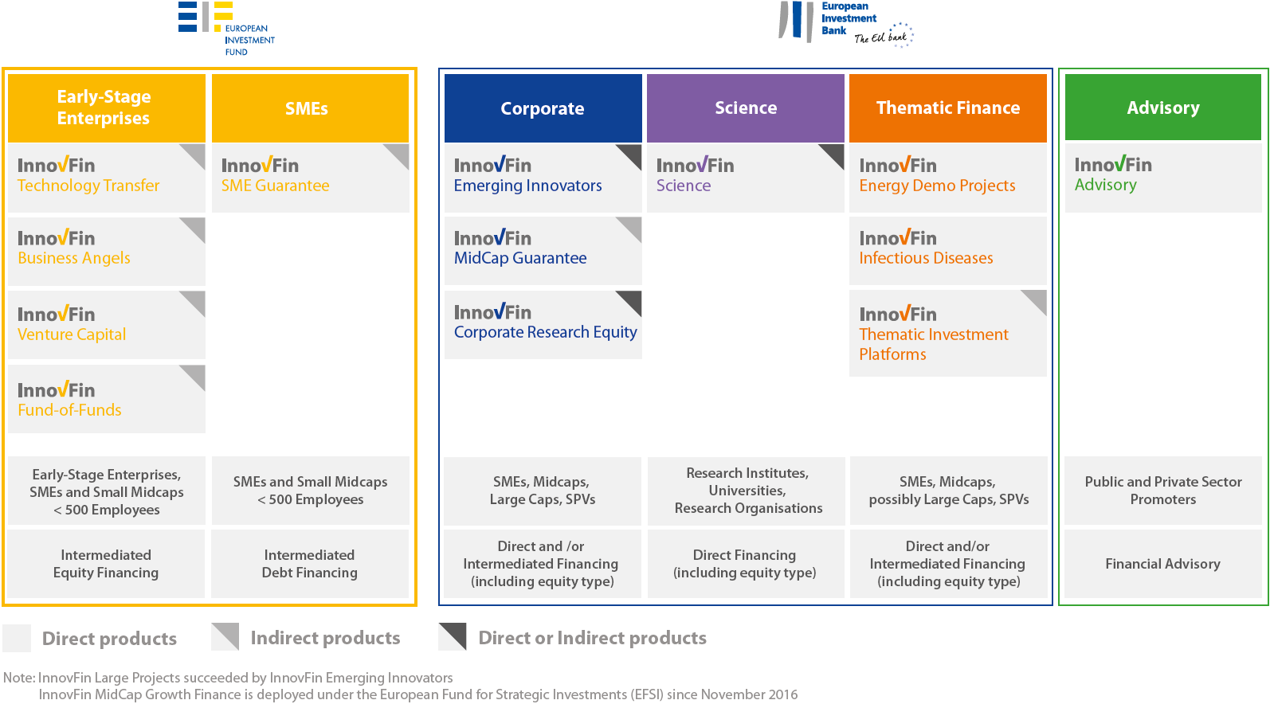
InnovFin Product Overview

Slide 6


InnovFin SME Guarantee – intervention logic
INNOVATIVE PROJECT
INNOVATION
of all types
INNOVATIVE COMPANY
R&I cost-intensive:
> 5-10% of operating costs or >20% of loan amount
Use financing for innovative products, processes, services, business models
registered a technology right and wish to exploit it
with high technological or industrial risk of failure
investing in new products / new geographical market
for at least 80% of the innovative endeavor
fast-growing enterprise
All SECTORS
VC fund or Business Angel investee
INCREMENTAL or DISRUPTIVE
TECH, BUSINESS MODEL, PROCESS, SERVICE …
recipients of R&I support schemes: grants, loans, guarantees, tax credits, prizes

Slide 7

InnovFin Equity – intervention logic
Investment focus of financial intermediaries
INNOVATION
Technology/knowledge intensive
H2020 sectors
& societal challenges
EARLY STAGE
Proof of concept (PoC)
Technology transfer
Pre seed
Seed
startup
ICT/KET
Nanotechnologies
Biotech
Cleantech
FOCUS ON FUND STRATEGY
ALL FORMS: pre-corporate and corporate
Startups, spin-offs, spin-outs, joint ventures, projects, technology rights, etc.
Medtech
Resource efficiency
In VC portfolio all companies must be innovative with high growth potential
Food security /
bio- economy
Health and demographics
Mostly disruptive and new-to-the-world innovations
All TYPES:
COMMERICAL &
SOCIAL ENTERPISES
Climate change
Space new pilot

Slide 8
InnovFin Product Overview

Slide 9

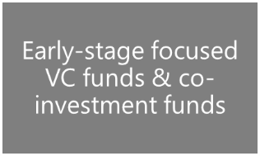

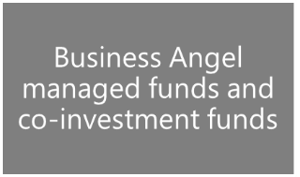
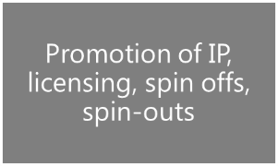


InnovFin Equity – list of funds currently selected at http://www.eif.org/what_we_do/equity/single_eu_equity_instrument/innovfin-equity/innovfin-equity-signed-deals.pdf
Basic features
Stage coverage
FoF targets at least 4 countries (EU and/or H2020 Associated Countries)
Early Stage focus
Pre-seed, seed, start up phases (seed & A rounds included)
Focus on Horizon 2020 objectives
(e.g. ICT, life sciences, clean energy)
Pari-passu, at least 30%
investment from private investors
Investment size
up to EUR 50m
Up to 25/50% of total commitments
x2 of investment ticket in eligible investees
EU + Horizon 2020 Associated Countries
Call for Expression of Interest
PRE-SEED PHASE
PROOF OF CONCEPT
SEED PHASE
START-UP PHASE
EMERGING GROWTH
DEVELOPMENT

Slide 10
Pan-European VC Funds-of-Funds
Policy fit score Expected performance grade | HIGH | SIGNIFICANT
A
B
C
Sum of target fund size
€ 2.1bn
Total EU commitments
€410m
Horizon 2020 €200m
EFSI €105m
COSME
€105m
FoF1
€300m
FoF2
€500m
FoF4
€200m
FoF3
€400m
FoF5
€200m
FoF6
€500m

Slide 11
InnovFin Product Overview

Slide 12
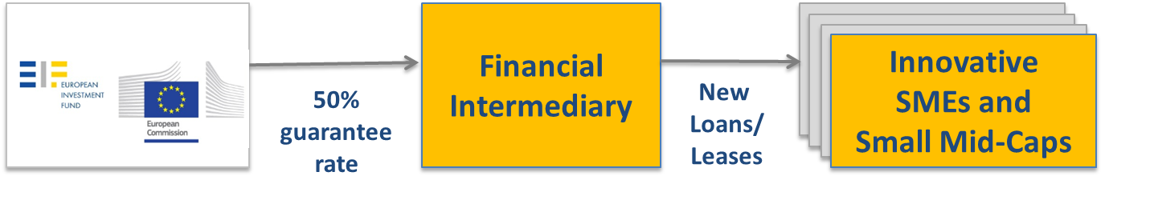
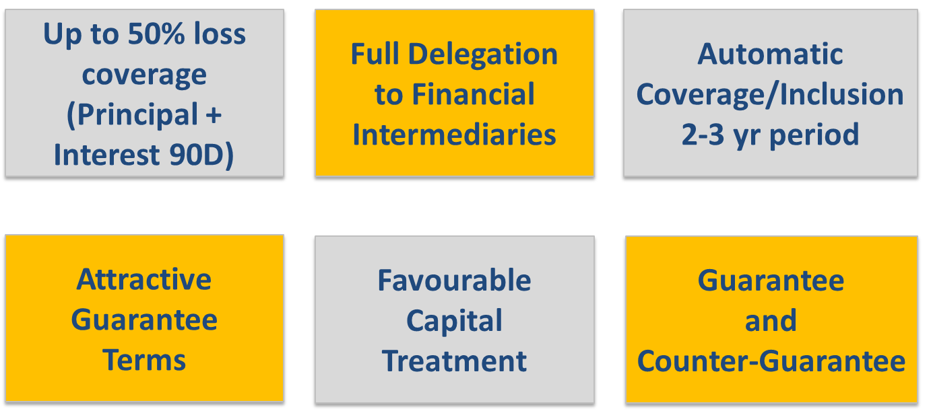

InnovFin SME Guarantee
  Guarantee covers risk related to losses of a portfolio

Slide 13
InnovFin SME Guarantee - Key Terms
Direct Guarantees
Counter - Guarantees
EU 28 & H2020 Associated Countries
SMEs
Small Mid-caps
Innovative
Final Beneficiaries
Maturity: up to 10 years
Amount:
up to EUR 7.5m (EUR or LCY)
Loans, credit lines, bonds, leases
Transactions
(senior debt only)
Working Capital
Tangible & Intangible Assets
Business Transfers
Purpose

Slide 14
Implementation Update
As of 17 October 2017
Since October 2014
+ Georgia
+Israel
+Armenia
+ Tunisia
5
  InnovFin implementation:
    162 applications
        146 for the direct guarantee (of which 2 for subordinated debt)
        16 applications for the counter-guarantee
    135 guarantee contracts signed
        covering 38 countries
        for a total guarantee amount of EUR 6260m
    Enabling over EUR 13,3bn of loans/ leases to innovative SMEs and small mid-caps
    Currently supporting c. 8160 SMEs and small mid-caps and c. 355 000
Blue – Signed / Yellow – Under appraisal
14
⁽¹⁾ Includes Umbrella Participating Entities / ⁽²⁾ Including multiple contracts under Umbrella structures / ⁽³⁾ Portfolio view as of 30 June 2017
14

Slide 15
Implementation Update
List of financial intermediaries (full list at http://www.eif.org/what_we_do/guarantees/single_eu_debt_instrument/innovfin-guarantee-facility/innovfin-smeg_signatures.pdf)
    Across the EU and Horizon 2020 associated countries: diverse types of intermediaries
        Large banking groups
        Regional banks
        National/regional promotional institutions
        Guarantee institutions
        (Venture) Debt funds
        New innovative structure in the pipeline (Crowdfunding/lending platforms)
15
6

Slide 16

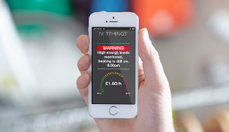
Case study (1)
Final Recipient
Innovation eligibility criteria
Company
Net Things
Country
United Kingdom
Type of business
Technology
1
The Beneficiary intends to use the funds to invest in producing, developing or implementing new or substantially improved products, processes or services that are innovative
  Final recipient type: early-stage SME
  Edinburgh based technology firm which developed universal platform for connecting and controlling devices over the Internet
    Used for energy and security management
  Loan purpose: implementation, trial and testing of energy management system called “Click”, developed by Net Things
    “Click”, the companies flagship product, enables cost-effective energy management of large estates or small commercial outlets
  Basis for eligibility: implementation of new products
With a risk of technological, business, or industrial failure
New !
Includes innovative production or delivery method; and
Organisational or process innovation – business models

Slide 17

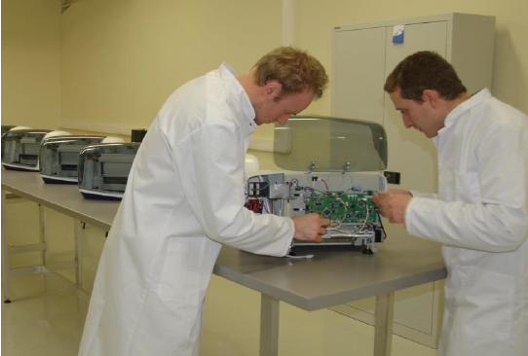
Case study (2)
Final Recipient
Innovation eligibility criteria
Company
WOW Technologies
Country
Belgium
Type of business
Engineering company
2
The Final Beneficiary is a “fast-growing enterprise” operating in a market for less than 12 years following its first commercial sale
  Final recipient type: small business
  Specialised in the production of tailor-made machinery and automated equipment for various sectors (aeronautics, biotech, pharma, agriculture, energy etc.)
    Team of 64 specialists with significant potential for further growth
    Targeted number of employees above 100 in five years
  Loan purpose: working capital investment and increase in number of employees
  Basis for eligibility: fast-growing and highly adaptive enterprise which can serve as a producer for multiple industries
“Fast-growing enterprise” – average annualised endogenous growth in employees or turnover >20% a year, over a three-year period, and ten or more employees at the beginning of the observation

Slide 18

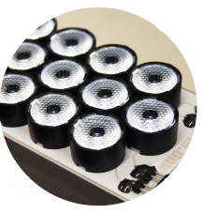
Case study (3)
Final Recipient
Innovation eligibility criteria
Company
Aurel
Country
Italy
Type of business
Customized Electronics
3
The Final Beneficiary has been operating in the market for less than 7 years following its first commercial sale, and its R&I costs represent at least 5% of total operating costs
  Final recipient type: small business
  Aurel manufactures machines and automation systems for electronic production of sensors, energy and electronic modules
    Developing and manufacturing electronic circuits in thick film industry
    Power lighting industry
    Heating elements & breaking resistors
  Loan purpose: acquisition of new equipment, specialist staff and research in areas of power lighting and power resistors
  Basis for eligibility: frequent R&I costs and investments
in at least one of the three years preceding the loan application

Slide 19
InnovFin Product Overview

Slide 20


How does InnovFin Science work?
EIF
R&I Activities,
EUREKA or ERA,
R&I Infrastructure
>EUR 50m
Direct Lending
>EUR 25m
Direct long term financing for Research Institutes, Universities and Research Organizations in any Participating Country.
Eligible project required. EIB finances up to 50% of R&I Activities, R&I Infrastructure, EUREKA or ERA investments.
Comprehensive due diligence including project due diligence (technical, financial, economic).
EIB standard documentation.

Slide 21
InnovFin Product Overview

Slide 22


Innovation Finance Advisory- What do we do?
Enable maximum access to finance for innovative projects
Pipeline Development
Projects Advisory
Horizontal Activities
Improve bankability/investment readiness
Enable earlier/ faster access to finance
Light Project Advisory
Improve framework conditions for financing
Develop “business case” for new financing mechanisms in RDI sectors
Prepare studies on increasing effectiveness of financial instruments to address specific sector/RDI policy objectives
Projects
Advisory
InnovFin Advisory
Horizontal Activities
Transfer of Lessons Learned
Arctic Arc
Fuel Cells and Hydrogen Joint Undertaking (H2M)
Philips Health Continuum
Circular Economy (CE)
Key Enabling Technologies (KETs)
Infectious Diseases Financing Facility (IDFF)
Bio-economy
RTOs/EARTO
Synergies between Projects Advisory and Horizontal Activities

Slide 23
Thank you for your attention…
Any questions?
Samuel.maenhout@ec.europa.eu
More information on InnovFin products at
http://www.eib.org/products/blending/innovfin/products/index.htm
EFSI for SMEs and small midcaps
EFSI for other types of organisations

Slide 24






How does the MidCap Guarantee work?
EIF
Financial
Intermediary
50%
Guarantee
EUR 25m
Innovative
Midcaps
3,000 employees
New
Loans
50% loss coverage for new midcap loans of up to EUR 50m not covered under InnovFin SME Guarantee
Pari-passu sharing of risk and pricing
Full delegation to financial intermediaries
Favourable capital treatment expected

Slide 25

How does InnovFin Corporate Research Equity work?
EIF
Corporate
>3,000 Employees
Contingent Funding
Funding
R&D Project(s)
Operational resources
Terms
Advantages
Direct contingent loan of EUR 75m-150m split between an EFSI tranche of min EUR 60m and InnovFin tranche for the remainder
Loans can be structured as off-balance sheet liabilities
Loans will be contingent upon the success of the underlying investments
Loans will be participating, i.e. remuneration in line with the success
EIB can finance up to 50% of all investments over 3 years
No Crowding out. Complementary finance to house banks
EIB signalling effect to attract other banks & investors
Long-term lending at attractive terms
Growth finance without dilution of shareholders

Slide 26

InnovFin Technology Transfer
Promotion of IP, licensing, spin offs, spin-outs
Pre-seed and seed funds, including affiliated with TTOs, ROs, HEIs
Open to Proof-of-Concept pockets
Investment size up to 50% of total commitments
Investment size up to EUR 50 million
TRL 3-8
At least 50% of fund size focused on TT
SMEs, JVs, projects

Slide 27

InnovFin Business Angels
Business Angel managed funds and
co-investment funds
Open for experienced business angels wishing to team up and set up their first BA funds
Investment size typically up to 50% of total commitments
BA Funds are expected to take investment decisions, & not passively co-invest
May invest >50% fund size if the co-investment ratio is not higher than 50% on deal-by-deal basis
Investment size up to EUR 50 million
Focus on ICT and other H2020 sectors
Emphasis on seed and start-up stage; can include social enterprises

Slide 28
InnovFin VC
Early-stage focused VC funds & co-investment funds
Available for first-time or emerging investment teams
Investment size typically up to 25%, but not higher than 50% of total commitments
Open to multi-stage strategies
(combining other EIF-managed resources)
Focus on one or more H2020 sectors
Seed stage and series A rounds, series B on case-by-case basis
First closing preferred, other closings if catalytic
Investment size up to EUR 50 million

Slide 29
InnovFin Funds-of-Funds (distinct from Pan-European FoF, q.v.)
FoF targets at least 4 countries (EU and/or H2020 Associated Countries)
Commitments to venture fund-of- funds
Investment size up to EUR 50 million
(typically up to 25% of total FoF’s commitments)
Investee funds should focus on H2020 sectors
Investee FMs established or operating in EU or H2020 Associated Countries
At least 50% aggregate investee funds investable amounts to be placed in EU
Open to multi-stage strategies with significant (>30%) early-stage allocation
Effective & transparent FoF governance

Slide 30
Innovation Eligibility Criteria
30

Slide 31
Innovation Eligibility Criteria¹
Short Description | Description | Sufficient Evidence
1. Innovative products / processes / services | Final Recipient intends to use the funds to invest in producing, developing or implementing new or substantially improved (i) products, processes or services, or (ii) production or delivery methods, or (iii) organisational or process innovation including business models that are innovative and where there is a risk of technological, industrial or business failure | (i) declaration of intent and (ii) business plan where such risks of failure are evidenced by an external expert
2. Fast-growing enterprise | Final Recipient is operating for less than 12 years, with an average annualized employee or turnover growth greater than 20% a year, over a 3-year period. Final Recipient must have ten or more employees at the beginning of the observation period | Appropriate evidence of such information provided in the financial statements, evidence of growth rate and employees
3. R&I costs ≥ 5% of operating costs | Final Recipient is operating in a market for less than 7 years, whose R&I costs represent at least 5% of its total operating costs, in at least one of the 3 years preceding the loan application. In case of a Final Recipient (eg. start-up) without financial history, the calculation is done using its current financial statements | Appropriate evidence of such information provided in the financial statements
4. Innovation potential | Final Recipient shall have a significant innovation potential or be an “R&I-intensive enterprise”. This is assessed through an additional 11 sub-criteria, where the most used criteria are detailed below: | As per one of the below criteria
a) Annual R&I expenses ≥ 20% of transaction size | Annual R&I expenses are ≥ 20% of the requested loan amount and the Final Recipient’s business plan indicates the increase in R&I expenses is at least equal to requested Final Recipient Transaction amount | Financial statements evidencing R&I and total operating costs Undertaking of the company and business plan evidencing expenditures
b) 80% of funds spent on R&I activities | Final Recipient will spend at least 80% of the transaction on R&I activities. Condition: the remaining 20% to be spent on costs necessary to enable such activities. | Undertaking of the company and business plan evidencing expenditures
c) Innovation support / grants | Final Recipient has been formally awarded grants, loans or guarantees from European R&I schemes (Horizon 2020/FP7) or national research or innovation support schemes. Condition: over last 3 years and the final recipient transaction should not be covering the same expense. | Evidence of award dated less than 36 months before
d) R&D Prize | Final Recipient has been awarded over the last 24 months with an R&D prize or innovation prize, provided by an EU institution or an EU body. | Evidence of an innovation prize dated less than 24 months before
¹ At least one criterion needs to be met
31
3

Slide 32
Innovation Eligibility Criteria¹ (cont’d)
Short Description | Description | Sufficient Evidence
e) Technology right | Final Recipient has registered at least one technology right in the last 24 months, and the purpose of the loan is to enable the use of this technology. Technology right could be a patent, utility model, topography, semiconductor product, supplementary protection certificate medicinal products, plant breeder’s certificate or software copyright | Technology right with the registration dated less than 24 months before
f) Venture Capital | Final Recipient is an early stage SME that has received an investment over last 24 months from a venture capital investor / business angel. | Evidence of the investment
g) Risk Finance Investment | Final Recipient requires a risk finance investment which is ≥ 50% of its annual turnover in preceding 5 years. Condition: based on the business plan prepared in view of entering new product or geographical market | Business plan evidencing the intention
h) R&I costs at least 10% of total operating costs | Final Recipient’s R&I costs represent at least 10% of its total operating costs in at least one of three preceding years (or current financial statements if no financial history) | Financial statements evidencing R&I and total operating costs
i) Small mid-cap and R&I costs at least 10% of total operating costs | Final Recipient is a small mid-cap and its R&I costs represent at least 10% per year of its total operating costs in the three preceding years or at least 15% in at least one of the three preceding years preceding the Final Recipient's application for the final recipient transaction. | Financial statements evidencing R&I and total operating costs
j) R&I costs qualify under EU support measure | Final Recipient has incurred R&I expenses qualified in the past 36 months by competent national, regional or institutional bodies, as a part of support measures approved by the European Commission designed to incentivize R&I (example: “Credit Impot-Recherche” in France) Conditions: Designation shall not be limited to or otherwise in favour of any particular industry, shall reflect one of the innovation criteria with the exception 4d), the body must be independent of the financial intermediary and final recipient and final recipient transaction covers incremental expenditures as indicated in the business plan. | Evidence of such qualification Business plan evidencing the intention
k) Designated innovative | Final Recipient has been designated as an innovative company in the last 36 months Conditions: The designation is made by an independent national, regional or EU body under publicly available criteria and the final recipient transaction covers incremental expenditures. | Evidence of such designation
¹ At least one criterion needs to be met
32
4

