Slide 1
Helsinki Institute of Physics
Markus Aicheler
30.11.2017

Slide 2
Our mission
The Helsinki Institute of Physics is a physics research institute that is operated jointly by the University of Helsinki, Aalto University, the University of Jyväskylä, the Lappeenranta University of Technology, and the Tampere University of Technology. The research activity at the institute covers an extensive range of subjects in theoretical physics and experimental subatomic physics. The mandate of the institute is to carry out and facilitate research in basic and applied physics as well as in physics research and technology development at international accelerator laboratories. The institute is responsible for the Finnish research collaboration with CERN. Also, the institute coordinates the Finnish contribution to the FAIR laboratory (Facility for Antiproton and Ion Research) currently under construction in Darmstadt, Germany.
Source: http://www.hip.fi/

Slide 3
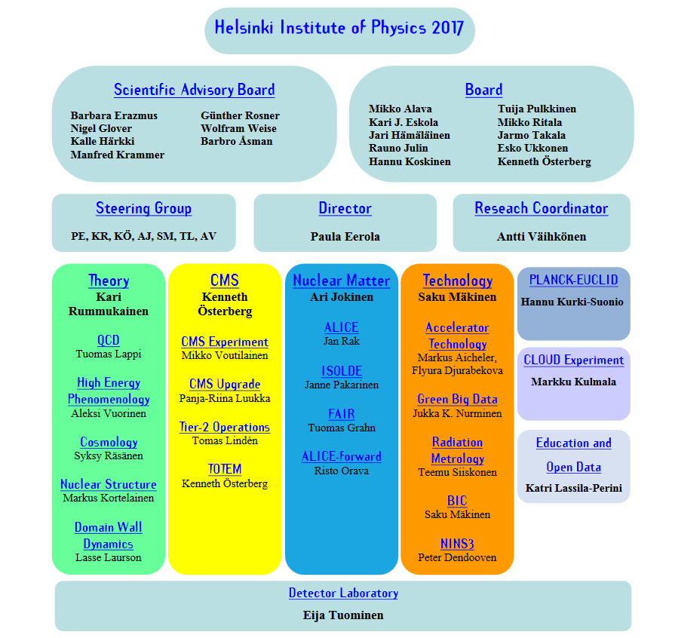
Will change beginning of 2018
Four established programs
Starting 2018 Accelerator Technology program will be split in two:
Modules, Structures & Manufacturing
Materials for accelerator technology

Slide 4
Acc-Tech: Modules, Structures & Manufacturing http://research.hip.fi/hwp/acctech/accelerator-technology/m-s-m/
The interest of the group lays in expanding the portfolio of manufacturing techniques and their industrial stakeholders applicable to upcoming accelerator machine challenges. Examples for typical manufacturing demands are: Ultra-high precision machining and assembly, additive manufacturing of metals and ceramics as well as high temperature bonding. The group tries to foster collaborations on these fields between Finnish companies and big science projects.
Small group of currently 6 people (one researcher 5 PhD students)
Current main focus is CLIC:
  Heavy enrolment in the CLIC module development and design (2-3 persons @CERN)
  Development of a non-destructive method with micron precision to measure the internal shape of the CLIC accelerating structure disk stack using Fourier Domain Short Coherence Interferometry (FDSCI).
  Development of a rapid ultralow pressure manometer to dynamically measure the outgassing from a RF loaded structure during one RF pulse
Other area of work: Technology development for Beam instrumentation with CERN

Slide 5
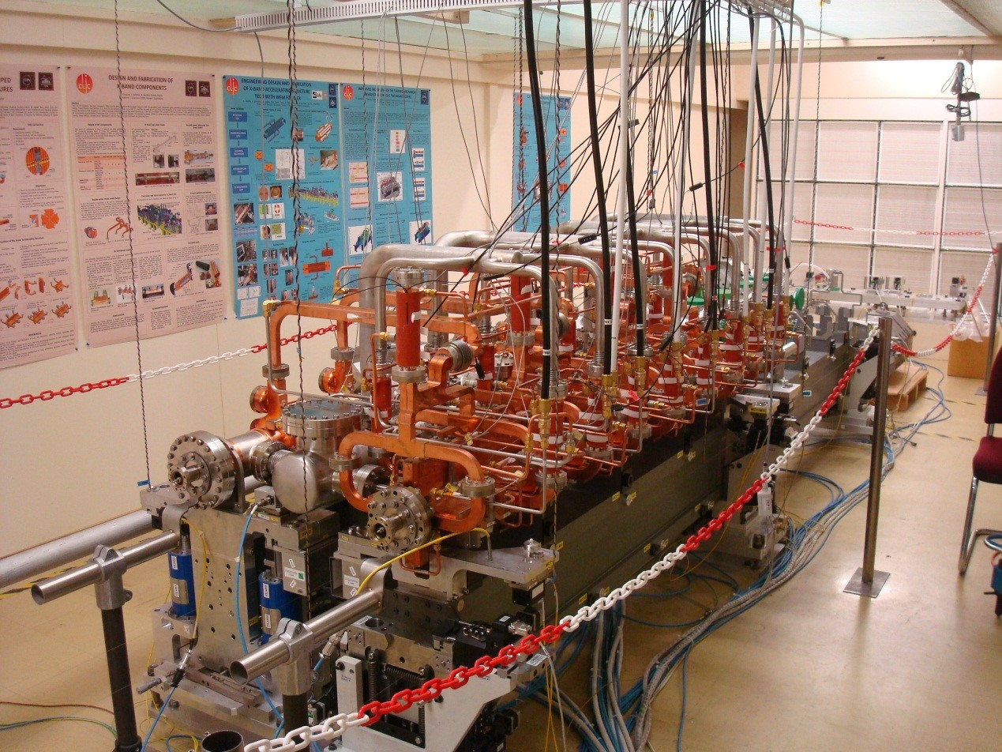
Examples CLIC-module
CLIC CDR baseline design from 2013 test-mockup
Running thermal tests combined with numerical simulations in order to predict individual deformations and compensate for
Testing individual components for installation and alignment methods
Powering and cooling of individual components for establishing heat dissipation to air and cooling optimisation

Slide 6
Examples CLIC-module
Since beginning of 2017 we are establishing new baseline requirements for the CLIC module
New design optimized for 380 GeV machine
Two versions: klystron based and drive beam based
Ongoing major efforts with C&V and civil engineering in order to converge to a coherent ventilation scheme able to cope with heat dissipation from module (CLIC module is responsible for 95% of heat)
New-generation module design just started based on two possible layouts

Slide 7
What we would like to do for XLS
Help establishing alignment and stability requirements for each component in the linac
Develop design for support structure of components for the entire length of the accelerator
Use lessons learned from CLIC module for high quality and affordable realization of support design
Use synergy in prototyping for CLIC module to improve XLS support design if necessary

