Slide 1
New button-type BPM design for BESSY VSR
J.-G. Hwang, G. Schwietz, M. Ries, A. Schälicke, V. Dürr, D. Wolk
Helmholtz-Zentrum Berlin (HZB)

Slide 2
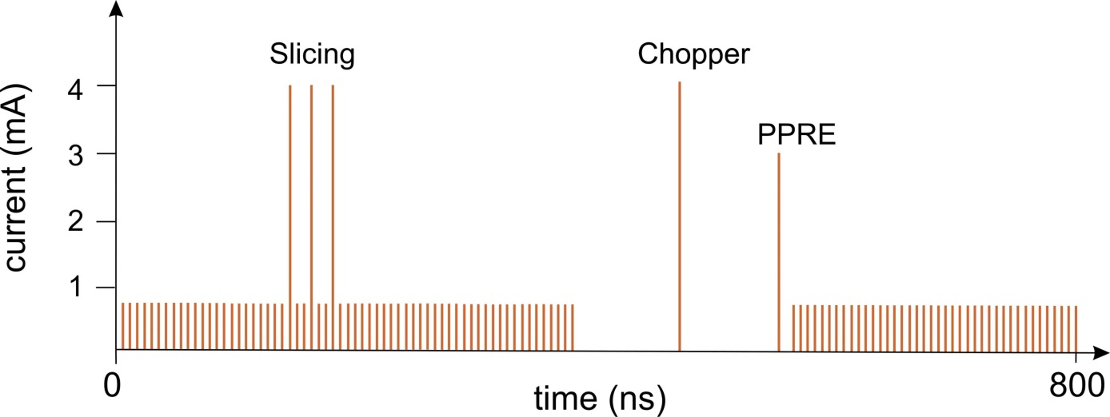
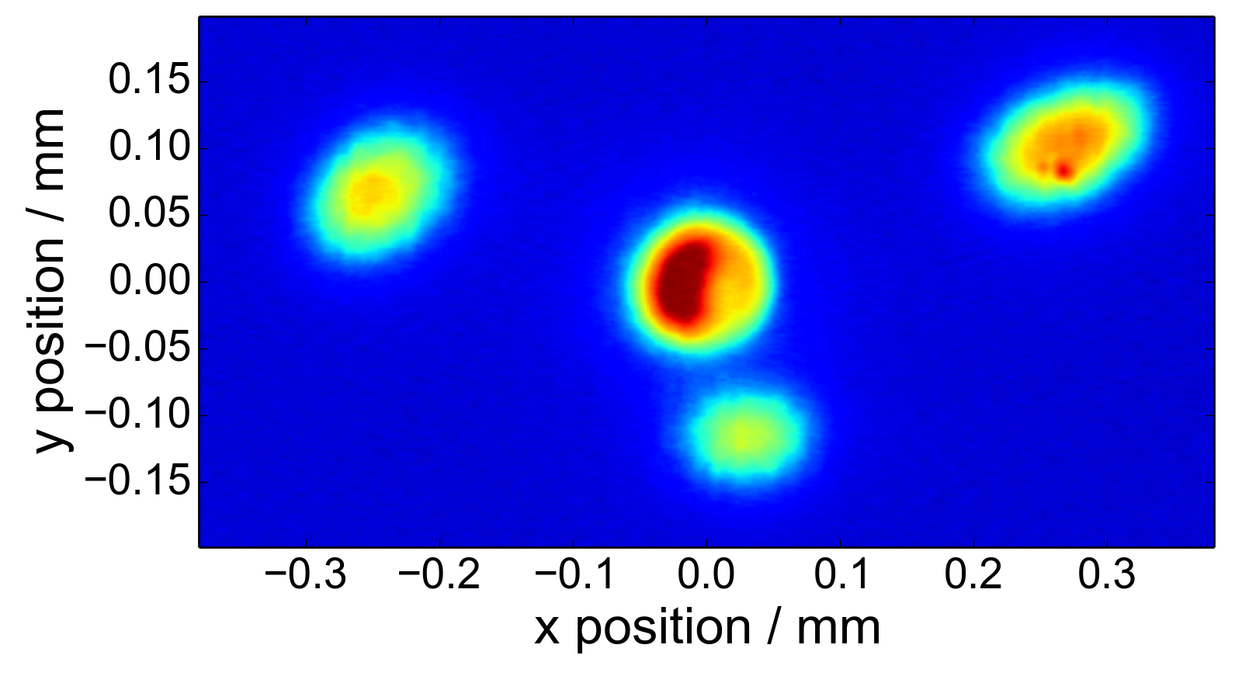
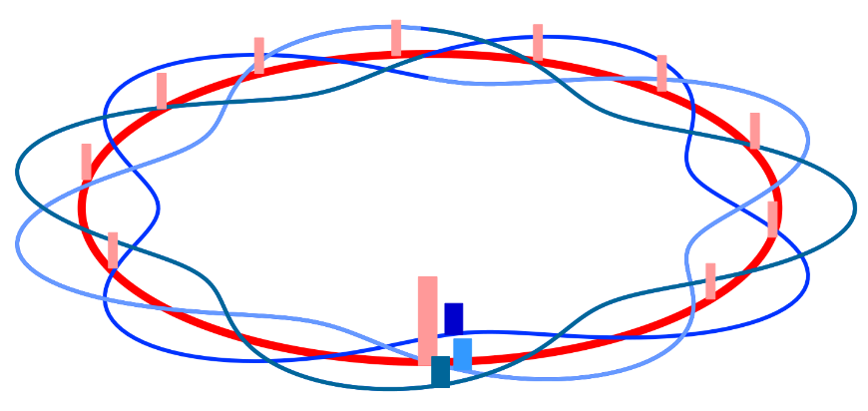
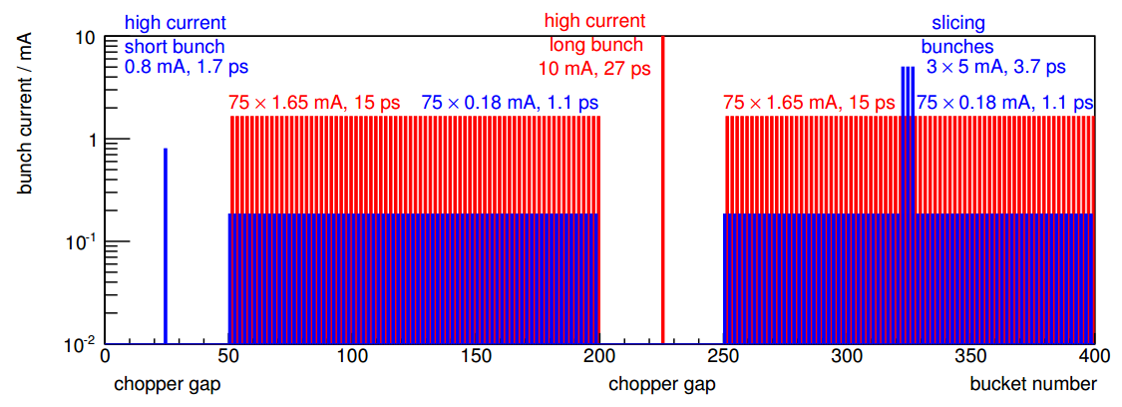
Motivation
BESSY II
- Hybrid fill pattern
0.8 mA multi-bunch
4 mA slicing
4 mA chopper
3 mA PPRE
TRIBs
- Large offset
- Selective
BESSY VSR
- Intensity
1.65 mA (15 ps)
0.18 mA (1.1 ps)
Standard orbit
Island orbit

Slide 3
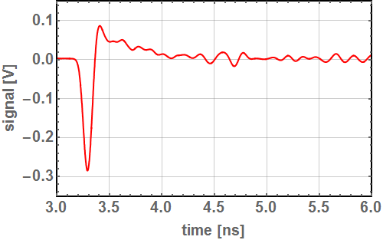

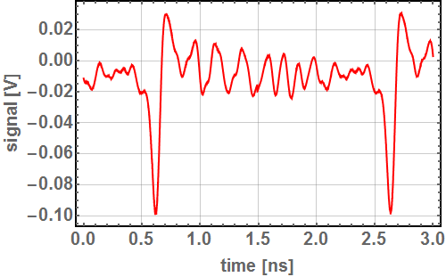
BESSY II button-type Beam Position Monitor
Single bunch (1 mA)
Multibunch

Slide 4
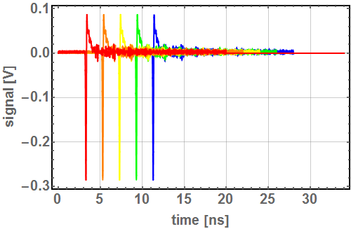
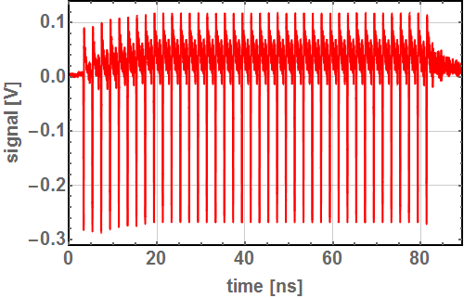
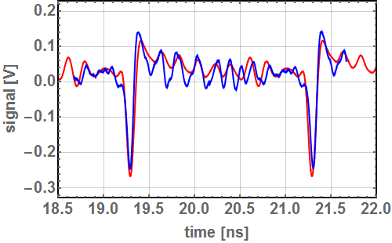
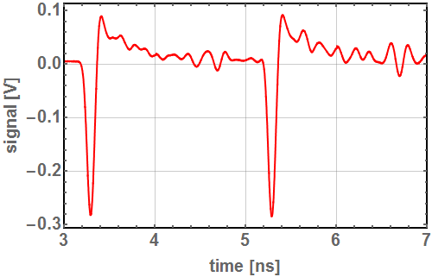
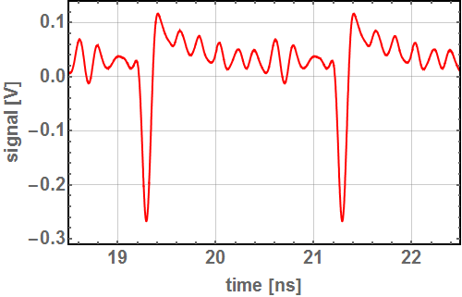
BESSY II button-type Beam Position Monitor
Superposition
▬ Measured
▬ Calculated

Slide 5
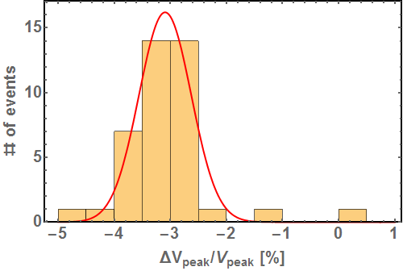
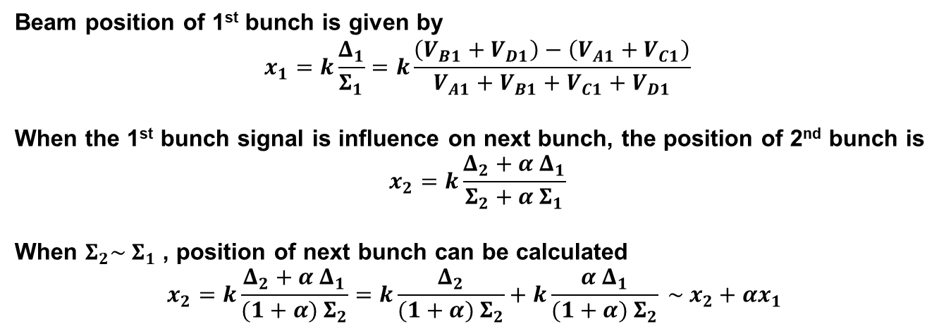
BESSY II button-type Beam Position Monitor
Peak shift : 3.1 %
Fluctuation : ~ 0.66 %
Beam position of 1st bunch is given by
$$x_{1}=k\frac{Δ_{1}}{Σ_{1}}=k\frac{\left(V_{B1}+V_{D1}\right)−\left(V_{A1}+V_{C1}\right)}{V_{A1}+V_{B1}+V_{C1}+V_{D1}}$$
When the 1st bunch signal is influence on next bunch, the position of 2nd bunch is
$$x_{2}=k\frac{Δ_{2}+{α Δ}_{1}}{Σ_{2}{+ α Σ}_{1}}$$
When $Σ_{2}{\sim Σ}_{1}$ , position of next bunch can be calculated
$$x_{2}=k\frac{Δ_{2}+{α Δ}_{1}}{(1{+ α) Σ}_{2}}=k\frac{Δ_{2}}{(1{+ α) Σ}_{2}}+k\frac{α Δ_{1}}{(1{+ α) Σ}_{2}} \sim x_{2}+αx_{1}$$

Slide 6
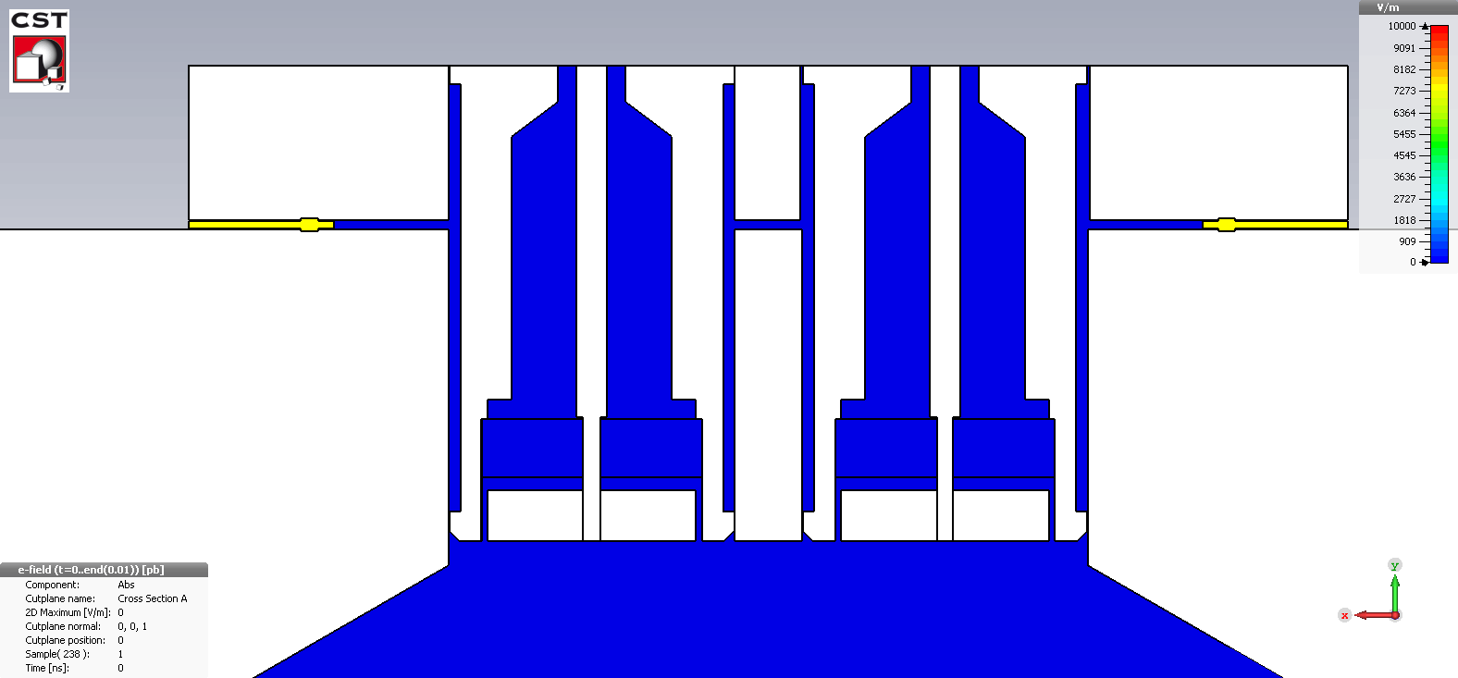
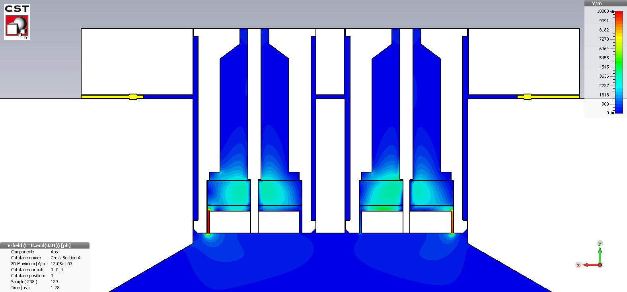
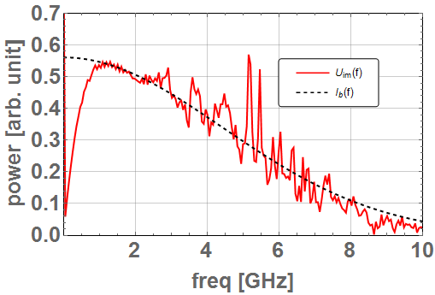
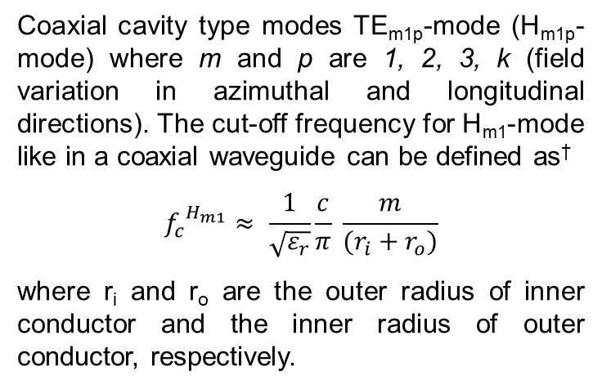
BESSY II button-type Beam Position Monitor
Trapped mode in insulator and button
BESSY-II button
f_{c} @ button : 8.60 GHz
(10.8 mm diameter )
f_{c} @ insulator : 4.91 GHz
Coaxial cavity type modes TE_{m1p}-mode (H_{m1p}-mode) where m and p are 1, 2, 3, k (field variation in azimuthal and longitudinal directions). The cut-off frequency for H_{m1}-mode like in a coaxial waveguide can be defined as†
$${f_{c}}_{}^{H_{m1}}≈ \frac{1}{\sqrt{ε_{r}}}\frac{c}{π} \frac{m}{(r_{i}+r_{o})}$$
where r_{i} and r_{o} are the outer radius of inner conductor and the inner radius of outer conductor, respectively.

Slide 7
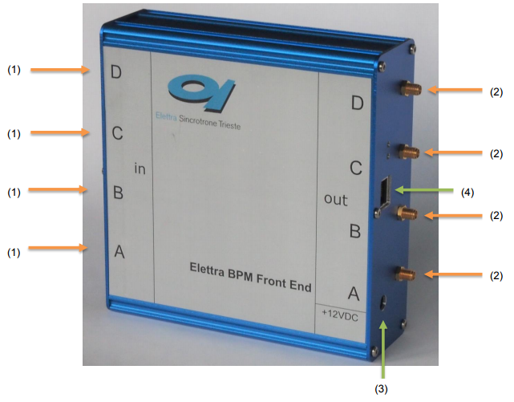
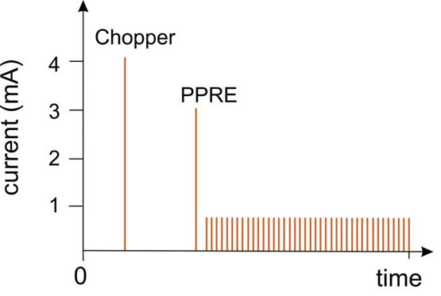
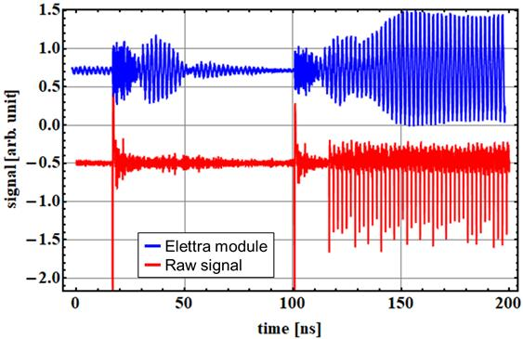
For bunch-by-bunch BPM system
Compensation
by front-end system
- High frequency noise rejection
- Bandwidth (Ringing)
- Short and long-term stability
by new BPM design
- Simple/direct solution
- Non-cost effective
Front-end from Elettra

Slide 8
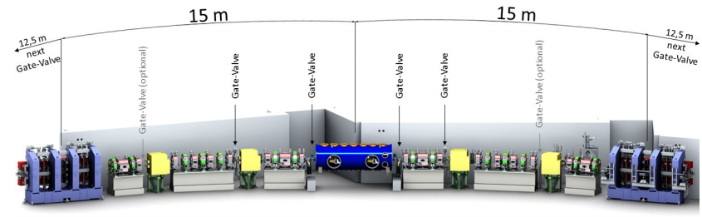
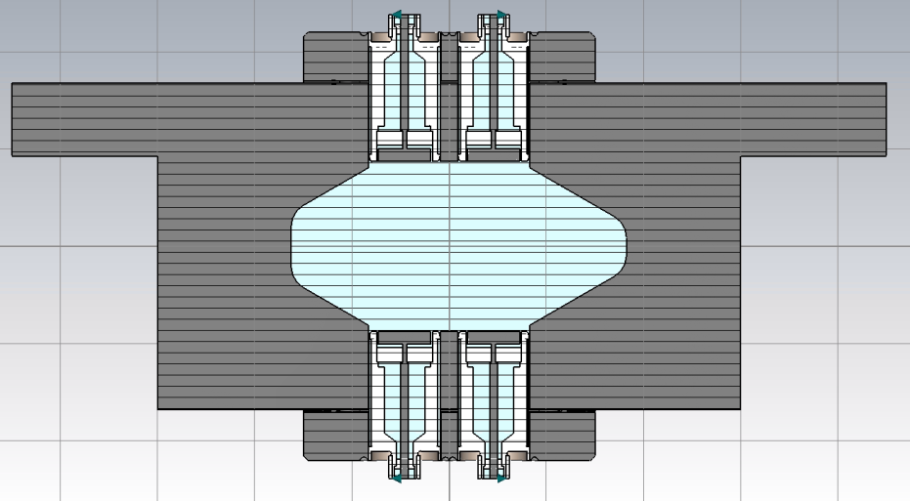
new BPM opportunity (BESSY VSR)
5 multipole magnets in front and behind the VSR cryomodule
→ Chamber dimension : 24 x 55 mm
1. Button head : Signal ↑ and wake field↓
2. Insulator : Impedance and High frequency (ringing)↓
3. Button structure (impedance) : Reflection signal ↓
4. Distance between buttions :
Resolution ↓
5. Gap between button and chamber (housing) : RF shield
Impedance matching
Button structure
dimensions & button layout
Chamber
Insulator material

Slide 9
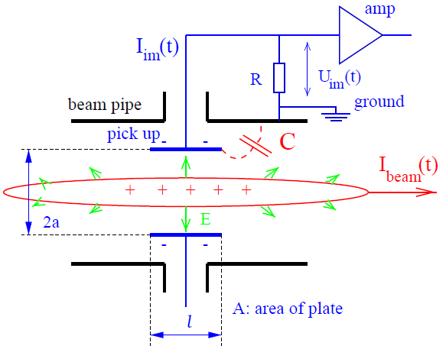
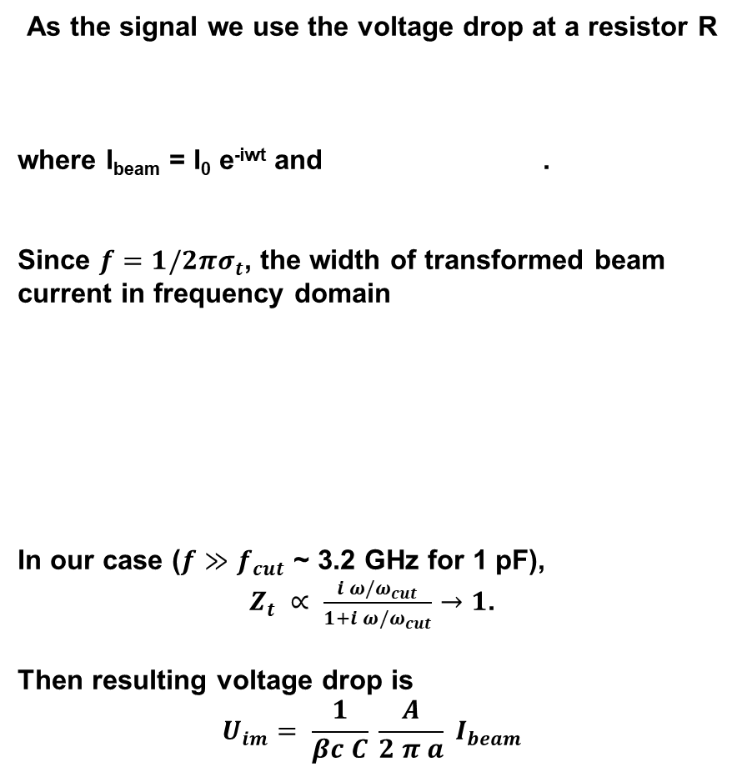
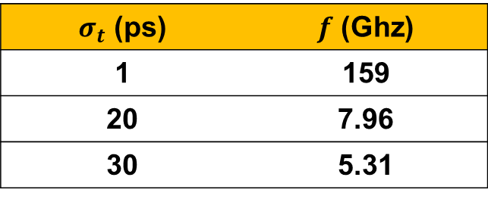
New button-type Beam Position Monitor (Button head)
Curtesy of Peter Forck
As the signal we use the voltage drop at a resistor R
where I_{beam} = I₀ e^{-iwt} and .
Since $f=1/2πσ_{t}$, the width of transformed beam current in frequency domain
In our case ($f≫f_{cut}$ ~ 3.2 GHz for 1 pF),
$Z_{t} ∝ \frac{i ω/ω_{cut}}{1+i ω/ω_{cut}}→1$.
Then resulting voltage drop is
$$U_{im}= \frac{1}{βc C} \frac{A}{2 π a} I_{beam}$$
$σ_{t}$ (ps) | $f$ (Ghz)
1 | 159
20 | 7.96
30 | 5.31
To enhance signal strength
- Size of button ↑
- Capacitance of button↓
- Chamber size ↓
But
Size of button ↑ → f_{cut} ↓
Chamber size ↓ → Wake field↑

Slide 10
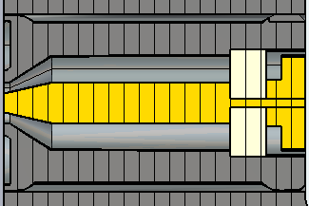
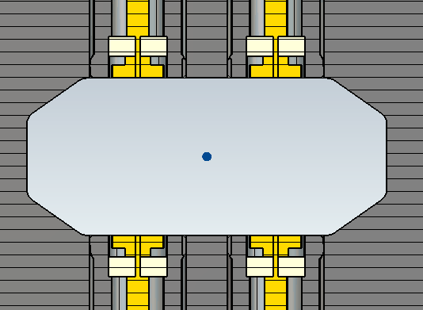
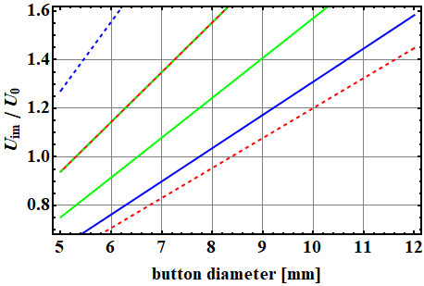
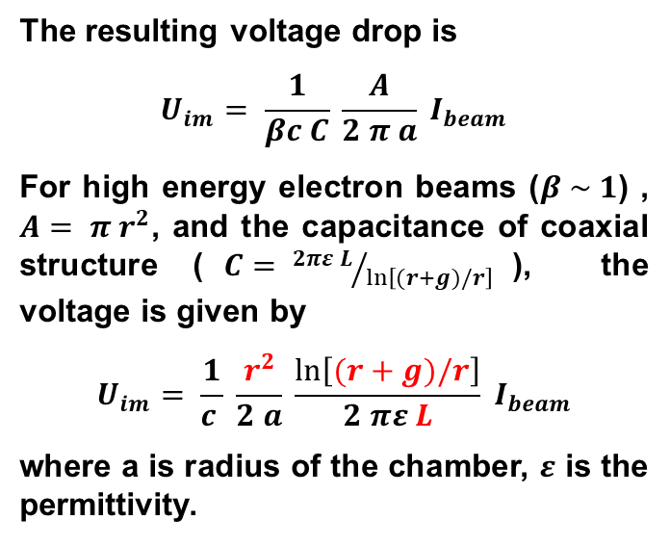
New button-type Beam Position Monitor (Button head)
Button
L
g
a
r
The resulting voltage drop is
$$U_{im}= \frac{1}{βc C} \frac{A}{2 π a} I_{beam}$$
For high energy electron beams ($β \sim 1$) , $A= π{ r}^{2}$, and the capacitance of coaxial structure ($C= {2πε L}/{\ln\left[(r+g)/r\right]}$), the voltage is given by
$$U_{im}= \frac{1}{c } \frac{r^{2}}{2 a} \frac{\ln\left[(r+g)/r\right]}{2 πε L} I_{beam}$$
where a is radius of the chamber, $ε$ is the permittivity.
▬ L = 2.0 mm −− g = 0.3 mm
▬ L = 2.5 mm −− g = 0.5 mm
▬ L = 3.0 mm −− g = 0.7 mm

Slide 11
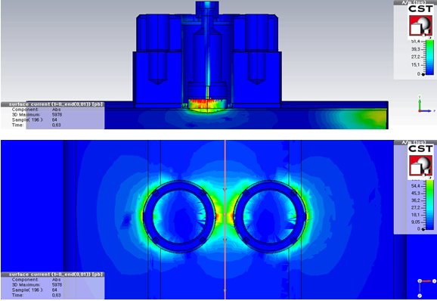
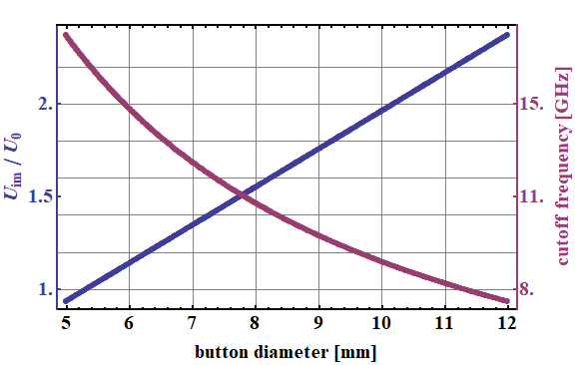
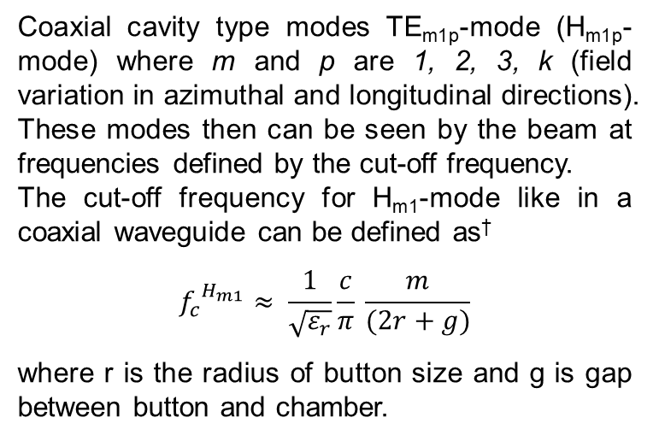
New button-type Beam Position Monitor (Button head)
Coaxial cavity type modes TE_{m1p}-mode (H_{m1p}-mode) where m and p are 1, 2, 3, k (field variation in azimuthal and longitudinal directions). These modes then can be seen by the beam at frequencies defined by the cut-off frequency.
The cut-off frequency for H_{m1}-mode like in a coaxial waveguide can be defined as†
$${f_{c}}_{}^{H_{m1}}≈ \frac{1}{\sqrt{ε_{r}}}\frac{c}{π} \frac{m}{(2r+g)}$$
where r is the radius of button size and g is gap between button and chamber.
Large button
- Signal strength ↑
- Cutoff frequency ↓
What is meant by the cutoff frequency f_{c}?
-The desirable TEM mode is allowed to propagate at all frequencies, but at frequencies above f_{c} the first higher-order mode called TE11 is also allowed to propagate*.
L = 2.0 mm
g = 0.5 mm
† A. Blednykh et. al., Proceedings of IPAC15, MOPMN021 (2015).
*https://www.microwaves101.com/encyclopedias/coax

Slide 12
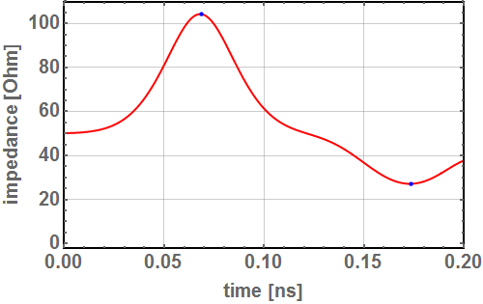
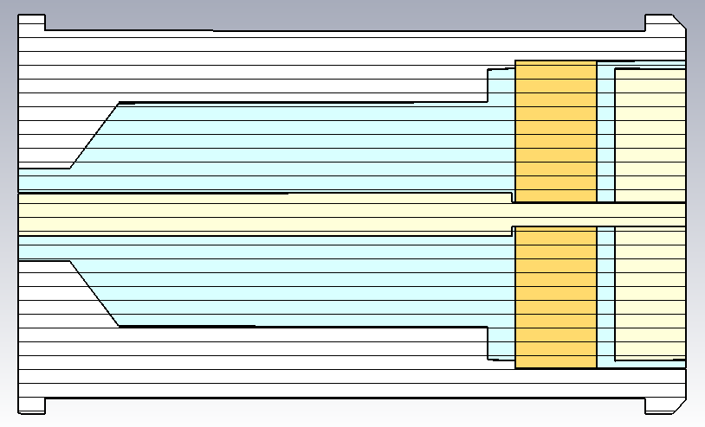
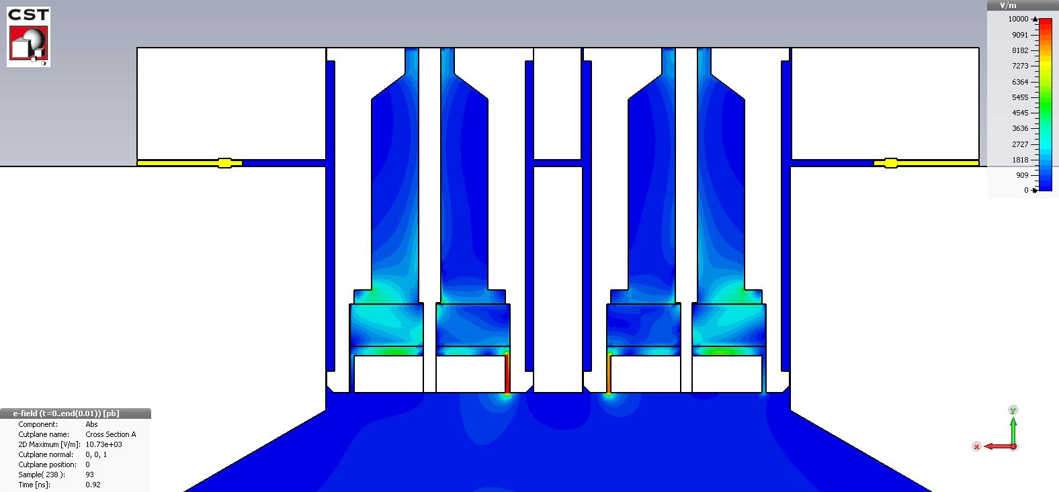
New button-type Beam Position Monitor (Impedance matching)
Impedance mismatching
Old button
Trapped mode in between insulator and button housing

Slide 13
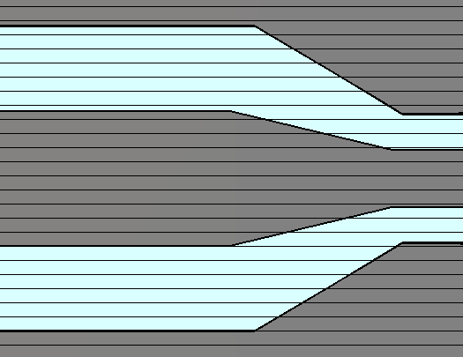
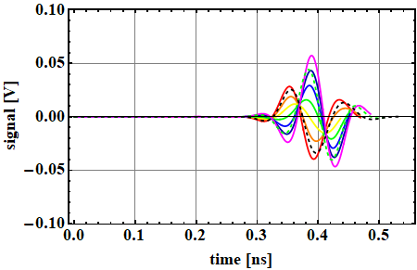
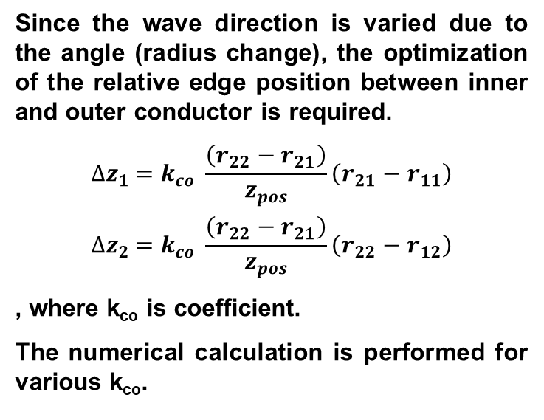
New button-type Beam Position Monitor (Impedance matching)
r
?
r₂₂
r₁₂
˟ ˟ ˟ ˟
˟ ˟ ˟ ˟
˟ ˟ ˟ ˟
z_{pos}
r₂₁
r₁₁
● ● ● ●
● ● ● ●
● ● ● ●
˟ ˟ ˟ ˟
˟ ˟ ˟ ˟
˟ ˟ ˟ ˟
z
Δz₂
Δz₁
Since the wave direction is varied due to the angle (radius change), the optimization of the relative edge position between inner and outer conductor is required.
$${∆z}_{1} =k_{co} \frac{\left(r_{22}−r_{21}\right)}{z_{pos}}\left(r_{21}−r_{11}\right)$$
$${∆z}_{2} =k_{co} \frac{\left(r_{22}−r_{21}\right)}{z_{pos}}\left(r_{22}−r_{12}\right)$$
, where k_{co} is coefficient.
The numerical calculation is performed for various k_{co}.
▬ k_{co} = 0.0 ▬ k_{co} = 0.1
▬ k_{co} = 0.2 ▬ k_{co} = 0.3
▬ k_{co} = 0.4 ▬ k_{co} = 0.5
▬ k_{co} = 0.6 --- original
Z_{L} = 48.2 Ω for k_{co} = 0.2

Slide 14
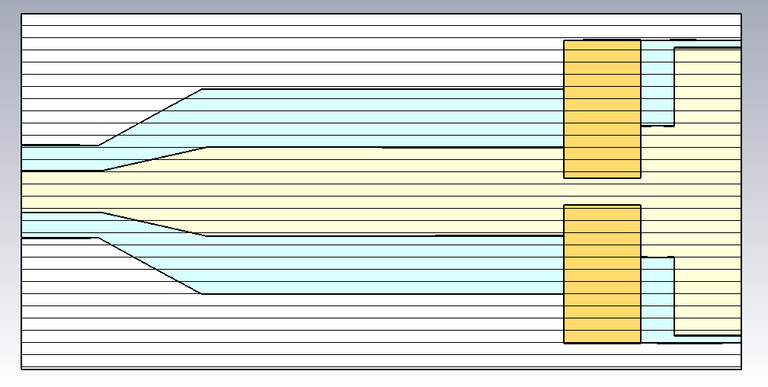
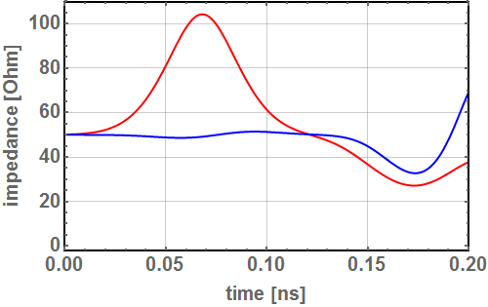
New button-type Beam Position Monitor (Impedance matching)
Old button
New button
Button
▬ Old button
▬ New button

Slide 15
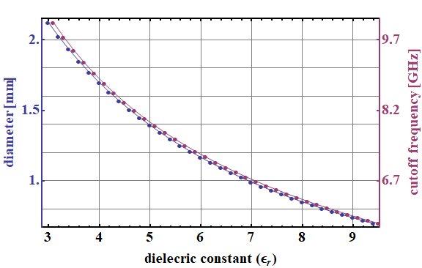
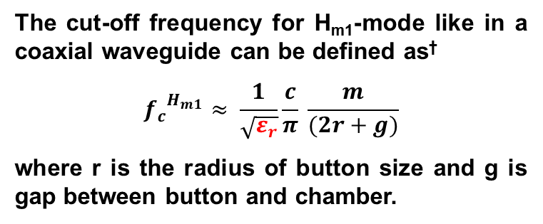
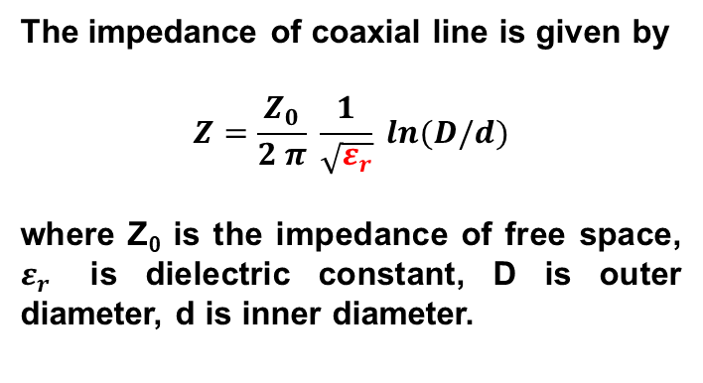
New button-type Beam Position Monitor (Insulator)
Dielectric constant of materials of useable insulator
- Zirconia : 10 ~ 23
- Aluminum oxide : 9.0 ~ 9.8
- Magnesium oxide : 9.0 ~ 10.1
- Aluminum nitride : 9.0
- Nitride : 7.5
- Silicon nitride : 7.5
- Diamond : 5.7
- Fused silica : 3.82
Fused silica
Alumina
The cut-off frequency for H_{m1}-mode like in a coaxial waveguide can be defined as†
$${f_{c}}_{}^{H_{m1}}≈ \frac{1}{\sqrt{ε_{r}}}\frac{c}{π} \frac{m}{(2r+g)}$$
where r is the radius of button size and g is gap between button and chamber.
The impedance of coaxial line is given by
$$Z=\frac{Z_{0}}{2 π} \frac{1}{\sqrt{ε_{r}}} ln(D/d)$$
where Z₀ is the impedance of free space, $ε_{r}$ is dielectric constant, D is outer diameter, d is inner diameter.

Slide 16
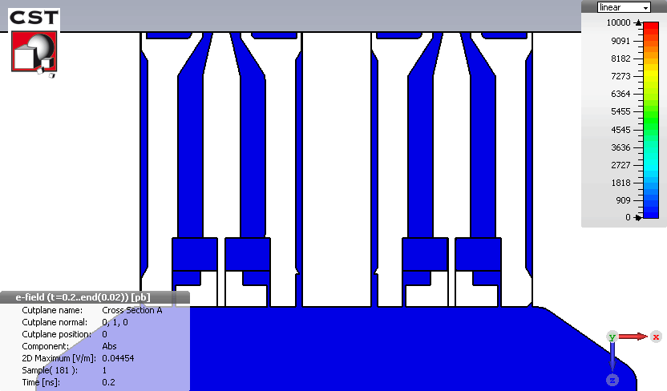
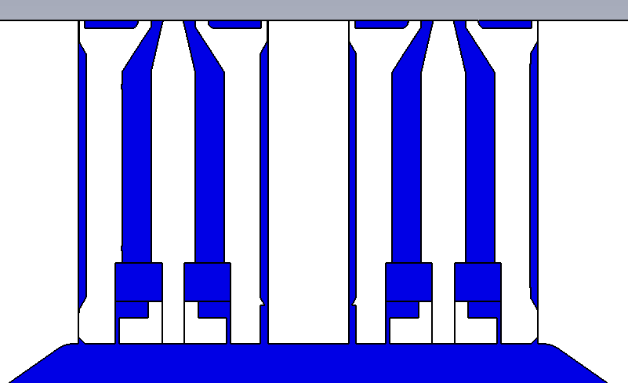
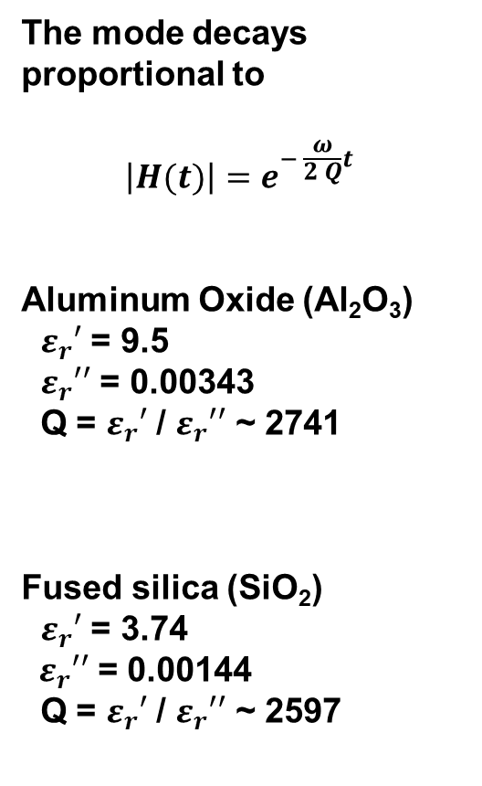
New button-type Beam Position Monitor (Insulator)
The mode decays proportional to
$$\left|H(t)\right|=e^{− \frac{ω}{2 Q}t }$$
Aluminum Oxide (Al₂O₃)
$ε_{r}′$ = 9.5
$ε_{r}′′$ = 0.00343
Q = $ε_{r}′$ / $ε_{r}′′$ ~ 2741
Fused silica (SiO₂)
$ε_{r}′$ = 3.74
$ε_{r}′′$ = 0.00144
Q = $ε_{r}′$ / $ε_{r}′′$ ~ 2597

Slide 17
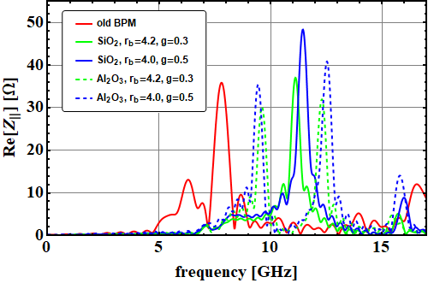
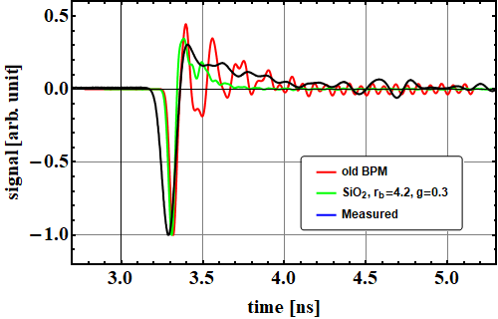
New button-type Beam Position Monitor (Insulator)
1. Fused silica (SiO₂)
Hardness kg/mm2 600
Thermal Conductivity W/m•°K 1.38
Coefficient of Thermal Expansion 10^–6/°C 0.55
Dielectric Constant@ 1 MHz 3.82
Dissipation Factor@ 1 MHz 0.00002
2. Aluminum Oxide (Al₂O₃)
Hardness kg/mm2 1440
Thermal Conductivity W/m•°K 35
Coefficient of Thermal Expansion 10^–6/°C 8.4
Dielectric Constant@ 1 MHz 9.0 ~ 9.8
Dissipation Factor@ 1 kHz 0.0002

Slide 18
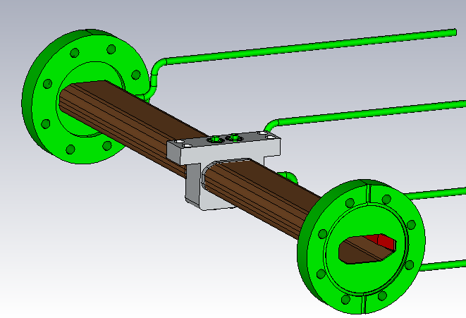
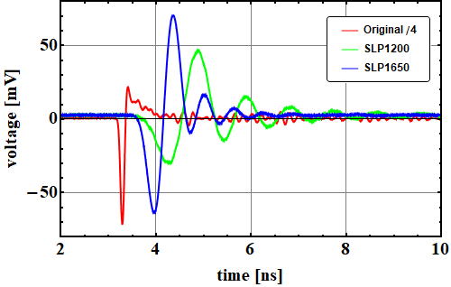

Conclusion
High accuracy bunch-by-bunch BPM
Please check your BPM .
LPF / BPF?
Three solutions are under-investigation.
- New BPM design
- Self-compensation scheme
- Flat-phase filter
Thank you for your attention.

