Slide 1
Detection of beam losses in the triplet and cold BLM sensitivity
A. Tsinganis, F. Cerutti, A. Lechner (EN/STI/FDA)
with A. Mereghetti, Y. Zou (BE/ABP)
41st HL-LHC TCC Meeting – November 23, 2017

Slide 2
Outline
Introduction
Calculation setup
  Layout and optics
  Loss scenario
Results
  Peak power density in coils
  BLM response
  “cryoBLM” response
Summary

Slide 3
Introduction
Previous study presented at cryo-BLM integration kick-off meeting (05/12/2016, A. Mereghetti, M. Sapinski) https://indico.cern.ch/event/592778/
  Objective: to set triplet BLM thresholds capable of identifying the onset of abnormal losses on top of the usual debris signal and trigger a beam dump before quench
  Conclusion: the signature from the abnormal steady-state loss was recognizable, but did not fully stand out against the debris signal; a single value of BLM threshold could not be assigned to all triplet BLMs
New elements:
  Relation between local and global loss rate is now known
  The presence of Inermet shielding in the triplet beam screen requires higher losses in order to induce a quench
Goals of this study:
  Calculation of BLM pattern in the HL triplet for stable operation (v1.3) and for a loss scenario in IR5
  Evaluation of “cryoBLM” effectiveness with respect to conventional BLMs

Slide 4
Layout, optics and loss scenario

Slide 5
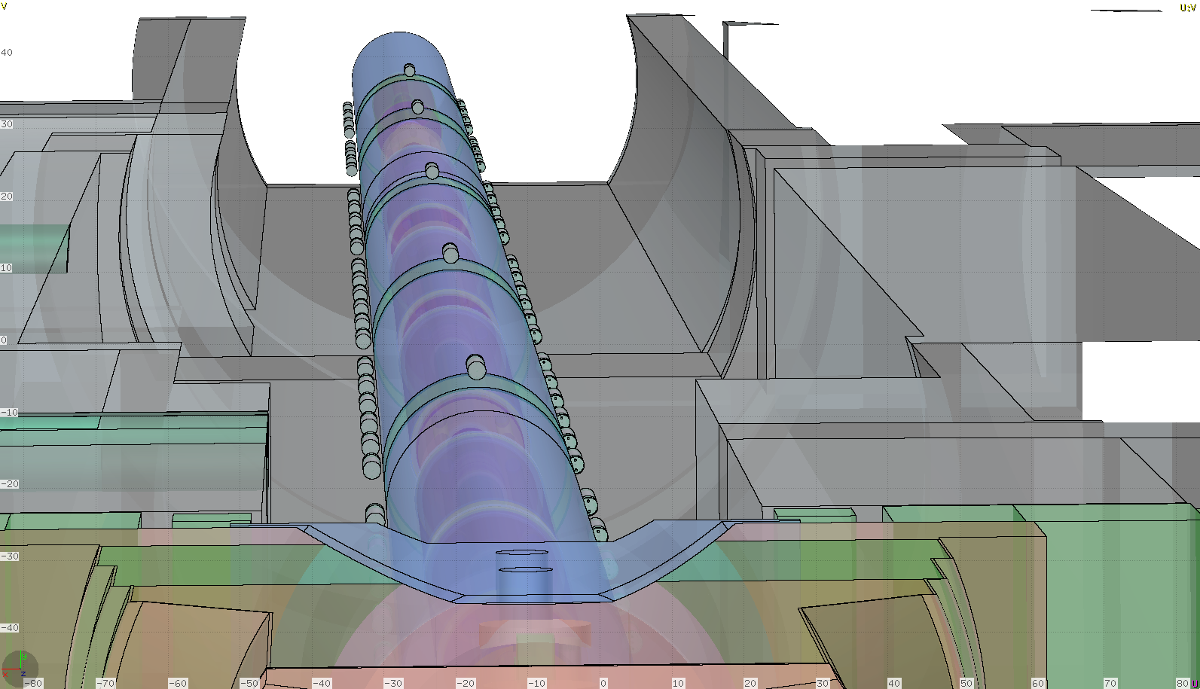
Simulated geometry (triplet-D1)
HL-LHCV1.3 (255μrad half crossing angle, β*=20cm)

Slide 6
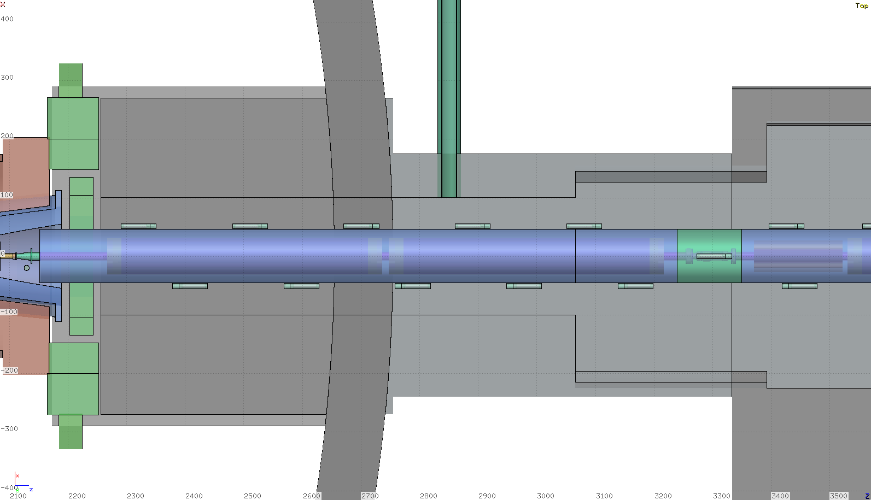
Simulated geometry (triplet-D1)
Several BLMs placed to obtain a finer-grained information

Slide 7
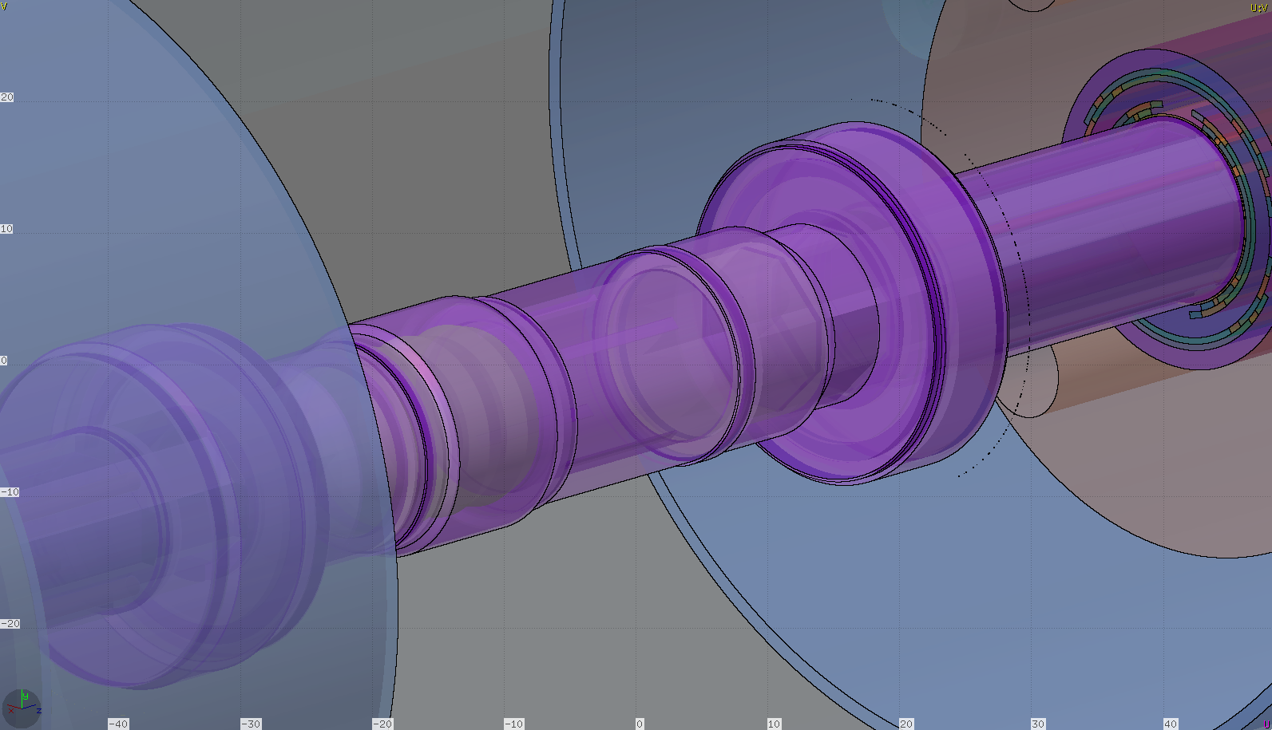
Scoring for “cryoBLMs”
Additional scoring added on the interconnect flanges to represent a reasonable cryoBLM location

Slide 8
Loss scenario
Tracking calculations performed by Y. Zou & A. Mereghetti with:
  7.0 TeV beam momentum, 𝜷∗=15cm, 295μrad half crossing angle
  Open TCTs in IR1/2/5/8
    Aim: to simulate missing protection from TCTs
  Open TCLA in IR7, TCSG in IR6, TCDQ in IR6
    Aim: to increase losses in the triplet
  TCLs open
Highest losses recorded right of IP5 (incoming beam)

Slide 9
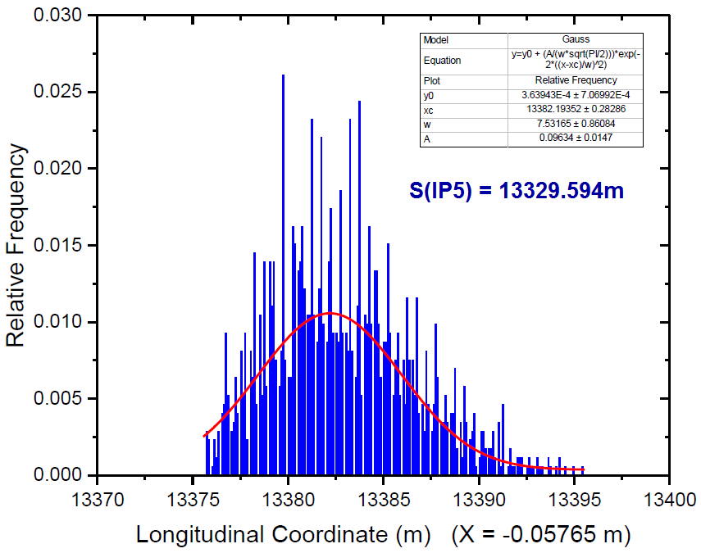
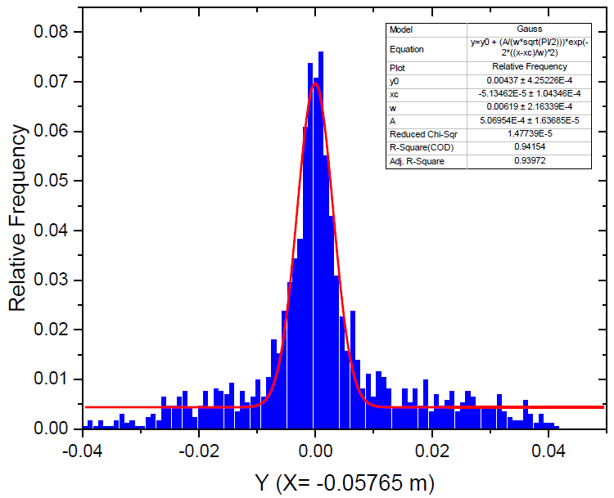
Loss scenario
Only losses on horizontal plane were considered (dominant contribution)
In FLUKA, events were sampled from the fitted distributions in s, x, x’, y, y’
Losses concentrated between Q3 and Q2B

Slide 10
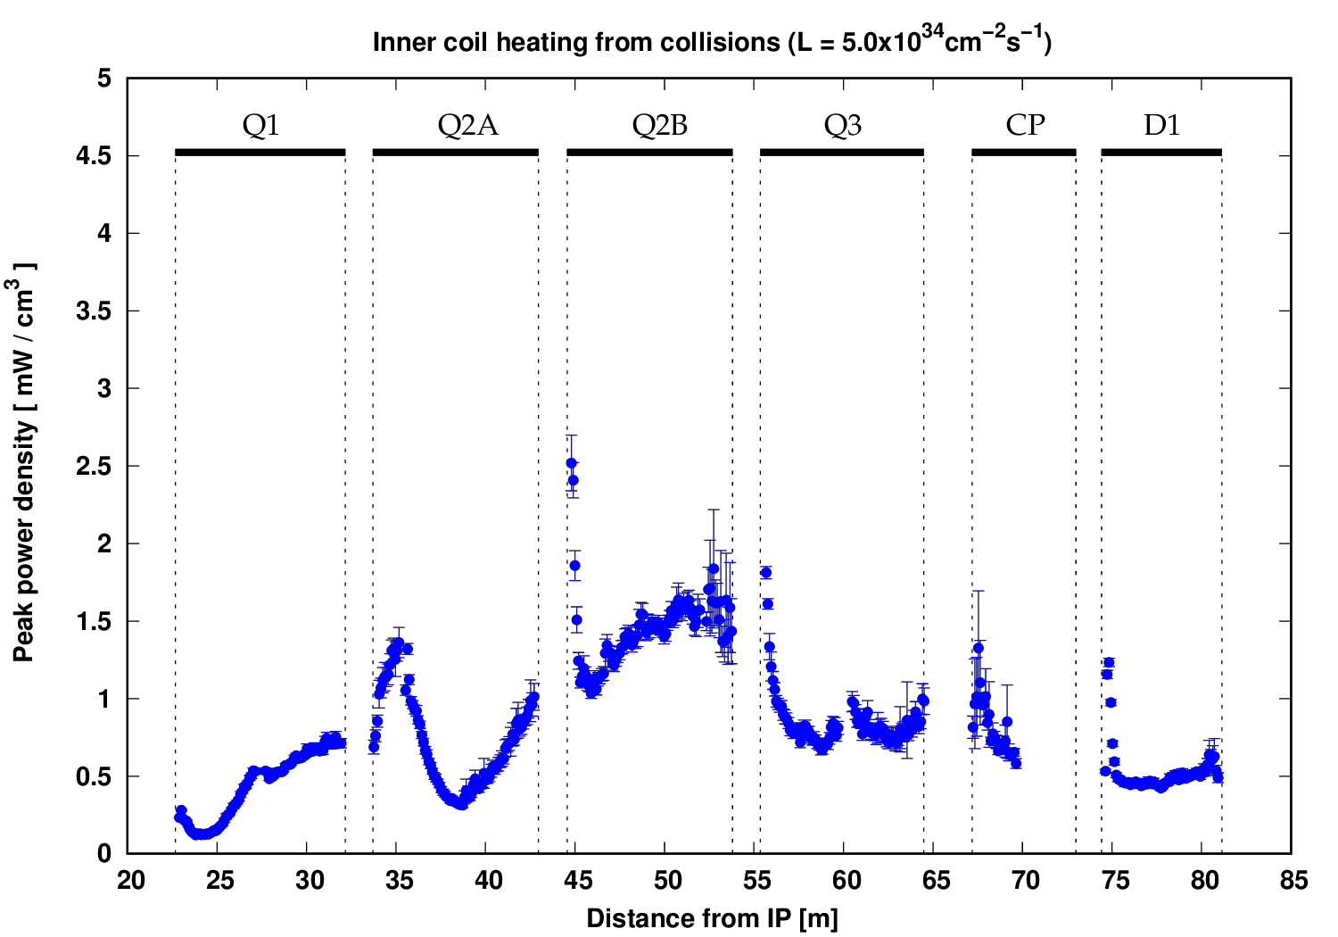
Triplet-D1: Peak power density profile
(Debris, L=5.0x10³⁴ cm⁻² s⁻¹)

Slide 11
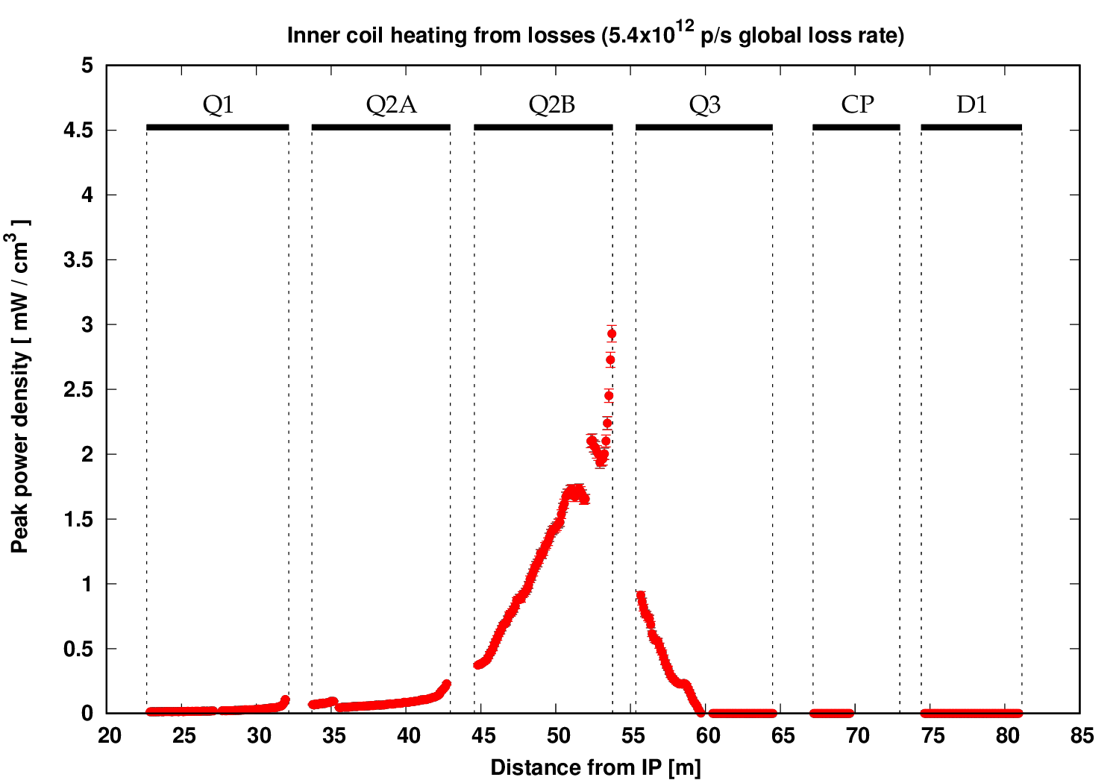
Triplet-D1: Peak power density profile
(Losses)
MCBX corrector
Normalised in order to reach the 4mW/cm³ design limit in the MCBX corrector when added to the debris load

Slide 12
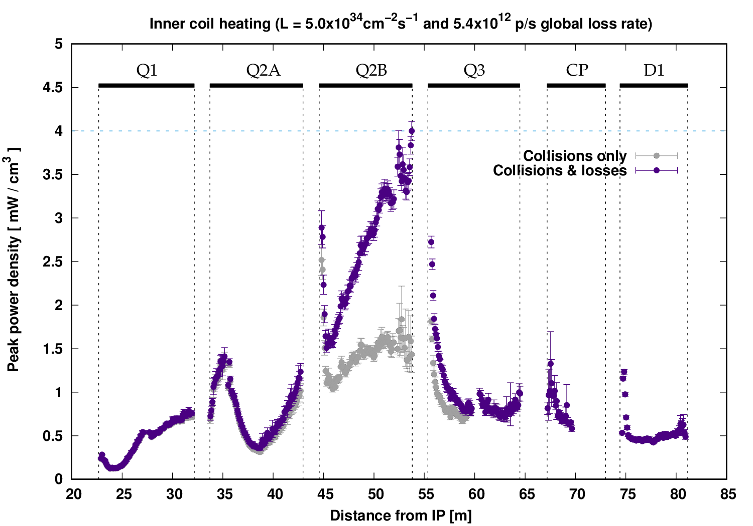
Triplet-D1: Peak power density profile
(Debris and losses, 4mW/cm³ maximum value)
Corresponds to 3.0x10⁸ p/s lost locally ➔ 5.39x10¹² p/s global loss rate
Two minutes of beam life-time, ~6 MW of power lost
Such an abnormally low life-time is dumped in the collimation system, hence local detection is not essential

Slide 13
BLM pattern

Slide 14
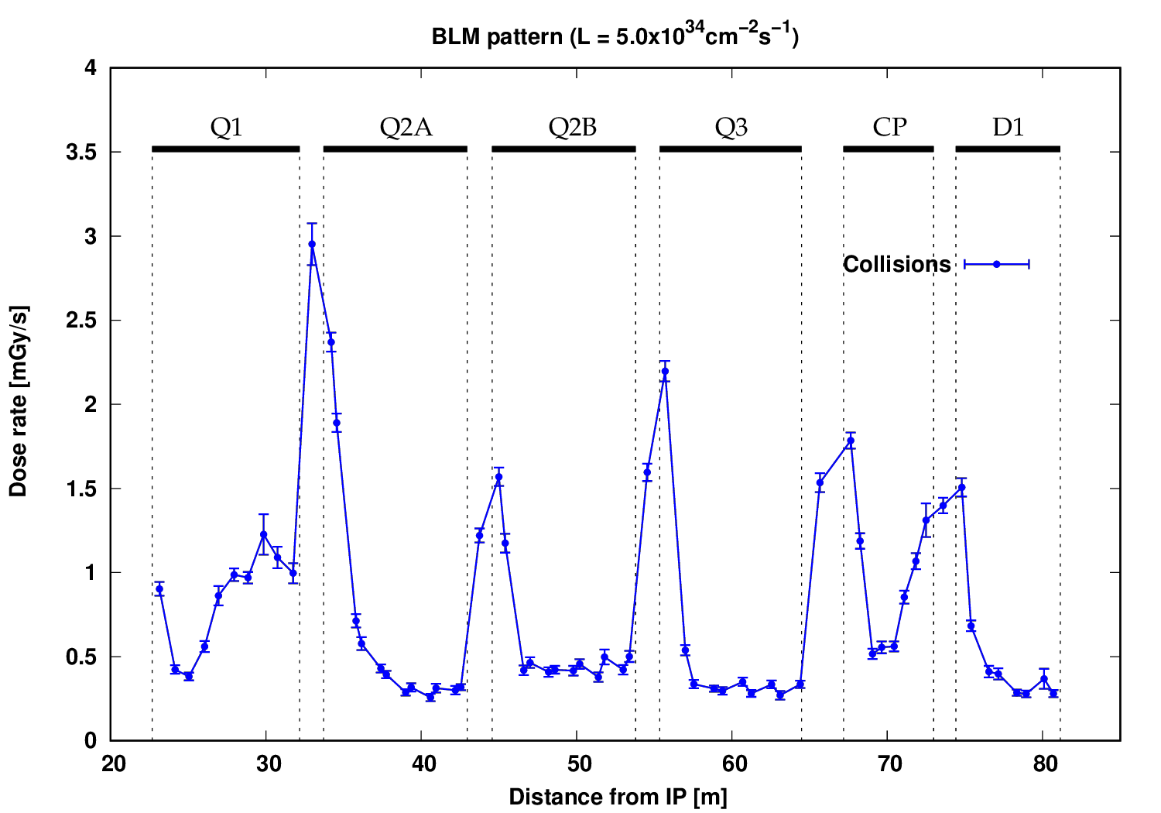
Normal BLM response to collision debris
“cryoBLM”
positions
This high-resolution pattern could guide the optimisation of the BLM placement

Slide 15
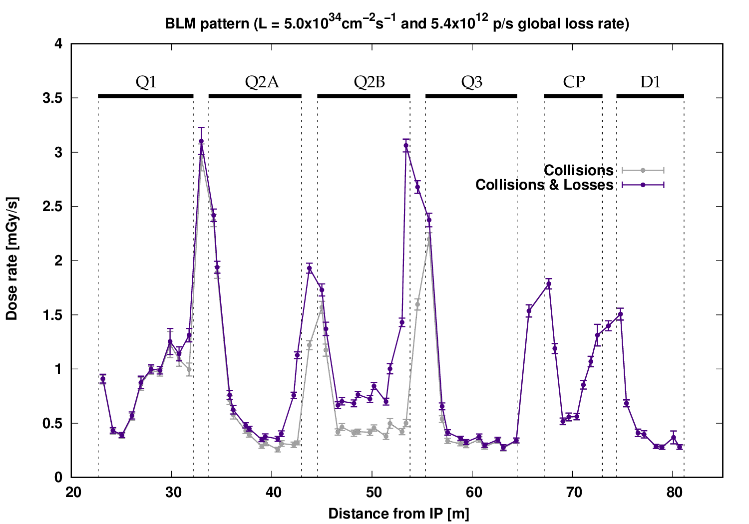
Normal BLM response: debris and losses
Highest sensitivity at end of Q2B

Slide 16
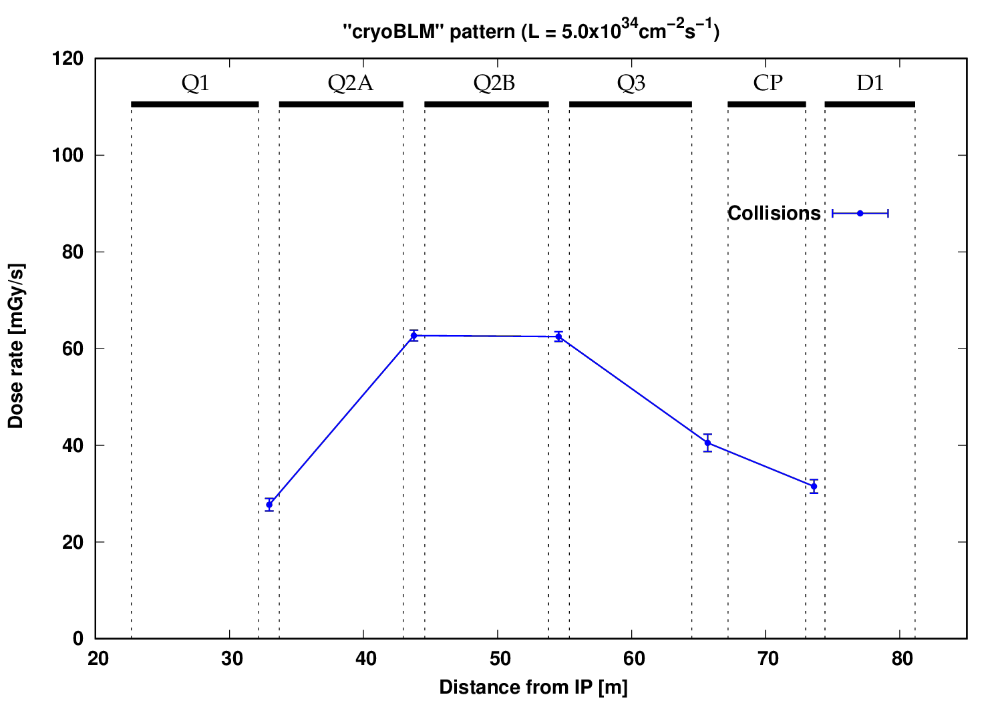
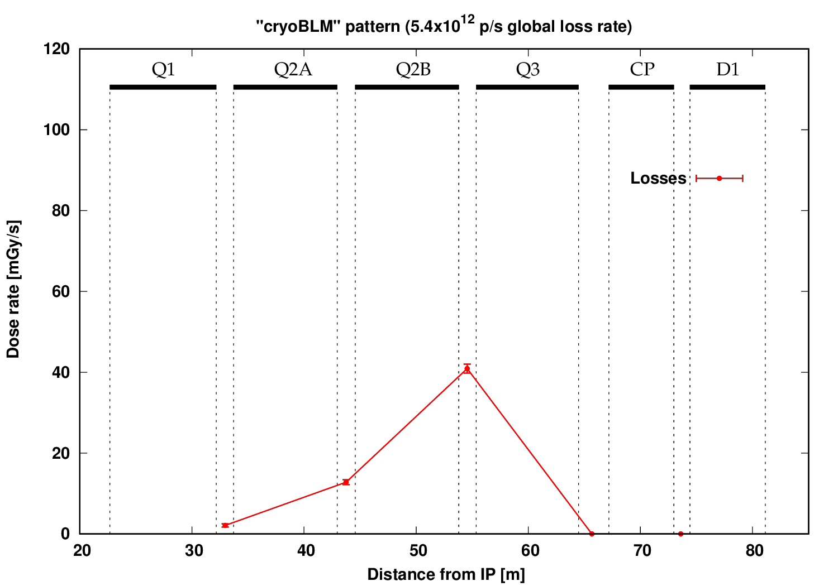
“cryoBLM” response: debris vs. losses comparison
N.B.: “cryoBLM” values have a strong azimuthal dependence → their exact placement is critical
The maximum values were considered for this study
“cryoBLM” values (debris)
Dist. from IP [m] | Min. [Gy/s] | Max. [Gy/s]
32.97 | 0.018 | 0.028
43.75 | 0.021 | 0.064
54.55 | 0.026 | 0.065
65.67 | 0.019 | 0.039
73.6 | 0.019 | 0.032

Slide 17
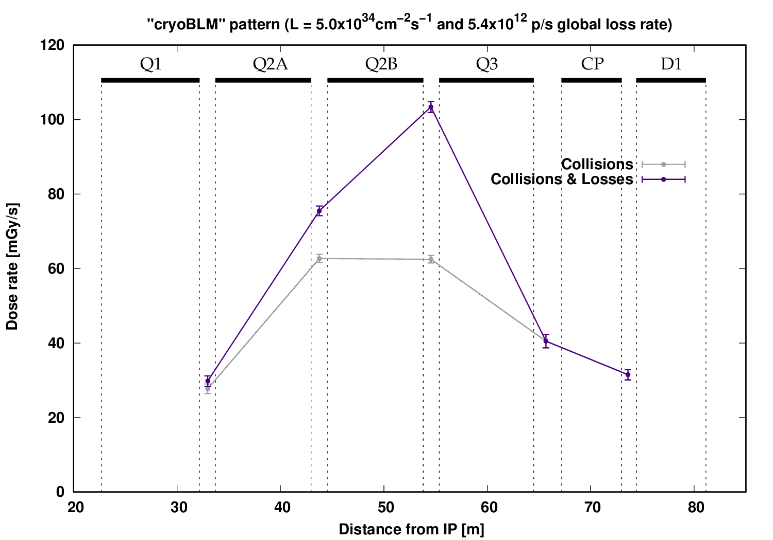
“cryoBLM” response: debris and losses
Highest sensitivity also at end of Q2B
Not comparable to the normal BLM sensitivity gain due to the less favourable positioning

Slide 18
Summary
Abnormal losses would only represent an operational threat in the triplet for beam life-times that are sufficiently low to induce a dump in the collimation region by design
Even for the corresponding extreme loss rate, the presence of cold BLMs does not necessarily increase the detection sensitivity compared with what could be achieved with conventional BLMs, whose placement is less constrained and can be optimised to maximise pattern changes

