Slide 1
FAP Project Management Toolkit
20/03/2018

Slide 2
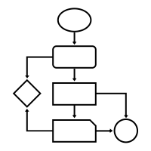



FAP-TPR-PA
Administrative processes
Project management & Business Analysis
Computer support
Notes:
FAP = Finance and Administrative Processes
Admin processes
Central point of contact for CERN administrative procedure
Process streamlining, ensure consistency and provide support
Maintenance of the Admin eGuide, admin forms
PM & BA
PM + BA for changes to admin processes and related tools
Bridging AIS and other stakeholders
Communications
Computer support
Hardware support to administrative departments + CERN Council + VIP visits
Management of access rights to admin software
2nd line support on technical issues for administrative software

Slide 3





Background
Strong department PM experience, rich with diversity
People & Environment
Methodologies & Tools
IT
Administration

Slide 4






FAP needs
Better project visibility
Harmonised follow-up & reporting
Common methodology and tools
POW
✓
✗
✓
✗
✓
✓
...
Objectives
Scope
Roles
Planning
Risks

Slide 5
Approach
Inspired by what works well:
  Best practices in FAP
  OpenSE
  Personal experience
Tailored:
  Designed with FAP projects in mind
  Key milestones & flexibility
  Templates & examples

Slide 6
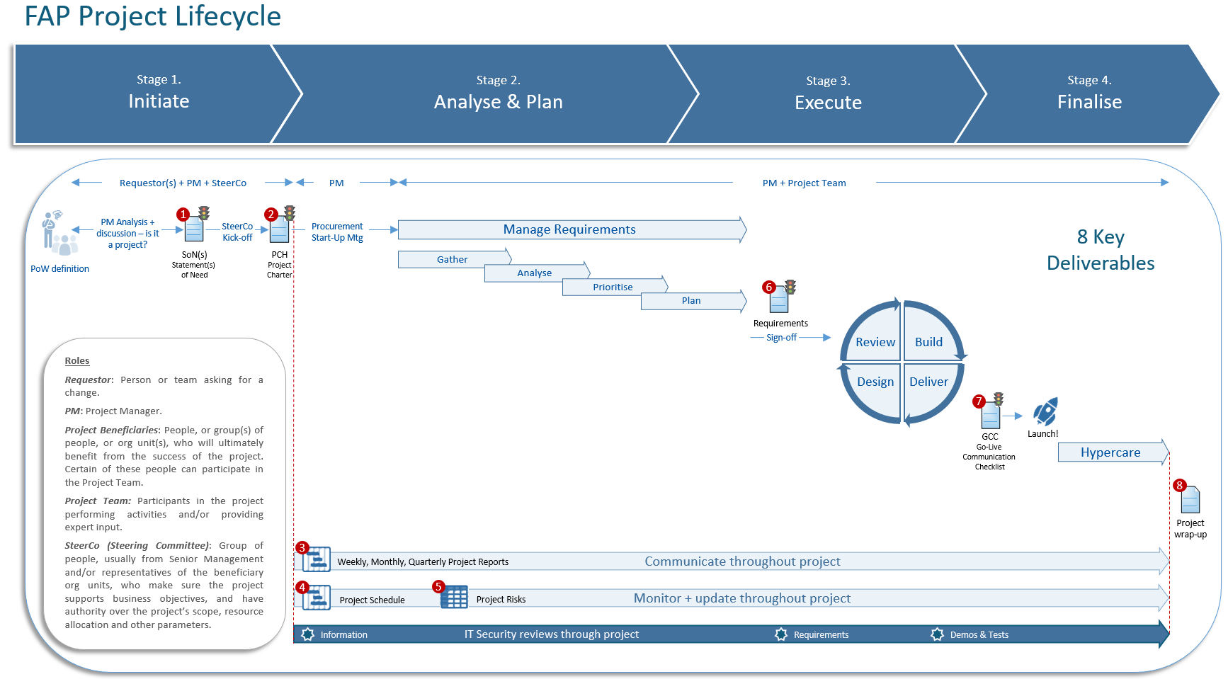

Slide 7
Next steps
Centralise projects information
Fine-tune toolkit based on feedback
Share outside of FAP?
→ Toolkit

